Slide 1
Information Security overview
Pertemuan 1
Prodi Sistem Informasi - Fakultas Ilmu Komputer

Slide 2
Objectives
Understand the definition of information security
Understand the key terms and basic principle of information security
Understand the roles of professionals involved in information security within an organization

Slide 3
What is Security?
“The quality or state of being secure—to be free from danger”
A successful organization should have multiple layers of security in place:
Physical security
Personal security
Operations security
Communications security
Network security

Slide 4
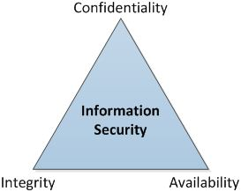
What is Information Security?
The protection of information and its critical elements, including systems and hardware that use, store, and transmit that information

Slide 5
What is Information Security?
C.I.A. triangle was standard based on:
Confidentiality: assurance that information is not disclosed to unauthorized persons
Integrity: protection against unauthorized modification or destruction of information
Availability: timely, reliable access to data and information services for authorized users
C.I.A. triangle now expanded into list of critical characteristics of information

Slide 6
Obstacle
Security vs Convenience
Security vs Performance

Slide 7
Balancing Information Security and Convenience
Impossible to obtain perfect security—it is a process, not an absolute
Security should be considered balance between protection and availability
To achieve balance, level of security must allow reasonable access, yet protect against threats

Slide 8
Why Information need to be protected?
Networks of computers became more common; so too did the need to interconnect networks
Internet became first manifestation of a global network of networks
In early Internet deployments, security was treated as a low priority

Slide 9
The Internet brings millions of computer networks into communication with each other—many of them unsecured
Ability to secure a computer’s data influenced by the security of every computer to which it is connected

Slide 10
Lack of Awareness
Manajemen:
“Layanan jalan dulu, aman belakangan”
“Sejauh ini bisnis aman-aman saja”
“Perlu investasi untuk keamanan”
Karyawan:
“Sharing password”
etc

Slide 11
Kesadaran akan masalah keamanan masih rendah!
Bagaimana untuk meyakinkan management untuk melakukan investasi di bidang keamanan?
Membutuhkan justifikasi perlunya investasi infrastruktur keamanan

Slide 12
Threat
External:
DDoS
Carder
Malware
Phising
Spam email
Etc

Slide 13
Internal:
Malware
Disgruntled employee
Corporate espionage
Human Error (e.g Misconfiguration)
Server down
Internal fraud
Power abuse
etc

Slide 14
Notes:
It is important to note that the same computer can be both the subject and object of an attack, especially in multi-user systems.

Slide 15
“Lack of internal security awareness is still one of our biggest threats. Technology can reduce risks to a point but it is people who are the weakest link.”
--Deloitte Global Security Survey 2004 Respondent

Slide 16
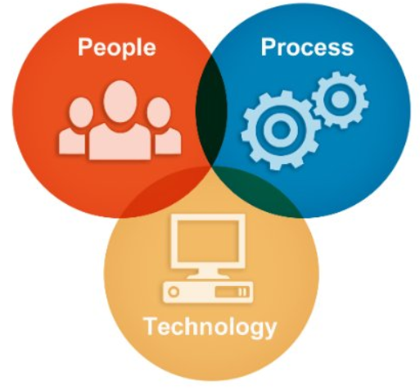
Control
Control: policy, procedure, standard, awareness, training, patching vulnerability

Slide 17
Security is Process
Security is not product, but it is Process
It is impossible to get 100% security
Need to continuous improvement the information security

Slide 18
Security Professionals and the Organization
Wide range of professionals required to support a diverse information security program
Senior management is key component; also, additional administrative support and technical expertise required to implement details of IS/ IT

Slide 19
Senior Management
Chief Information Security Officer (CISO)
Primarily responsible for assessment, management, and implementation of IS in the organization
Usually reports directly to the CIO
Head of Information Security
Primarily responsible for assessment, management, and implementation of IS in the organization
Usually reports directly to the C level based on Organization Structure

Slide 20
Information Security Team
A number of individual who are experienced in one or more facets of technical and non-technical areas:
Security Engineer – Red Team
Security Engineer – Blue Team
Security Engineer – Governance Risk & Compliance (GRC) Team
Information Security Analyst
Security professionals
IT Auditor
etc

Slide 21
Any Question?

