Slide 1
Information Security Management System (ISMS)
Pertemuan 3
Prodi Sistem Informasi - Fakultas Ilmu Komputer

Slide 2
ISO 27001 - Overview
International Standards Organization (ISO)
Information Security Management System (“ISMS”)
Based on British Standard 7799
Management system – Process
Conform not comply
Framework for established scope

Slide 3
What is ISO/IEC 27001:2013
Leading International Standard for ISMS. Specifies the requirements for establishing, implementing, maintaining, monitoring, reviewing and continually improving the ISMS within the context of the organization.
Best Standard for complying with information security legislation.
Not a technical standard that describes the ISMS in technical detail.
Does not focus on information technology alone, but also other important business assets, resources, and processes in the organization.

Slide 4
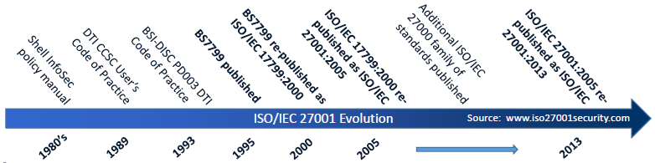
ISO/IEC 27001 Evolution

Slide 5
What is ISO/IEC 27001:2013
ISO does not perform certification.
Organizations looking to get certified to an ISO standard must contact an independent certification body.
Certification bodies must use the ISO’s Committee on Conformity Assessment (CASCO) standards related to the certification process.

Slide 6
Why Implement ISO 27001
Best framework for complying with information security legal, regulatory and contractual requirements
Better organizational image because of the certificate issued by a certification body
Proves that senior management are committed to the security of the organization
Focused on reducing the risks for information that is valuable for the organization Provides a common goal
Optimized operations within the organization because of clearly defined responsibilities and business processes
Builds a culture of security

Slide 7
ISO 27001 Clause
Clause 4 Context of the organization
  4.1 Understanding the organization and its context
  4.2 Understanding the needs and expectations of interested parties
  4.3 Determining the scope of the information security management system
  4.4 Information security management system
Clause 5 Leadership
  5.1 Leadership and commitment
  5.2 Policy
  5.3 Organizational roles, responsibilities and authorities

Slide 8
ISO 27001 Clause
Clause 6 Planning
  6.1 Actions to address risks and opportunities
  6.2 Information security objectives and planning to achieve them
Clause 7 Support
  7.1 Resources
  7.2 Competence
  7.3 Awareness
  7.4 Communication
  7.5 Documented information

Slide 9
ISO 27001 Clause
Clause 8 Operation
  8.1 Operational planning and control
  8.2 Information security risk assessment
  8.3 Information security risk treatment
Clause 9 Performance Evaluation
  9.1 Monitoring, measurement, analysis and evaluation
  9.2 Internal audit
  9.3 Management review
Clause 10 Improvement
  10.1 Nonconformity and corrective action
  10.2 Continual improvement

Slide 10
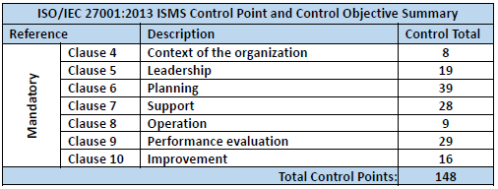
ISO 27001 Clause

Slide 11
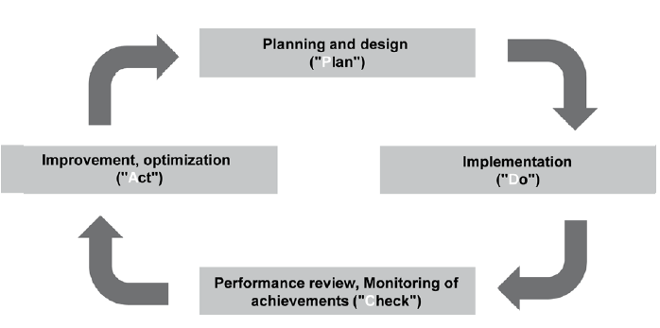
Lifecycle of the Information Security

Slide 12
Lifecycle of the Information Security
“Plan-Do-Check-Act” (“PDCA”)
Plan - Establish the planning for policy, the ISMS objectives, processes and procedures related to risk management and the improvement of information security to provide results in line with the global policies and objectives of the organization.
Do - Implement and exploit the ISMS policy, controls, processes and procedures.

Slide 13
Lifecycle of the Information Security
Check - Assess and, if applicable, measure the performances of the processes against the policy, objectives and practical experience and report results to management for review.
Act - Undertake corrective and preventive actions, on the basis of the results of the ISMS internal audit and management review, or other relevant information to continually improve the said system.

Slide 14
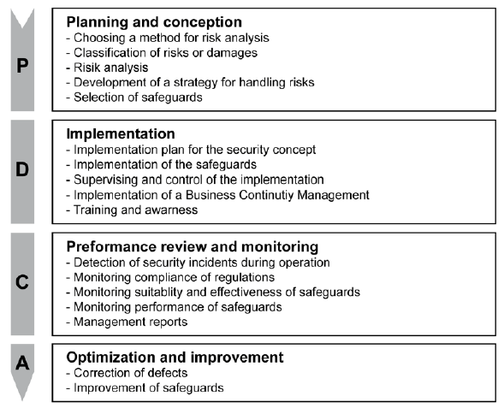
Lifecycle of the Information Security

Slide 15
Selecting a method for Risk Assessment
Possible damage to the business activities and tasks of an institution due to information security incidents must be analysed and assessed.
A method for risk assessment is therefore an integral part of every information security management system.
In order to be able to identify a risk, the threats must be ascertained and their potential for causing damage and the probability that they will occur must be assessed.

Slide 16
Selecting a method for Risk Assessment
There are various risk assessment methods that come into question depending on the application, organizational boundary conditions, type of industry and level of information security that is aspired to
  ISO/IEC 27005: 2011 Information technology -- Security techniques -- Information security risk management
  COSO (Committee of Sponsoring Organizations of the Treadway Commission)
  BSI standard 100-3 entitled "Risk analysis“
  etc

Slide 17
Classifying risks and damages
Depending on the selected method for risk assessment, the information security management must ascertain how threats, the potential for causing damage, occurrence probabilities and the resulting risks should be classified and assessed.
  Occurrence probability: rarely, frequently, very frequently
  Potential extent of damages: moderate, high, very high

Slide 18
Determine response to the risks
Risks can be reduced by implementing appropriate security measures
Risks can be avoided, for instance, by restructuring or abandoning business processes or tasks
Risks can be transferred, for instance, through outsourcing or insurances
Risks can be accepted

Slide 19
Selecting Information Security Safeguard
Organisation (including specifying responsibilities, assigning duties and separating functions/ SoD, regulating how information is handled, applications and IT components, hardware and software management, change management, etc.)
Personnel (e.g. briefing new staff members, making deputisation arrangements, etc)
Training and increasing people's awareness on information security
Data protection (for all information, applications and IT components)

Slide 20
Selecting Information Security Safeguard
Computer virus protection
Protection of information during processing, transmission and storage (e.g. through the use of cryptography)
- Hardware and software development
- Conduct during IT security incidents (incident handling)
- Contingency planning and maintenance of business activities in an emergency (business continuity)

Slide 21
Development of an implementation plan for security concept
An implementation plan must include the following issues:
Specification of priorities (implementation sequence)
Specification of responsibilities for initiation
Provision of resources by the management
Implementation planning for individual measures (specifying deadlines and costs and the specification of the persons responsible for the implementation and specification of deadlines as well as the persons responsible for checking the implementation and the effectiveness of measures).

Slide 22
Implementation of information security safeguards
The planned information security safeguards must be implemented in accordance with the implementation plan.
In the process, information security must be integrated in the organisation-wide procedures and processes.
If difficulties arise during implementation, they should be communicated immediately so that solutions can be devised to overcome them.

Slide 23
Supervising and checking the implementation
Regular checks must be performed to ensure that the set objectives are complied with.
If objectives cannot be complied with, the member of the management level responsible for information security must be informed so that problems can be responded to in time.

Slide 24
Reaction to changes during routine operation
In the case of changes to routine operation (e.g. the introduction of new business processes, modifications to the organisation or introduction of new IT systems)
the security concept and the associated documents (as well as a list of the spheres of responsibility or a list of the IT systems) must be updated.

Slide 25
Detection of information security incidents during routine operation
Mistakes that are critical to security and information security incidents to be avoided as far as possible, to be limited in their impact or at least noticed early on.
  tools for monitoring systems,
  integrity checks,
  keeping a log of access,
  actions or errors,
  controlling the access to buildings

Slide 26
Checking that the requirements are being complied
Regular checks must be performed to see whether all the IT security measures are being applied and implemented as planned in the security concept.
This must involve checking that the technical security measures (e.g. as regards the configuration) and the organisational regulations (e.g. processes, procedures and operations) are complied

Slide 27
Checking the suitability and effectiveness of information security safeguards
Regular checks must be performed to determine whether the information security safeguards are appropriate for achieving the information security objectives that have been set.
Their suitability can be assessed, for instance, by:
  evaluating past information security incidents,
  interviewing staff members
  performing penetration tests.

Slide 28
Management appraisals
The management level must be kept informed about the results of the checks at regular intervals and in an adequate manner by the information security management.
The problems, successes and opportunities for improvements should be pointed out.

Slide 29
Summary
Adoption of an ISMS should be a strategic decision for an organization.
ISMS is a holistic approach to managing information security – confidentiality, integrity, and availability of information and data.
Laws and regulations are continuing to evolve to address information security risk and privacy. ISO/IEC 27001:2013 is the best framework for complying with information security legislation.

Slide 30
Summary
ISO/IEC 27001:2013 is not a technical standard for IT only.
Increasing trend in adopting a holistic approach (using ISO/IEC 27001:2013) in managing information security risks.
Organizations need to conduct an information security awareness.

Slide 31
Any Question?

