Slide 1
Risk Management
Pertemuan 4
Prodi Sistem Informasi - Fakultas Ilmu Komputer

Slide 2
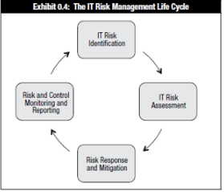
Risk Management
Cyclic Process
Process based on the complete cycle of all elements

Slide 3
Introduction
Information security departments are created primarily to manage IT risk
Managing risk is one of the key responsibilities of every manager within the organization
In any well-developed risk management program, two formal processes are at work:
  Risk identification and assessment
  Risk control

Slide 4
Introduction
What is Risk?
“the combination of the probability of an event and its consequence”

Slide 5
Risk Management
Risk management is a process, which means the safeguards and controls that are devised and implemented
Risk management is the process of assessing the risks to an organization’s information and determining how those risks can be controlled or mitigated

Slide 6
Risk Identification

Slide 7
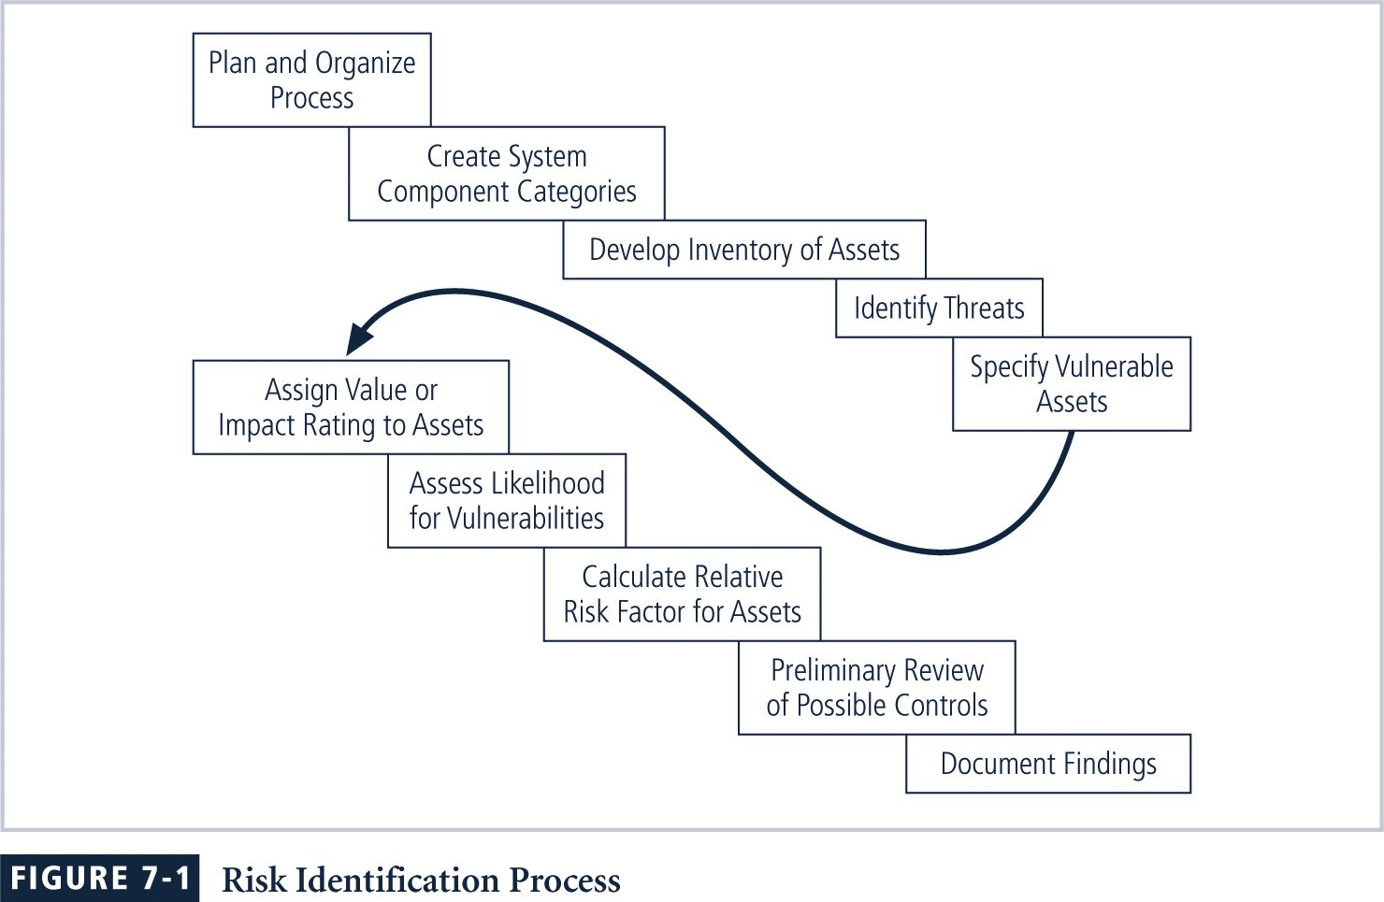
Risk Identification Process

Slide 8
Risk Identification
Risk identification begins with the process of self-examination
Managers identify the organization’s information assets, classify them into useful groups, and prioritize them by their overall importance

Slide 9
Creating an Inventory of Information Assets
Identify information assets, including people, procedures, data and information, software, hardware, and networking elements
This step should be done without pre-judging the value of each asset; values will be assigned later in the process

Slide 10
List of Assets
Information
Reputation/ Brand
Intelectual Property
Facilities
Equipment
Cash and investment
Costumer list
Research
People
Service & Business Process

Slide 11
Attributes for Assets
When deciding which attributes to track for each information asset, consider the following list of potential attributes:
  Name
  IP address
  MAC address
  Asset type
  Serial number
  Manufacturer name
  Manufacturer’s model or part number
  Software version, update revision, or FCO number
  Physical location
  Logical location
  Controlling entity

Slide 12
Identifying Hardware, Software, and Network Assets
Whether automated or manual, the inventory process requires a certain amount of planning
Determine which attributes of each of these information assets should be tracked
That will depend on the needs of the organization and its risk management efforts

Slide 13
Organizational Assets Used in Systems

Slide 14
Identifying People, Procedures, and
Data Assets
Responsibility for identifying, describing, and evaluating these information assets should be assigned to managers who possess the necessary knowledge, experience, and judgment
As these assets are identified, they should be recorded via a reliable data-handling process like the one used for hardware and software

Slide 15
Classifying and Categorizing Assets
Once the initial inventory is assembled, determine whether its asset categories are meaningful
Inventory should also reflect sensitivity and security priority assigned to each information asset
A classification scheme categorizes these information assets based on their sensitivity and security needs

Slide 16
Classifying and Categorizing Assets
Each of these categories designates the level of protection needed for a particular information asset
Some asset types, such as personnel, may require an alternative classification scheme that would identify the clearance needed to use the asset type
Classification categories must be comprehensive and mutually exclusive

Slide 17
Security Clearances
In a security clearance structure, each user of an information asset is assigned an authorization level that indicates the level of information classification they may access
Most organizations have developed roles and corresponding security clearances, so individuals are assigned into groups that correlate with the classifications of the information assets they need for their work
In the need-to-know principle, regardless of one’s security clearance, an individual is not allowed to view data simply because it falls within that individual’s level of clearance

Slide 18
Threat Identification
Any organization typically faces a wide variety of threats
If you assume that every threat can and will attack every information asset, then the project scope becomes too complex
To make the process less unwieldy, each step in the threat identification and vulnerability identification process is managed separately and then coordinated at the end

Slide 19
Threat Identification
Each threat presents a unique challenge to information security and must be handled with specific controls that directly address the particular threat and the threat agent’s attack strategy
Before threats can be assessed in the risk identification process, however, each threat must be further examined to determine its potential to affect the targeted information asset
In general, this process is referred to as a threat assessment

Slide 20
List of Threat
Natural event
Theft
Sabotage/ Terrorism
Criminal Act
Software error
Mechanical failure
Accidents

Slide 21
Threats to Information Security

Slide 22
Vulnerability Assessment
Once you have identified the information assets of the organization and documented some threat assessment criteria, you can begin to review every information asset for each threat
This review leads to the creation of a list of vulnerabilities that remain potential risks to the organization
Vulnerabilities are specific avenues that threat agents can exploit to attack an information asset
At the end of the risk identification process, a list of assets and their vulnerabilities has been developed
This list serves as the starting point for the next step in the risk management process: risk assessment

Slide 23
Vulnerability Assessment
Network vulnerability
Physical access
Application and web facing services
Utilities
Processes
etc

Slide 24
The TVA (Threat-Vulnerability-Assets) Worksheet
At the end of the risk identification process, a list of assets and their vulnerabilities has been developed
Another list prioritizes threats facing the organization based on the weighted table discussed earlier
These lists can be combined into a single worksheet

Slide 25
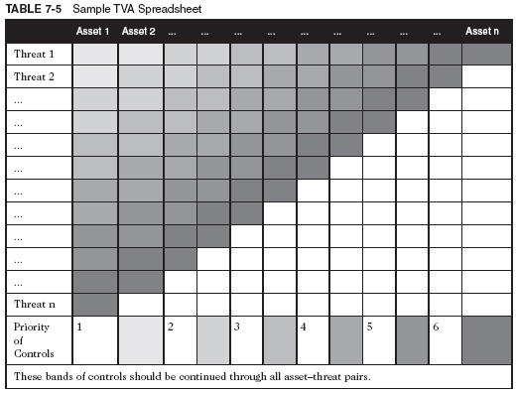
Sample TVA Spreadsheet

Slide 26
Risk Assessment

Slide 27
Risk Assessment
The goal at this point is to create a method to evaluate the relative risk of each listed vulnerability

Slide 28
Risk Assessment
Risk is
The likelihood of the occurrence of a vulnerability
Multiplied by
The value of the information asset
Minus
The percentage of risk mitigated by current controls
Plus
The uncertainty of current knowledge of the vulnerability

Slide 29
Likelihood
Likelihood is the overall rating—often a numerical value on a defined scale (such as 0.1 – 1.0)—of the probability that a specific vulnerability will be exploited
Using the information documented during the risk identification process, you can assign weighted scores based on the value of each information asset, i.e. 1-100, low-med-high, etc.

Slide 30
Assessing Potential Lost
To be effective, the likelihood values must be assigned by asking:
  Which threats present a danger to this organization’s assets in the given environment?
  Which threats represent the most danger to the organization’s information?
  How much would it cost to recover from a successful attack?
  Which threats would require the greatest expenditure to prevent?
  Which of the aforementioned questions is the most important to the protection of information from threats within this organization?

Slide 31
Percentage of Risk
Mitigated by Current Controls
If a vulnerability is fully managed by an existing control, it can be set aside
If it is partially controlled, estimate what percentage of the vulnerability has been controlled

Slide 32
Uncertainty
It is not possible to know everything about every vulnerability
The degree to which a current control can reduce risk is also subject to estimation error
Uncertainty is an estimate made by the manager using judgment and experience

Slide 33
Risk Determination Example
Asset A has a value of 50 and one vulnerability, which has a likelihood of 1.0 with no current controls. Your assumptions and data are 90% accurate.

Slide 34
Risk Determination Example
The resulting ranked list of risk ratings for the three vulnerabilities is as follows:
  Asset A: Vulnerability 1 rated as 55 = (50 × 1.0) – 0% + 10%

Slide 35
Risk Determination Case
Asset B has a value of 100 and has two vulnerabilities: vulnerability #2 has a likelihood of 0.5 with a current control that addresses 50% of its risk; vulnerability # 3 has a likelihood of 0.1 with no current controls. Your assumptions and data are 80% accurate.

Slide 36
Risk Determination Case
  Asset B: Vulnerability 2 rated as 35 = (100 × 0.5) – 50% + 20%
  Asset B: Vulnerability 3 rated as 12 = (100 × 0.1) – 0 % + 20%

Slide 37
Identify Possible Controls
For each threat and its associated vulnerabilities that have residual risk, create a preliminary list of control ideas
Three general categories of controls exist:
  Policies
  Programs
  Technical controls

Slide 38
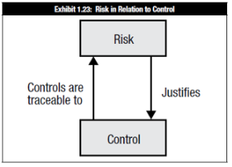
Identify Possible Controls
Ownership & Accountability must be assigned to the risk
Risk owner determines necessary controls
Also responsible for control monitoring

Slide 39
IT Risk Register/ Profile
Purpose: to consolidate all information about risk into a central repository
List of all known risk, with:
  Severity, source & potential impact
  Risk owner
  Current status
  Information gathered, by audit, vulnerability assessment, penetration testing, etc.

Slide 40
Documenting the Results of Risk Assessment
The goal of the risk management process so far has been to identify information assets and their vulnerabilities and to rank them according to the need for protection
In preparing this list, a wealth of factual information about the assets and the threats they face is collected
Also, information about the controls that are already in place is collected
The final summarized document is the ranked vulnerability risk worksheet

Slide 41
Documenting the Results of Risk Assessment
What should the documentation package look like?
What are the deliverables from this stage of the risk management project?
The risk identification process should designate what function the reports serve, who is responsible for preparing them, and who reviews them

Slide 42
Risk RESPONSE

Slide 43
Risk Appetite
Risk appetite defines the quantity and nature of risk that organizations are willing to accept, as they evaluate the trade-offs between perfect security and unlimited accessibility
Reasoned approach to risk is one that balances expense against possible losses if exploited

Slide 44
Residual Risk
When vulnerabilities have been controlled as much as possible, there is often remaining risk that has not been completely accounted for → residual risk
Residual Risk:
  Risk from a threat less the effect of threat-reducing safeguards plus
  Risk from a vulnerability less the effect of vulnerability-reducing safeguards plus
  Risk to an asset less the effect of asset value-reducing safeguards

Slide 45
Residual Risk
The significance of residual risk must be judged within the context of an organization’s risk appetite
The goal of information security is not to bring residual risk to zero, but to bring it in line with an organization’s risk appetite

Slide 46
Risk Control Strategies
An organization must choose one of four basic strategies to control risks
  Avoidance: applying safeguards that eliminate or reduce the remaining uncontrolled risks for the vulnerability
  Transference: shifting the risk to other areas or to outside entities
  Mitigation: reducing the impact should the vulnerability be exploited
  Acceptance: understanding the consequences and accepting the risk without control or mitigation

Slide 47
Avoidance
Avoidance is the risk control strategy that attempts to prevent the exploitation of the vulnerability
Avoidance is accomplished through:
  Application of policy
  Application of training and education
  Countering threats
  Implementation of technical security controls and safeguards

Slide 48
Transference
Transference is the control approach that attempts to shift the risk to other assets, other processes, or other organizations
May be accomplished by
  Rethinking how services are offered
  Revising deployment models
  Outsourcing to other organizations
  Purchasing insurance
  Implementing service contracts with providers

Slide 49
Mitigation
Mitigation is the control approach that attempts to reduce, by means of planning and preparation, the damage caused by the exploitation of vulnerability
This approach includes three types of plans:
  Disaster recovery plan (DRP)
  Incident response plan (IRP)
  Business continuity plan (BCP)
Mitigation depends upon the ability to detect and respond to an attack as quickly as possible

Slide 50
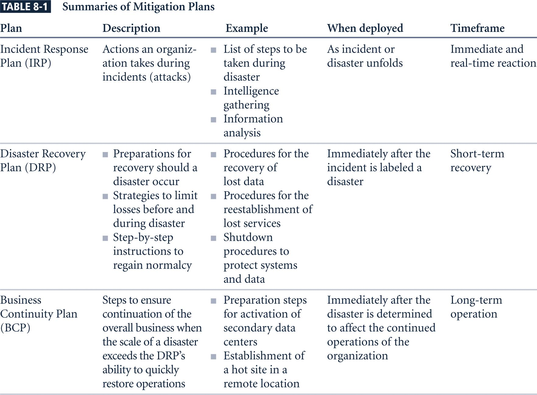
Mitigation

Slide 51
Acceptance
Acceptance is the choice to do nothing to protect an information asset and to accept the loss when it occurs
This control, or lack of control, assumes that it may be a prudent business decision to
  Examine alternatives
  Conclude the cost of protecting an asset does not justify the security expenditure

Slide 52
Acceptance
Only valid use of acceptance strategy occurs when organization has:
  Determined level of risk to information asset
  Assessed probability of attack and likelihood of a successful exploitation of vulnerability
  Estimated potential loss from attacks
  Performed a thorough cost benefit analysis
  Evaluated controls using each appropriate type of feasibility
  Decided that the particular asset did not justify the cost of protection

Slide 53
Risk Response Strategy Selection
Which Response is precise choice?

Slide 54
Risk Response Strategy Selection
involves selecting one of the four risk control strategies for the vulnerabilities present within the organization
If the loss is within the range of losses the organization can absorb, or if the attacker’s gain is less than expected costs of the attack, the organization may choose to accept the risk
Otherwise, one of the other control strategies will have to be selected

Slide 55
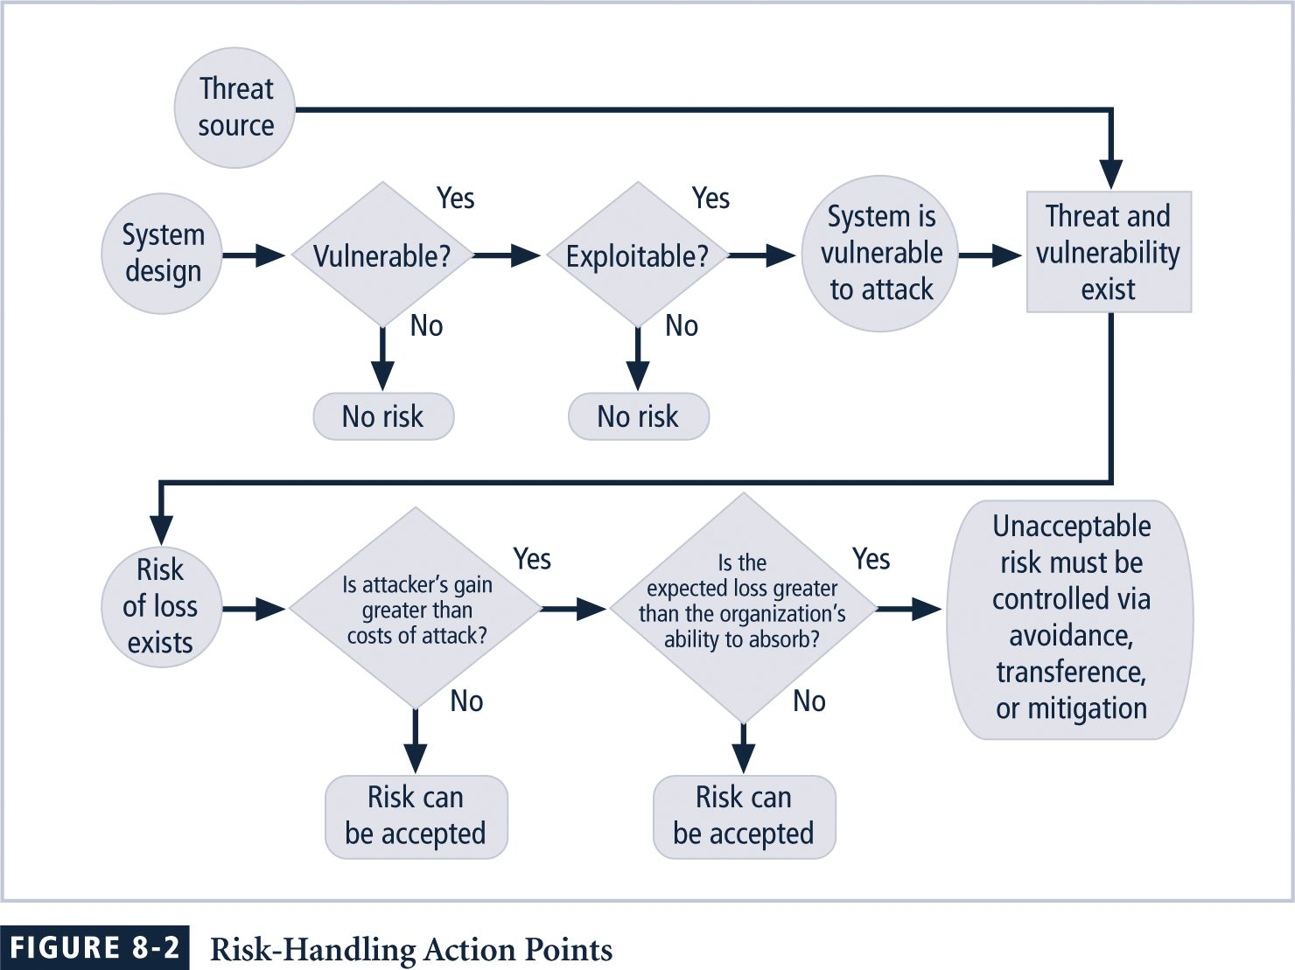
Risk Handling Action Points

Slide 56
Risk Response Strategy Selection
Some rules:
  When a vulnerability exists: Implement security controls to reduce the likelihood of a vulnerability being exercised
  When a vulnerability can be exploited: Apply layered controls to minimize the risk or prevent occurrence
  When the attacker’s potential gain is greater than the costs of attack: Apply protections to increase the attacker’s cost, or reduce the attacker’s gain, using technical or managerial controls
  When potential loss is substantial: Apply design controls to limit the extent of the attack, thereby reducing the potential for loss

Slide 57
Managing Risk Control
Once a control strategy has been selected and implemented
  Effectiveness of controls should be monitored and measured on an ongoing basis to determine its effectiveness
  Accuracy of estimated risk that will remain after all planned controls are in place

Slide 58
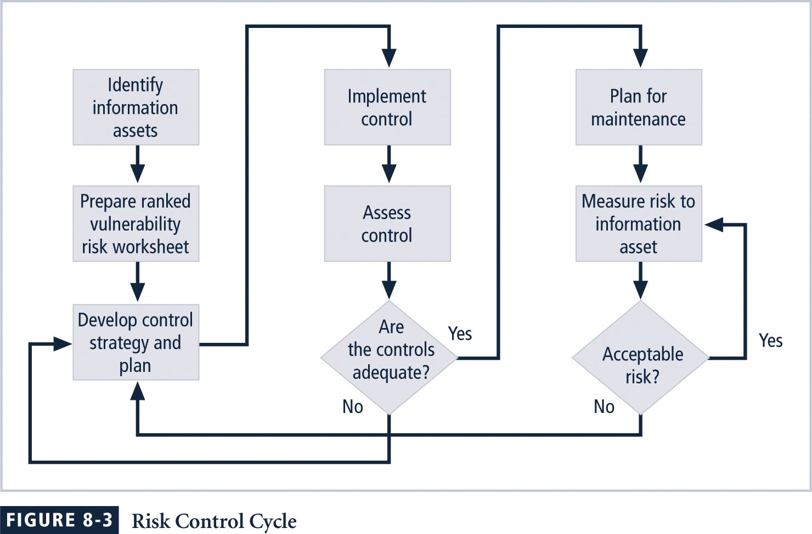
The Risk Control Cycle

Slide 59
Categories of Control
Controlling risk by means of avoidance, mitigation, or transference may be accomplished by implementing controls or safeguards
Controls can be grouped for discussion by one of four categories:
  Control function
  Architectural layer
  Strategy layer
  Information security principle

Slide 60
Control Function
Preventive controls
  Stop attempts to exploit a vulnerability by implementing enforcement of an organizational policy or a security principle
  Use a technical procedure, or some combination of technical means and enforcement methods
Detective controls
  Warn organizations of violations of security principles, organizational policies, or attempts to exploit vulnerabilities
  Use techniques such as audit trails, intrusion detection, and configuration monitoring

Slide 61
Architectural Layer
Some controls apply to one or more layers of an organization’s technical architecture
Possible architectural layers include the following:
  Organizational policy
  External networks
  Extranets
  Demilitarized zones
  Intranets
  Network devices that interface network zones
  Systems
  Applications

Slide 62
Strategy Layer
Controls are sometimes classified by the risk control strategy they operate within:
  Avoidance
  Mitigation
  Transference
Note that the acceptance strategy is not an option since it involves the absence of controls

Slide 63
Information Security Principle
Risk controls operate within one or more of the commonly accepted information security principles:
  Confidentiality
  Integrity
  Availability
  Authentication
  Authorization
  Accountability
  Privacy

Slide 64
Documenting Result
When risk management program has been completed, series of proposed controls are prepared
  Each justified by one or more feasibility or rationalization approaches
At minimum, each information asset-threat pair should have a documented control strategy that
  Clearly identifies any residual risk remaining after the proposed strategy has been executed

Slide 65
Risk MONITORING and REVIEW

Slide 66
Monitoring and Review
Monitoring
‘Live’ nature of assessments
Possible modification to procedures
Review
Identifies changes to procedures
Possible modification to assessment

Slide 67
The Octave Method
Operationally Critical Threat, Asset, and Vulnerability EvaluationSM (OCTAVESM) Method:
  Defines essential components of a comprehensive, systematic, context-driven, self-directed information security risk evaluation
By following OCTAVE Method, organization can make information-protection decisions based on risks to confidentiality, integrity, and availability of critical information technology assets

Slide 68
The OCTAVE Method
For more information, you can download the OctaveSM method implementation guide from www.cert.org/octave/omig.html

Slide 69
Any Question?

