Slide 1
Information Security Polcy
Pertemuan 5
Prodi Sistem Informasi - Fakultas Ilmu Komputer

Slide 2
Introduction
This chapter focuses on information security policy:
What it is
How to write it
How to implement it
How to maintain it

Slide 3
Introduction
The one success of any information security program lies in policy development
Policy is the essential foundation of an effective information security program
An effective information security training and awareness effort cannot be initiated without writing information security policies

Slide 4
Basic Rules in Build a Policy
Policy should never conflict with law
Policy must be able to stand up in court, if challenged
Policy must be properly supported and administered

Slide 5
Basic Rules in Build a Policy
All policies must contribute to the success of the organization
Management must ensure the adequate sharing of responsibility for proper use of information systems
End users of information systems should be involved in the steps of policy formulation

Slide 6
Why Policy
A quality information security program begins and ends with policy
Although information security policies are the least expensive means of control to execute, they are often the most difficult to implement
Policy controls cost only the time and effort that the management team spends to create, approve and communicate them, and that employees spend integrating the policies into their daily activities
Cost of hiring a consultant is minimal compared to technical controls

Slide 7
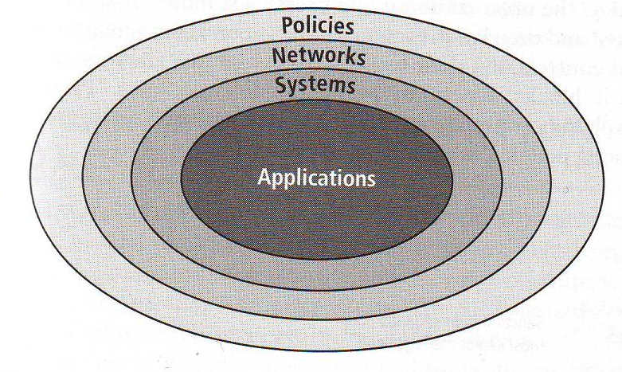
Bull’s Eye Model

Slide 8
Bull’s Eye Model Layer
Policies – the outer layer in the bull’s eye diagram, first layer of defense
Networks – the place where threats from public networks meet the organization’s networking infrastructure; in the past, most information security efforts have focused on networks, and until recently information security was often thought to be synonymous with network security
Systems – computers used as servers, desktop computers, and systems used for process control and manufacturing systems
Application – all applications systems, ranging from packed applications such as office automation and e-mail programs, to high-end ERP packages and custom application software developed by the organization

Slide 9
Policies are important reference documents for internal audits & for resolution of legal disputes about management’s due diligence
Policy documents can act as a clear statement of management’s intent

Slide 10
Policy, Procedur & Standard
Policy: plan or course of action that influences & determines decisions
Standards: more detailed statement of what must be done to comply with policy
Practices, procedures & guidelines: explain how employees will comply with policy

Slide 11
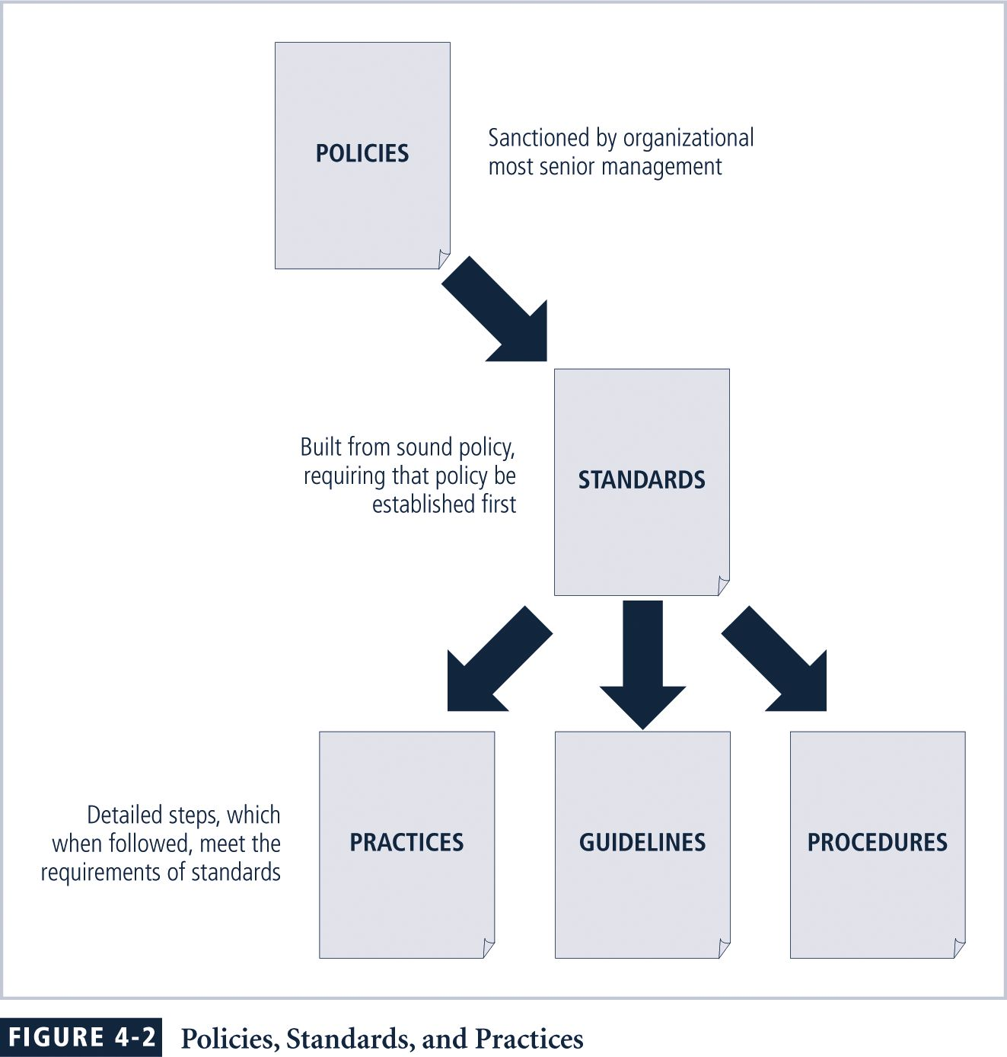

Slide 12
For policies to be effective, they must be:
Properly disseminated
Read
Understood
Agreed-to

Slide 13
Policies require constant modification & maintenance
In order to produce a complete infosec policy, management must define 3 types of infosec policy:
Enterprise infosec program policy
Issue-specific infosec policies
Systems-specific infosec policies (Standard)

Slide 14
Enterprise InfoSec Policy (EISP)
Sets strategic direction, scope, & tone for organization’s security efforts
Assigns responsibilities for various areas of infosec
Guides development, implementation,& management requirements of infosec program

Slide 15
Components of the EISP
Statement of Purpose: What the policy is for
Authorized Uses: Who can use the technology governed by the policy and for what purpose
Need for Information Technology Security: justifies importance of infosec in the organization
Information Technology Security Responsibilities & Roles: Defines organizational structure
Violations of Policy
References Information Technology standards & guidelines

Slide 16
Sample of the EISP
Protection Of Information: Information must be protected in a manner commensurate with its sensitivity, value, & criticality (Data Security Policy)
Information Handling, Access, & Usage: Information is a vital asset & all accesses to, uses of, & processing of Company X information must be consistent with policies & standards (Control Access & User Access Policy)
etc

Slide 17
Issue-Specific Security Policy (ISSP)
Provides detailed, targeted guidance to instruct organization in secure use of tech systems
Begins with intro to fundamental technological philosophy of organization
Serves to protect employee & organization from inefficiency/ambiguity
Documents how technology-based system is controlled Identifies Processes & authorities that provide this control
Serves to indemnify organization against liability for inappropriate or illegal system use

Slide 18
Issue-Specific Security Policy (ISSP) Should
Address specific technology-based systems
Require frequent updates
Contain an issue statement on the organization’s position on an issue

Slide 19
Issue-Specific Security Policy (ISSP) Sample
Guidelines on anti-virus process
Email-policy
Password
Third party connection agreement
Acceptable use policy

Slide 20
Management Guidance SysSPs
They may often be created to function as standards to be used when configuring or maintaining systems
SysSPs can be separated into:
Management guidance
Technical specifications
Combined in a single policy document

Slide 21
Management Guidance SysSPs
System administrators’ directions on implementing managerial policy
Each type of equipment has its own type of policies
Two general methods of implementing such technical controls:
1. Access control lists
2. Configuration rules

Slide 22
Access Control Lists
ACLs enable administrations to restrict access according to user, computer, time, duration, or even a particular file
more ...

Slide 23
Access Control Lists
Who can use the system
What authorized users can access
When authorized users can access the system
Where authorized users can access the system from
How authorized users can access the system
Restricting what users can access, e.g. printers, files, communications, & applications

Slide 24
Access Control Lists
ACL Administrators set user privileges
Read
Write
Create
Modify
Delete
Compare
Copy

Slide 25
Guidelines for Effective Policy
Developed using industry-accepted practices
Distributed using all appropriate methods
Reviewed or read by all employees
Understood by all employees
Formally agreed to by act or assertion
Uniformly applied and enforced

Slide 26
Developing Information Security Policy
Investigation Phase
Analysis Phase
Design Phase
Implementation Phase
Maintenance Phase

Slide 27
Investigation Phase
Support from senior management (CIO)
Support and active involvement of IT management
Clear articulation of goals
Participation by the affected communities of interest
Detailed outline of the scope of the policy development project

Slide 28
Analysis Phase
The analysis phase should produce the following:
A new or recent risk assessment or IT audit documenting the information security needs of the organization.
Gathering of key reference materials – including any existing policies

Slide 29
Design Phase
Users or organization members acknowledge they have received and read the policy
How policies will be distributed
How verification of distribution will be accomplished
Specifications for any automated tools
Revisions to feasibility analysis reports based on improved costs & benefits as design is clarified

Slide 30
Implementation Phase
Write the policies!
Make certain policies are enforceable as written Resources:
The Web
Government sites such as NIST
Professional literature
Peer networks
Professional consultants

Slide 31
Maintenance Phase
Policy development team responsible for monitoring, maintaining, and modifying the policy

Slide 32
Policy Distribution
Hand policy to employees
Post policy on a public bulletin board
E-mail
Intranet
Document management system

Slide 33
Policy Reading
Examine that all affected parties read the policy

Slide 34
Policy Comprehension
Language
At a reasonable reading level
With minimal technical jargon and management terminology

Slide 35
Policy Compliance
Policies must be agreed to by act or affirmation
Corporations incorporate policy confirmation statements into employment contracts, annual evaluations

Slide 36
Policy Enforcement
Uniform and impartial enforcement
High standards of due care with regard to policy management – to defend against claims made by terminated employees

Slide 37
Policy Management
Policy administrator
Review schedule
Review procedures and practices
Policy and revision dates

Slide 38
Policy Administrator
Policy administrator
Champion
Mid-level staff member
Solicits input from business and information security communities
Makes sure policy document and subsequent revisions are distributed

Slide 39
Review Schedule
Periodically reviewed for currency and accuracy, and modified to keep current
Organized schedule of review
Reviewed at least annually
Solicit input from representatives of all affected parties, management, and staff

Slide 40
Review Procedures and Practices
Easy submission of recommendations
All comments examined
Management approved changes implemented

Slide 41
Policy and Revision Date
Often published without a date
Legal issue – are employees “complying with an out-of-date policy
Should include date of origin, revision dates
don’t use “today’s date” in the document
expiration date

Slide 42
Final Note
Policies are a countermeasure to protect assets from threats
Policies exist to inform employees of acceptable (unacceptable) behavior
Are meant to improve employee productivity and prevent potentially embarrassing situations
Communicate penalties for noncompliance

Slide 43
Any Question?

