Slide 1
Vulnerability Assessment
Pertemuan 6
Prodi Sistem Informasi - Fakultas Ilmu Komputer

Slide 2
Why Need Vulnerability Assessment
  Vulnerabilities on a network are GOLD to cyber criminals:
    Provide unauthorized entry to networks
    Can expose confidential information, fuel stolen identities, violate privacy laws, or paralyse operations
    Exposure is extreme for networks with vulnerable devices connected by IP

Slide 3
Why Need Vulnerability Assessment
Network Security assessment
  Evaluation and Auditing the security
  Firewall Penetration Test (Policy auditing)
  IDS proof/evaluation
  Identifying unexpected new servers
Identifying open ports for
  proactively protect the network (Network and security admin)
  attacking it (Hackers)

Slide 4
Vulnerability Scanning
Vulnerability scanners are automated tools that scan hosts and networks for known vulnerabilities and weaknesses
Credentialed vs. non-credentialed
Example:
  Nessus

Slide 5
Vulnerability Scanning
Scanning tools collect the information that an attacker needs to succeed
Footprinting
  Organized research of the Internet addresses owned or controlled by a target organization

Slide 6
How Vulnerability Scanner Work
Similar to virus scanning software:
  Contain a database of vulnerability signatures that the tool searches for on a target system
  Cannot find vulnerabilities not in the database
    New vulnerabilities are discovered often
    Vulnerability database must be updated regularly

Slide 7
How Vulnerability Scanners Work
GUI
Target 1
Target 2
Vulnerability Database
Scanning Engine
Target 3
Knowledge Base
Target 4
Results

Slide 8
Typical Vulnerabilities Checked
Network vulnerabilities
Host-based (OS) vulnerabilities
  Misconfigured file permissions
  Open services
  Missing patches
  Vulnerabilities in commonly exploited applications (e.g. Web, DNS, and mail servers)

Slide 9
Typical Vulnerabilities Checked
Common configuration errors
  Examples: weak/no passwords
Default configuration weaknesses
  Examples: default accounts and passwords
Well-known system/application vulnerabilities
  Examples:
    Missing OS patches
    An old, vulnerable version of a web server

Slide 10
Benefit of Vulnerability Scanner
Very good at checking for hundreds (or thousands) of potential problems quickly
  Automated
  Regularly
May catch mistakes/oversights by the system or network administrator
Defense in depth

Slide 11
Drawbacks of Vulnerability Scanner
Report “potential” vulnerabilities
Only as good as the vulnerability database
Can cause complacency
Cannot match the skill of a talented attacker

Slide 12
Attackers use Vulnerability Scanners
From network scanning an attacker has learned:
  List of addresses of live hosts
  Network topology
  OS on live hosts
  Open ports on live hosts
  Service name and program version on open ports

Slide 13
Nessus
Free, open-source vulnerability scanner
Two major components:
  Server
    Vulnerability database
    Scanning engine
  (Web) Client
    Configure a scan
    View results of a scan

Slide 14
Nessus Plug-ins
Vulnerability checks are modularized:
  Each vulnerability is checked by a small program called a plug-in
  More than 20,000 plug-ins form the Nessus vulnerability database (updated regularly)
  Customizable – user can write new plug-ins
    In C
    In Nessus Attack-Scripting Language (NASL)

Slide 15
Vulnerabilities Checked by Nessus
Some major plug-in groups:
  Windows
  Backdoors
  CGI abuses
  Firewalls
  FTP
  Remote file access
  RPC
  SMTP
  DOS

Slide 16
Running a Nessus Scan
Make sure the server is running and has the latest vulnerability database
Start the client
Connect to the server
Select which plug-ins to use
Select target systems to scan
Execute the scan
View the results

Slide 17
Nessus Results
Vulnerabilities ranked as high, medium, or low risk
Need to be checked (and interpreted)
Can be used to search for/create exploits along with previous information collected:
  OS type
  List of open ports
  List of services and versions
  List of vulnerabilities

Slide 18
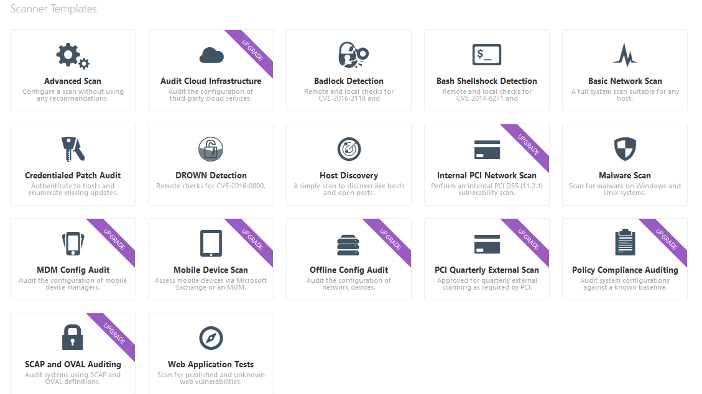
Nessus Scanning Template

Slide 19
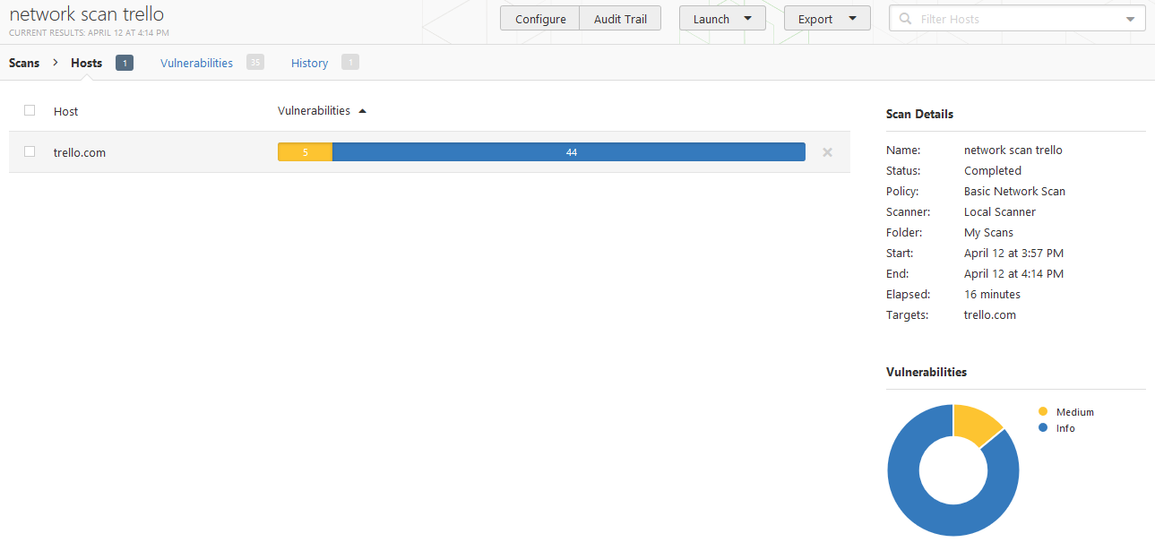
Example Scanning through Nessus

Slide 20
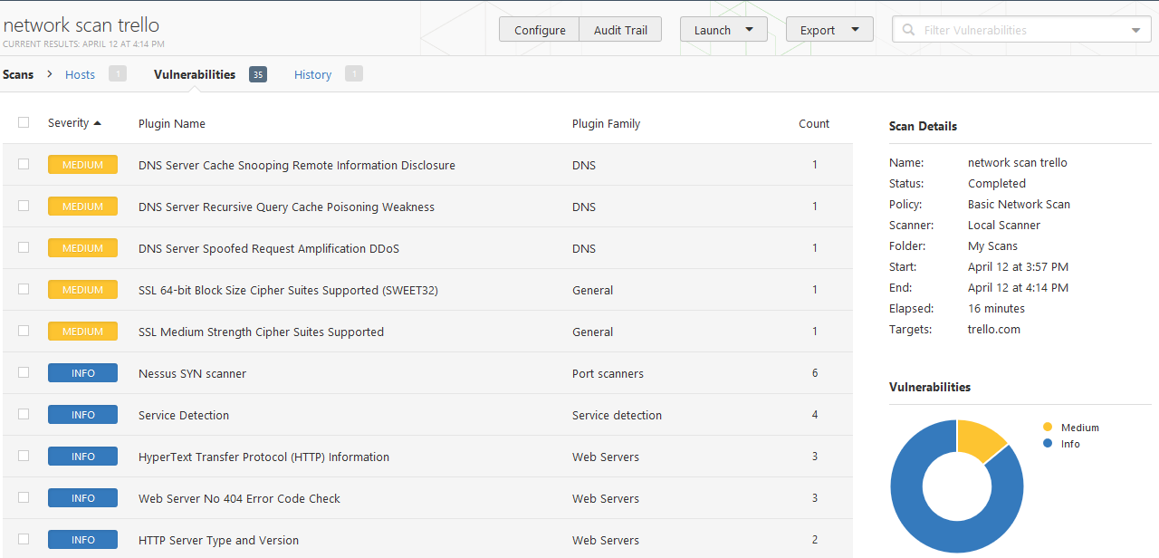
Example Scanning through Nessus

Slide 21
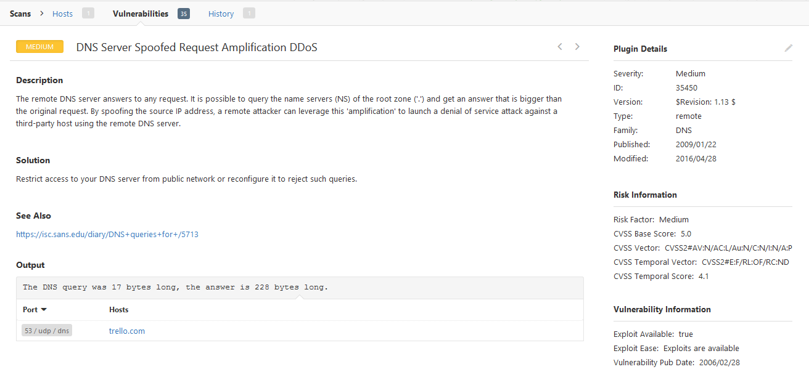
Example Scanning through Nessus

Slide 22
Port Scanning
Port
  Network channel or connection point in a data communications system
Port scanning utilities (or port scanners)
  Can identify (or fingerprint) active computers on a network and active ports and services on those computers, the functions and roles fulfilled by the machines, and other useful information

Slide 23
Port Scanning
Well-known ports are those from 0 through 1023
Registered ports are those from 1024 through 49151
Dynamic and private ports are those from 49152 through 65535
Open ports
  Can be used to send commands to a computer
  Gain access to a server
  Exert control over a networking device
  Thus must be secured

Slide 24
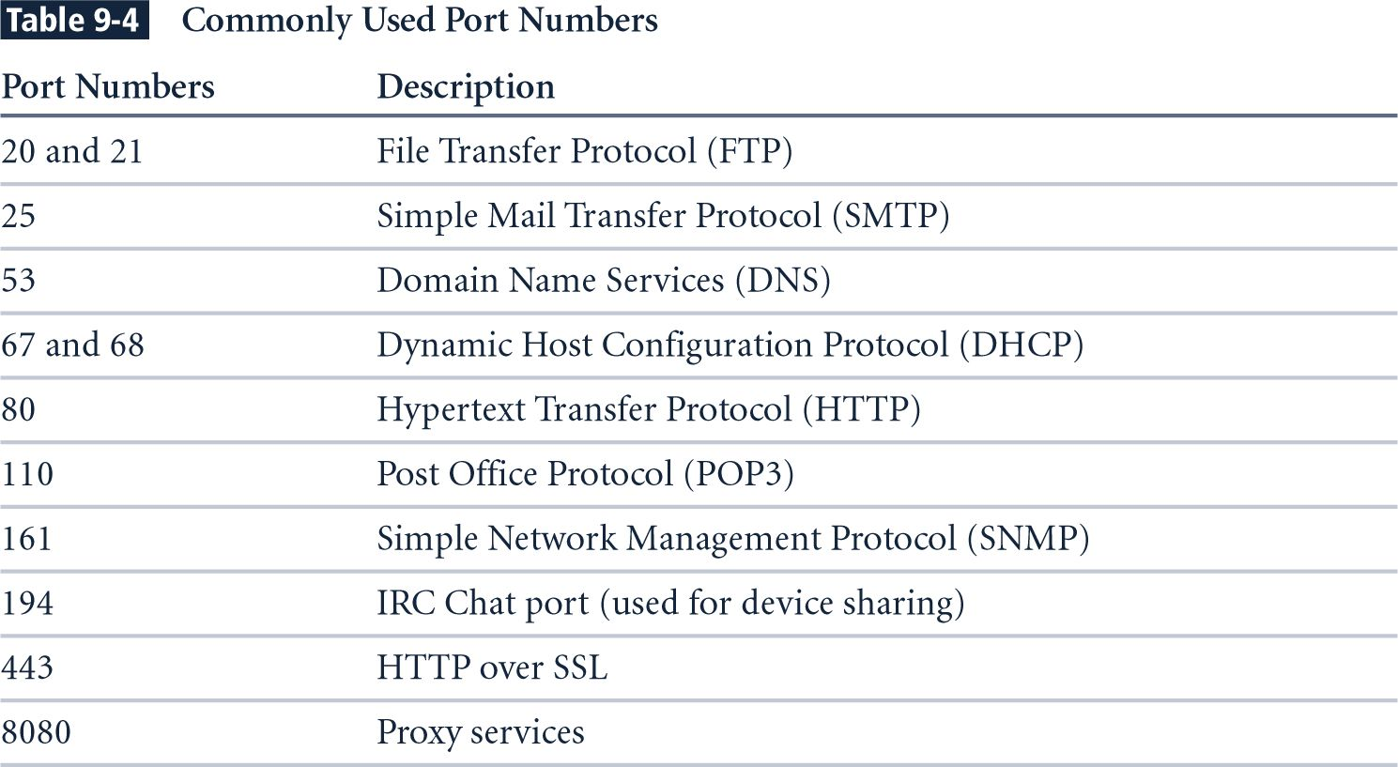
Commonly Used Port Numbers

Slide 25
Port Scanning
Method to gather information regarding the devices running on the network
Typically to discover services or servers on a network
  Which hosts are up?
  Which services are offering?

Slide 26
Port Scanning
Example Tool
  nmap
Scanning types
  Host discovery
  port scanning
  Version detection
  OS detection

Slide 27
Nmap
A well known and free security scanner written by Fyodor (http://insecure.org/nmap/)
  First released Sept 1, 1997 in Phrack 51 “The Art of Port Scanning”
  Version 7.40 as of this doc
An excellent tool
  Long history of development and support
  Continuous development and improvements
  “Industry Standard” port scanner

Slide 28
Nmap Features
Host Discovery: Which host is alive?
  Identifying computers on a network, for example listing the computers which respond to pings (Ping Sweeps)
Port Scanning : What services are available?
  Enumerating the open ports on one or more target computers

Slide 29
Nmap Features
Service and Version Detection : Which version is running?
  Determine the application name and version number
OS Detection: What platforms are served?
  Remotely determining the OS and some hardware characteristics of network devices

Slide 30
TCP Scanning
Use basic TCP connection establishment mechanism; complete 3-ways handshake
Easily to detect by inspecting the system log
SYN
SYN/ACK
Scanner
ACK
Target
a port is opened
SYN
RST/ACK
Scanner
Target
a port is closed

Slide 31
Status Service
Open
Close
Filtered

Slide 32
Post Scanning Detection
For Administrators to detect scanning
  Logs suspicious packets
  Identifies connections not properly terminated
  Records ports usage
  access control list (/etc/hosts.deny)
  mengubah routing table (drop)
  mengubah rule dari firewall

Slide 33
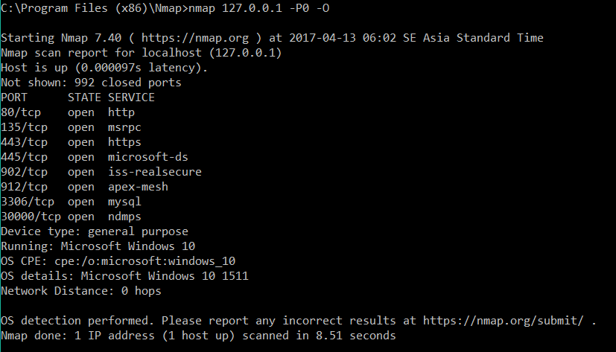
Example - Nmap

Slide 34
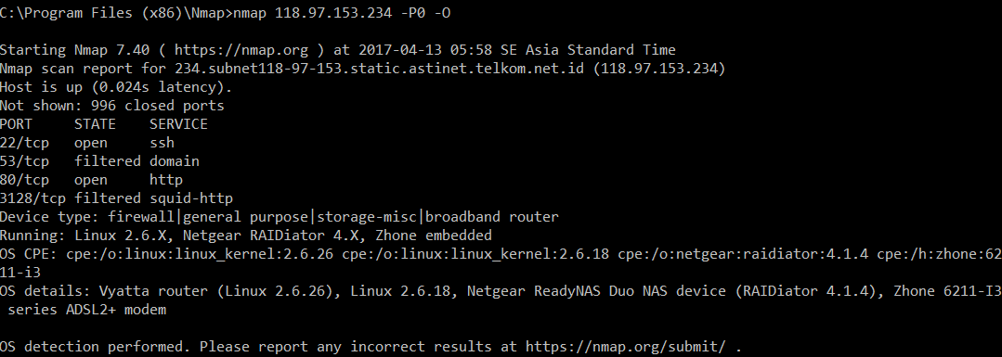
Example - Nmap

Slide 35
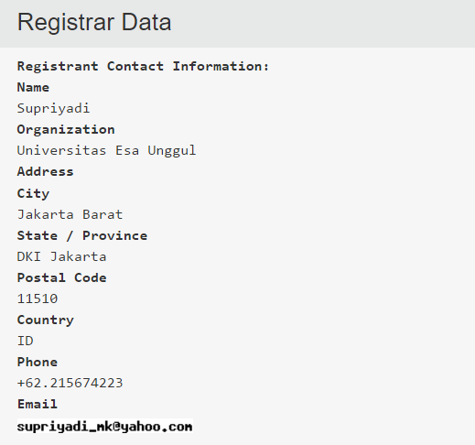
Discovering Other Information
Whois

Slide 36
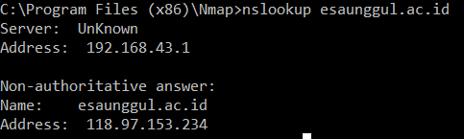
Discovering Other Information
Nslookup

Slide 37
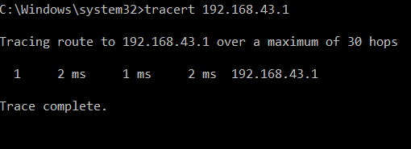
Discovering Other Information
Routing

Slide 38
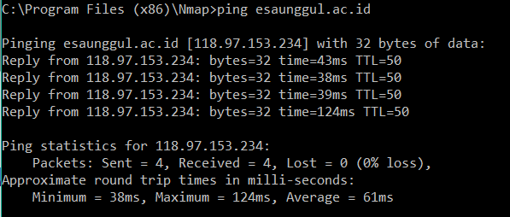
Discovering Other Information
Service alive

Slide 39
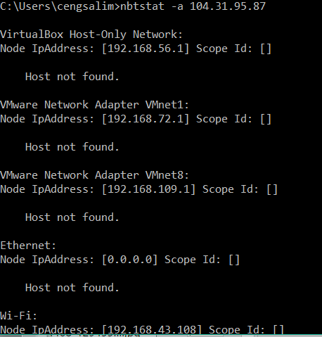
Discovering Other Information
nbstat

Slide 40
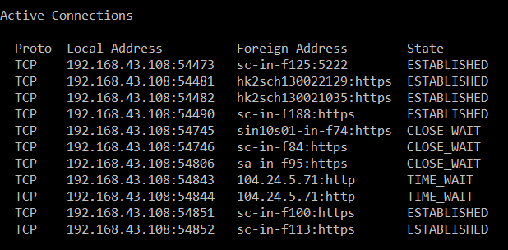
Discovering Other Information
Netstat

Slide 41
Summary
Vulnerability scanners are automated tools that scan hosts and networks for known vulnerabilities and weaknesses
Used by defenders to automatically check for many known problems
Used by attackers to prepare for and plan attacks
Make sure all information which is unnecessary and discovered by scanner are closed

Slide 42
Any Question?

