Slide 1
Vulnerability Assessment (Case Study)
Pertemuan 7
Prodi Sistem Informasi - Fakultas Ilmu Komputer

Slide 2
Case Study
Each students perform vulnerability assessment simulation using Nessus against specified online application
Each student conduct information gathering regarding the chosen object case study

Slide 3
Case Study
Each students create report and presentation regarding the finding of vilnerable in the system during information gathering and vulnerability assessment process

Slide 4
Running a Nessus Scan
Make sure the server is running and has the latest vulnerability database
Start the client
Connect to the server
Select which plug-ins to use
Select target systems to scan
Execute the scan
View the results

Slide 5
Nessus Results
Vulnerabilities ranked as high, medium, or low risk
Need to be checked (and interpreted)
Can be used to search for/create exploits along with previous information collected:
  OS type
  List of open ports
  List of services and versions
  List of vulnerabilities

Slide 6
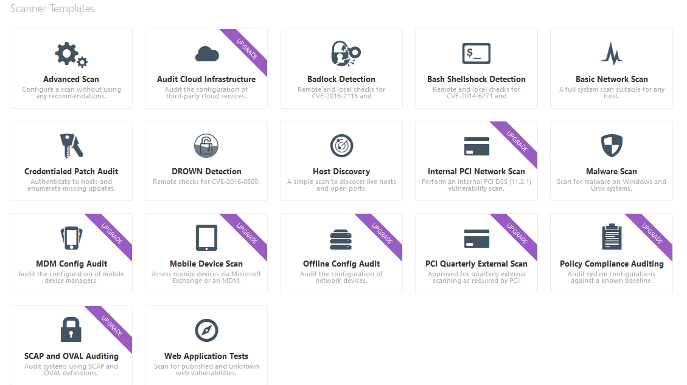
Nessus Scanning Template

Slide 7
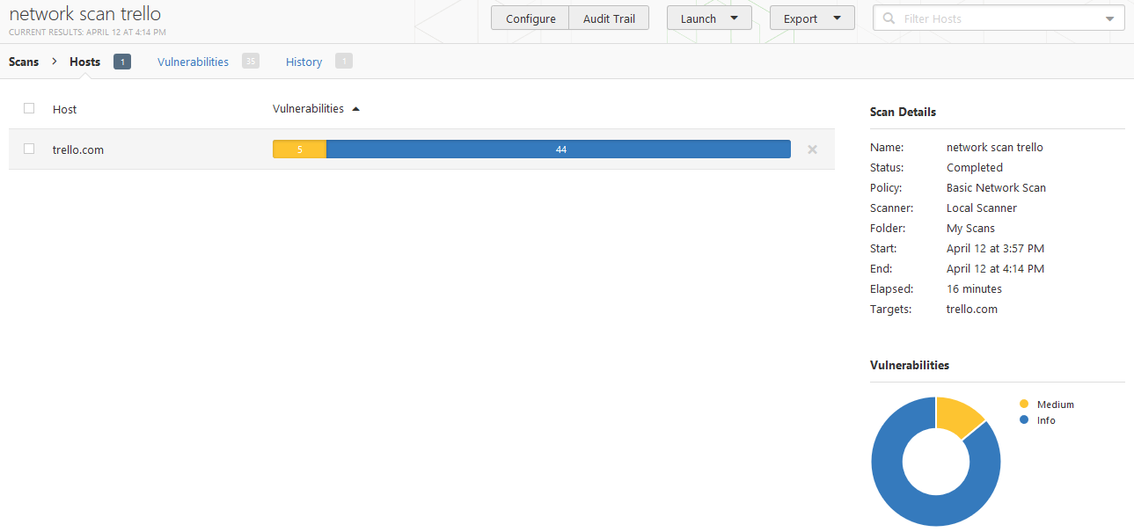
Example Scanning through Nessus

Slide 8
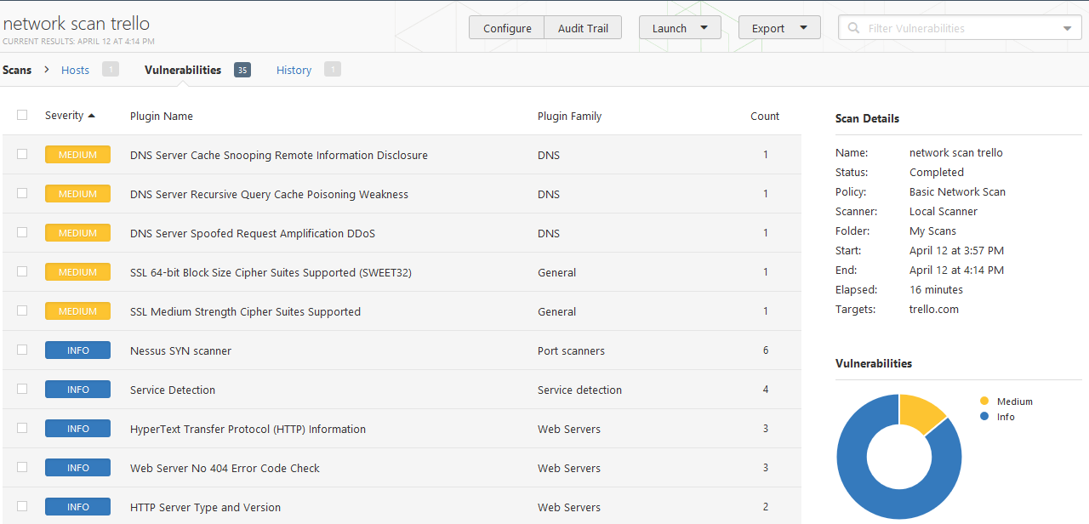
Example Scanning through Nessus

Slide 9
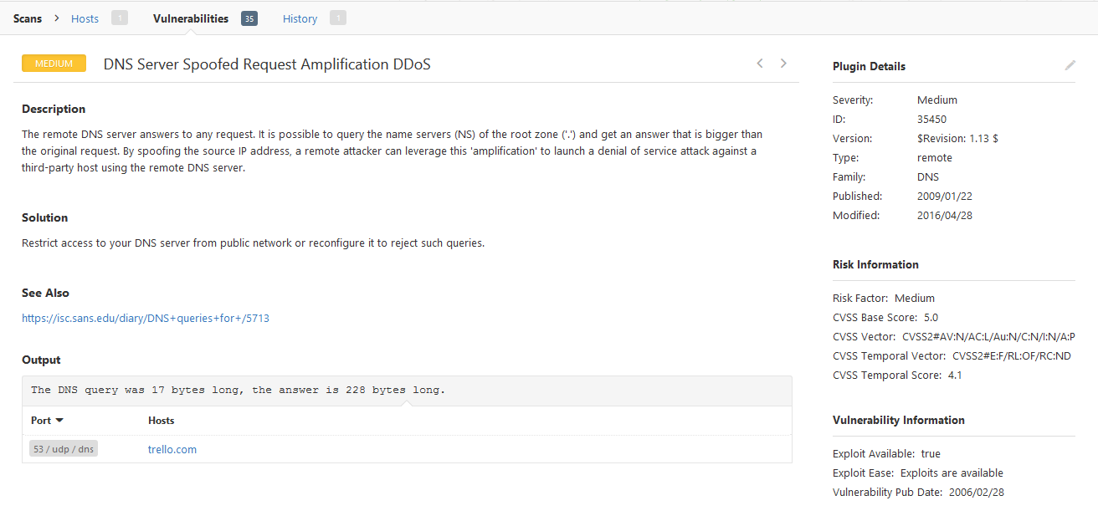
Example Scanning through Nessus

