Slide 1
Information Right Management
Pertemuan 9
Prodi Sistem Informasi - Fakultas Ilmu Komputer

Slide 2
Information Right Management
Information right management encompasses two processes:
Authentication is the process to verifying and validating the identity (who you are).
Authorization is he process where requests to access a particular resource should be granted or denied to appropriate privilege.
A successful access control approach—whether intended to control physical access or logical access—always consists of both authentication and authorization

Slide 3
Authentication vs Authorization
Authentication (password/crypto/etc.)
Who are you?
Authorization (Acess control)
What are you allowed to do.
Focus is policy
Enforcement Mechanism
- How its policy implemented/enforced

Slide 4
Authentication Mechanism
Mechanism types:
Something you know
Something you have
Something you are
Something you produce
Strong authentication uses at least two different authentication mechanism types

Slide 5
Something You Know
This type of authentication mechanism verifies the user’s identity by means of a password, passphrase, or other unique code
A password is a private word or combination of characters that only the user should know
A passphrase is a plain-language phrase, typically longer than a password, from which a virtual password is derived
A good rule of thumb is to require that passwords be at least eight characters long and contain at least one number and one special character

Slide 6
Password Power (1)

Slide 7
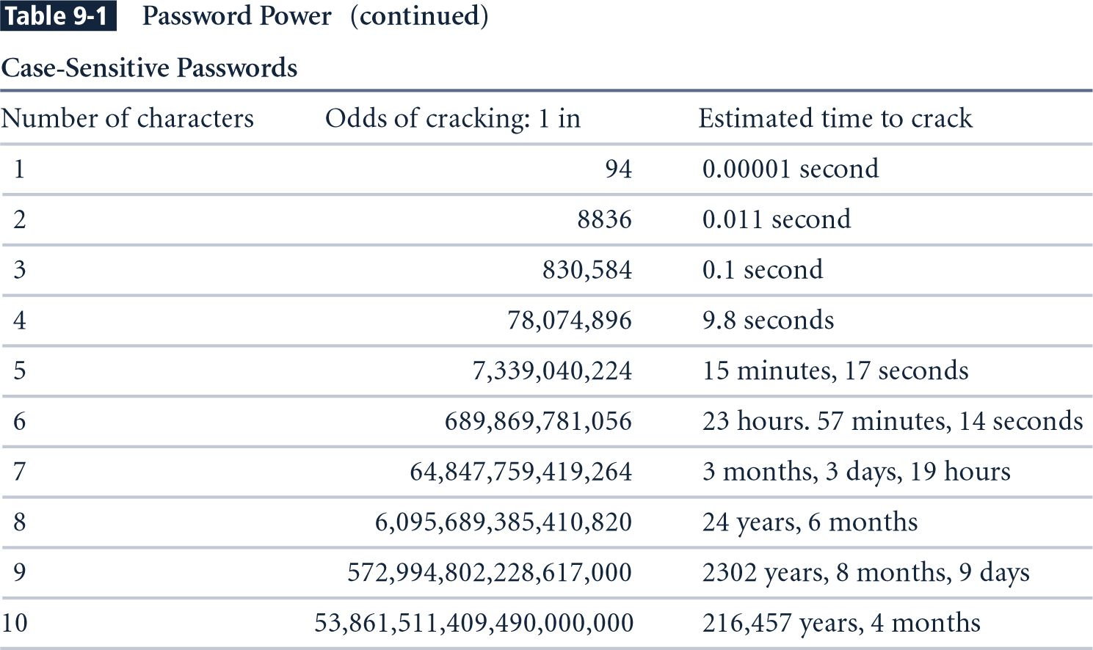
Password Power (2)

Slide 8
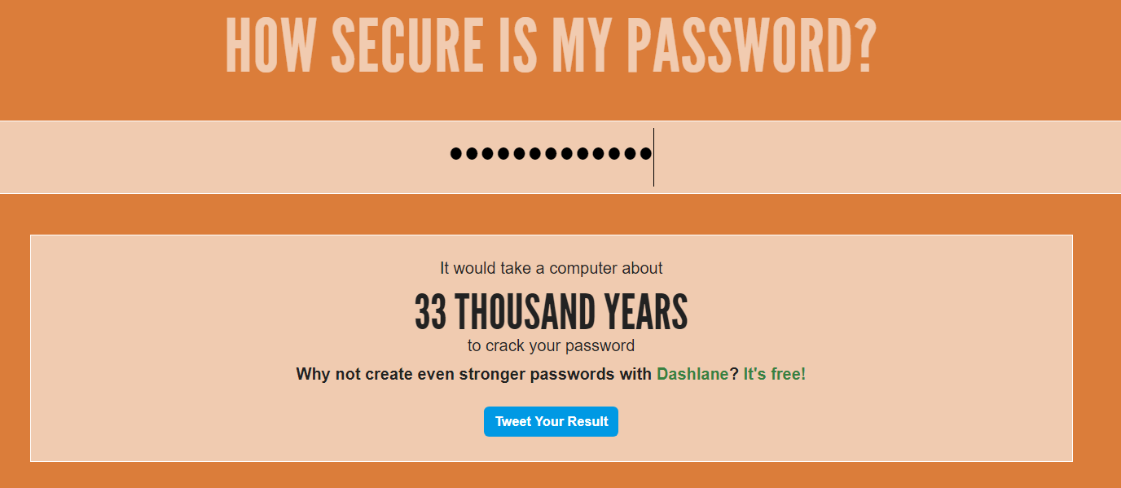
Check Password Power
https://howsecureismypassword.net/
https://password.kaspersky.com/

Slide 9
Something You Have
This authentication mechanism makes use of something (a card, key, or token) that user or system possesses
One example is a dumb card (such as an ATM cards) with magnetic stripes
Another example is the smart card containing a processor
Another device often used is the cryptographic token, a processor in a card that has a display
Tokens may be either synchronous or asynchronous

Slide 10
Access Control Token

Slide 11
Something You Are
This authentication mechanism takes advantage of something inherent in the user that is evaluated using biometrics
Most of the technologies that scan human characteristics convert these images to obtain some form of minutiae — unique points of reference that are digitized and stored in an encrypted format

Slide 12
Something You Do
This type of authentication makes use of something the user performs or produces
It includes technology related to signature recognition and voice recognition, for example

Slide 13
Authorization
Authorization for each authenticated user
System performs authentication process to verify specific entity
Grants access to resources for only that entity
Authorization for members of a group
System matches authenticated entities to a list of group memberships
Grants access to resources based on group’s access rights
Authorization across multiple systems
Central authentication and authorization system verifies entity identity
Grants a set of credentials to verified entity

Slide 14
Managing Information Right
To appropriately manage information right, an organization must have a formal access control policy in place
Determines how access rights are granted to entities and groups
Must include provisions for periodically reviewing all access rights, granting access rights to new employees, changing access rights when job roles change, and revoking access rights as appropriate

Slide 15
Access to Library - Example
Authentication
ID Check
Access Control
Visitor - allowed in
Member - allowed to borrow
Staff - allowed to access All area
Enforcement Mechanism
Walls, Doors, Locks, Bouncers

Slide 16
What do this for?
Express information access policies.
Who can access my files, who can’t, how.
Sandboxing: Minimize damage inflicted by malicous program.
Privilege Seperation: Allow programs to be written to minimize damage in case of failure.
Think about compartments in a ship
Defense-in-Depth

Slide 17
Principle
Principle of Least privilege
Make controls granular enough and apply them to enforce them to minimize harm.
Need to know basis
determines whether the person should have access or not

Slide 18
Principle
This model is generally used to help understand the various issues involved in access control
The subject issues requests to access the object, and protection is enforced by a reference monitor that knows which subjects are allowed to issue which requests

Slide 19
Subjects and Objects
Subjects
can be processes, modules, roles
Objects
can be files, processes, etc.
Authentication often used to subjects, but not necessary.
e.g. process assumes identity of one subject, then another.
Authorization often focus on objects

Slide 20
Elementary Form
Whitelists/Blacklists (Single object, multiple Subjects)
Examples: Spam prevention
Blacklists:
Default on (fail open)
Hard to reason about who can access system
Whitelists:
Default off (fail closed)
Have to deal with adding whitelist entries

Slide 21
Access Control Matrix
Instantaneous protection state of a system
Dynamically Changing!
Objects
A
B
C
D
alice
0 | 0 | 1 | 0
1 | 1 | 0 | 1
0 | 0 | 1 | 0
1 | 1 | 0 | 1
subjects
bob
charlie
dave

Slide 22
Access Right
Document/ File:
Read
Write
Delete
Server:
Start
Stop
Reboot

Slide 23
Adding Access Rights
Access Rights
e.g. Simple: Read, Write
e.g. Complex: execute, change ownership
Objects
A
B
C
D
alice
r | r/w | r | -
r | r | - | r/w
- | - | w | -
 | r/w | - | w
subjects
bob
charlie
dave

Slide 24
Grouping
Subjects
Groups e.g. staff = {alice,dave}, students = {bob, charlie}, department, etc
Objects
Types e.g. system_file = {A,B}, user_file = {C,D}
Can have compound names
e.g. in AFS talg:friends, system:backup

Slide 25
ACL’s (Access Control Lists)
What if I break my matrix down by columns?
Each object has a set of <user, right> tuples
A {<bob, r/w>, <alice,w>}
Properties
Good for many applications (file systems)
Can grow quite large

Slide 26
ACL’s (Access Control Lists)

Slide 27
Capabilities
What if I break my matrix down by rows
Alice {<A,r/w>, <B,w>, <C,r>}
Properties
Natural model for delegation (rights coupled to object)
Each tuple can be viewed as a handle to an object

Slide 28
Capabilities List

Slide 29
Protection Domain
ACLs and capabilities help to efficiently implement the access control matrix, but can still become quite cumbersome
A protection domain is a set of (object, access rights) pairs, where each pair specifies for a given object exactly what operations can be carried out
By associating a protection domain with each request, we can cut down on redundant information in access control lists

Slide 30
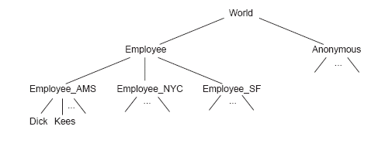
Protection Domain
One approach to using protection domains is to construct groups of users
Another approach is to use roles instead of groups
Roles: head of a department, manager of a project, member of a personnel search committee

Slide 31
Model of Access Control
Discretionary Access Control (DAC)
Mandatory Access Control (MAC)
Role Base Access Control (RBAC)

Slide 32
Discretionary Access Control (DAC)
Access to data objects (files, directories, etc.) is permitted based on the identity of users.
Explicit access rules that establish who can, or cannot, execute which actions on which resources.
Discretionary: users can be given the ability of passing on their privileges to other users, where granting and revocation of privileges is regulated by an administrative policy.

Slide 33
Mandatory Access Control (MAC)
In MAC users do not have the authority to override the policies and it totally controlled centrally by the security policy administrator
MAC is a system-wide policy which defines who is allowed to have access; individual user cannot change that access rules. It totally relies on the central system.
MAC policies are defined by the system administrator, and it is strictly enforced by the OS or security kernel.

Slide 34
Role Base Access Control (RBAC)
Many organizations base access control decisions on “the roles that individual users take on as part of the organization”.
They prefer to centrally control and maintain access rights that reflect the organization’s protection guidelines.
With RBAC, role-permission relationships can be predefined, which makes it simple to assign users to the predefined roles.
The combination of users and permissions tend to change over time, the permissions associated with a role are more stable.

Slide 35
Role Base Access Control (RBAC)

Slide 36
Any Question?

