Slide 1
Chapter
1
Information Systems in Global Business Today
Sumber : www.cwu.edu/~bayazito/386sum08ch1.ppt‎

Slide 2
Management Information Systems
Chapter 1 Information Systems in Global Business Today
LEARNING OBJECTIVES
Explain why information systems are so essential in business today.
Define an information system from both a technical and a business perspective.
Identify and describe the three dimensions of information systems.

Slide 3
Management Information Systems
Chapter 1 Information Systems in Global Business Today
LEARNING OBJECTIVES (Continued)
Assess the complementary assets required for information technology to provide value to a business.
Identify and describe contemporary approaches to the study of information systems and distinguish between computer literacy and information systems literacy.

Slide 4
Management Information Systems
Chapter 1 Information Systems in Global Business Today
Smart Systems and Smart Ways of Working Help Toyota Become Number One
Problem: Tough competition and demanding customers.
Solutions: Redesigned order and production processes reduce costs, increase revenue, and improve customer service.
Oracle E-Business Suite makes it possible to build cars to order and forecast demand and production requirements more accurately.
Demonstrates IT’s role in analyzing market trends and monitoring quality, efficiency, and costs.
Illustrates the emerging digital firm landscape where businesses can use tools to analyze critical data.

Slide 5
Management Information Systems
Chapter 1 Information Systems in Global Business Today
The Role of Information Systems in Business Today
How information systems are transforming business
Globalization opportunities
The emerging digital firm
Strategic business objectives of information systems
Operational excellence
New products, services, and business models
Customer and supplier intimacy
Improved decision making
Competitive advantage
Survival

Slide 6
Management Information Systems
Chapter 1 Information Systems in Global Business Today
WHY INFORMATION SYSTEMS?
Globalization:
Management and control in a global marketplace
Competition in world markets
Global workgroups
Global delivery systems

Slide 7
Management Information Systems
Chapter 1 Information Systems in Global Business Today
WHY INFORMATION SYSTEMS?
Emergence of the Digital Firm:
Digitally enabled relationships with customers, suppliers, and employees
Core business processes accomplished using digital networks
Digital management of key corporate assets

Slide 8
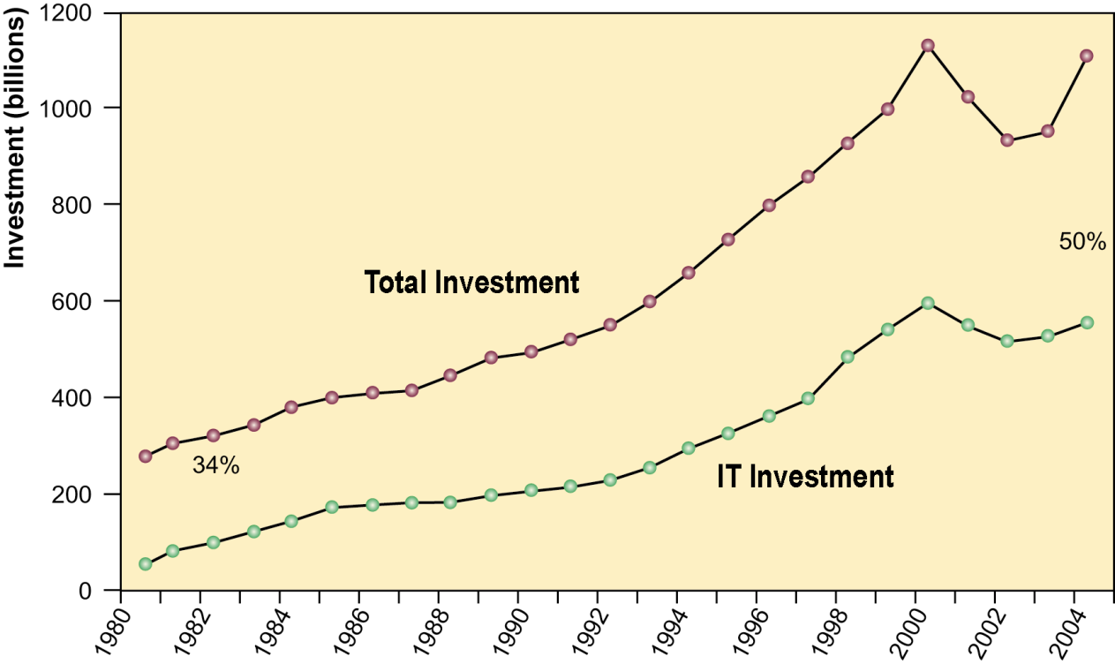
Management Information Systems
Chapter 1 Information Systems in Global Business Today
The Role of Information Systems in Business Today
Information Technology Capital Investment
Information technology investment, defined as hardware, software, and communications equipment, grew from 34% to 50% between 1980 and 2004. Source: Based on data in U.S. Department of Commerce, Bureau of Economic Analysis, National Income and Product Accounts, 2006.
Figure 1-1

Slide 9
Management Information Systems
Chapter 1 Information Systems in Global Business Today
Perspectives on Information Systems
What is an information system?
A set of interrelated components that collect (or retrieve), process, store, and distribute information to support decision making and control in an organization

Slide 10
Management Information Systems
Chapter 1 Information Systems in Global Business Today
PERSPECTIVES ON INFORMATION SYSTEMS
What is an Information System? (Continued)
Data: Streams of raw facts representing events such as business transactions
Information: Clusters of facts meaningful and useful to human beings in the processes such as making decisions

Slide 11
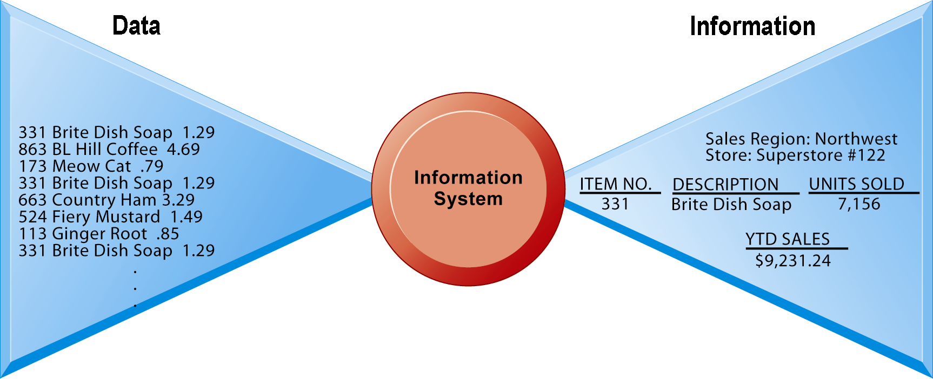
Management Information Systems
Chapter 1 Information Systems in Global Business Today
Perspectives on Information Systems
Data and Information
Raw data from a supermarket checkout counter can be processed and organized to produce meaningful information, such as the total unit sales of dish detergent or the total sales revenue from dish detergent for a specific store or sales territory.
Figure 1-3

Slide 12
Management Information Systems
Chapter 1 Information Systems in Global Business Today
PERSPECTIVES ON INFORMATION SYSTEMS
Computer-Based Information System (CBIS)
Rely on computer hardware and software
Processing and disseminating information
Collecting, storing, and using information

Slide 13
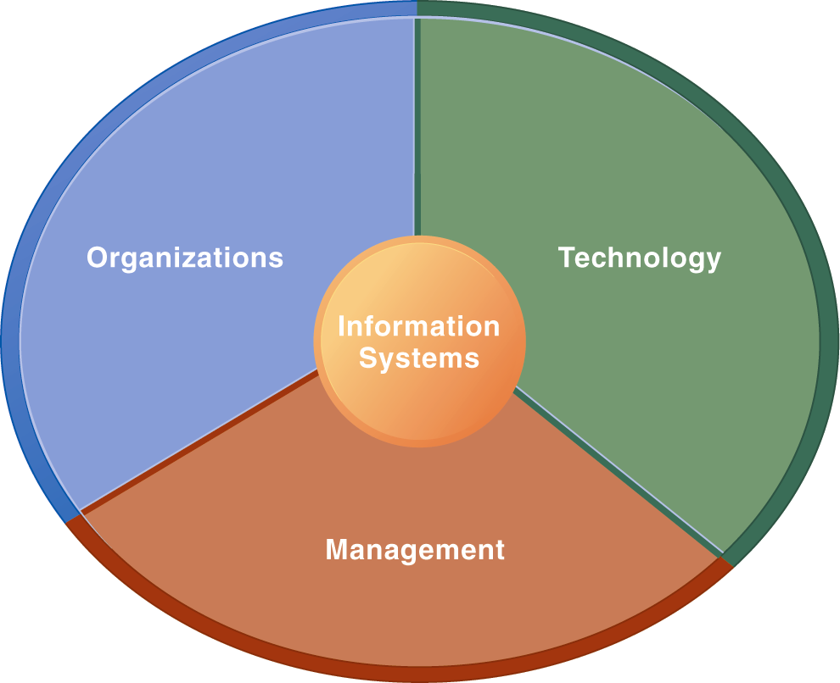
Management Information Systems
Chapter 1 Information Systems in Global Business Today
Perspectives on Information Systems
Information Systems Are More Than Computers
Using information systems effectively requires an understanding of the organization, management, and information technology shaping the systems. An information system creates value for the firm as an organizational and management solution to challenges posed by the environment.
Figure 1-5

Slide 14
Management Information Systems
Chapter 1 Information Systems in Global Business Today m
PERSPECTIVES ON INFORMATION SYSTEMS
Dimensions of Information Systems
Three Important Dimensions of Information Systems
Organizations
Managers
Technology
You will need to understand and balance these dimensions of information systems in order to create business value.

Slide 15
Management Information Systems
Chapter 1 Information Systems in Global Business Today
PERSPECTIVES ON INFORMATION SYSTEMS
The Organizational Dimension of Information Systems
People
Structure
Business processes
Culture
Politics

Slide 16
Management Information Systems
Chapter 1 Information Systems in Global Business Today
PERSPECTIVES ON INFORMATION SYSTEMS
The Management Dimension of Information Systems
Managers are:
Senior managers
Middle managers
Operational managers
Innovators of new processes
Leaders: set agendas

Slide 17
Management Information Systems
Chapter 1 Information Systems in Global Business Today
PERSPECTIVES ON INFORMATION SYSTEMS
The Technology Dimension of Information Systems
Information technology is one of the tools managers use to cope with change:
Hardware: Physical equipment
Software: Detailed preprogrammed instructions
Storage: Physical media for storing data and the software

Slide 18
Management Information Systems
Chapter 1 Information Systems in Global Business Today
PERSPECTIVES ON INFORMATION SYSTEMS
The Technology Dimension of Information Systems (Continued)
Communications technology: Transfers data from one physical location to another
Networks: Links computers to share data or resources (Internet, intranet, extranet)
Managers need to know enough about information technology to make intelligent decisions about how to use it for creating business value.

Slide 19
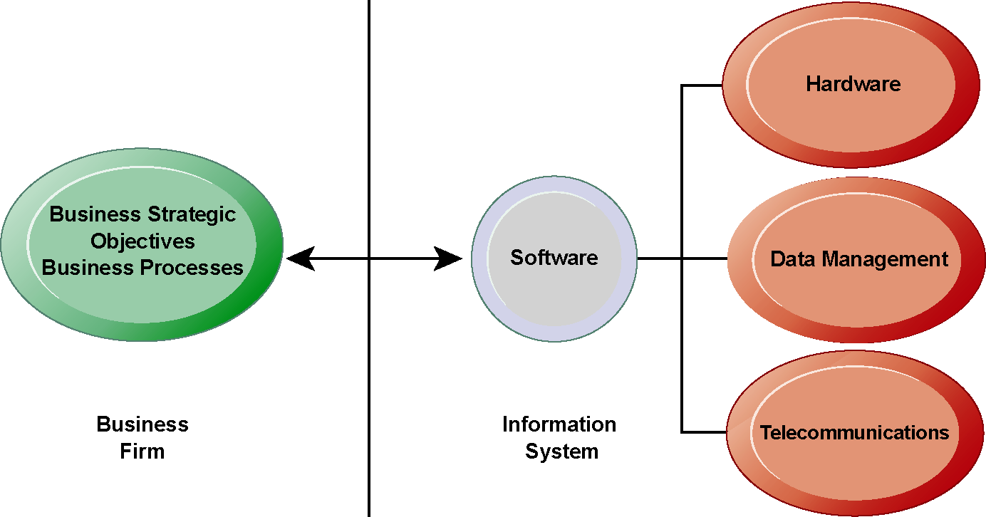
Management Information Systems
Chapter 1 Information Systems in Global Business Today
The Role of Information Systems in Business Today
The Interdependence Between Organizations and Information Technology
There is a growing interdependence between a firm’s information systems and its business capabilities. Changes in strategy, rules, and business processes increasingly require changes in hardware, software, databases, and telecommunications. Often, what the organization would like to do depends on what its systems will permit it to do.
Figure 1-2

Slide 20
Management Information Systems
Chapter 1 Information Systems in Global Business Today
Perspectives on Information Systems
UPS Competes Globally with Information Technology
Read the Interactive Session: Technology, and then discuss the following questions:
What are the inputs, processing, and outputs of UPS’s package tracking system?
What technologies are used by UPS? How are these technologies related to UPS’s business strategy?
What problems do UPS’s information systems solve? What would happen if these systems were not available?

