Slide 1
Pemodelan Proses Bisnis
Pengenalan Proses Bisnis
Pertemuan 1
Dosen Pengampu: Alivia Yulfitri (2017)
Prodi Sistem Informasi - Fakultas Ilmu Komputer

Slide 2
Materi Sebelum UTS
Introduction
Konsep BPM Life Cycle
BPM Critical Success Factors
Tahapan Identifikasi proses bisnis (analisis strategi)
Tahapan Identifikasi proses bisnis (tahapan dan teknik)
Studi kasus
Tahapan discovery proses bisnis

Slide 3
Materi Setelah UTS
Tahapan Analisis
Analisis proses bisnis utama
Analisis sub proses bisnis
Studi kasus
Business proses re-engineering
Studi kasus
Monitoring dan controlling proses bisnis

Slide 4
Tujuan Mata Kuliah
Memberikan pengetahuan tentang:
  Proses
  Proses Bisnis
  Analisa Proses Bisnis
  Modelling Proses Bisnis

Slide 5
Referensi
Fundamentals of Business Process Management, Marlon Dumas, Springer book
Guide to the Business Process Management Common Body of Knowledge (ABPMP BPM CBOK)
Business analysis techniques, 72 Essential Tools for Success, James Cadle
Workflow Modeling - Tools for Process Improvement and Application Development(2001), Alec Sharp - Pattrick McDermott
Berbagai situs web

Slide 6
Definisi Proses
  A process is set of logically related tasks performed to achieve a defined business outcome
  A collection of activities that, taken together, create value for customer e.g. new product for customer. This tasks are inter-related tasks

Slide 7
Process definition
  A process is a set of actions that take inputs,
  and then add value to provide desirable outputs.
Customers
Suppliers
Resources
Internet
Product
Process
Inputs
Outputs

Slide 8
Business
“… a course of action or a procedure … a series of stages in manufacture or some other operation…” [the concise oxford dictionary]
“… a series of actions, changes, or functions bringing about a result.” [dictionary.com]

Slide 9
What is a (Business) Process?
Collection of related events, activities and decisions, that involve a number of actors and resources, and that collectively lead to an outcome that is of value to an organization or its customers.
Examples:
Order-to-Cash
Procure-to-Pay
Application-to-Approval
Claim-to-Settlement
Fault-to-Resolution (Issue-to-Resolution)
Notes:
Events correspond to things that happen ``atomically'', meaning that they have no duration. For example, the arrival of a plant to the depot is an event. This event may trigger the execution of series of activities. For example, when a plant arrives, the site engineer inspects the plant. This inspection is an activity, in the sense that it takes time. When an activity is rather simple and takes relatively little time, we call it a task. For example, if the inspection that the site engineer performs is quite simple -- e.g. just checking that the plant received corresponds to what was ordered -- we can say that the ``plant inspection'' is a task. If on the other hand the inspection of the plant requires many steps -- such as checking that the plant fulfills the specification included in the purchase order, checking that the plant is in working order, and checking the plant comes with all the required accessories and safety devices -- we will treat it as an ``activity''. The distinction between task and activity is not always clear-cut. This is why, very often people will use the term task and activity interchangeably.
Order-to-cash: This is a process that starts when a customer places an order to purchase a product or a service, and ends when the product or service in question has been delivered and the corresponding payment has been received. An order-to-cash process encompasses activities such as purchase order verification, shipment (in the case of physical products), delivery, invoicing, payment receipt and acknowledgment.
Quote-to-order: This process typically precedes the order-to-cash process. It starts from the point when a ``request for quote'' is received from a customer, to the point when the customer places a purchase order. The order-to-cash process takes the relay from that point on. The combination of a quote-to-order and the corresponding order-to-cash process is called a quote-to-cash process.
Procure-to-pay: This is a process that starts when a stakeholder within an organization -- typically an employee -- determines that a given product or service needs to be purchased. It ends when the product or service has been delivered and paid for. A procure-to-pay process includes activities such as approving the purchase, obtaining quotes, selecting a supplier, issuing a purchase order, receiving the goods (or consuming the service), checking and paying the invoice. Procure-to-pay can be seen as the dual of quote-to-cash in the context of business-to-business interactions. For every procure-to-pay process there is a corresponding quote-to-cash process on the supplier's side.
Issue-to-resolution. This is a process that starts when a customer raises a problem, such as a complaint related to a defect in a product or an issue encountered when consuming a service. The process continues until the customer, the supplier, or preferably both of them, agree that the issue has been resolved. A variant of this process can be found in insurance companies that have to deal with ``insurance claims''. This variant is often called claim-to-resolution.

Slide 10




“My washing machine won’t work!”
Warranty?
Call Centre
Technician
Customer
Customer
Customer
Parts
Store
Service
Dispatch
fault-report-to-resolution process
VALUE
© Michael Rosemann
Notes:
The execution of a process leads to one or several \emph{outcomes}. For example, the above process leads to a plant being used by BuildIT, as well as a payment being made to the plant's supplier. These outcomes deliver \emph{value} to the key actors involved in the process, which in this example are BuildIT and the supplier. In some cases, this value is not achieved or is only partially achieved. For example, when a plant is returned, no value is gained, neither by BuildIT nor by the supplier. This corresponds to a \emph{negative outcome}, as opposed to a \emph{positive outcome} that delivers value to the actors involved.

Slide 11
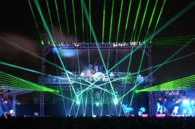
ELEMEN PENTING PROSES
Activities
  active elements (e.g. ‘enter sales order’)
  time-consuming, resource-demanding
  state-changing
Events
  passive elements (e.g. ‘sales order has been entered’)
  represent conditions / circumstances
  atomic, instantaneous

Slide 12

ELEMEN PENTING PROSES
Business Objects (or Data)
  the organizational artifacts that undergo state changes
  physical or electronic information
  examples:
    sales order, digital object, consulting proposal
Actors (or Resources)
  the entities performing process activities and generating events
  human and systems
  examples:
    financial officer, warehouse clerk
    ERP, CRM, SAP, application X…

Slide 13
BAGAIMANA MENGKOMBINASIKAN ELEMEN TSB?
  What needs be done and when? - Control flow
  What do we need to work on? – Data
  Who’s doing the work? - Resources (human & systems)

Slide 14
Processes and Outcomes
Every process leads to one or several outcomes, positive or negative
  Positive outcomes deliver value
  Negative outcomes reduce value
Fault-to-resolution process
  Fault repaired without technician intervention
  Fault repaired with minor technician intervention
  Fault repaired and fully covered by warranty
  Fault repaired and partly covered by warranty
  Fault repaired but not covered by warranty
  Fault not repaired (customer withdrew request)

Slide 15
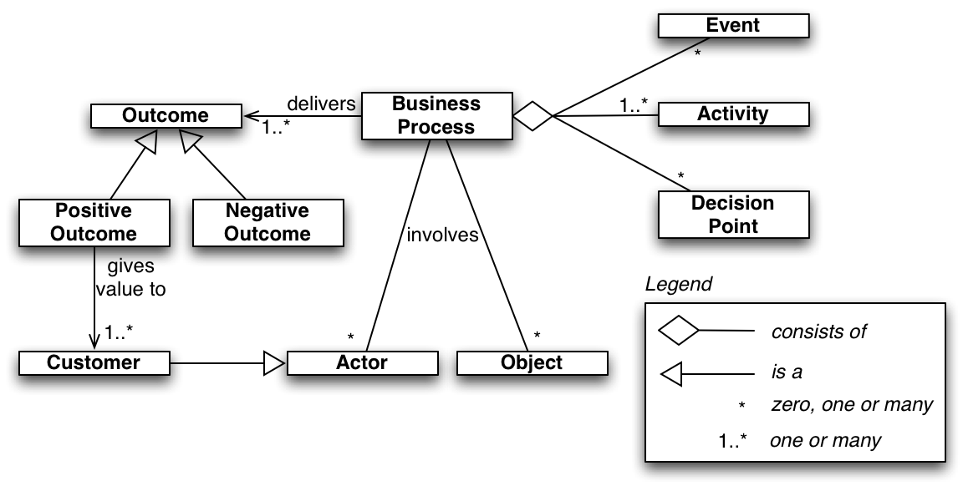
What is a Business Process: Recap

Slide 16
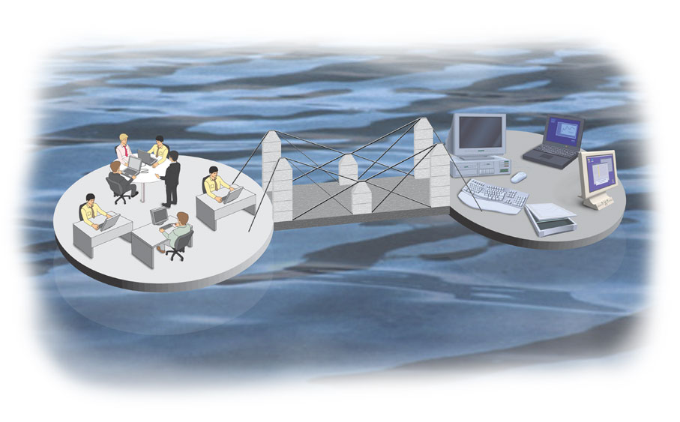
BPM: What is it?
Body of principles, methods and tools to design, analyze, execute and monitor business processes
In this course, we will focus on BPM based on process models.
Notes:
Business Process Management (BPM) is the art and science of overseeing how work is performed in an organization in view of ensuring consistent outcomes and identifying and taking advantage of improvement opportunities. In this context, the term ``improvement'' may take different meanings depending on the objectives of the organization. Typical examples of improvements include reducing costs, reducing execution times and reducing error rates. Importantly, BPM is not about improving the way individual activities are performed, but rather, it is about managing entire chains of events, activities and decisions that ultimately add value to the organization.
Within the broad context of the above definition, BPM regroups a body of methods for managing business operations on the basis of process models. Process models represent the understanding that people in the organization have about how work is done or should be done. They act as the bridge between business operations and IT systems. They allow us to understand how IT systems contribute to adding value to the organization by streamlining its work practices.

Slide 17

Why BPM?
“The first rule of any technology used in a business is that automation applied to an efficient operation will magnify the efficiency.
The second is that automation applied to an inefficient operation will magnify the inefficiency.”

Slide 18
Why BPM?
Information
Yields
Technology
Business
Value
Enables
Yields
Process
Change
Index Group (1982)
Notes:
BPM provides a natural ground for bridging IT and business, because many (perhaps most) IT projects in enterprises are ultimately aimed at improving a business process

Slide 19
How to engage in BPM?
Continuous Process Improvement (CPI)
Does not put into question the current process structure
Seeks to identify issues and resolve them incrementally, one step at a time and one fix at a time
Business Process Re-Engineering (BPR)
Puts into question the fundamental assumptions and principles of the existing process structure
Aims to achieve breakthrough, for example by removing costly tasks that do not directly add value

Slide 20
The Ford Case Study (Hammer 1990)
Ford needed to review its procurement process to:
Do it cheaper (cut costs)
Do it faster (reduce turnaround times)
Do it better (reduce error rates)
Accounts payable in North America alone employed > 500 people and turnaround times for processing POs and invoices was in the order of weeks
Notes:
Hammer, M., (1990). "Reengineering Work: Don't Automate, Obliterate", Harvard Business Review, July/August, pp. 104–112.

Slide 21
The Ford Case Study
Automation would bring some improvement (20% improvement)
But Ford decided not to do it… Why?
  Because at the time, the technology needed to automate the process was not yet available.
  Because nobody at Ford knew how to develop the technology needed to automate the process.
  Because there were not enough computers and computer-literate employees at Ford.
  None of the above

Slide 22

The correct answer is …
Mazda’s Accounts Payable Department

Slide 23
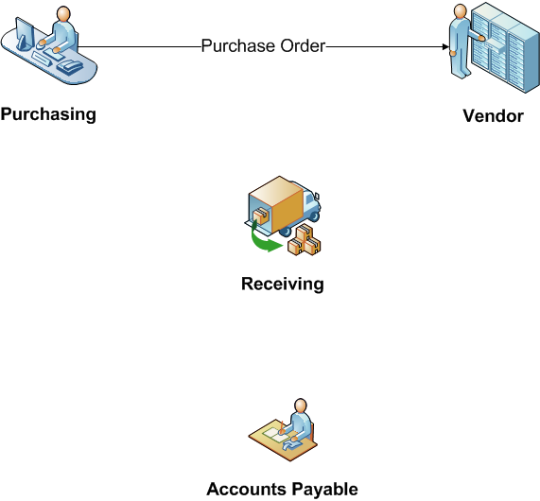
How the process worked? (“as is”)

Slide 24
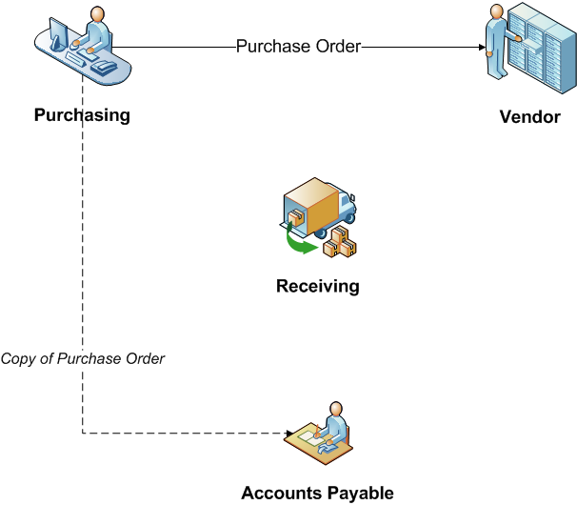
How the process worked? (“as is”)

Slide 25
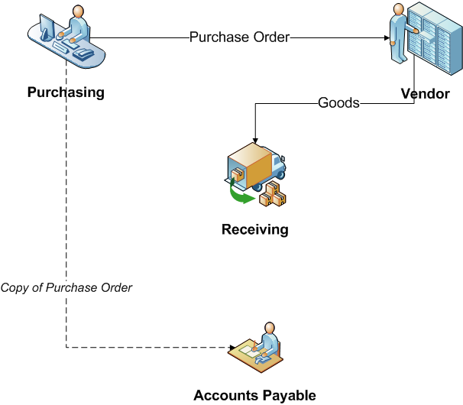
How the process worked? (“as is”)

Slide 26
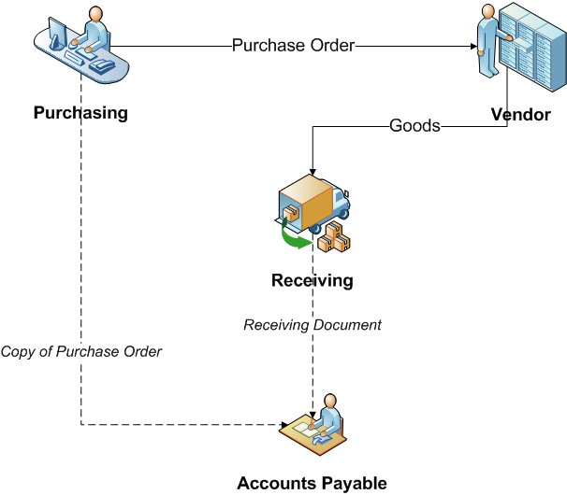
How the process worked? (“as is”)

Slide 27
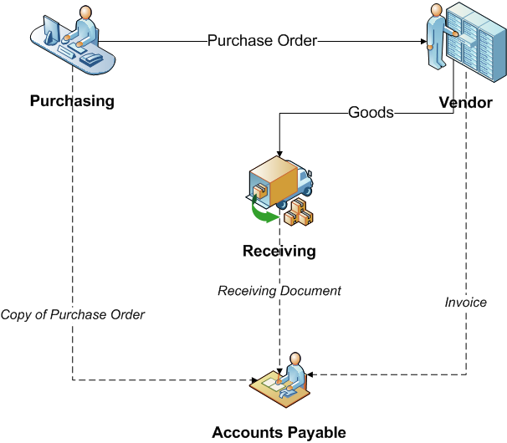
How the process worked? (“as is”)

Slide 28
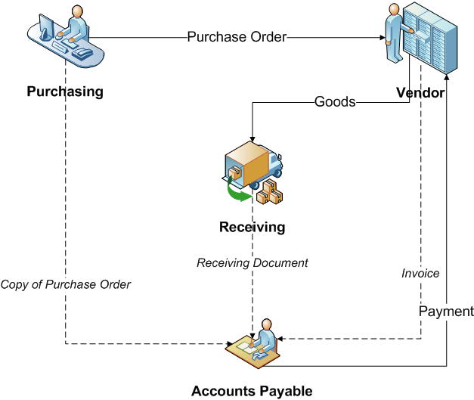
How the process worked? (“as is”)

Slide 29
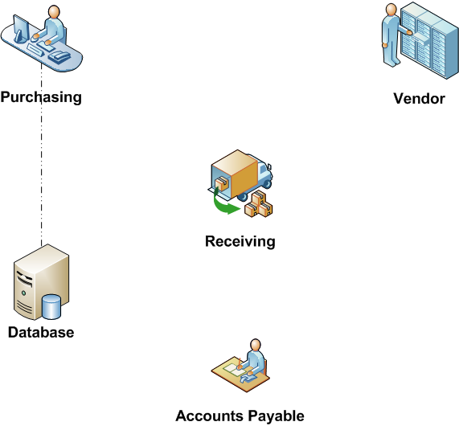
Reengineering Process (“to be”)

Slide 30
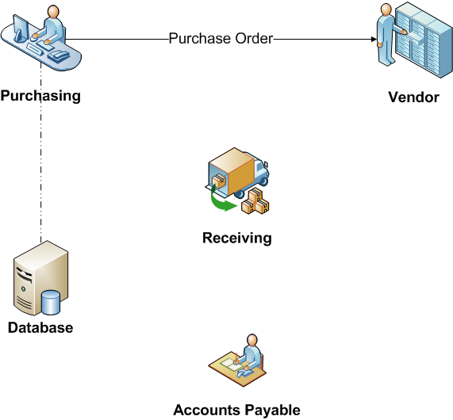
Reengineering Process (“to be”)

Slide 31
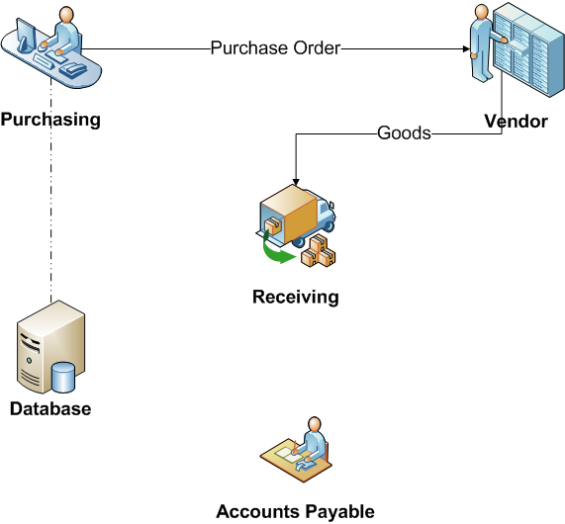
Reengineering Process (“to be”)

Slide 32
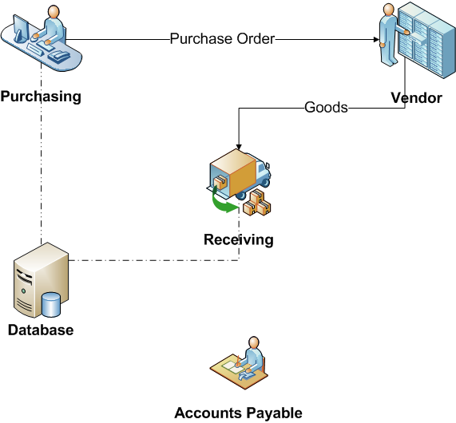
Reengineering Process (“to be”)

Slide 33

Reengineering Process (“to be”)

Slide 34
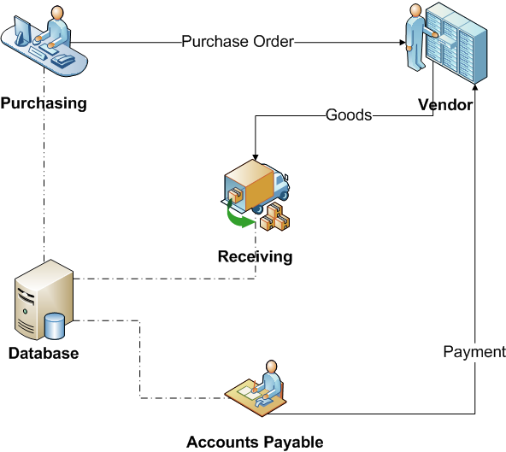
Reengineering Process (“to be”)

Slide 35
The result…
75% reduction in head count
Material control is simpler and financial information is more accurate
Purchase requisition is faster
Less overdue payments
➔ Why automate something we don’t need to do? Automate things that need to be done.

Slide 36
How to engage in BPM?
Process identification
and opportunity assessment
Process discovery (as-is)
Process analysis
Process re-design (to-be)
Process implementation
Process monitoring/controlling
Process Modeling Tools
Process Management Systems

Slide 37
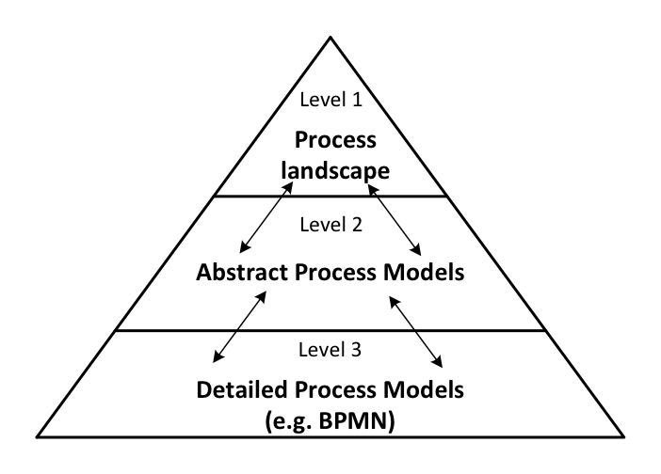
Process Identification
Core processes
Support processes
Management processes
Quote handling
Product delivery
Invoice handling
Detailed quote
handling process

Slide 38
Phase 1: Performance Measure Identification and Selection
Cost
Cost per execution
Resource utilization
Waste
Time
Cycle time
Waiting time
Quality
Error rates
Customer feedback
Non-value-adding time
SLA violations
Notes:
There are three dimensions where we typically look for process metrics: cost, time and quality.
Do it faster, do it cheaper, do it better.

Slide 39
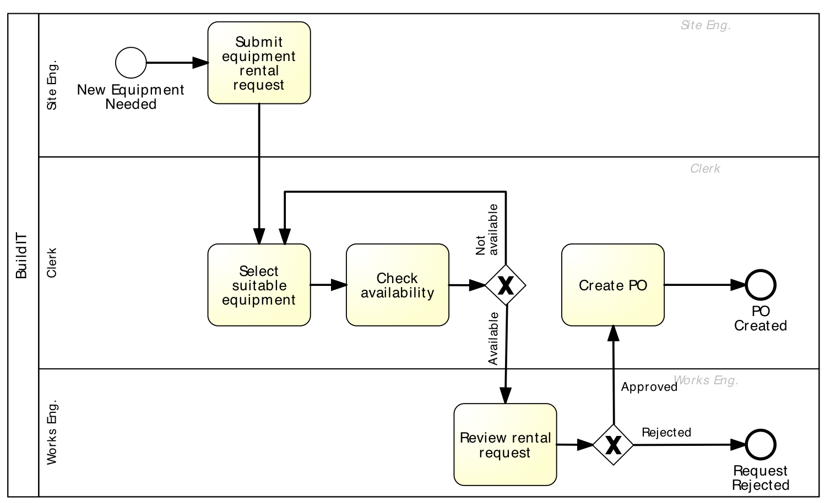
Phase 2: Process Discovery
Notes:
During this phase, we identify stakeholders, observe, interview, build insight, map the process and its issues

Slide 40
Phase 3: Analysis
Qualitative analysis
Root-cause analysis
Issue register
Quantitative Analysis
Flow analysis
Process simulation
Queuing analysis
PICK charts

Slide 41
Issue Register
Issue No. | Short Description | Issue Explanation | Broad Consequence | Assumptions | Impact
2 | Information regarding units does not match | Units in Relocation system do not match information provided by ... | Wrongly calculated entitlements cause manual calculation... | 5% of cases go to the wrong queue, 5 minutes to sort queue and redirect. 5% recalculating on average 10 minutes per calculation. | 28,000x0.05x15 = 21,000 minutes 350 hours/7.5 47 hrs 9.5 working days
5 | Protected/ Mandatory data entry fields | Not all fields in data entry forms are relevant but mandatory. So "fuzzy" information is entered | Resource intensive, incorrect data. Cases in Clarify need to physically be closed. | 5% of cases taking 2 minutes to locate and close. 5% of relocations requiring entry that is not needed taking 30 minutes each. | 28,000x0.05x32 = 44,800 minutes 477 hours/7.5 99.5 hrs 20 working days
11 | Information on posting orders | Time consuming to sort through posting orders to identify relocations.... | MBR does not get Info pack therefore cannot process move. More information could be provided which could be used later in process ... | Only 1/3 rd of postings and CIPC’s are entitled to relocation. 28000 relocations then sorting through 84000 postings. 3 to 4 minutes on average to sort through each. | 84,000x3.5 = 294,000 min/60/7.5 = 653 days /250 working days in year. 2.61 FTE
© Michael Rosemann

Slide 42
Simulation / What-If Analysis
10 applications per hour
Poisson arrival process (negative exponential)
0.3
0.5
0.7
0.8
0.5
0.2
Task | Role | Execution Time (mean, dev.)
Receive application | system | 0 | 0
Check completeness | Clerk | 30 mins | 10 mins
Perform checks | Clerk | 2 hours | 1 hour
Request info | system | 1 min | 0
… | … | … | …

Slide 43
Simulation output: KPIs

Slide 44
Phase 4: Process Re-Design
Costs
Time
Flexibility
Quality

Slide 45
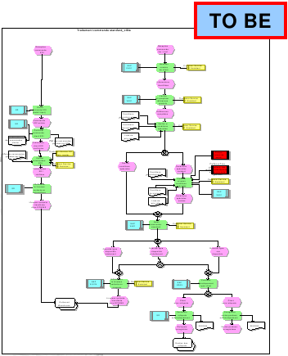
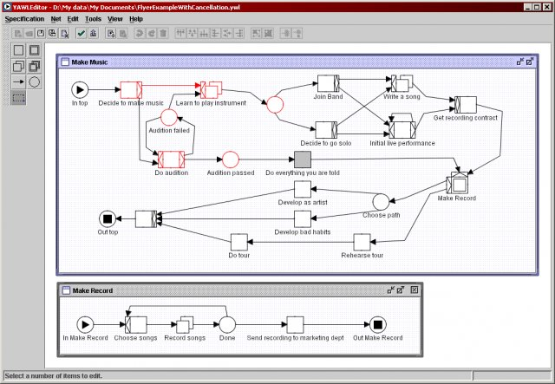
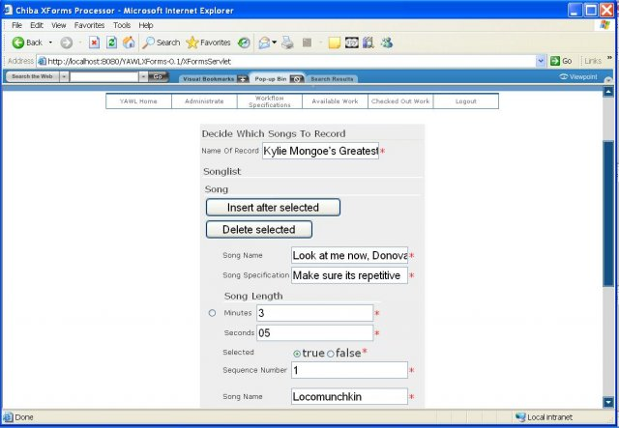
Phases 5-6. When technology Kicks in..

Slide 46
Process Execution Engines
BPMN-based
  BizAgi
  Activiti
  Progress Savvion
BPEL-based
  Oracle SOA Suite
  ActiveVOS BPM
  IBM BPM
Microsoft
  BizTalk
  Windows Workflow Foundation

Slide 47
THANK YOU

