Slide 1
Pemodelan Proses Bisnis
Studi Kasus: Analisis Proses Bisnis Pertemuan 11 Dosen Pengampu: Alivia Yulfitri (2017)
Prodi Sistem Informasi - Fakultas Ilmu Komputer

Slide 2
Referensi
Business Process Management (BPM) - Process Re-Design, Marlon Dumas

Slide 3
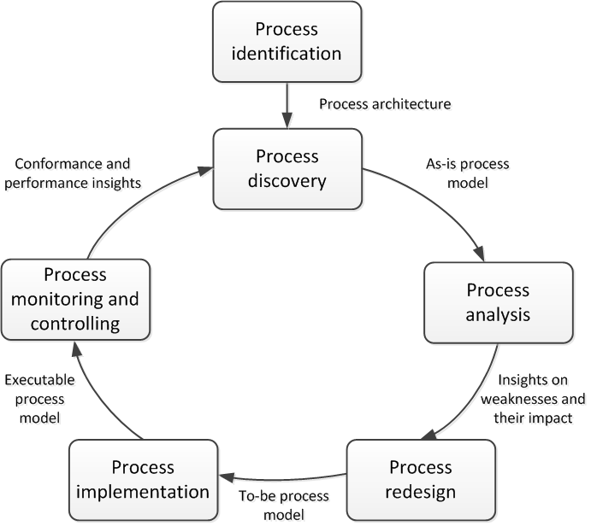
Where are we?

Slide 4
The Devil’s Quadrangle
Costs
Time
Flexibility
Quality
(T+/-,Q+/-,C+/-,F+/-)

Slide 5
Design criterion 1: Time
Cycle time, including
service time (including set-up)
transport time (can often be reduced)
waiting time
Due to resource contention (limited capacity)
Due to external communication (waiting for client/partner)
Several ways to improve time properties:
Improve average
Improve variance
Increase ability to meet due dates
Increase perception of wait time

Slide 6
Design criterion 2: Quality
Product
Product meets specifications and/or expectations
Process, e.g.
Promises made to customers and (reasonable) customer expectations are met
Data and documents are handled correctly
Decisions made in the process are correct
Correct & timely information is provided to the customer

Slide 7
Design criterion 3: Cost
Type of costs
fixed or variable
per time unit, per use (consumable resources)
processing, management, or support.
human, system (hardware/software), or external,

Slide 8
Design Criterion 4: Flexibility
Ability to react to changes.
Flexibility of
resources (ability to execute many tasks/new tasks)
process (ability to handle various cases and changing workloads)
management (ability to change rules/allocation)
organization (ability to change the structure and responsiveness to demands of market or business partners

Slide 9
Process Redesign
Purpose: Identify possibilities for improving the design of a process: “as is” → “to be”
No silver-bullet: requires creativity
Redesign heuristics can be used to generate ideas
Descriprive modelling
of the real world (as-is)
Prescriptive modelling
of the real world (to-be)

Slide 10
Re-Design Heuristics
Task elimination
Task composition
Triage
Resequencing
Parallelism
Process specialization and standardization
Resource optimization
Communication optimization
Automation

Slide 11
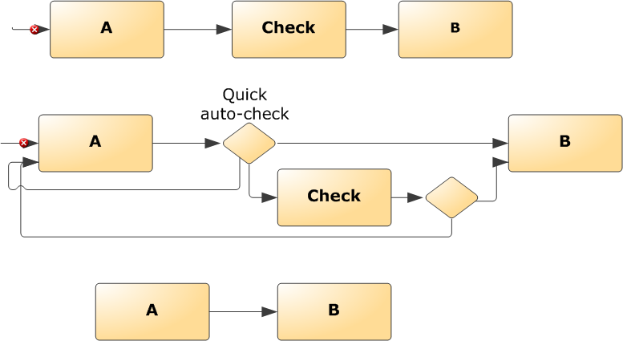
(1) Task Elimination
Sometimes "checks" may be skipped: trade-off between the cost of the check and the cost of not doing the check.
(T+,Q-,C+/-)

Slide 12
(1) Task Elimination (cont.)
Other tasks to consider for elimination:
Print
Copy
Archive
Store
More generally: non-value adding activities
Task elimination can be achieved by delegating authority, e.g.
No need for approval if amount less than Y
Employees have budget for small expenses

Slide 13
Example

Slide 14
(2) Task composition (merge or split)
Pros: less work to commit, allows for specialization.
Cons: setup time, fragmentation, less commitment.
Pros of merging: setup reduction, no fragmentation, less transportation time, more commitment
Cons of merging: more work to commit, one person needs to be qualified for both tasks being merged
Splitting can be an opportunity to enable partial self-service, e.g. decouple scanning and payment in a supermarket
(T+,F-)

Slide 15
Example

Slide 16
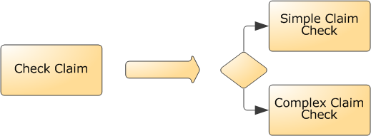
(3) Triage
Consider dividing a general task into two or more alternative tasks or the integration of two or more alternative tasks into one general task.
(T+,F-)

Slide 17
(4) Resequencing
Order tasks based on cost/effect
Put “knock-out checks” first – identify problems early
Postpone expensive tasks until the end.
In other words: order the tasks using the ratio “costs/effect”.
(T+,C-)

Slide 18
Example

Slide 19
(5) Parallelism
More parallelism leads to improved performance: reduction of waiting times and better use of capacity.
Two types of parallelism: semi and real parallelism.
IT infrastructures which allow for the sharing of data and work enable parallelism.
A
B
A
+
+
(T++)
B

Slide 20
Example

Slide 21
Exercise
Textbook, chapter 1, exercise 1.5 (Prescription fulfillment process)
What tasks could be re-ordered to address current customer service problems?
Hint: consider the tradeoffs between front-loading and backloading checks in the process.

Slide 22
(6) Process specialization / standardization
Process specialization
Differentiate by customer classes, geographical locations, time periods (winter, summer), …
Different activities, different resource pools,
Process standardization
All cases treated equally (as much as possible)
Resources are pooled together
F+/-, C+/-

Slide 23
Example

Slide 24
(7) Resource optimization
Centralization: Treat geographically dispersed resources as if they are centralized
Avoid one group of people overloaded and another (similar) group waiting for work.
Case assignment: “Let workers perform as many steps as possible for single cases”
The extreme scenario is to have “case managers”
Flexible assignment: “Assign work in such a way that maximal ﬂexibility is preseved for the near future”
Empower: "Give workers most of the decision-making authority instead of relying on middle management”
Empowerment should go hand-in-hand with accountability
(T+,Q-)

Slide 25
Example

Slide 26
(8) Communication optimization
Reduce the number of messages to be exchanged with customers and business partners
But avoid overly front-loading the process
Try to automate the handling of messages (send/receive).
Use standardized, programmatic whenever economical (EDI, XML, Web services)
Prevents communication errors
If possible, use asynchronous instead of synchronous communication.
(T+,Q+,C+/-,F-)

Slide 27
Interlude: the Complete Kit Concept
Many processes follow the “complete kit” concept:
Work should not begin until all pieces necessary to complete the job are available
In such cases, consider three principles:
Provide complete and easy-to- follow instructions for those who will initiate the process.
If a process cannot start, the client should be notified of all defects that could be reasonably identified at the onset of the process.
Consider the tradeoff between “incomplete-kit” process initiation and roundtrip to revise and resubmit a request.
Michael zur Muehlen: “Service Processes: The Customer at the Center?”
http://tinyurl.com/5tunkxy
Notes:
Boaz Ronen, “The Complete Kit Concept,” International Journal of Production Research, Volume 30, Issue 10 October 1992, pages 2457 – 2466.

Slide 28
Exercise
Textbook, chapter 1, exercise 1.5 (Prescription fulfillment process)
What is the current communication structure?
What issues arise from the current communication structure?
How can the communication structure be improved?

Slide 29
(9) Automation
Use data sharing (Intranets, ERPs) to:
Increase availability of information to improve decisions or visibility (subject to security/privacy)
Avoid duplicate data entry, paper copies
Use network technology to:
Replace materials (e.g. paper document) flow with information flow
E.g. querying government agency DBs replacing document flow
Increase communication speed: e-mail, SMS
Note: e-mails are unavoidable, but not always desirable
Enable self-service (e.g. online forms)
(T+,Q+/-,C+/-,F-)

Slide 30
(9) Automation (cont.)
Use tracking technology to identify/locate materials and resources where reasonable
Identification: Bar code, RFID
Location: indoor positioning, GPS
Automate tasks and decisions
Capture and automate business rules where effective
Automate end-to-end processes
See next lecture (BPMS)

Slide 31
Exercise
Textbook, chapter 1, exercise 1.5 (Prescription fulfillment process)
How can automation be applied in this process?

Slide 32
Acknowledgments
Some material in this lecture is taken from www.workflowcourse.com
© Wil van der Aalst, Hajo A. Reijers

