Slide 1
Pemodelan Proses Bisnis
Business Process Monitoring
Pertemuan 14
Dosen Pengampu: Alivia Yulfitri (2017)
Prodi Sistem Informasi - Fakultas Ilmu Komputer

Slide 2
Process Monitoring and Controlling
Process
design
Strengths/
weaknesses
Process
Monitoring &
Controlling
Process
design
Imple-
mentation
Process
execution
(Re-)
implemen-
tiation
Analysis
Process
execution

Slide 3
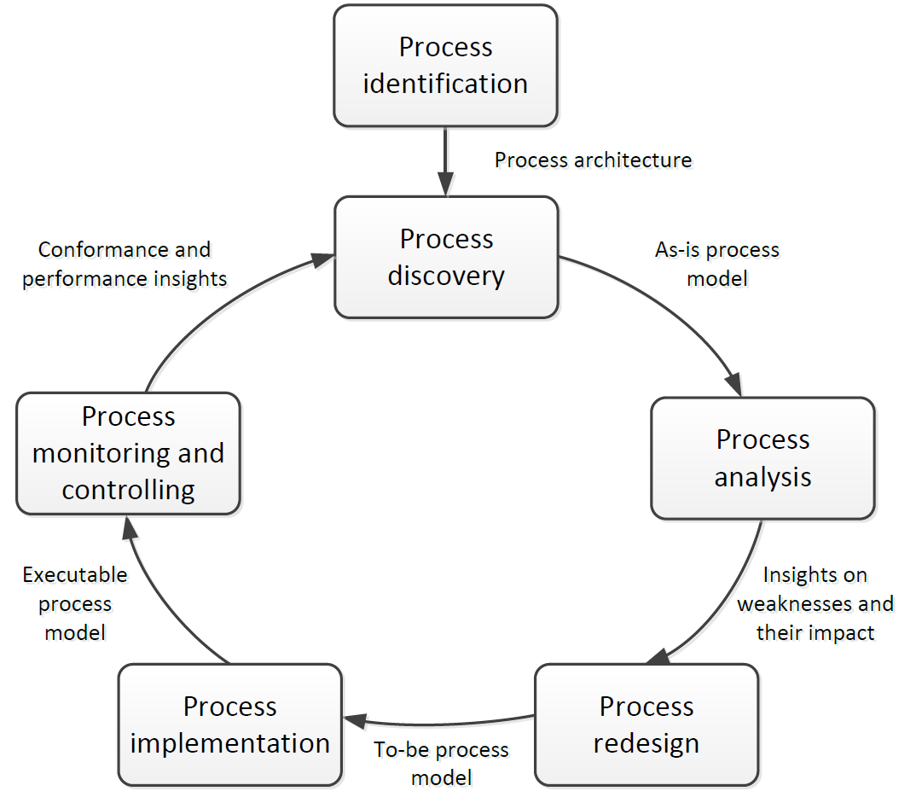
BPM Lifecycle

Slide 4
Types of Process Monitoring
Runtime Monitoring (Business Activity Monitoring)
  Viewing the load of the process
  Identifying problematic cases
  Identifying late cases (risk of missing deadlines), etc.
Post-mortem Monitoring (aka Business Process Analytics)
  Performance KPIs: cycle times, resource utilization, error rates, …
  Identification of bottlenecks
See for example:
  BizAgi BAM: http://wiki.bizagi.com/en/index.php?title=Analysis_Reports_BAM
  Analytics: http://wiki.bizagi.com/en/index.php?title=Analysis_Reports_Analytics
Notes:
For a long time “monitoring” was only known has measuring the performance of hardware (e.g. response time).
Organisational monitoring means the analysis of processes from an IT but also and especially from an organisational viewpoint.
With an efficient process monitoring it should be possible to answer
immediately to a customer request like “What is the current status of my order?”
What is my beginning to end cycle-time, system response-time, or system queue-time for each business process?
I want to improve my supply chain’s responsiveness to customer demands by reducing my “Order to Cash” cycle time by 10%. What specific business process areas and users do I need to improve and train to achieve this goal?
What are the slowest business process areas? How do today’s averages compare to the last months average?
Who are my slowest users for the transaction, “Create sales order”? How do their individual averages compare to our departments benchmark?
Is my system secure? Which users executed the payroll process today?
Based on these trends, Forrester and Gartner Group are both calling for a new kind of technology management at the process level: e-business process monitoring. The justification for this call is that in e-business environments, automatic interpretation and routing of online information about the status of business process execution will become routine, and messages automatically deriving from inside the company will seamlessly integrate with those from business partners.
Established online brands are already starting to integrate external services. Take the example of Sony Corp., which recently announced a new credit card, mileage program, and online bank. For the online Sony customer, the lines separating the different business divisions of Sony and its partnering bank are no longer visible. Thus, IT service management for such complex services has to guarantee the continuity of business processes regardless of the business unit or service partner performing the action. Only better communication and information integration can achieve this goal.

Slide 5
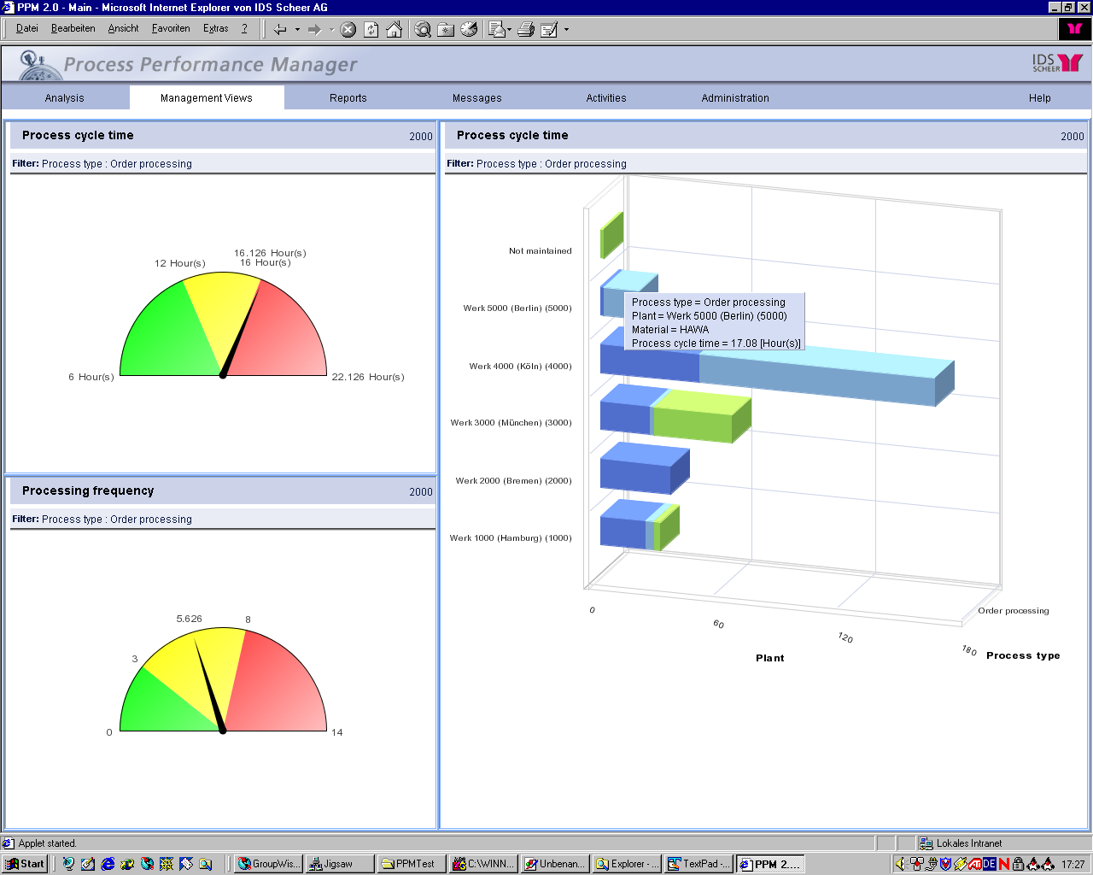
Process Monitoring: Dashboards
Process Cycle Time
of Order Processing
Process Frequency
of Order Processing
Process Cycle Time
of Order Processing
split up to different Plants
IDS (2003)

Slide 6
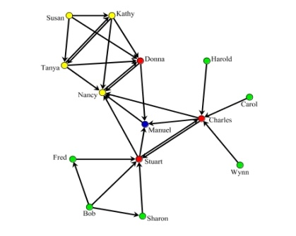

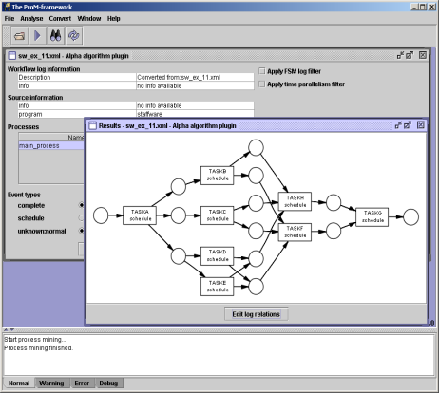
Beyond Monitoring – Process Mining
2) process model
3) organizational model
4) social network
1) basic performance metrics
5) performance characteristics
6) auditing/security
If …then …
www.processmining.org

Slide 7
Process Mining Tools
ARIS Process Performance Manager
Percetive Reflect
Fujitsu Interstage (BPM Analytics)
ProM

Slide 8
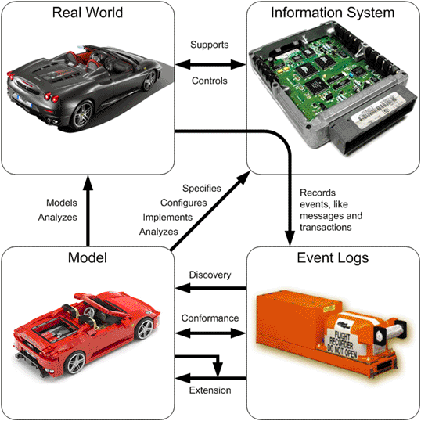
Process Mining

Slide 9
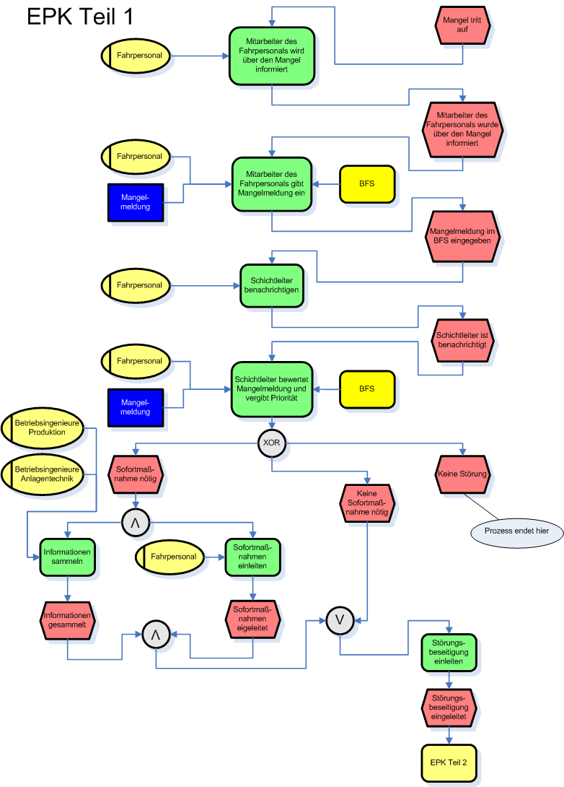
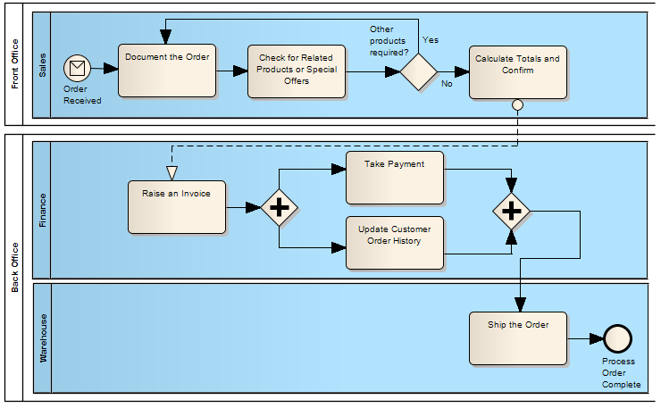
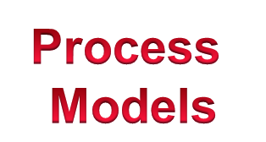
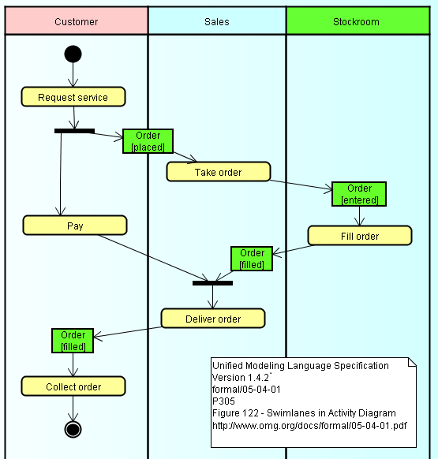
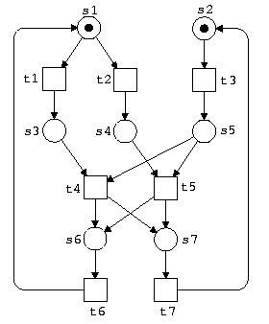
Process Models

Slide 10
Process discovery
α
algorithm
www.processmining.org

Slide 11
Conformance Checking
www.processmining.org

Slide 12
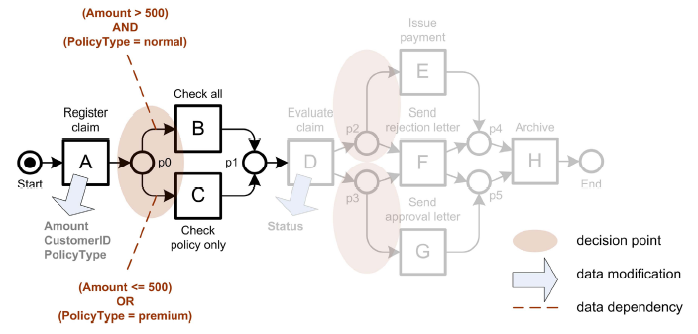
Advanced Features: Decision mining

Slide 13

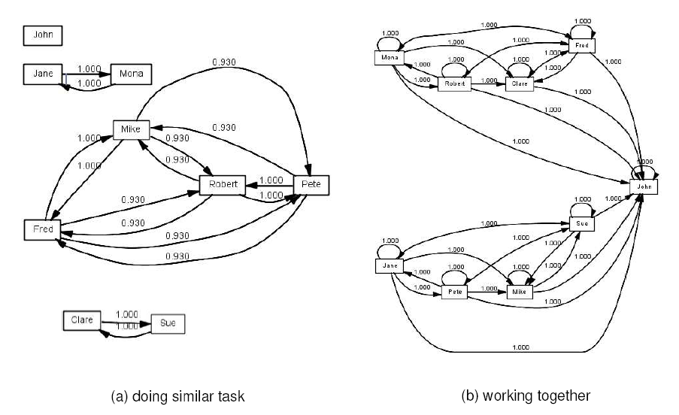
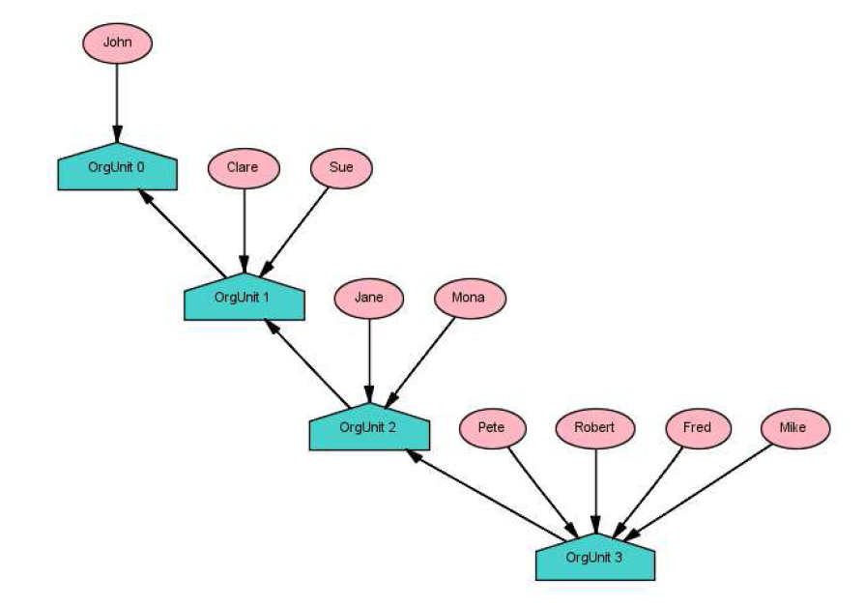
Advanced Features: Social network mining

Slide 14
ProM Demo
http://www.processmining.org/
www.workflowcourse.com

