Slide 1
Pemodelan Proses Bisnis
Identifikasi Proses
Pertemuan 5
Dosen Pengampu: Alivia Yulfitri (2017)
Prodi Sistem Informasi - Fakultas Ilmu Komputer

Slide 2
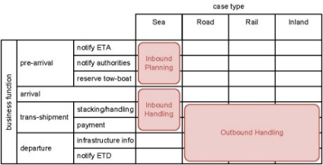
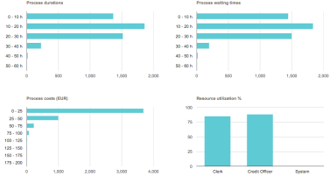

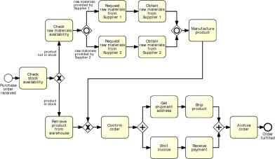
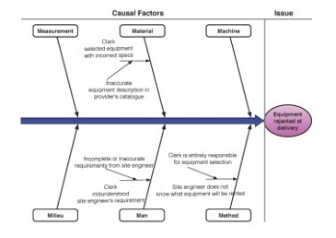
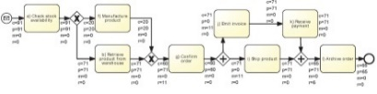
BPM Lifecycle

Slide 3
Process Identification
What?
  Define an organization’s business processes
  Establish criteria to prioritize the management of these processes
Why?
  Understand the organization
  Maximize value of BPM initiatives
Output: Process Architecture
  Captures business processes and their scope
  Serves as a framework for defining priorities and scope of subsequent BPM phases (e.g. modelling, redesign and automation).

Slide 4
Process Identification Steps
Designation phase
  Enumerate main processes
  Determine process scope: boundaries (horizontal and vertical) and interrelationships (order and hierarchical)
Evaluation phase (a.k.a. Process Selection)
  Evaluate processes’
  Alignment with strategic objectives
  Health (e.g. performance, compliance, sustainability…)
  Culture & politics
  Feasibility to being successfully improved
  Risk of not improving them
After Davenport (1993)

Slide 5
Process Enumeration
There is no “number fits all” - it really depends on organization’s domain and size
Trade-off:
  ensuring process scope is manageable, since
  process scope determines potential impact

Slide 6
Process Scoping
Processes are interdependent →
Insights into interrelations required
  Horizontal: upstream – downstream processes
  Vertical: root (a.k.a. main) processes – sub-processes
Processes change over time
  identification should be exploratory and iterative
  improvement opportunities are time-constrained
  Process Architecture

Slide 7
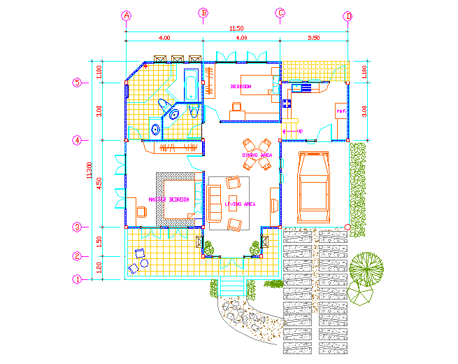
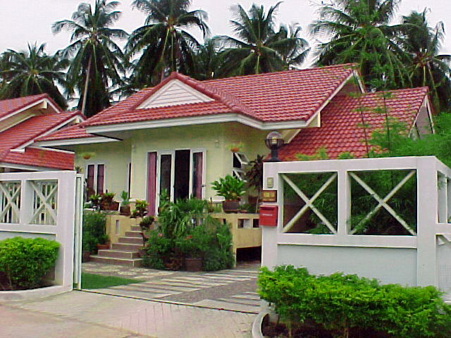
Process Architecture

Slide 8
Architecture: high level picture of an organization
After Rummler and Brache (1990)

Slide 9
“Process” Architecture
Value chains

Slide 10
Components of a Process Architecture
Management Processes
Core Processes
Suppliers / Partners
Customers / Owners
Support Processes
After Porter

Slide 11
Core, Management and Support Processes

Slide 12
Process Architecture Example
Television New Zealand

Slide 13
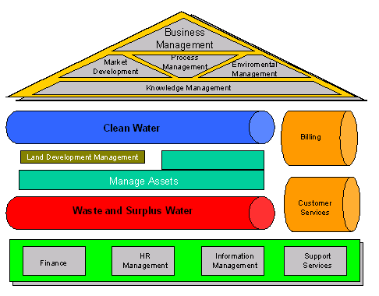
Process Architecture Example
WA Water Corporation

Slide 14
Process Architecture Example
An insurance company
Strategic
Management
Corporate
Development
Investor
Relations
Management Processes
Risk Assessment
and Management
Market
Development
Sales and Marketing
Underwriting
Management
Policy
Servicing
Claims
Management
Collections and Disbursement
Asset Management
Core Processes
Finance/
Treasury
Legal/
Audit
Reinsurance
IT
HR
Enabling Processes

Slide 15
Selected questions for scoping a process
If Process Architecture already in place: where does the process fit into the Process Architecture?
On what level is the unit of analysis, i.e. end-to-end process, procedure or operation?
What are the previous/subsequent processes and what are the interfaces to them?
What variants does this process have?
What underlying processes describe elements of this process in more detail?

Slide 16
Various techniques to scope a process
Identify relevant stakeholders and objectives, e.g. via a Stakeholder-Objectives Matrix
Identify relevant context, e.g. via a SIPOC (Suppliers, Inputs, Process, Output, Customers) Diagram
Identify relevant process boundaries, e.g. via a Case/Function Matrix
Identify relevant guides and enablers, e.g. via an IGEO (Input/Guides/Enablers/Outputs) Diagram
A combination of the above

Slide 17
Identify Process Stakeholders
  Process owner, responsible for the effective and efficient operation of the process being modeled
  Primary process participants, i.e. those who are directly involved in the execution of the process under analysis
  Secondary process participants, i.e. those who are directly involved in the execution of the preceding or succeeding processes

Slide 18
Identify Process Objectives
Primary (hard) process objectives
  Time, cost, quality (minimise, maximise)
  satisfaction, compliance, flexibility, predictability
Secondary process objectives
  To purchase goods, to hire new staff members
Accompany with appropriate process metrics
Let involved stakeholders define their priorities

Slide 19
Guidelines to identify horizontal boundaries
Change of flow object in the process
Change of multiplicity of flow object in the process
Change of transactional state
Process contains logical separation in time
Process contains logical separation in space
Process contains logical separation in other dimension
Follow scope in reference model (see later)
Based on functions/cases covered

Slide 20
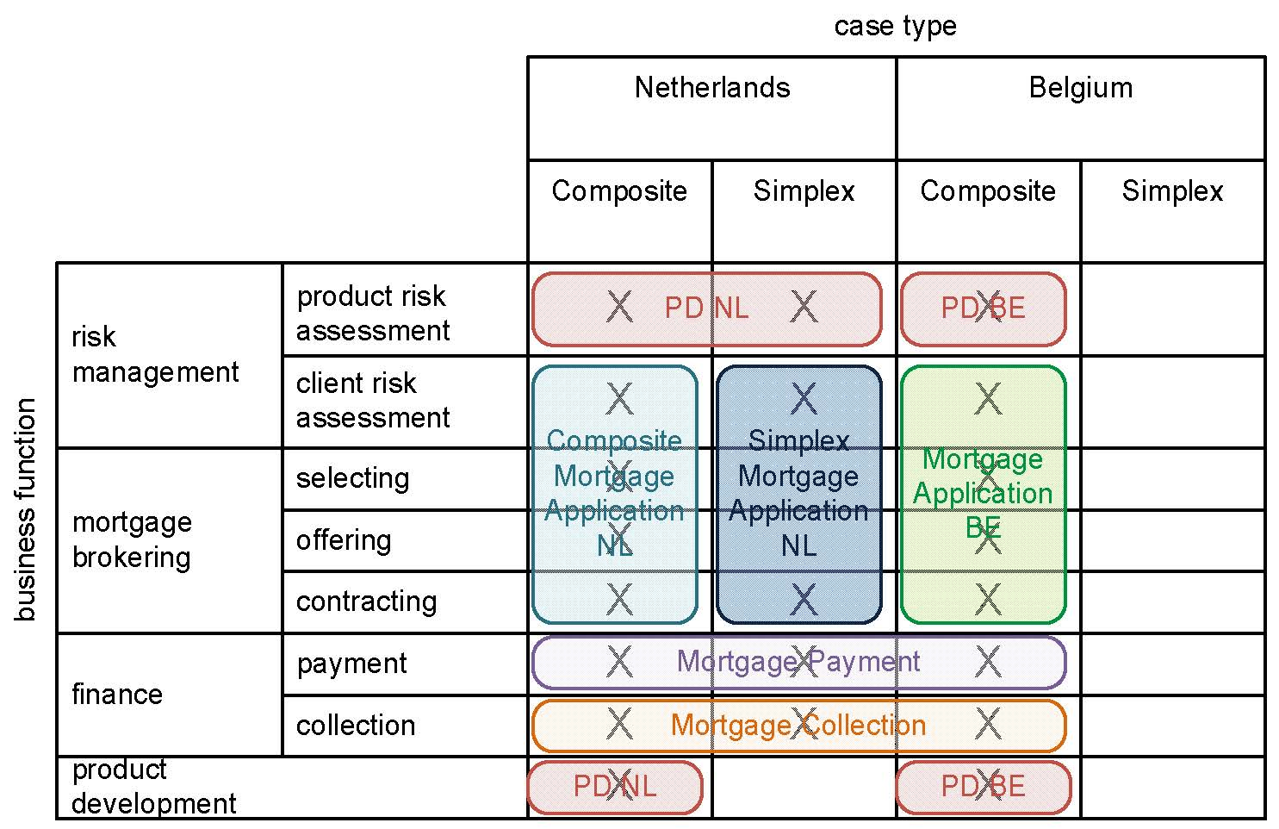
A stepwise method to build process architectures
Case/function matrix (see Chap. 2 of textbook)

Slide 21
Identify vertical boundaries: typical artefacts in a Process Hierarchy
Value chains
  A major line of business, has direct effect on a company's business results and strategic importance. Stays at a high level. For example: presentation of a product to the market.
(Root/Main) Processes
  Processes build up value chains and mutually affect each other. For example: market research.
Sub-processes
  Sub-processes build up processes. They involve multiple activities and can be layered on different levels of granularity (i.e. sub-sub-processes). For example: sales operation, preparation of sales budget, reception of customer orders.
Process tasks
  Process tasks build up processes and sub-processes. These tasks are conducted by one or more individuals within the same function. For example: reception of customer orders involves review of these orders and incorporating them into the system.
Initial focus of Process Enumeration

Slide 22
Hierarchy Example: British Telecom
Meta
Level
Model structure, methodology and modelling standards
Defines business activities
Distinguishes operational customer oriented processes from management and strategic process
Level A
Business Activities
Business Levels
Level B
Logical
Levels
Shows groups of related business functions and standard end-to-end processes (e.g. Service Streams)
Process Groupings
Level C
Core processes that combine together to deliver Service Streams and other end-to-end processes
Core Processes
Process Levels
Level D
Decomposition of core processes into detailed ‘success model’ business process flows
Business Process Flows
Level E
Detailed operational process flows with error conditions and product and geographical variants (where required).
Physical
Levels
Operational Process Flows
Operations Levels
Level F
Further decomposition of detailed operational where required
Detailed Process Flows
© British Telecommunications (2006)

Slide 23
Strategic View
Level A
Business Activities
Business
Objectives
Business
KPIs
Business
Balanced Scorecard
Business Layer
Level B
Process Groupings
Business Unit
Objectives
Business Unit
Scorecard
Business
Value Streams
Unit KPIs
Level C
Core Processes
Business Process
Value Streams
Operational Unit
Objectives
Process Layer
Level D
Business Process Flows
Level E
Operational Process Flows
Implementation
Level F
Detailed Process Flows
Davis (2005)

Slide 24
Process View
Level A
Business Activities
Business Activities
Business Layer
Level B
Value Domains
Business Functions
Service Streams
Process Service Lines
Process Groupings
End-to-End
Processes
Enabling Streams
Level C
Core Processes
Core
processes
Process Layer
Level D
Tasks
Business Process Flows
Processes
Level E
Steps
Operational Process Flows
Resources
Sub-processes
Implementation
Level F
Operations
Detailed Process Flows
Detailed Processes
Detailed Resources
Davis (2005)

Slide 25
Organisation View
Level A
Business Activities
Business
Business Layer
Level B
Process Groupings
Business Units
Level C
Core Processes
Operational Units
Process Layer
Level D
Business Process Flows
Operational Teams
Level E
Operational Process Flows
Operational Roles
Implementation
Level F
Detailed Process Flows
Davis (2005)

Slide 26
Data View
Level A
Business Activities
Business Layer
Cust
Level B
contact
Customer
cn
n
Inquiry
Customer
1
1
1
budget
1
1
1
Cust
1
n
Customer
1
Customer
1
Process Groupings
Account
1
Offer
1
1
Customer
credit
1
limit
n
Corporate Data Model
1
Level C
Function Data
Core Processes
Business
Information
Process Layer
Level D
System
Entities
Business Process Flows
Process
Information
FunctionEntities
Level E
Procedural
Information
Phone #
Operational Process Flows
department
Function
Attributes
Title
Implementation
Level F
Phone #
department
System
Attributes
Detailed Process Flows
Title
Davis (2005)

Slide 27
Systems View
Level A
Business Activities
Business Layer
Level B
System
Domains
Process Groupings
Level C
Core Processes
System
Types
Process Layer
Level D
Business Process Flows
System Types and
Modules Types
Systems and
Modules
Level E
Operational Process Flows
Screens
System IT Functions
Implementation
Level F
(System Specific)
Detailed Process Flows
Davis (2005)

Slide 28
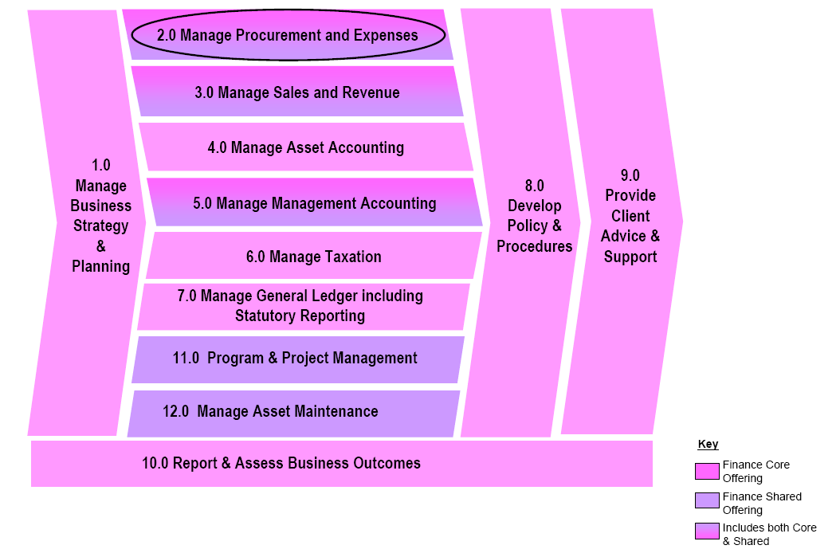
Hierarchy Example: QLD Shared Service Agency
Level A

Slide 29
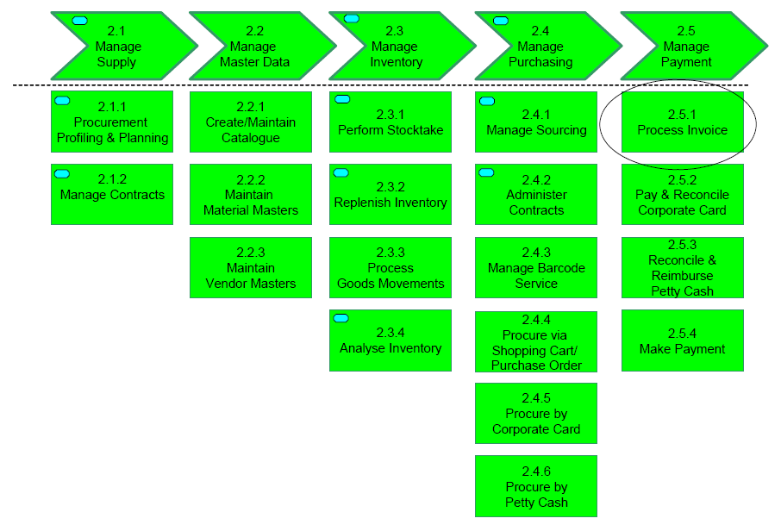
Hierarchy Example: QLD Shared Service Agency
Level B
Level C

Slide 30
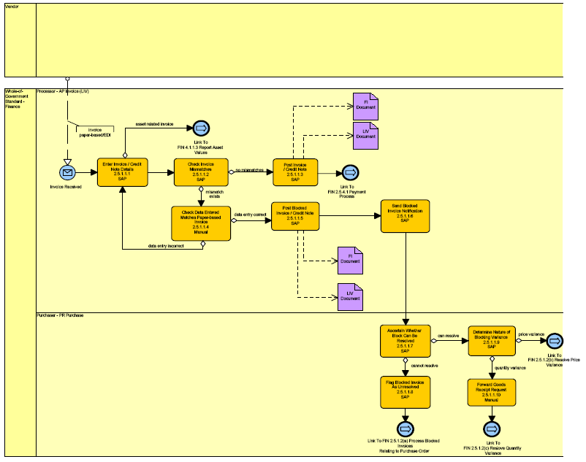
Hierarchy Example: QLD Shared Service Agency
Level D

Slide 31
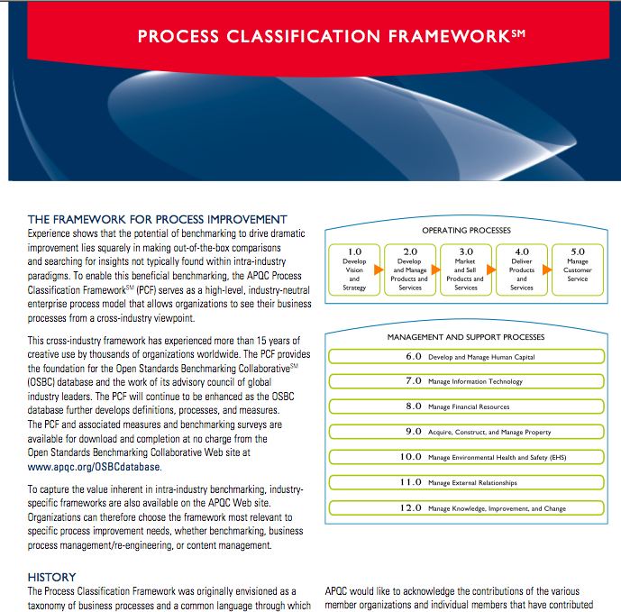
Designation via Reference Models
Example: the APQC Process Classification Framework (PCF)
industry-neutral
enterprise model
Open standard for benchmarking
Four levels
  Categories
  Process group
  Process
  Activity

Slide 32
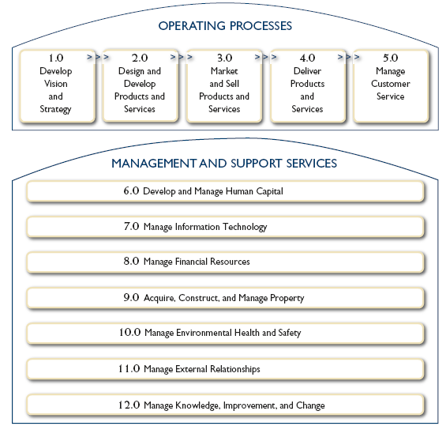
APQC PCF Overview

Slide 33
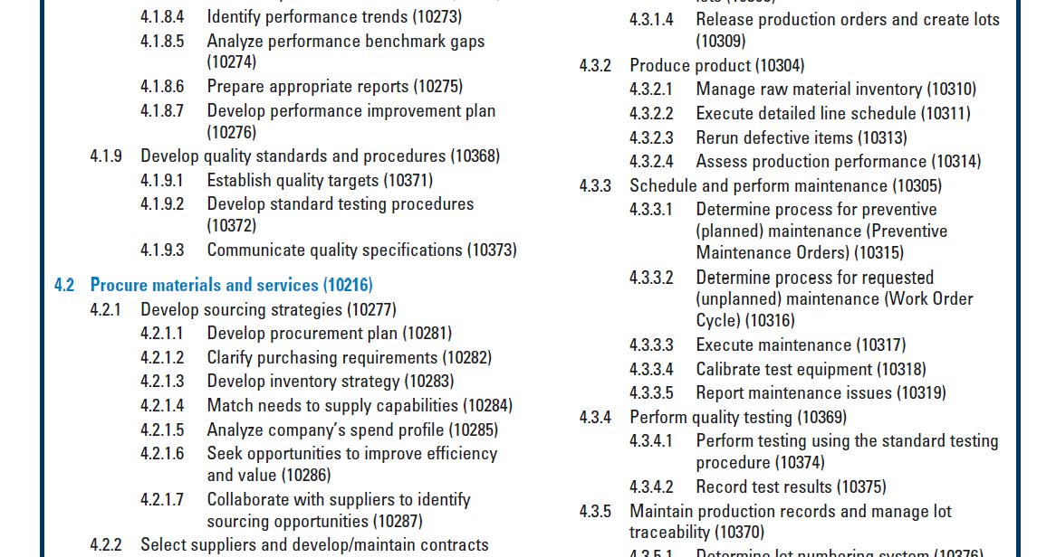
APQC Classification Framework

Slide 34
APQC Classification Framework
Available industry sectors:
Aerospace & Defense
Automotive
Banking
Broadcasting
Consumer Electronics Just released
Consumer Products
Education
Electric Utilities
Petroleum Downstream
Petroleum Upstream
Pharmaceutical
Retail
Telecommunications

Slide 35
The Evaluation Phase (aka Process Selection)
Importance
  Which processes have the greatest impact on the organization‘s strategic goals?
Dysfunction
  Which processes are in the deepest trouble?
Feasibility
  Which process is the most susceptible to successful
  process management?
  Process Portfolio Management
Hammer, Champy (1993)

Slide 36
Evaluation Example
Process Portfolio of an Australian Retailer
Primary Focus
High
F
D
E
T
C
G
W
Z
Importance (priority)
I
K
A
N
H
P
U
V
X
B
J
Y
M
R
Q
Low
L
O
Poor
Good
0
Process Health
4

Slide 37
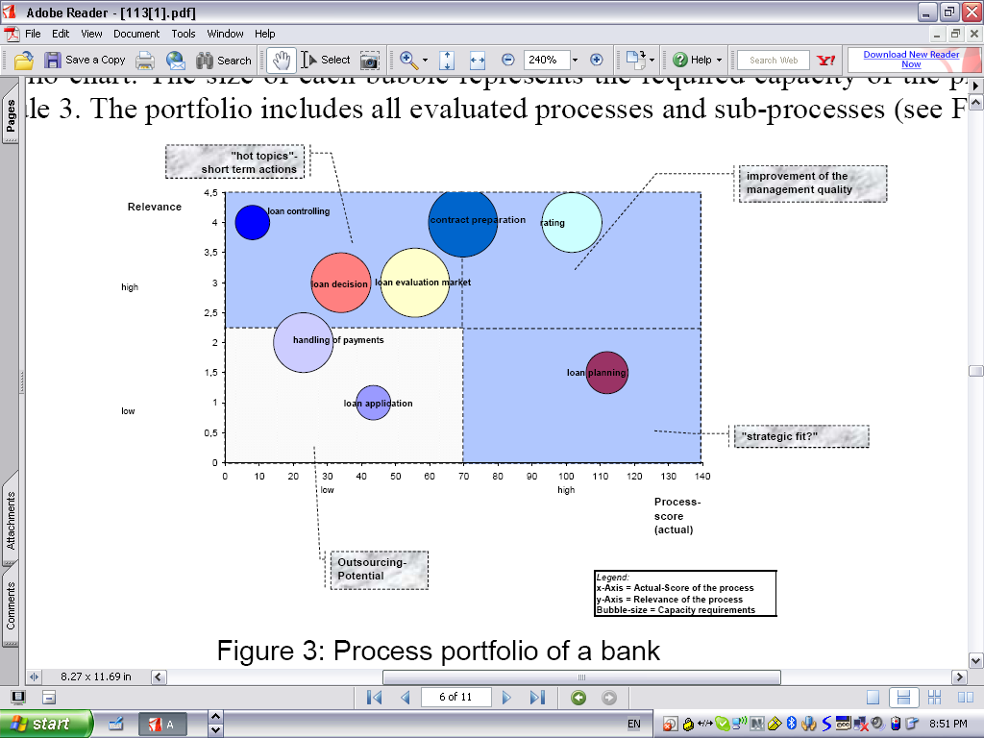
Evaluation Example
Process Portfolio of a bank
Praeg (2007)

Slide 38
The Evaluation Phase: nasty questions
Does an assessment of the importance, dysfuncioning and feasibility always point to the same processes to actively manage?
Should all processes that are dysfunctional, of strategic importance and feasible to manage be subjected to BPM initiatives?

Slide 39
Alternative: Selection Project by Project
Processes are identified with every request from
a line of business
Ensures high relevance for involved business unit
Reactive approach (-)
Often restricted to discrete improvement (-)
No conscious process selection approach (-)

Slide 40
Pitfalls of Process Identification (1/2)
The purpose of the project is not clear enough leading to inappropriate scoping of the process.
The scope of the process is too narrow leading to the fact that later the identified root-causes are located outside the boundaries of the process under analysis
The scope of the process is too wide leading to a process improvement project that has to be compromised in its lack of detail

Slide 41
Pitfalls of Process Identification (2/2)
The process is identified in isolation to other projects due to poor portfolio management leading to redundancies and inconsistencies between these projects
Involved project members and stakeholders have not been sufficiently informed about the benefits of the project leading to limited participation
The involved project members and stakeholders have not been carefully selected leading to a very limited source of knowledge
The business process architect has poor facilitation skills and cannot resolve emerging conflicts between the project members and stakeholders.

Slide 42

References
Required
Chapter 2 of textbook “Fundamentals of BPM”
Recommended
T.H. Davenport, “Process Innovation: Reengineering Work Through Information Technology”, Harvard Business School Press, 1993
M. Hammer, J. Champy, “Reengineering the Corporation: A Manifesto for Business Revolution”, HarperCollins, 1993
M.E. Porter, “Competitive Advantage: Creating and Sustaining Superior Performance”, Free Press, 1985
M. Rosemann, “Process Portfolio Management”, BPTrends, April 2006
R. Dijkman, I. Vanderfeesten, H.A. Reijers, “The road to a business process architecture: an overview of approaches and their use”. BETA Working Paper Series, WP 350. Eindhoven University of Technology, Eindhoven (2011)
Web-sites
http://www.value-chain.org (Value Reference Model)
http://www.mindtools.com/pages/article/newSTR_66.htm (more on value chains)
http://www.apqc.org/process-classification-framework (APQC PCF website)

