Slide 1
Pemodelan Proses Bisnis
Process Analysis
Pertemuan 8 dan 9
Dosen Pengampu: Alivia Yulfitri (2017)
Prodi Sistem Informasi - Fakultas Ilmu Komputer

Slide 2
Referensi
Business Process Management (BPM)
Marlon Dumas (Quantitative Process Analysis)

Slide 3
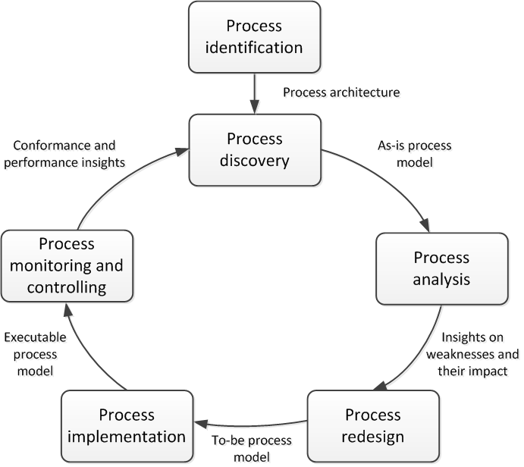
Business Process Analysis

Slide 4
Process Analysis Techniques
Qualitative analysis
Value-Added Analysis
Issue Register
Quantitative Analysis
Quantitative Flow Analysis
Process Simulation
Queuing Theory
Root-Cause Analysis
Pareto Analysis

Slide 5
Process Performance Measures
Link the identified processes to measurable objectives
Quantify the benefits of improvement
Profit maximizing firms
Non-profit organizations
Maximize long term
shareholder value
Survive and grow
while satisfying customer needs
Maximize revenues and
minimize costs
Use resources efficiently while
satisfying customer needs
Satisfy customer needs (effectiveness)
in an efficient way (efficiency)
Inspired by a slide by Manuel Laguna & John Marklund

Slide 6
Process Performance Measures
Cost
Cost per execution
Resource utilization
Waste
Time
Cycle time
Waiting time / time spent in non-value-added tasks
Quality
Error rates (negative outcomes, wrong info)
Missed promise

Slide 7

Let’s start with time
Mark McGuinness: Time Management for Creative People

Slide 8
Cycle Time Analysis
Cycle time: Difference between a job’s start and end time
Cycle time analysis: the task of calculating the average cycle time for an entire process or process fragment
  Assumes that the average activity times for all involved activities are available (activity time = waiting time + processing time)
In the simplest case a process consists of a sequence of activities on a sequential path
  The average cycle time is the sum of the average activity times
… but in general we must be able to account for
  Alternative paths (XOR splits)
  Parallel paths (AND splits)
  Rework (cycles)

Slide 9
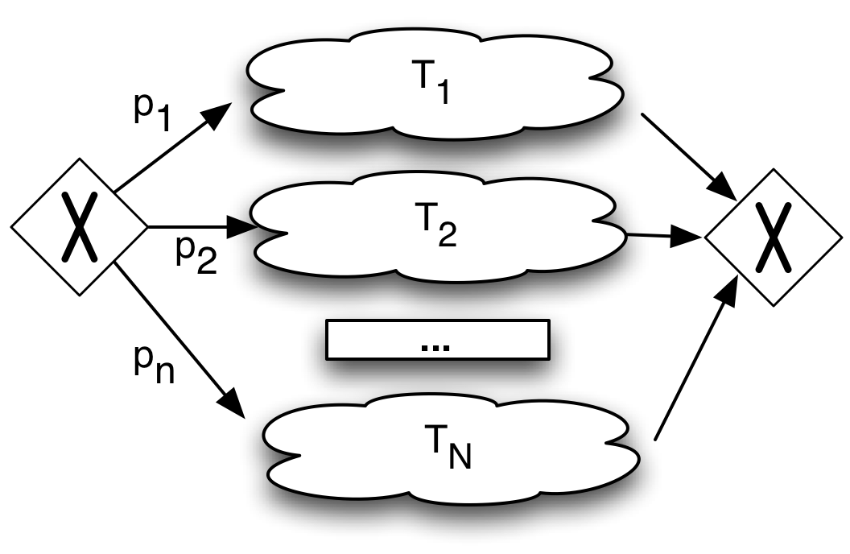
Alternative Paths
CT = p₁T₁+p₂T₂+…+p_{n}T_{n} =
Inspired by a slide by Manuel Laguna & John Marklund

Slide 10
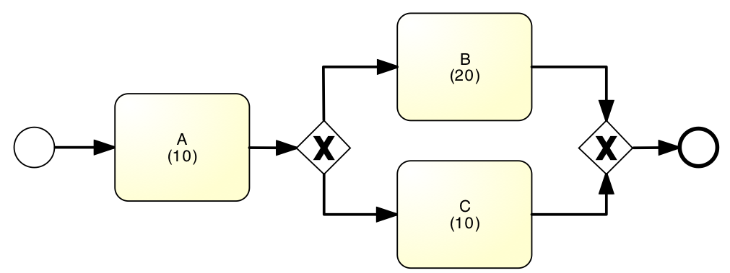
Alternative Paths – Example
What is the average cycle time?

Slide 11
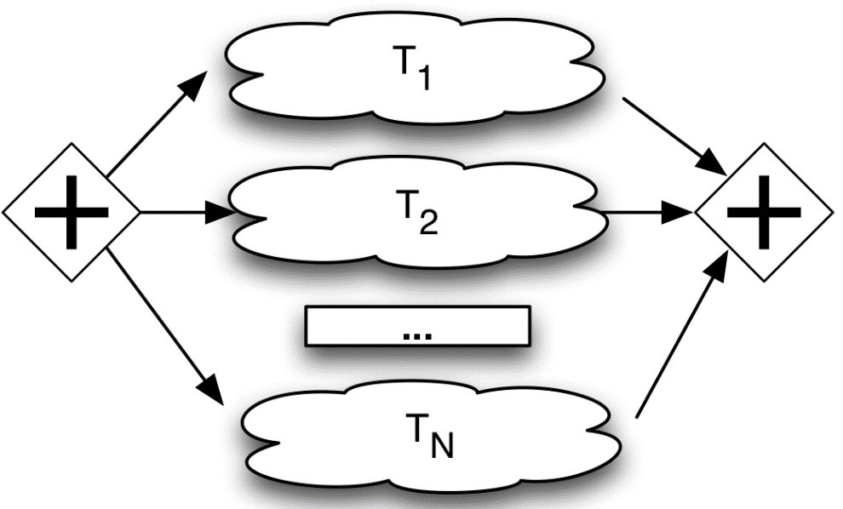
Parallel Paths
If two activities related to the same job are done in parallel the contribution to the cycle time for the job is the maximum of the two activity times.
CT_{parallel} = Max{T₁, T₂,…, T_{M}}
Inspired by a slide by Manuel Laguna & John Marklund

Slide 12
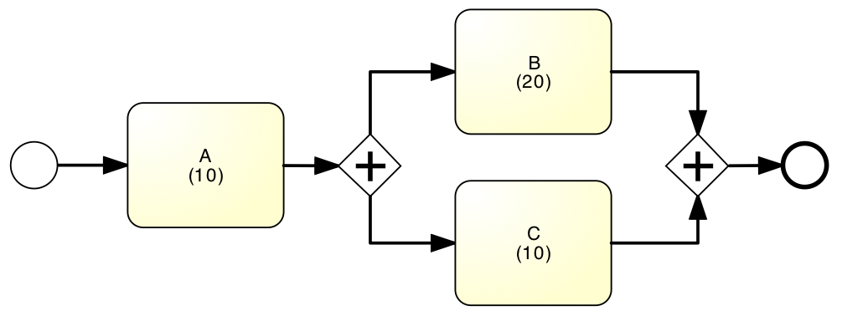
Parallel Paths – Example
What is the average cycle time?

Slide 13
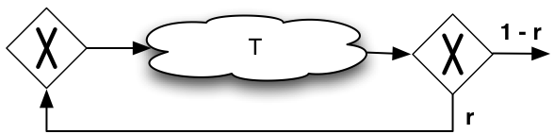
Rework
Many processes include control or inspection points where if the job does not meet certain standard, it is sent back for rework
CT = T/(1-r)

Slide 14
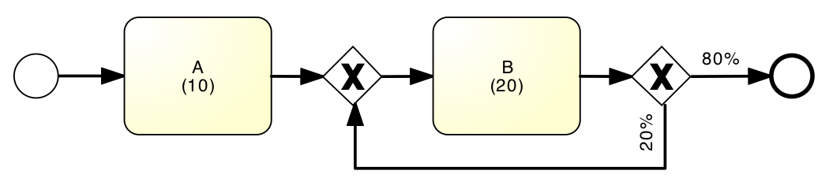
Rework – Example
What is the average cycle time?

Slide 15
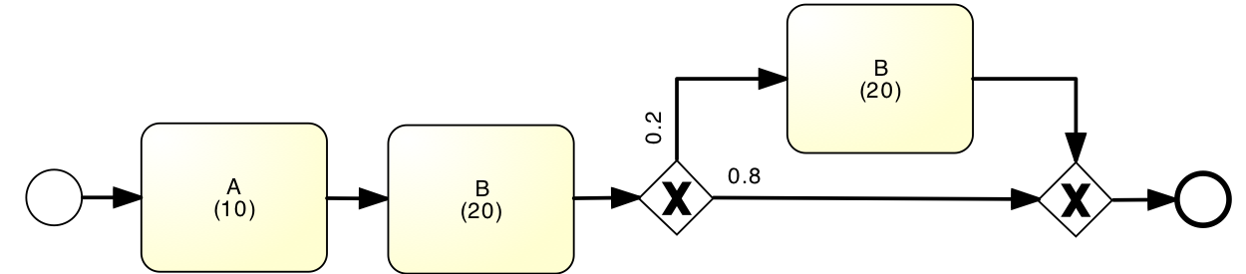
Rework At Most Once – Example
What is the average cycle time?

Slide 16
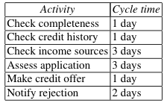
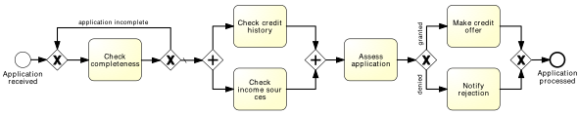
Quick exercise
Calculate cycle time

Slide 17
Cycle Time Efficiency
Measured as the percentage of the total cycle time spent on value adding activities.
CT = cycle time as defined before
Theoretical Cycle Time (TCT) is the cycle time if we only counted value-adding activities and excluded any waiting time or handover time
  Count only processing times
Cycle Time Efficiency =
Inspired by a slide by Manuel Laguna & John Marklund
Notes:
After this slide it is suitable with a larger example of Cycle Time Analysis, for example, Problems 9 & 10, Chapter 4 in Laguna.

Slide 18
Flow Analysis
The previous technique for cycle time analysis is only one example of what can be done using flow analysis techniques
Other applications:
  Calculating cost-per-process-instance (cf. Textbook)
  Calculating error rates at the process level
  Estimating capacity requirements

Slide 19
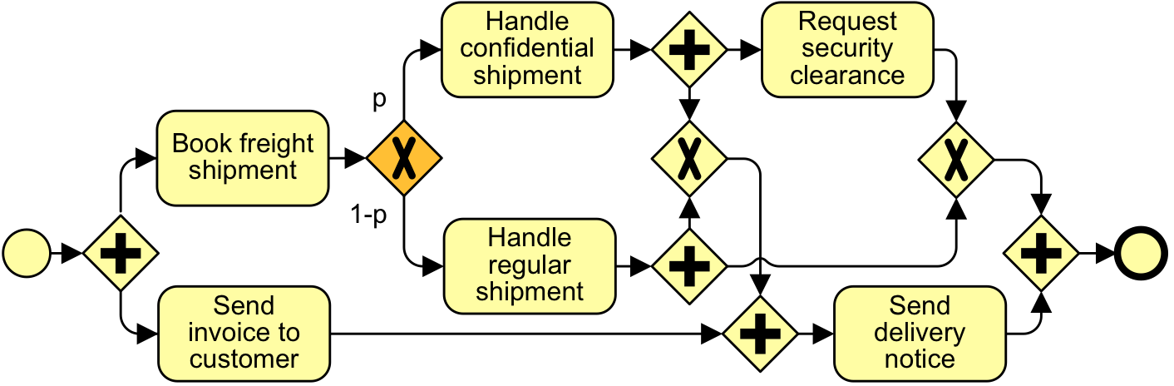
Limitation 1: Not all Models are Structured
0.3
0.5
0.7
0.8
0.5
0.2

Slide 20
Limitation 2: Fixed load + fixed resource capacity
Cycle time analysis does not consider waiting times due to resource contention
Queuing analysis and simulation address these limitations and have a broader applicability

Slide 21
Cycle Time & Work-In-Progress
WIP = (average) Work-In-Process
  Number of cases that are running (started but not yet completed)
  E.g. # of active and unfilled orders in an order-to-cash process
WIP is a form of waste (cf. 7+1 sources of waste)
Little’s Formula: WIP = λ·CT
  λ = arrival rate (number of new cases per time unit)
  CT = cycle time

Slide 22
Exercise
A fast-food restaurant receives on average 1200 customers per day (between 10:00 and 22:00). During peak times (12:00-15:00 and 18:00-21:00), the restaurant receives around 900 customers in total, and 90 customers can be found in the restaurant (on average) at a given point in time. At non-peak times, the restaurant receives 300 customers in total, and 30 customers can be found in the restaurant (on average) at a given point in time.
  What is the average time that a customer spends in the restaurant during peak times?
  What is the average time that a customer spends in the restaurant during non-peak times?

Slide 23
Exercise (cont.)
  The restaurant plans to launch a marketing campaign to attract more customers. However, the restaurant’s capacity is limited and becomes too full during peak times. What can the restaurant do to address this issue without investing in extending its building?

Slide 24
Process Analysis Techniques
Qualitative analysis
Value-Added Analysis
Issue Register
Quantitative Analysis
Quantitative Flow Analysis
Process Simulation
Queuing Theory
Root-Cause Analysis
Pareto Analysis

Slide 25
Why flow analysis is not enough?
Flow analysis does not consider waiting times due to resource contention
Queuing analysis and simulation address these limitations and have a broader applicability

Slide 26
Why is Queuing Analysis Important?
Capacity problems are very common in industry and one of the main drivers of process redesign
  Need to balance the cost of increased capacity against the gains of increased productivity and service
Queuing and waiting time analysis is particularly important in service systems
  Large costs of waiting and of lost sales due to waiting
Prototype Example – ER at a Hospital
Patients arrive by ambulance or by their own accord
One doctor is always on duty
More patients seeks help ⇒ longer waiting times
Question: Should another MD position be instated?
© Laguna & Marklund

Slide 27
Delay is Caused by Job Interference
Deterministic traffic
Variable but spaced apart traffic
If arrivals are regular or sufficiently spaced apart, no queuing delay occurs
© Dimitri P. Bertsekas
Notes:
Queuing occurs every time user demand exceeds server capacity.
Delays are due to several reasons. Let’s examine some of them…

Slide 28
Burstiness Causes Interference
Queuing results from variability in service times and/or interarrival intervals
© Dimitri P. Bertsekas
Notes:
What does “bursty traffic” mean?

Slide 29
Job Size Variation Causes Interference
Deterministic arrivals, variable job sizes
© Dimitri P. Bertsekas
Notes:
Arrivals are deterministic (e.g. the intervals between 2 consecutive arrivals are always the same), however some jobs are longer than others

Slide 30
High Utilization Exacerbates Interference
The queuing probability increases as the load increases
Utilization close to 100% is unsustainable → too long queuing times
© Dimitri P. Bertsekas
Notes:
Delay probability is higher under heavy loading conditions than when the traffic is light

Slide 31
The Poisson Process
Common arrival assumption in many queuing and simulation models
The times between arrivals are independent, identically distributed and exponential
  P (arrival < t) = 1 – e^{-λt}
Key property: The fact that a certain event has not happened tells us nothing about how long it will take before it happens
  e.g., P(X > 40 | X >= 30) = P (X > 10)
© Laguna & Marklund
Notes:
A useful queuing model represents a real-life system with sufficient accuracy and is analytically tractable. A queuing model based on the Poisson process often meets these two requirements. A Poisson process models random events (such as a customer arrival, a request for action from a web server, or the completion of the actions requested of a web server) as emanating from a memoryless process. That is, the length of the time interval from the current time to the occurrence of the next event does not depend upon the time of occurrence of the last event
Independent increments: the numbers of occurrences counted in disjoint intervals are independent from each other
Stationary increments: the probability distribution of the number of occurrences counted in any time interval only depends on the length of the interval
Closed under Addiction and Subtraction

Slide 32
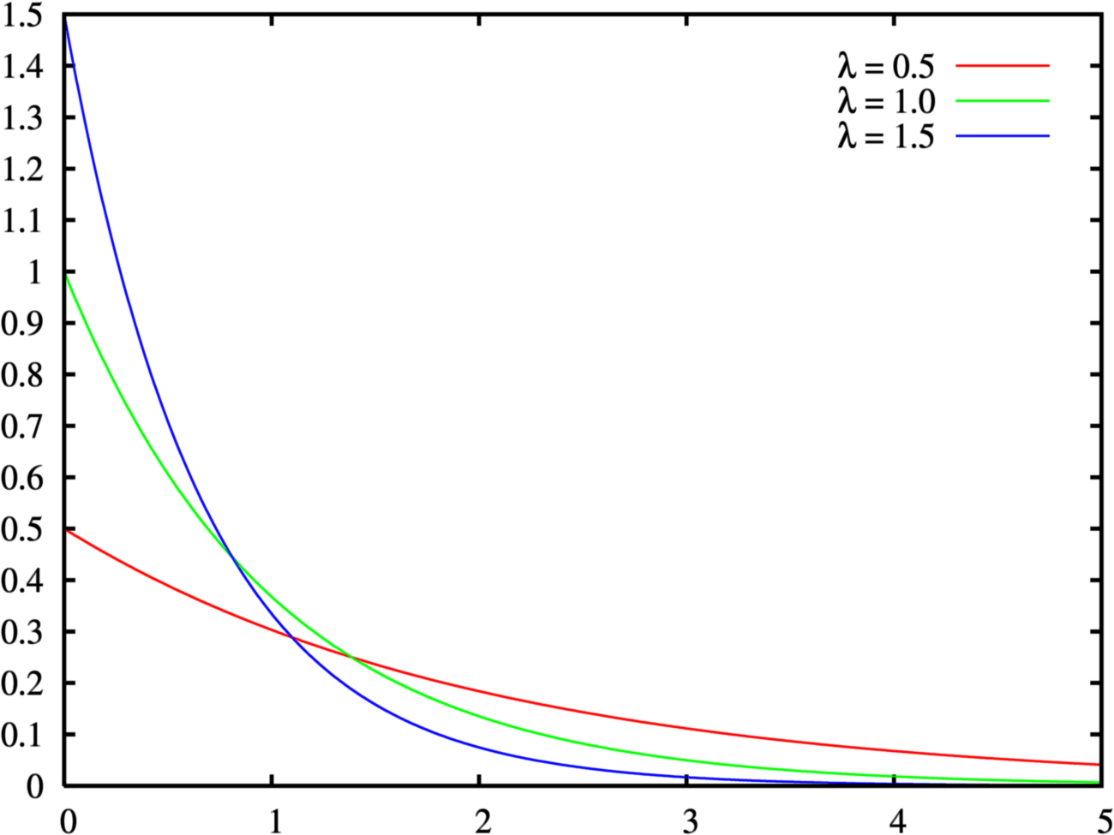
Negative Exponential Distribution

Slide 33
Queuing theory: basic concepts
waiting
service
arrivals
λ
c
μ
Basic characteristics:
λ (mean arrival rate) = average number of arrivals per time unit
μ (mean service rate) = average numberof jobs that can be handled by one server per time unit:
c = number of servers
© Wil van der Aalst

Slide 34
Queuing theory concepts (cont.)
λ
c
μ
Wq,Lq
W,L
Given λ , μ and c, we can calculate :
occupation rate: ρ
Wq = average time in queue
W = average system in system (i.e. cycle time)
Lq = average number in queue (i.e. length of queue)
L = average number in system average (i.e. Work-in-Progress)
© Wil van der Aalst

Slide 35
M/M/1 queue
λ
1
μ
Assumptions:
time between arrivals and service time follow a negative exponential distribution
1 server (c = 1)
FIFO
L=ρ/(1- ρ)
L_{q}= ρ²/(1- ρ) = L-ρ
W=L/λ=1/(μ- λ)
Wq=Lq/λ= λ /( μ(μ- λ))
© Laguna & Marklund

Slide 36
M/M/c queue
Now there are c servers in parallel, so the expected capacity per time unit is then c*μ
Little’s Formula ⇒ Wq=Lq/λ
W=Wq+(1/μ)
Little’s Formula ⇒ L=λW
© Laguna & Marklund

Slide 37
Tool Support
For M/M/c systems, the exact computation of Lq is rather complex…
Consider using a tool, e.g.
  http://apps.business.ualberta.ca/aingolfsson/qtp/
  http://www.stat.auckland.ac.nz/~stats255/qsim/qsim.html

Slide 38
Example – ER at County Hospital
Situation
  Patients arrive according to a Poisson process with intensity λ (⇔ the time between arrivals is exp(λ) distributed.
  The service time (the doctor’s examination and treatment time of a patient) follows an exponential distribution with mean 1/μ (=exp(μ) distributed)
  The ER can be modeled as an M/M/c system where c=the number of doctors
Data gathering
  λ = 2 patients per hour
  μ = 3 patients per hour
Question
  Should the capacity be increased from 1 to 2 doctors?
© Laguna & Marklund

Slide 39
Queuing Analysis – Hospital Scenario
Interpretation
  To be in the queue = to be in the waiting room
  To be in the system = to be in the ER (waiting or under treatment)
Is it warranted to hire a second doctor ?
Characteristic | One doctor (c=1) | Two Doctors (c=2)
ρ | 2/3 | 1/3
Lq | 4/3 patients | 1/12 patients
L | 2 patients | 3/4 patients
Wq | 2/3 h = 40 minutes | 1/24 h = 2.5 minutes
W | 1 h | 3/8 h = 22.5 minutes
© Laguna & Marklund

Slide 40
Process Simulation
Drawbacks of queuing theory:
  Generally not applicable when system includes parallel activities
  Requires case-by-case mathematical analysis
  Assumes “steady-state” (valid only for “long-term” analysis)
Process simulation is more versatile (also more popular)
Process simulation = run a large number of process instances, gather data (cost, duration, resource usage) and calculate statistics from the output

Slide 41
Process Simulation
Steps in evaluating a process with simulation
  Model the process (e.g. BPMN)
  Enhance the process model with simulation info ➔ simulation model
    Based on assumptions or better based on data (logs)
  Run the simulation
  Analyze the simulation outputs
    Process duration and cost stats and histograms
    Waiting times (per activity)
    Resource utilization (per resource)
  Repeat for alternative scenarios

Slide 42
Elements of a simulation model
The process model including:
  Events, activities, control-flow relations (flows, gateways)
  Resource classes (i.e. lanes)
Resource assignment
  Mapping from activities to resource classes
Processing times
  Per activity or per activity-resource pair
Costs
  Per activity and/or per activity-resource pair
Arrival rate of process instances
Conditional branching probabilities (XOR gateways)

Slide 43
Simulation Example – BPMN model

Slide 44
Resource Pools (Roles)
Two options to define resource pools
  Define individual resources of type clerk
  Or assign a number of “anonymous” resources all with the same cost
E.g.
  3 anonymous clerks with cost of € 10 per hour, 8 hours per day
  2 individually named clerks
    Jim: € 12.4 per hour
    Mike: € 14.8 per hour
  1 manager John at € 20 per hour, 8 hours per day

Slide 45
Resource pools and execution times
Task | Role | Execution Time Normal distribution: mean and std deviation
Receive application | system | 0 | 0
Check completeness | Clerk | 30 mins | 10 mins
Perform checks | Clerk | 2 hours | 1 hour
Request info | system | 1 min | 0
Receive info (Event) | system | 48 hours | 24 hours
Make decision | Manager | 1 hour | 30 mins
Notify rejection | system | 1 min | 0
Time out (Time) | system | 72 hours | 0
Receive review request (Event) | system | 48 hours | 12 hours
Notify acceptance | system | 1 min | 0
Deliver Credit card | system | 1 hour | 0
Alternative: assign execution times to the tasks only (like in cycle time analysis)

Slide 46
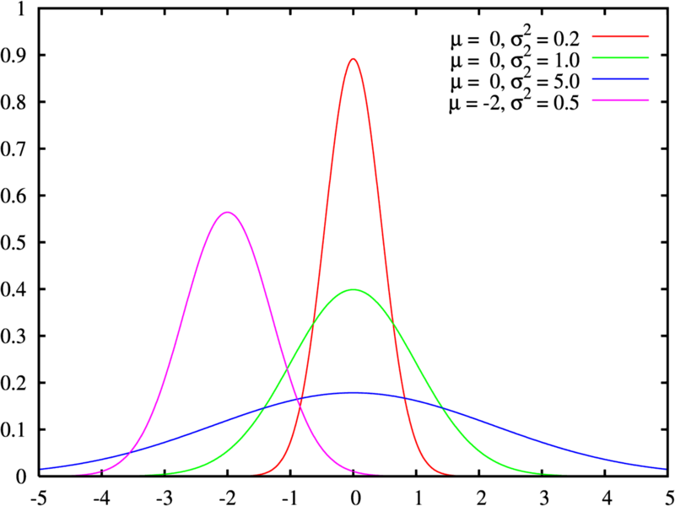
Reminder: Normal Distribution

Slide 47
Arrival rate and branching probabilities
10 applications per hour (one at a time)
Poisson arrival process (negative exponential)
0.3
0.5
0.7
0.8
0.5
0.2
Alternative: instead of branching probabilities one can assign “conditional expressions” to the branches based on input data

Slide 48
Simulation output: KPIs

Slide 49
Simulation output: detailed logs
Process Instance | # Activities | Start | End | Cycle Time | Cycle Time (s) | Total Time
6 | 5 | 4/06/2007 13:00 | 4/06/2007 16:26 | 03:26:44 | 12403.586 | 03:26:44
7 | 5 | 4/06/2007 14:00 | 5/06/2007 9:30 | 19:30:38 | 70238.376 | 19:30:38
11 | 5 | 4/06/2007 18:00 | 5/06/2007 12:14 | 18:14:56 | 65695.612 | 18:14:56
13 | 5 | 4/06/2007 20:00 | 5/06/2007 13:14 | 17:14:56 | 62095.612 | 17:14:56
16 | 5 | 4/06/2007 23:00 | 5/06/2007 15:06 | 16:06:29 | 57989.23 | 16:06:29
22 | 5 | 5/06/2007 5:00 | 6/06/2007 10:01 | 29:01:39 | 104498.797 | 29:01:39
27 | 8 | 5/06/2007 10:00 | 6/06/2007 12:33 | 26:33:21 | 95600.649 | 26:33:21
Process Instance | Activity ID | Activity Name | Activity Type | Resource | Start | End
6 | aed54717-f044-4da1-b543-82a660809ecb | Check for completeness | Task | Manager | 4/06/2007 13:00 | 4/06/2007 13:53
6 | a270f5c6-7e16-42c1-bfc4-dd10ce8dc835 | Perform checks | Task | Clerk | 4/06/2007 13:53 | 4/06/2007 15:25
6 | 77511d7c-1eda-40ea-ac7d-886fa03de15b | Make decision | Task | Manager | 4/06/2007 15:25 | 4/06/2007 15:26
6 | 099a64eb-1865-4888-86e6-e7de36d348c2 | Notify acceptance | IntermediateEvent | (none) | 4/06/2007 15:26 | 4/06/2007 15:26
6 | 0a72cf69-5425-4f31-8c7e-6d093429ab04 | Deliver card | Task | System | 4/06/2007 15:26 | 4/06/2007 16:26
7 | aed54717-f044-4da1-b543-82a660809ecb | Check for completeness | Task | Manager | 4/06/2007 14:00 | 4/06/2007 14:31
7 | a270f5c6-7e16-42c1-bfc4-dd10ce8dc835 | Perform checks | Task | Clerk | 4/06/2007 14:31 | 5/06/2007 8:30

Slide 50
Tools for Process Simulation
Listed in no specific order:
ITP Commerce Process Modeler for Visio
  Models presented earlier are made with ITP Commerce
Progress Savvion Process Modeler
IBM Websphere Business Modeler
Oracle BPA
ARIS
ProSim

Slide 51
Simple Online Simulator
BIMP: http://bimp.cs.ut.ee/
Accepts standard BPMN 2.0 as input
Link from Signavio Academic Edition to BIMP
  Open a model in Signavio and push it to BIMP using the flask icon

Slide 52
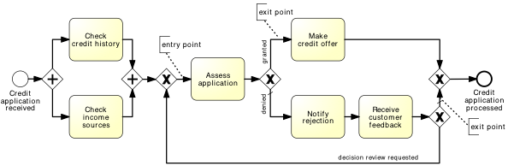
BIMP Demo

