Slide 1
Service AND SYSTEM PERSPECTIVES
Indriani Noor Hapsari
Source:
http://web.nchu.edu.tw/~pfsum/papers/Service_Systems_V3.ppt

Slide 2
Outlines
Service Systems
Organization as a Service System (OaaS)
Layer Structure of a Service System
Service Management, SOT, Service Blueprint and SOA
Service Science & Computing

Slide 3
Service Systems
3

Slide 4
Systems View
Physical Systems
  Central nervous systems
  Immune systems
  Solar system
  Eco-systems
Engineering systems
  Ventilation systems
  High Speed Rails
  Mechanical systems
  Information systems
  Internet
Business/Management
  Enterprises/NGO
  Information systems
  Factories
  Banks
  Accounting firms

Slide 5
Systems View
What is a Service?
  Service Science area
    Provider/client interaction that creates and captures value
    A change in condition or state of an economic entity (or thing) caused by another
    Intangible and perishable… created and used simultaneously
    Deed, act, or performance
    All economic activity whose output is not physical product or construction
    (http://www.research.ibm.com/ssme/services.shtml)

Slide 6
Systems View
  Computer Science area
    A mechanism to enable access to one or more capabilities, where the access is provided using a prescribed interface and is exercised consistent with constraints and policies as specified by the service description
    (http://www.oasis-open.org/committees/tc_home.php?wg_abbrev=soa-rm)
    A service is an abstract resource that represents a capability of performing tasks that represents a coherent functionality from the point of view of provider entities and requester entities.
    (http://www.w3.org/TR/ws-arch/#service)

Slide 7
Systems View
  Economic Area
    A service is a set of one time consumable and perishable benefits
      delivered from the accountable service provider, mostly in close coaction with his internal and external service suppliers,
      effectuated by distinct functions of technical systems and by distinct activities of individuals, respectively,
      commissioned according to the needs of his service consumers by the service customer from the accountable service provider,
      rendered individually to an authorized service consumer at his/her dedicated trigger,
      and, finally, consumed and utilized by the triggering service consumer for executing his/her upcoming business activity or private activity.
      (http://en.wikipedia.org/wiki/Service_(economics))

Slide 8
Systems View
Examples of services
  Transportation: Taxi, Bus, Train, Ferry, Airplane
  Logistics (carrier services), 3PL
  Banking & Finance, Professional Consultant
  Government, Education, Health Care
  Travel Industry (e.g. Hotel, Travel Agents)
  Entertainment, Movies, Gambling
  Restaurant, Food & Beverage
  Google Search, Google Map, iTune, KKBox
  Internet Services, Telecom Services, Cloud Services

Slide 9
Systems View
In accordance with Service Research & Innovation Initiative, Special Interest Groups
  Healthcare IT Services
  Financial
  Intelligent Services/Knowledge Management
  Cloud Services
  Telco/Mobile Services
  Service Innovation/Engineering/Quality
  Cross Enterprise Collaboration
  Service Innovation for Public Sectors
  Service Innovation for Emerging Markets
  Environmental Services
  University Research Programs/New Curriculum Development
  IT for Agriculture
  HPC as Services
  Service Management & Marketing

Slide 10
Product-Service Systems
Definition
  A system that produces products and provides services to its customers is a product-service system.
Examples
  Acer is a PS system. It produces notebooks and provides after-sell services.
  TV manufacturer is a PS system. It produces TV and provides after-sell services.

Slide 11
Product Systems
Definition
  A system that solely produces products to its customers is called product system.
This kind of systems does rarely exist.
  Even an OEM will sell not just products manufacturing, but also with [service level] agreements in products delivery schedule, after-sell services, and others.
  So, better call these systems Product-Oriented System.
Related concept: Good-Dominant Logic
Supply Chain

Slide 12
Service Systems
Definition
  A system that solely provides services to its customers is called service system.
Examples
  Normally, companies in the service sector
  Accounting firms, Banks, Law firms
  Car repairing workshops
  Restaurants, Hotels, KTV, Pubs/Bars
  IT consultant firms
  Marketing consultant firms
Related Concept: Service-Dominant Logic
Service Supply Chain

Slide 13
Service Delivery Process
(Routine work)
-Repeated every month, every week, every day
R&D: New product design, new service delivery process
R&D
Marketing/Sales
Customer Service
Services from
Suppliers
Services/Products
to Customers
Management Process
-Quality Control
-Schedule Tracking
Bank & Investors
Management Processes
Finance/Acct. (Process)
HR (Process)
Support Processes
Business Development
IT Mgt
External Organizations

Slide 14
Service Systems
The primary objective of an organization is to provide high quality services/products to the customers.
The focus is on how to design the process to deliver high quality products and good services.
Two processes have to be carefully designed: service delivery/production process and management process.
Customers are expected to be involved in the process (i.e. service encounter).
Each employee (department) is involved to accomplish this ultimate objective.
Employee (department) could take part in more than one process. Employee (department) could take multiple roles in an organization.
An organization is social network. In other words, it is a service system or a product-service system.

Slide 15
Service Systems
Such a system design is complicated.
  System approach, i.e. an organization is a system
  Three interrelated issues:
    Service encounter
    Service delivery process
    Organization design
  Required knowledge
    System Theory
    System Engineering and/or Service Marketing

Slide 16
Service Systems
Service encounter (c.f. User requirement specification)
  Customer interaction with the organization
  Tools:
    Business model
    UML – User case diagrams
  Required knowledge
    Consumer Behaviors
    User Experience Design
    Human-Computer Interactions
    Imagination

Slide 17
Service Systems
Service delivery process (c.f. Process models)
  Extended from the service encounter
  Detail specifications on the interactions amongst customers, employees within the organizations and employees in the suppliers
  Tools:
    Service blueprint
    UML – Sequence diagrams
  Business operations design

Slide 18
Service Systems
Organization design (c.f. Design models)
  Organization structure (i.e. architecture)
    Modular structure, quality measures, KPI, etc.
    Operation management specification
  Modeling and analysis for the optimal design
  Required knowledge
    Organization Theory (Principles in structuring)
    Organization Behavior (Human factors)
    Modeling & Simulations
    Principles of Management

Slide 19
Conceptual Diagram of an Organization Design
R&D
Marketing/Sales
Customer Service
Services from
Suppliers
Services/Products
to Customers
Service Delivery Process
Management Processes
Service Encounter
Finance/Acct. (Process)
HR (Process)
Business Development
IT Mgt

Slide 20
Organization as a Product-Service System
People/Machine
Organization
Department
Three levels of views of an organization: (1) Organization as a PS System (2) Department as a PS/S System, (3) People/Machine as a PS/S System

Slide 21
Organization as a Product-Service System
Organization
Core PS/S Systems

Slide 22
Organization as a Service System (OaaS)

Slide 23
Organization as a Composition of Service Units
Service Unit
Organization
Service Unit
Organization can be defined as a PS System. Each department can then be defined as a Service Unit. Working Teams (color blocks) can also be viewed as service units.

Slide 24
Organization as a Composition of Service Units
Service unit transforms input resources to the products and/or services to other service units or customers.
Service unit is realized by Process, People, Tools.
  Process defines the tasks to manufacture the physical goods and/or deliver the services.
  People are responsible to accomplish the tasks which are defined in the process.
  Tools (Technologies) can help people to do the job easier.

Slide 25
Organization as a Composition of Service Units
Input
Resources
Products/
Services
People
Processes
Tools
Tools include (i) hardware like plastic molding machine, rice cookers, computers, scanners; and (ii) information systems.

Slide 26
Organization as a Composition of Service Units
Kitchen is a service unit in a restaurant.
  Product to be delivered: Cuisines.
  Service to be added: Delicious.
  Cooking dishes is the process.
  The chefs and the waiters are the people who cook and serve the customers.
  Ovens, pans, gas cookers and rice cookers are the tools for the chefs to cook.
  Online ordering system is the tool for the chefs and waiters to better serve the customers.

Slide 27
Organization as a Composition of Service Units
SD Department is a service unit in an IT firm.
  Product to be delivered: Information systems.
  Service to be added: System maintenance.
  System development is the process.
  Software engineers, analysts and programmers are the people who develop the system.
  CASE tools and UML are the tools for the SD team to develop the system.

Slide 28
Organization as a Composition of Service Units
Organization
Core Service Units

Slide 29
Organization as a Composition of Service Units
Human Resource Department is a service unit.
  Interview and recruit the right people to fill in the service units.
Accounting Department is a service unit.
  Releasing payrolls to the people.
  Paying the suppliers for their raw materials or services.
Sales & Marketing Department is a service unit.
  Products/services promotion, Marketing survey.
Customer Service Department is a service unit.

Slide 30
Organization as a Composition of Service Units
Board of Directors (BoD) is a service unit.
  Analyze the five years plan, and the future development plan.
Information System Department is a service unit.
  Develop and maintain information system to support the processes to be done in the service units within the organization.
R&D Department is a service unit.
  Product design and Production scheduling

Slide 31
Organization as a Service Unit
Industry is a network of organizations. An organization can be defined as a service unit which serves other organizations in the network.
31

Slide 32
Layer Structure of a Service System (Service Systems Model)
32

Slide 33
Layer Structure
Services
Organization as a Service System
Services
Services
IS as a Service System
Services
Cloud as a Service System

Slide 34
Layer Structure
C.F. OSI Open System Model for Network Protocol.
Services
Organization as a Service System
Services
Process Unit as a Service System
IS as a Service System
Software as a Service System
Platform as a Service System
Infrastructure as a Service System

Slide 35
Layer Structure
Layered Structure
  Systematic approach to analyze/design a service system.
  An overall picture for understanding, analysis (evaluate), design, develop and maintain/manage a service system.
  Lower layer provides services for the upper layer. The topmost layer is “customers”.
  Participants in the same layer provide services amongst each others.
Similar idea comes from other layered models
  Service blueprint
  OSI 7-Layer model for computer networks
  Cloud computing

Slide 36
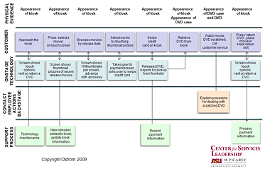
Layer Structure
Service Blueprint

Slide 37
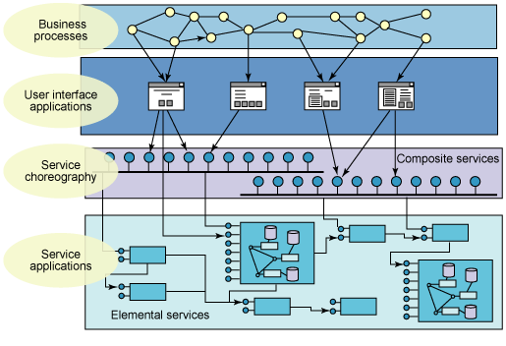
Layer Structure
Service Oriented Architecture

Slide 38
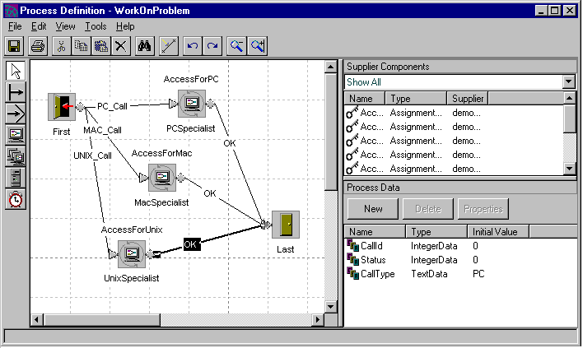
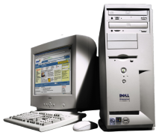


1
Distribution
Business Domain
Purchasing
Order Management
Inventory
2
Business Processes
create, modify,
suspend,
cancel orders,
schedule orders,
create, modify,
delete bulk orders,
order progress
3
Business Services
4
Infrastructure Services
5
Component-based service realizations
6
CRM
ERP
Databases
Packaged
Applications
Legacy
Applications
Operational Systems
38

Slide 39
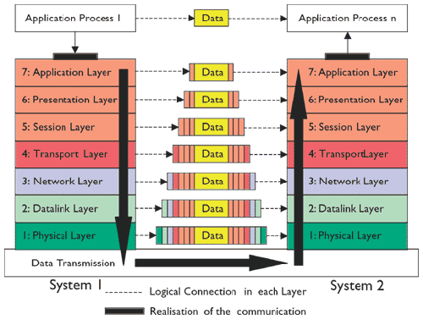
Layer Structure
OSI 7 Layer Model for Computer Networks

Slide 40
Service Management, Service Oriented Thinking, Service Blueprint and Service Oriented Architecture
40

Slide 41
Service Management
Service Management
  Managing the process, the people and the tools of all the service units within an organization (or industry) in order to deliver quality services/products to the end customers.
  Manage the services for managing the usage and the development of the services.
Challenges in Service Management
  Complexity of the service systems.
  Organization, partners, suppliers and customers are all participants in the system.
  Definition of “Service” is not unique (e.g. OEM is providing production service to its clients.)

Slide 42
Service Management
Information Management
  Manage the usage of the information system, and the information technologies for the IS.
  Develop the IS (as a tool) for people to do better job.
  Manage the technologies for managing the usage and development of the IS.
Technology Management (Management of Technology)
  Manage the usage of the tools for people to do better job.
  Develop the right tools for people to do better job.
  Manage the technologies for managing the usage and the development of the tools.
  (Manage the tools for managing the usage and the development of the tools)

Slide 43
Service Management
Technology as a Product
  Manage the usage and the development of the technologies for people to manage the design and production of new products.
  Product-Related Issues
    Product Design, Product Innovation, Product Life-Cycle, Manufacturing, Quality Control, SCM
    Intellectual Property, R&D, Industry-Academia Collaboration
    Technology Commercialization, Technology Transfer
  Managerial Issues
    Marketing, CRM, Project Management, Creative Management
    Information Systems & E-Commerce, Knowledge Management
    Strategic Management, Business Ethic, Entrepreneurship
  Innovation Issues
    Social Networks, National Innovation Networks (facilitate product innovation), Industrial Analysis
    Organization Transform, Systems Thinking, Intellectual Property Law

Slide 44
Service Management
Technology as a Tool (Service)
  Manage the usage and development of the tools for people to manage the organization.
  Manage the usage and development of the tools for people to manage the usage of the tools.
  Tools-Related Issues
    Tools Design, Intellectual Property, Technology Forecasting & Assessment
    R&D, Industry-Academia Collaboration
    Software as a Service, Infrastructure as a Service
  Managerial Issues
    Marketing, CRM, Project Management, Creative Management
    Information Systems & E-Commerce, Knowledge Management
    Strategic Management, Business Ethic
  Innovation Issues
    Social Networks, National Innovation Networks (facilitate the use of innovative technologies), Industrial Analysis
    Systems Thinking, Intellectual Property Law, Techno Park & Incubation

Slide 45
Service Oriented Thinking
Service dominant logic
An intuitive approach to develop an organization (a business) and the information system that supports the organization.
Question 1
  How to model and analyze the business processes from the service system point of view?
Question 2
  How to analyze, design and build the information system from the service system point of view?
Answer to Question 1: Service Blueprint, Sequence Diagrams, Use Case Diagram, Value Networks, Queuing theory
Answer to Question 2: For IT-enable services, we can rely on service oriented architecture (SOA), web services

Slide 46
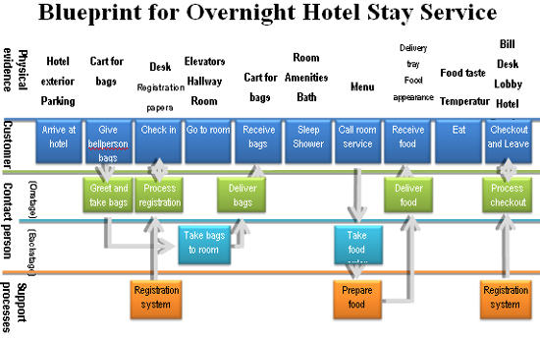
Service Blueprint

Slide 47
Service Oriented Architecture
M.P. Papazoglou, Web Services: Principles and Technology, Prentice-Hall, 2007. (P.22-23)
SOA is a logical way of designing a software system to provide services to either end-user applications or to other services distributed in a network, via published and discoverable interfaces.
SOA as a design philosophy is independent of any specific technology. It can be implemented without the use of Web services.

Slide 48
Service Oriented Architecture

Slide 49
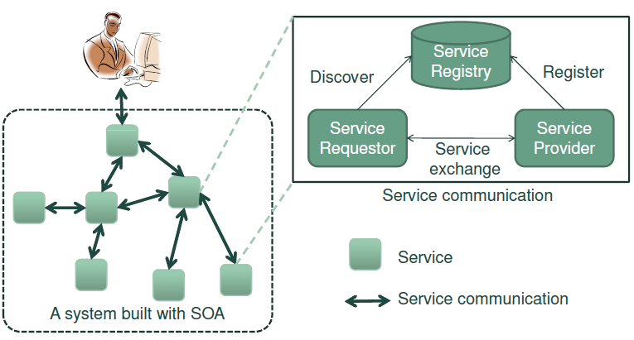
Service Oriented Architecture

Slide 50
Service Oriented Architecture
The service model allows for a clear distinction to be made between:
  service providers (organizations that provide the service implementations, supply their service descriptions, and provide related technical and business support);
  service clients (end-user organizations that use some service);
  service registry a searchable directory where service descriptions can be published and searched.
    Service requestors find service descriptions in the registry and obtain binding information for services.
    This information is sufficient for the service requestor to contact, or bind to, the service provider and thus make use of the services it provides.
Note: IBM, SAP, and HP already shut down their service registration services in 2006.

Slide 51
Service Oriented Architecture
Web services are implemented by a collection of several related technologies & standards.
Choreography - CDL4WS
Business
Processes
Orchestration - BPEL4WS
Transactions
Quality of
Service
WS-Reliability
WS-Security
Coordination
Management
Context
UDDI
Discovery
Description
WSDL
Description
SOAP
Message
XML
HTTP,JMS, SMTP
Transport

Slide 52
Information System as a Service System
Peter Checkland and Sue Howell, Information, Systems, and Information Systems: making sense of the field view on an information system.
A consequence of the nature of the process, in which intentions are formed and purposeful action is undertaken by people who are supported by information, is that ‘information system’ has to be seen as a service system: one which serves those taking the action.

Slide 53
Information System as a Service System
Hence its form and content will have to be dictated by how the action supported is conceptualized.
This means that ‘information systems development’ must start by carefully defining the action to be served, in its specific context, and using that definition to decide what information is needed and how technology can help provide it. (This reverses what often happens today in organizations – with poor results – which then lead to spectacular headlines about ‘another IT failure’.)” (Pp. 219-220)

Slide 54
1
Distribution
Business Domain
Purchasing
Order Management
Inventory
2
Business Processes
create, modify,
suspend,
cancel orders,
schedule orders,
create, modify,
delete bulk orders,
order progress
3
Business Services
4
Infrastructure Services
5
Component-based service realizations
6
CRM
ERP
Databases
Packaged
Applications
Legacy
Applications
Operational Systems

Slide 55
Information System as a Service System

Slide 56
Service Science & Computing
56

Slide 57
The “Science”
Computer Science (From Wikipedia)
  Computer science or computing science is the study of the theoretical foundations of information and computation and of practical techniques for their implementation and application in computer systems.
  Computer science has many sub-fields including computational complexity theory, computer graphics, programming language and complier, computer networks, database management, human-computer interaction, system programming, software engineering, artificial intelligence.

Slide 58
The “Science”
Management Science (From Wikipedia)
  Management science (MS), is an interdisciplinary branch of applied mathematics devoted to optimal decision planning, with strong links with economics, business, engineering, and other sciences. It uses various scientific research-based principles, strategies, and analytical methods including mathematical modeling, statistics and numerical algorithms to improve an organization's ability to enact rational and meaningful management decisions by arriving at optimal or near optimal solutions to complex decision problems. In short, management sciences help businesses to achieve their goals using the scientific methods of operational research.

Slide 59
The “Science”
Social Science (From Wikipedia)
  The social "sciences" are the fields of scholarship that study society. "Social science" is commonly used as an umbrella term to refer to a plurality of fields outside of the natural sciences. These include: anthropology, archaeology, business administration, communication, criminology, economics, education, government, linguistics, international relations, political "science" and, in some contexts, geography, history, law, and psychology. The term may be used, however, in the specific context of referring to the original science of society established in 19th century sociology. Émile Durkheim, Karl Marx and Max Weber are typically cited as the principal architects of modern social "science" by this definition.

Slide 60
The “Science”
Life Science (From Wikipedia)
  The life sciences comprise all fields of science that involve the scientific study of living organisms, like plants, animals, and human beings. However, the study of behavior of organisms, such as practiced in ethology and psychology, is only included in as much as it involves a clearly biological aspect. While biology remains the centerpiece of the life sciences, technological advances in molecular biology and biotechnology have led to a burgeoning of specializations and new, often interdisciplinary, fields.

Slide 61
The “Science”
Behavioral Science (From Wikipedia)
  The term behavioral science encompasses all the disciplines that explore the activities of and interactions among organisms in the natural world. It involves the systematic analysis and investigation of human and animal behavior through controlled and naturalistic observation, and disciplined scientific experimentation. It attempts to accomplish legitimate, objective conclusions through rigorous formulations and observation (E.D. Klemke, R. Hollinger & A.D. Kline, (eds.) (1980)). Examples of behavioral sciences include psychology, cognitive science, and anthropology.

Slide 62
The “Science”
System Science (From Wikipedia)
  Systems science is an interdisciplinary field of science that studies the nature of complex systems in nature, society, and science. It aims to develop interdisciplinary foundations, which are applicable in a variety of areas, such as engineering, biology, medicine and social sciences.
  Systems sciences covers formal sciences fields like complex systems, cybernetics, dynamical systems theory, and systems theory, and applications in the field of the natural and social sciences and engineering.

Slide 63
The “Science”
W.D. Rowe, What is systems science and cybernetics? IEEE Transactions on Systems Science and Cybernetics, Vol.SSC-1, No.1, pp.2-3, November, 1965.
  Systems science is defined as the scientific theory and methodology that is common to all large collections of interacting functional units that together achieve a defined purpose.
  It includes the application of common methods in analysis, simulations, synthesis, implementation, evaluation, and parameter interaction. The field is concerned with large technological systems as opposed to specific control systems or components. It includes the economics, operation, logistics, and utilization as well as engineering design of systems.
  In general, the system science participants approach problems from an optimization point of view, i.e., the system is described analytically by a set of cause and effect relationships whose parameters can be varied to optimize a particular measure of effectiveness.

Slide 64
Service Science
“Service Science, Management and Engineering (SSME) is a new multi-disciplinary research and academic effort that integrates aspects of established fields such as computer science, operations research, engineering, management sciences, business strategy, social and cognitive sciences, and legal sciences.” [IBM's definition]
“Service Science, Management, and Engineering (SSME) is an interdisciplinary approach to the study, design, and implementation of service systems – complex systems in which specific arrangements of people and technologies take actions that provide value for others.” [Wikipedia's definition]

Slide 65
Service Science
Jim Spohrer, Paul P. Maglio, John Bailey, and Daniel Gruhl, Steps toward a science of service systems, IEEE Computer Magazine, 71-77, January 2007.
  Service is a kind of action, performance, or promise that’s exchanged for value between provider and client. Service is performed in close contact with a client; the more knowledge-intensive and customized the service, the more the service process depends critically on client participation and input, whether by providing labor, property, or information.
    R.F. Lusch and S.L. Vargo, eds., “The Service-Dominant Logic of Marketing: Dialog, Debate, and Directions,” M.E. Sharpe, 2006.
    S.E. Sampson and C.M. Froehle, “Foundations and Implications of a Proposed Unified Services Theory,” Production and Operations Management, summer 2006, pp. 329-343.

Slide 66
Service Science
Jim Spohrer, Paul P. Maglio, John Bailey, and Daniel Gruhl, Steps toward a science of service systems, IEEE Computer Magazine, 71-77, January 2007.
  Service systems comprise service providers and service clients working together to co-produce value in complex value chains or networks.
    J.M. Tien and D. Berg, “A Case for Service Systems Engineering,” Journal of Systems Science and Systems Eng., Mar. 2003, pp.113-128.
    J. Gadrey, “The Misuse of Productivity Concepts in Services: Lessons from a Comparison between France and the United States,” J. Gadrey and F. Gallouj, eds., Productivity, Innovation and Knowledge in Services: New Economic and Socioeconomic Approaches, Edward Elgar Publishing, 2002.

Slide 67
Service Science
Jim Spohrer, Paul P. Maglio, John Bailey, and Daniel Gruhl, Steps toward a science of service systems, IEEE Computer Magazine, 71-77, January 2007.
  Service Science, Management, and Engineering is the application of scientific, management, and engineering disciplines to tasks that one organization (service provider) beneficially performs for and with another (service client).
  SSME aims to understand how an organization can invest effectively to create service innovations and to realize more predictable outcomes.
    Science–what service systems are and how to understand their evolution;
    Management–how to invest to improve service systems; and
    Engineering–how to invent new technologies that improve the scaling of service systems.

Slide 68
Service Science
Mary Jo Bitner, Stephen W. Brown, Michael Goul, Susan Urban, Services Science Journey: Foundations, Progress, and Challenges, 2008.
  Services Science is an emerging discipline that focuses on fundamental science, models, theories and applications to drive innovation, competition, and quality of life through services.
  Some of the research clusters we foresee developing within our Services Science Initiative include groups that would focus on: IT Services Solutions; Business Models for Services; Computing Models for Services; Healthcare Innovation; Technology and Service Delivery; Service Design; Customer Loyalty and Relationships.

Slide 69
Service Science
Kwei-Jay Lin, The design of an accountability framework for service engineering, Proceedings of the 41st Hawaii International conference on System Science, 2008.
  The goal of our service science and engineering research is to advance IT-based services technology by developing a service framework and companion toolset for service innovation, composition and delivery.
  Our research also aim at inventing and reinventing business models to target toward the 21st century societal and business environments.

Slide 70
Service Science
Kwei-Jay Lin, The design of an accountability framework for service engineering, Proceedings of the 41st Hawaii International conference on System Science, 2008.
  The study takes a systematic approach to service engineering. By building a service infrastructure using current and next generation IT technologies (including wired and wireless Internet, SOA, embedded devices, sensor network, etc.).
  We hope to provide the scientific and technical foundation necessary for many enterprises to transition from product-oriented business operations to high-value service-centered businesses.

Slide 71
Services Computing
Liang-Jie (LJ) Zhang, EIC Editorial: Introduction to the Body of Knowledge Areas of Services Computing, IEEE Transactions on Services Computing, Vol.1(2), 62-74, 2008.
  Services represent a type of relationships-based interactions (activities) between at least one service provider and one service consumer to achieve a certain business goal or solution objective.

Slide 72
Services Computing
  14 main knowledge areas of the Services Computing discipline included in the TSC taxonomy can be categorized into the following four categories:
    Services and Services Systems
    Services Technologies
    Services Consulting and Delivery
    Services Solution and Management
  The connection between business architecture and IT architecture is one of the major focus areas of Services Computing.

Slide 73
Services Computing
  The general topics of services lifecycle cover the following six phases:
    Consulting and Strategic Planning,
    Services Engagement,
    Services Delivery,
    Services Operation,
    Services Billing,
    Services Management.
  Each phase of the services lifecycle can be performed by one or multiple parties.
  Key Factors in Services Lifecycle cover Data and Information, Processes, People, Resources, Financial Factors, Knowledge and Skills, as well as Innovation and Technology.

