Slide 1
Introduction to
Service Oriented Architecture
CSR321 Rekayasa Layanan

Slide 2
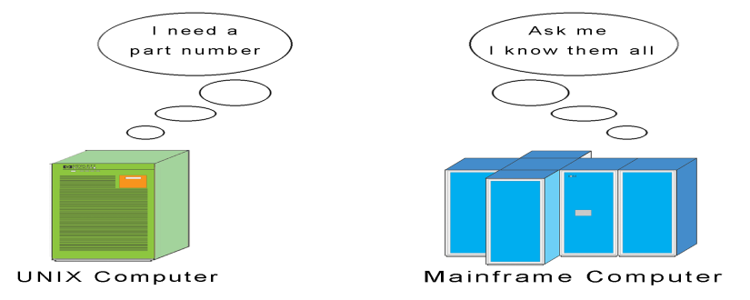
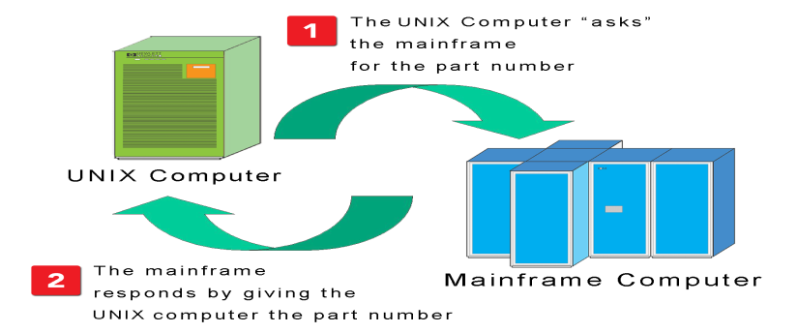
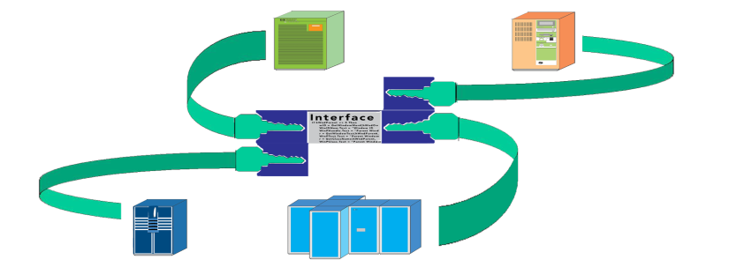
What is SOA? First, Understand “Tight Coupling”
Data and functionality typically reside on more than one system (and application)
Applications need to be able to “talk to each other”
Status quo: Proprietary or custom communication interfaces between applications
Source: H. Taylor, “Service-Oriented Architecture (SOA) 101 ‘What’s Hype, What’s Real?’“, Juniper Networks, Inc.,2007.

Slide 3
Challenges with Tight Coupling
While tight coupling is inherently sound, the following challenges are encountered in its implementation:
  It’s costly to maintain
  Slow and costly to change
  Cost and complexity compounded by multi-party scenarios such as B2B or integration with the public sector
  Cost and complexity of managing and changing a tightly coupled architecture makes business agility difficult (IT can’t keep up with business needs, but it’s not their fault)
  Does not support reuse!
Recognized for many years as challenge industry wanted to solve
Evolution of reuse solutions reflects industry’s concerns
  Header files, inheritance and polymorphism at the object level, frameworks
  CORBA (Common Object Request Broker Architecture)
  Microsoft COM (Component Object Model)
  EAI (Enterprise Application Integration )
  Web Services
Source: H. Taylor, “Service-Oriented Architecture (SOA) 101 ‘What’s Hype, What’s Real?’“, Juniper Networks, Inc.,2007.

Slide 4
Challenges with Tight Coupling
While tight coupling is inherently sound, the following challenges are encountered in its implementation:
  It’s costly to maintain
  Slow and costly to change
  Cost and complexity compounded by multi-party scenarios such as B2B or integration with the public sector
  Cost and complexity of managing and changing a tightly coupled architecture makes business agility difficult (IT can’t keep up with business needs, but it’s not their fault)
  Does not support reuse!
Recognized for many years as challenge industry wanted to solve
Evolution of reuse solutions reflects industry’s concerns
  Header files, inheritance and polymorphism at the object level, frameworks
  CORBA (Common Object Request Broker Architecture)
  Microsoft COM (Component Object Model)
  EAI (Enterprise Application Integration )
  Web Services
Source: H. Taylor, “Service-Oriented Architecture (SOA) 101 ‘What’s Hype, What’s Real?’“, Juniper Networks, Inc.,2007.

Slide 5
Challenges with Tight Coupling
Overview of CORBA
Tier1 belongs to traditional Web browsers and Web-centric applications
Tier 2 runs on any server that can support HTTP and CORBA clients
  CORBA objects, like EJBs, encapsulate business logic
Tier 3 consists of almost anything a CORBA object can access
The 3-Tier CORBA/Java Object Web.
Source: Client/Server Programming with JAVA and CORBA
Second Edition by R. Orfali and D. Harkey, p. 45.

Slide 6
Challenges with Tight Coupling
Overview of COM
  Microsoft COM (Component Object Model) enables software components to communicate
  COM is used by developers to create re-usable software components, link components together to build applications, and take advantage of Windows services
  COM objects can be created with a variety of programming languages including object-oriented languages such as C++
  The family of COM technologies includes COM+, Distributed COM (DCOM) and ActiveX® Controls.
  The .NET Framework provides bi-directional interoperability with COM, which enables COM-based applications to use .NET components and .NET applications to use COM components
Reasons CORBA, COM, EAI and others did not work
  Lack of open standards
  Proprietary components
Source: http://www.microsoft.com/com
Notes:
6

Slide 7
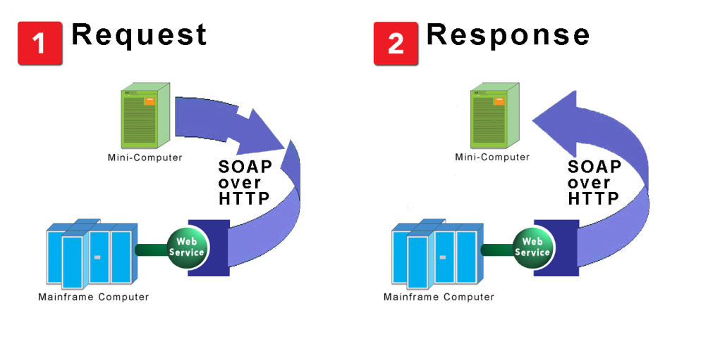
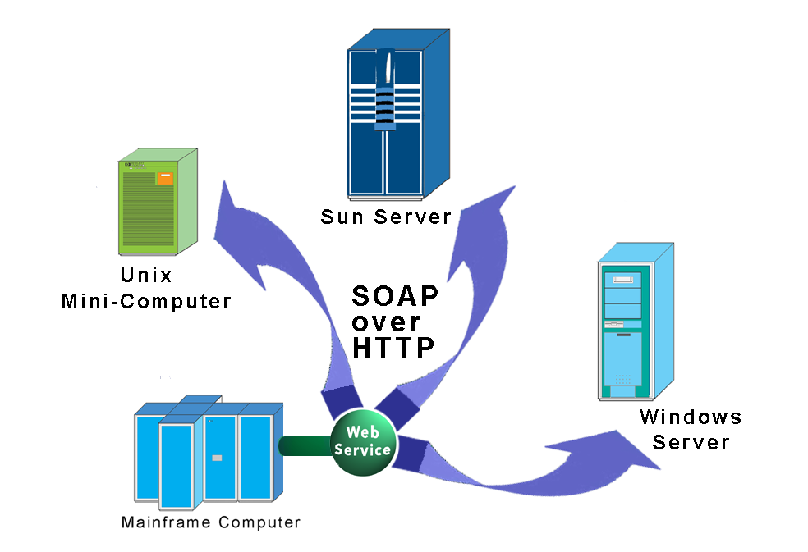
SOA: The Ideal of Open Interoperability (Loose Coupling)
SOA – A Definition
An IT architecture composed of software that has been exposed as “Services” – i.e. invoked on demand using a standard communication protocol.
“Web Services” – software available as a “service” using Internet protocols.
One software application talking to another using a standards-based (i.e. non-proprietary) language over a standards-based communication protocol.
Universal “Dial Tone” between software applications
An IT architecture that enables “loose coupling” of applications
Source: H. Taylor, “Service-Oriented Architecture (SOA) 101 ‘What’s Hype, What’s Real?’“, Juniper Networks, Inc.,2007.

Slide 8
Core SOA Definitions
Source: H. Taylor, “Service-Oriented Architecture (SOA) 101 ‘What’s Hype, What’s Real?’“, Juniper Networks, Inc.,2007.
XML – Extensible Markup Language
SOAP – Simple Object Access Protocol
WSDL – Web Services Description Language
UDDI - Universal Description, Discovery and Integration
ESB – Enterprise Service Bus
Key Concepts
  Network Transparency
  Virtualized endpoint
  Self-describing software
  Universally discoverable software
  Universally understood software
  Machine to machine interaction
Notes:
8

Slide 9
SOA Usage & Supporting Platforms
Source: H. Taylor, “Service-Oriented Architecture (SOA) 101 ‘What’s Hype, What’s Real?’“, Juniper Networks, Inc.,2007.
SOA Usage
  B2B
  Enterprise Application Integration (EAI)
  Application to Application
  Government
Major Players in SOA Space
  IBM: WebSphere SOA Product Suite
  BEA: Aqualogic (WebLogic)
  Oracle: Fusion Middleware
  Microsoft: .NET
  SAP: NetWeaver
Notes:
9

Slide 10
What Makes Web Services Appealing?
 | CORBA | JAVA RMI | ONC(SUN) RPC | WEB SERVICES
Data Encoding | Common Data Representation (CDR) | Serialized Java/CDR | Extended Data Representation (XDR) | XML (WS-I doc-literal, SOAP Encoding)
Message Format | IIOP (GIOP) | RMI Protocol/IIOP | RPC RMS | SOAP
Transport Protocol | TCP | TCP | UDP TCP | HTTP
Description Language | CORBA IDL | Java Interface/Class | RPC IDL | WSDL
Discovery Mechanism | COS Naming | RMI Registry | Undefined | UDDI
Invocation Method | CORBA RMI | Java RMI (method call) | RPC | Undefined
Source: See [ 56], Page 4.

Slide 11
Cross-Enterprise Solution Architecture
Figure illustrates tomorrow’s e-business solution architecture
4 stakeholders communicate via Web services
  Suppliers
  Customers
  Enterprise
  Employees
Source: Mobility, Security and Web Services: Technologies and
Service-Oriented Architectures for a new Era of IT Solutions by Gerhard Wiehler, p. 46.

Slide 12
e-Business Architecture for B2B
1 External Provider, 2 Enterprises: A & B
Enterprise B Purchasing accesses Enterprise A’s Inventory Web Service
Both enterprises access an authentication Web service provided by an external provider
Enterprises A & B separately access Web services that provide Payment and Logistics Web Services
Source: Mobility, Security and Web Services: Technologies and
Service-Oriented Architectures for a new Era of IT Solutions by Gerhard Wiehler, p. 101.

Slide 13
End Slides.

