Slide 1
Studi Kasus: Return Handling
CSR321 Rekayasa Layanan

Slide 2
Description
Retail companies have been accepting sold goods back from their clients for a long time. This operation is generally called return handling, goods inﬂow, or reverse inventory.
The case study presented here is based on the work done by de Koster et al.

Slide 3
General Background Information
MO1 is a mail-order retail company. It sells electronic goods, such as television sets, home theater systems, CDs, DVDs and cables.
MO1 runs an e-commerce web site where customers can place orders. MO1 also releases printed catalogues and accepts orders over the phone.
Mail-order companies experience a high rate of return. This is true for MO1. Customers return about 15% of the goods sold. About 20% of the warehouse space is dedicated toward returns handling.

Slide 4
Current Business Operation
Products can be returned within 30 days of delivery.
MO1 offers full satisfaction guarantee. If, for any reason, a customer is not happy with a product, all she has to do is call the customer support line.
If the dissatisfaction is due to a perceived technical problem, customer support does its best to resolve them. If the customer conﬁrms her decision to return, the customer service representative logs the reason for return and provides the customer with a return address.
All returns are sent to a warehouse. When a package arrives, a staff member locates the call center log for the order to ﬁnd out why the product is being returned. What MO1 does with the returned products depends on the reason for return. Exhibit 1.4 summarizes the actions.
Exhibit 1.5 shows the current business process in a graphical form. A business process manager or analyst will typically model the business process this way using graphical notations.

Slide 6
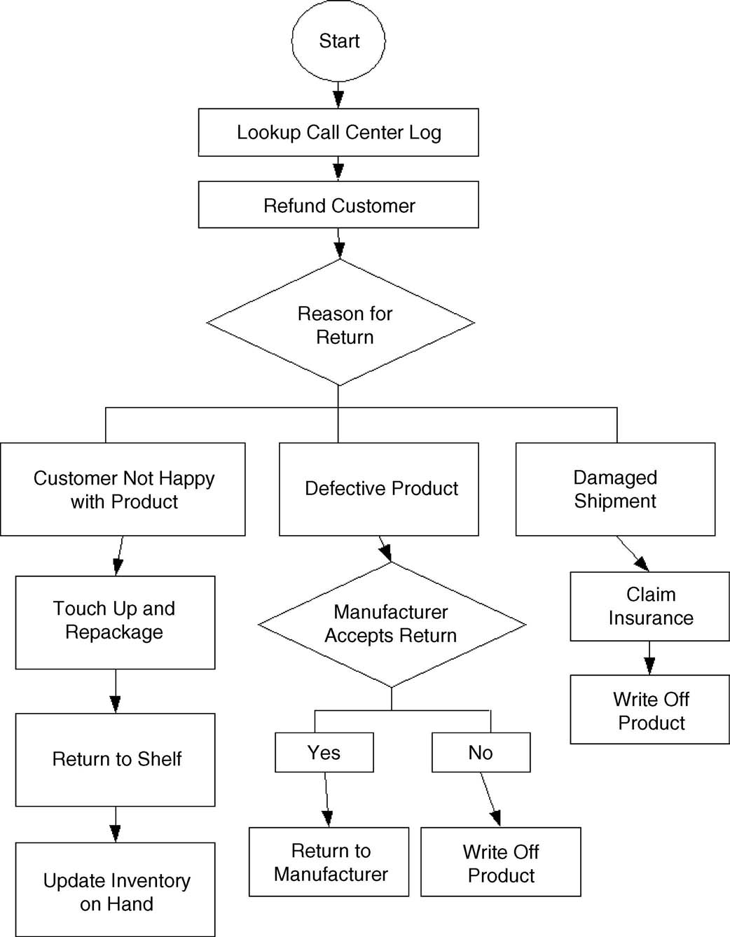

Slide 7
The Problems
Overall, MO1 needs to lower the cost of return handling and minimize errors. Speciﬁcally, the following problems exist in the current operation:
When a returned package is received, it takes a staff member several minutes to locate the order details and the call center log.
The staff attempts to locate the information by searching for the customer’s name and address.
Staff member has to manually enter the same data in several systems.
These systems include call center, warehouse management system, manufacturer’s web site, shipping carrier’s web site, and the accounting system.
This slows down the operation and introduces errors.

Slide 8
The Problems (Cont’d)
Some of the defective items are sent back to the manufacturer.
Staff member had made mistakes when preparing the package for shipment to the manufacturer.
Shipping label has been printed with the address of the wrong manufacturer.
Currently, staff members log into the accounting system and initiate refund to the customer. This has led to errors and in some cases malpractice.

Slide 9
Improvement Opportunities
MO1 has identiﬁed several areas of improvement:
It is generally believed that certain products have a higher rate of return. This may have to do with the way the product is represented in the web site or the printed catalogue. MO1 would like to know which products have a high return rate so that appropriate changes can be made to the description and photograph of the product.

Slide 10
Improvement Opportunities (Cont’d)
For some of the cheaper items, processing the return costs more than the item itself.
In these cases, items could be simply scrapped.
Return processing can be considerably sped up with a better designed warehouse workﬂow and more efﬁcient sorting process for returned packages.
The main focus area here will be integration between different systems, which will eliminate the need for duplicate data entry.

Slide 11
How Can SOA Help?

Slide 12
How Can SOA Help?
Use BPM to scrutinize the current business process, to find several ways to make it more error-proof and faster.
Identiﬁed the roles and responsibilities of each service provider. Then look for ways to automate the tasks by developing services. Task automation can further speed up the operation and reduce error.
Develop an orchestration. This will oversee the sequence of tasks. Orchestration has a twofold advantage. It helps with automation. It can also capture key statistical data known as KPIs, which help us get a better understanding about the business and improve its operations.

Slide 13
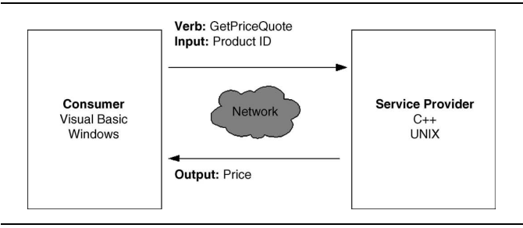

Slide 14
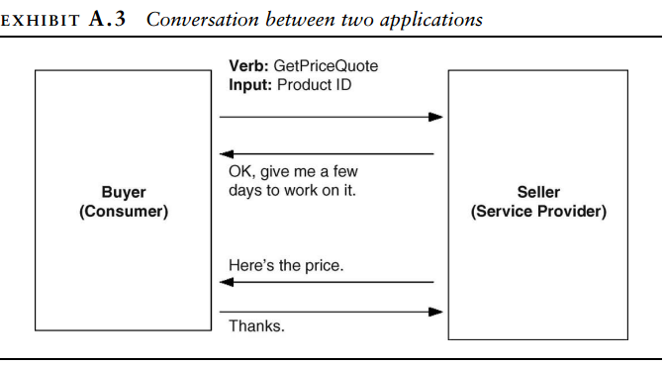

Slide 15
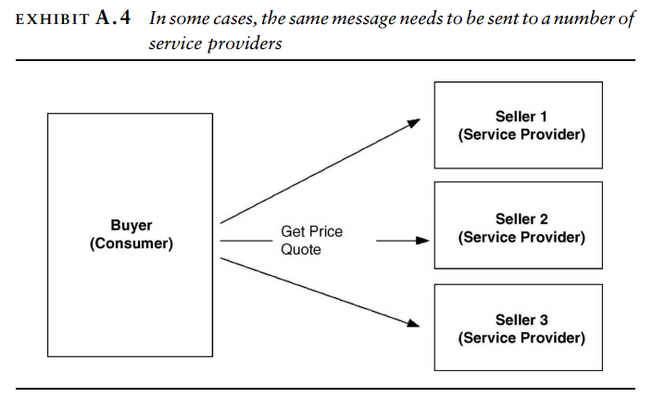

Slide 16
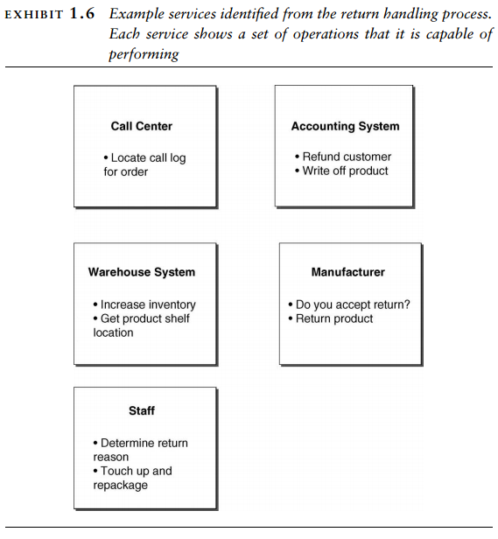

Slide 17
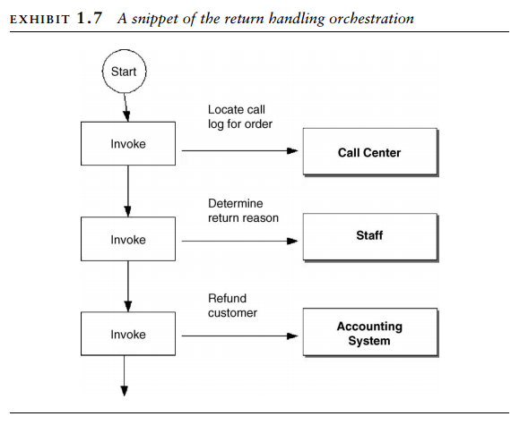

Slide 18
Return Handling Problem
In SOA, the business process itself executes as a software. It can automate many tasks, for example, pulling up the call center log and initiating a refund with the accounting system. The employees do not have to log into all kinds of different software applications and manually enter data.
Next, SOA requires that you formally identify the players in the process. They are called service providers or simply services.
In the return handling process, the services are:
the employees: accept returned packages, do touchups, and repackage. They also place items in good condition back on the shelf.
the web site,
the call center application,
the accounting system: can be asked to refund the credit card used for an order.
the manufacturer, and
the shipping carrier are the services: can be asked to accept an insurance claim for damaged goods
Once services are identified, their roles and responsibilities become very clear. SOA now requires you to look for ways to automate tasks. Task automation can significantly reduce error and cost.

