Slide 1
Business Process and SOA
Indriani Noor Hapsari

Slide 2
Enterprise
An enterprise is a group of people with a common goal, which they try to achieve through utilization of resources (people, money, energy, material, space, time, etc).
The degree of success of the enterprise is often measured by the ratio between the outputs and inputs.
Alexis Leon, “Enterprise Resource Planning”, Tata McGraw Hill, 2008

Slide 3
Enterprise
INPUT
PROCESS
OUTPUT
Resources
Attainment of the Goal
Productivity = Output : Input
Alexis Leon, “Enterprise Resource Planning”, Tata McGraw Hill, 2008

Slide 4
Enterprise
The level of productivity depends on the execution of certain managerial functions such as planning, organizing, directing, and controlling.
Alexis Leon, “Enterprise Resource Planning”, Tata McGraw Hill, 2008

Slide 5
Traditional Organization
The Organization is divided into different units based on the functions their perform.
Organization that make product to sell have the following functional areas of operation: purchasing, production, and material management, marketing and sales, accounting and finance, human resources, etc.
The various departments have their own goals.
The different departments function in isolation and have their own data collection and analysis system.
One functional areas was not aware of what was happening in the other areas.
This lack of knowledge created conflicts of interests.
Alexis Leon, “Enterprise Resource Planning”, Tata McGraw Hill, 2008

Slide 6
“Enterprise” way…
In the enterprise way, the entire organization is considered as a single system.
Information about all the aspects of the organization is stored centrally and is available to all departments, thus avoiding conflicts.
Alexis Leon, “Enterprise Resource Planning”, Tata McGraw Hill, 2008

Slide 7
Business Function vs Business Process
BUSINESS FUNCTION
Inventory
Production
Sales
Marketing
Human Resource
BUSINESS PROCESSES
A process cuts across more than one business function to get a task done.

Slide 8
Business Function vs Business Process
Recently managers and organizations have started to think in terms of business process rather than business functions.
Inter-departmental information sharing through the use of integrated information systems will help the organization in achieving customer satisfaction while improving their productivity and efficiency.

Slide 9
Business Process
A business process is a set of coordinated tasks and activities, conducted by both people and equipment that will lead to accomplishing a specific organizational goal.
A business process can be decomposed into sub-processes, which have their own attributes, but also contribute to achieving goal of the super-process.
The analysis of business processes typically includes the mapping of processes and sub-processes down to activity level.
Activities are part of the business process that do not include any decision making and thus not worth decomposing, such as “answer the phone”, “prepare the invoice”, “send the fax”, etc.
Alexis Leon, “Enterprise Resource Planning”, Tata McGraw Hill, 2008

Slide 10
Three types of business processes
Management Processes
Govern the operation of a system.
Examples: corporate governance, strategic management.
Operational Processes
Create the primary value stream and are part of the core business.
Examples: Purchasing, Manufacturing, Marketing, Sales.
Supporting Processes
Support the core processes.
Examples: Accounting, Recruitment, IT-Support.
Alexis Leon, “Enterprise Resource Planning”, Tata McGraw Hill, 2008

Slide 11
Business Process Characteristics (1)
Definability
It must have clearly defined boundaries, input, and output.
Order
It must consist of activities that are ordered according to their position in time and space.
Customer
There must be a recipient of the process’ outcome, a customer.
Value-adding
The transformation taking place within the process must add value to the recipient, either upstream or downstream.
Alexis Leon, “Enterprise Resource Planning”, Tata McGraw Hill, 2008

Slide 12
Business Process Characteristics (2)
Embeddedness
A process cannot exist in itself, it must be embedded in an organizational structure.
Cross-functionality
A process regularly can, but not necessarily must, span several functions.
Process owner
A person being responsible for the performance and continuous improvement of the process.
Alexis Leon, “Enterprise Resource Planning”, Tata McGraw Hill, 2008

Slide 13
Business Process & SOA
Automation of business processes is one of the key goals of SOA.
BPM deals with deﬁnition and optimization of business processes.
SOA depends heavily on business processes. Without a commitment to developing and following business processes, SOA is not likely to succeed in an organization.

Slide 14
Components of a Business Process
Trigger event. This starts a business process.
Input to the process. This might be information, goods, or contracts that must exist before the process can begin.
Tasks that need to be carried out. The tasks can be performed by people, machine, or software. Roles and responsibilities around these tasks are well deﬁned. Just like a process, a task can also have input and produced value (output).
Sequence or order of the tasks.
Exception scenarios. How does the process deal with erroneous or unusual situations?
Output of the process. This is the ﬁnal goal achieved by the process.

Slide 15
Becoming Process Oriented
How does an operation go from being ad hoc and disorganized to being process oriented?
The Software Engineering Institute (SEI) of Carnegie Mellon University grappled with that issue. The output of their work is famously known as the Capability Maturity Model Integration (CMMI).
The model captures the way a business becomes increasingly process oriented.
Although the model was originally designed for the software development industry, it is generally applicable to any business.
In CMMI, the quality of deﬁnition and management of a speciﬁc business process is called capability. According to the model, a process goes through ﬁve different levels of increasing capability.

Slide 16
CMMI
Level 0: Incomplete or not performed. At this very early stage, the business may be just thinking of carrying out the process. Or, the process may be performed in a partial manner.
Level 1:Performed. At this level, employees are performing the process and achieving real goals. However, there is no management recognition of the process. There is no careful planning. The process loosely follows a structure informally arrived at by the employees.
Level 2: Managed. At this stage, the process is carefully thought out, tuned, and well documented. Management is fully aware of it. This means that proper resources are allocated to make sure that the process completes smoothly. Roles and responsibilities are clearly laid out. Management makes sure that the employees receive training. The process is also controlled, which means that management makes sure that the employees are following the process properly.
Level 3: Deﬁned. A deﬁned process is a managed process that adheres to a corporate-wide standard.
Level 4: Quantitatively managed. At this level, key performance indicators (KPIs) are deﬁned and captured. The numbers are used to make sure that the business is performing at an optimal level.
Level 5: Optimizing. At this most advanced level, KPIs are used to optimize the time and cost of the process

Slide 17
Before you can automate a process, it must be well understood and well deﬁned.
In the CMMI model, it should be at least in the level 2 ‘‘managed’’ stage.

Slide 18
Business Process Management
Business process management (BPM) is a discipline that covers all aspects of deﬁning and performing business processes. The BPM tries to promote the standardization of common business processes, as a means of furthering e-business and business-to-business development.
Business Process Management Systems (BPMS) is a system that is responsible for the design, deployment, monitoring and managing of key internal IT systems as well as key partner IT systems. BPMS are able to analyze, dissect and alter the behavior of an organizations key processes in such a way as to potentially reshape the way an organization does its business.
By providing the tools, technologies and industry standards, BPMS will enable an organization to decompose every aspect of its key business processes and assess the value it provides to the organization, rip out inefficiencies in the process execution and if necessary, outsource the major pieces of the process to proven experts in an on-demand strategy

Slide 19
Components of BPM
Define the Business Process. This involves modeling the process.
Establish the business process. This involves activities such as training the staff and writing software to automate the tasks. This is the groundwork needed before the process is put into practice.
Put the process into practice and begin following the process.
Monitor and control the process. Performance level of the staff is monitored and managed. How long does it take from order placement to shipment? How long on average does a machine sit idle waiting for a job?
Improve the business process. BPM encourages an organization to form a dedicated process management team that monitors the processes, KPIs, customer satisfaction ﬁgures, and the competition, and suggests enhancements to the process.

Slide 20
Business Process & SOA
Conventional Enterprise Application Integration (EAI) already saw the beneﬁt in workﬂow.
A workﬂow was a sequence of nodes arranged in a ﬂowchart-like fashion. Each node acted either as a data source or as a sink.
A source contributed input data to the workﬂow. The workﬂow delivered data to the sinks.

Slide 21
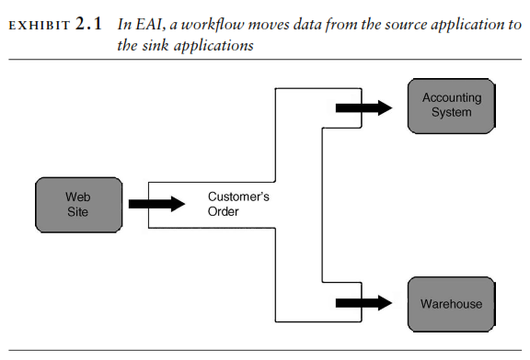

Slide 22
Business Process & SOA
The workﬂow uses data conversion modules to prepare data appropriate for each sink.
The workﬂow helped the EAI architects grapple with complex data synchronization problems.
Individual applications no longer had to know anything about other applications’ data format or programming logic.
The workﬂow now controlled the entire ﬂow path of the data from a central location.
SOA took workﬂow to its next level—a business process.

Slide 23
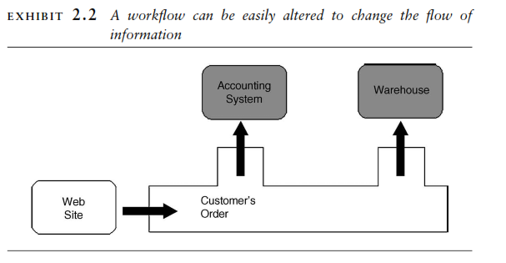
Notes:
We know that customer’s order data is getting copied to the accounting system and the warehouse. But, what are the sinks doing with the data? Are we processing a new order? Or, is this an update to an order that has been already placed? Is the accounting system checking for credit? Or, is it preparing an invoice? We cannot tell.

Slide 24
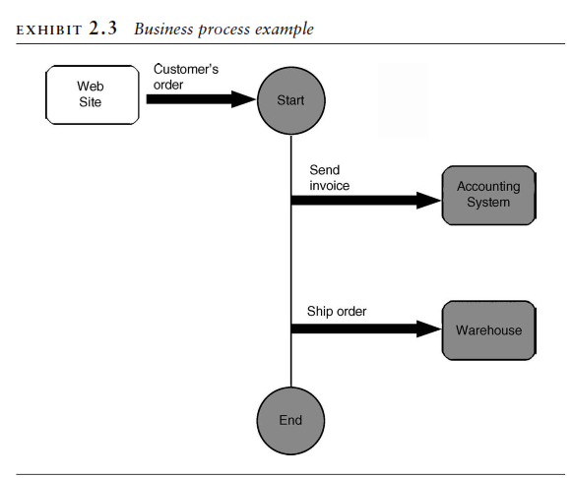
Trigger: Placement of an order on the web
data source
The workﬂow now has become a sequence of activities—in other words, a business process.

Slide 25
Business Proses & SOA
SOA replaced the IT centric notions such as data source and sink with management centric objects like tasks, roles, and responsibilities.
SOA also does not mandate that these tasks be performed entirely by software. They can be performed by people, software, and by external organizations.
SOA really confronts IT to think beyond software and understand how the business operates where not everything can be automated through software.
When SOA proposed using business process for application integration, a bridge was formed between the two. Both can now come to the table, have the same goal, and speak the same language.

Slide 26
Becoming Service Oriented
All businesses are inherently service oriented. Employees offer services by performing certain tasks.
Machines manufacture goods.
Software applications store and offer information.
The organization as a whole provides certain services to its customers and partners.
When IT recognizes this pattern and adopts service as the foundation of everything a company does, it becomes service oriented.
SOA, then, encourages a business to be process oriented and IT to be service oriented.

Slide 27
Relationship between business process and service
A business process is a sequence of activities.
Employees, machines, and software systems perform these activities. They are called service providers, or, in short, services.
Each service is capable of performing a few tasks.
A business process acts as a conductor in an orchestra and asks the service providers to perform speciﬁc tasks.
And in this way, services become the building blocks of a business.

Slide 28
Relationship between business process and service
In SOA, a business process literally runs as software.
This is known as business process automation. An automated business process is also known as orchestration.
Essentially, the orchestration software does the coordination of tasks that eventually complete a business goal.
For the ﬁrst time, key business operations are overseen, controlled, and managed by a piece of software.
Airbus 320 was the ﬁrst major airplane to be piloted by software.

Slide 29
Relationship between business process and service
It is tempting to think that automating a process will improve its performance. But that is not true.
A poorly designed process that takes too long and costs too much will continue to be that way after you have automated it. SOA does not magically make a process more efﬁcient.
It does provide ways which, when used, can improve a process. For example, you can eliminate duplicate manual data entry in multiple systems by having the orchestration automatically transfer the data to these systems.

Slide 30
Business Process Modeling
Object oriented analysis and design (OOAD) had tremendous impact on IT. Business problems were captured as use cases. They were then analyzed to deﬁne classes, such as Customer and Order.
The approach allowed IT to grapple with complex problems. A software application developed using this approach is generally easier to understand and maintain.
As successful as OOAD was, its scope was limited to individual software applications. Objects were the building blocks of a single application.
Unfortunately, a business rarely does anything using just one software application, or using just software, for that matter.

Slide 31
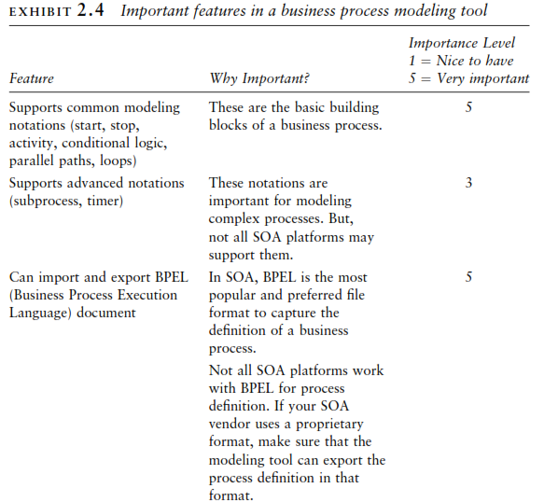

Slide 32
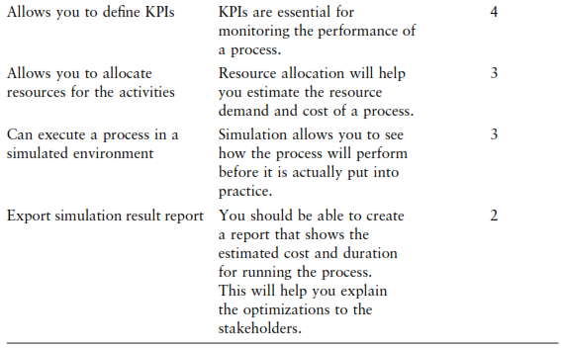

Slide 33
Task 2: Explore Business Process Modeling Tools

