Slide 1
Pertemuan-2
Information Systems
By Kundang K Juman, Ir. MMSI

Slide 2
Information Systems Objectives
Understand limitations of Legacy systems
Describe enterprise systems & Enterprise resources planning (ERP) systems
Explain the value chain concept
Show how an enterprise system supports the organization’s value chain
Illustrate value of systems integration
Enumerate the pros and cons of implementing enterprise systems
Enterprise
Systems

Slide 3
Information Systems Silos
Departments had their own systems. Very little system-to-system communication across departments
What is wrong with systems arranged in this manner?

Slide 4
ERP Brings Integration

Slide 5
ERP = Software packages

Slide 6
Enterprise systems - ES
How the Enterprise systems facilitate the purchasing function:
Provide electronic order form (P-Rqn), budget info, templates, legal notices, etc;
Apply business rules -determine if purchase does not exceed budget;
Routing the order for approval;
Assist buyer with selection of appropriate vendor;
Connect to ES of business partners;
Providing information for decision making.

Slide 7
Enterprise Resource Planning (ERP) systems
ERP systems are software packages that can be used for the core systems necessary to support enterprise systems

Slide 8
Third-Party Modules
Customer Relationship Management (CRM)—builds and maintains customer related data
Customer Self-Service (CSS)—allows customers to complete tasks without assistance
Sales Force Automation (SFA)—automates sales tasks such as order processing and tracking

Slide 9
Third-Party Modules, Cont’d.
Supply Chain Management (SCM)—plans and executes demand planning, inventory acquisition, manufacturing, distributing and selling
Product Lifecycle Management (PLM)—manages product data from design through disposal of product

Slide 10
Enterprise Systems & Value Chain
Enterprise systems facilitate value chain management
The value chain is the system of activities that transform inputs into outputs valued by the customer
The goal of an organization is to add the greatest value with the lowest costs thereby increasing competitive advantage

Slide 11
Value Chain and System

Slide 12
How is value created?
By working at low cost
Leveraging resources e.g. IT
Enhancing differentiation e.g. through quality, workmanship, etc
Responding promptly to customer requirements

Slide 13
The Value of Systems Integration
How an ES can assist a firm in optimizing its value system:
Coordination of value activities (through sharing data across business processes).
Enterprise system ensures available to promise (ATP) services
Permit optimal planning and decision making (e.g., by provide world-wide visibility of inventory balances and customer and vendor data, orders from customers can be sourced in a way that balances purchasing costs with shipping costs).

Slide 14
Inefficient Customer Service
1. Check if the customer exists in the system and has good credit.

Slide 15
Inefficient Customer Service & Solution
If Sally kept the customer on the phone throughout this process, she would be providing a poor service
Solution to inefficient service:
Enterprise system establishes available to promise (ATP) by checking warehouses and scheduled manufacturing
Price and creditworthiness automatically determined from database

Slide 16
Processing Orders Requires Multiple Tables
Data, Field, record, file, table, database
Identify the key business event data (who, what, where, when) you would want to capture (Note, “why” not included).

Slide 17
Stored Data Used for Decisions

Slide 18
Approaches to building & designing ES
Enterprise application integration
Connect the information systems of multiple organisations together through data standards or platforms such as EDI, XML, UNIX
Event-driven architecture
Business events are “pushed” immediately and simultaneously to all interested parties
Enterprise operates in real-time
Event notification is sent through middleware (publish and send).

Slide 19
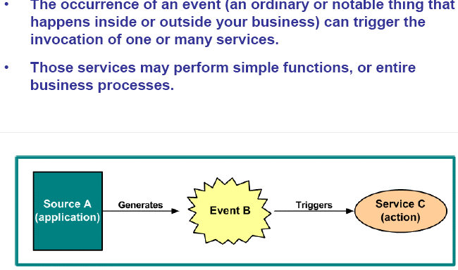
Event-driven architecture
Source: Michelson B, Elemental Links

Slide 20
Event-driven architecture
Source: Michelson B, Elemental Links

Slide 21
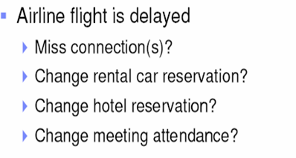

Slide 22
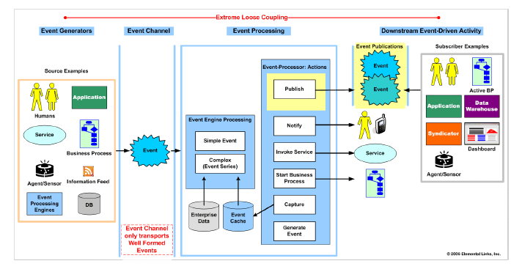
Event-driven architecture
Source: Michelson B, Elemental Links

Slide 23
Pros & Cons of Enterprise systems (also see Gelinas et al., p 65)

Slide 24
IDENTIFY AUDIT & CONTROL RISKS IN ERP SYSTEMS
ERP = Software packages

Slide 25
Major ERP Modules
Sales and Distribution
Based on SAP (best selling ERP)
Materials Management
Financial Accounting
Controlling and Profitability Analysis
Human Resources

Slide 26
Major ERP Modules
Sales and Distribution
Records customer orders
Shipping
Billing
Connections to
Materials management module
Financial accounting module
Controlling module
Based on SAP (best selling ERP)

Slide 27
Major ERP Modules, Cont’d.
Materials Management
Acquisition and management of goods from vendors
Purchase order preparation
Receiving
Recording invoice
Interacts with
Sales and distribution module
Financial accounting module
Controlling module

Slide 28
Major ERP Modules, Cont’d.
Financial Accounting
Plays a central role in an ERP system and incorporates data from other modules into general ledger accounts and financial statements
Business events from other modules, such as SD and MM, are incorporated by the FI module into the general ledger accounts and included in the external account statements, the balance sheet, profit and loss statement, and statement of cash flows.
The FI module also includes accounts receivable and accounts payable functions to record and manage that data directly and to complete events begun in the SD and MM modules.

Slide 29
Major ERP Modules, Cont’d.
Controlling and Profitability Analysis
Handles internal accounting including:
Cost center accounting
Profitability analysis for sales
Activity-based accounting
Budgeting
Human Resources
Recruiting, management and administration of personnel
Payroll processing
Training, reporting, benefits

Slide 30
Enterprise systems & goals of information system
How ES achieve the goals of information system:
Ensure that relevant & understandable data is collected
By providing one central database reliability, validity and accuracy are assured/enhanced
Enforcing standards & business rules ensures consistency and completeness
Sharing of services ensures efficiency & consistency

