Slide 1
Pertemuan-1
Architecture ENTERPRISE Systems
By Kundang K Juman, Ir. MMSI

Slide 2
Outline
1. What is an enterprise information system (EIS) architecture?
2. What are architectural representations?
3. What are types of component descriptions?
4. What is a framework for information systems architecture?
5. What are the elements of Zachman’s framework for ISA?

Slide 3
1. What is an Enterprise Information System Architecture (EISA)? (http://www.zachman.com/about-the-zachman-framework)
GIS as an enterprise information system (IS)
Participants in enterprise GIS often do not share the same terminology and perspective
Need a way foster shared understanding of terminology given different perspectives
EISA framework encourages shared understanding through architecture perspective
Thus, EISA offers multiple perspectives for understanding IS, hence GIS, as enterprise information systems

Slide 4
Why do we need shared terms for information systems architecture?
What “client owners” intend might differ from what “programmers” intend
They might use the same term “data”, but they refer to different things depending on their perspective
What things look like differs from how things work
The same term, but they refer to different things depending on what you describe, e.g. process
Necessary to define the term based on participants’ view and component description
Participant view: client owner, designer, builder
Component description: data, process, network

Slide 5
Three main participants - analogy of architectural concept -
Client
Owner
2) Architect’s drawings
1) Bubble chart schematic
3) Architect’s plans
4) Contractor’s plans
Designer
Builder

Slide 6
Analogy of architectural concept
Architect’s bubble chart schematic – all view
Mutual understanding among all involved, and particularly between client and architect (designer)
Architect’s drawings – client’s view
A transcription of the client’s perceptual requirements
Tasks to be accomplished given resources (time, budget)
Architect’s plans – designer’s view
A translation of the client’s perceptions/requirements into a product
Tasks translated into a physical product
Constractor’s plans – builder’s view
The plans representing builder’s perspective
How tasks are accomplished given technology constraints

Slide 7
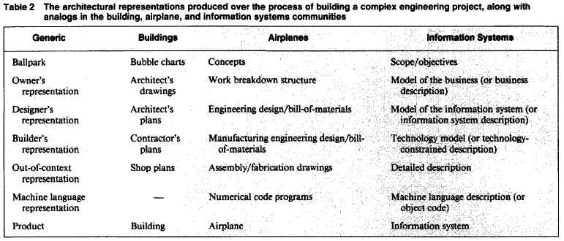
2. What are the architectural representations of an IS?
Each of the architectural representations (artifacts) differs from the other in essence, not merely in level of detail

Slide 8
3. What are types of component descriptions?
The same product can be described differently in terms of:
Data model: What things are made of, entity-relationship-entity (Description I)
Process model: How things work, input-process-output (Description II)
Network model: Where the flow occurs, Node-line-node (Description III)

Slide 9
4. What is a framework for ISA?
Two axes of the framework for information systems architecture are important
1) Architectural Representations
It represents different perspectives of the different participants
Client, designer, builder’s view (person centric)
Business, information system, technology model
2) Types of Component Descriptions
The same product can be described, for different purposes, in different ways
Structure, transform, flow
Data, process, network (connectivity) centric views

Slide 10
Framework of IS architecture
Component Representation | A. Data | B. Process | C. Network
1. Client
2. Designer
3. Builder
Each element on an axis of the matrix (A, B, C an 1, 2, 3) is explicitly different from all other elements on that one axis
Different in content, meaning, motivation, and use.
For example, in the data column, entity is seen as business entity from client’s point of view, data entity from designer’s point of view, and data row from builder’s point of view (data-centric views)

Slide 11
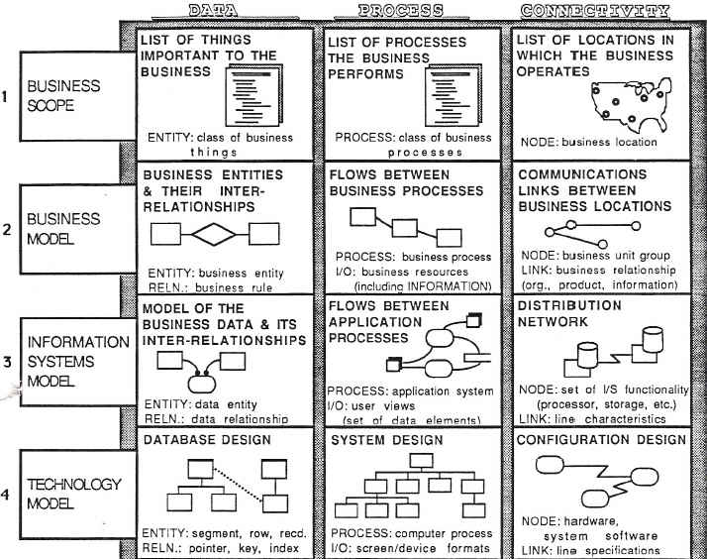
5. What are the elements of Zachman’s Framework for Information Systems Architecture?
All view
Client’s view
Designer’s view
Builder’s view
Zachman 1987

Slide 12
A. Architectural representations for describing the data (see handout)
Business scope (all perspective)
A list of all the things that are important to the business (e.g. product, part, supplies, employee, promotion, customer order, shipment)
It supports strategy/resource investment decisions
Business model (client perspective)
Entity means “business” entity (e.g. DEPT, PROJ)
Relationship means the relationship between business entity (m:n relationship is allowed)
Information systems model (designer perspective)
Concepts independent of specific technology
Entity means “data” entity (e.g. DEPT, DEPTPRJ, PROJ)
Relationship means the relationship between data entity (m:n relationship is not allowed)
Technology model (builder perspective)
Technology constraints are being applied
Entity means technology-constrained equivalent (e.g. row, segment)
Relationship means technology-constrained (e.g. key, pointer)

Slide 13
B. Architectural representations for describing the process
Business scope (all perspective)
A list of business process; not definitive about I/O
Business model (client’s perspective)
Process means “business” process
I/O involves business resources
e.g. Functional flow diagram
Information systems model (designer’s perspective)
Process means “application” process
I/O involves user views (i.e. some aggregation of data elements that flow into and out of the application processes)
e.g. Data flow diagram
Technology model (builder’s perspective)
Process means computer function
I/O involves device formats
e.g. Structure chart

Slide 14
C. Architectural representations for describing the network
Business scope (all perspective)
A list of locations in which the business operates
Support strategy/resource investment decision for selecting the subset of locations in which to actually locate technology
Business model (client perspective)
Node involves business units at some geographic locations
Link involves logistics connections of product or information
Information system model (designer perspective)
Node involves information system function
Link involves special characteristics of communication line
Technology model (builder perspective)
Node involves physical hardware and software
Link involves complete specification of communications line

Slide 15
C. Architectural representations for other components
Consider Other Components of A – F
Consider Other Representations of 1 – 6

Slide 16
Conclusions
Information system architecture can be understood in two aspects – type of component description and architectural representation
Architecture described in terms of components – data, process, and network, etc.
Architecture viewed from different perspectives – client, designer, and builder, etc.
Role of designer is to bridge the view of the client owner with the view of the builder to implement the GIS for any of the six scopes described in previous lecture

