Slide 1
INDRA G ROCHYAT, S.Sn., MA., M.Ds.
Metodologi Penelitian
Pertemuan 1
Desain Produk, Desain Komunikasi Visual, dan Desain Interior

Slide 2
VISI DAN MISI UNIVERSITAS ESA UNGGUL

Slide 3
Materi Sebelum UTS
01. Pendahuluan dan Pengenalan
02. Approaching Design
03. The necessitty of Design Research
04. Positioning Research
05. Exploring Qualitative Approach
06. Exploring Quantitative Approach
07. Discovering Process

Slide 4
Materi Setelah UTS
08. Managing Information for research
09. Citing and Review Of Literature
10. Outlining, Abstracting and concluding
11. Developing Proposal (I)
12. Developing Proposal (II + III)
13. Proposal Discussion/ Research purpose
14. Proposal Discussion/ Research purpose

Slide 6
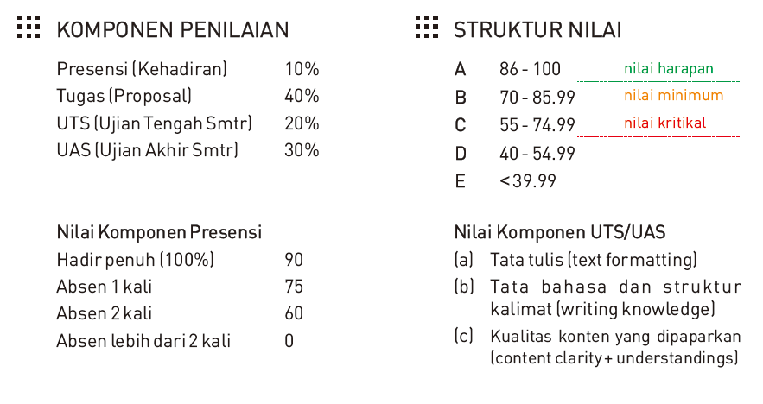

Slide 12
Pustaka
Sjarif, Ahmad., MSD, PhD, DIKTAT PERKULIAHAN METODOLOGI DESAIN, Pasca Sarjana, Universitas Trisakti, 2015

