Slide 1
INDRA G ROCHYAT, S.Sn., MA., M.Ds.
Metodologi Penelitian
Pertemuan 5
Exploring Quantitative Approach

Slide 4
Quantitative
A formal, objective, systematic process in which numerical data are utilized to obtain information (Burns-Grove in Cormack, 1991, p 140)
Proses sistematik, obyektif, dan formal dengan menggunakan data numerikal untuk mendapatkan informasi
Explore topics in more objective and breadth
Fixed in terms of object and timing of analysis

Slide 5
Quantitative Approach is used when research is…
To identify variations (of objects, subjects, and/or environmental elements):
differences and/or similarities
To identify characteristics
To evaluate and/or predict causal relationship
To identify objective and significance reasoning
To explore knowledge from various information
Creswell, J. W. 1994. Research Design: Qualitative and Quantitative Approaches. CA: Sage Publications.

Slide 6
Quantitative
Method of Collecting Data
Creswell, J. W. 1994. Research Design: Qualitative and Quantitative Approaches. CA: Sage Publications.
Salkind, Neil J. 1997. Exploring Research: Third Edition. NJ: Prentice Hall Inc
Robson, Colin. 1993. Real World Research. Oxford, UK: Blackwell Publishers

Slide 7
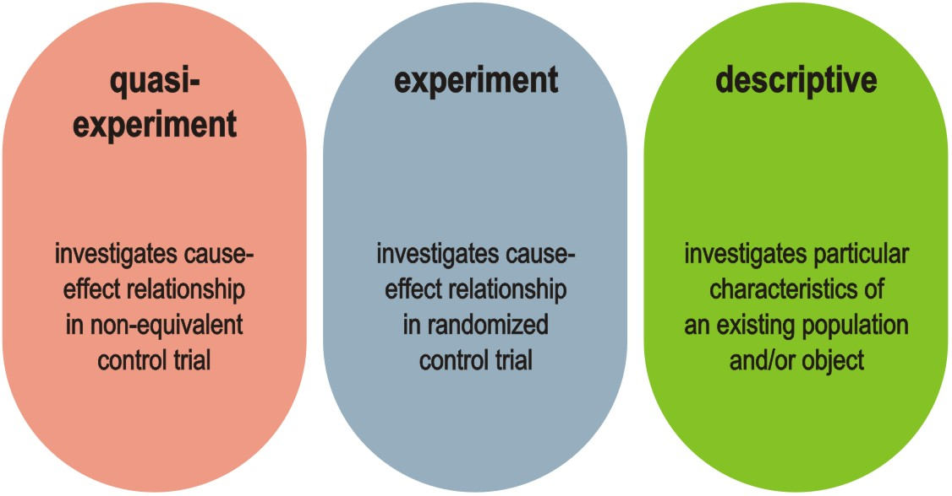
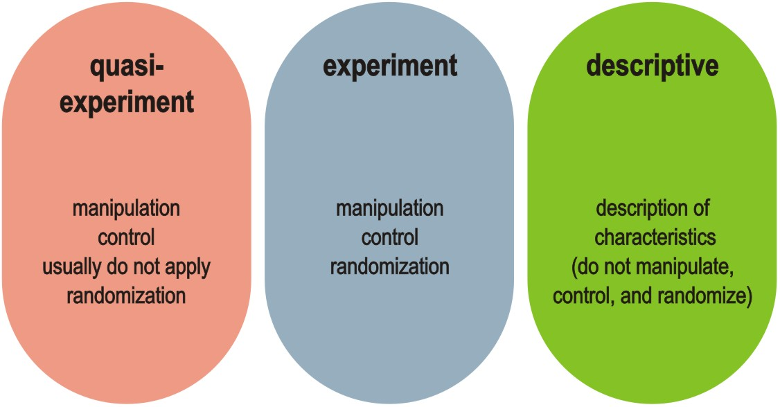

Slide 8
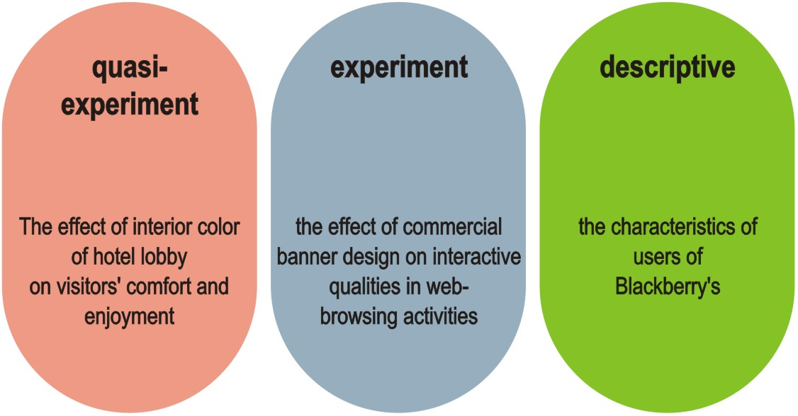
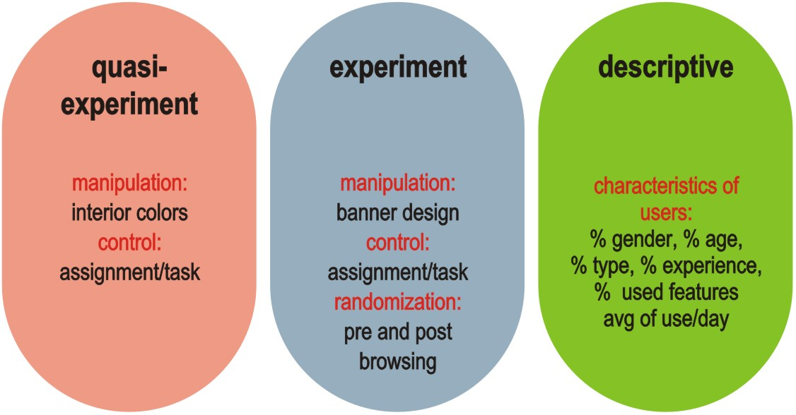

Slide 9
Concept associated with Quantitative Mode of Research
Creswell, J. W. 1994. Research Design: Qualitative and Quantitative Approaches. CA: Sage Publications.
Salkind, Neil J. 1997. Exploring Research: Third Edition. NJ: Prentice Hall Inc
Robson, Colin. 1993. Real World Research. Oxford, UK: Blackwell Publishers

Slide 10
manipulation
artificial condition and/or circumstances for testing (researchers “do something” to the object being studied)
control
planned and organized action to suit the “reality” of a situation being studied (researchers manage variables for the study)
randomization
controlled action to assign equal probability of any condition (researchers manage condition for the study, e.g. assigned group, questions)
sampling
method of selecting certain number of units (subjects) from total population (MacLeod-Hockey, 1981)
measurement level (scale), variable, hypothesis

Slide 11
Understanding
Sampling
Creswell, J. W. 1994. Research Design: Qualitative and Quantitative Approaches. CA: Sage Publications.
Salkind, Neil J. 1997. Exploring Research: Third Edition. NJ: Prentice Hall Inc
Robson, Colin. 1993. Real World Research. Oxford, UK: Blackwell Publishers

Slide 12
Probability sampling
simple random
sampling through equal and independent chance
define population
list members of population
assign number to each member
use criterion to select sample
(table of random numbers)
systematic
sampling through systematic chance
divide size of population into systematic order
choose starting point to select sample
follow the process gradually

Slide 13
stratified
sampling through proportion representational chance
list population according to their representational proportion
assigned number for each member
select sample according to their representation
cluster
sampling through group and/or membership chance
identify population of selected group
select sample according to equal chance on selected group

Slide 14
Non-probability sampling
convenience
sampling through captive and convenient chance
e.g. students, colleagues
quota
sampling through certain quota number.
e.g. fulfilling certain
numbers and/or
representation
purposive
sampling through typicality of purposes and/or interests
e.g. web browser, administrator

Slide 15
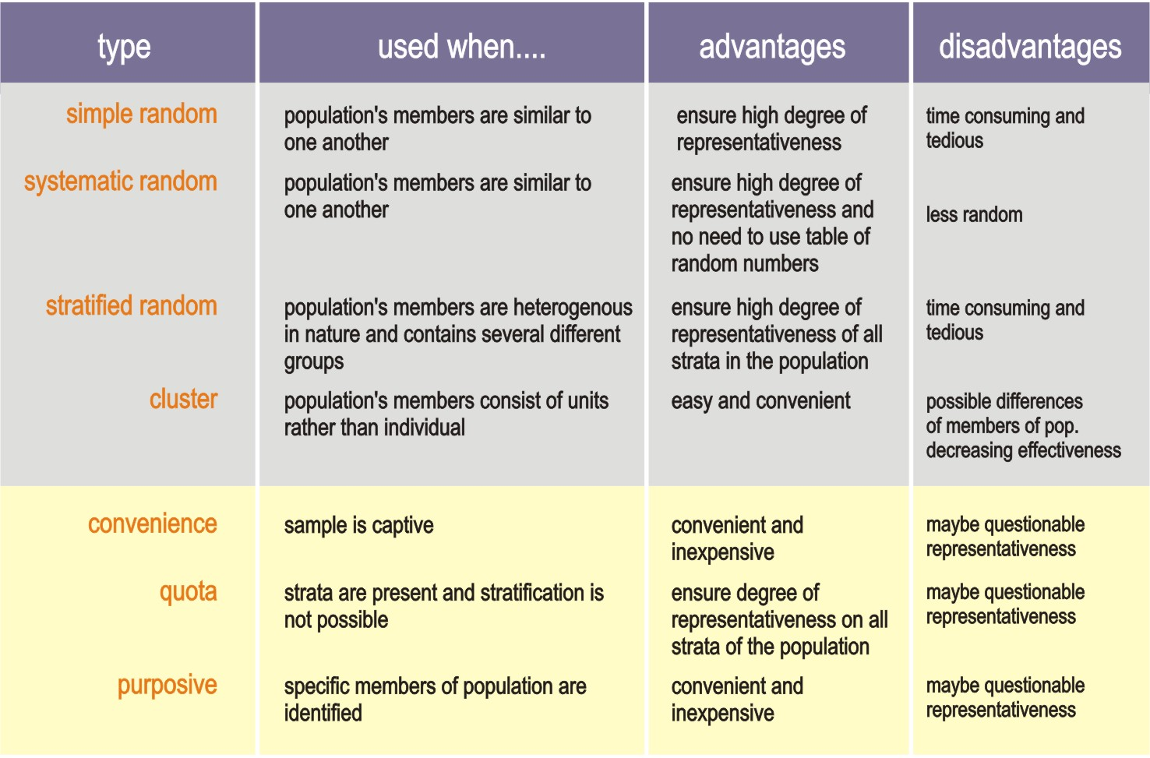

Slide 16
Type of
Measurement
Level / Scale

Slide 17
measurement
level
nominal
differentiated by possessing that can not measurable / mutually exclusive
:: agama, warna rambut, ras/etnik
ordinal
differentiated by ordered of continuum or rankings
:: pendidikan, kelas, tipe/luasan rumah
interval
differentiated by equal measurement
:: angka temperatur, kondisi perseptual
ratio
differentiated by precise measurement, starting from zero
:: jumlah pendapatan

Slide 18
Type of
Variables

Slide 19
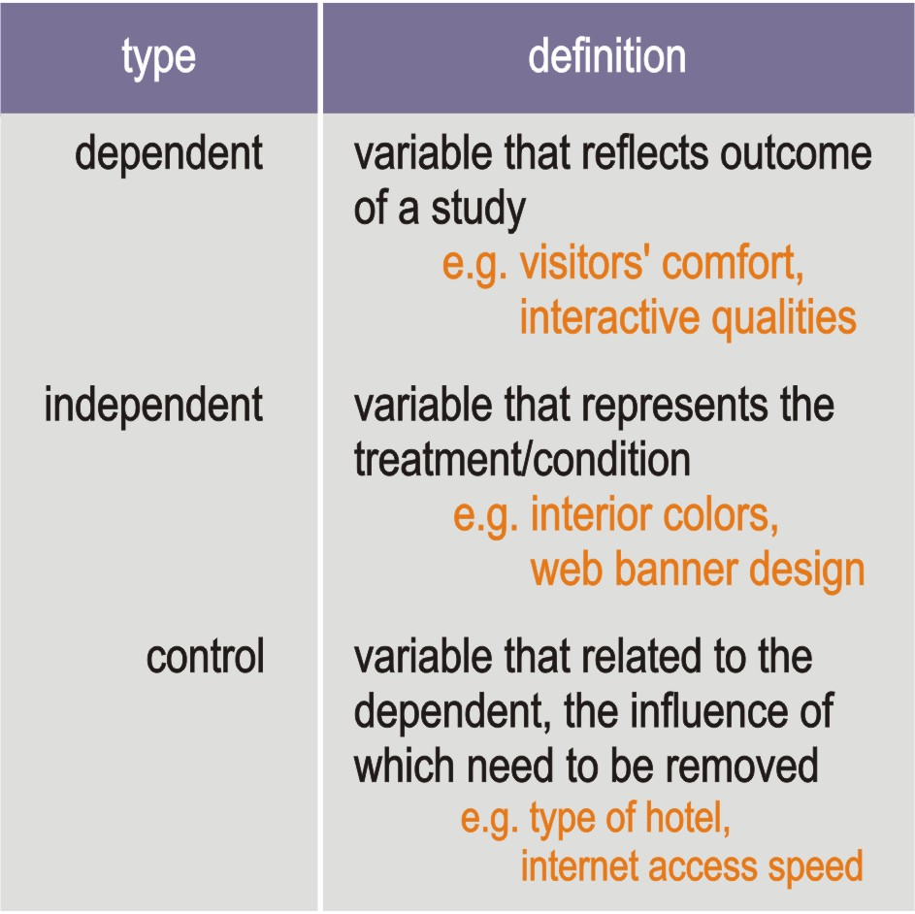
variable

Slide 20
Type of
Hypothesis

Slide 21
research
hypothesis
a definite statement of the relationship between variables to be tested

Slide 23
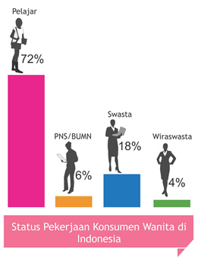
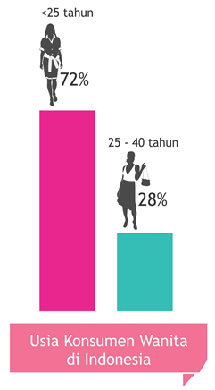
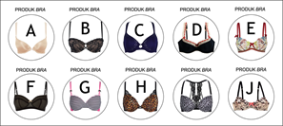
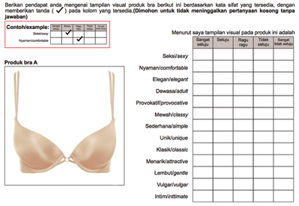
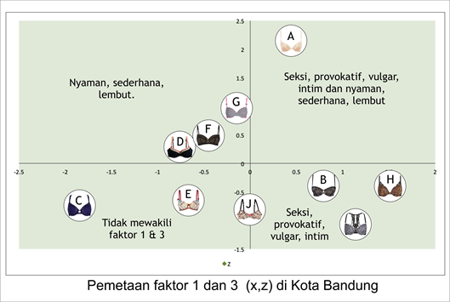
Tampilan Visual Produk Intimate Apparel Bra dan Pengaruhnya Terhadap Pesepsi Konsumen Wanita

Slide 24
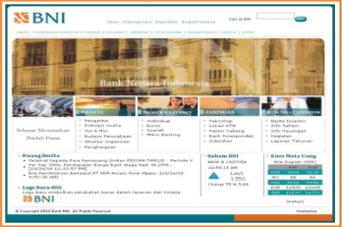
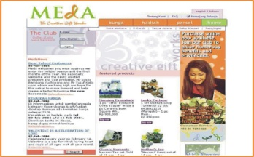
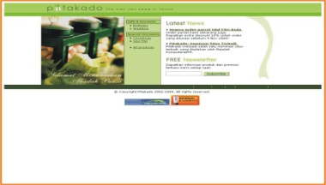
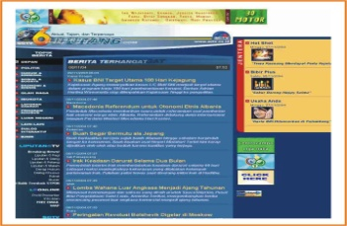
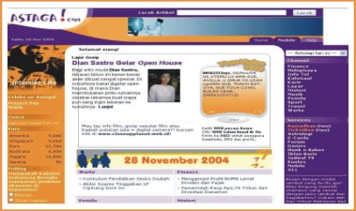
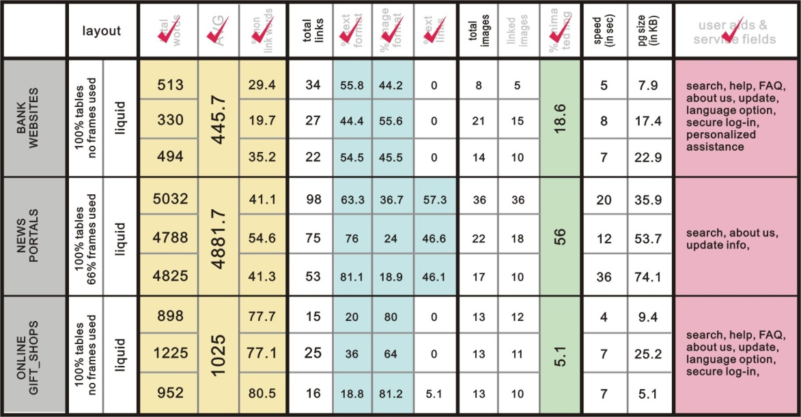
Analisis Relasi Tampilan Desain Website Komersial dengan Kualitas Interaksi Pengguna
Asumsi: Desain website memiliki karakteristik sesuai domain komersialnya

Slide 25
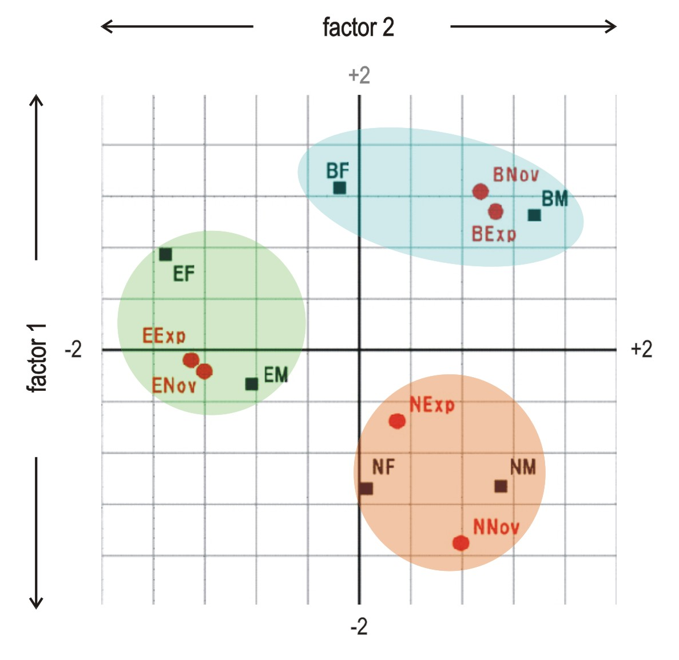
bank
factor 1: high
factor 2: medium - high
Reputasi/tampilan visual / densitas informasi/navigasi menjadi faktor penentu
news
factor 1: low - medium
factor 2: medium - high
Densitas informasi/ navigasi visual menjadi faktor penentu
gift-shop
factor 1: medium
factor 2: low - medium
Reputasi/tampilan visual menjadi faktor penentu

Slide 26
Pustaka
Sjarif, Ahmad., MSD, PhD, DIKTAT PERKULIAHAN METODOLOGI DESAIN, Pasca Sarjana, Universitas Trisakti, 2015

