Slide 1
Tinjauan design
Sakundria satya murti wardhana ssn, mdes, HDII

Slide 2
Era design
Presentasi Desain dari sisi Era /Zaman
early modernism 1900 - 30
art deco 1910 - 39
modernism 1920 - 49
contemporary 1945 - 60

Slide 3
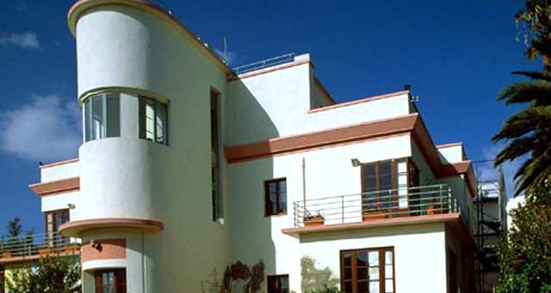
early modernism

Slide 4
art deco

Slide 5
modernizm

Slide 6
contemporary

