Slide 1
Tinjauan design
Sakundria satya murti wardhana ssn, mdes, HDII

Slide 2
Era design
Pengenalan Desain dari sisi Era /Zaman
renaissance 1400 - 1600
baroque 1600 – 1730
rococo 1715 – 70
neo classicism 1760 - 1830

Slide 3
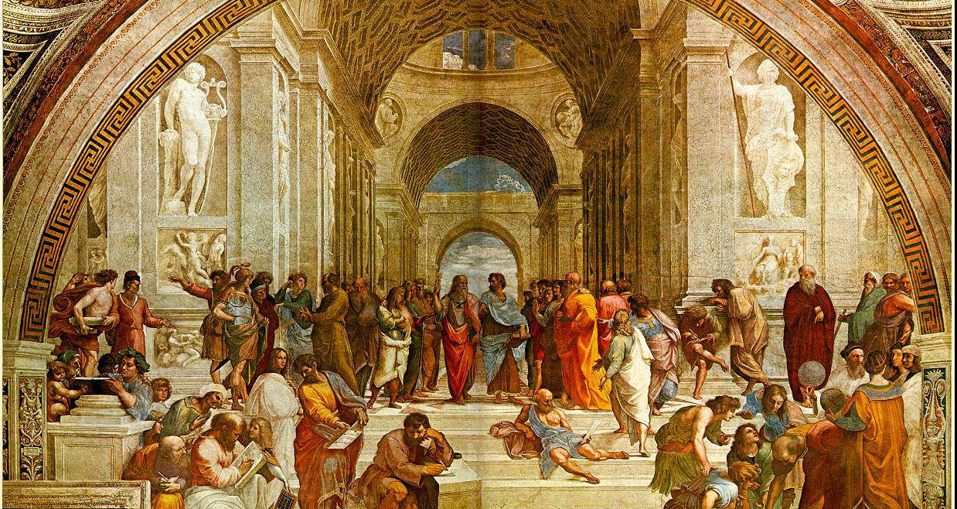
renaissance

Slide 4

baroque

Slide 5
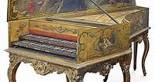
rococo

Slide 6
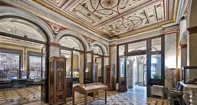
Neo classiscm

