Slide 1
Tinjauan design
Sakundria satya murti wardhana ssn, mdes, HDII

Slide 2
Era design
Presentasi dari era {lanjutan}
historic revival 1820 - 1900
the aesthetic movement 1870 - 90
arts and crafts 1880 - 1920
art neuveau 1890 - 1914

Slide 3
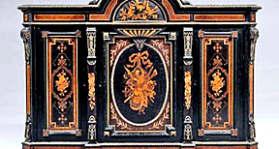
Historic revivals

Slide 4
the aesthetic movement

Slide 5
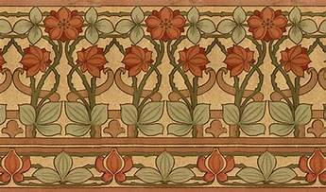
roarts and crafts

Slide 6
art neuveau

