Slide 1
DESIGN INTERIOR Iv
PERENCANAAN INTERIOR public space
DOSEN : SAKUNDRIA SATYA MURTI WARDHANA SSn. MDes, HDII

Slide 2
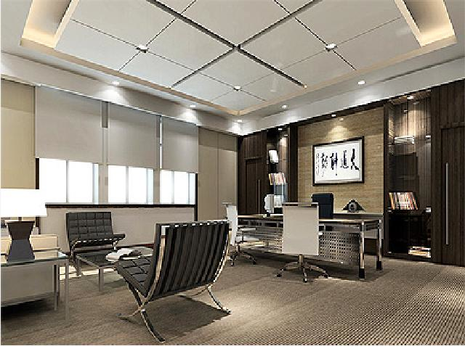
Laporan hasil survey

Slide 3
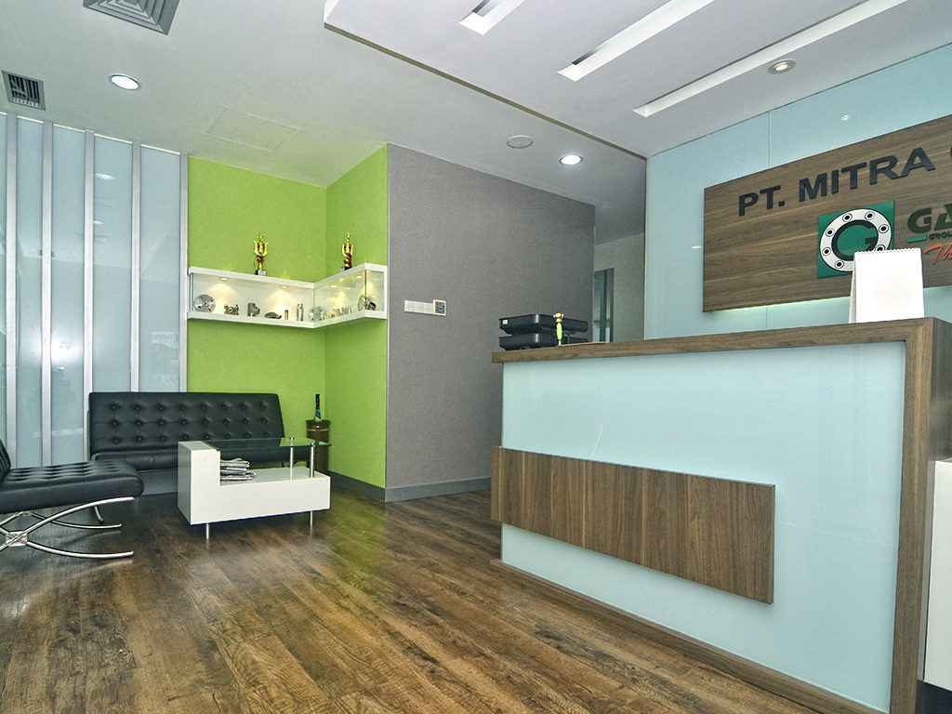

Slide 4
Persiapan presentasi

