Slide 1

SKETCHING
Drawing techniques for Product Design
Materi I
By : JHON VITER M. S.Des M.Des

Slide 2
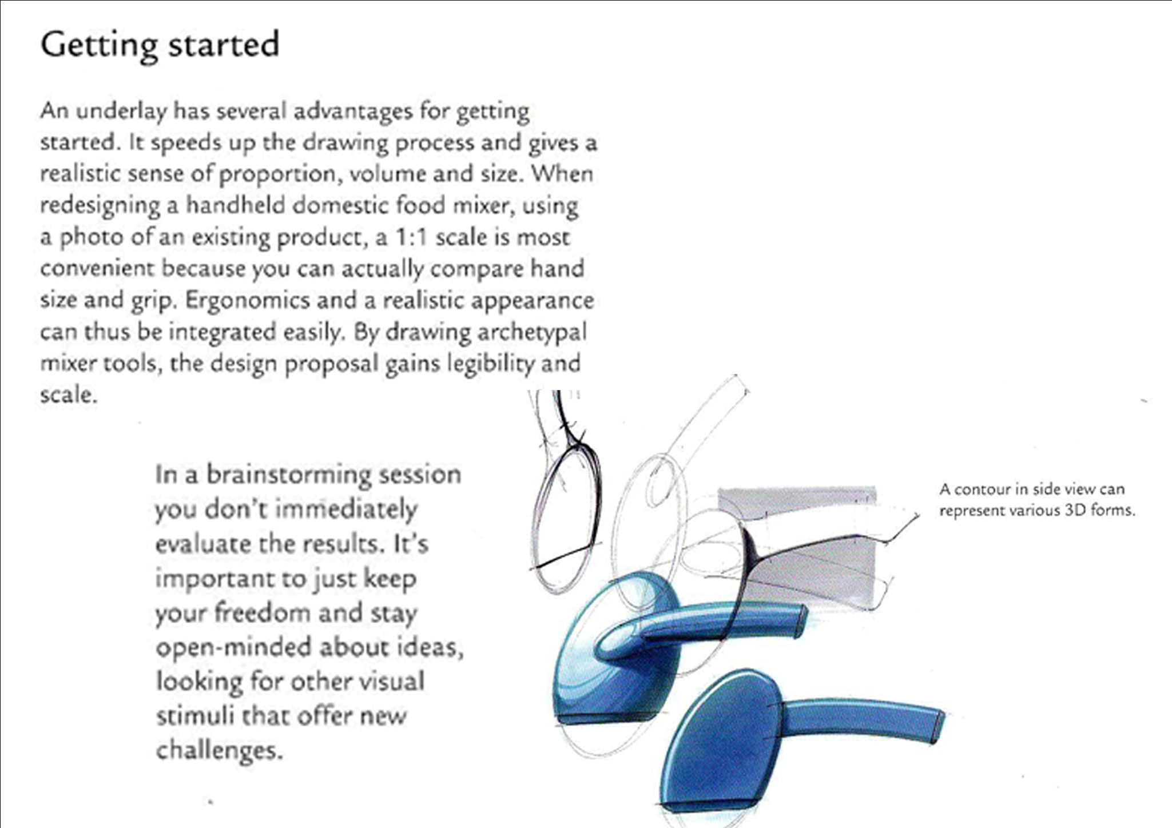

Slide 3
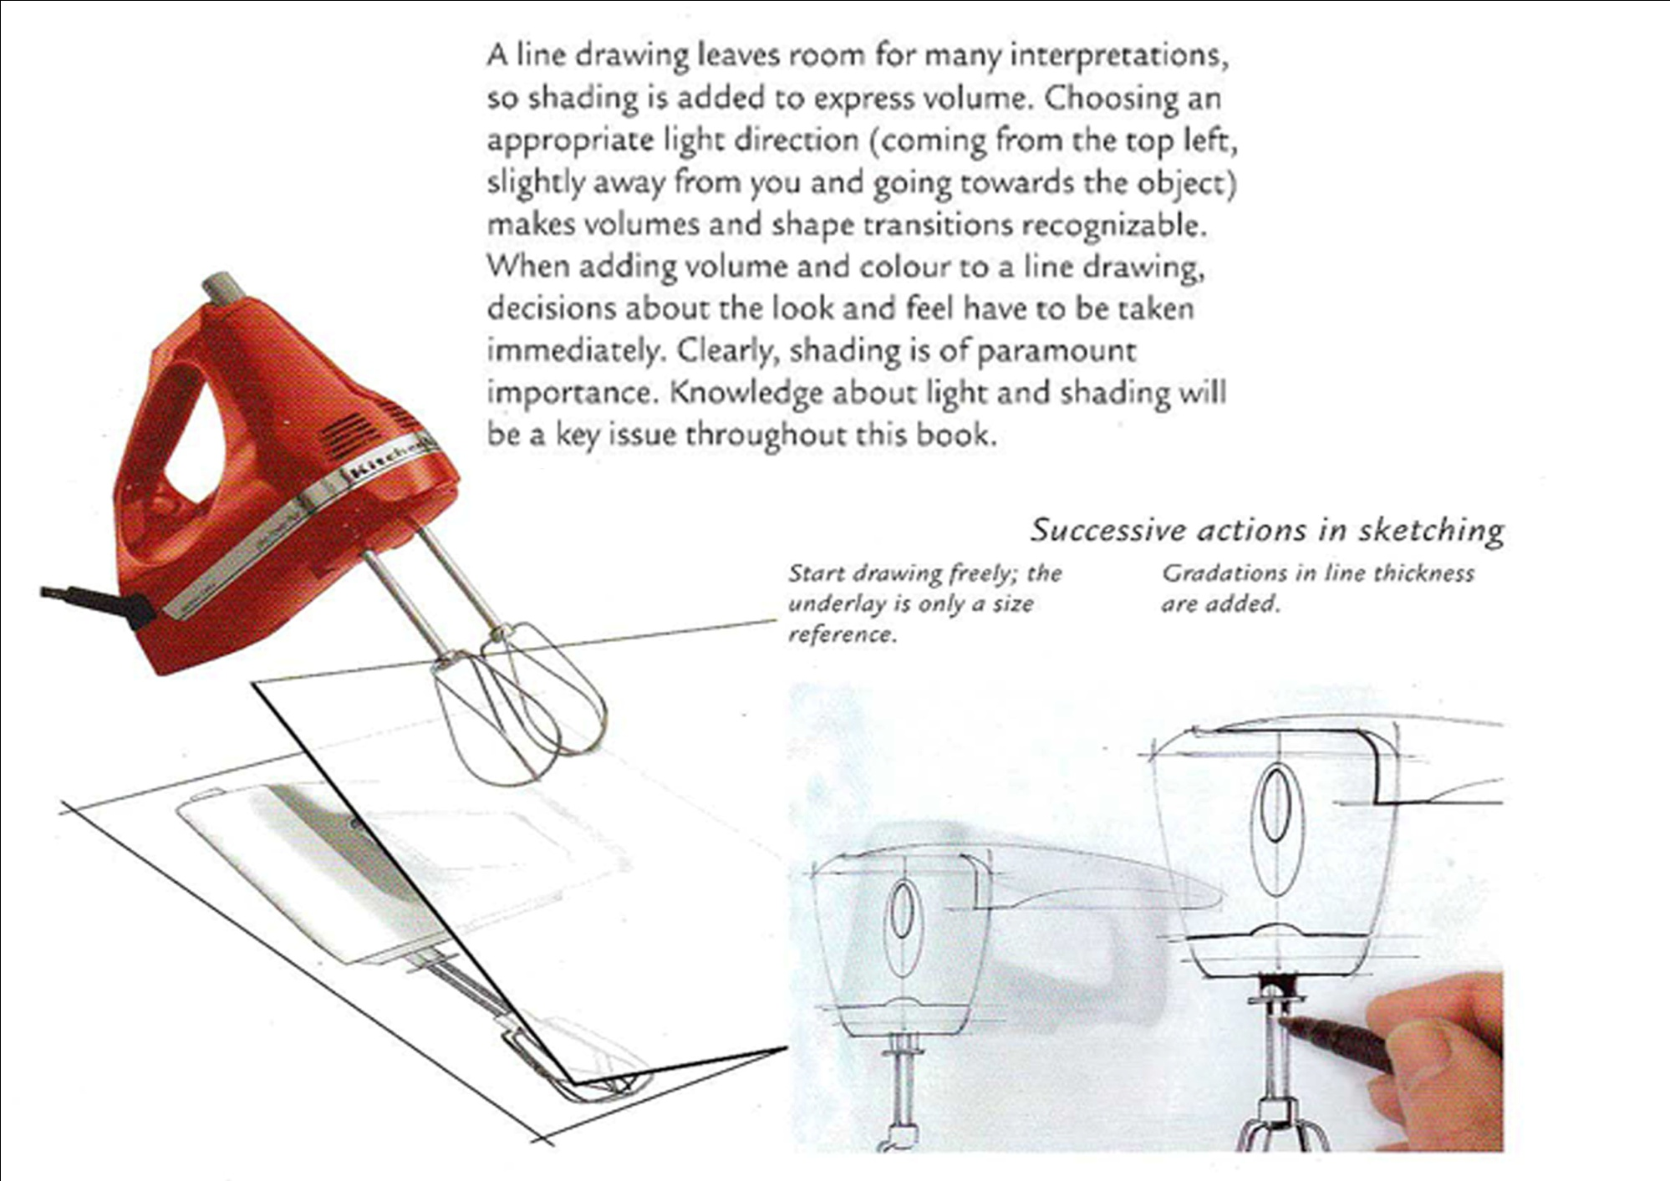

Slide 4
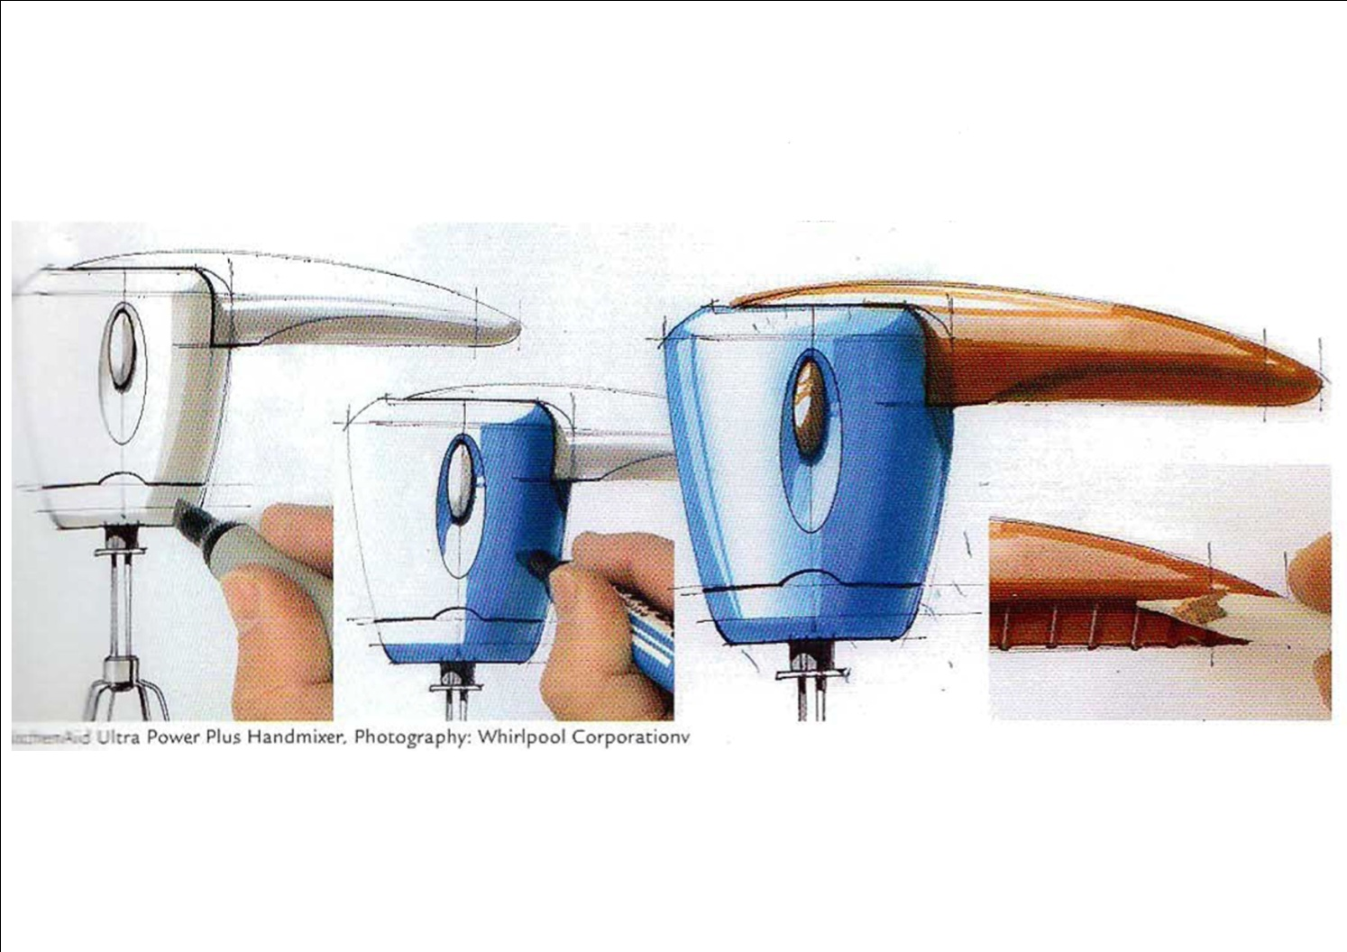

Slide 5
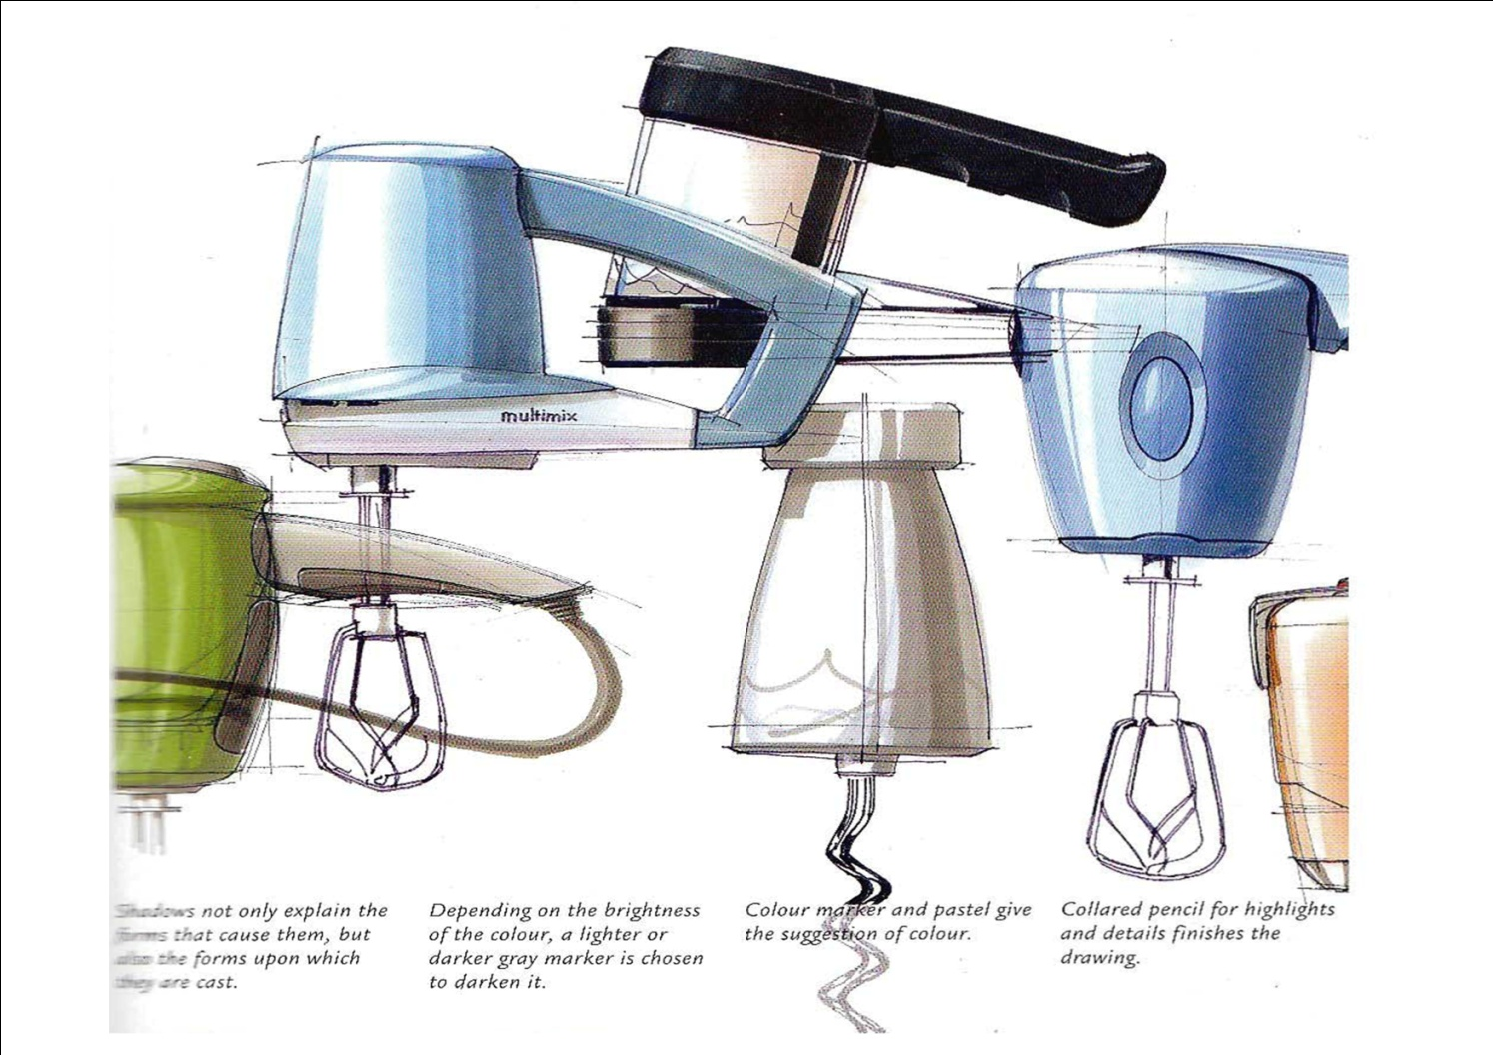

Slide 6
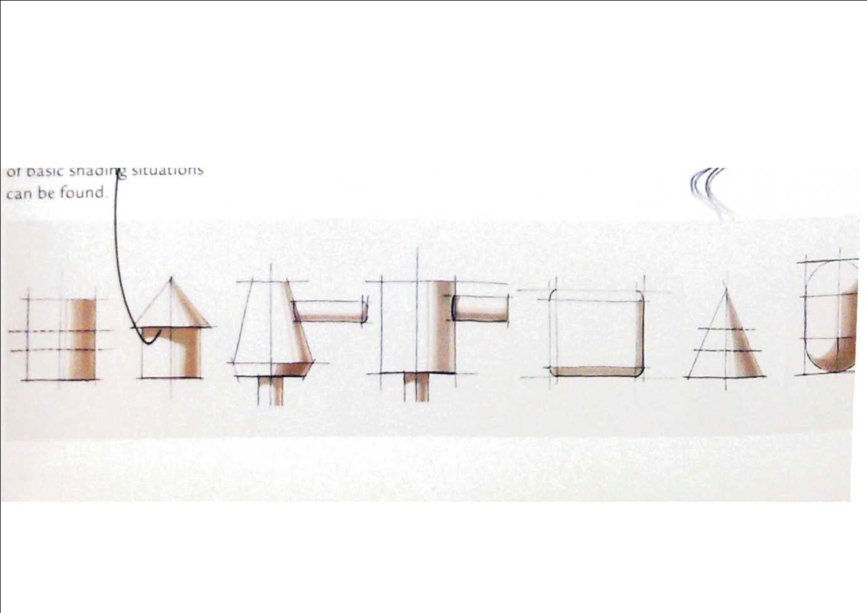

Slide 7
