Slide 1
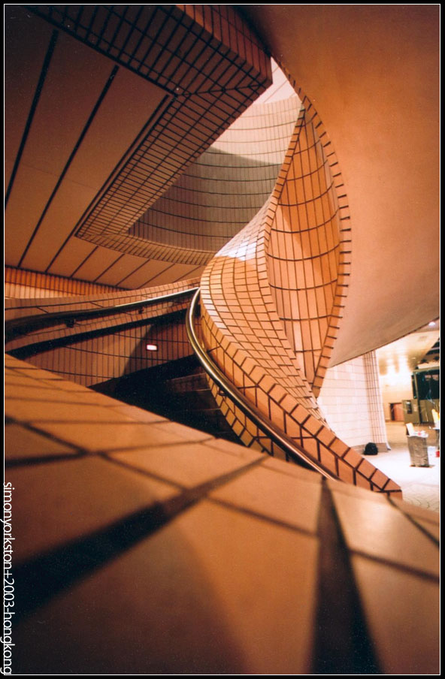
Simplifying Shape
Drawing Techniques for Product Design
Materi II
By : JHON VITER M. S.Des M.Des

