Slide 1
Pertemuan 9 dan 10 PavilionBooth
EXHIBITION
1 SIDE OPEN / U TYPE
2 SIDE OPEN / L TYPE
3.SIDE OPEN / BACKWALL TYPE
4 SIDE OPEN / ISLAND

Slide 2
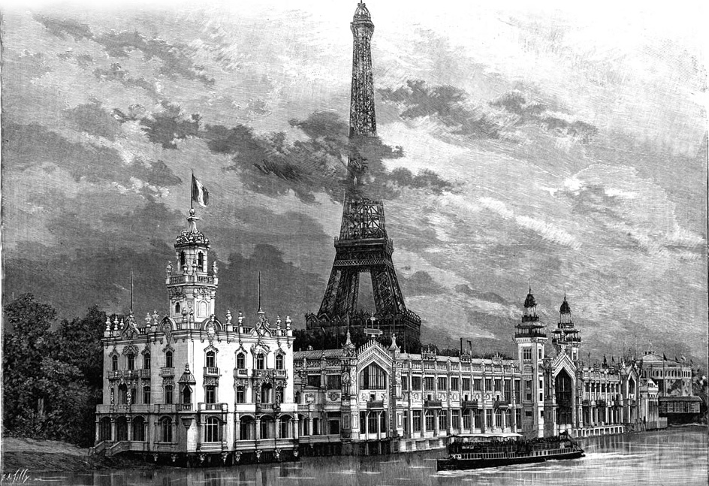
Pertemuan 11 dan 12
asistensi dan konsultasi desain
Milan 1906

Slide 3
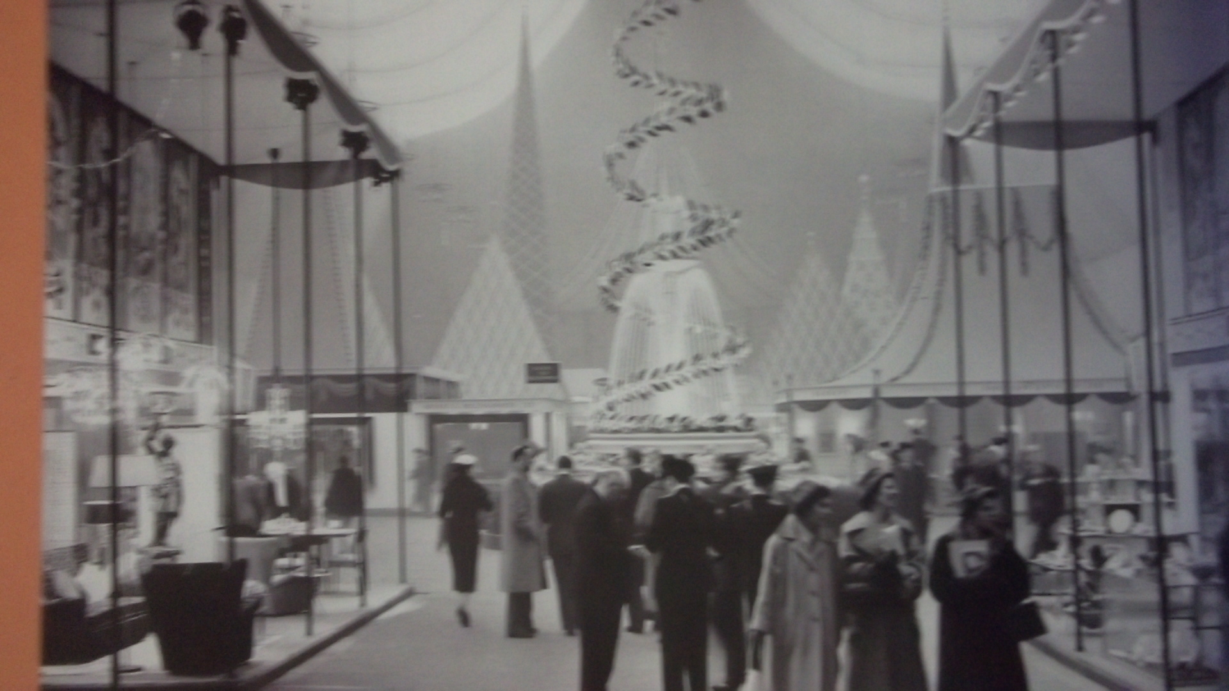
1stExhibition…..
Ideal Home exhibition ,London UK 1957

Slide 4
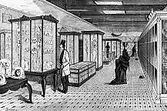
Exhibition display

Slide 5
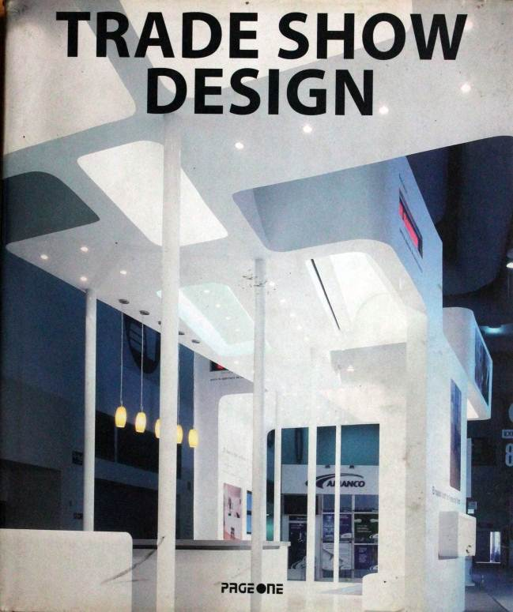
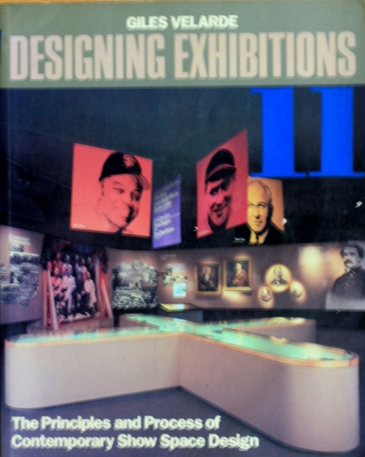
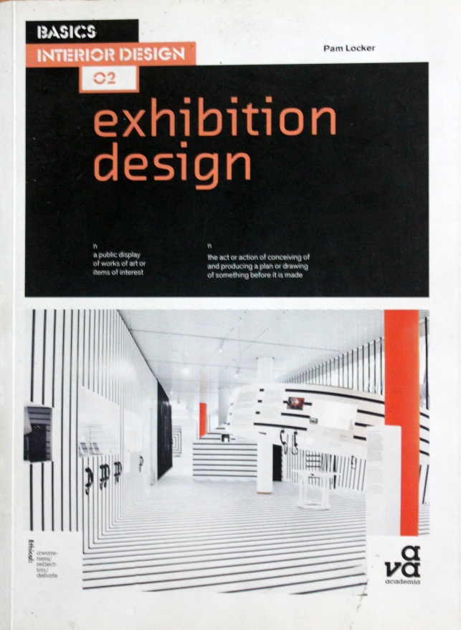
Exhibition Book

Slide 7
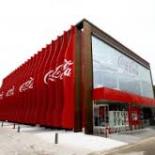

Slide 8
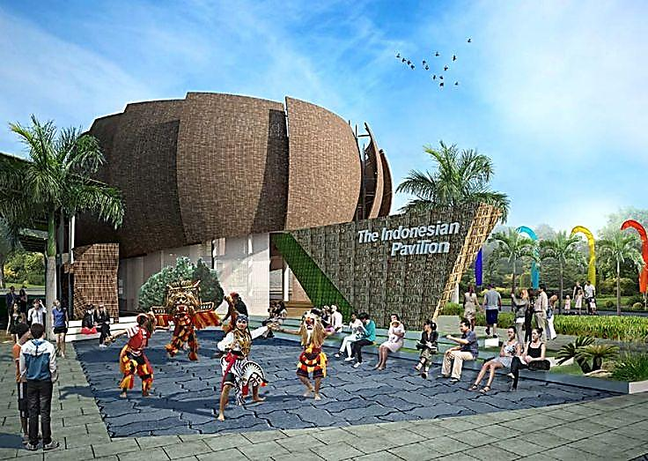
Indonesia Pavilion Milan Expo 2015

Slide 9
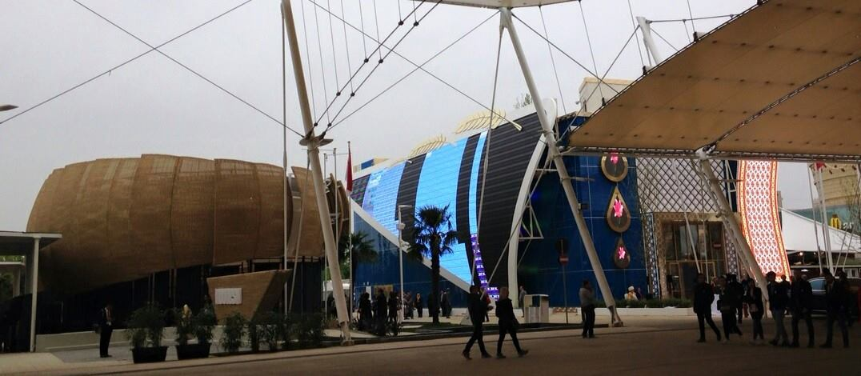
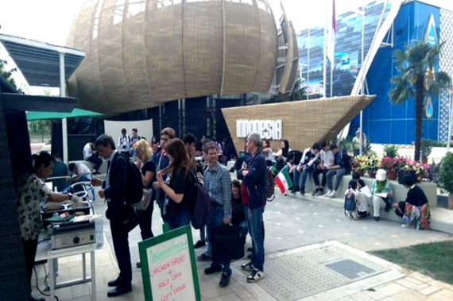
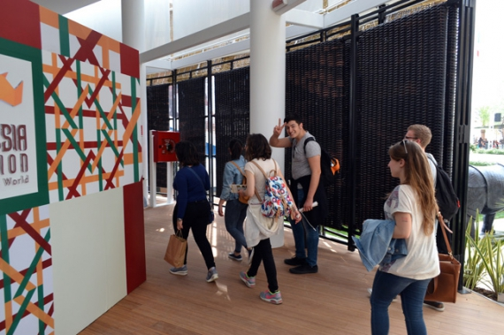

Slide 10
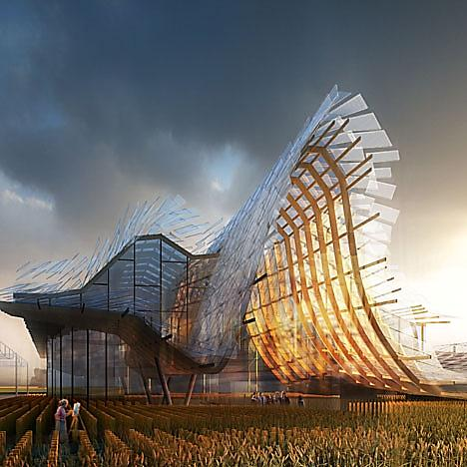

Slide 11
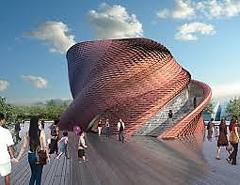

Slide 12
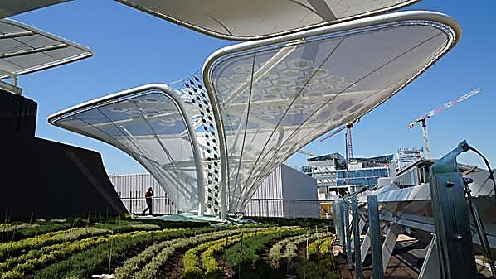

Slide 13
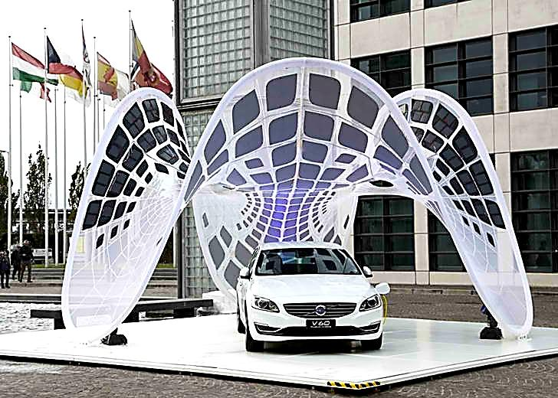
Photovoltaic Glass tech

Slide 14
