Slide 1
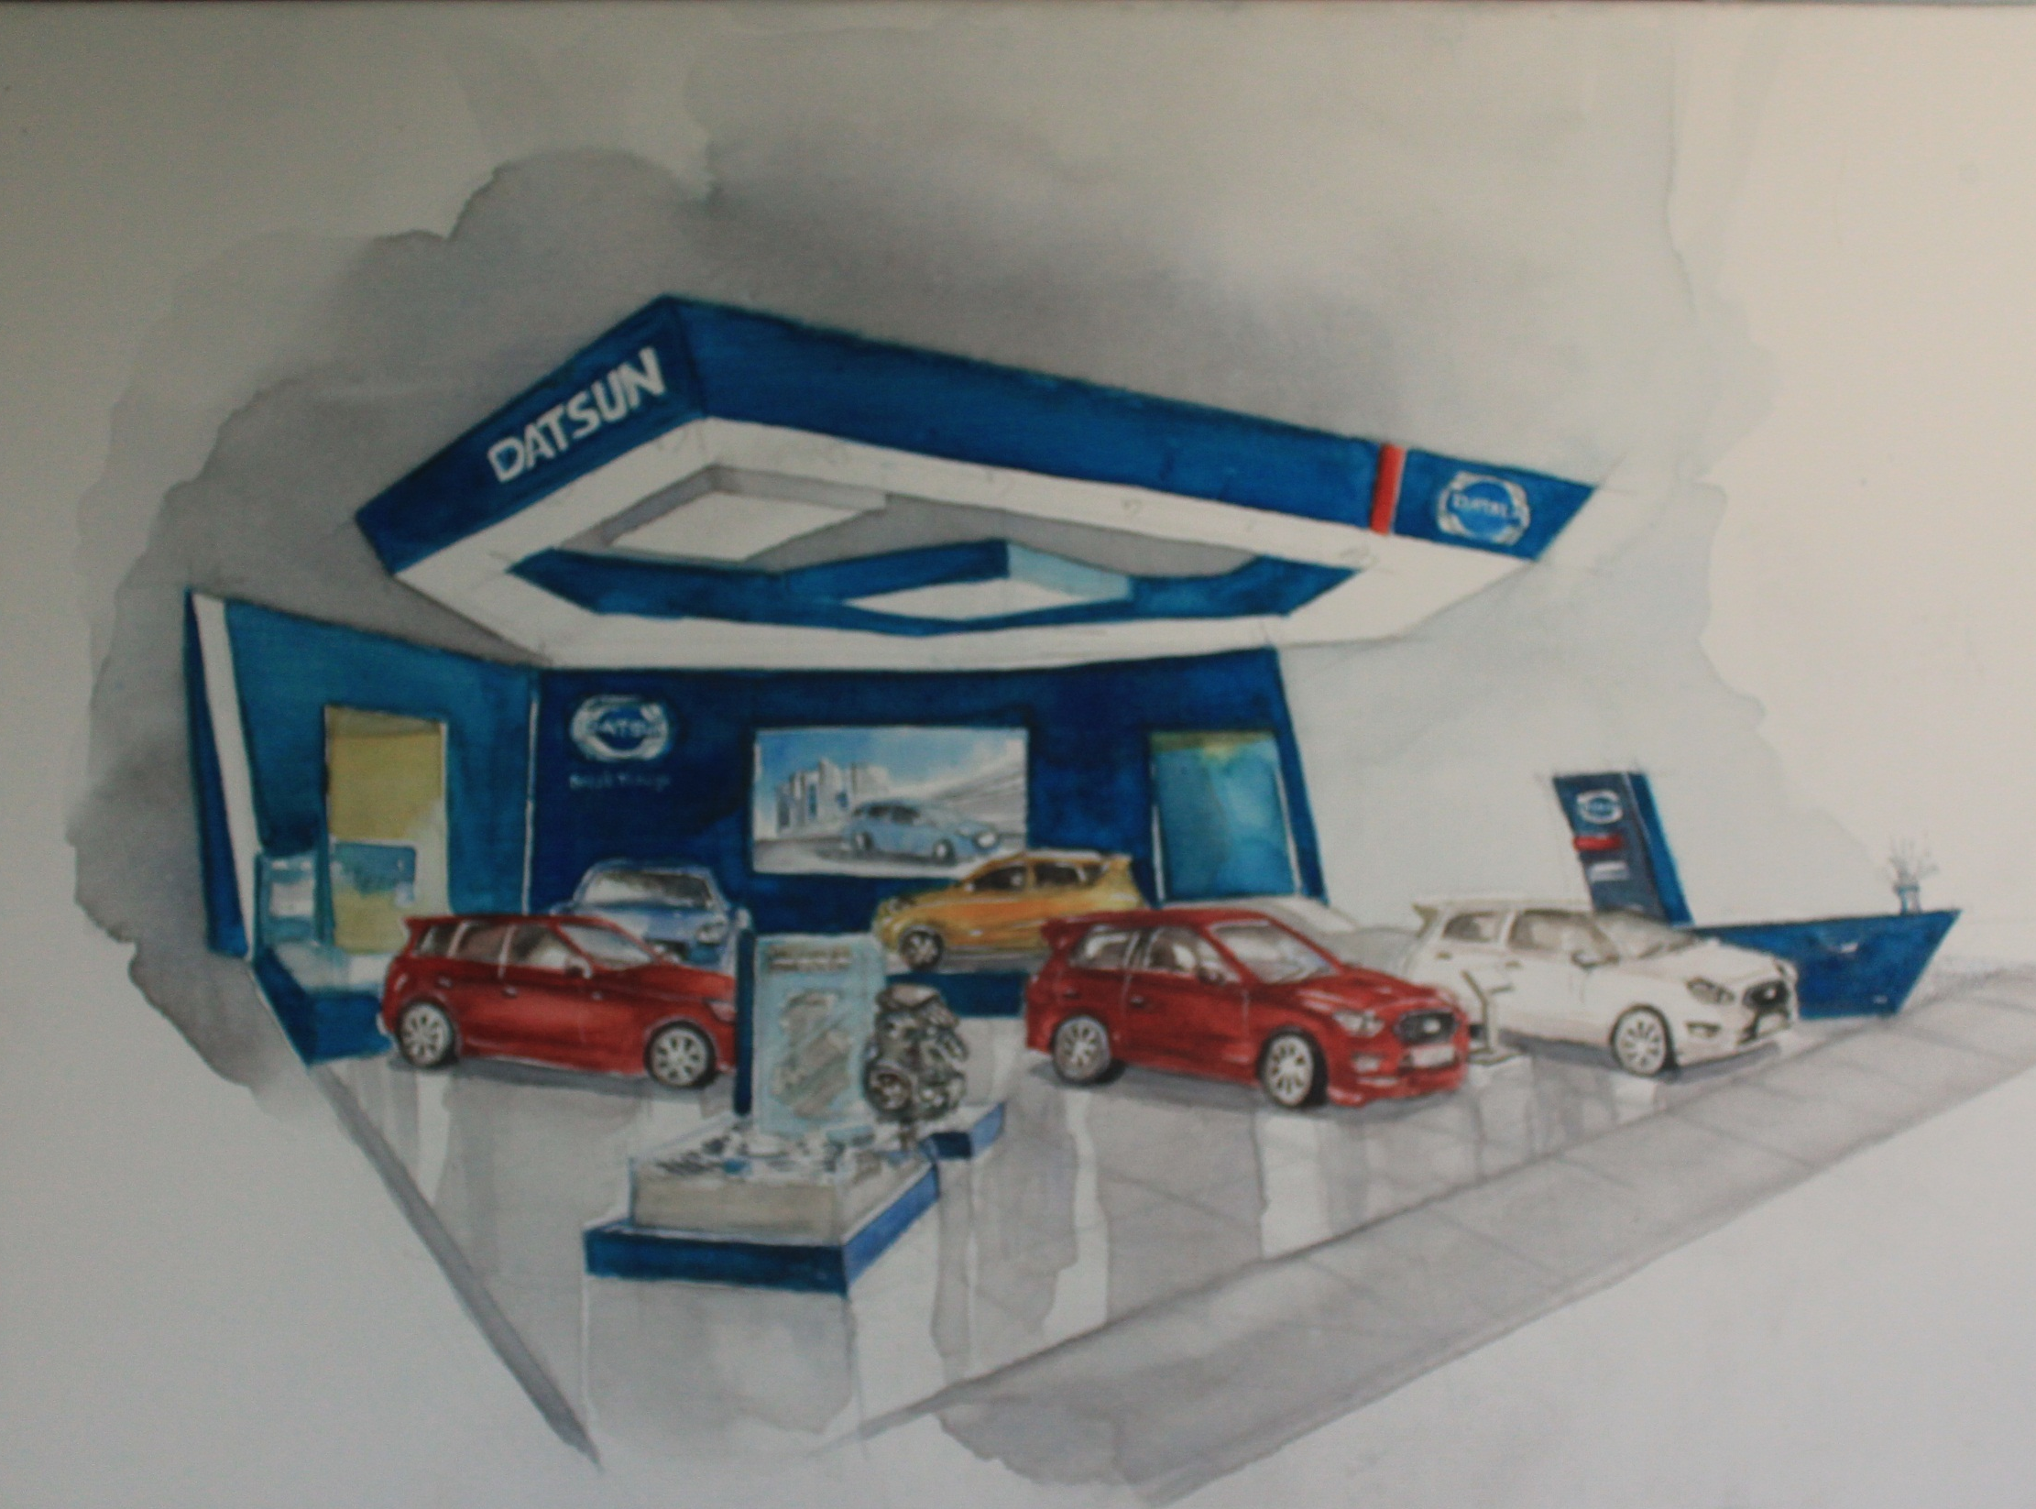
pertemuan 1 pengantar exhibition design exhibition design 1980 – 2016
Daniel Agus Wijaya., M.Ds Sumber :Drs KrisWardhana,M.Sn

Slide 2
What is an Exhibition ?

Slide 3
E X H I B I T I O N is ……….
MAGIC

Slide 4
Pertemuan 2. Fieldtrip pameran umum
Exposition.....
Exhibition skala besar di Perancis ( 1840 & 1937 )
BIE ( the Bureau International des Expositions =
International Exhibitions Bureau )
Pertama kali “ Expo “ digunakan 1960an
Exhibition publik terbesar dan berskala Internasional , Teknologi,Budaya dan Ekonomi
Setaraf dengan Olimpiade.( Games )
(Pam Locker, 2011, Exhibition design : What is an Exhibition ? )

Slide 5
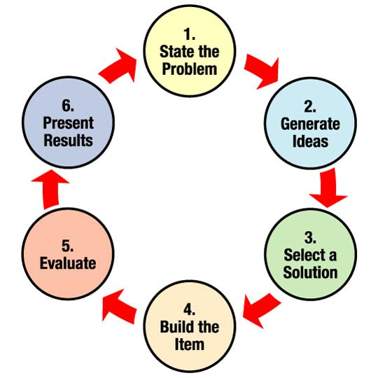
Pertemuan 3. Analisa fieldtrip
Design process basic…

Slide 6
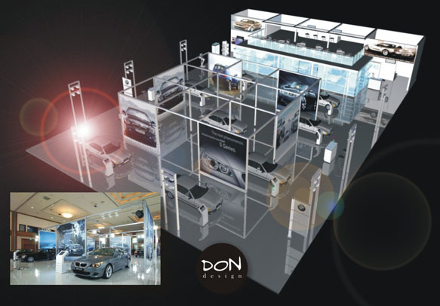
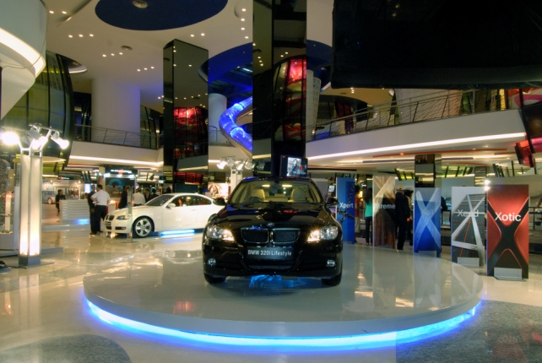
EXHIBITION
IMAGE
PRODUCT
MARKET

Slide 7
Pertemuan 4.
Pilihan EXHIBITION
Expo
Trade Fair
Pavilion
Roadshow
Product Lounge
Moving Exhibition
Thematic Exhibition
Museum Exhibition

Slide 8
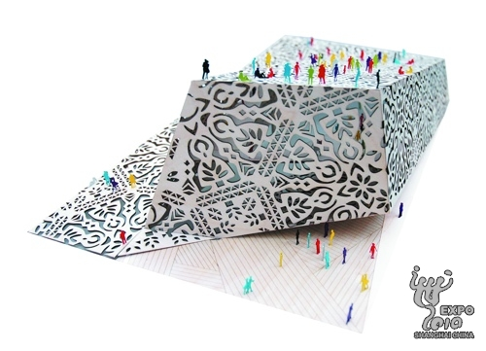
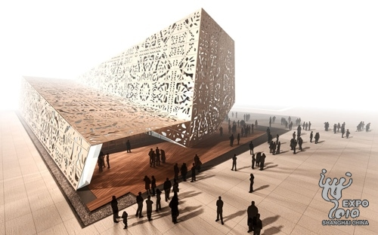
Pertemuan 6 dan 7.presentasi project, gambar rendering visual desain

Slide 9
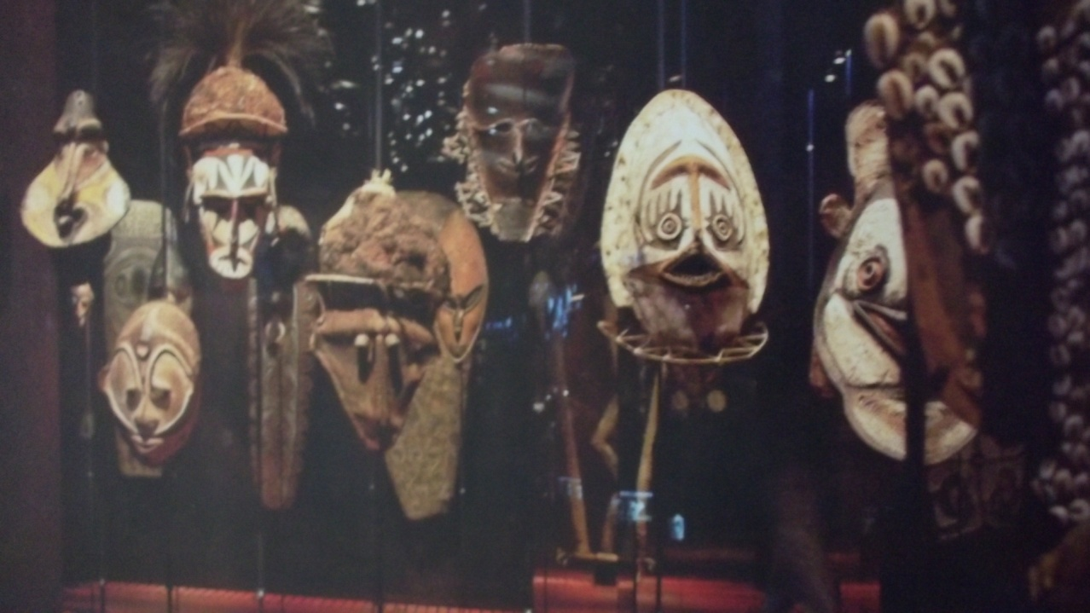
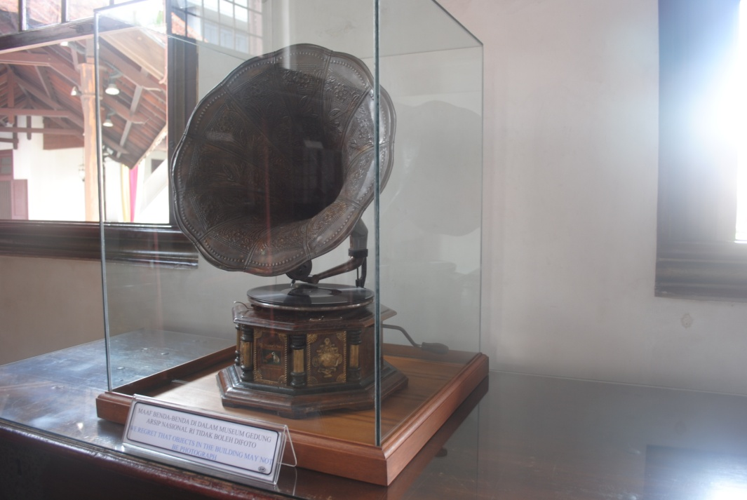
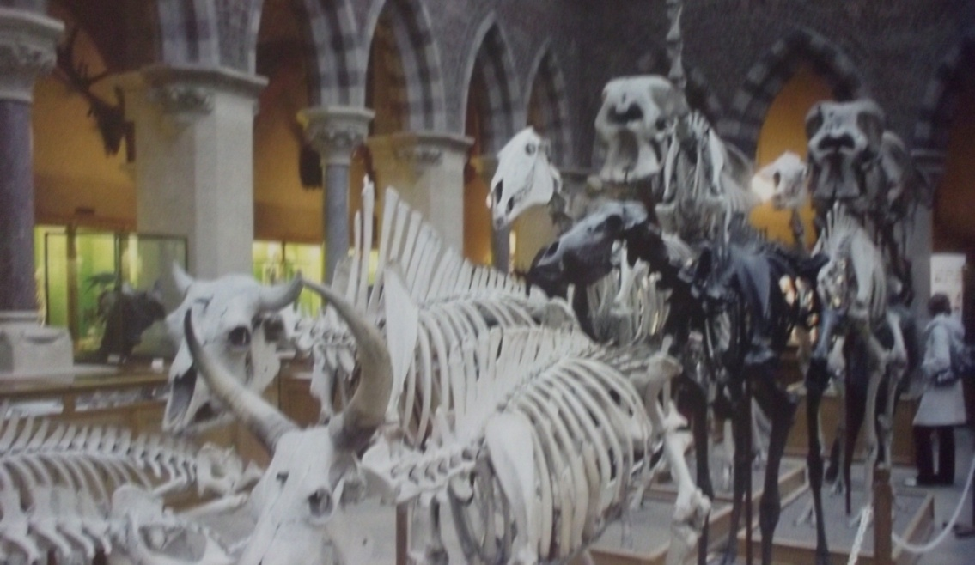
Museum Exhibition

Slide 10
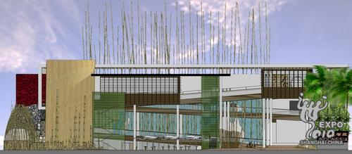
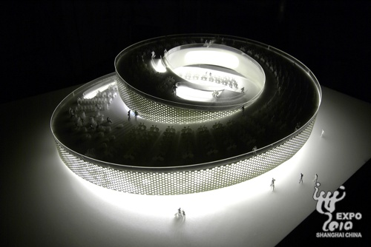
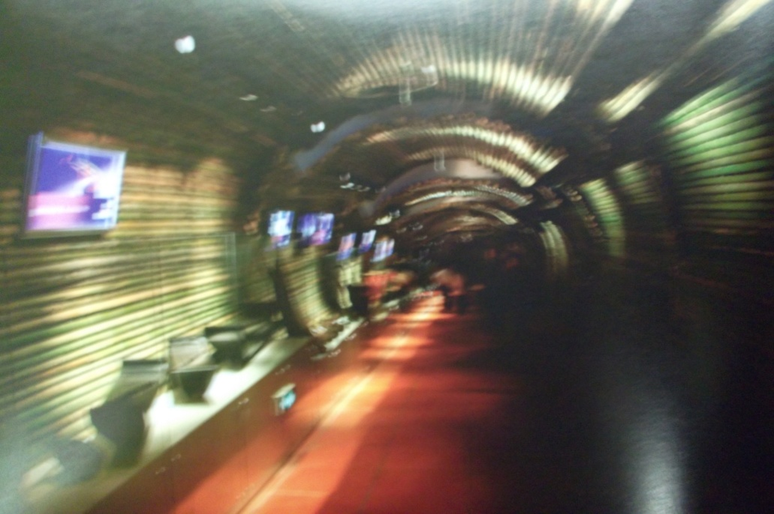
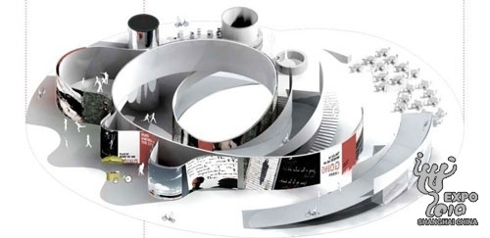
Pavilion

Slide 11
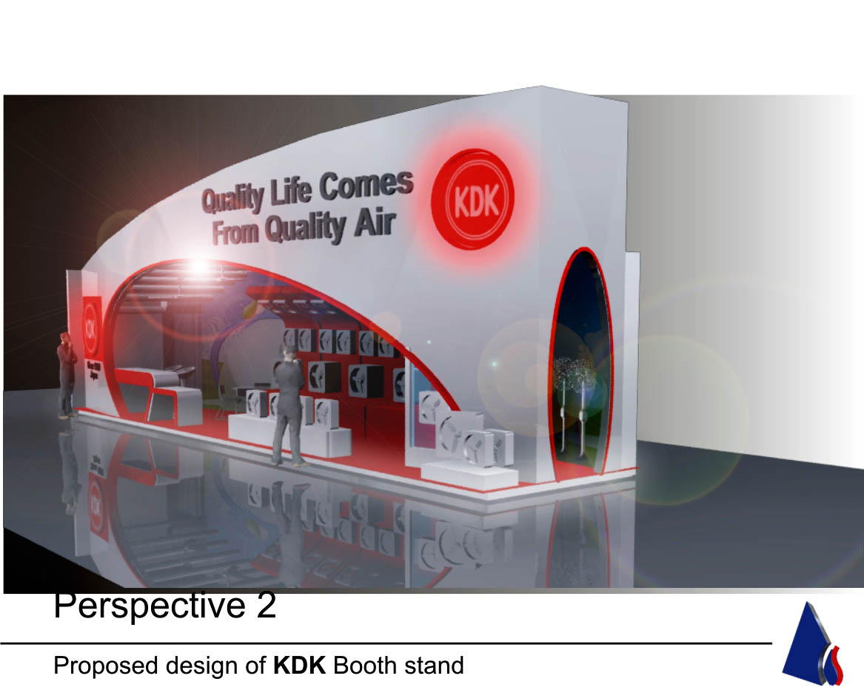
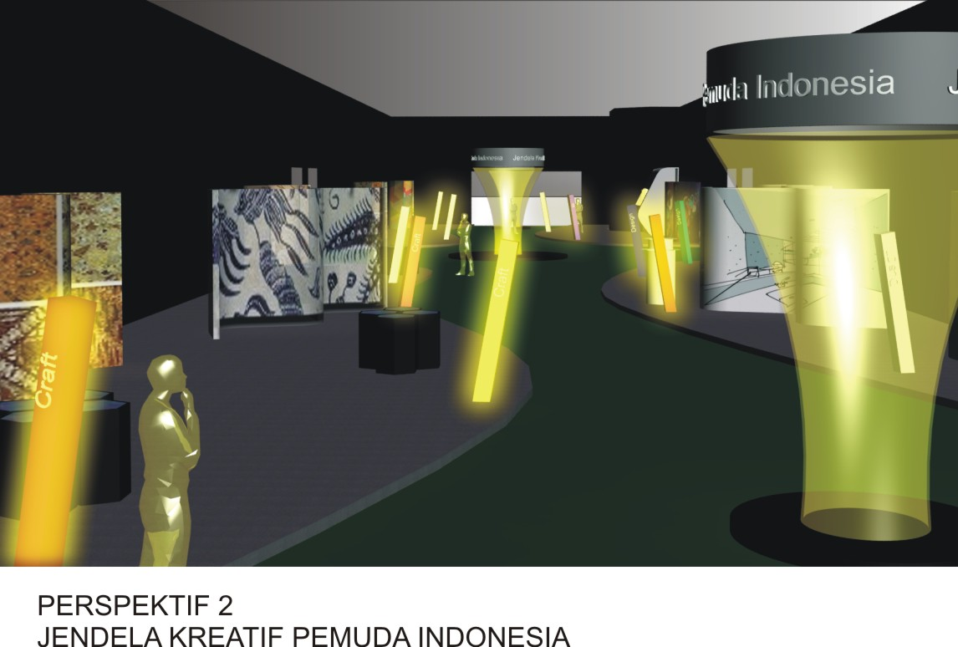
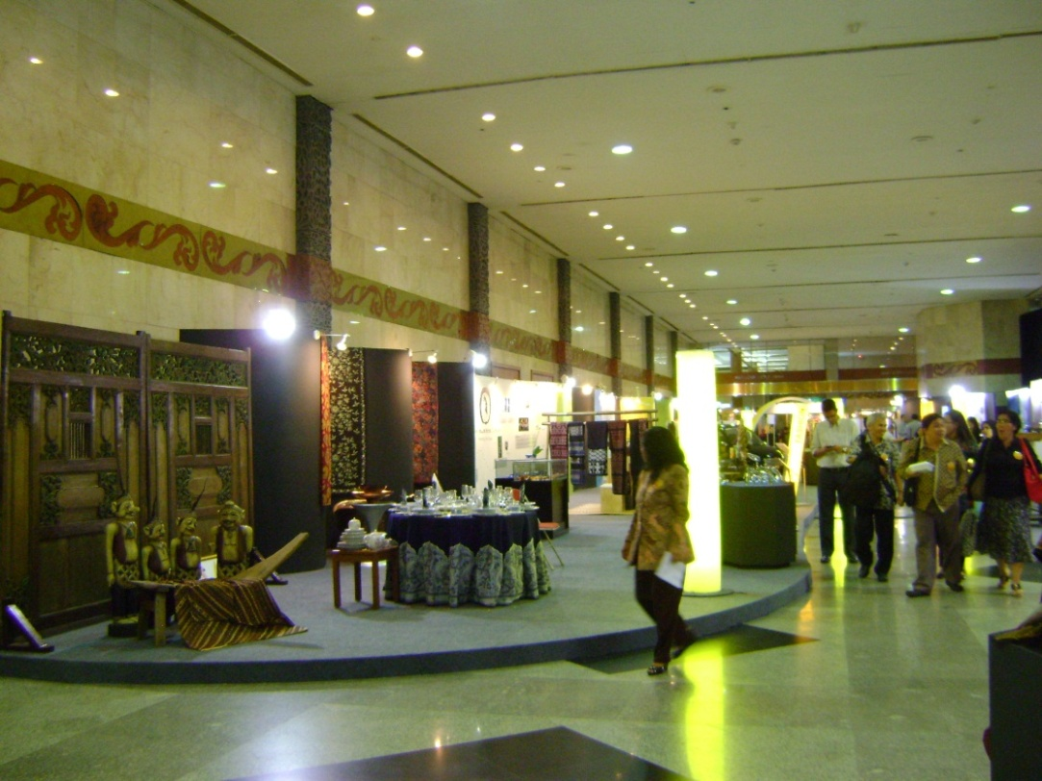
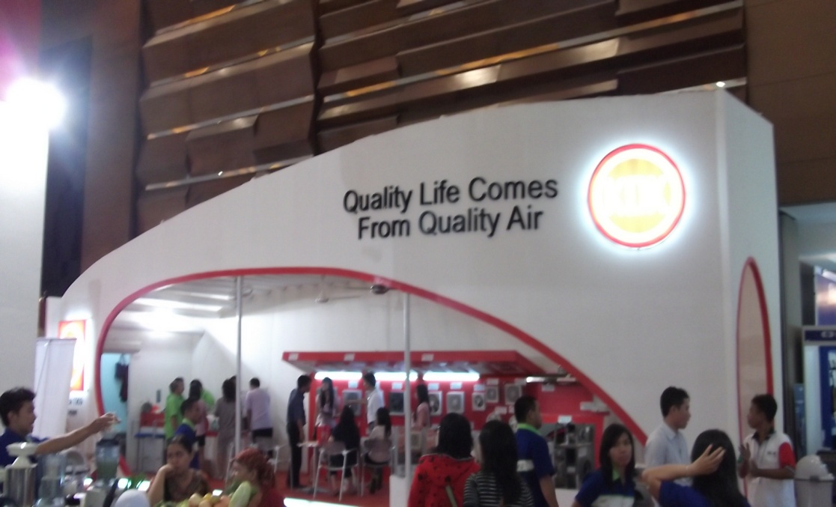
Trade Fair

Slide 12
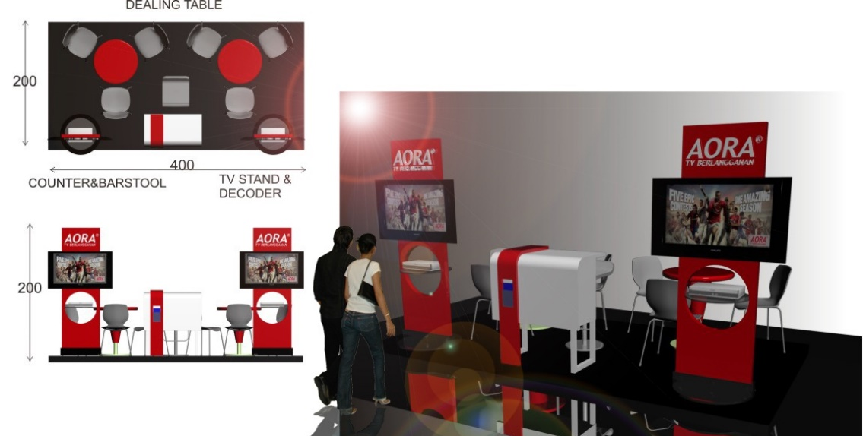
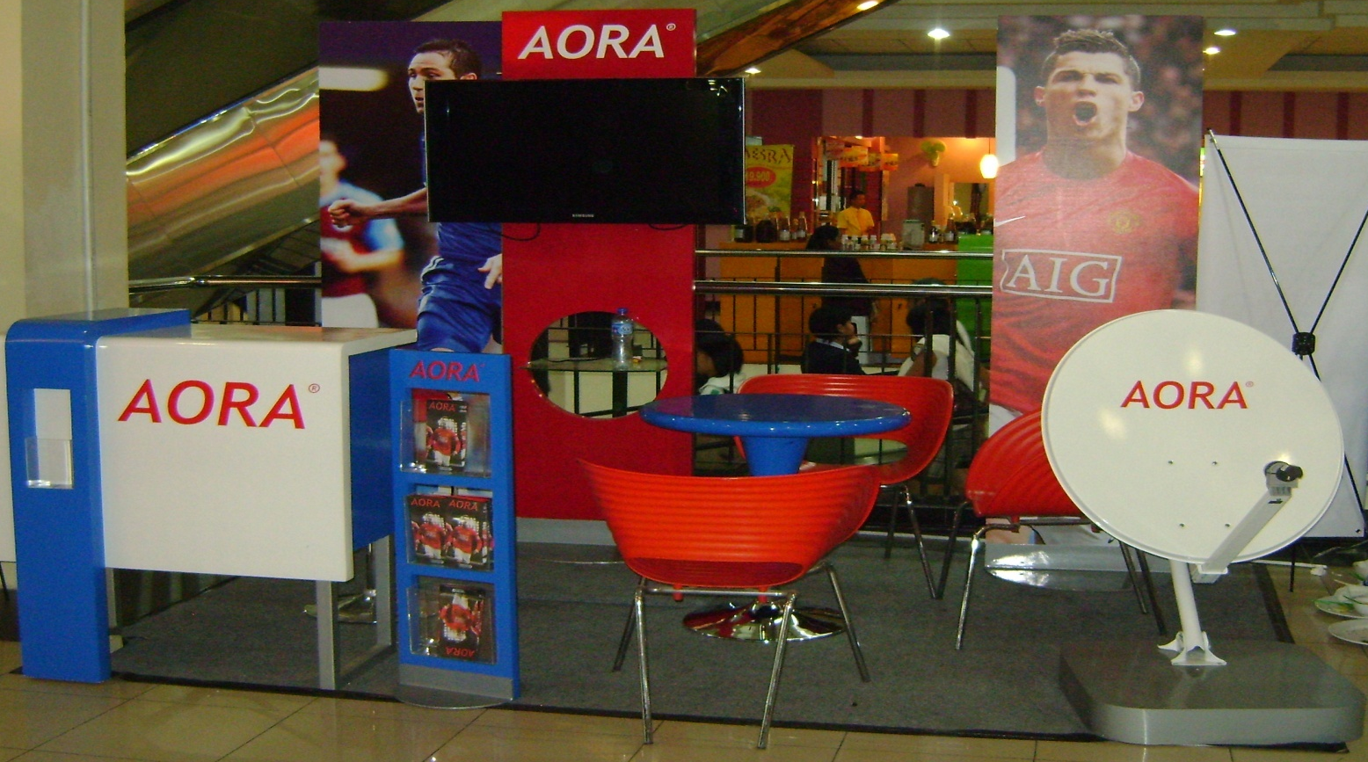
Road show

Slide 13
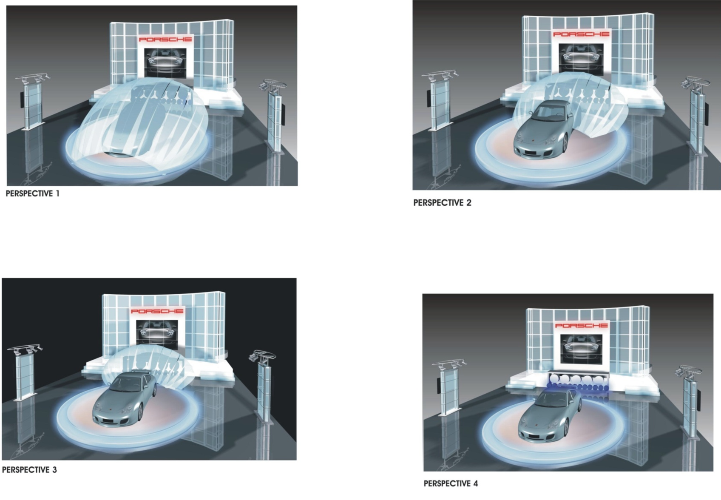
Product Launch

Slide 14
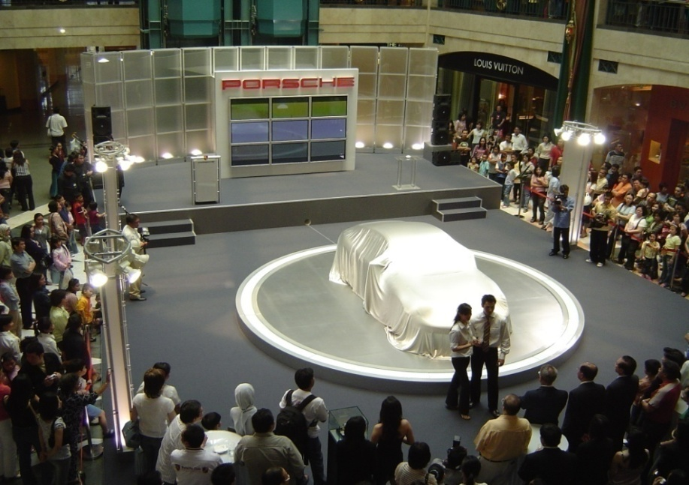
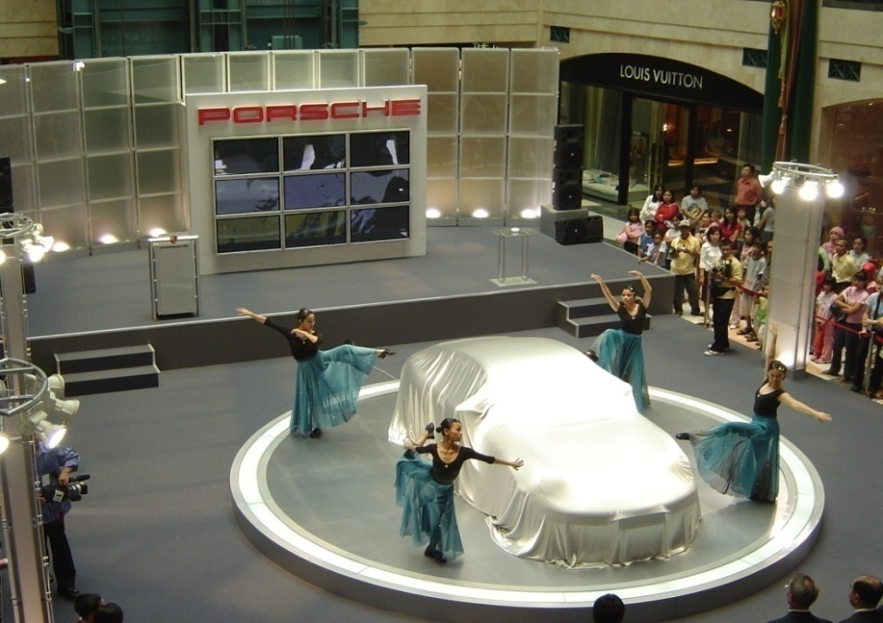
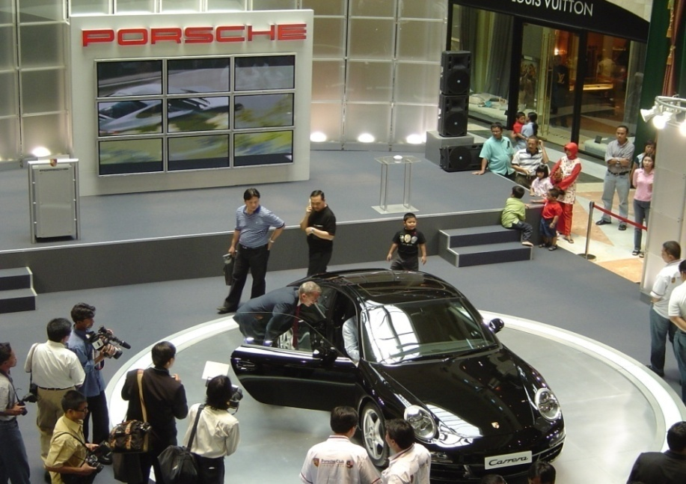
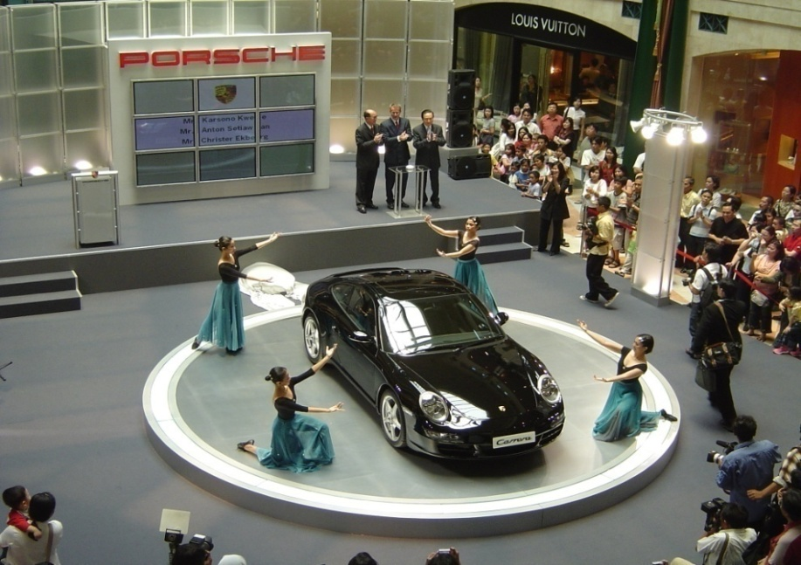
Product Launch

Slide 15
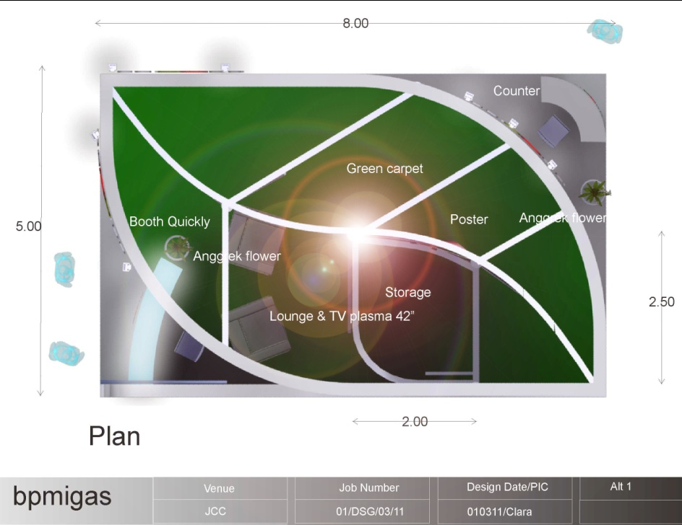
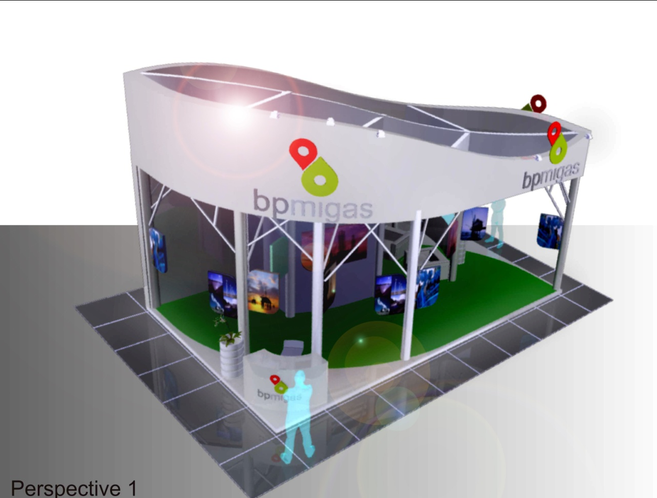
Thematic Exhibition

Slide 16
Pertemuan 5.Spek Tugas
Klasifikasi
EXHIBITION
Small Stand 37 m2
Medium Stand 37-148 m2
Large Stand 149-370 m2
Giant Stand 371 - …Hall/Solo Exhibition
Pavilion

Slide 17
Pertemuan 8.
UJIAN TENGAH SEMESTER (UTS)

