Slide 1
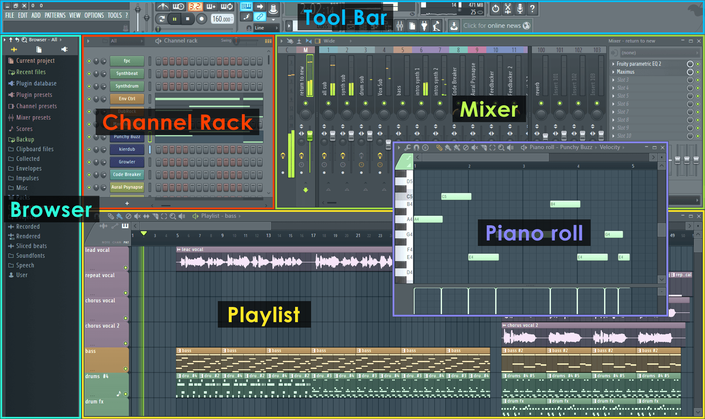
Basic iNTERFACE

Slide 2
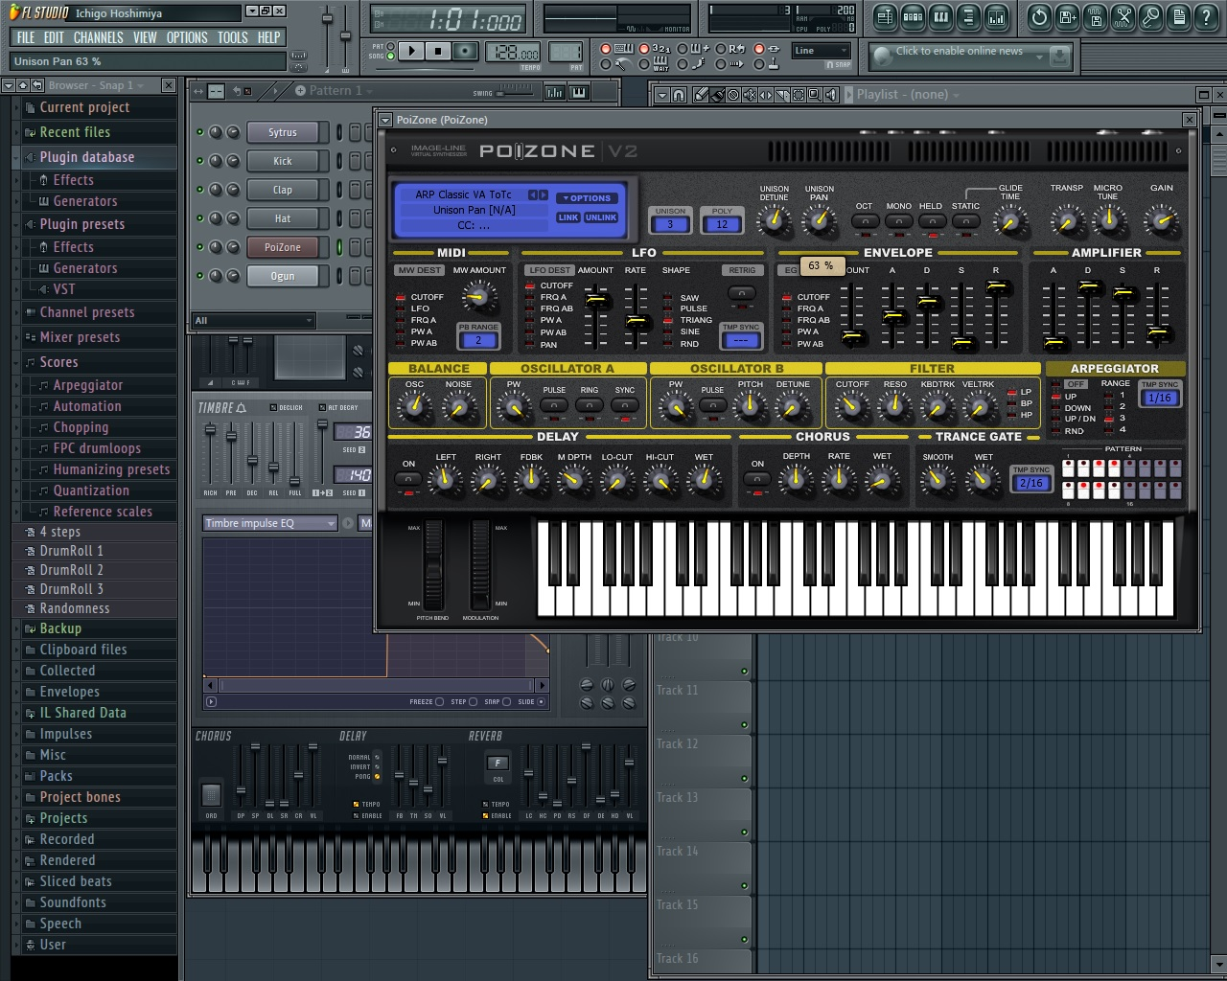

Slide 3
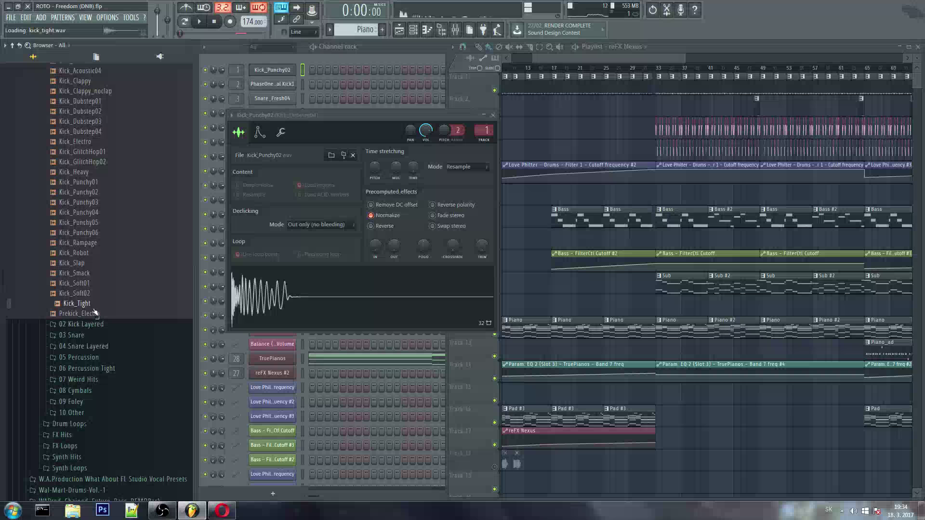
INSTRUMENTS BROWSER

Slide 4
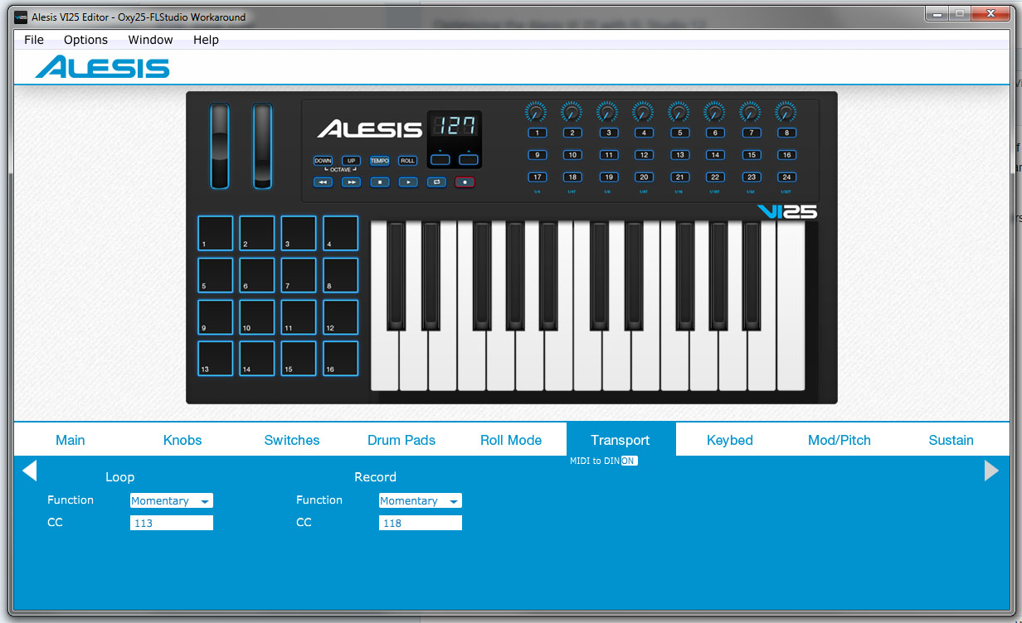
MIDI PLUGINS

