Slide 1
FINANCIAL REPORTING AND ACCOUNTING STANDARDS
PERTEMUAN #1
EBA302
AKUNTANSI KEUANGAN MENENGAH I + LAB
6542– SRI HANDAYANI, SE, MM, MAk, CPMA
PROGRAM STUDI AKUNTANSI
FAKULTAS EKONOMI DAN BISNIS
UNIVERSITAS ESA UNGGUL

Slide 2
KEMAMPUAN AKHIR YANG DIHARAPKAN
Mahasiswa mampu menjelaskan konsep dan terminologi akuntansi keuangan dan standar akuntansi

Slide 3
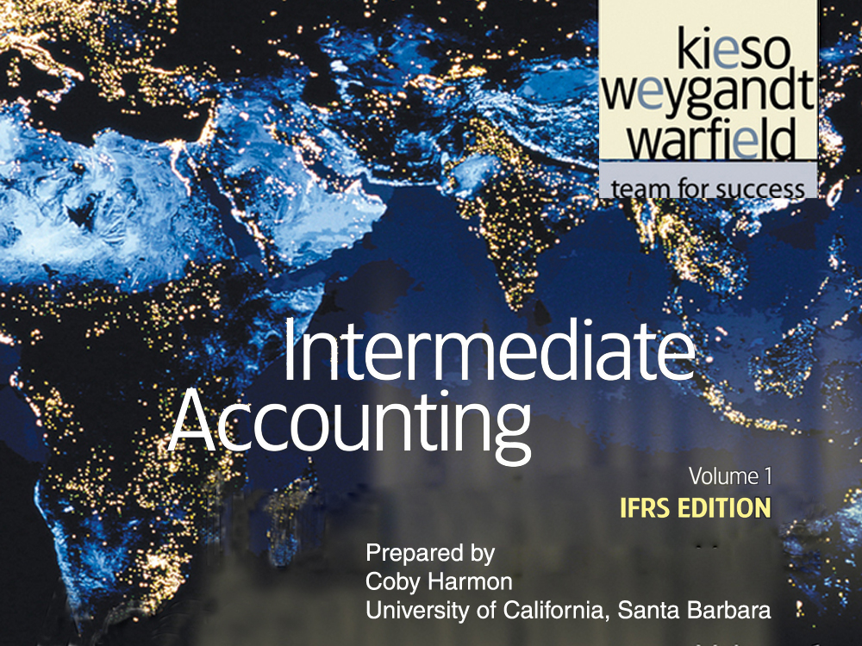

Slide 4
C H A P T E R 1
FINANCIAL REPORTING AND ACCOUNTING STANDARDS
Intermediate Accounting
IFRS Edition
Kieso, Weygandt, and Warfield

Slide 5
Learning Objectives
Identify the major financial statements and other means of financial reporting.
Explain how accounting assists in the efficient use of scarce resources.
Explain the need for high-quality standards.
Identify the objective of financial reporting.
Identify the major policy-setting bodies and their role in the standard-setting process.
Explain the meaning of IFRS.
Describe the challenges facing financial reporting.

Slide 6
Financial Reporting and Accounting Standards
Global Markets
Objective of Financial Reporting
Standard-Setting Organizations
Financial Reporting Challenges
Financial statements and financial reporting
Accounting and capital allocation
High-quality standards
General-purpose financial statements
Capital providers
Entity perspective
Decision-usefulness
IOSCO
IASB
Hierarchy of IFRS
Political environment
Expectations gap
Significant financial reporting issues
Ethics
International convergence

Slide 7
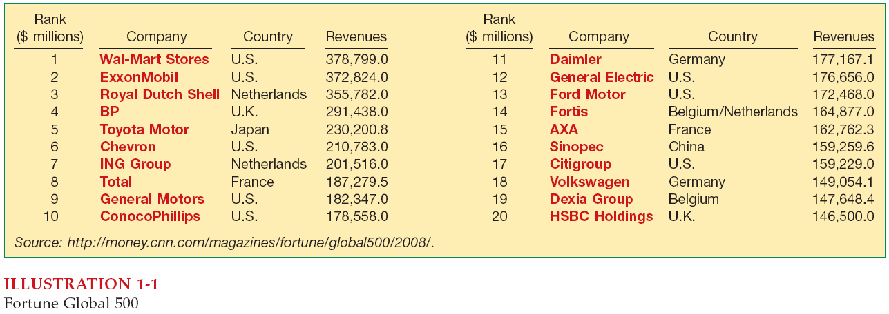
Global Markets
World markets are becoming increasingly intertwined.
Top 20 Global Companies In Terms Of Sales

Slide 8
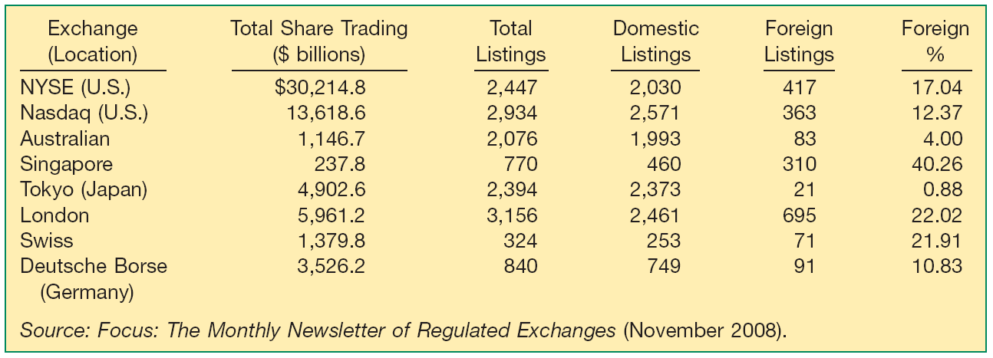
Global Markets
Significant number of foreign companies are found on national exchanges.
Illustration 1-2
International Exchange
Statistics

Slide 9
Global Markets
Financial Statements and Financial Reporting
Characteristics of accounting are:
the identification, measurement, and communication of financial information about
economic entities to
interested parties.
LO 1 Identify the major financial statements and other means of financial reporting.

Slide 10
Global Markets
Economic Entity
Financial Statements
Additional Information
Financial Information
Accounting?
Identify
and
Measure
and
Communicate
Statement of Financial Position
Income Statement or Statement of Comprehensive Income
Statement of Cash Flows
Statement of Changes in Equity
Note Disclosures
President’s letter
Prospectuses
Reports filed with governmental agencies
News releases
Forecasts
Environmental impact statements
Etc.
LO 1 Identify the major financial statements and other means of financial reporting.

Slide 11
Global Markets
Accounting and Capital Allocation
Resources are limited. Efficient use of resources often determines whether a business thrives.
Illustration 1-3 Capital Allocation Process
LO 2 Explain how accounting assists in the efficient use of scare resources.

Slide 12
Global Markets
High Quality Standards
Globalization demands a single set of high-quality international accounting standards. Some elements:
Single set of high-quality accounting standards established by a single standard-setting body.
Consistency in application and interpretation.
Common disclosures.
Common high-quality auditing standards and practices.
Common approach to regulatory review and enforcement.
Education and training of market participants.
(Continued)
LO 3 Explain the need for high-quality standards.

Slide 13
Global Markets
High Quality Standards
Globalization demands a single set of high-quality international accounting standards. Some elements:
Common delivery systems (e.g., eXtensible Business Reporting Language—XBRL).
Common approach to corporate governance and legal frameworks around the world
LO 3 Explain the need for high-quality standards.

Slide 14
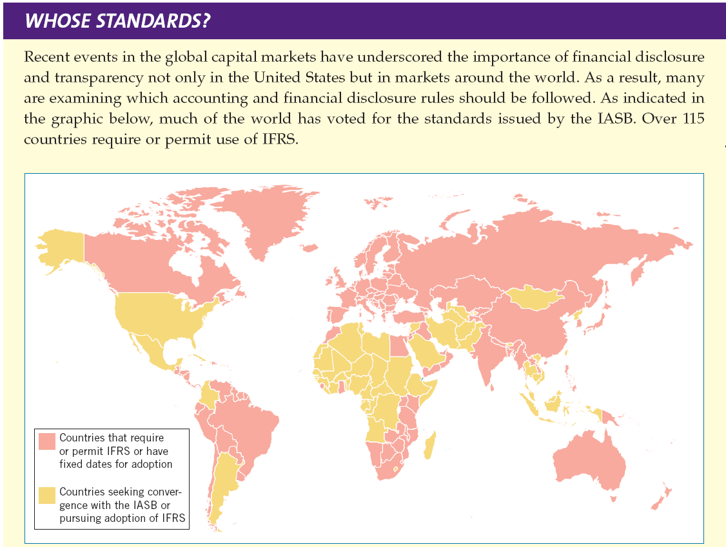
LO 3 Explain the need for high-quality standards.

Slide 15
Objective of Financial Accounting
Objective: Provide financial information about the reporting entity that is useful to
present and potential equity investors,
lenders, and
other creditors
in making decisions in their capacity as capital providers.
LO 4 Identify the objectives of financial reporting.

Slide 16
Objective of Financial Accounting
General-Purpose Financial Statements
Provide financial reporting information to a wide variety of users.
Provide the most useful information possible at the least cost.
Capital Providers (Investors)
Investors are the primary user group.
LO 4 Identify the objectives of financial reporting.

Slide 17
Objective of Financial Accounting
Entity Perspective
Companies viewed as separate and distinct from their owners.
Decision-Usefulness
Investors are interested in assessing the company’s
ability to generate net cash inflows and
management’s ability to protect and enhance the capital providers’ investments.
LO 4 Identify the objectives of financial reporting.

Slide 18
Objective of Financial Accounting
Review Question
The objective of financial reporting places most emphasis on:
reporting to capital providers.
reporting on stewardship.
providing specific guidance related to specific needs.
providing information to individuals who are experts in the field.
LO 4 Identify the objectives of financial reporting.

Slide 19
Objective of Financial Accounting
Review Question
General-purpose financial statements are prepared primarily for:
internal users.
external users.
auditors.
government regulators.
LO 4 Identify the objectives of financial reporting.

Slide 20
Standard-Setting Organizations
Two Major Organizations:
International Accounting Standards Board (IASB)
Issues International Financial Reporting Standards (IFRS).
Standards used on most foreign exchanges.
Standards used by foreign companies listing on U.S. securities exchanges.
IFRS used in over 115 countries.
LO 5 Identify the major policy-setting bodies and their role in the standard-setting process.

Slide 21
Standard-Setting Organizations
Two Major Organizations:
Financial Accounting Standards Board (FASB)
Issues Statements of Financial Accounting Standards (SFAS).
Required for all U.S.-based companies.
LO 5 Identify the major policy-setting bodies and their role in the standard-setting process.

Slide 22
Standard-Setting Organizations
International Organization of Securities Commissions (IOSCO)
Does not set accounting standards.
Dedicated to ensuring that global markets can operate in an efficient and effective basis.
http://www.iosco.org/
LO 5 Identify the major policy-setting bodies and their role in the standard-setting process.

Slide 23
Standard-Setting Organizations
International Accounting Standards Board (IASB)
Composed of four organizations—
International Accounting Standards Committee Foundation (IASCF)
International Accounting Standards Board (IASB)
Standards Advisory Council
International Financial Reporting Interpretations Committee (IFRIC)
http://www.iasb.org
LO 5 Identify the major policy-setting bodies and their role in the standard-setting process.

Slide 24
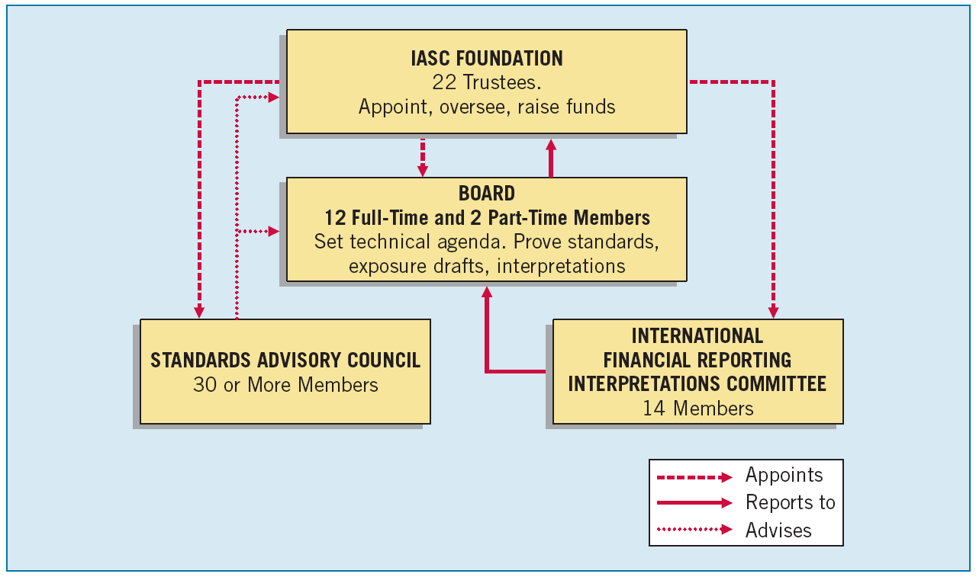
Standard-Setting Organizations
Illustration 1-4
International Standard-Setting Structure
LO 5 Identify the major policy-setting bodies and their role in the standard-setting process.

Slide 25
Standard-Setting Organizations
Review Question
IFRS stands for:
International Federation of Reporting Services.
Independent Financial Reporting Standards.
International Financial Reporting Standards.
Integrated Financial Reporting Services.
LO 5 Identify the major policy-setting bodies and their role in the standard-setting process.

Slide 26
Standard-Setting Organizations
Review Question
The major key players on the international side are the:
IASB and FASB.
SEC and FASB.
IOSCO and the SEC.
IASB and IOSCO.
LO 5 Identify the major policy-setting bodies and their role in the standard-setting process.

Slide 27
Standard-Setting Organizations
Review Question
Which body from the U.S. side is similar to the IASB?
SEC.
FASB.
FASC.
FAF.
LO 5 Identify the major policy-setting bodies and their role in the standard-setting process.

Slide 28
Due Process
The IASB due process has the following elements:
Independent standard-setting board;
Thorough and systematic process for developing standards;
Engagement with investors, regulators, business leaders, and the global accountancy profession at every stage of the process; and
Collaborative efforts with the worldwide standard-setting community.
LO 5 Identify the major policy-setting bodies and their role in the standard-setting process.

Slide 29
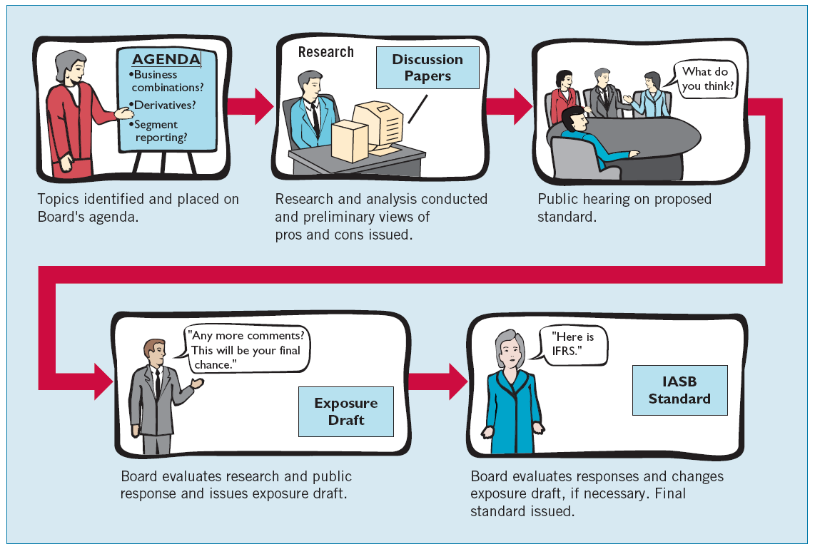
Due Process
Illustration 1-4
International Standard-Setting Structure
LO 5 Identify the major policy-setting bodies and their role in the standard-setting process.

Slide 30
Due Process
Review Question
Accounting standard-setters use the following process in establishing international standards:
Research, exposure draft, discussion paper, standard.
Discussion paper, research, exposure draft, standard.
Research, preliminary views, discussion paper, standard.
Research, discussion paper, exposure draft, standard.
LO 5 Identify the major policy-setting bodies and their role in the standard-setting process.

Slide 31
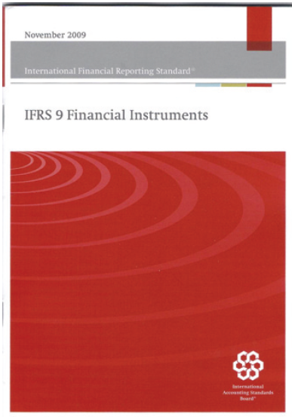
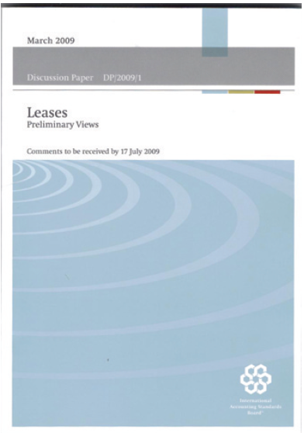
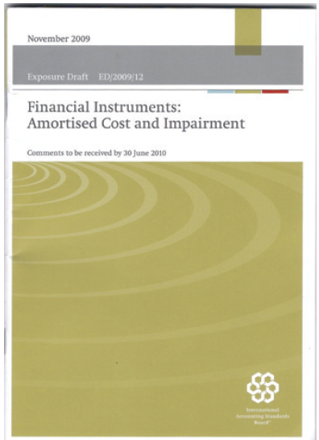
Types of Pronouncements
Issued by the IASB:
International Financial Reporting Standards.
Framework for financial reporting.
International financial reporting interpretations.
LO 5 Identify the major policy-setting bodies and their role in the standard-setting process.

Slide 32
Types of Pronouncements
Hierarchy of IFRS
Companies first look to:
International Financial Reporting Standards;
International Accounting Standards; and
Interpretations originated by the International Financial Reporting Interpretations Committee (IFRIC) or the former Standing Interpretations Committee (SIC).
LO 6 Explain the meaning of IFRS.

Slide 33
Types of Pronouncements
Review Question
IFRS is comprised of:
International Financial Reporting Standards and FASB financial reporting standards.
International Financial Reporting Standards, International Accounting Standards, and international accounting interpretations.
International Accounting Standards and international accounting interpretations.
FASB financial reporting standards and International Accounting Standards.
LO 6 Explain the meaning of IFRS.

Slide 34
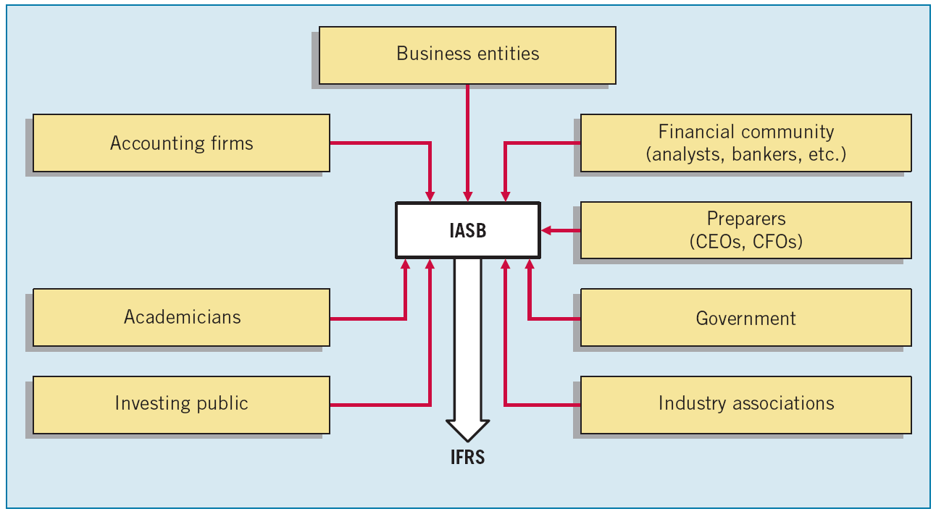
Financial Reporting Challenges
IFRS in a Political Environment
Illustration 1-6
User Groups that Influence the Formulation of Accounting Standards
LO 7 Describe the challenges facing financial reporting.

Slide 35
Financial Reporting Challenges
The Expectations Gap
What the public thinks accountants should do vs. what accountants think they can do.
Significant Financial Reporting Issues
Non-financial measurements
Forward-looking information
Sort assets
Timeliness
LO 7 Describe the challenges facing financial reporting.

Slide 36
Financial Reporting Challenges
Ethics in the Environment of Financial Accounting
Companies that concentrate on “maximizing the bottom line,” “facing the challenges of competition,” and “stressing short-term results” place accountants in an environment of conflict and pressure.
IFRS does not always provide an answer.
Doing the right thing is not always easy or obvious.
LO 7 Describe the challenges facing financial reporting.

Slide 37
Financial Reporting Challenges
International Convergence
In 2002 the IASB and the FASB formalized their commitment to the convergence of U.S. GAAP and international standards. The Boards agreed to:
Make their existing financial reporting standards fully converged as soon as practicable, and
Coordinate their future work programs to ensure that once achieved, convergence is maintained.
LO 7 Describe the challenges facing financial reporting.

Slide 38
Financial Reporting Challenges
Review Question
The expectations gap is:
what financial information management provides and what users want.
what the public thinks accountants should do and what accountants think they can do.
what the governmental agencies want from standard-setting and what the standard-setters provide.
what the users of financial statements want from the government and what is provided.
LO 7 Describe the challenges facing financial reporting.

Slide 39
The fact that there are differences between IFRS and U.S. GAAP should not be surprising because standard-setters have developed standards in response to different user needs.
IFRS tends to be simpler and more flexible in its accounting and disclosure requirements.
The U.S. SEC recently eliminated the need for foreign companies that trade shares in U.S. markets to reconcile their accounting with U.S. GAAP.

Slide 40
Appendix 1A
THE U.S. STANDARD-SETTING ENVIRONMENT
Organizations responsible for developing financial accounting standards (GAAP) in the United States:
Securities and Exchange Commission (SEC).
Financial Accounting Standards Board (FASB).
http://www.sec.gov/
http://www.fasb.org/

Slide 41
Securities and Exchange Commission
Established by federal government
Accounting and reporting for public companies
Securities Act of 1933
Securities Act of 1934
Encouraged private standard-setting body
SEC requires public companies to adhere to GAAP
SEC Oversight
Enforcement Authority
LO 8 Identify the major policy-setting bodies and their role in the standard-setting process.

Slide 42
Financial Accounting Standards Board
Wheat Committee’s recommendations resulted in the creation of a the Financial Accounting Standards Board (FASB) in 1973.
Financial Accounting Foundation
Selects members of the FASB
Funds their activities
Exercises general oversight.
Financial Accounting Standards Board
Mission to establish and improve standards of financial accounting and reporting.
Financial Accounting Standards Advisory Council
Consult on major policy issues.
LO 8 Identify the major policy-setting bodies and their role in the standard-setting process.

Slide 43
Financial Accounting Standards Board
Missions is to establish and improve standards of financial accounting and reporting. Differences between FASB and APB include:
Smaller Membership
Full-time, Remunerated Membership
Greater Autonomy
Increased Independence
Broader Representation
LO 6 Identify the major policy-setting bodies and their role in the standard-setting process.

Slide 44
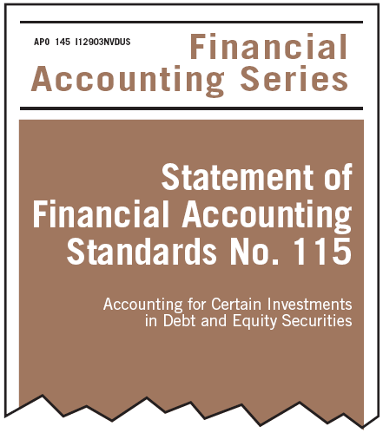
Financial Accounting Standards Board
Due Process
FASB relies on two basic premises:
Responsive to entire economic community
Operate in full view of the public
Step 1 = Topic placed on agenda
Step 2 = Research conducted and Discussion Memorandum issued.
Step 3 = Public hearing
Step 4 = Board evaluates research, public response and issues Exposure Draft
Step 5 = Board evaluates responses and issues final Statement of Financial Accounting Standard
LO 8 Identify the major policy-setting bodies and their role in the standard-setting process.

Slide 45
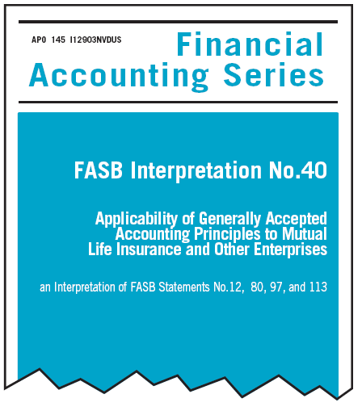
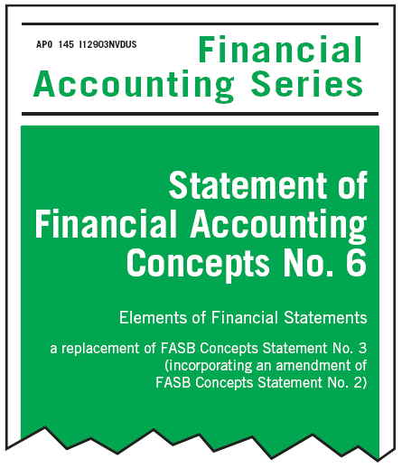
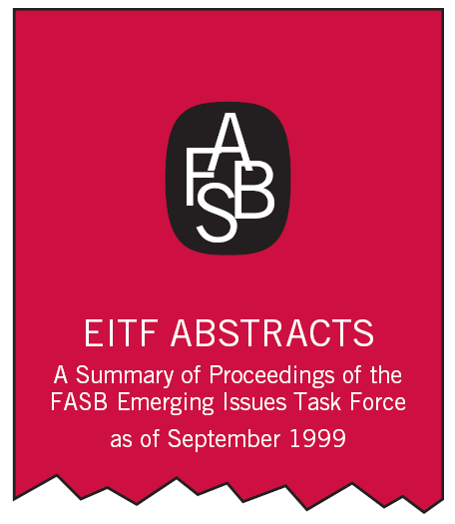
Financial Accounting Standards Board
Types of Pronouncements
Standards, Interpretations, and Staff Positions.
Financial Accounting Concepts
Emerging Issues Task Force Statements
LO 8 Identify the major policy-setting bodies and their role in the standard-setting process.

Slide 46
Financial Accounting Standards Board
U.S. Generally Accepted Accounting Principles
Principles that have substantial authoritative support.
Major sources of GAAP:
FASB Standards, Interpretations, and Staff Positions
APB Opinions
AICPA Accounting Research Bulletins
When the Board approves a new standard, staff position, etc., the results are included in the Codification through an Accounting Standards Update.
LO 8 Identify the major policy-setting bodies and their role in the standard-setting process.

Slide 47
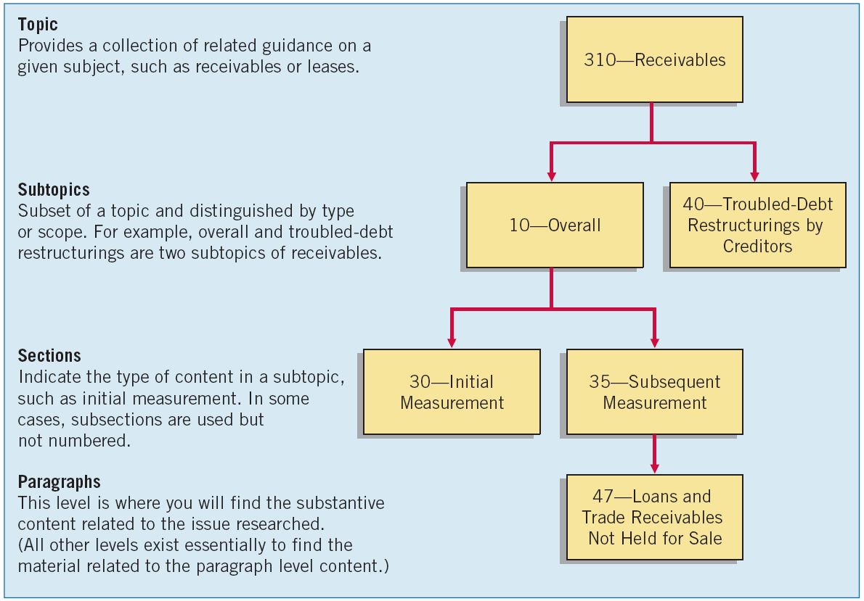
Financial Accounting Standards Board
Illustration 1A-2
The Codification
Framework
LO 8 Identify the major policy-setting bodies and their role in the standard-setting process.

Slide 48
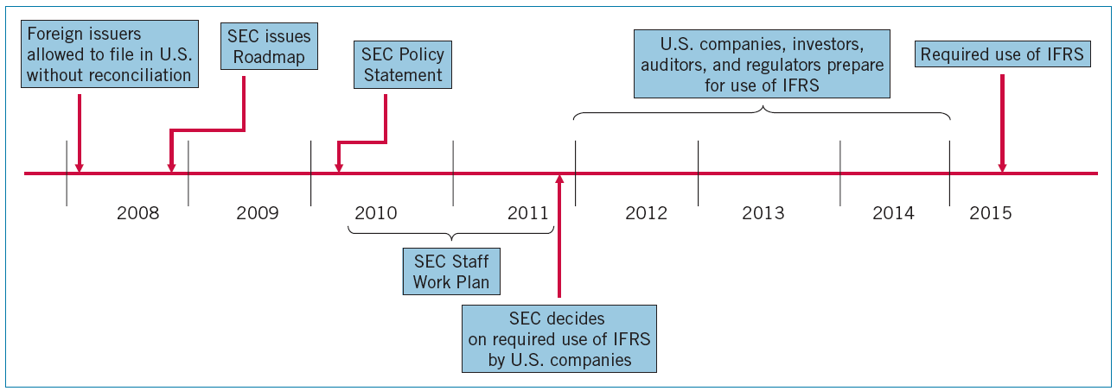
International Accounting Convergence
Improvements in Accounting Standards
IASB and FASB have set up an extensive work plan to achieve one set of international standards.
Illustration 1A-3
IFRS Adoption Timeline
LO 8 Identify the major policy-setting bodies and their role in the standard-setting process.

Slide 49
International Accounting Convergence
SEC Work Plan
Sufficient development and application of IFRS.
Independent standard-setting for the benefit of investors.
Investor understanding and education.
Regulatory environment.
Impact on large and small financial statement preparers.
Human capital readiness.
LO 8 Identify the major policy-setting bodies and their role in the standard-setting process.

Slide 50
Copyright
Copyright © 2011 John Wiley & Sons, Inc. All rights reserved. Reproduction or translation of this work beyond that permitted in Section 117 of the 1976 United States Copyright Act without the express written permission of the copyright owner is unlawful. Request for further information should be addressed to the Permissions Department, John Wiley & Sons, Inc. The purchaser may make back-up copies for his/her own use only and not for distribution or resale. The Publisher assumes no responsibility for errors, omissions, or damages, caused by the use of these programs or from the use of the information contained herein.

