Slide 1
ACQUISITION AND DISPOSITION OF PROPERTY, PLANT, AND EQUIPMENT
PERTEMUAN #10
EBA302
AKUNTANSI KEUANGAN MENENGAH I + LAB
6542– SRI HANDAYANI, SE, MM, MAk, CPMA
PROGRAM STUDI AKUNTANSI
FAKULTAS EKONOMI DAN BISNIS
UNIVERSITAS ESA UNGGUL

Slide 2
KEMAMPUAN AKHIR YANG DIHARAPKAN
Mahasiswa mampu memproses transaksi akuisisi, disposisi Property Plant dan Equipment.

Slide 3
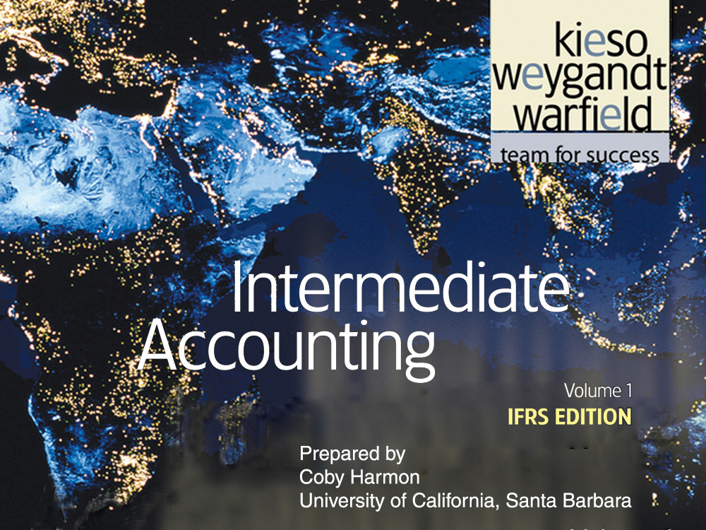

Slide 4
C H A P T E R 10
ACQUISITION AND DISPOSITION OF PROPERTY, PLANT, AND EQUIPMENT
Intermediate Accounting
IFRS Edition
Kieso, Weygandt, and Warfield

Slide 5
Learning Objectives
Describe property, plant, and equipment.
Identify the costs to include in initial valuation of property, plant, and equipment.
Describe the accounting problems associated with self-constructed assets.
Describe the accounting problems associated with interest capitalization.
Understand accounting issues related to acquiring and valuing plant assets.
Describe the accounting treatment for costs subsequent to acquisition.
Describe the accounting treatment for the disposal of property, plant, and equipment.

Slide 6
Acquisition and Disposition of Property, Plant, and Equipment
Acquisition
Valuation
Cost Subsequent to Acquisition
Dispositions
Acquisition costs: land, buildings, equipment
Self-constructed assets
Interest costs
Observations
Cash discounts
Deferred contracts
Lump-sum purchases
Stock issuance
Non-monetary exchanges
Government grants
Additions
Improvements and replacements
Rearrangement and reorganization
Repairs
Summary
Sale
Involuntary conversion

Slide 7
Property, Plant, and Equipment
Property, plant, and equipment is defined as tangible assets that are held for use in production or supply of goods and services, for rentals to others, or for administrative purposes; they are expected to be used during more than one period.
“Used in operations” and not for resale.
Long-term in nature and usually depreciated.
Possess physical substance.
Includes:
Land,
Building structures (offices, factories, warehouses), and
Equipment (machinery, furniture, tools).
LO 1 Describe property, plant, and equipment.

Slide 8
Acquisition of PP&E
Historical cost measures the cash or cash equivalent price of obtaining the asset and bringing it to the location and condition necessary for its intended use.
Companies value property, plant, and equipment in subsequent periods using either the
  cost method or
  fair value (revaluation) method.
LO 2 Identify the costs to include in initial valuation of property, plant, and equipment.

Slide 9
Acquisition of PP&E
Cost of Land
Includes all costs to acquire land and ready it for use. Costs typically include:
purchase price;
closing costs, such as title to the land, attorney’s fees, and recording fees;
costs of grading, filling, draining, and clearing;
assumption of any liens, mortgages, or encumbrances on the property; and
additional land improvements that have an indefinite life.
LO 2

Slide 10
Acquisition of PP&E
Cost of Land
Improvements with limited lives, such as private driveways, walks, fences, and parking lots, are recorded as Land Improvements and depreciated.
  Land acquired and held for speculation is classified as an investment.
  Land held by a real estate concern for resale should be classified as inventory.
LO 2 Identify the costs to include in initial valuation of property, plant, and equipment.

Slide 11
Acquisition of PP&E
Cost of Buildings
Includes all costs related directly to acquisition or construction. Cost typically include:
materials, labor, and overhead costs incurred during construction and
professional fees and building permits.
LO 2 Identify the costs to include in initial valuation of property, plant, and equipment.

Slide 12
Acquisition of PP&E
Cost of Equipment
Include all costs incurred in acquiring the equipment and preparing it for use. Costs typically include:
purchase price,
freight and handling charges
insurance on the equipment while in transit,
cost of special foundations if required,
assembling and installation costs, and
costs of conducting trial runs.
LO 2 Identify the costs to include in initial valuation of property, plant, and equipment.

Slide 13
Acquisition of PP&E
E10-1 (variation): The expenditures and receipts below are related to land, land improvements, and buildings acquired for use in a business enterprise. Determine how the following should be classified:
Classification
Money borrowed to pay building contractor
Payment for construction from note proceeds
Cost of land fill and clearing
Delinquent real estate taxes on property assumed
Premium on 6-month insurance policy during construction
Refund of 1-month insurance premium because construction completed early
Notes Payable
Building
Land
Land
Building
(Building)
LO 2 Identify the costs to include in initial valuation of property, plant, and equipment.

Slide 14
Acquisition of PP&E
E10-1 (variation): The expenditures and receipts below are related to land, land improvements, and buildings acquired for use in a business enterprise. Determine how the following should be classified:
Classification
(g) Architect’s fee on building
(h) Cost of real estate purchased as a plant site (land €200,000 and building €50,000)
(i) Commission fee paid to real estate agency
(j) Installation of fences around property
(k) Cost of razing and removing building
Proceeds from salvage of demolished building
Cost of parking lots and driveways
Cost of trees and shrubbery (permanent)
Building
Land
Land
Land Improvements
Land
(Land)
Land Improvements
Land
LO 2

Slide 15
Acquisition of PP&E
Self-Constructed Assets
Costs typically include:
Materials and direct labor
Overhead can be handled in two ways:
  Assign no fixed overhead
  Assign a portion of all overhead to the construction process.
  Companies use the second method extensively.
LO 3 Describe the accounting problems associated with self-constructed assets.

Slide 16
Acquisition of PP&E
Interest Costs During Construction
Three approaches have been suggested to account for the interest incurred in financing the construction.
Illustration 10-1
Increase to Cost of Asset
$ 0
$ ?
Capitalize no interest during construction
Capitalize all costs of funds
Capitalize actual costs incurred during construction (with modification)
IFRS
LO 4 Describe the accounting problems associated with interest capitalization.

Slide 17
Acquisition of PP&E
Interest Costs During Construction
IFRS requires — capitalizing actual interest (with modification).
Consistent with historical cost.
Capitalization considers three items:
  Qualifying assets.
  Capitalization period.
  Amount to capitalize.
LO 4 Describe the accounting problems associated with interest capitalization.

Slide 18
Acquisition of PP&E
Qualifying Assets
Require a substantial period of time to get them ready for their intended use.
Two types of assets:
  Assets under construction for a company’s own use.
  Assets intended for sale or lease that are constructed or produced as discrete projects.
LO 4 Describe the accounting problems associated with interest capitalization.

Slide 19
Acquisition of PP&E
Capitalization Period
Begins when:
Expenditures for the asset have been made.
Activities for readying the asset are in progress .
Interest costs are being incurred.
Ends when:
The asset is substantially complete and ready for use.
LO 4 Describe the accounting problems associated with interest capitalization.

Slide 20
Acquisition of PP&E
Amount to Capitalize
Capitalize the lesser of:
Actual interest costs
Avoidable interest - the amount of interest that could have been avoided if expenditures for the asset had not been made.
LO 4 Describe the accounting problems associated with interest capitalization.

Slide 21
Acquisition of PP&E
Interest Capitalization Illustration: Blue Corporation borrowed $200,000 at 12% interest from State Bank on Jan. 1, 2011, for specific purposes of constructing special-purpose equipment to be used in its operations. Construction on the equipment began on Jan. 1, 2011, and the following expenditures were made prior to the project’s completion on Dec. 31, 2011:
Other general debt existing on Jan. 1, 2011:
$500,000, 14%, 10-year bonds payable
$300,000, 10%, 5-year note payable
LO 4 Describe the accounting problems associated with interest capitalization.

Slide 22
Acquisition of PP&E
Step 1 - Determine which assets qualify for capitalization of interest.
  Special purpose equipment qualifies because it requires a period of time to get ready and it will be used in the company’s operations.
Step 2 - Determine the capitalization period.
  The capitalization period is from Jan. 1, 2011 through Dec. 31, 2011, because expenditures are being made and interest costs are being incurred during this period while construction is taking place.
LO 4 Describe the accounting problems associated with interest capitalization.

Slide 23
Acquisition of PP&E
Step 3 - Compute weighted-average accumulated expenditures.
A company weights the construction expenditures by the amount of time (fraction of a year or accounting period) that it can incur interest cost on the expenditure.
LO 4 Describe the accounting problems associated with interest capitalization.

Slide 24
Acquisition of PP&E
Step 4 - Compute the Actual and Avoidable Interest.
Selecting Appropriate Interest Rate:
For the portion of weighted-average accumulated expenditures that is less than or equal to any amounts borrowed specifically to finance construction of the assets, use the interest rate incurred on the specific borrowings.
For the portion of weighted-average accumulated expenditures that is greater than any debt incurred specifically to finance construction of the assets, use a weighted average of interest rates incurred on all other outstanding debt during the period.
LO 4 Describe the accounting problems associated with interest capitalization.

Slide 25
Acquisition of PP&E
Step 4 - Compute the Actual and Avoidable Interest.
Actual Interest
Weighted-average interest rate on general debt
$100,000 $800,000
= 12.5%
Avoidable Interest
LO 4 Describe the accounting problems associated with interest capitalization.

Slide 26
Acquisition of PP&E
Step 5 – Capitalize the lesser of Avoidable interest or Actual interest.
Journal entry to Capitalize Interest:
Equipment 30,250
Interest expense 30,250
LO 4 Describe the accounting problems associated with interest capitalization.

Slide 27
Acquisition of PP&E
Comprehensive Illustration: On November 1, 2010, Shalla Company contracted Pfeifer Construction Co. to construct a building for $1,400,000 on land costing $100,000 (purchased from the contractor and included in the first payment). Shalla made the following payments to the construction company during 2011.
LO 4 Describe the accounting problems associated with interest capitalization.

Slide 28
Acquisition of PP&E
Pfeifer Construction completed the building, ready for occupancy, on December 31, 2011. Shalla had the following debt outstanding at December 31, 2011.
Specific Construction Debt
1. 15%, 3-year note to finance purchase of land and construction of the building, dated December 31, 2010, with interest payable annually on December 31
Other Debt
2. 10%, 5-year note payable, dated December 31, 2007, with interest payable annually on December 31
3. 12%, 10-year bonds issued December 31, 2006, with interest payable annually on December 31
$750,000
$550,000
$600,000
Compute weighted-average accumulated expenditures for 2011.
LO 4 Describe the accounting problems associated with interest capitalization.

Slide 29
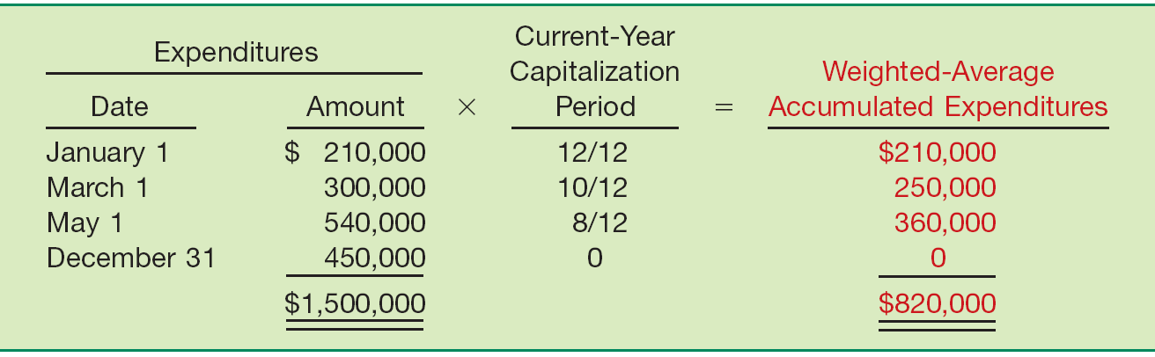
Acquisition of PP&E
Compute weighted-average accumulated expenditures for 2011.
Illustration 10-4
LO 4 Describe the accounting problems associated with interest capitalization.

Slide 30
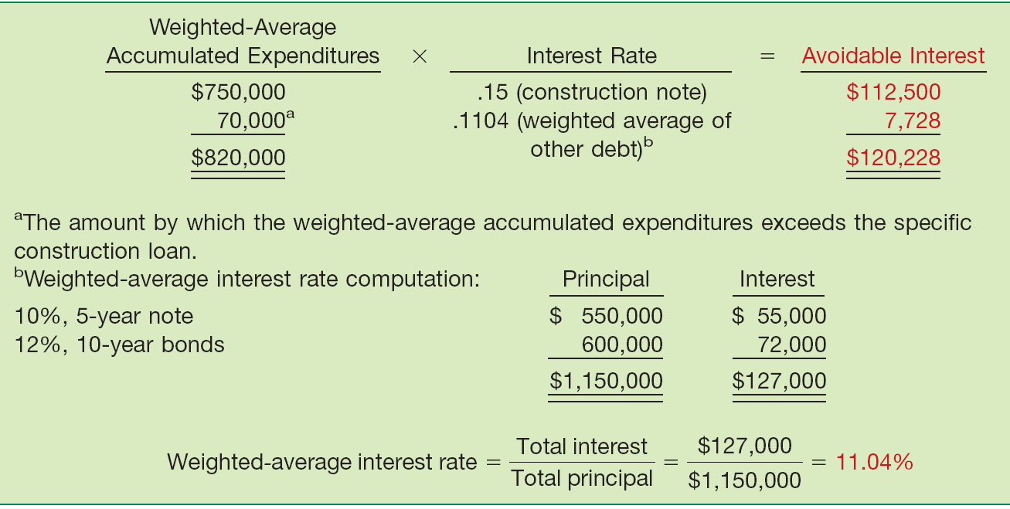
Acquisition of PP&E
Compute the avoidable interest.
Illustration 10-5
LO 4 Describe the accounting problems associated with interest capitalization.

Slide 31
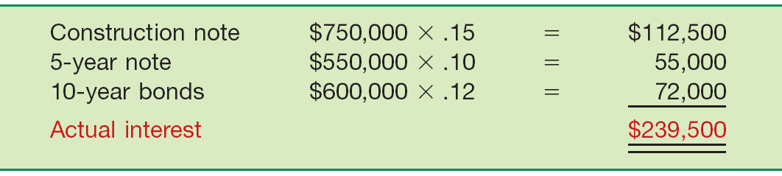
Acquisition of PP&E
Compute the actual interest cost, which represents the maximum amount of interest that it may capitalize during 2011,
Illustration 10-6
The interest cost that Shalla capitalizes is the lesser of $120,228 (avoidable interest) and $239,500 (actual interest), or $120,228.
LO 4 Describe the accounting problems associated with interest capitalization.

Slide 32
Acquisition of PP&E
Shalla records the following journal entries during 2011:
January 1 Land 100,000
Building (or CIP) 110,000
Cash 210,000
March 1 Building 300,000
Cash 300,000
May 1 Building 540,000
Cash 540,000
December 31 Building 450,000
Cash 450,000
Building (Capitalized Interest) 120,228
Interest Expense 119,272
Cash 239,500
LO 4 Describe the accounting problems associated with interest capitalization.

Slide 33
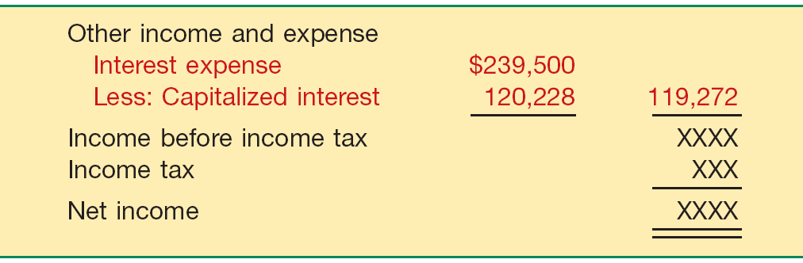
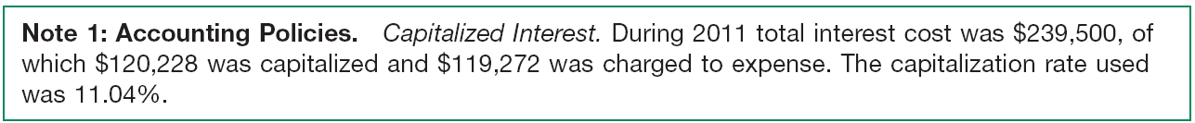
Acquisition of PP&E
At December 31, 2011, Shalla discloses the amount of interest capitalized either as part of the income statement or in the notes accompanying the financial statements.
Illustration 10-7
Illustration 10-8
LO 4 Describe the accounting problems associated with interest capitalization.

Slide 34
Acquisition of PP&E
Special Issues Related to Interest Capitalization
Expenditures for land.
  Interest costs capitalized are part of the cost of the plant, not the land.
Interest revenue.
  Interest revenue should be offset against interest cost when determining the amount of interest to capitalized.
LO 4 Describe the accounting problems associated with interest capitalization.

Slide 35
Valuation of PP&E
Companies should record property, plant, and equipment:
  at the fair value of what they give up or
  at the fair value of the asset received,
whichever is more clearly evident.
LO 5 Understand accounting issues related to acquiring and valuing plant assets.

Slide 36
Valuation of PP&E
Cash Discounts — Whether taken or not — generally considered a reduction in the cost of the asset.
Deferred-Payment Contracts — Assets, purchased through long term credit, are recorded at the present value of the consideration exchanged.
Lump-Sum Purchases — Allocate the total cost among the various assets on the basis of their fair market values.
Issuance of Shares — The market value of the shares issued is a fair indication of the cost of the property acquired.
LO 5 Understand accounting issues related to acquiring and valuing plant assets.

Slide 37
Valuation of PP&E
Exchanges of Nonmonetary Assets
Ordinarily accounted for on the basis of:
  the fair value of the asset given up or
  the fair value of the asset received,
whichever is clearly more evident.
Companies should recognize immediately any gains or losses on the exchange when the transaction has commercial substance.
LO 5 Understand accounting issues related to acquiring and valuing plant assets.

Slide 38
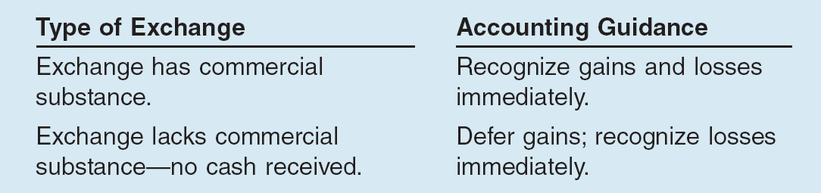
Valuation of PP&E
Meaning of Commercial Substance
Exchange has commercial substance if the future cash flows change as a result of the transaction.
That is, if the two parties’ economic positions change, the transaction has commercial substance.
Illustration 10-10
LO 5 Understand accounting issues related to acquiring and valuing plant assets.

Slide 39
Valuation of PP&E
Exchanges - Loss Situation
Companies recognize a loss immediately whether the exchange has commercial substance or not.
Rationale: Companies should not value assets at more than their cash equivalent price; if the loss were deferred, assets would be overstated.
LO 5 Understand accounting issues related to acquiring and valuing plant assets.

Slide 40
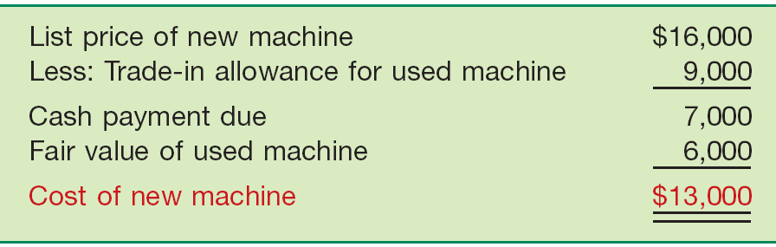
Valuation of PP&E
Illustration: Information Processing, Inc. trades its used machine for a new model at Jerrod Business Solutions Inc. The exchange has commercial substance. The used machine has a book value of $8,000 (original cost $12,000 less $4,000 accumulated depreciation) and a fair value of $6,000. The new model lists for $16,000. Jerrod gives Information Processing a trade-in allowance of $9,000 for the used machine. Information Processing computes the cost of the new asset as follows.
Illustration 10-11
LO 5 Understand accounting issues related to acquiring and valuing plant assets.

Slide 41
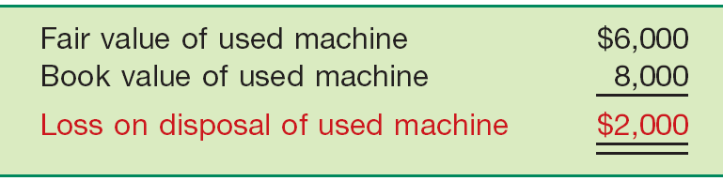
Valuation of PP&E
Illustration: Information Processing records this transaction as follows:
Equipment 13,000
Accumulated Depreciation—Equipment 4,000
Loss on Disposal of Equipment 2,000
Equipment 12,000
Cash 7,000
Illustration 10-12
Loss on Disposal
LO 5 Understand accounting issues related to acquiring and valuing plant assets.

Slide 42
Valuation of PP&E
Exchanges - Gain Situation
Has Commercial Substance. Company usually records the cost of a nonmonetary asset acquired in exchange for another nonmonetary asset at the fair value of the asset given up, and immediately recognizes a gain.
LO 5 Understand accounting issues related to acquiring and valuing plant assets.

Slide 43
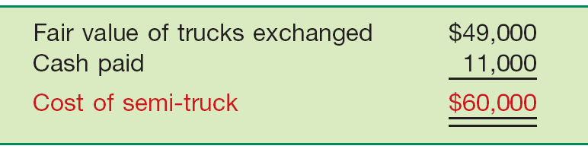
Valuation of PP&E
Illustration: Interstate Transportation Company exchanged a number of used trucks plus cash for a semi-truck. The used trucks have a combined book value of $42,000 (cost $64,000 less $22,000 accumulated depreciation). Interstate’s purchasing agent, experienced in the second-hand market, indicates that the used trucks have a fair market value of $49,000. In addition to the trucks, Interstate must pay $11,000 cash for the semi-truck. Interstate computes the cost of the semi-truck as follows.
Illustration 10-13
LO 5 Understand accounting issues related to acquiring and valuing plant assets.

Slide 44
Valuation of PP&E
Illustration: Interstate records the exchange transaction as follows:
Semi-truck 60,000
Accumulated Depreciation—Trucks 22,000
Trucks 64,000
Gain on disposal of Used Trucks 7,000
Cash 11,000
Illustration 10-14
Gain on Disposal
LO 5 Understand accounting issues related to acquiring and valuing plant assets.

Slide 45
Valuation of PP&E
Exchanges - Gain Situation
Lacks Commercial Substance.
Now assume that Interstate Transportation Company exchange lacks commercial substance. That is, the economic position of Interstate did not change significantly as a result of this exchange. In this case, Interstate defers the gain of $7,000 and reduces the basis of the semi-truck.
LO 5 Understand accounting issues related to acquiring and valuing plant assets.

Slide 46
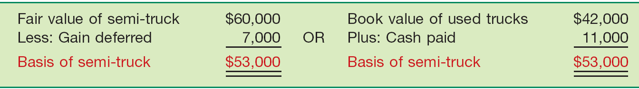
Valuation of PP&E
Illustration: Interstate records the exchange transaction as follows:
Semi-truck 53,000
Accumulated Depreciation—Trucks 22,000
Trucks 64,000
Cash 11,000
Illustration 10-15
LO 5 Understand accounting issues related to acquiring and valuing plant assets.

Slide 47
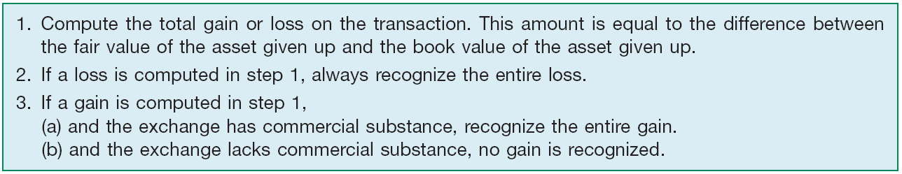
Valuation of PP&E
Summary of Gain and Loss Recognition on Exchanges of Non-Monetary Assets
Illustration 10-16
Disclosure include:
  nature of the transaction(s),
  method of accounting for the assets exchanged, and
  gains or losses recognized on the exchanges.
LO 5 Understand accounting issues related to acquiring and valuing plant assets.

Slide 48
Valuation of PP&E
E10-19: Santana Company exchanged equipment used in its manufacturing operations plus $2,000 in cash for similar equipment used in the operations of Delaware Company. The following information pertains to the exchange.
Instructions: Prepare the journal entries to record the exchange on the books of both companies.
LO 5 Understand accounting issues related to acquiring and valuing plant assets.

Slide 49
Valuation of PP&E
Calculation of Gain or Loss
LO 5 Understand accounting issues related to acquiring and valuing plant assets.

Slide 50
Valuation of PP&E
Has Commercial Substance
Santana:
Equipment 15,500
Accumulated depreciation 19,000
Cash 2,000
Equipment 28,000
Gain on exchange 4,500
Delaware:
Cash 2,000
Equipment 13,500
Accumulated depreciation 10,000
Loss on exchange 2,500
Equipment 28,000
LO 5 Understand accounting issues related to acquiring and valuing plant assets.

Slide 51
Valuation of PP&E
Santana (Has Commercial Substance):
Equipment 15,500
Accumulated depreciation 19,000
Cash 2,000
Equipment 28,000
Gain on disposal of equipment 4,500
Santana (LACKS Commercial Substance):
Equipment (15,500 – 4,500) 11,000
Accumulated depreciation 19,000
Cash 2,000
Equipment 28,000
LO 5 Understand accounting issues related to acquiring and valuing plant assets.

Slide 52
Valuation of PP&E
Delaware (Has Commercial Substance):
Cash 2,000
Equipment 13,500
Accumulated depreciation 10,000
Loss on disposal of equipment 2,500
Equipment 28,000
Delaware (LACKS Commercial Substance):
Cash 2,000
Equipment 13,500
Accumulated depreciation 10,000
Loss on disposal of equipment 2,500
Equipment 28,000
LO 5 Understand accounting issues related to acquiring and valuing plant assets.

Slide 53
Valuation of PP&E
Government Grants
Grants are assistance received from a government in the form of transfers of resources to a company in return for past or future compliance with certain conditions relating to the operating activities of the company.
IFRS requires grants to be recognized in income (income approach) on a systematic basis that matches them with the related costs that they are intended to compensate.
LO 5 Understand accounting issues related to acquiring and valuing plant assets.

Slide 54
Valuation of PP&E
Example 1: Grant for Lab Equipment. AG Company received a €500,000 subsidy from the government to purchase lab equipment on January 2, 2011. The lab equipment cost is €2,000,000, has a useful life of five years, and is depreciated on the straight-line basis.
IFRS allows AG to record this grant in one of two ways:
  Credit Deferred Grant Revenue for the subsidy and amortize the deferred grant revenue over the five-year period.
  Credit the lab equipment for the subsidy and depreciate this amount over the five-year period.
LO 5 Understand accounting issues related to acquiring and valuing plant assets.

Slide 55
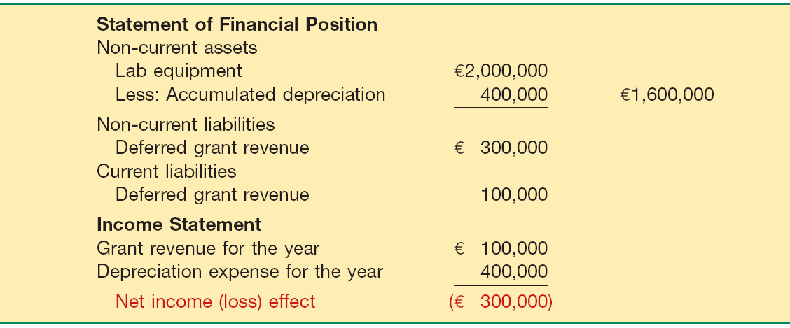
Valuation of PP&E
Example 1: Grant for Lab Equipment. If AG chooses to record deferred revenue of $500,000, it amortizes this amount over the five-year period to income ($100,000 per year). The effects on the financial statements at December 31, 2011, are:
Illustration 10-17
LO 5 Understand accounting issues related to acquiring and valuing plant assets.

Slide 56
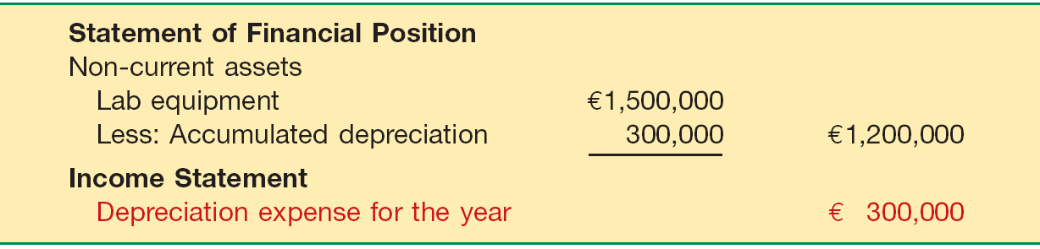
Valuation of PP&E
Example 1: Grant for Lab Equipment. If AG chooses to reduce the cost of the lab equipment, AG reports the equipment at €1,500,000 (€2,000,000 €500,000) and depreciates this amount over the five-year period. The effects on the financial statements at December 31, 2011, are:
Illustration 10-18
LO 5 Understand accounting issues related to acquiring and valuing plant assets.

Slide 57
Valuation of PP&E
Contributions
When a company contributes a non-monetary asset, it should record the amount of the donation as an expense at the fair value of the donated asset.
Illustration: Kline Industries donates land to the City of San Paulo for a city park. The land cost $80,000 and has a fair value of $110,000. Kline Industries records this donation as follows.
Contribution Expense 110,000
Land 80,000
Gain on Disposal of Land 30,000
LO 5 Understand accounting issues related to acquiring and valuing plant assets.

Slide 58
Costs Subsequent to Acquisition
Recognize costs subsequent to acquisition as an asset when the costs can be
  measured reliably and
  it is probable that the company will obtain future economic benefits.
Future economic benefit would include increases in
  useful life,
  quantity of product produced, and
  quality of product produced.
LO 6 Describe the accounting treatment for costs subsequent to acquisition.

Slide 59
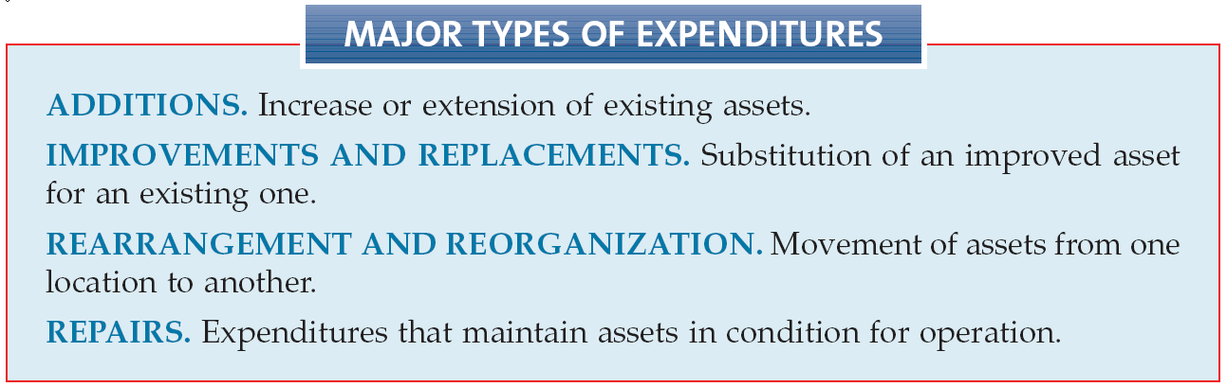
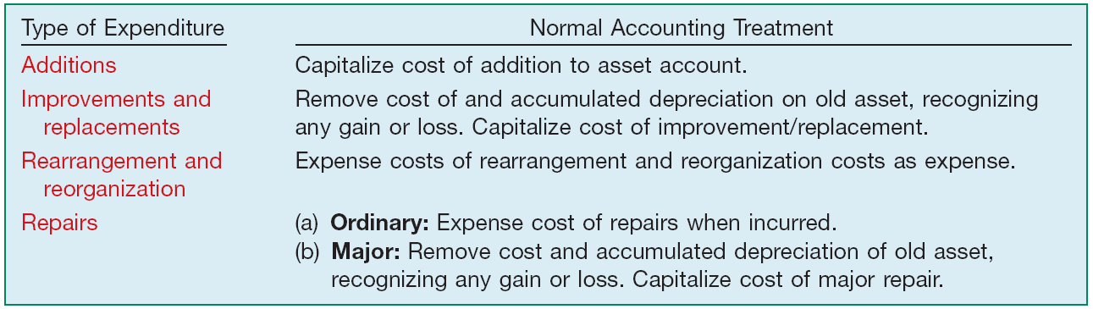
Costs Subsequent to Acquisition
Illustration 10-21
LO 6

Slide 60
Disposition of PP&E
A company may retire plant assets voluntarily or dispose of them by
  sale,
  exchange,
  involuntary conversion, or
  abandonment.
  Depreciation must be taken up to the date of disposition.
LO 7 Describe the accounting treatment for the disposal of property, plant, and equipment.

Slide 61
Disposition of PP&E
Sale of Plant Assets
BE10-15: Ottawa Corporation owns machinery that cost $20,000 when purchased on July 1, 2007. Depreciation has been recorded at a rate of $2,400 per year, resulting in a balance in accumulated depreciation of $8,400 at December 31, 2010. The machinery is sold on September 1, 2011, for $10,500.
Prepare journal entries to
  update depreciation for 2011 and
  record the sale.
LO 7 Describe the accounting treatment for the disposal of property, plant, and equipment.

Slide 62
Disposition of PP&E
a) Depreciation for 2011
Depreciation expense ($2,400 x 8/12) 1,600
Accumulated depreciation 1,600
b) Record the sale
Cash 10,500
Accumulated depreciation 10,000
Machinery 20,000
Gain on sale 500
*
* $8,400 + $1,600 = $10,000
LO 7 Describe the accounting treatment for the disposal of property, plant, and equipment.

Slide 63
Disposition of PP&E
Involuntary Conversion
Sometimes an asset’s service is terminated through some type of involuntary conversion such as fire, flood, theft, or condemnation.
Companies report the difference between the amount recovered (e.g., from a condemnation award or insurance recovery), if any, and the asset’s book value as a gain or loss.
They treat these gains or losses like any other type of disposition.
LO 7 Describe the accounting treatment for the disposal of property, plant, and equipment.

Slide 64
Copyright
Copyright © 2011 John Wiley & Sons, Inc. All rights reserved. Reproduction or translation of this work beyond that permitted in Section 117 of the 1976 United States Copyright Act without the express written permission of the copyright owner is unlawful. Request for further information should be addressed to the Permissions Department, John Wiley & Sons, Inc. The purchaser may make back-up copies for his/her own use only and not for distribution or resale. The Publisher assumes no responsibility for errors, omissions, or damages, caused by the use of these programs or from the use of the information contained herein.

Slide 65
SEKIAN
DAN
TERIMA KASIH

