Slide 1
DEPRECIATION, IMPAIRMENTS, AND DEPLETION
PERTEMUAN #11
EBA302
AKUNTANSI KEUANGAN MENENGAH I + LAB
6542– SRI HANDAYANI, SE, MM, MAk, CPMA
PROGRAM STUDI AKUNTANSI
FAKULTAS EKONOMI DAN BISNIS
UNIVERSITAS ESA UNGGUL

Slide 2
KEMAMPUAN AKHIR YANG DIHARAPKAN
Mahasiswa mampu menganalisis pemrosesan akuntansi mengenai depresiasi, impairment, dan deplesi

Slide 3
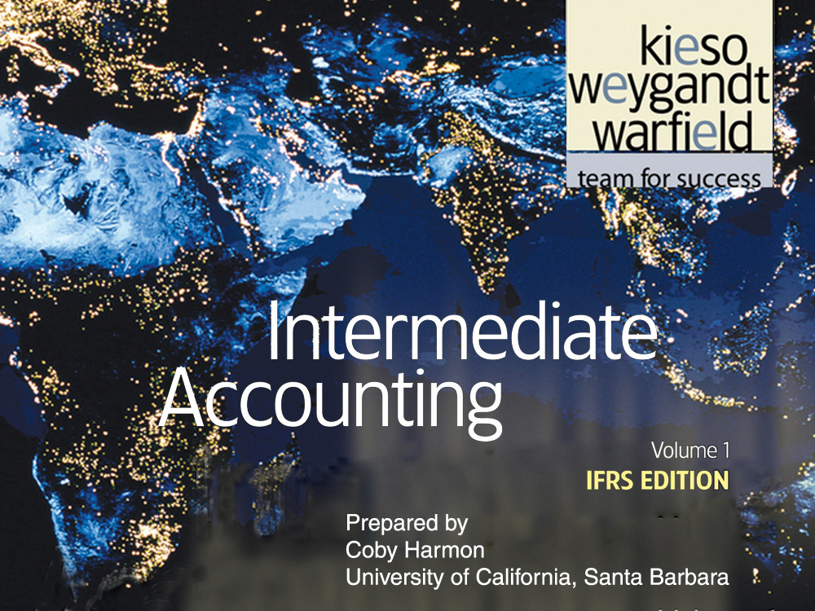

Slide 4
C H A P T E R 11
DEPRECIATION, IMPAIRMENTS, AND DEPLETION
Intermediate Accounting
IFRS Edition
Kieso, Weygandt, and Warfield

Slide 5
Learning Objectives
Explain the concept of depreciation.
Identify the factors involved in the depreciation process.
Compare activity, straight-line, and diminishing-charge methods of depreciation.
Explain component depreciation.
Explain the accounting issues related to asset impairment.
Explain the accounting procedures for depletion of mineral resources.
Explain the accounting for revaluations.
Explain how to report and analyze property, plant, equipment, and mineral resources.

Slide 6
Depreciation, Impairments, and Depletion
Depreciation
Impairments
Depletion
Revaluations
Presentation and Analysis
Factors involved
Methods of depreciation
Component depreciation
Special issues
Recognizing impairments
Impairment illustrations
Reversal of loss
Cash-generating units
Assets to be disposed of
Establishing a base
Write-off of resource cost
Estimating reserves
Liquidating dividends
Presentation
Recognition
Issues
Presentation
Analysis

Slide 7
Depreciation - Method of Cost Allocation
Depreciation is the accounting process of allocating the cost of tangible assets to expense in a systematic and rational manner to those periods expected to benefit from the use of the asset.
Allocating costs of long-term assets:
  Long-lived assets = Depreciation expense
  Intangibles = Amortization expense
  Mineral resources = Depletion expense
LO 1 Explain the concept of depreciation.

Slide 8
Depreciation - Method of Cost Allocation
Factors Involved in the Depreciation Process
Three basic questions:
What depreciable base is to be used?
What is the asset’s useful life?
What method of cost apportionment is best?
LO 2 Identify the factors involved in the depreciation process.

Slide 9
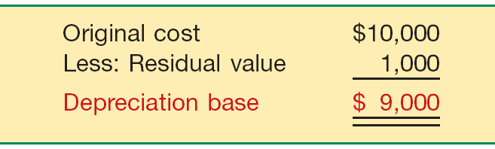
Depreciation - Method of Cost Allocation
Factors Involved in the Depreciation Process
Depreciable Base
Illustration 11-1
LO 2 Identify the factors involved in the depreciation process.

Slide 10
Depreciation - Method of Cost Allocation
Factors Involved in the Depreciation Process
Estimation of Service Lifes
  Service life often differs from physical life.
  Companies retire assets for two reasons:
    Physical factors (casualty or expiration of physical life)
    Economic factors (inadequacy, supersession, and obsolescence).
LO 2 Identify the factors involved in the depreciation process.

Slide 11
Depreciation - Method of Cost Allocation
Methods of Depreciation
The profession requires the method employed be “systematic and rational.” Examples include:
Activity method (units of use or production).
Straight-line method.
Diminishing (accelerated)-charge methods:
  Sum-of-the-years’-digits.
  Declining-balance method.
LO 3 Compare activity, straight-line, and diminishing-charge methods of depreciation.

Slide 12
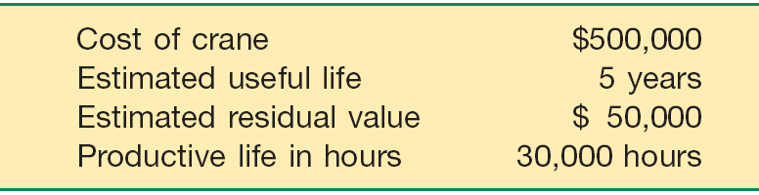
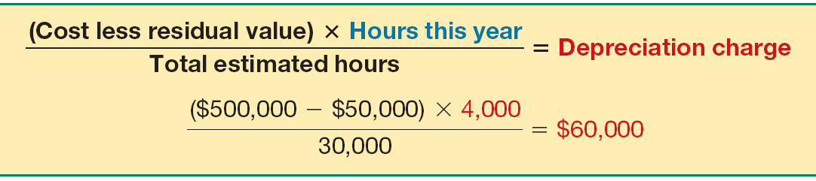
Depreciation - Method of Cost Allocation
Activity Method
Illustration 11-2
Stanley Coal Mines Facts
Illustration: If Stanley uses the crane for 4,000 hours the first year, the depreciation charge is:
Illustration 11-3
LO 3

Slide 13
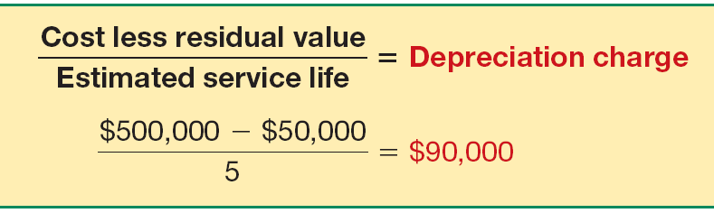
Depreciation - Method of Cost Allocation
Straight-Line Method
Illustration 11-2
Stanley Coal Mines Facts
Illustration: Stanley computes depreciation as follows:
Illustration 11-4
LO 3

Slide 14
Depreciation - Method of Cost Allocation
Diminishing-Charge Methods
Illustration 11-2
Stanley Coal Mines Facts
Sum-of-the-Years’-Digits. Each fraction uses the sum of the years as a denominator (5 + 4 + 3 + 2 + 1 = 15). The numerator is the number of years of estimated life remaining as of the beginning of the year.
Alternate sum-of-the-years’ calculation
n(n+1)
5(5+1)
=
=
15
2
2
LO 3

Slide 15
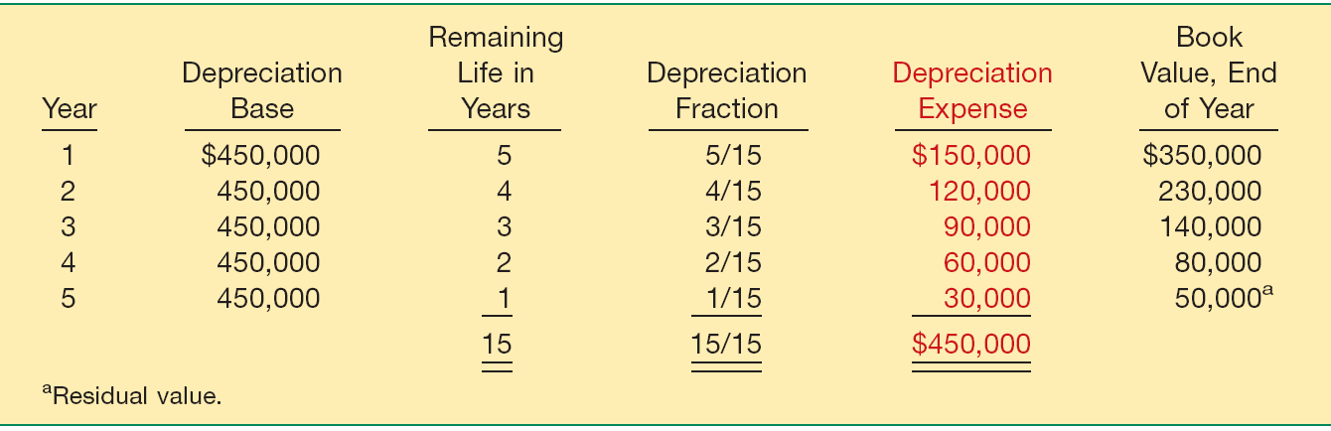
Depreciation - Method of Cost Allocation
Sum-of-the-Years’-Digits
Illustration 11-6
LO 3 Compare activity, straight-line, and diminishing-charge methods of depreciation.

Slide 16
Depreciation - Method of Cost Allocation
Diminishing-Charge Methods
Illustration 11-2
Stanley Coal Mines Facts
Declining-Balance Method.
  Utilizes a depreciation rate (%) that is some multiple of the straight-line method.
  Does not deduct the residual value in computing the depreciation base.
LO 3

Slide 17
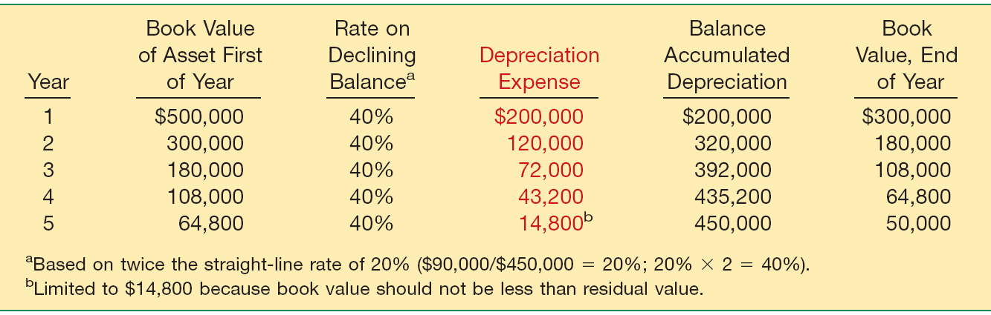
Depreciation - Method of Cost Allocation
Declining-Balance Method
Illustration 11-7
LO 3 Compare activity, straight-line, and diminishing-charge methods of depreciation.

Slide 18
Depreciation - Method of Cost Allocation
Component Depreciation
IFRS requires that each part of an item of property, plant, and equipment that is significant to the total cost of the asset must be depreciated separately.
LO 4 Explain component depreciation.

Slide 19
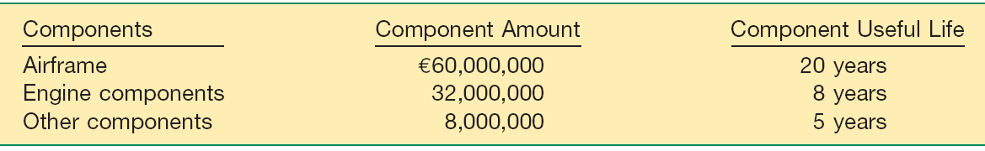
Depreciation - Method of Cost Allocation
Component Depreciation
Illustration: EuroAsia Airlines purchases an airplane for €100,000,000 on January 1, 2011. The airplane has a useful life of 20 years and a residual value of €0. EuroAsia uses the straight-line method of depreciation for all its airplanes. EuroAsia identifies the following components, amounts, and useful lives.
Illustration 11-8
LO 4 Explain component depreciation.

Slide 20
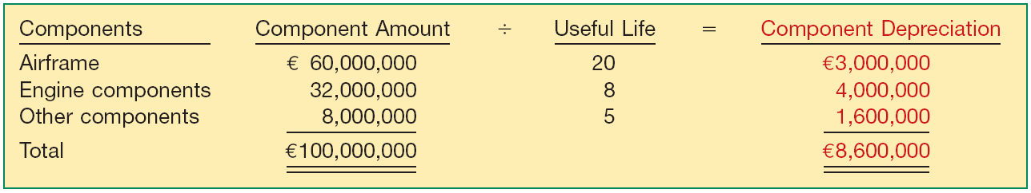
Depreciation - Method of Cost Allocation
Computation of depreciation expense for EuroAsia for 2011.
Illustration 11-9
Depreciation journal entry for 2011.
Depreciation Expense 8,600,000
Accumulated Depreciation—Airplane 8,600,000
LO 4 Explain component depreciation.

Slide 21
Depreciation - Method of Cost Allocation
Special Depreciation Issues
How should companies compute depreciation for partial periods?
Does depreciation provide for the replacement of assets?
How should companies handle revisions in depreciation rates?
LO 4 Explain component depreciation.

Slide 22
Depreciation - Method of Cost Allocation
E11-5 (Depreciation Computations—Four Methods): Maserati Corporation purchased a new machine for its assembly process on August 1, 2010. The cost of this machine was €150,000. The company estimated that the machine would have a salvage value of €24,000 at the end of its service life. Its life is estimated
at 5 years and its working hours are estimated at 21,000 hours. Year-end is December 31.
Instructions: Compute the depreciation expense for 2010 under the following methods.
(a) Straight-line depreciation. (c) Sum-of-the-years’-digits.
(b) Activity method (d) Double-declining balance.
LO 3 Compare activity, straight-line, and diminishing-charge methods of depreciation.

Slide 23
Depreciation - Method of Cost Allocation
Straight-line Method
LO 3 Compare activity, straight-line, and diminishing-charge methods of depreciation.

Slide 24
Depreciation - Method of Cost Allocation
Activity Method
(Assume 800 hours used in 2010)
LO 3

Slide 25
Depreciation - Method of Cost Allocation
5/12 = .416667
7/12 = .583333
Sum-of-the-Years’-Digits Method
LO 3

Slide 26
Depreciation - Method of Cost Allocation
Double-Declining Balance Method
LO 3

Slide 27
Depreciation - Method of Cost Allocation
Depreciation and Replacement of PP&E
Depreciation
  Does not involve a current cash outflow.
  Funds for the replacement of the assets come from the revenues.
LO 4 Explain component depreciation.

Slide 28
Depreciation - Method of Cost Allocation
Revision of Depreciation Rates
  Accounted for in the current and prospective periods.
  Not handled retrospectively
  Not considered errors or extraordinary items
LO 4 Explain component depreciation.

Slide 29
Change in Estimate Example
Arcadia HS, purchased equipment for $510,000 which was estimated to have a useful life of 10 years with a residual value of $10,000 at the end of that time. Depreciation has been recorded for 7 years on a straight-line basis. In 2010 (year 8), it is determined that the total estimated life should be 15 years with a residual value of $5,000 at the end of that time.
Questions:
  What is the journal entry to correct the prior years’ depreciation?
  Calculate the depreciation expense for 2010.
No Entry
Required
LO 4 Explain component depreciation.

Slide 30
Change in Estimate Example
After 7 years
Equipment cost $510,000
Salvage value - 10,000
Depreciable base 500,000
Useful life (original) 10 years
Annual depreciation $ 50,000
First, establish NBV at date of change in estimate.
x 7 years = $350,000
Balance Sheet (Dec. 31, 2009)
Equipment
$510,000
Accumulated depreciation
350,000
Net book value (NBV)
$160,000
LO 4 Explain component depreciation.

Slide 31
Change in Estimate Example
After 7 years
Net book value $160,000
Salvage value (new) 5,000
Depreciable base 155,000
Useful life remaining 8 years
Annual depreciation $ 19,375
Depreciation Expense calculation for 2010.
Journal entry for 2010
Depreciation expense 19,375
Accumulated depreciation 19,375
LO 4 Explain component depreciation.

Slide 32
Impairments
Recognizing Impairments
A long-lived tangible asset is impaired when a company is not able to recover the asset’s carrying amount either through using it or by selling it.
On an annual basis, companies review the asset for indicators of impairments—that is, a decline in the asset’s cash-generating ability through use or sale.
LO 5 Explain the accounting issues related to asset impairment.

Slide 33
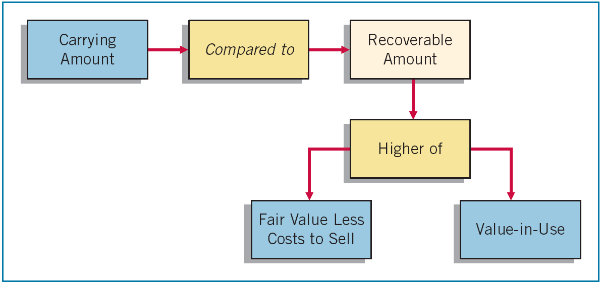
Impairments
Recognizing Impairments
If impairment indicators are present, then an impairment test must be conducted.
Illustration 11-15
LO 5

Slide 34
Impairments
Example: Assume that Cruz Company performs an impairment test for its equipment. The carrying amount of Cruz’s equipment is $200,000, its fair value less costs to sell is $180,000, and its value-in-use is $205,000.
Illustration 11-15
$200,000
$205,000
No Impairment
$180,000
$205,000
LO 5

Slide 35
Impairments
Example: Assume the same information for Cruz Company except that the value-in-use of Cruz’s equipment is $175,000 rather than $205,000.
$20,000 Impairment Loss
Illustration 11-15
$200,000
$180,000
$180,000
$175,000
LO 5

Slide 36
Impairments
Example: Assume the same information for Cruz Company except that the value-in-use of Cruz’s equipment is $175,000 rather than $205,000.
$20,000 Impairment Loss
Illustration 11-15
$200,000
$180,000
Cruz makes the following entry to record the impairment loss.
Loss on Impairment 20,000
Accumulated Depreciation—Equipment 20,000
LO 5

Slide 37
Impairments
Impairments Illustrations
Case 1
At December 31, 2011, Hanoi Company has equipment with a cost of VND26,000,000, and accumulated depreciation of VND12,000,000. The equipment has a total useful life of four years with a residual value of VND2,000,000. The following information relates to this equipment.
  The equipment’s carrying amount at December 31, 2011, is VND14,000,000 (VND26,000,000 VND12,000,000).
  Hanoi uses straight-line depreciation. Depreciation was VND6,000,000 for 2011 and is recorded.
  Hanoi has determined that the recoverable amount for this asset at December 31, 2011, is VND11,000,000.
  The remaining useful life after December 31, 2011, is two years.
LO 5

Slide 38
Impairments
Case 1: Hanoi records the impairment on its equipment at December 31, 2011, as follows.
VND3,000,000 Impairment Loss
Illustration 11-15
VND14,000,000
VND11,000,000
Loss on Impairment 3,000,000
Accumulated Depreciation—Equipment 3,000,000
LO 5

Slide 39
Impairments
Equipment VND 26,000,000
Less: Accumulated Depreciation-Equipment 15,000,000
Carrying value (Dec. 31, 2011) VND 11,000,000
Hanoi Company determines that the equipment’s total useful life has not changed (remaining useful life is still two years). However, the estimated residual value of the equipment is now zero. Hanoi continues to use straight-line depreciation and makes the following journal entry to record depreciation for 2012.
Depreciation Expense 5,500,000
Accumulated Depreciation—Equipment 5,500,000
LO 5

Slide 40
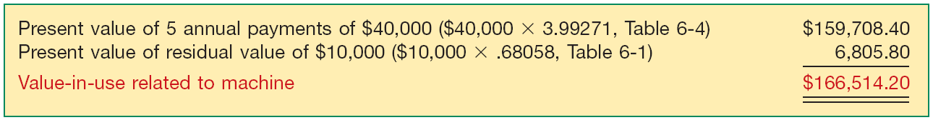
Impairments
Impairments Illustrations
Case 2
At the end of 2010, Verma Company tests a machine for impairment. The machine has a carrying amount of $200,000. It has an estimated remaining useful life of five years. Because there is little market-related information on which to base a recoverable amount based on fair value, Verma determines the machine’s recoverable amount should be based on value-in-use. Verma uses a discount rate of 8 percent. Verma’s analysis indicates that its future cash flows will be $40,000 each year for five years, and it will receive a residual value of $10,000 at the end of the five years. It is assumed that all cash flows occur at the end of the year.
Illustration 11-16
LO 5

Slide 41
Impairments
Case 2: Computation of the impairment loss on the machine at the end of 2010.
$33,486 Impairment Loss
Illustration 11-15
$200,000
$166,514
Unknown
$166,514
LO 5

Slide 42
Impairments
Case 2: Computation of the impairment loss on the machine at the end of 2010.
$33,486 Impairment Loss
Illustration 11-15
$200,000
$166,514
Loss on Impairment 33,486
Accumulated Depreciation—Machine 33,486
Unknown
$166,514
LO 5

Slide 43
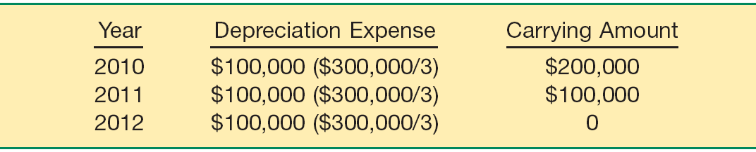
Impairments
Reversal of Impairment Loss
Illustration: Tan Company purchases equipment on January 1, 2010, for $300,000, useful life of three years, and no residual value.
At December 31, 2010, Tan records an impairment loss of $20,000.
Loss on Impairment 20,000
Accumulated Depreciation—Equipment 20,000
LO 5

Slide 44
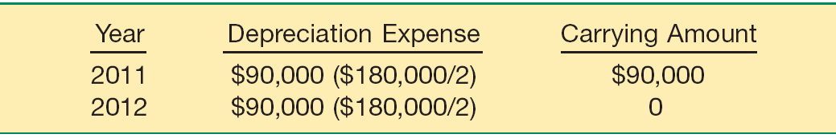
Impairments
Reversal of Impairment Loss
Depreciation expense and related carrying amount after the impairment.
At the end of 2011, Tan determines that the recoverable amount of the equipment is $96,000. Tan reverses the impairment loss.
Accumulated Depreciation—Equipment 6,000
Recovery of Impairment Loss 6,000
LO 5

Slide 45
Impairments
Cash-Generating Units
When it is not possible to assess a single asset for impairment because the single asset generates cash flows only in combination with other assets, companies identify the smallest group of assets that can be identified that generate cash flows independently of the cash flows from other assets.
LO 5 Explain the accounting issues related to asset impairment.

Slide 46
Impairments
Impairment of Assets to Be Disposed Of
Report the impaired asset at the lower-of-cost-or-net realizable value (fair value less costs to sell).
No depreciation or amortization is taken on assets held for disposal during the period they are held.
Can write up or down an asset held for disposal in future periods, as long as the carrying amount after the write up never exceeds the carrying amount of the asset before the impairment.
LO 5 Explain the accounting issues related to asset impairment.

Slide 47
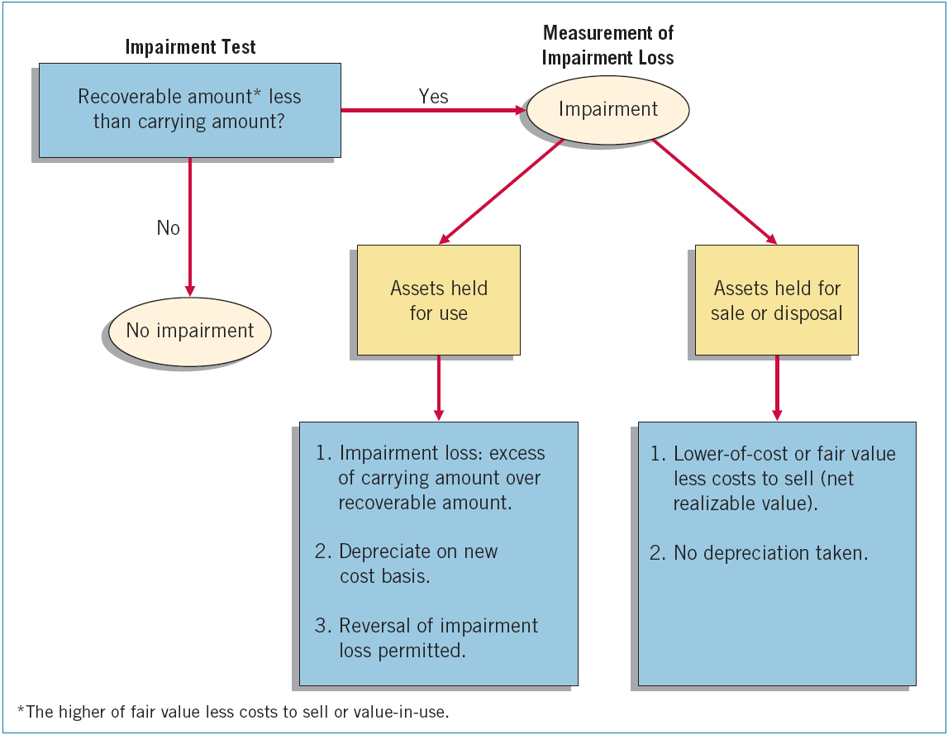
Impairments
Illustration 11-18
Graphic of Accounting for Impairments
LO 5

Slide 48
Depletion
Natural resources can be divided into two categories:
  Biological assets (timberlands)
    Fair value approach (chapter 9)
  Mineral resources (oil, gas, and mineral mining).
    Complete removal (consumption) of the asset.
    Replacement of the asset only by an act of nature.
Depletion - process of allocating the cost of mineral resources.
LO 6 Explain the accounting procedures for depletion of mineral resources.

Slide 49
Depletion
Establishing a Depletion Base
Computation of the depletion base involves:
  Pre-exploratory costs.
  Exploratory and evaluation costs.
  Development costs.
LO 6 Explain the accounting procedures for depletion of mineral resources.

Slide 50
Depletion
Write-off of Resource Cost
Normally, companies compute depletion on a units-of-production method (activity approach). Depletion is a function of the number of units extracted during the period.
Calculation:
Total cost – Residual value
= Depletion cost per unit
Total estimated units available
Units extracted x Cost per unit
= Depletion
LO 6 Explain the accounting procedures for depletion of mineral resources.

Slide 51
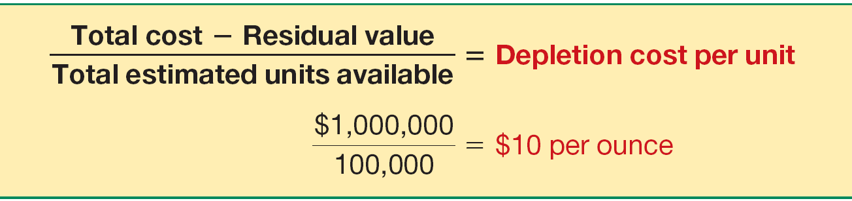
Depletion
Illustration: MaClede Co. acquired the right to use 1,000 acres of land in South Africa to mine for silver. The lease cost is $50,000, and the related exploration costs on the property are $100,000. Intangible development costs incurred in opening the mine are $850,000. MaClede estimates that the mine will provide approximately 100,000 ounces of silver.
Illustration 11-18
LO 6 Explain the accounting procedures for depletion of mineral resources.

Slide 52

Depletion
If MaClede extracts 25,000 ounces in the first year, then the depletion for the year is $250,000 (25,000 ounces x $10).
Inventory 250,000
Accumulated Depletion 250,000
MaClede’s statement of financial position:
Depletion cost related to inventory sold is part of cost of goods sold.
LO 6

Slide 53
Depletion
Estimating Recoverable Reserves
Same as accounting for changes in estimates.
Revise the depletion rate on a prospective basis.
Divides the remaining cost by the new estimate of the recoverable reserves.
LO 6 Explain the accounting procedures for depletion of mineral resources.

Slide 54
Depletion
Liquidating Dividends - Dividends greater than the amount of accumulated net income.
Illustration: Callahan Mining had a retained earnings balance of £1,650,000, accumulated depletion on mineral properties of £2,100,000, and share premium of £5,435,493. Callahan’s board declared a dividend of £3 a share on the 1,000,000 shares outstanding. It records the £3,000,000 cash dividend as follows.
Retained Earnings 1,650,000
Share Premium—Ordinary 1,350,000
Cash 3,000,000
LO 6 Explain the accounting procedures for depletion of mineral resources.

Slide 55
Depletion
Presentation on the Financial Statements
Disclosures related to E&E expenditures should include:
  Accounting policies for exploration and evaluation expenditures, including the recognition of E&E assets.
  Amounts of assets, liabilities, income and expense, and operating cash flow arising from the exploration for and evaluation of mineral resources.
LO 6 Explain the accounting procedures for depletion of mineral resources.

Slide 56
Revaluations
Recognizing Revaluations
Companies may value long-lived tangible asset after acquisition at cost or fair value.
Network Rail (GBR) elected to use fair values to account for its railroad network.
  Increased long-lived tangible assets by £4,289 million.
  Change in the fair value accounted for by adjusting the asset account and establishing an unrealized gain.
  Unrealized gain is often referred to as revaluation surplus.
LO 7 Explain the accounting for revaluations.

Slide 57
Revaluations
Revaluation—Land
Illustration: Siemens Group (DEU) purchased land for €1,000,000 on January 5, 2010. The company elects to use revaluation accounting for the land in subsequent periods. At December 31, 2010, the land’s fair value is €1,200,000. The entry to record the land at fair value is as follows.
Land 200,000
Unrealized Gain on Revaluation - Land 200,000
Unrealized Gain on Revaluation—Land increases other comprehensive income in the statement of comprehensive income.
LO 7 Explain the accounting for revaluations.

Slide 58
Revaluations
Revaluation—Depreciable Assets
Illustration: Lenovo Group (CHN) purchases equipment for ¥500,000 on January 2, 2010. The equipment has a useful life of five years, is depreciated using the straight-line method of depreciation, and its residual value is zero. Lenovo chooses to revalue its equipment to fair value over the life of the equipment. Lenovo records depreciation expense of ¥100,000 (¥500,000 5) at December 31, 2010, as follows.
Depreciation Expense 100,000
Accumulated Depreciation—Equipment 100,000
LO 7 Explain the accounting for revaluations.

Slide 59
Revaluations
Revaluation—Depreciable Assets
After this entry, Lenovo’s equipment has a carrying amount of ¥400,000 (¥500,000 - ¥100,000). Lenovo receives an independent appraisal for the fair value of equipment at December 31, 2010, which is ¥460,000.
Accumulated Depreciation—Equipment 100,000
Equipment 40,000
Unrealized Gain on Revaluation—Equipment 60,000
LO 7 Explain the accounting for revaluations.

Slide 60
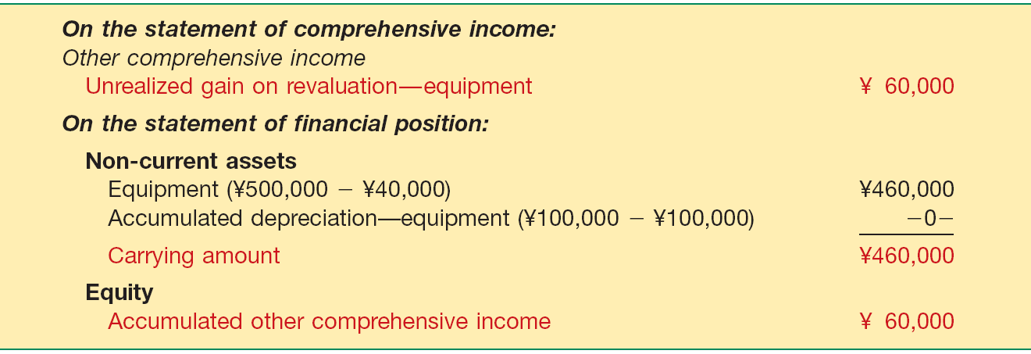
Revaluations
Revaluation—Depreciable Assets
Illustration 11-22
Financial Statement
Presentation—Revaluations
Lenovo reports depreciation expense of ¥100,000. The Accumulated Other Comprehensive Income account related to revaluations cannot have a negative balance.
LO 7 Explain the accounting for revaluations.

Slide 61
Revaluations
Revaluations Issues
Company can select to value only one class of assets, say buildings, and not revalue other assets such as land or equipment.
Most companies do not use revaluation accounting.
  Substantial and continuing costs associated with appraisals.
  Gains associated with revaluations above historical cost are not reported in net income but rather go directly to equity.
  Losses associated with revaluation below historical cost decrease net income. In addition, the higher depreciation charges related to the revalued assets also reduce net income.
LO 7 Explain the accounting for revaluations.

Slide 62
Presentation and Analysis
Presentation of Property, Plant, Equipment, and Mineral Resources
Depreciating assets, use Accumulated Depreciation.
Depleting assets may include use of Accumulated Depletion account, or the direct reduction of asset.
Disclosures
Basis of valuation (usually cost)
Pledges, liens, and other commitments
LO 8 Explain how to report and analyze property, plant, equipment, and mineral resources.

Slide 63
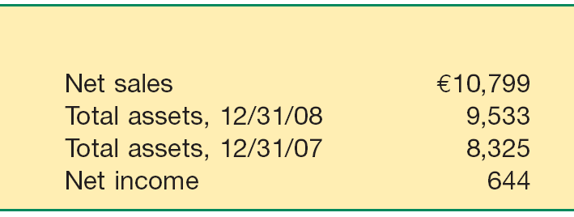

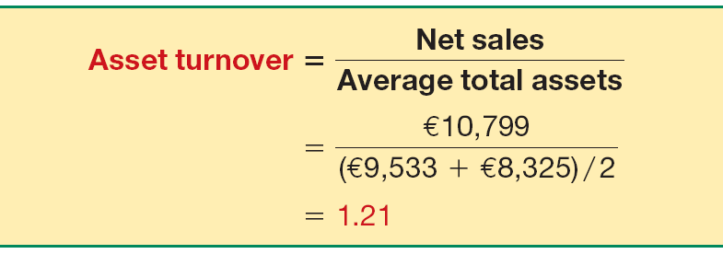
Presentation and Analysis
Analysis of Property, Plant, and Equipment
Asset Turnover Ratio
Measure of a firm’s ability to generate sales from a particular investment in assets.
Illustration 11-24
LO 8

Slide 64

Presentation and Analysis
Analysis of Property, Plant, and Equipment
Profit Margin on Sales
Measure of the ability to generate operating income from a particular level of sales.
Illustration 11-25
LO 8

Slide 65
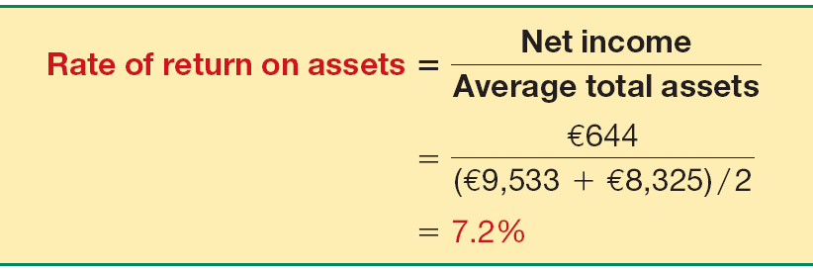
Presentation and Analysis
Analysis of Property, Plant, and Equipment
Rate of Return on Assets
Measures a firm’s success in using assets to generate earnings.
Illustration 11-26
LO 8

Slide 66
Presentation and Analysis
Analyst obtains further insight into the behavior of ROA by disaggregating it into components of profit margin on sales and asset turnover as follows:
Rate of Return on Assets
Profit Margin on Sales
Asset Turnover
=
x
Net Income
Net Income
Net Sales
=
x
Average Total Assets
Net Sales
Average Total Assets
LO 8 Explain how to report and analyze property, plant, equipment, and mineral resources.

Slide 67
Presentation and Analysis
Analyst obtains further insight into the behavior of ROA by disaggregating it into components of profit margin on sales and asset turnover as follows:
Rate of Return on Assets
Profit Margin on Sales
Asset Turnover
=
x
€644
€644
€10,799
=
x
(€9,533 €8,325) / 2
€10,799
(€9,533 €8,325) / 2
7.2%
=
5.96%
x
1.21
LO 8 Explain how to report and analyze property, plant, equipment, and mineral resources.

Slide 68


  Under both iGAAP and U.S. GAAP, interest costs incurred during construction must be capitalized.
  The accounting for exchanges of non-monetary assets has recently converged between IFRS and U.S. GAAP. U.S. GAAP now requires that gains on exchanges of non-monetary assets be recognized if the exchange has commercial substance. This is the same framework used in IFRS.
  U.S. GAAP also views depreciation as allocation of cost over an asset’s life. U.S. GAAP permits the same depreciation methods (straight-line, diminishing-balance, units-of-production) as IFRS.

Slide 69
  IFRS requires component depreciation. Under U.S. GAAP, component depreciation is permitted but is rarely used.
  Under IFRS, companies can use either the historical cost model or the revaluation model. U.S. GAAP does not permit revaluations of property, plant, and equipment or mineral resources.
  In testing for impairments of long-lived assets, U.S. GAAP uses a two-step model to test for impairments. The IFRS impairment test is stricter. However, unlike U.S. GAAP, reversals of impairment losses are permitted.

Slide 70
The general rules for revaluation accounting are as follows.
  When a company revalues its long-lived tangible assets above historical cost, it reports an unrealized gain that increases other comprehensive income. Thus, the unrealized gain bypasses net income, increases other comprehensive income, and increases accumulated other comprehensive income.
  If a company experiences a loss on impairment (decrease of value below historical cost), the loss reduces income and retained earnings. Thus, gains on revaluation increase equity but not net income, whereas losses decrease income and retained earnings (and therefore equity).
LO 9 Explain revaluation accounting procedures.

Slide 71
  If a revaluation increase reverses a decrease that was previously reported as an impairment loss, a company credits the revaluation increase to income using the account Recovery of Impairment Loss up to the amount of the prior loss. Any additional valuation increase above historical cost increases other comprehensive income and is credited to Unrealized Gain on Revaluation.
  If a revaluation decrease reverses an increase that was reported as an unrealized gain, a company first reduces other comprehensive income by eliminating the unrealized gain. Any additional valuation decrease reduces net income and is reported as a loss on impairment.
LO 9 Explain revaluation accounting procedures.

Slide 72
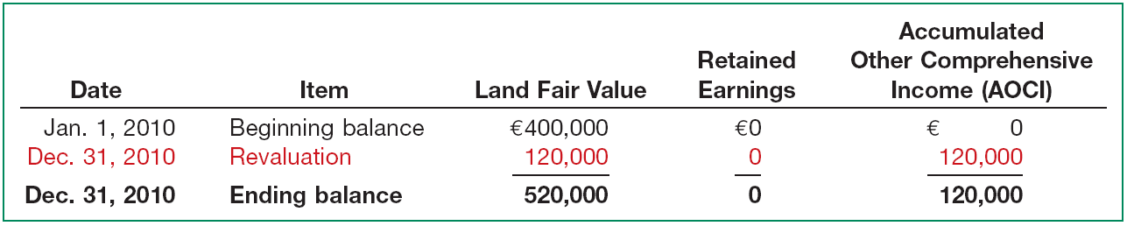
Revaluation of Land
Revaluation—2010: Valuation Increase
Illustration: Unilever Group (GBR and NLD) purchased land on January 1, 2010, that cost €400,000. Unilever decides to report the land at fair value in subsequent periods. At December 31, 2010, an appraisal of the land indicates that its fair value is €520,000. Unilever makes the following entry to record the increase in fair value.
Land 120,000
Unrealized Gain on Revaluation—Land 120,000
Illustration 11A-1
LO 9

Slide 73
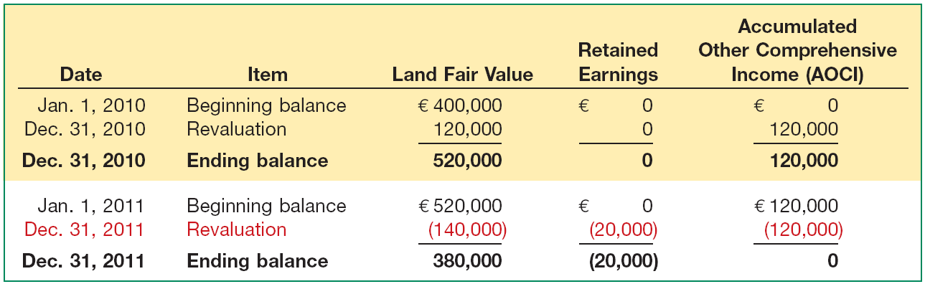
Revaluation of Land
Revaluation—2011: Decrease below Cost
Illustration: What happens if the land’s fair value at December 31, 2011, is €380,000, a decrease of €140,000 (€520,000 - €380,000)?
Unrealized Gain on Revaluation—Land 120,000
Loss on Impairment 20,000
Land 140,000
Illustration 11A-2
LO 9

Slide 74
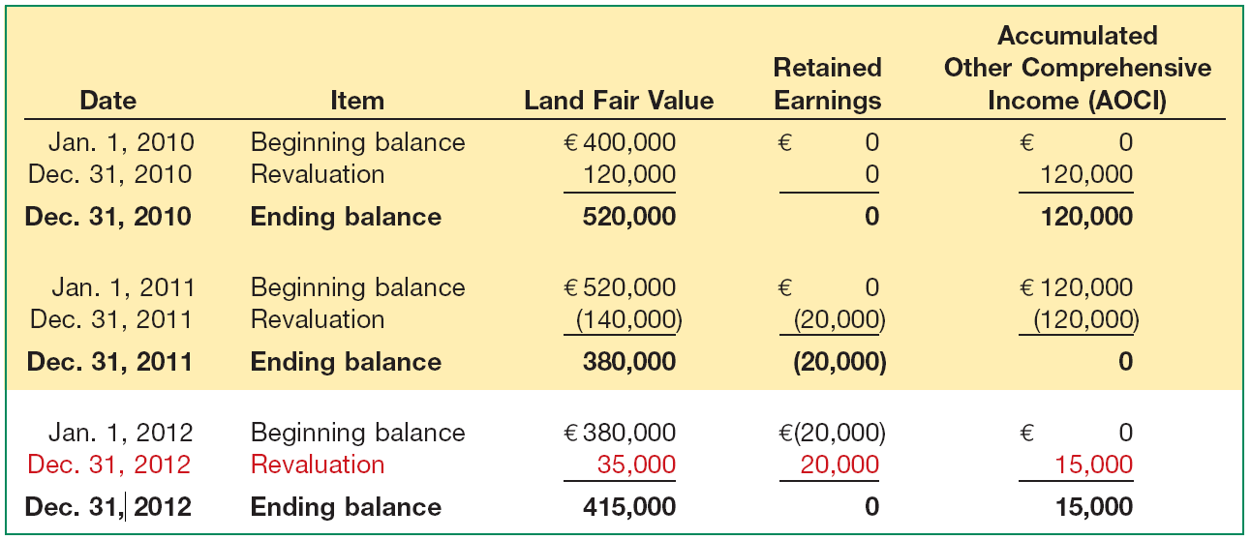
Revaluation of Land
Revaluation—2012: Recovery of Loss
Illustration: At December 31, 2012, Unilever’s land value increases to €415,000, an increase of €35,000 (€415,000 - €380,000).
Land 35,000
Unrealized Gain on Revaluation—Land 15,000
Recovery of Impairment Loss 20,000
Illustration 11A-3
LO 9

Slide 75
Copyright
Copyright © 2011 John Wiley & Sons, Inc. All rights reserved. Reproduction or translation of this work beyond that permitted in Section 117 of the 1976 United States Copyright Act without the express written permission of the copyright owner is unlawful. Request for further information should be addressed to the Permissions Department, John Wiley & Sons, Inc. The purchaser may make back-up copies for his/her own use only and not for distribution or resale. The Publisher assumes no responsibility for errors, omissions, or damages, caused by the use of these programs or from the use of the information contained herein.

Slide 76
SEKIAN
DAN
TERIMA KASIH

