Slide 1
INTANGIBLE ASSETS
PERTEMUAN #12
EBA302
AKUNTANSI KEUANGAN MENENGAH I + LAB
6542– SRI HANDAYANI, SE, MM, MAk, CPMA
PROGRAM STUDI AKUNTANSI
FAKULTAS EKONOMI DAN BISNIS
UNIVERSITAS ESA UNGGUL

Slide 2
KEMAMPUAN AKHIR YANG DIHARAPKAN
Mahasiswa mampu menganalisis pemrosesan secara akuntansi mengenai aset tidak berwujud

Slide 3
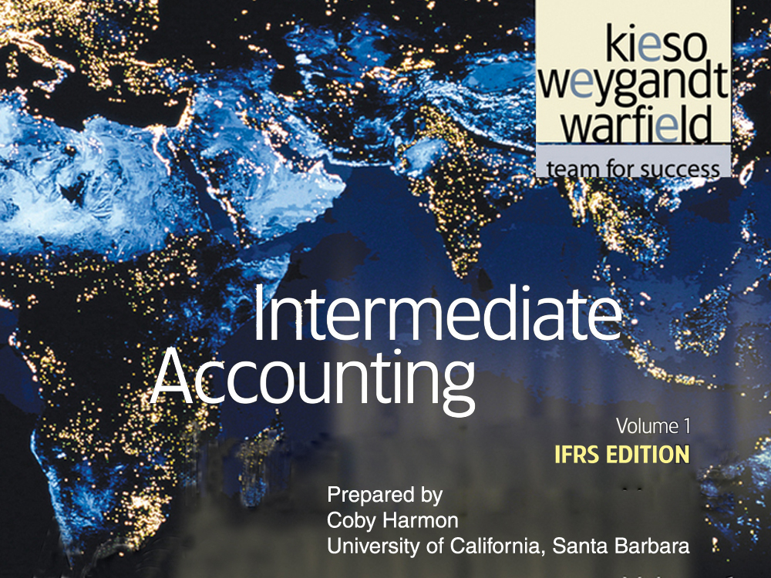

Slide 4
C H A P T E R 12
INTANGIBLE ASSETS
Intermediate Accounting
IFRS Edition
Kieso, Weygandt, and Warfield

Slide 5
Learning Objectives
Describe the characteristics of intangible assets.
Identify the costs to include in the initial valuation of intangible assets.
Explain the procedure for amortizing intangible assets.
Describe the types of intangible assets.
Explain the conceptual issues related to goodwill.
Describe the accounting procedures for recording goodwill.
Explain the accounting issues related to intangible asset impairments.
Identify the conceptual issues related to research and development costs.
Describe the accounting for research and development and similar costs.
Indicate the presentation of intangible assets and related items.

Slide 6
Intangible Assets
Intangible Asset Issues
Types of Intangibles
Impairment of Intangibles
Research and Development Costs
Presentation of Intangibles and Related Items
Characteristics
Valuation
Amortization
Marketing-related
Customer-related
Artistic-related
Contract-related
Technology-related
Goodwill
Limited-life intangibles
Reversal of impairment loss
Indefinite-life intangibles other than goodwill
Goodwill
Identifying R&D
Accounting for R&D
Similar costs
Conceptual questions
Intangible assets
R&D costs

Slide 7
Intangible Asset Issues
Characteristics
Three Main Characteristics:
Identifiable,
Lack physical existence.
Not monetary assets.
Normally classified as non-current asset.
LO 1 Describe the characteristics of intangible assets.

Slide 8
Intangible Asset Issues
Valuation
Purchased Intangibles:
Recorded at cost.
Includes all costs necessary to make the intangible asset ready for its intended use.
Typical costs include:
Purchase price.
Legal fees.
Other incidental expenses.
LO 2 Identify the costs to include in the initial valuation of intangible assets.

Slide 9
Intangible Asset Issues
Valuation
Internally Created Intangibles:
Companies expense all research phase costs and some development phase costs.
Certain development costs are capitalized once economic viability criteria are met.
IFRS identifies several specific criteria that must be met before development costs are capitalized.
LO 2 Identify the costs to include in the initial valuation of intangible assets.

Slide 10
Intangible Asset Issues
Internally Created Intangibles
Illustration 12-1
Research and
Development Stages
LO 2 Identify the costs to include in the initial valuation of intangible assets.

Slide 11
Intangible Asset Issues
Amortization of Intangibles
Limited-Life Intangibles:
Amortize by systematic charge to expense over useful life.
Credit asset account or accumulated amortization.
Useful life should reflect the periods over which the asset will contribute to cash flows.
Amortization should be cost less residual value.
IFRS requires companies to assess the residual values and useful lives of intangible assets at least annually.
LO 3 Explain the procedure for amortizing intangible assets.

Slide 12
Intangible Asset Issues
Amortization of Intangibles
Indefinite-Life Intangibles:
No foreseeable limit on time the asset is expected to provide cash flows.
No amortization.
Must test indefinite-life intangibles for impairment at least annually.
LO 3 Explain the procedure for amortizing intangible assets.

Slide 13
Intangible Asset Issues
Amortization of Intangibles
Illustration 12-2
Accounting Treatment
for Intangibles
LO 3 Explain the procedure for amortizing intangible assets.

Slide 14
Types of Intangibles
Six Major Categories:
Marketing-related.
Customer-related.
Artistic-related.
Contract-related.
Technology-related.
Goodwill.
LO 4 Describe the types of intangible assets.

Slide 15
Types of Intangibles
Marketing-Related Intangible Assets
Examples:
Trademarks or trade names, newspaper mastheads, Internet domain names, and non-competition agreements.
In the United States trademark or trade name has legal protection for indefinite number of 10 year renewal periods.
Capitalize acquisition costs.
No amortization.
LO 4 Describe the types of intangible assets.

Slide 16
Types of Intangibles
Customer-Related Intangible Assets
Examples:
Customer lists, order or production backlogs, and both contractual and non-contractual customer relationships.
Capitalize acquisition costs.
Amortized to expense over useful life.
LO 4 Describe the types of intangible assets.

Slide 17
Types of Intangibles
Illustration: Green Market Inc. acquires the customer list of a large newspaper for €6,000,000 on January 1, 2011. Green Market expects to benefit from the information evenly over a three-year period. Record the purchase of the customer list and the amortization of the customer list at the end of each year.
Jan. 1
Customer List 6,000,000
Cash 6,000,000
Dec. 31
2010
2011
2012
Amortization expense 2,000,000
Customer list 2,000,000
LO 4 Describe the types of intangible assets.

Slide 18
Types of Intangibles
Artistic-Related Intangible Assets
Examples:
Plays, literary works, musical works, pictures, photographs, and video and audiovisual material.
Copyright granted for the life of the creator plus 70 years.
Capitalize costs of acquiring and defending.
Amortized to expense over useful life.
Mickey Mouse
and
LO 4

Slide 19
Types of Intangibles
Contract-Related Intangible Assets
Examples:
Franchise and licensing agreements, construction permits, broadcast rights, and service or supply contracts.
Franchise (or license) with a limited life should be amortized to expense over the life of the franchise.
Franchise with an indefinite life should be carried at cost and not amortized.
LO 4

Slide 20
Types of Intangibles
Technology-Related Intangible Assets
Examples:
Patented technology and trade secrets granted by a governmental body.
Patent gives holder exclusive use for a period of 20 years.
Capitalize costs of purchasing a patent.
Expense any R&D costs in developing a patent.
Amortize over legal life or useful life, whichever is shorter.
LO 4 Describe the types of intangible assets.

Slide 21
Types of Intangibles
Illustration: Harcott Co. incurs $180,000 in legal costs on January 1, 2011, to successfully defend a patent. The patent’s useful life is 20 years, amortized on a straight-line basis. Harcott records the legal fees and the amortization at the end of 2011 as follows.
Jan. 1
Patent 180,000
Cash 180,000
Dec. 31
Patent amortization expense 9,000
Patent 9,000
LO 4 Describe the types of intangible assets.

Slide 22
Types of Intangibles
Goodwill
Conceptually, represents the future economic benefits arising from the other assets acquired in a business combination that are not individually identified and separately recognized.
Only recorded when an entire business is purchased.
Goodwill is measured as the excess of ...
cost of the purchase over the FMV of the identifiable net assets purchased.
Internally created goodwill should not be capitalized.
LO 5 Explain the conceptual issues related to goodwill.

Slide 23
Recording Goodwill
Illustration: Multi-Diversified, Inc. decides that it needs a parts division to supplement its existing tractor distributorship. The president of Multi-Diversified is interested in buying São Paulo, Brazil. The illustration presents the statement of financial position of Tractorling Company.
Illustration 12-4
LO 6 Describe the accounting procedures for recording goodwill.

Slide 24
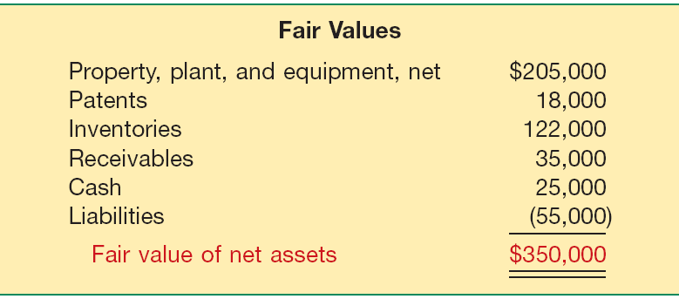
Recording Goodwill
Illustration: Multi-Diversified investigates Tractorling’s underlying assets to determine their fair values.
Illustration 12-5
Tractorling Company decides to accept Multi-Diversified’s offer of $400,000. What is the value of the goodwill, if any?
LO 6 Describe the accounting procedures for recording goodwill.

Slide 25
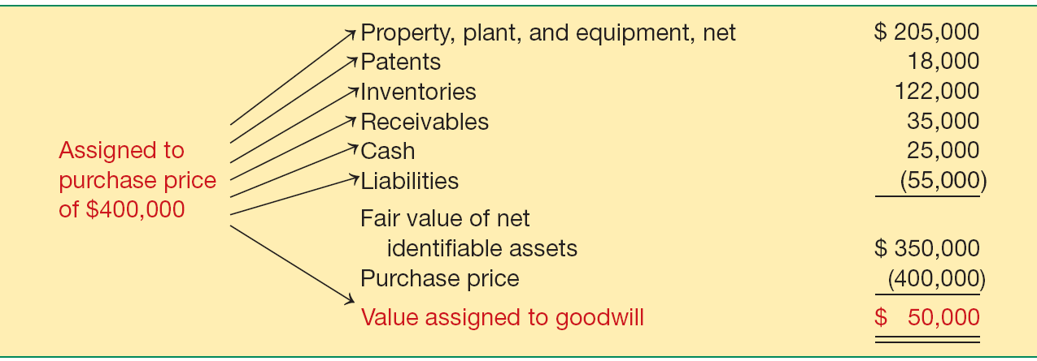
Recording Goodwill
Illustration: Determination of Goodwill.
Illustration 12-6
LO 6 Describe the accounting procedures for recording goodwill.

Slide 26
Recording Goodwill
Illustration: Multi-Diversified records this transaction as follows.
Property, Plant, and Equipment 205,000
Patents 18,000
Inventories 122,000
Receivables 35,000
Cash 25,000
Goodwill 50,000
Liabilities 55,000
Cash 400,000
LO 6 Describe the accounting procedures for recording goodwill.

Slide 27
Goodwill
Goodwill Write-off
Goodwill considered to have an indefinite life.
Should not be amortized.
Only adjust carrying value when goodwill is impaired.
Bargain Purchase
Purchase price less than the fair value of net assets acquired.
Amount is recorded as a gain by the purchaser.
LO 6 Describe the accounting procedures for recording goodwill.

Slide 28
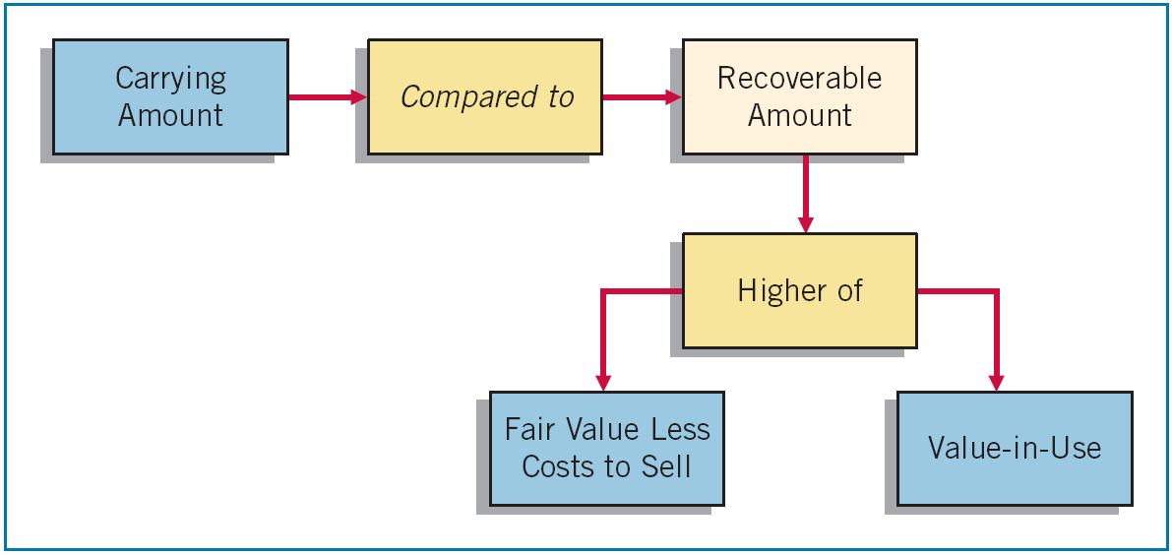
Impairment of Intangible Assets
Impairment of Limited-Life Intangibles
Same as impairment for long-lived assets in Chapter 11.
Illustration 11-15
LO 7 Explain the accounting issues related to intangible-asset impairments.

Slide 29
Impairment of Intangible Assets
Illustration: Lerch, Inc. has a patent on how to extract oil from shale rock, with a carrying value of $5,000,000 at the end of 2010. Unfortunately, several recent non-shale-oil discoveries adversely affected the demand for shale-oil technology, indicating that the patent is impaired. Lerch determines the recoverable amount for the patent, based on value-in-use (because there is no active market for the patent). Lerch estimates the patent’s value-in-use at $2,000,000, based on the discounted expected net future cash flows at its market rate of interest.
LO 7 Explain the accounting issues related to intangible asset impairments.

Slide 30
Impairment of Intangible Assets
Calculate the impairment loss (based on value-in-use).
$3,000,000 Impairment Loss
Illustration 11-15
$5,000,000
$2,000,000
Unknown
$2,000,000
LO 7 Explain the accounting issues related to intangible asset impairments.

Slide 31
Impairment of Intangible Assets
Calculate the impairment loss (based on value-in-use).
$3,000,000 Impairment Loss
Illustration 11-15
$5,000,000
$2,000,000
Entry to record the impairment loss.
Loss on Impairment 3,000,000
Patents 3,000,000
Unknown
$2,000,000
LO 7 Explain the accounting issues related to intangible asset impairments.

Slide 32
Impairment of Intangible Assets
Reversal of Impairment Loss
Illustration: The carrying value of the patent after impairment is $2,000,000. Lerch’s amortization is $400,000 ($2000,000 / 5) over the remaining five years of the patent’s life. The amortization expense and related carrying amount after the impairment is shown below:
Illustration 12-8
LO 7 Explain the accounting issues related to intangible asset impairments.

Slide 33
Impairment of Intangible Assets
Reversal of Impairment Loss
Early in 2012, based on improving conditions in the market for shale-oil technology, Lerch remeasures the recoverable amount of the patent to be $1,750,000. In this case, Lerch reverses a portion of the recognized impairment loss.
Patents ($1,750,000-$1,600,000) 150,000
Loss on Impairment 150,000
LO 7 Explain the accounting issues related to intangible asset impairments.

Slide 34
Impairment of Intangible Assets
Impairment of Indefinite-Life Intangibles Other than Goodwill
Should be tested for impairment at least annually.
Impairment test is the same as that for limited-life intangibles. That is,
compare the recoverable amount of the intangible asset with the asset’s carrying value.
If the recoverable amount is less than the carrying amount, the company recognizes an impairment.
LO 7 Explain the accounting issues related to intangible asset impairments.

Slide 35
Impairment of Intangible Assets
Illustration: Arcon Radio purchased a broadcast license for $2,000,000. The license is renewable every 10 years. Arcon Radio has renewed the license with the GCC twice, at a minimal cost. Because it expects cash flows to last indefinitely, Arcon reports the license as an indefinite-life intangible asset. Recently, the GCC decided to auction these licenses to the highest bidder instead of renewing them. Based on recent auctions of similar licenses, Arcon Radio estimates the fair value less costs to sell (the recoverable amount) of its license to be $1,500,000.
Illustration 12-9
LO 7 Explain the accounting issues related to intangible asset impairments.

Slide 36
Impairment of Intangible Assets
Impairment of Goodwill
Companies must test goodwill at least annually.
Impairment test is conducted based on the cash-generating unit to which the goodwill is assigned.
Because there is rarely a market for cash-generating units, estimation of the recoverable amount for goodwill impairments is usually based on value-in-use estimates.
LO 7 Explain the accounting issues related to intangible asset impairments.

Slide 37
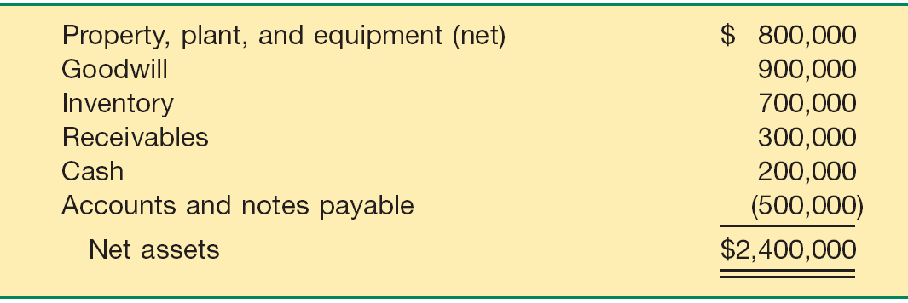
Impairment of Intangible Assets
Illustration: Kohlbuy Corporation has three divisions. It purchased
one division, Pritt Products, four years ago for $2 million. Unfortunately, Pritt experienced operating losses over the last three quarters. Kohlbuy management is now reviewing the division (the cash-generating unit), for purposes of its annual impairment
testing. Pritt Division’s net assets, including the associated goodwill of $900,000 from the purchase:
Illustration 12-10
LO 7

Slide 38
Impairment of Intangible Assets
Kohlbuy determines the recoverable amount for the Pritt Division to be $2,800,000, based on a value-in-use estimate.
Illustration 11-15
$2,400,000
$2,800,000
No Impairment
Unknown
$2,800,000
LO 7

Slide 39
Impairment of Intangible Assets
Assume that the recoverable amount for the Pritt Division is $1,900,000, instead of $2,800,000.
$500,000 Impairment Loss
Illustration 11-15
$2,400,000
$1,900,000
Unknown
$1,900,000
LO 7

Slide 40
Impairment of Intangible Assets
Assume that the recoverable amount for the Pritt Division is $1,900,000, instead of $2,800,000.
$500,000 Impairment Loss
Illustration 11-15
$2,400,000
$1,900,000
Loss on Impairment 500,000
Goodwill 500,000
Unknown
$1,900,000
LO 7

Slide 41
Research and Development Costs
Research and development (R&D) costs are not in themselves intangible assets.
Frequently results in something that a company patents or copyrights such as:
new product,
process,
idea,
formula,
composition, or
literary work.
LO 8 Identify the conceptual issues related to research and development costs.

Slide 42
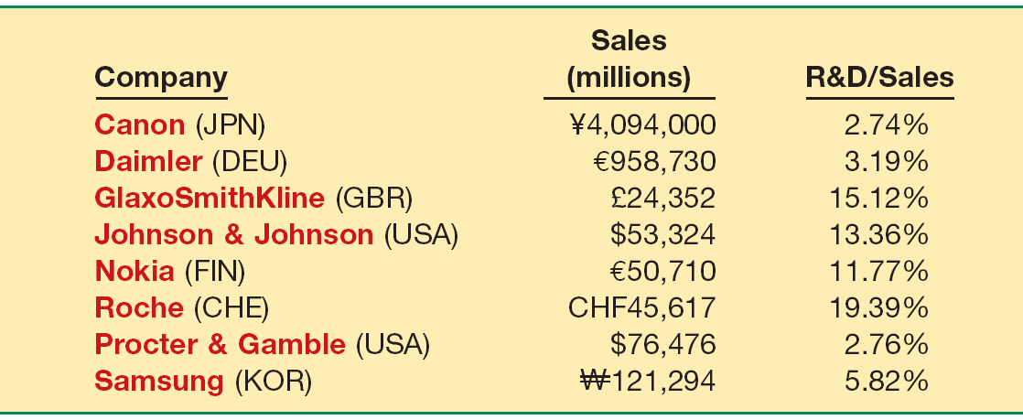
Research and Development Costs
Companies spend considerable sums on research and development.
Illustration 12-12
LO 8 Identify the conceptual issues related to research and development costs.

Slide 43
Research and Development Costs
Research costs must be expensed as incurred.
Development costs may or may not be expensed as incurred.
Capitalization begins when the project is far enough along in the process such that the economic benefits of the R&D project will flow to the company (the project is economically viable).
LO 8 Identify the conceptual issues related to research and development costs.

Slide 44
Research and Development Costs
Identifying R & D Activities
Illustration 12-13
Research Activities
Original and planned investigation undertaken with the prospect of gaining new scientific or technical knowledge and understanding.
Examples
Laboratory research aimed at discovery of new knowledge; searching for applications of new research findings.
Development Activities
Application of research findings or other
knowledge to a plan or design for the production of new or substantially improved materials, devices, products, processes, systems, or services
before the start of commercial production or use.
Examples
Conceptual formulation and design of possible product or process alternatives; construction of prototypes and
operation of pilot plants.
LO 8 Identify the conceptual issues related to research and development costs.

Slide 45
Research and Development Costs
Accounting for R & D Activities
Costs Associated with R&D Activities:
Materials, Equipment, and Facilities
Personnel
Purchased Intangibles
Contract Services
Indirect Costs
LO 9 Describe the accounting for research and development and similar costs.

Slide 46
Research and Development Costs
E12-1: Indicate how items on the list below would generally be reported in the financial statements.
Item
Classification
1. Investment in a subsidiary company.
2. Timberland.
3. Cost of engineering activity required to advance the design of a product to the manufacturing stage.
4. Lease prepayment.
5. Cost of equipment obtained.
6. Cost of searching for applications of new research findings.
Long-term investments
PP&E
R&D expense
Prepaid rent
PP&E
R&D expense
LO 9

Slide 47
Research and Development Costs
Item
Classification
Cost incurred in the formation of a corporation.
Operating losses incurred in the start-up of a business.
Training costs incurred in start-up of new operation.
Purchase cost of a franchise.
Goodwill generated internally.
Cost of testing in search of product alternatives.
Expense
Operating loss
Expense
Intangible
Not recorded
R&D expense
LO 9 Describe the accounting for research and development and similar costs.

Slide 48
Research and Development Costs
Item
Classification
Goodwill acquired in the purchase of a business.
Cost of developing a patent.
Cost of purchasing a patent from an inventor.
Legal costs incurred in securing a patent.
Unrecovered costs of a successful legal suit to protect the patent.
Intangible
R&D expense
Intangible
Intangible
Intangible
LO 9 Describe the accounting for research and development and similar costs.

Slide 49
Research and Development Costs
Item
Classification
Cost of conceptual formulation of possible product alternatives.
Cost of purchasing a copyright.
Development costs incurred after achieving economic viability.
Long-term receivables.
Cost of developing a trademark.
Cost of purchasing a trademark.
R&D expense
Intangible
Intangible
Long-term investment
Expense
Intangible
LO 9 Describe the accounting for research and development and similar costs.

Slide 50
Research and Development Costs
Other Costs Similar to R & D Costs
Start-up costs for a new operation.
should expensed as incurred.
Initial operating losses.
Should not be capitalized.
Advertising costs.
Should expensed as incurred.
If R&D–related intangibles (often referred to as in-process R&D) are also acquired in a business combination, they are also recognized and measured at fair value.
LO 9 Describe the accounting for research and development and similar costs.

Slide 51
Research and Development Costs
E12-17: Compute the amount to be reported as research and development expense.
$330,000 / 5 = $66,000
R&D Expense
Cost of equipment acquired that will have alternative uses in future R&D projects over the next 5 years.
$330,000
$66,000
Materials consumed in R&D projects
59,000
59,000
Consulting fees paid to outsiders for R&D projects
100,000
100,000
Personnel costs of persons involved in R&D projects
128,000
128,000
Indirect costs reasonably allocable to R&D projects
50,000
50,000
Materials purchased for future R&D projects
34,000
0
$403,000
LO 9 Describe the accounting for research and development and similar costs.

Slide 52
Presentations of Intangibles and Related Items
Presentation of Intangible Assets
Statement of Financial Position
Intangible assets shown as a separate item.
Reporting is similar to the reporting of property, plant, and equipment.
Contra accounts may not be shown for intangibles.
Companies should report as a separate item all intangible assets other than goodwill.
LO 10 Indicate the presentation of intangible assets and related items.

Slide 53
Presentations of Intangibles and Related Items
Presentation of Intangible Assets
Income Statement
Amortization expense.
Impairment losses and reversals other than goodwill separately (usually in the operating section).
LO 10 Indicate the presentation of intangible assets and related items.

Slide 54
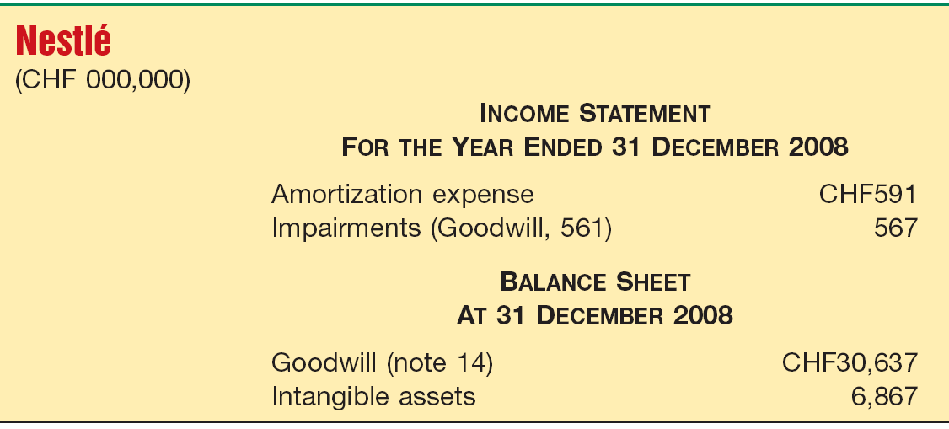
Presentations of Intangibles and Related Items
Presentation of Intangible Assets
Illustration 12-15
LO 10 Indicate the presentation of intangible assets and related items.

Slide 55
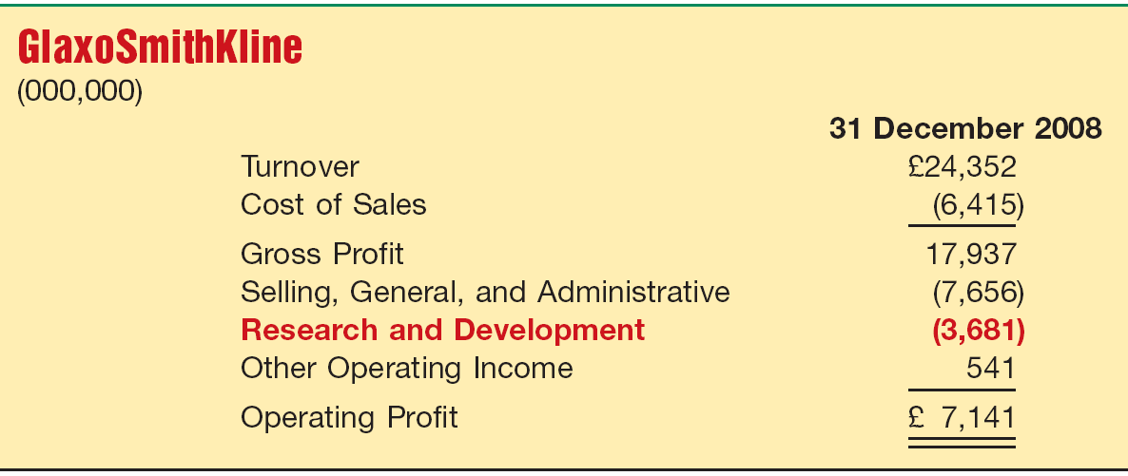
Presentations of Intangibles and Related Items
Presentation of Intangible Assets
Illustration 12-16
LO 10 Indicate the presentation of intangible assets and related items.

Slide 56
Both U.S. GAAP and IFRS segregate the costs associated with research and development into the two components. Costs in the research phase are always expensed under both IFRS and U.S. GAAP. Under IFRS, however, costs in the development phase are capitalized once economic viability is achieved.
While IFRS permits some capitalization of internally generated intangible assets (e.g., brands and development costs that meet economic viability criteria), U.S. GAAP requires expensing of all research and development costs.

Slide 57
Under U.S. GAAP, impairment loss is measured as the excess of the carrying amount over the asset’s fair value. Under IFRS, the impairment test is based on the asset’s carrying amount compared to its recoverable amount (the higher of the asset’s fair value less costs to sell and its value-in-use).
While IFRS allows reversal of impairment losses when there has been a change in economic conditions or in the expected use of the asset, under U.S. GAAP, impairment losses cannot be reversed for assets to be held and used; the impairment loss results in a new cost basis for the asset. IFRS and U.S. GAAP are similar in the accounting for the impairments of assets held for disposal.

Slide 58
With issuance of a recent converged statement on business combinations (IFRS 3 and SFAS No. 141—Revised ), IFRS and U.S. GAAP are very similar for intangibles acquired in a business combination. That is, companies recognize an intangible asset separately from goodwill if the intangible represents contractual or legal rights or is capable of being separated or divided and sold, transferred, licensed, rented, or exchanged. In addition, under both U.S. GAAP and IFRS, companies recognize acquired in-process research and development (IPR&D) as a separate intangible asset if it meets the definition of an intangible asset and its fair value can be measured reliably.

Slide 59
Copyright
Copyright © 2011 John Wiley & Sons, Inc. All rights reserved. Reproduction or translation of this work beyond that permitted in Section 117 of the 1976 United States Copyright Act without the express written permission of the copyright owner is unlawful. Request for further information should be addressed to the Permissions Department, John Wiley & Sons, Inc. The purchaser may make back-up copies for his/her own use only and not for distribution or resale. The Publisher assumes no responsibility for errors, omissions, or damages, caused by the use of these programs or from the use of the information contained herein.

