Slide 1
CURRENT LIABILITIES, PROVISIONS, AND CONTINGENCIES
PERTEMUAN #13
EBA302
AKUNTANSI KEUANGAN MENENGAH I + LAB
6542– SRI HANDAYANI, SE, MM, MAk, CPMA
PROGRAM STUDI AKUNTANSI
FAKULTAS EKONOMI DAN BISNIS
UNIVERSITAS ESA UNGGUL

Slide 2
KEMAMPUAN AKHIR YANG DIHARAPKAN
Mahasiswa mampu menganalisis pemrosesan secara akuntansi mengenai utang jangka pendek

Slide 4
C H A P T E R 13
CURRENT LIABILITIES, PROVISIONS, AND CONTINGENCIES
Intermediate Accounting
IFRS Edition
Kieso, Weygandt, and Warfield

Slide 5
Learning Objectives
Describe the nature, type, and valuation of current liabilities.
Explain the classification issues of short-term debt expected to be refinanced.
Identify types of employee-related liabilities.
Explain the accounting for different types of provisions.
Identify the criteria used to account for and disclose contingent liabilities and assets.
Indicate how to present and analyze liability-related information.

Slide 6
Current Liabilities and Contingencies
Current Liabilities
Provisions
Contingencies
Presentation and Analysis
What is a liability?
What is a current liability?
Recognition
Measurement
Common types
Disclosures
Contingent liabilities
Contingent assets
Presentation of current liabilities
Analysis of current liabilities

Slide 7
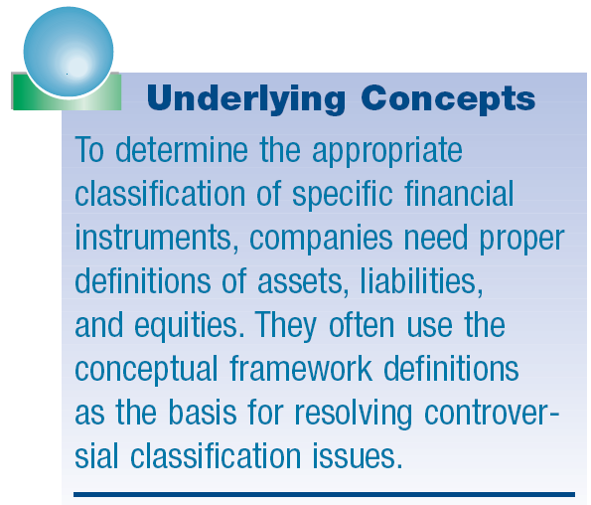
What is a Liability?
Three essential characteristics:
Present obligation.
Arises from past events.
Results in an outflow of resources (cash, goods, services).

Slide 8
What is a Current Liability?
Current liability is reported if one of two conditions exists:
Liability is expected to be settled within its normal operating cycle; or
Liability is expected to be settled within 12 months after the reporting date.
The operating cycle is the period of time elapsing between the acquisition of goods and services and the final cash realization resulting from sales and subsequent collections.
LO 1 Describe the nature, type, and valuation of current liabilities.

Slide 9
What is a Current Liability?
Typical Current Liabilities:
Accounts payable.
Notes payable.
Current maturities of long-term debt.
Short-term obligations expected to be refinanced.
Dividends payable.
Customer advances and deposits.
Unearned revenues.
Sales taxes payable.
Income taxes payable.
Employee-related liabilities.
LO 1 Describe the nature, type, and valuation of current liabilities.

Slide 10
What is a Current Liability?
Accounts Payable (trade accounts payable)
Balances owed to others for goods, supplies, or services purchased on open account.
Time lag between the receipt of services or acquisition of title to assets and the payment for them.
Terms of the sale (e.g., 2/10, n/30 or 1/10, E.O.M.) usually state period of extended credit, commonly 30 to 60 days.
LO 1 Describe the nature, type, and valuation of current liabilities.

Slide 11
What is a Current Liability?
Notes Payable
Written promises to pay a certain sum of money on a specified future date.
Arise from purchases, financing, or other transactions.
Notes classified as short-term or long-term.
Notes may be interest-bearing or zero-interest-bearing.
LO 1 Describe the nature, type, and valuation of current liabilities.

Slide 12
What is a Current Liability?
Interest-Bearing Note Issued
Illustration: Castle National Bank agrees to lend $100,000 on March 1, 2011, to Landscape Co. if Landscape signs a $100,000, 6 percent, four-month note. Landscape records the cash received on March 1 as follows:
Cash 100,000
Notes Payable 100,000
LO 1 Describe the nature, type, and valuation of current liabilities.

Slide 13
What is a Current Liability?
If Landscape prepares financial statements semiannually, it makes the following adjusting entry to recognize interest expense and interest payable at June 30:
Interest calculation =
($100,000 x 6% x 4/12) = $2,000
Interest expense 2,000
Interest payable 2,000
LO 1 Describe the nature, type, and valuation of current liabilities.

Slide 14
What is a Current Liability?
At maturity (July 1), Landscape records payment of the note and accrued interest as follows.
Notes payable 100,000
Interest payable 2,000
Cash 102,000
LO 1 Describe the nature, type, and valuation of current liabilities.

Slide 15
What is a Current Liability?
Zero-Bearing Note Issued
Illustration: On March 1, Landscape issues a $102,000, four-month, zero-interest-bearing note to Castle National Bank. The present value of the note is $100,000. Landscape records this transaction as follows.
Cash 100,000
Notes payable 100,000
LO 1 Describe the nature, type, and valuation of current liabilities.

Slide 16
What is a Current Liability?
If Landscape prepares financial statements semiannually, it makes the following adjusting entry to recognize interest expense and the increase in the note payable of $2,000 at June 30.
Interest expense 2,000
Notes payable 2,000
At maturity (July 1), Landscape must pay the note, as follows.
Notes payable 102,000
Cash 102,000
LO 1 Describe the nature, type, and valuation of current liabilities.

Slide 17
What is a Current Liability?
E13-2: (Accounts and Notes Payable) The following are selected 2010 transactions of Darby Corporation.
Sept. 1 - Purchased inventory from Orion Company on account for $50,000. Darby records purchases gross and uses a periodic inventory system.
Oct. 1 - Issued a $50,000, 12-month, 8% note to Orion in payment of account.
Oct. 1 - Borrowed $75,000 from the Shore Bank by signing a 12-month, zero-interest-bearing $81,000 note.
Prepare journal entries for the selected transactions.
LO 1 Describe the nature, type, and valuation of current liabilities.

Slide 18
What is a Current Liability?
Sept. 1 - Purchased inventory from Orion Company on account for $50,000. Darby records purchases gross and uses a periodic inventory system.
Sept. 1 Purchases 50,000
Accounts payable 50,000
LO 1 Describe the nature, type, and valuation of current liabilities.

Slide 19
What is a Current Liability?
Oct. 1 - Issued a $50,000, 12-month, 8% note to Orion in payment of account.
Oct. 1 Accounts payable 50,000
Notes payable 50,000
Interest calculation =
($50,000 x 8% x 3/12) = $1,000
Dec. 31 Interest expense 1,000
Interest payable 1,000
LO 1 Describe the nature, type, and valuation of current liabilities.

Slide 20
What is a Current Liability?
Oct. 1 - Borrowed $75,000 from the Shore Bank by signing a 12-month, zero-interest-bearing $81,000 note.
Oct. 1 Cash 75,000
Notes payable 75,000
Interest calculation =
($6,000 x 3/12) = $1,500
Dec. 31 Interest expense 1,500
Notes payable 1,500
LO 1 Describe the nature, type, and valuation of current liabilities.

Slide 21
What is a Current Liability?
Current Maturities of Long-Term Debt
Portion of bonds, mortgage notes, and other long-term indebtedness that matures within the next fiscal year.
Exclude long-term debts maturing currently if they are to be:
Retired by assets accumulated that have not been shown as current assets,
Refinanced, or retired from the proceeds of a new debt issue, or
Converted into ordinary shares.
LO 1 Describe the nature, type, and valuation of current liabilities.

Slide 22
What is a Current Liability?
Short-Term Obligations Expected to Be Refinanced
Exclude from current liabilities if both of the following conditions are met:
Must intend to refinance the obligation on a long-term basis.
Must have an unconditional right to defer settlement of the liability for at least 12 months after the reporting date.
LO 2 Explain the classification issues of short-term debt expected to be refinanced.

Slide 23
What is a Current Liability?
E13-4 (Refinancing of Short-Term Debt): The CFO for Hendricks Corporation is discussing with the company’s chief executive officer issues related to the company’s short-term obligations. Presently, both the current ratio and the acid-test ratio for the company are quite low, and the chief executive officer is wondering if any of these short-term obligations could be reclassified as long-term. The financial reporting date is December 31, 2010. Two short-term obligations were discussed, and the following action was taken by the CFO.
Instructions: Indicate how these transactions should be reported at Dec. 31, 2010, on Hendricks’ statement of financial position.
LO 2

Slide 24
What is a Current Liability?
Short-term obligation A: Hendricks has a $50,000 short-term obligation due on March 1, 2011. The CFO discussed with its lender whether the payment could be extended to March 1, 2013, provided Hendricks agrees to provide additional collateral. An agreement is reached on February 1, 2011, to change the loan terms to extend the obligation’s maturity to March 1, 2013. The financial statements are authorized for issuance on April 1, 2011.
Liability of $50,000
Refinance completed
Liability due for payment
Statement Issuance
Dec. 31, 2010
Feb. 1, 2011
Mar. 1, 2011
Apr. 1, 2011
LO 2 Explain the classification issues of short-term debt expected to be refinanced.

Slide 25
What is a Current Liability?
Short-term obligation A: Hendricks has a $50,000 short-term obligation due on March 1, 2011. The CFO discussed with its lender whether the payment could be extended to March 1, 2013, provided Hendricks agrees to provide additional collateral. An agreement is reached on February 1, 2011, to change the loan terms to extend the obligation’s maturity to March 1, 2013. The financial statements are authorized for issuance on April 1, 2011.
Current Liability of $50,000
Since the agreement was not in place as of the reporting date (December 31, 2010), the obligation should be reported as a current liability.
Dec. 31, 2010
LO 2 Explain the classification issues of short-term debt expected to be refinanced.

Slide 26
What is a Current Liability?
Short-term obligation B: Hendricks also has another short-term obligation of $120,000 due on February 15, 2011. In its discussion with the lender, the lender agrees to extend the maturity date to February 1, 2012. The agreement is signed on December 18, 2010. The financial statements are authorized for issuance on March 31, 2011.
Refinance completed
Liability of $120,000
Liability due for payment
Statement Issuance
Dec. 18, 2010
Dec. 31, 2010
Feb. 15, 2011
Mar. 31, 2011
LO 2 Explain the classification issues of short-term debt expected to be refinanced.

Slide 27
What is a Current Liability?
Short-term obligation B: Hendricks also has another short-term obligation of $120,000 due on February 15, 2011. In its discussion with the lender, the lender agrees to extend the maturity date to February 1, 2012. The agreement is signed on December 18, 2010. The financial statements are authorized for issuance on March 31, 2011.
Non-Current Liability of $120,000
Refinance completed
Since the agreement was in place as of the reporting date (December 31, 2010), the obligation is reported as a non-current liability.
Dec. 18, 2010
Dec. 31, 2010
LO 2 Explain the classification issues of short-term debt expected to be refinanced.

Slide 28
What is a Current Liability?
Dividends Payable
Amount owed by a corporation to its stockholders as a result of board of directors’ authorization.
Generally paid within three months.
Undeclared dividends on cumulative preference shares not recognized as a liability.
Dividends payable in the form of additional shares are not recognized as a liability. Reported in equity.
LO 2 Explain the classification issues of short-term debt expected to be refinanced.

Slide 29
What is a Current Liability?
Customer Advances and Deposits
Returnable cash deposits received from customers and employees.
May be classified as current or non-current liabilities.
LO 2 Explain the classification issues of short-term debt expected to be refinanced.

Slide 30
What is a Current Liability?
Unearned Revenues
Payment received before delivering goods or rendering services?
Illustration 13-2
Unearned and Earned Revenue Accounts
LO 2 Explain the classification issues of short-term debt expected to be refinanced.

Slide 31
What is a Current Liability?
BE13-6: Sports Pro Magazine sold 12,000 annual subscriptions on August 1, 2010, for $18 each. Prepare Sports Pro’s August 1, 2010, journal entry and the December 31, 2010, annual adjusting entry.
Aug. 1 Cash 216,000
Unearned revenue 216,000
(12,000 x $18)
Dec. 31 Unearned revenue 90,000
Subscription revenue 90,000
($216,000 x 5/12 = $90,000)
LO 2 Explain the classification issues of short-term debt expected to be refinanced.

Slide 32
What is a Current Liability?
Sales Taxes Payable
Retailers must collect sales taxes or value-added taxes (VAT) from customers on transfers of tangible personal property and on certain services and then remit to the proper governmental authority.
LO 2 Explain the classification issues of short-term debt expected to be refinanced.

Slide 33
What is a Current Liability?
BE13-7: Dillons Corporation made credit sales of $30,000 which are subject to 6% sales tax. The corporation also made cash sales which totaled $20,670 including the 6% sales tax. (a) prepare the entry to record Dillons’ credit sales. (b) Prepare the entry to record Dillons’ cash sales.
Accounts receivable 31,800
Sales 30,000
Sales tax payable ($30,000 x 6% = $1,800) 1,800
Cash 20,670
Sales ($20,670 ÷ 1.06 = $19,500) 19,500
Sales tax payable 1,170
LO 2

Slide 34
What is a Current Liability?
Income Tax Payable
Businesses must prepare an income tax return and compute the income tax payable.
Taxes payable are a current liability.
Corporations must make periodic tax payments.
Differences between taxable income and accounting income sometimes occur (Chapter 19).
LO 2 Explain the classification issues of short-term debt expected to be refinanced.

Slide 35
What is a Current Liability?
Employee-Related Liabilities
Amounts owed to employees for salaries or wages are reported as a current liability.
Current liabilities may include:
Payroll deductions.
Compensated absences.
Bonuses.
LO 3 Identify types of employee-related liabilities.

Slide 36
What is a Current Liability?
Payroll Deductions
Taxes:
Social Security Taxes
Income Tax Withholding
Illustration 13-3
Summary of Payroll Liabilities
LO 3 Identify types of employee-related liabilities.

Slide 37
What is a Current Liability?
Illustration: Assume a weekly payroll of $10,000 entirely subject to Social Security taxes (8%), with income tax withholding of $1,320 and union dues of $88 deducted. The company records the wages and salaries paid and the employee payroll deductions as follows.
Wages and salaries expense 10,000
Withholding taxes payable 1,320
Social security taxes payable 800
Union dues payable 88
Cash 7,792
LO 3 Identify types of employee-related liabilities.

Slide 38
What is a Current Liability?
Illustration: Assume a weekly payroll of $10,000 entirely subject to Social Security taxes (8%), with income tax withholding of $1,320 and union dues of $88 deducted. The company records the employer payroll taxes as follows.
Payroll tax expense 800
Social security taxes payable 800
The employer must remit to the government its share of Social Security tax along with the amount of Social Security tax deducted from each employee’s gross compensation.
LO 3 Identify types of employee-related liabilities.

Slide 39
What is a Current Liability?
Compensated Absences
Paid absences for vacation, illness and maternity, paternity, and jury leaves.
Vested rights - employer has an obligation to make payment to an employee even after terminating his or her employment.
Accumulated rights - employees can carry forward to future periods if not used in the period in which earned.
Non-accumulating rights - do not carry forward; they lapse if not used.
LO 3 Identify types of employee-related liabilities.

Slide 40
What is a Current Liability?
Illustration: Amutron Inc. began operations on January 1, 2011. The company employs 10 individuals and pays each €480 per week. Employees earned 20 unused vacation weeks in 2011. In 2012, the employees used the vacation weeks, but now they each earn €540 per week. Amutron accrues the accumulated vacation pay on December 31, 2011, as follows.
Wages expense 9,600
Vacation wages payable 9,600
In 2012, it records the payment of vacation pay as follows.
Vacation wages payable 9,600
Wages expense 1,200
Cash 10,800
LO 3

Slide 41
What is a Current Liability?
Profit-Sharing and Bonus Plans
Payments to certain or all employees in addition to their regular salaries or wages.
Bonuses paid are an operating expense.
Unpaid bonuses should be reported as a current liability.
LO 3 Identify types of employee-related liabilities.

Slide 42
Provisions
Provision is a liability of uncertain timing or amount.
Reported either as current or non-current liability.
Common types are
Obligations related to litigation.
Warrantees or product guarantees.
Business restructurings.
Environmental damage.
Uncertainty about the timing or amount of the future expenditure required to settle the obligation.
LO 4 Explain the accounting for different types of provisions.

Slide 43
Recognition of a Provision
Companies accrue an expense and related liability for a provision only if the following three conditions are met:
Warrantees or product guarantees.
Probable that an outflow of resources will be required to settle the obligation; and
A reliable estimate can be made.
LO 4 Explain the accounting for different types of provisions.

Slide 44
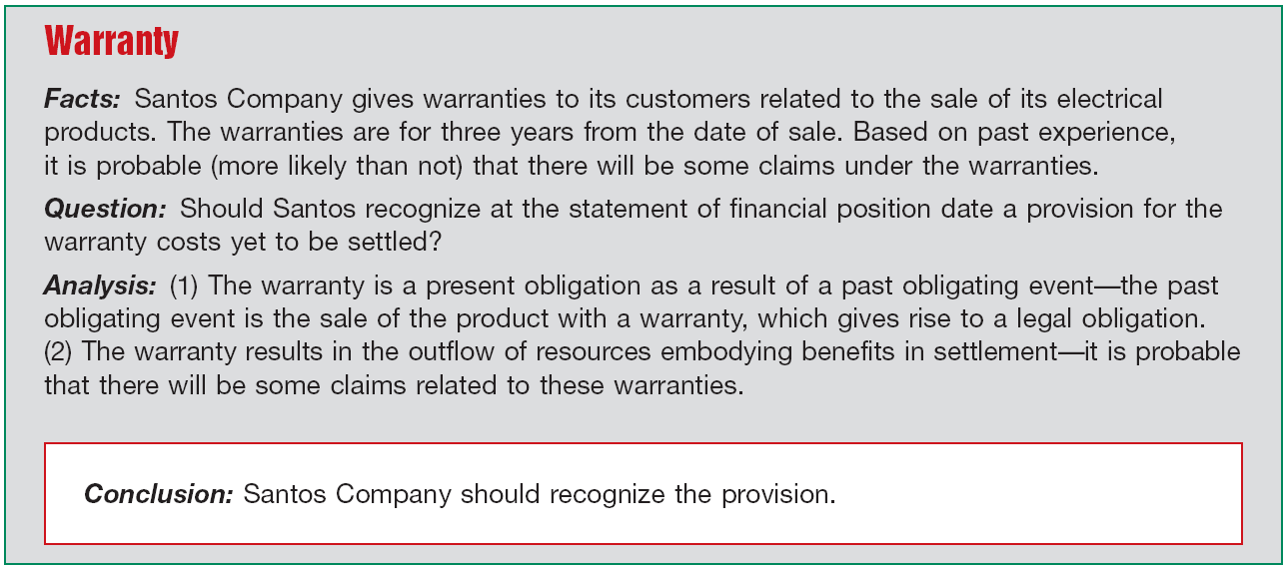
Recognition of a Provision
Recognition Examples
A reliable estimate of the amount of the obligation can be determined.
Illustration 13-4
LO 4

Slide 45
Recognition of a Provision
Recognition Examples
Constructive obligation is an obligation that derives from a company’s actions where:
By an established pattern of past practice, published policies, or a sufficiently specific current statement, the company has indicated to other parties that it will accept certain responsibilities; and
As a result, the company has created a valid expectation on the part of those other parties that it will discharge those responsibilities.
LO 4 Explain the accounting for different types of provisions.

Slide 46
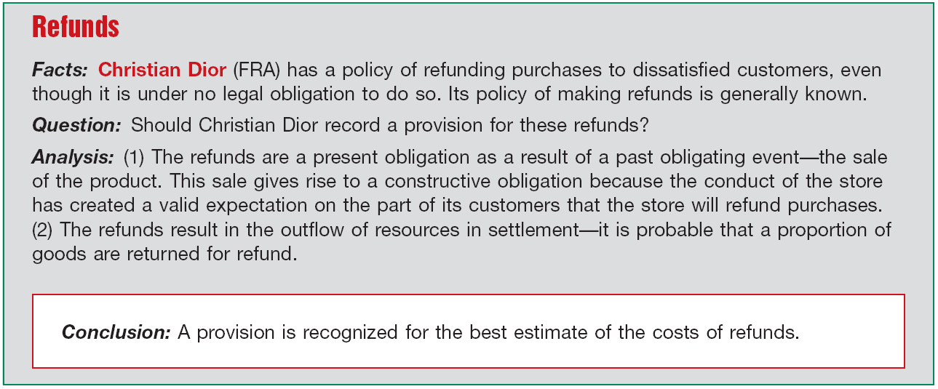
Recognition of a Provision
Recognition Examples
A reliable estimate of the amount of the obligation can be determined.
Illustration 13-5
LO 4

Slide 47
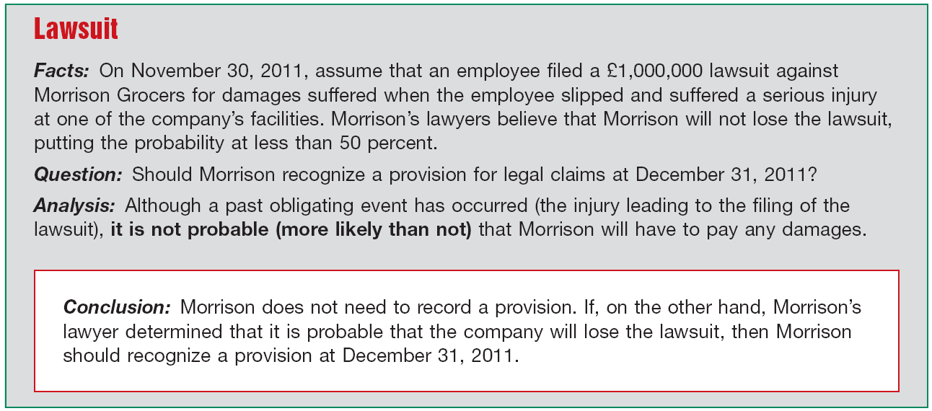
Recognition of a Provision
Recognition Examples
A reliable estimate of the amount of the obligation can be determined.
Illustration 13-6
LO 4

Slide 48
Measurement of Provisions
How does a company determine the amount to report for a provision?
IFRS:
Amount recognized should be the best estimate of the expenditure required to settle the present obligation.
Best estimate represents the amount that a company would pay to settle the obligation at the statement of financial position date.
LO 4 Explain the accounting for different types of provisions.

Slide 49
Measurement of Provisions
Measurement Examples
Management must use judgment, based on past or similar transactions, discussions with experts, and any other pertinent information.
Toyota warranties. Toyota might determine that 80 percent of its cars will not have any warranty cost, 12 percent will have substantial costs, and 8 percent will have a much smaller cost. In this case, by weighting all the possible outcomes by their associated probabilities, Toyota arrives at an expected value for its warranty liability.
LO 4 Explain the accounting for different types of provisions.

Slide 50
Measurement of Provisions
Measurement Examples
Management must use judgment, based on past or similar transactions, discussions with experts, and any other pertinent information.
Carrefour refunds. Carrefour sells many items at varying selling prices. Refunds to customers for products sold may be viewed as a continuous range of refunds, with each point in the range having the same probability of occurrence. In this case, the midpoint in the range can be used as the basis for measuring the amount of the refunds.
LO 4 Explain the accounting for different types of provisions.

Slide 51
Measurement of Provisions
Measurement Examples
Novartis lawsuit. Large companies like Novartis are involved in numerous litigation issues related to their products. Where a single obligation such as a lawsuit is being measured, the most likely outcome of the lawsuit may be the best estimate of the liability.
Measurement of the liability should consider the time value of money. Future events that may have an impact on the measurement of the costs should be considered.
LO 4 Explain the accounting for different types of provisions.

Slide 52
Common Types of Provisions
Common Types:
Lawsuits
Warranties
Premiums
Environmental
Onerous contracts
Restructuring
IFRS requires extensive disclosure related to provisions in the notes to the financial statements, however companies do not record or report in the notes general risk contingencies inherent in business operations (e.g., the possibility of war, strike, uninsurable catastrophes, or a business recession).
LO 4 Explain the accounting for different types of provisions.

Slide 53
Common Types of Provisions
Litigation Provisions
Companies must consider the following in determining whether to record a liability with respect to pending or threatened litigation and actual or possible claims and assessments.
Time period in which the underlying cause of action occurred.
Probability of an unfavorable outcome.
Ability to make a reasonable estimate of the amount of loss.
LO 4 Explain the accounting for different types of provisions.

Slide 54
Common Types of Provisions
Litigation Provisions
With respect to unfiled suits and unasserted claims and assessments, a company must determine
the degree of probability that a suit may be filed or a claim or assessment may be asserted, and
the probability of an unfavorable outcome.
If both are probable, if the loss is reasonably estimable, and if the cause for action is dated on or before the date of the financial statements, then the company should accrue the liability.
LO 4 Explain the accounting for different types of provisions.

Slide 55
Common Types of Provisions
BE13-10: Scorcese Inc. is involved in a lawsuit at December 31, 2010. (a) Prepare the December 31 entry assuming it is probable that Scorcese will be liable for $900,000 as a result of this suit. (b) Prepare the December 31 entry, if any, assuming it is not probable that Scorcese will be liable for any payment as a result of this suit.
(a) Lawsuit loss 900,000
Lawsuit liability 900,000
(b) No entry is necessary. The loss is not accrued because it is not probable that a liability has been incurred at 12/31/10.
LO 4 Explain the accounting for different types of provisions.

Slide 56
Common Types of Provisions
Warranty Provisions
Promise made by a seller to a buyer to make good on a deficiency of quantity, quality, or performance in a product.
If it is probable that customers will make warranty claims and a company can reasonably estimate the costs involved, the company must record an expense.
LO 4 Explain the accounting for different types of provisions.

Slide 57
Common Types of Provisions
Warranty Provisions
Two basic methods of accounting for warranty costs:
Cash-Basis method
Expense warranty costs as incurred, because
it is not probable that a liability has been incurred, or
it cannot reasonably estimate the amount of the liability.
LO 4 Explain the accounting for different types of provisions.

Slide 58
Common Types of Provisions
Warranty Provisions
Two basic methods of accounting for warranty costs:
Accrual-Basis method
Charge warranty costs to operating expense in the year of sale.
Method is the generally accepted method.
Referred to as the expense warranty approach.
LO 4 Explain the accounting for different types of provisions.

Slide 59
Common Types of Provisions
BE13-13: Streep Factory provides a 2-year warranty with one of its products which was first sold in 2010. In that year, Streep spent $70,000 servicing warranty claims. At year-end, Streep estimates that an additional $400,000 will be spent in the future to service warranty claims related to 2010 sales. Prepare Streep’s journal entry to record the $70,000 expenditure, and the December 31 adjusting entry.
2010 Warranty expense 70,000
Cash 70,000
12/31/10 Warranty expense 400,000
Warranty liability 400,000
LO 4 Explain the accounting for different types of provisions.

Slide 60
Common Types of Provisions
Premiums and Coupons
Companies should charge the costs of premiums and coupons to expense in the period of the sale that benefits from the plan.
Accounting:
Estimate the number of outstanding premium offers that customers will present for redemption.
Charge cost of premium offers to Premium Expense and credits Premium Liability.
LO 4 Explain the accounting for different types of provisions.

Slide 61
Common Types of Provisions
Illustration: Fluffy Cakemix Company offered its customers a large non-breakable mixing bowl in exchange for 25 cents and 10 boxtops. The mixing bowl costs Fluffy Cakemix Company 75 cents, and the company estimates that customers will redeem 60 percent of the boxtops. The premium offer began in June 2011 and resulted in the transactions journalized below. Fluffy Cakemix Company records purchase of 20,000 mixing bowls as follows.
Inventory of Premium Mixing Bowls 15,000
Cash 15,000
$20,000 x .75 = $15,000
LO 4 Explain the accounting for different types of provisions.

Slide 62
Common Types of Provisions
Illustration: The entry to record sales of 300,000 boxes of cake mix would be:
300,000 x .80 = $240,000
Cash 240,000
Sales 240,000
Fluffy records the actual redemption of 60,000 boxtops, the receipt of 25 cents per 10 boxtops, and the delivery of the mixing bowls as follows.
Cash [(60,000 / 10) x $0.25] 1,500
Premium Expense 3,000
Inventory of Premium Mixing Bowls 4,500
Computation: (60,000 / 10) x $0.75 = $4,500
LO 4

Slide 63
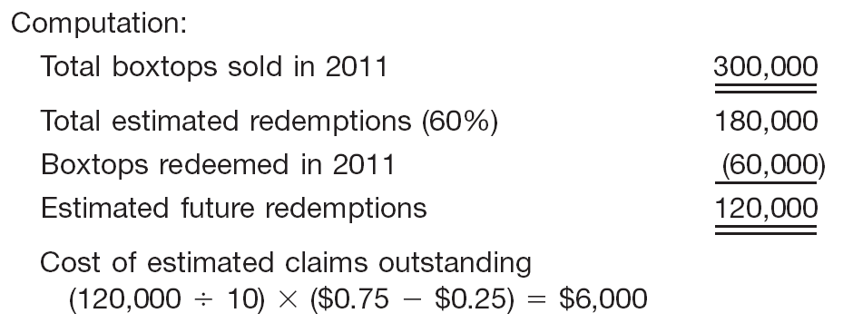
Common Types of Provisions
Illustration: Finally, Fluffy makes an end-of-period adjusting entry for estimated liability for outstanding premium offers (boxtops) as follows.
Premium Expense 6,000
Premium Liability 6,000
LO 4

Slide 64
Common Types of Provisions
Environmental Provisions
A company must recognize an environmental liability when it has an existing legal obligation associated with the retirement of a long-lived asset and when it can reasonably estimate the amount of the liability.
LO 4 Explain the accounting for different types of provisions.

Slide 65
Common Types of Provisions
Environmental Provisions
Obligating Events. Examples of existing legal obligations, which require recognition of a liability include, but are not limited to:
Decommissioning nuclear facilities,
Dismantling, restoring, and reclamation of oil and gas properties,
Certain closure, reclamation, and removal costs of mining facilities,
Closure and post-closure costs of landfills.
LO 4 Explain the accounting for different types of provisions.

Slide 66
Common Types of Provisions
Environmental Provisions
Measurement. A company initially measures an environmental liability at the best estimate of its future costs.
Recognition and Allocation. To record an environmental liability a company includes
the cost associated with the environmental liability in the carrying amount of the related long-lived asset, and
records a liability for the same amount.
LO 4 Explain the accounting for different types of provisions.

Slide 67
Common Types of Provisions
Illustration: On January 1, 2010, Wildcat Oil Company erected an oil platform in the Gulf of Mexico. Wildcat is legally required to dismantle and remove the platform at the end of its useful life, estimated to be five years. Wildcat estimates that dismantling and removal will cost $1,000,000. Based on a 10 percent discount rate, the fair value of the environmental liability is estimated to be $620,920 ($1,000,000 x .62092). Wildcat records this liability on Jan. 1, 2011 as follows.
Drilling platform 620,920
Environmental liability 620,920
LO 4 Explain the accounting for different types of provisions.

Slide 68
Common Types of Provisions
Illustration: During the life of the asset, Wildcat allocates the asset retirement cost to expense. Using the straight-line method, Wildcat makes the following entries to record this expense.
December 31, 2011, 2012, 2013, 2014, 2015
Depreciation expense ($620,920 / 5) 124,184
Accumulated depreciation 124,184
LO 4 Explain the accounting for different types of provisions.

Slide 69
Common Types of Provisions
Illustration: In addition, Wildcat must accrue interest expense each period. Wildcat records interest expense and the related increase in the environmental liability on December 31, 2011, as follows.
December 31, 2011
Interest expense ($620,092 x 10%) 62,092
Environmental liability 62,092
LO 4 Explain the accounting for different types of provisions.

Slide 70
Common Types of Provisions
Illustration: On January 10, 2016, Wildcat contracts with Rig Reclaimers, Inc. to dismantle the platform at a contract price of $995,000. Wildcat makes the following journal entry to
record settlement of the liability.
January 10, 2016
Environmental liability 1,000,000
Gain on settlement of liability 5,000
Cash 995,000
LO 4 Explain the accounting for different types of provisions.

Slide 71
Common Types of Provisions
Onerous Contract Provisions
“The unavoidable costs of meeting the obligations exceed the economic benefits expected to be received.”
The expected costs should reflect the least net cost of exiting from the contract, which is the lower of
the cost of fulfilling the contract, or
the compensation or penalties arising from failure to fulfill the contract.
LO 4 Explain the accounting for different types of provisions.

Slide 72
Common Types of Provisions
Onerous Contract Provisions
Illustration: Sumart Sports operates profitably in a factory that it has leased and on which it pays monthly rentals. Sumart decides to relocate its operations to another facility. However, the lease on the old facility continues for the next three years. Unfortunately, Sumart cannot cancel the lease nor will it be able to sublet the factory to another party. The expected costs to satisfy this onerous contract are €200,000. In this case, Sumart makes the following entry.
Loss on lease contract 200,000
Lease contract liability 200,000
LO 4 Explain the accounting for different types of provisions.

Slide 73
Common Types of Provisions
Onerous Contract Provisions
Assume the same facts as above for the Sumart example and the expected costs to fulfill the contract are €200,000. However, Sumart can cancel the lease by paying a penalty of €175,000. In this case, Sumart should record the liability as follows.
Loss on lease contract 175,000
Lease contract liability 175,000
LO 4 Explain the accounting for different types of provisions.

Slide 74
Common Types of Provisions
Restructuring Provisions
Restructurings are defined as a “program that is planned and controlled by management and materially changes either
the scope of a business undertaken by the company; or
the manner in which that business is conducted.”
Companies are required to have a detailed formal plan for the restructuring and to have raised a valid expectation to those affected by implementation or announcement of the plan.
LO 4 Explain the accounting for different types of provisions.

Slide 75
Common Types of Provisions
Restructuring Provisions
IFRS provides specific guidance related to certain costs and losses that should be excluded from the restructuring provision.
Illustration 13-9
LO 4 Explain the accounting for different types of provisions.

Slide 76
Common Types of Provisions
Restructuring Provisions
Illustration 13-10
LO 4

Slide 77
Common Types of Provisions
Self-Insurance
Self-insurance is not insurance, but risk assumption.
There is little theoretical justification for the establishment of a liability based on a hypothetical charge to insurance expense.
Conditions for accrual stated in IFRS are not satisfied prior to the occurrence of the event.
LO 4 Explain the accounting for different types of provisions.

Slide 78
Disclosures Related To Provisions
A company must provide a reconciliation of its beginning to ending balance for each major class of provisions, identifying what caused the change during the period.
In addition,
Provision must be described and the expected timing of any outflows disclosed.
Disclosure about uncertainties related to expected outflows as well as expected reimbursements should be provided.
LO 4 Explain the accounting for different types of provisions.

Slide 79
Contingent Liabilities
Contingent liabilities are not recognized in the financial statements because they are
A possible obligation (not yet confirmed),
A present obligation for which it is not probable that payment will be made, or
A present obligation for which a reliable estimate of the obligation cannot be made.
LO 5 Identify the criteria used to account for and disclose contingent liabilities and assets.

Slide 80
Contingent Liabilities
Contingent Liabilities Guidelines
Illustration 13-12
LO 5 Identify the criteria used to account for and disclose contingent liabilities and assets.

Slide 81
Contingent Assets
A contingent asset is a possible asset that arises from past events and whose existence will be confirmed by the occurrence or non-occurrence of uncertain future events not wholly within the control of the company. Typical contingent assets are:
Possible receipts of monies from gifts, donations, bonuses.
Possible refunds from the government in tax disputes.
Pending court cases with a probable favorable outcome.
Contingent assets are not recognized on the statement of financial position.
LO 5 Identify the criteria used to account for and disclose contingent liabilities and assets.

Slide 82
Contingent Assets
Contingent Asset Guidelines
Illustration 13-14
Contingent assets are disclosed when an inflow of economic benefits is considered more likely than not to occur (greater than 50 percent).
LO 5 Identify the criteria used to account for and disclose contingent liabilities and assets.

Slide 83
Presentation of Current Liabilities
Presentation of Current Liabilities
Usually reported at their full maturity value.
Difference between present value and the maturity value is considered immaterial.
LO 6 Indicate how to present and analyze liability-related information.

Slide 84
Presentation of Current Liabilities
Illustration 13-15
LO 6 Indicate how to present and analyze liability-related information.

Slide 85
Analysis of Current Liabilities
Liquidity regarding a liability is the expected time to elapse before its payment. Two ratios to help assess liquidity are:
LO 6 Indicate how to present and analyze liability-related information.

Slide 86
Copyright
Copyright © 2011 John Wiley & Sons, Inc. All rights reserved. Reproduction or translation of this work beyond that permitted in Section 117 of the 1976 United States Copyright Act without the express written permission of the copyright owner is unlawful. Request for further information should be addressed to the Permissions Department, John Wiley & Sons, Inc. The purchaser may make back-up copies for his/her own use only and not for distribution or resale. The Publisher assumes no responsibility for errors, omissions, or damages, caused by the use of these programs or from the use of the information contained herein.

