Slide 1
NON-CURRENT LIABILITIES
PERTEMUAN #14
EBA302
AKUNTANSI KEUANGAN MENENGAH I + LAB
6542– SRI HANDAYANI, SE, MM, MAk, CPMA
PROGRAM STUDI AKUNTANSI
FAKULTAS EKONOMI DAN BISNIS
UNIVERSITAS ESA UNGGUL

Slide 2
KEMAMPUAN AKHIR YANG DIHARAPKAN
Mahasiswa mampu menganalisis pemrosesan secara akuntansi mengenai kontinjensi

Slide 3
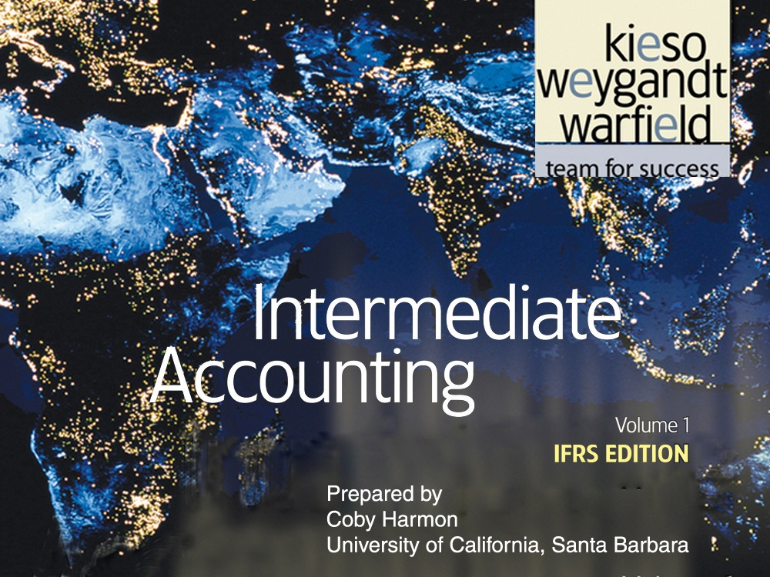

Slide 4
C H A P T E R 14
NON-CURRENT LIABILITIES
Intermediate Accounting
IFRS Edition
Kieso, Weygandt, and Warfield

Slide 5
Learning Objectives
Describe the formal procedures associated with issuing long-term debt.
Identify various types of bond issues.
Describe the accounting valuation for bonds at date of issuance.
Apply the methods of bond discount and premium amortization.
Explain the accounting for long-term notes payable.
Describe the accounting for the extinguishment of non-current liabilities.
Describe the accounting for the fair value option.
Explain the reporting of off-balance-sheet financing arrangements.
Indicate how to present and analyze non-current liabilities.

Slide 6
Long-Term Liabilities
Bonds Payable
Long-Term Notes Payable
Special Issues
Issuing bonds
Types and ratings
Valuation
Effective-interest method
Notes issued at face value
Notes not issued at face value
Special situations
Mortgage notes payable
Extinguishments
Fair value option
Off-balance-sheet financing
Presentation and analysis

Slide 7
Bonds Payable
Non-current liabilities (long-term debt) consist of an expected outflow of resources arising from present obligations that are not payable within a year or the operating cycle of the company, whichever is longer.
Examples:
Bonds payable
Long-term notes payable
Mortgages payable
Pension liabilities
Lease liabilities
Long-term debt has various covenants or restrictions.
LO 1 Describe the formal procedures associated with issuing long-term debt.

Slide 8
Issuing Bonds
Bond contract known as a bond indenture.
Represents a promise to pay:
  sum of money at designated maturity date, plus
  periodic interest at a specified rate on the maturity amount (face value).
Paper certificate, typically a $1,000 face value.
Interest payments usually made semiannually.
Used when the amount of capital needed is too large for one lender to supply.
LO 1 Describe the formal procedures associated with issuing long-term debt.

Slide 9
Types and Ratings of Bonds
Common types found in practice:
  Secured and Unsecured (debenture) bonds.
  Term, Serial, and Callable bonds.
  Convertible, Commodity-Backed, Deep-Discount bonds.
  Registered and Bearer (Coupon) bonds.
  Income and Revenue bonds.
LO 2 Identify various types of bond issues.

Slide 10


Types and Ratings of Bonds
Corporate bond listing.
Company Name
Price as a % of par
Interest rate based on price
Interest rate paid as a % of par value
Creditworthiness
LO 2 Identify various types of bond issues.

Slide 11
Valuation of Bonds Payable
Issuance and marketing of bonds to the public:
  Usually takes weeks or months.
  Issuing company must
    Arrange for underwriters.
    Obtain regulatory approval of the bond issue, undergo audits, and issue a prospectus.
    Have bond certificates printed.
LO 3 Describe the accounting valuation for bonds at date of issuance.

Slide 12
Valuation of Bonds Payable
Selling price of a bond issue is set by the
  supply and demand of buyers and sellers,
  relative risk,
  market conditions, and
  state of the economy.
Investment community values a bond at the present value of its expected future cash flows, which consist of (1) interest and (2) principal.
LO 3 Describe the accounting valuation for bonds at date of issuance.

Slide 13
Valuation of Bonds Payable
Interest Rate
  Stated, coupon, or nominal rate = Rate written in the terms of the bond indenture.
    Bond issuer sets this rate.
    Stated as a percentage of bond face value (par).
  Market rate or effective yield = Rate that provides an acceptable return commensurate with the issuer’s risk.
    Rate of interest actually earned by the bondholders.
LO 3 Describe the accounting valuation for bonds at date of issuance.

Slide 14
Valuation of Bonds Payable
How do you calculate the amount of interest that is actually paid to the bondholder each period?
How do you calculate the amount of interest that is actually recorded as interest expense by the issuer of the bonds?
(Stated rate x Face Value of the bond)
(Market rate x Carrying Value of the bond)
LO 3 Describe the accounting valuation for bonds at date of issuance.

Slide 15
Valuation of Bonds Payable
Assume Stated Rate of 8%
Market Interest
Bonds Sold At
6%
Premium
8%
Par Value
10%
Discount
LO 3

Slide 16
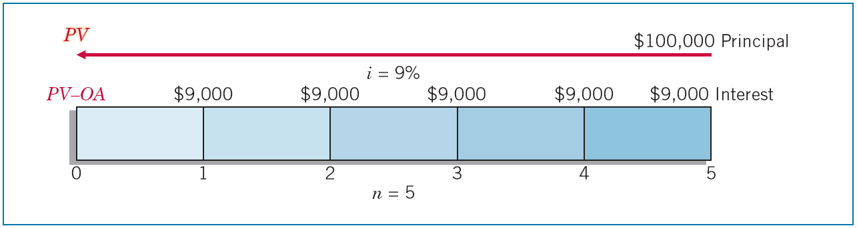
Bonds Issued at Par
Illustration: Santos Company issues $100,000 in bonds dated January 1, 2011, due in five years with 9 percent interest payable annually on January 1. At the time of issue, the market rate for such bonds is 9 percent.
Illustration 14-1
LO 3 Describe the accounting valuation for bonds at date of issuance.

Slide 17
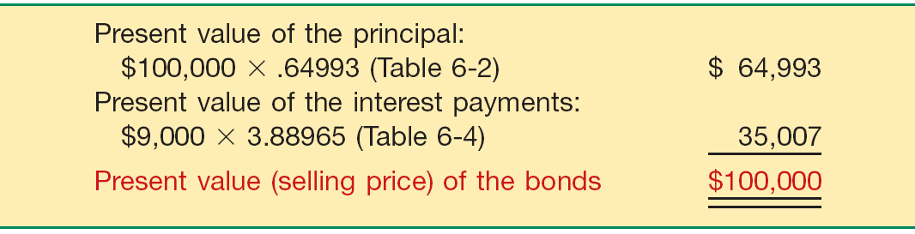
Bonds Issued at Par
Illustration 14-1
Illustration 14-2
LO 3 Describe the accounting valuation for bonds at date of issuance.

Slide 18
Bonds Issued at Par
Journal entry on date of issue, Jan. 1, 2011.
Cash 100,000
Bonds payable 100,000
Journal entry to record accrued interest at Dec. 31, 2011.
Bond interest expense 9,000
Bond interest payable 9,000
Journal entry to record first payment on Jan. 1, 2012.
Bond interest payable 9,000
Cash 9,000
LO 3

Slide 19
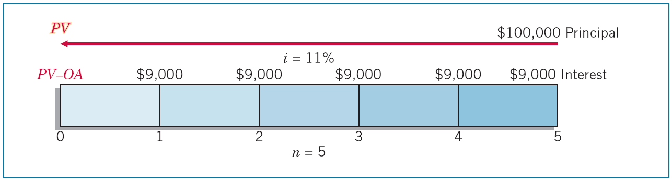
Bonds Issued at a Discount
Illustration: Assuming now that Santos issues $100,000 in bonds, due in five years with 9 percent interest payable annually at year-end. At the time of issue, the market rate for such bonds is 11 percent.
Illustration 14-3
LO 3 Describe the accounting valuation for bonds at date of issuance.

Slide 20
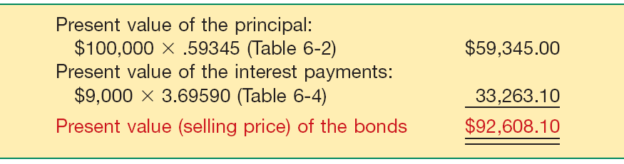
Bonds Issued at a Discount
Illustration 14-3
Illustration 14-4
LO 3 Describe the accounting valuation for bonds at date of issuance.

Slide 21
Bonds Issued at a Discount
Journal entry on date of issue, Jan. 1, 2011.
Cash 92,608
Bonds payable 92,608
Journal entry to record accrued interest at Dec. 31, 2011.
Bond interest expense 10,187
Bond interest payable 9,000
Bonds payable 1,187
Journal entry to record first payment on Jan. 1, 2012.
Bond interest payable 9,000
Cash 9,000
LO 3

Slide 22
Bonds Issued at a Discount
When bonds sell at less than face value:
  Investors demand a rate of interest higher than stated rate.
  Usually occurs because investors can earn a higher rate on alternative investments of equal risk.
  Cannot change stated rate so investors refuse to pay face value for the bonds.
  Investors receive interest at the stated rate computed on the face value, but they actually earn at an effective rate because they paid less than face value for the bonds.
LO 3 Describe the accounting valuation for bonds at date of issuance.

Slide 23
Effective-Interest Method
Bond issued at a discount - amount paid at maturity is more than the issue amount.
Bonds issued at a premium - company pays less at maturity relative to the issue price.
Adjustment to the cost is recorded as bond interest expense over the life of the bonds through a process called amortization.
Required procedure for amortization is the effective-interest method (also called present value amortization).
LO 4 Apply the methods of bond discount and premium amortization.

Slide 24
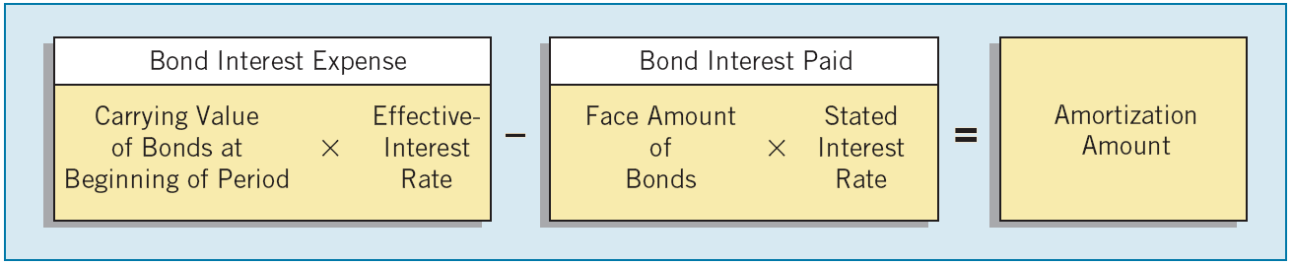
Effective-Interest Method
Effective-interest method produces a periodic interest expense equal to a constant percentage of the carrying value of the bonds.
Illustration 14-5
LO 4 Apply the methods of bond discount and premium amortization.

Slide 25
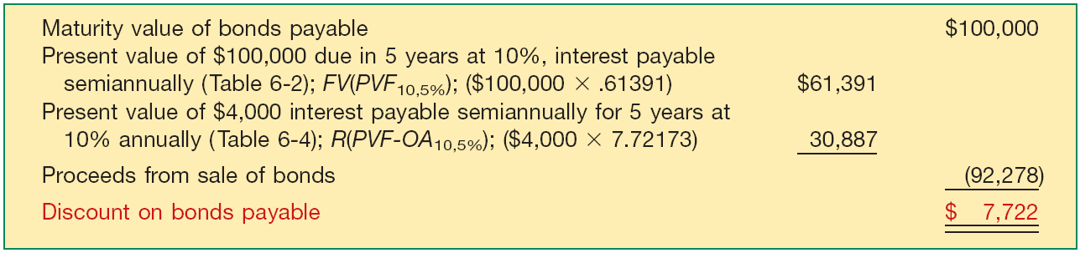
Effective-Interest Method
Bonds Issued at a Discount
Illustration: Evermaster Corporation issued $100,000 of 8% term bonds on January 1, 2011, due on January 1, 2016, with interest payable each July 1 and January 1. Investors require an effective-interest rate of 10%. Calculate the bond proceeds.
Illustration 14-6
LO 4 Apply the methods of bond discount and premium amortization.

Slide 26
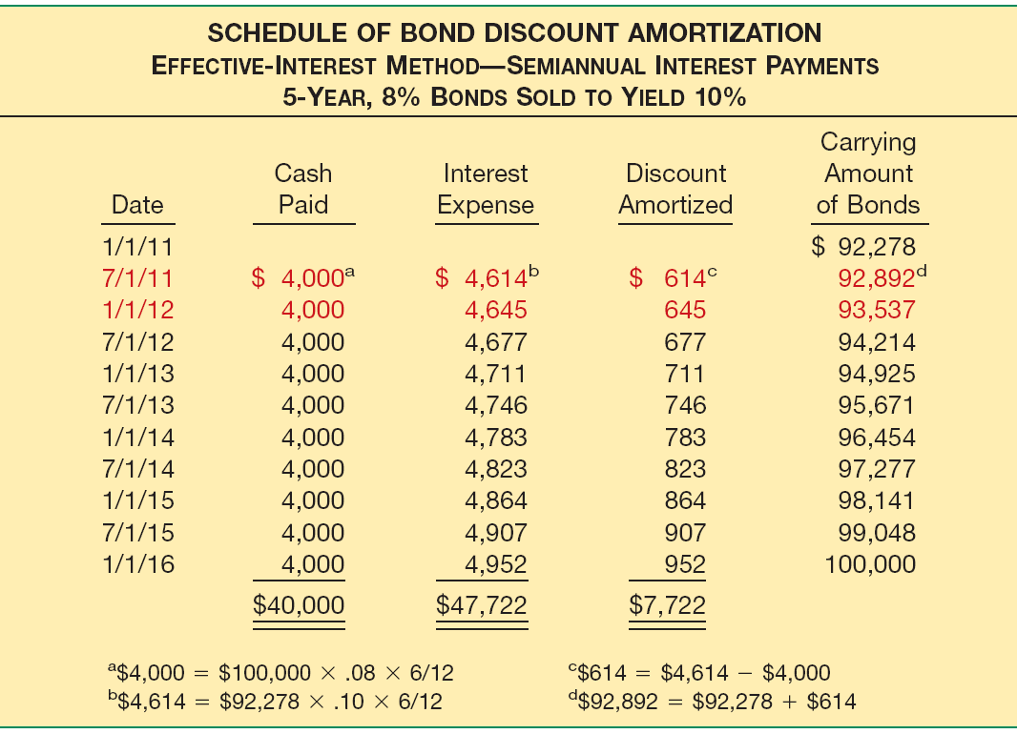
Effective-Interest Method
Illustration 14-7
LO 4

Slide 27
Effective-Interest Method
Illustration 14-7
Journal entry on date of issue, Jan. 1, 2011.
Cash 92,278
Bonds payable 92,278
LO 4

Slide 28
Effective-Interest Method
Illustration 14-7
Journal entry to record first payment and amortization of the discount on July 1, 2011.
Bond interest expense 4,614
Bonds payable 614
Cash 4,000
LO 4

Slide 29
Effective-Interest Method
Illustration 14-7
Journal entry to record accrued interest and amortization of the discount on Dec. 31, 2011.
Bond interest expense 4,645
Bond interest payable 4,000
Bonds payable 645
LO 4

Slide 30
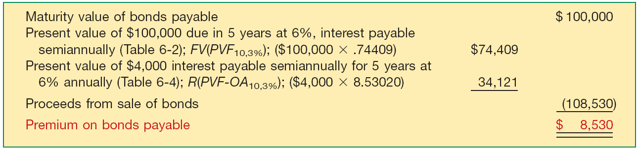
Effective-Interest Method
Bonds Issued at a Premium
Illustration: Evermaster Corporation issued $100,000 of 8% term bonds on January 1, 2011, due on January 1, 2016, with interest payable each July 1 and January 1. Investors require an effective-interest rate of 6%. Calculate the bond proceeds.
Illustration 14-8
LO 4 Apply the methods of bond discount and premium amortization.

Slide 31
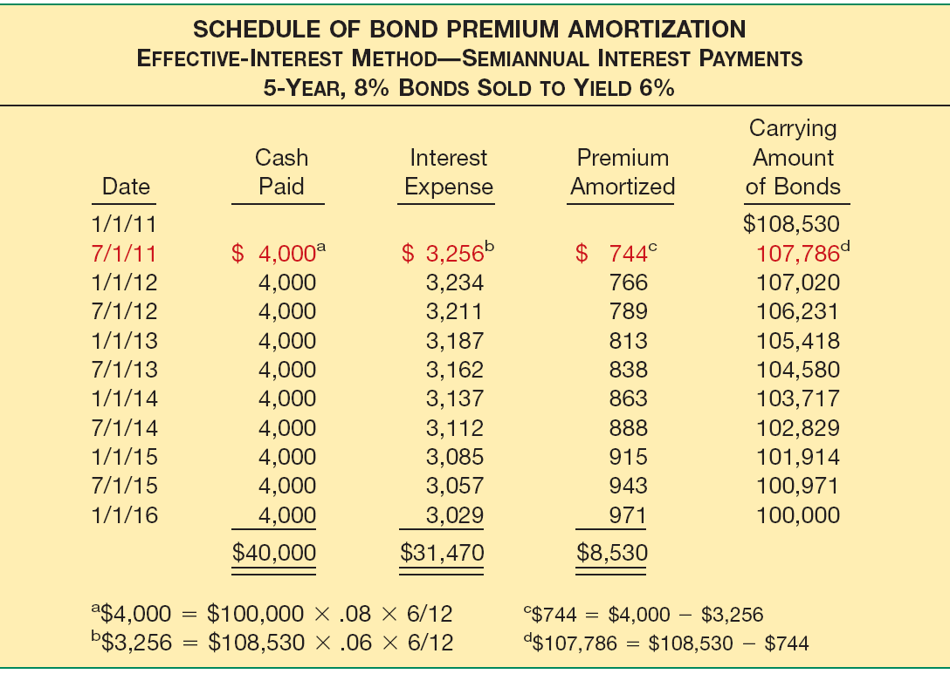
Effective-Interest Method
Illustration 14-9
LO 4

Slide 32
Effective-Interest Method
Illustration 14-9
Journal entry on date of issue, Jan. 1, 2011.
Cash 108,530
Bonds payable 108,530
LO 4

Slide 33
Effective-Interest Method
Illustration 14-9
Journal entry to record first payment and amortization of the premium on July 1, 2011.
Bond interest expense 3,256
Bonds payable 744
Cash 4,000
LO 4

Slide 34
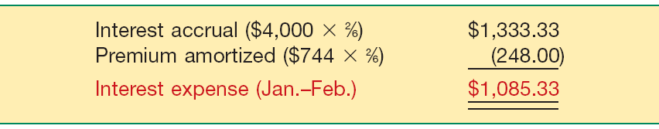
Effective-Interest Method
Accrued Interest
What happens if Evermaster prepares financial statements at the end of February 2011? In this case, the company prorates the premium by the appropriate number of months to arrive at the proper interest expense, as follows.
Illustration 14-10
LO 4 Apply the methods of bond discount and premium amortization.

Slide 35
Effective-Interest Method
Accrued Interest
Illustration 14-10
Evermaster records this accrual as follows.
Bond interest expense 1,085.33
Bonds payable 248.00
Bond interest payable 1,333.33
LO 4 Apply the methods of bond discount and premium amortization.

Slide 36
Effective-Interest Method
Bonds Issued between Interest Dates
Bond investors will pay the seller the interest accrued from the last interest payment date to the date of issue.
On the next semiannual interest payment date, bond investors will receive the full six months’ interest payment.
LO 4 Apply the methods of bond discount and premium amortization.

Slide 37
Effective-Interest Method
Bonds Issued at Par
Illustration: Assume Evermaster issued its five-year bonds, dated January 1, 2011, on May 1, 2011, at par ($100,000). Evermaster records the issuance of the bonds between interest dates as follows.
($100,000 x .08 x 4/12) = $2,667
Cash 100,000
Bonds payable 100,000
Cash 2,667
Bond interest expense 2,667
LO 4 Apply the methods of bond discount and premium amortization.

Slide 38
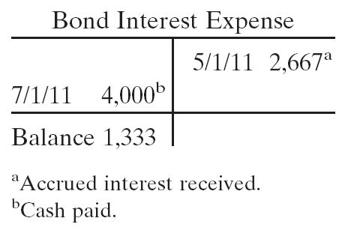
Effective-Interest Method
Bonds Issued at Par
On July 1, 2011, two months after the date of purchase, Evermaster pays the investors six months’ interest, by making the following entry.
($100,000 x .08 x 1/2) = $4,000
Bond interest expense 4,000
Cash 4,000
LO 4

Slide 39
Effective-Interest Method
Bonds Issued at Discount or Premium
Illustration: Assume that the Evermaster 8% bonds were issued on May 1, 2011, to yield 6%. Thus, the bonds are issued at a premium price of $108,039. Evermaster records the issuance of the bonds between interest dates as follows.
Cash 108,039
Bonds payable 108,039
Cash 2,667
Bond interest expense 2,667
LO 4 Apply the methods of bond discount and premium amortization.

Slide 40
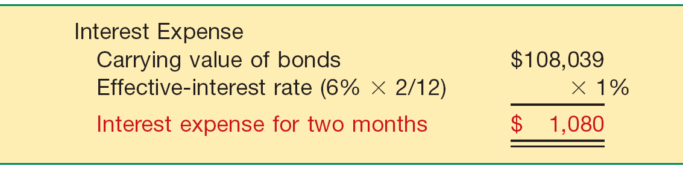
Effective-Interest Method
Bonds Issued at Discount or Premium
Evermaster then determines interest expense from the date of sale (May 1, 2011), not from the date of the bonds (January 1, 2011).
Illustration 14-12
LO 4 Apply the methods of bond discount and premium amortization.

Slide 41
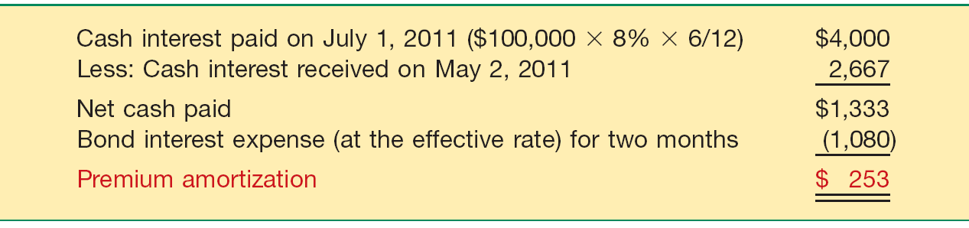
Effective-Interest Method
Bonds Issued at Discount or Premium
The premium amortization of the bonds is also for only two months.
Illustration 14-13
LO 4 Apply the methods of bond discount and premium amortization.

Slide 42
Effective-Interest Method
Bonds Issued at Discount or Premium
Evermaster therefore makes the following entries on July 1, 2011, to record the interest payment and the premium amortization.
Bond interest expense 4,000
Cash 4,000
Bonds payable 253
Bond interest expense 253
LO 4 Apply the methods of bond discount and premium amortization.

Slide 43
Long-Term Notes Payable
Accounting is Similar to Bonds
  A note is valued at the present value of its future interest and principal cash flows.
  Company amortizes any discount or premium over the life of the note.
LO 5 Explain the accounting for long-term notes payable.

Slide 44
Notes Issued at Face Value
BE14-9: Coldwell, Inc. issued a $100,000, 4-year, 10% note at face value to Flint Hills Bank on January 1, 2011, and received $100,000 cash. The note requires annual interest payments each December 31. Prepare Coldwell’s journal entries to record (a) the issuance of the note and (b) the December 31 interest payment.
(a) Cash 100,000
Notes payable 100,000
(b) Interest expense 10,000
Cash 10,000
($100,000 x 10% = $10,000)
LO 5 Explain the accounting for long-term notes payable.

Slide 45
Notes Not Issued at Face Value
Zero-Interest-Bearing Notes
Issuing company records the difference between the face amount and the present value (cash received) as
  a discount and
  amortizes that amount to interest expense over the life of the note.
LO 5 Explain the accounting for long-term notes payable.

Slide 46
Zero-Interest-Bearing Notes
BE14-10: Samson Corporation issued a 4-year, $75,000, zero-interest-bearing note to Brown Company on January 1, 2011, and received cash of $47,663. The implicit interest rate is 12%. Prepare Samson’s journal entries for (a) the Jan. 1 issuance and (b) the Dec. 31 recognition of interest.
LO 5

Slide 47
Zero-Interest-Bearing Notes
BE14-10: Samson Corporation issued a 4-year, $75,000, zero-interest-bearing note to Brown Company on January 1, 2011, and received cash of $47,663. The implicit interest rate is 12%. Prepare Samson’s journal entries for (a) the Jan. 1 issuance and (b) the Dec. 31 recognition of interest.
(a) Cash 47,663
Notes payable 47,663
(b) Interest expense 5,720
Notes payable 5,720
($47,663 x 12%)
LO 5 Explain the accounting for long-term notes payable.

Slide 48
Interest-Bearing Notes
BE14-11: McCormick Corporation issued a 4-year, $40,000, 5% note to Greenbush Company on Jan. 1, 2011, and received a computer that normally sells for $31,495. The note requires annual interest payments each Dec. 31. The market rate of interest is 12%. Prepare McCormick’s journal entries for (a) the Jan. 1 issuance and (b) the Dec. 31 interest.
LO 5

Slide 49
Interest-Bearing Notes
(a) Cash 31,495
Notes payable 31,495
Interest expense 3,779
Cash 2,000
Notes payable 1,779
LO 5

Slide 50
Special Notes Payable Situations
Notes Issued for Property, Goods, or Services
When exchanging the debt instrument for property, goods, or services in a bargained transaction, the stated interest rate is presumed to be fair unless:
No interest rate is stated, or
The stated interest rate is unreasonable, or
The face amount is materially different from the current cash price for the same or similar items or from the current fair value of the debt instrument.
LO 5 Explain the accounting for long-term notes payable.

Slide 51
Special Notes Payable Situations
Choice of Interest Rates
If a company cannot determine the fair value of the property, goods, services, or other rights, and if the note has no ready market, the company must approximate an applicable interest rate.
Choice of rate is affected by:
  Prevailing rates for similar instruments.
  Factors such as restrictive covenants, collateral, payment schedule, and the existing prime interest rate.
LO 5 Explain the accounting for long-term notes payable.

Slide 52
Special Notes Payable Situations
Illustration: On December 31, 2011, Wunderlich Company issued a promissory note to Brown Interiors Company for architectural services. The note has a face value of $550,000, a due date of December 31, 2016, and bears a stated interest rate of 2 percent, payable at the end of each year. Wunderlich cannot readily determine the fair value of the architectural services, nor is the note readily marketable. On the basis of Wunderlich’s credit rating, the absence of collateral, the prime interest rate at that date, and the prevailing interest on Wunderlich’s other outstanding debt, the company imputes an 8 percent interest rate as appropriate in this circumstance.
LO 5 Explain the accounting for long-term notes payable.

Slide 53
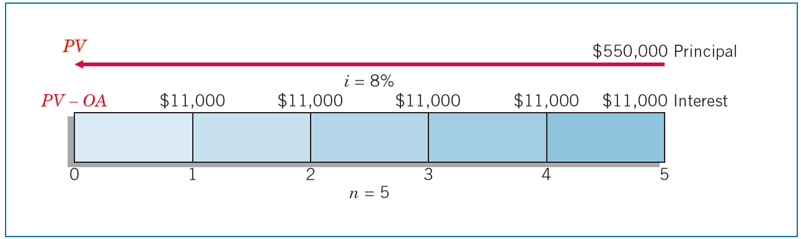
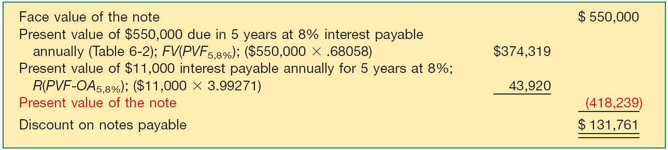
Special Notes Payable Situations
Illustration 14-18
Illustration 14-16
LO 5 Explain the accounting for long-term notes payable.

Slide 54
Special Notes Payable Situations
Wunderlich records issuance of the note on Dec. 31, 2011, in payment for the architectural services as follows.
Building (or Construction in Process) 418,239
Notes Payable 418,239
LO 5 Explain the accounting for long-term notes payable.

Slide 55
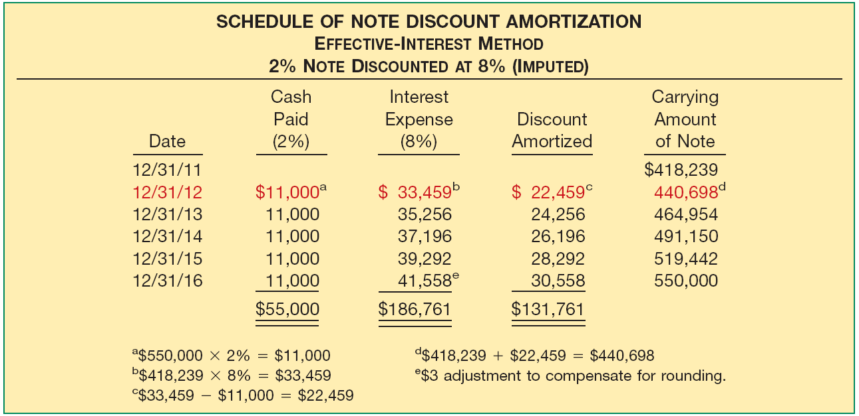
Special Notes Payable Situations
Illustration 14-20
Payment of first year’s interest and amortization of the discount.
Interest expense 33,459
Notes Payable 22,459
Cash 11,000
LO 5 Explain the accounting for long-term notes payable.

Slide 56
Mortgage Notes Payable
A promissory note secured by a document called a mortgage that pledges title to property as security for the loan.
  Most common form of long-term notes payable.
  Payable in full at maturity or in installments.
  Fixed-rate mortgage.
  Variable-rate mortgages.
LO 5 Explain the accounting for long-term notes payable.

Slide 57
Extinguishment of Non-Current Liabilities
Extinguishment with Cash before Maturity
  Reacquisition price > Net carrying amount = Loss
  Net carrying amount > Reacquisition price = Gain
  At time of reacquisition, unamortized premium or discount must be amortized up to the reacquisition date.
LO 6 Describe the accounting for extinguishment of non-current liabilities.

Slide 58
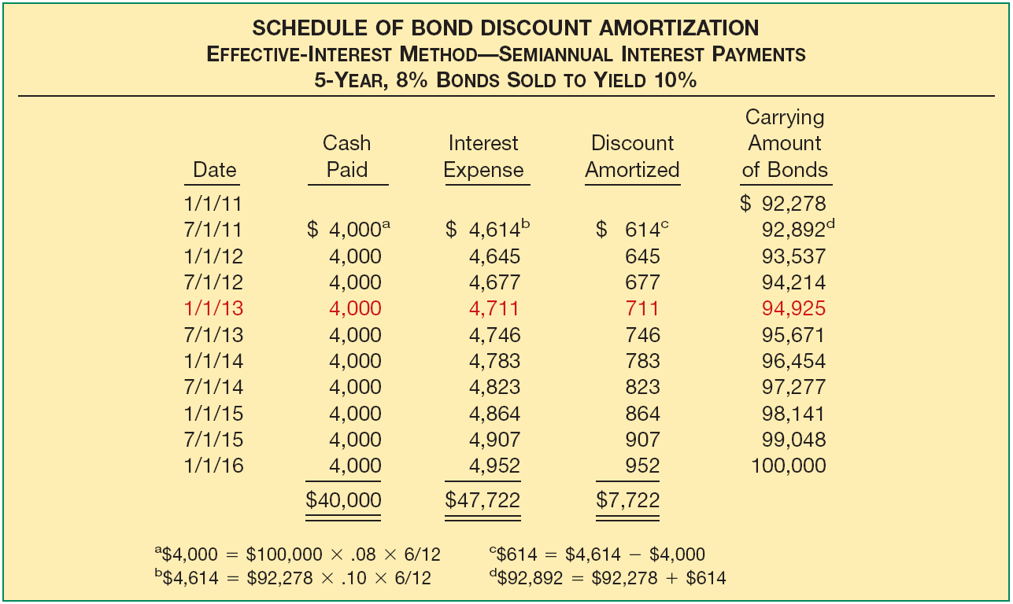
Extinguishment of Debt
Illustration: Evermaster bonds issued at a discount on January 1, 2011. These bonds are due in five years. The bonds have a par value of $100,000, a coupon rate of 8% paid semiannually, and were sold to yield 10%.
Illustration 14-21

Slide 59
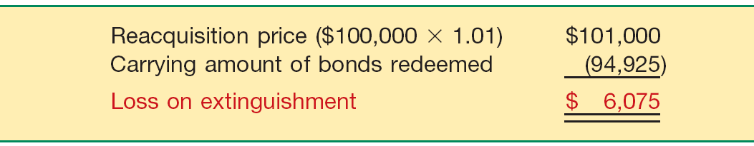
Extinguishment of Debt
Two years after the issue date on January 1, 2013, Evermaster calls the entire issue at 101 and cancels it.
Illustration 14-22
Evermaster records the reacquisition and cancellation of the bonds
Bonds payable 92,925
Loss on extinguishment of bonds 6,075
Cash 101,000
LO 6

Slide 60
Extinguishment of Non-Current Liabilities
Extinguishment by Exchanging Assets or Securities
  Creditor should account for the non-cash assets or equity interest received at their fair value.
  Debtor recognizes a gain equal to the excess of the carrying amount of the payable over the fair value of the assets or equity transferred.
LO 6 Describe the accounting for extinguishment of non-current liabilities.

Slide 61
Extinguishment of Non-Current Liabilities
  Illustration: Hamburg Bank loaned €20,000,000 to Bonn Mortgage Company. Bonn, in turn, invested these monies in residential apartment buildings. However, because of low occupancy rates, it cannot meet its loan obligations. Hamburg Bank agrees to accept from Bonn Mortgage real estate with a fair value of €16,000,000 in full settlement of the €20,000,000 loan obligation. The real estate has a carrying value of €21,000,000 on the books of Bonn Mortgage. Bonn (debtor) records this transaction as follows.
Note Payable to Hamburg Bank 20,000,000
Loss on Disposition of Real Estate 5,000,000
Real Estate 21,000,000
Gain on Extinguishment of Debt 4,000,000
LO 6

Slide 62
Extinguishment of Non-Current Liabilities
Extinguishment with Modification of Terms
Creditor may offer one or a combination of the following modifications:
  Reduction of the stated interest rate.
  Extension of the maturity date of the face amount of the debt.
  Reduction of the face amount of the debt.
  Reduction or deferral of any accrued interest.
LO 6 Describe the accounting for extinguishment of non-current liabilities.

Slide 63
Extinguishment of Non-Current Liabilities
Illustration: On December 31, 2010, Morgan National Bank enters into a debt modification agreement with Resorts Development Company, which is experiencing financial difficulties. The bank restructures a $10,500,000 loan receivable issued at par (interest paid to date) by:
  Reducing the principal obligation from $10,500,000 to $9,000,000;
  Extending the maturity date from December 31, 2010, to December 31, 2014; and
  Reducing the interest rate from the historical effective rate of 12 percent to 8 percent. Given Resorts Development’s financial distress, its market-based borrowing rate is 15 percent.
LO 6 Describe the accounting for extinguishment of non-current liabilities.

Slide 64
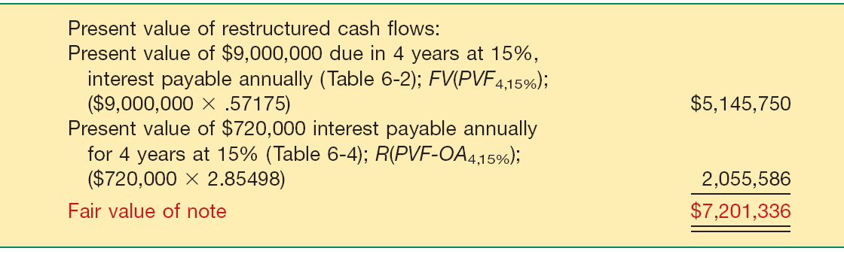
Extinguishment of Non-Current Liabilities
IFRS requires the modification to be accounted for as an extinguishment of the old note and issuance of the new note, measured at fair value.
Illustration 14-23
LO 6 Describe the accounting for extinguishment of non-current liabilities.

Slide 65
Extinguishment of Non-Current Liabilities
The gain on the modification is $3,298,664, which is the difference between the prior carrying value ($10,500,000) and the fair value of the restructured note, as computed in Illustration 14-23 ($7,201,336). Resorts Development makes the following entry to record the modification.
Note Payable (Old) 10,500,000
Gain on Extinguishment of Debt 3,298,664
Note Payable (New) 7,201,336
LO 6 Describe the accounting for extinguishment of non-current liabilities.

Slide 66
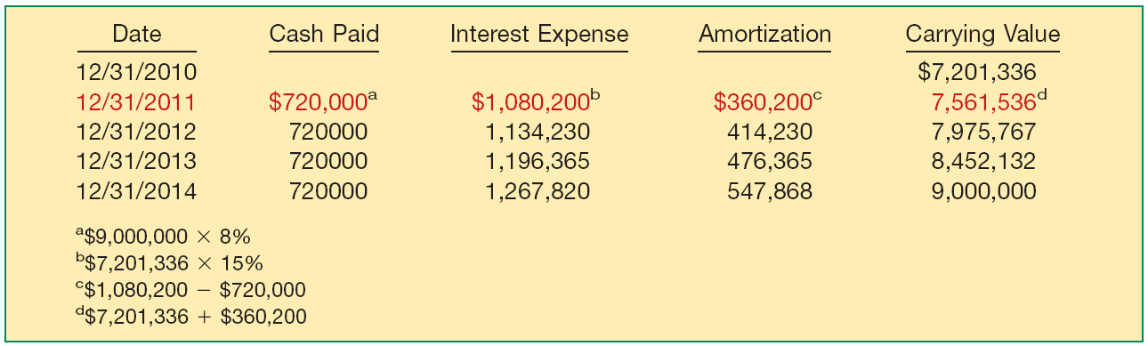
Extinguishment of Non-Current Liabilities
Amortization schedule for the new note.
Illustration 14-24
LO 6 Describe the accounting for extinguishment of non-current liabilities.

Slide 67
Fair Value Option
Companies have the option to record fair value in their accounts for most financial assets and liabilities, including bonds and notes payable.
The IASB believes that fair value measurement for financial instruments, including financial liabilities, provides more relevant and understandable information than amortized cost.
LO 7 Describe the accounting for the fair value option.

Slide 68
Fair Value Option
Fair Value Measurement
Non-current liabilities are recorded at fair value, with unrealized holding gains or losses reported as part of net income.
Illustrations: Edmonds Company has issued €500,000 of 6 percent bonds at face value on May 1, 2010. Edmonds chooses the fair value option for these bonds. At December 31, 2010, the value of the bonds is now €480,000 because interest rates in the market have increased to 8 percent.
Bonds Payable 20,000
Unrealized Holding Gain or Loss—Income 20,000
LO 7 Describe the accounting for the fair value option.

Slide 69
Off-Balance-Sheet Financing
Off-balance-sheet financing is an attempt to borrow monies in such a way to prevent recording the obligations.
Different Forms:
  Non-Consolidated Subsidiary
  Special Purpose Entity (SPE)
  Operating Leases
LO 8 Explain the reporting of off-balance-sheet financing arrangements.

Slide 70
Presentation and Analysis
Presentation of Non-Current Liabilities
Note disclosures generally indicate the nature of the liabilities, maturity dates, interest rates, call provisions, conversion privileges, restrictions imposed by the creditors, and assets designated or pledged as security.
Fair value of the debt should be discloses.
Must disclose future payments for sinking fund requirements and maturity amounts of long-term debt during each of the next five years.
LO 9 Indicate how to present and analyze non-current liabilities.

Slide 71
Presentation and Analysis
Analysis of Non-Current Liabilities
Two ratios that provide information about debt-paying ability and long-run solvency are:
1.
Debt to total assets
Total debt
=
Total assets
The higher the percentage of debt to total assets, the greater the risk that the company may be unable to meet its maturing obligations.
LO 9 Indicate how to present and analyze non-current liabilities.

Slide 72
Presentation and Analysis
Analysis of Long-Term Debt
Two ratios that provide information about debt-paying ability and long-run solvency are:
Income before income taxes and interest expense
2.
Times interest earned
=
Interest expense
Indicates the company’s ability to meet interest payments as they come due.
LO 9 Indicate how to present and analyze non-current liabilities.

Slide 73
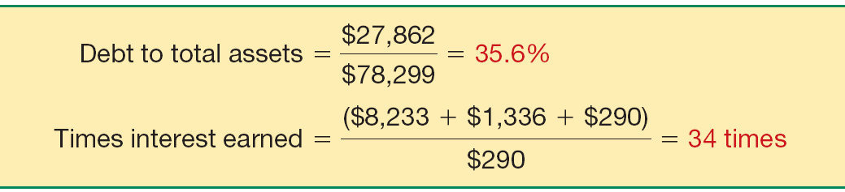
Presentation and Analysis
Illustration: Novartis has total liabilities of $27,862 million, total assets of $78,299 million, interest expense of $290 million, income taxes of $1,336 million, and net income of $8,233 million. We compute Novartis’s debt to total assets and times interest earned ratios as shown
Illustration 14-28
LO 9 Indicate how to present and analyze non-current liabilities.

Slide 74


  IFRS requires that the current portion of long-term debt be classified as current unless an agreement to refinance on a long-term basis is completed before the reporting date. U.S. GAAP requires companies to classify such a refinancing as current unless it is completed before the financial statements are issued.
  Both IFRS and U.S. GAAP require the best estimate of a probable loss. Under IFRS, if a range of estimates is predicted and no amount in the range is more likely than any other amount in the range, the “mid-point” of the range is used to measure the liability. In U.S. GAAP, the minimum amount in a range is used.

Slide 75
  U.S. GAAP uses the term contingency in a different way than IFRS. A contingency under U.S. GAAP may be reported as a liability under certain situations. IFRS does not permit a contingency to be recorded as a liability.
  IFRS uses the term provisions to discuss various liability items that have some uncertainty related to timing or amount. U.S. GAAP generally uses a term like estimated liabilities to refer to provisions.
  Both IFRS and U.S. GAAP prohibit the recognition of liabilities for future losses. In general, restructuring costs are recognized earlier under IFRS.
  IFRS and U.S. GAAP are similar in the treatment of environmental liabilities However, the recognition criteria for environmental liabilities are more stringent under U.S. GAAP: Environmental liabilities are not recognized unless there is a present legal obligation and the fair value of the obligation can be reasonably estimated.

Slide 76
  IFRS requires that debt issue costs are recorded as reductions in the carrying amount of the debt. Under U.S. GAAP, companies record these costs in a bond issuance cost account and amortize these costs over the life of the bonds.
  U.S. GAAP uses the term troubled debt restructurings and develops recognition rules related to this category. IFRS generally assumes that all restructurings should be considered extinguishments of debt.

Slide 77
Copyright
Copyright © 2011 John Wiley & Sons, Inc. All rights reserved. Reproduction or translation of this work beyond that permitted in Section 117 of the 1976 United States Copyright Act without the express written permission of the copyright owner is unlawful. Request for further information should be addressed to the Permissions Department, John Wiley & Sons, Inc. The purchaser may make back-up copies for his/her own use only and not for distribution or resale. The Publisher assumes no responsibility for errors, omissions, or damages, caused by the use of these programs or from the use of the information contained herein.

