Slide 1
CONCEPTUAL FRAMEWORK FOR FINANCIAL REPORTING
PERTEMUAN #2
EBA302
AKUNTANSI KEUANGAN MENENGAH I + LAB
6542– SRI HANDAYANI, SE, MM, MAk, CPMA
PROGRAM STUDI AKUNTANSI
FAKULTAS EKONOMI DAN BISNIS
UNIVERSITAS ESA UNGGUL

Slide 2
KEMAMPUAN AKHIR YANG DIHARAPKAN
Mahasiswa mampu menjelaskan rerangka konseptual untuk akutansi keuangan

Slide 3


Slide 5
C H A P T E R 2
CONCEPTUAL FRAMEWORK FOR FINANCIAL REPORTING
Intermediate Accounting
IFRS Edition
Kieso, Weygandt, and Warfield

Slide 6
Learning Objectives
Describe the usefulness of a conceptual framework.
Describe efforts to construct a conceptual framework.
Understand the objective of financial reporting.
Identify the qualitative characteristics of accounting information.
Define the basic elements of financial statements.
Describe the basic assumptions of accounting.
Explain the application of the basic principles of accounting.
Describe the impact that constraints have on reporting accounting information.

Slide 7
Conceptual Framework For Financial Reporting
Conceptual Framework
First Level: Basic Objective
Second Level: Fundamental Concepts
Third Level: Recognition, Measurement, and Disclosure Concepts
Need
Development
Overview
Qualitative characteristics
Basic elements
Basic assumptions
Basic principles
Constraints
Summary of the structure

Slide 8
Conceptual Framework
Conceptual Framework establishes the concepts that underlie financial reporting.
Need for a Conceptual Framework
Rule-making should build on and relate to an established body of concepts.
Enables IASB to issue more useful and consistent pronouncements over time.
LO 1 Describe the usefulness of a conceptual framework.

Slide 9
Conceptual Framework
Development of a Conceptual Framework
IASB and FASB are working on a joint project to develop a common conceptual framework
Framework will build on existing IASB and FASB frameworks.
Project has identified the objective of financial reporting (Chapter 1) and the qualitative characteristics of decision-useful financial reporting information.
LO 2 Describe efforts to construct a conceptual framework.

Slide 10
Conceptual Framework
Overview of the Conceptual Framework
Three levels:
First Level = Basic objective
Second Level = Qualitative characteristics and elements of financial statements
Third Level = Recognition, measurement, and disclosure concepts
LO 2 Describe efforts to construct a conceptual framework.

Slide 11
ASSUMPTIONS
Economic entity
Going concern
Monetary unit
Periodicity
Accrual
PRINCIPLES
Measurement
Revenue recognition
Expense recognition
Full disclosure
CONSTRAINTS
Cost
Materiality
Third level
QUALITATIVE CHARACTERISTICS
  Fundamental qualities
  Enhancing qualities
ELEMENTS
Assets
Liabilities
Equity
Income
Expenses
Second level
Illustration 2-7 Framework for Financial Reporting
OBJECTIVE
Provide information about the reporting
entity that is useful
to present and potential
equity investors,
lenders, and other
creditors in their
capacity as capital
Providers.
First level
LO 2 Describe efforts to construct a conceptual framework.

Slide 12
First Level: Basic Objective
OBJECTIVE
“To provide financial information about the reporting entity that is useful to present and potential equity investors, lenders, and other creditors in making decisions in their capacity as capital providers.”
Provided by issuing general-purpose financial statements.
Assumption is that users have reasonable knowledge of business and financial accounting matters to understand the information.
LO 3 Understand the objectives of financial reporting.

Slide 13
Second Level: Fundamental Concepts
Qualitative Characteristics of Accounting Information
IASB identified the Qualitative Characteristics of accounting information that distinguish better (more useful) information from inferior (less useful) information for decision-making purposes.
LO 4 Identify the qualitative characteristics of accounting information.

Slide 14
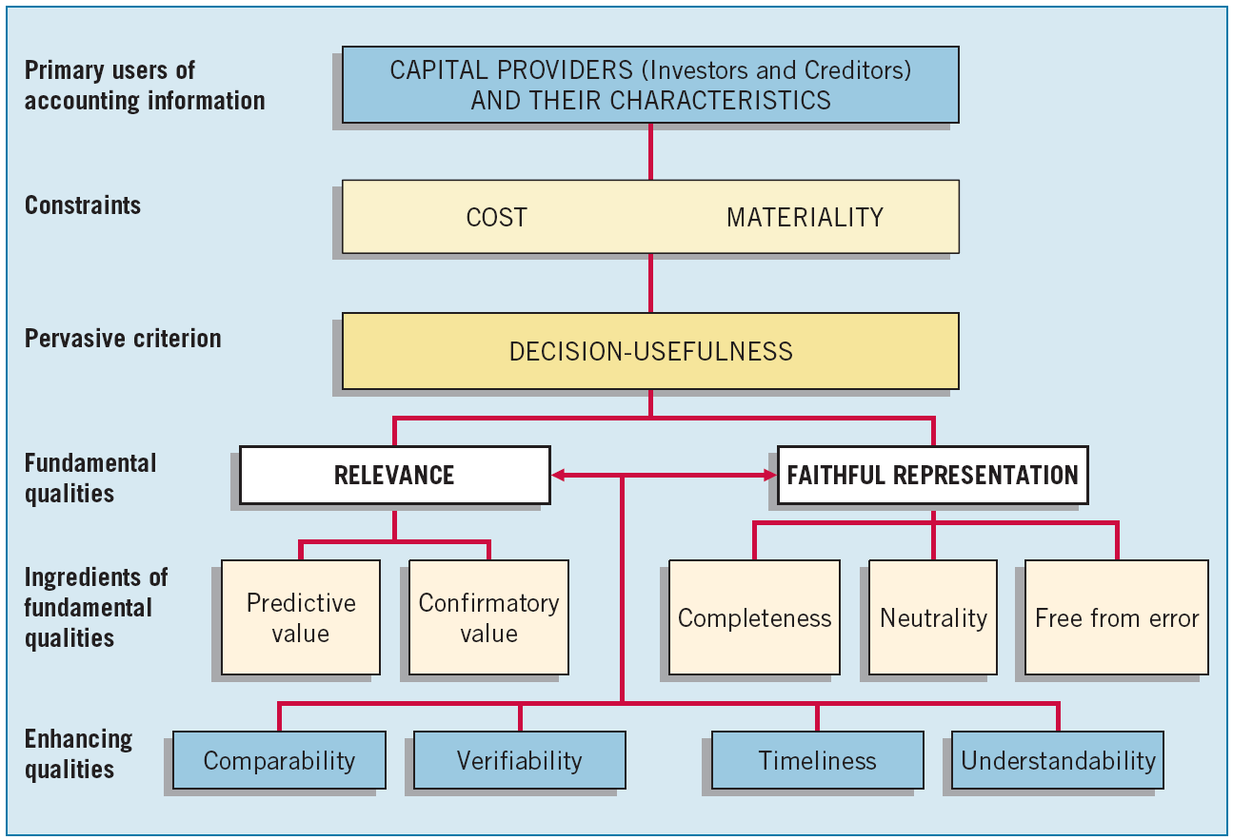
Second Level: Fundamental Concepts
Illustration 2-2 Hierarchy of Accounting Qualities
LO 4 Identify the qualitative characteristics of accounting information.

Slide 15
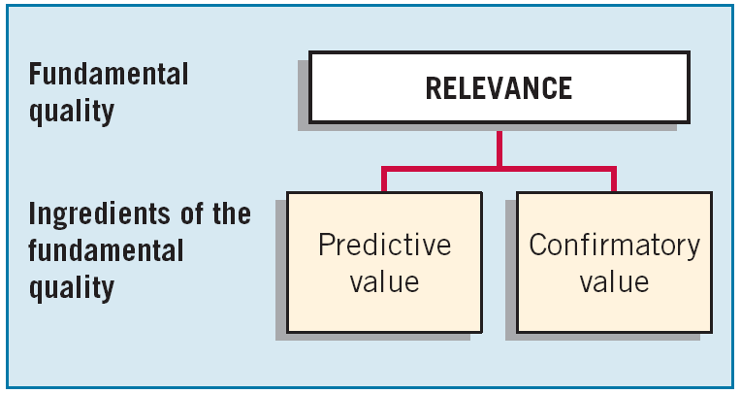
Second Level: Fundamental Concepts
Fundamental Quality - Relevance
Relevance is one of the two fundamental qualities that make accounting information useful for decision-making.
LO 4 Identify the qualitative characteristics of accounting information.

Slide 16
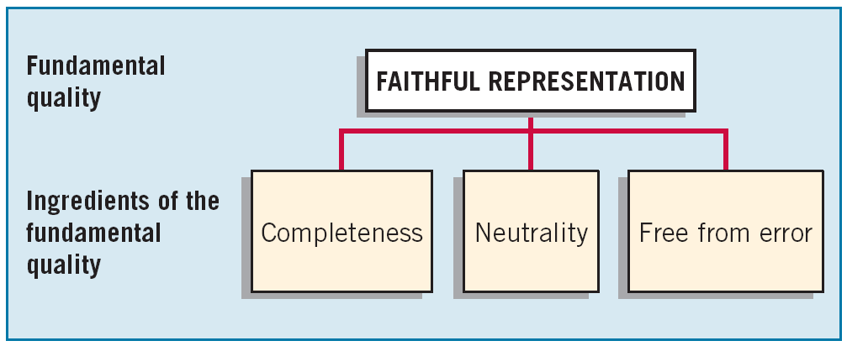
Second Level: Fundamental Concepts
Fundamental Quality – Faithful Representation
Faithful representation means that the numbers and descriptions match what really existed or happened.
LO 4 Identify the qualitative characteristics of accounting information.

Slide 17
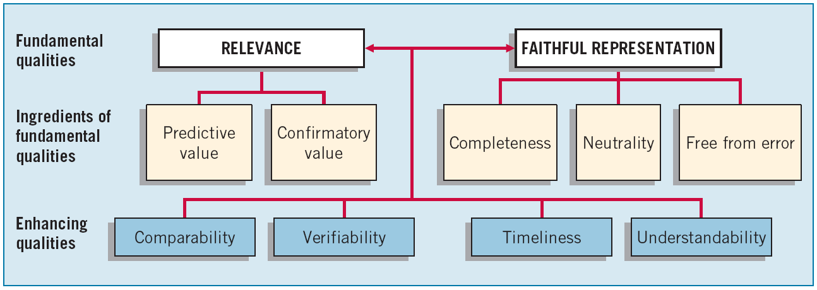
Second Level: Fundamental Concepts
Enhancing Qualities
Distinguish more-useful information from less-useful information.
LO 4 Identify the qualitative characteristics of accounting information.

Slide 18
ASSUMPTIONS
Economic entity
Going concern
Monetary unit
Periodicity
Accrual
PRINCIPLES
Measurement
Revenue recognition
Expense recognition
Full disclosure
CONSTRAINTS
Cost
Materiality
Third level
QUALITATIVE CHARACTERISTICS
  Fundamental qualities
  Enhancing qualities
ELEMENTS
Assets
Liabilities
Equity
Income
Expenses
Second level
Illustration 2-7 Framework for Financial Reporting
OBJECTIVE
Provide information about the reporting
entity that is useful
to present and potential
equity investors,
lenders, and other
creditors in their
capacity as capital
Providers.
First level
LO 4

Slide 19
Second Level: Basic Elements
LO 5 Define the basic elements of financial statements.

Slide 20
Second Level: Basic Elements
Exercise 2-4: Identify the qualitative characteristic(s) to be used given the information provided.
Characteristics
  Qualitative characteristic being employed when companies in the same industry are using the same accounting principles.
  Quality of information that confirms users’ earlier expectations.
  Imperative for providing comparisons of a company from period to period.
  Ignores the economic consequences of a standard or rule.
  Relevance
  Faithful representation
  Predictive value
  Confirmatory value
  Neutrality
  Completeness
  Timeliness
  Verifiability
  Understandability
  Comparability
LO 5

Slide 21
Second Level: Basic Elements
Exercise 2-4: Identify the qualitative characteristic(s) to be used given the information provided.
Characteristics
  Requires a high degree of consensus among individuals on a given measurement.
  Predictive value is an ingredient of this fundamental quality of information.
  Qualitative characteristics that enhance both relevance and faithful representation.
  Relevance
  Faithful representation
  Predictive value
  Confirmatory value
  Neutrality
  Completeness
  Timeliness
  Verifiability
  Understandability
  Comparability
LO 5

Slide 22
Second Level: Basic Elements
Exercise 2-4: Identify the qualitative characteristic(s) to be used given the information provided.
Characteristics
  Neutrality and completeness are ingredients of this fundamental quality of accounting information.
  Two fundamental qualities that make accounting information useful for decision-making purposes.
  Issuance of interim reports is an example of what enhancing ingredient?
  Relevance
  Faithful representation
  Predictive value
  Confirmatory value
  Neutrality
  Completeness
  Timeliness
  Verifiability
  Understandability
  Comparability
LO 5

Slide 23
Third Level: Recognition, Measurement, and Disclosure Concepts
These concepts explain how companies should recognize, measure, and report financial elements and events.
Recognition, Measurement, and Disclosure Concepts
ASSUMPTIONS
Economic entity
Going concern
Monetary unit
Periodicity
Accrual
PRINCIPLES
Measurement
Revenue recognition
Expense recognition
Full disclosure
CONSTRAINTS
Cost
Materiality
Illustration 2-7 Framework for Financial Reporting
LO 6 Describe the basic assumptions of accounting.

Slide 24
Third Level: Assumptions
Basic Assumptions
Economic Entity – company keeps its activity separate from its owners and other business unit.
Going Concern - company to last long enough to fulfill objectives and commitments.
Monetary Unit - money is the common denominator.
Periodicity - company can divide its economic activities into time periods.
Accrual Basis of Accounting – transactions are recorded in the periods in which the events occur.
LO 6 Describe the basic assumptions of accounting.

Slide 25
Third Level: Assumptions
E2-8: Identify which basic assumption of accounting is best described in each item below.
The economic activities of FedEx Corporation (USA) are divided into 12-month periods for the purpose of issuing annual reports.
Total S.A. (FRA) does not adjust amounts in its financial statements for the effects of inflation.
Barclays (GBR) reports current and non-current classifications in its statement of financial position.
The economic activities of Tokai Rubber Industries (JPN) and its subsidiaries are merged for accounting and reporting purposes.
Periodicity
Monetary
Unit
Going Concern
Economic
Entity
LO 6 Describe the basic assumptions of accounting.

Slide 26
Third Level: Principles
Principles
Measurement
  Cost is generally thought to be a faithful representation of the amount paid for a given item.
  Fair value is “the amount for which an asset could be exchanged, a liability settled, or an equity instrument granted could be exchanged, between knowledgeable, willing parties in an arm’s length transaction.”
  IASB has taken the step of giving companies the option to use fair value as the basis for measurement of financial assets and financial liabilities.
LO 7 Explain the application of the basic principles of accounting.

Slide 27
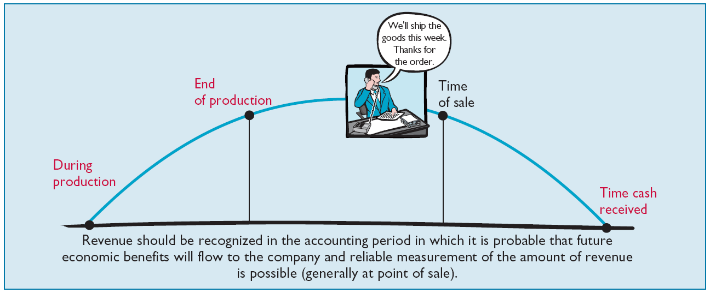
Third Level: Principles
Revenue Recognition - revenue is to be recognized when it is probable that future economic benefits will flow to the company and reliable measurement of the amount of revenue is possible.
Illustration 2-3 Timing of Revenue Recognition
LO 7 Explain the application of the basic principles of accounting.

Slide 28
Third Level: Principles
Expense Recognition - outflows or “using up” of assets or incurring of liabilities (or a combination of both) during a period as a result of delivering or producing goods and/or rendering services.
Illustration 2-4 Expense Recognition
“Let the expense follow the revenues.”
LO 7 Explain the application of the basic principles of accounting.

Slide 29
Third Level: Principles
Full Disclosure – providing information that is of sufficient importance to influence the judgment and decisions of an informed user.
Provided through:
  Financial Statements
  Notes to the Financial Statements
  Supplementary information
LO 7 Explain the application of the basic principles of accounting.

Slide 30
Third Level: Principles
BE2-9: Identify which basic principle of accounting is best described in each item below.
(a) Parmalat (ITA) reports revenue in its income statement when it is earned instead of when the cash is collected.
(b) Google (USA) recognizes depreciation expense for a machine over the 2-year period during which that machine helps the company earn revenue.
(c) KC Corp. (USA) reports information about pending lawsuits in the notes to its financial statements.
(d) Fuji Film (JPN) reports land on its balance sheet at the amount paid to acquire it, even though the estimated fair market value is greater.
Revenue
Recognition
Expense Recognition
Full
Disclosure
Measurement
LO 7 Explain the application of the basic principles of accounting.

Slide 31
Third Level: Constraints
Constraints
Cost – the cost of providing the information must be weighed against the benefits that can be derived from using it.
Materiality - an item is material if its inclusion or omission would influence or change the judgment of a reasonable person.
LO 8 Describe the impact that constraints have on reporting accounting information.

Slide 32
Third Level: Constraints
E2-11: What accounting constraints are illustrated by the items below?
(a) Willis Company does not disclose any information in the notes to the financial statements unless the value of the information to users exceeds the expense of gathering it.
(b) Beckham Corporation expenses the cost of wastebaskets in the year they are acquired.
Cost
Materiality
LO 8 Describe the impact that constraints have on reporting accounting information.

Slide 33
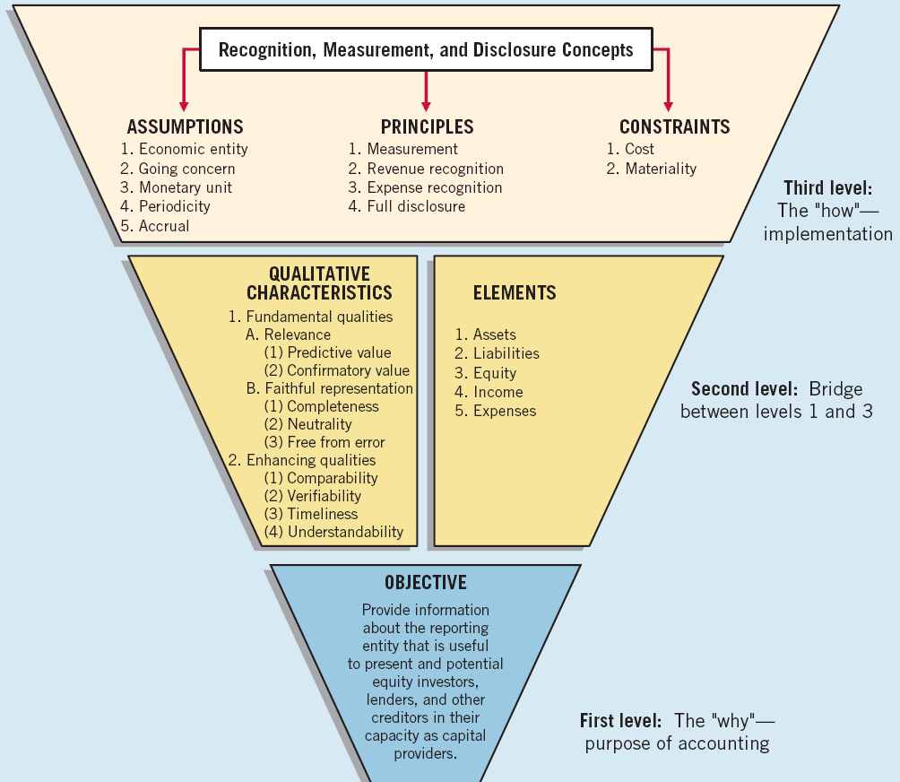
Summary of the Structure

Slide 34


  The existing conceptual frameworks underlying U.S. GAAP and IFRS are very similar.
  The converged framework should be a single document, unlike the two conceptual frameworks that presently exist.
  Both the IASB and FASB have similar measurement principles, based on historical cost and fair value. However, U.S. GAAP has a concept statement to guide estimation of fair values when market-related data is not available (Statement of Financial Accounting Concepts No. 7, “Using Cash Flow Information and Present Value in Accounting”). The IASB is considering a proposal to provide expanded guidance on estimating fair values.

Slide 35
Copyright
Copyright © 2011 John Wiley & Sons, Inc. All rights reserved. Reproduction or translation of this work beyond that permitted in Section 117 of the 1976 United States Copyright Act without the express written permission of the copyright owner is unlawful. Request for further information should be addressed to the Permissions Department, John Wiley & Sons, Inc. The purchaser may make back-up copies for his/her own use only and not for distribution or resale. The Publisher assumes no responsibility for errors, omissions, or damages, caused by the use of these programs or from the use of the information contained herein.

