Slide 1
INCOME STATEMENT AND RELATED INFORMATION
PERTEMUAN #4
EBA302
AKUNTANSI KEUANGAN MENENGAH I + LAB
6542– SRI HANDAYANI, SE, MM, MAk, CPMA
PROGRAM STUDI AKUNTANSI
FAKULTAS EKONOMI DAN BISNIS
UNIVERSITAS ESA UNGGUL

Slide 2
KEMAMPUAN AKHIR YANG DIHARAPKAN
Mahasiswa mampu menjelaskan dan membuat laporan laba rugi

Slide 3
C H A P T E R 4
INCOME STATEMENT AND RELATED INFORMATION
Intermediate Accounting
IFRS Edition
Kieso, Weygandt, and Warfield

Slide 4
Learning Objectives
Understand the uses and limitations of an income statement.
Understand the content and format of the income statement.
Prepare an income statement.
Explain how to report items in the income statement.
Identify where to report earnings per share information.
Explain intraperiod tax allocation.
Understand the reporting of accounting changes and errors.
Prepare a retained earnings statement.
Explain how to report other comprehensive income.

Slide 5
Income Statement and Related Information
Income Statement
Format of Income Statement
Reporting Within the Income Statement
Other Reporting Issues
Usefulness
Limitations
Quality of Earnings
Elements
Minimum disclosure
Intermediate components
Illustration
Condensed income statements
Gross profit
Income from operations
Income before income tax
Net income
Non-controlling interests
Earnings per share
Discontinued operations
Intraperiod tax allocation
Summary
Accounting changes and errors
Retained earnings statement
Comprehensive income
Changes in equity statement

Slide 6
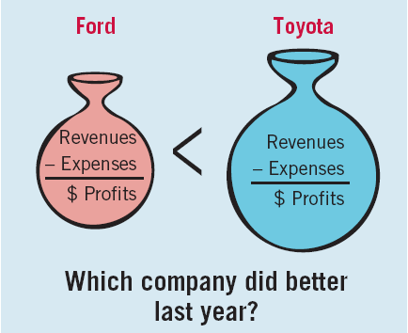
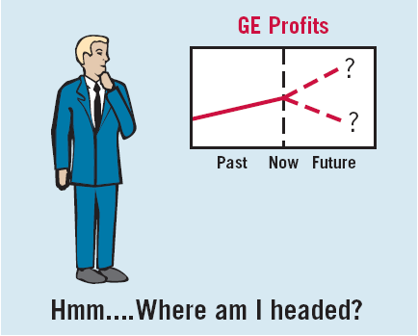
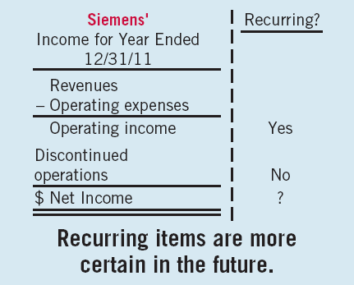
Income Statement
Usefulness
Evaluate past performance.
Predicting future performance.
Help assess the risk or uncertainty of achieving future cash flows.
LO 1 Understand the uses and limitations of an income statement.

Slide 7
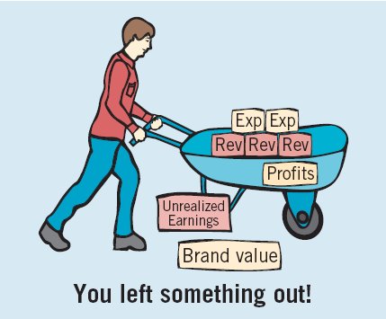
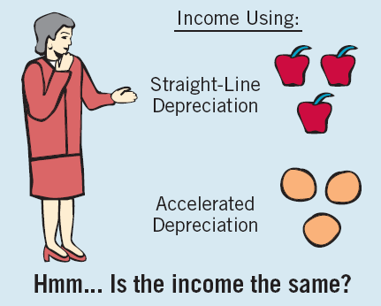
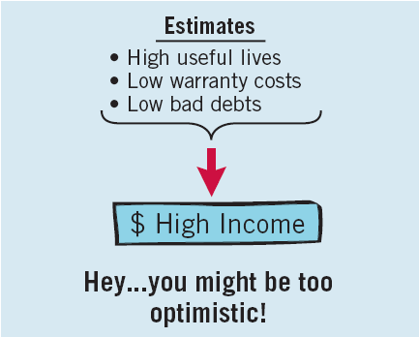
Income Statement
Limitations
Companies omit items that cannot be measured reliably.
Income is affected by the accounting methods employed.
Income measurement involves judgment.
LO 1 Understand the uses and limitations of an income statement.

Slide 8
Income Statement
Quality of Earnings
Companies have incentives to manage income to meet or beat market expectations, so that
market price of stock increases and
value of management’s compensation increase.
Quality of earnings is reduced if earnings management results in information that is less useful for predicting future earnings and cash flows.
LO 1 Understand the uses and limitations of an income statement.

Slide 9
Format of the Income Statement
Elements of the Income Statement
Income – Increases in economic benefits during the accounting period in the form of inflows or enhancements of assets or decreases of liabilities that result in increases in equity, other than those relating to contributions from shareholders.
LO 1 Understand the uses and limitations of an income statement.

Slide 10
Format of the Income Statement
Elements of the Income Statement
Income includes both revenues and gains.
Revenues - ordinary activities of a company
Gains - may or may not arise from ordinary activities.
Revenue Accounts
Gain Accounts
Sales
Fee revenue
Interest revenue
Dividend revenue
Rent revenue
Gains on the sale of long-term assets
Unrealized gains on available-for-sale securities.
LO 2 Understand the content and format of the income statement.

Slide 11
Format of the Income Statement
Elements of the Income Statement
Expenses – Decreases in economic benefits during the accounting period in the form of outflows or depletions of assets or incurrences of liabilities that result in decreases in equity, other than those relating to distributions to shareholders.
Examples of Expense Accounts
Cost of goods sold
Depreciation expense
Interest expense
Rent expense
Salary expense
LO 1 Understand the uses and limitations of an income statement.

Slide 12
Format of the Income Statement
Elements of the Income Statement
Expenses includes both expenses and losses.
Expenses - ordinary activities of a company
Losses - may or may not arise from ordinary activities.
Expense Accounts
Loss Accounts
Cost of goods sold
Depreciation expense
Interest expense
Rent expense
Salary expense
Losses on restructuring charges
Losses on to sale of long-term assets
Unrealized losses on available-for-sale securities.
LO 2 Understand the content and format of the income statement.

Slide 13
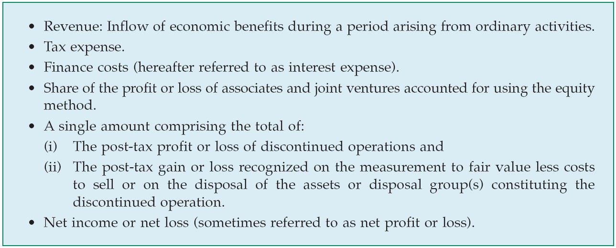
Format of the Income Statement
Elements of the Income Statement
IFRS requires, at a minimum, the following be presented on the income statement.
LO 2 Understand the content and format of the income statement.

Slide 14
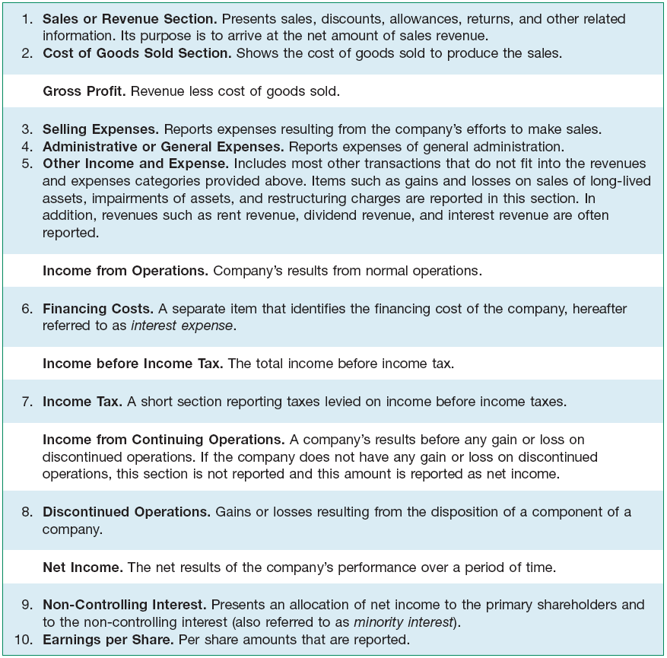
Format of the Income Statement
Intermediate Components
Common for companies to present some or all of these sections and totals within the income statement.
Illustration 4-1
Income Statement Format
LO 2

Slide 15
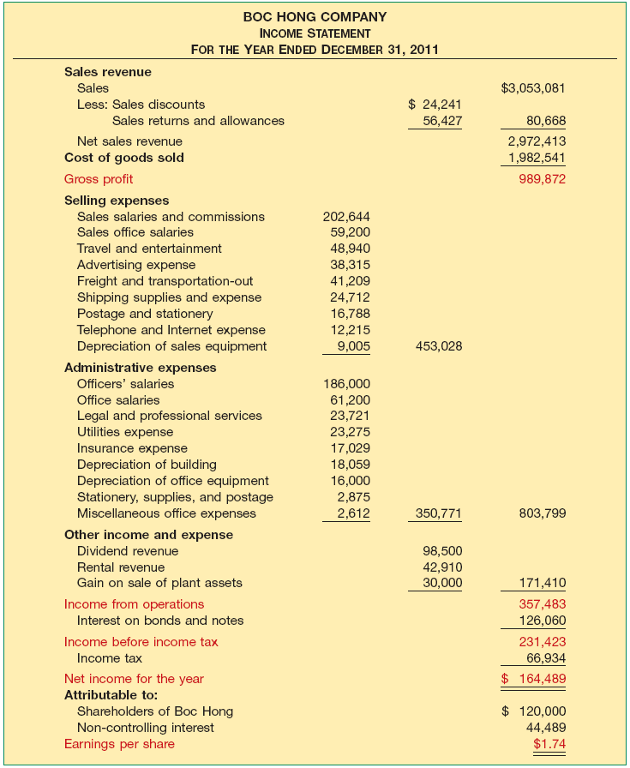
Format
Illustration
Includes all of the major items in the list above, except for discontinued operations.
Illustration 4-2
Income Statement
LO 3

Slide 16
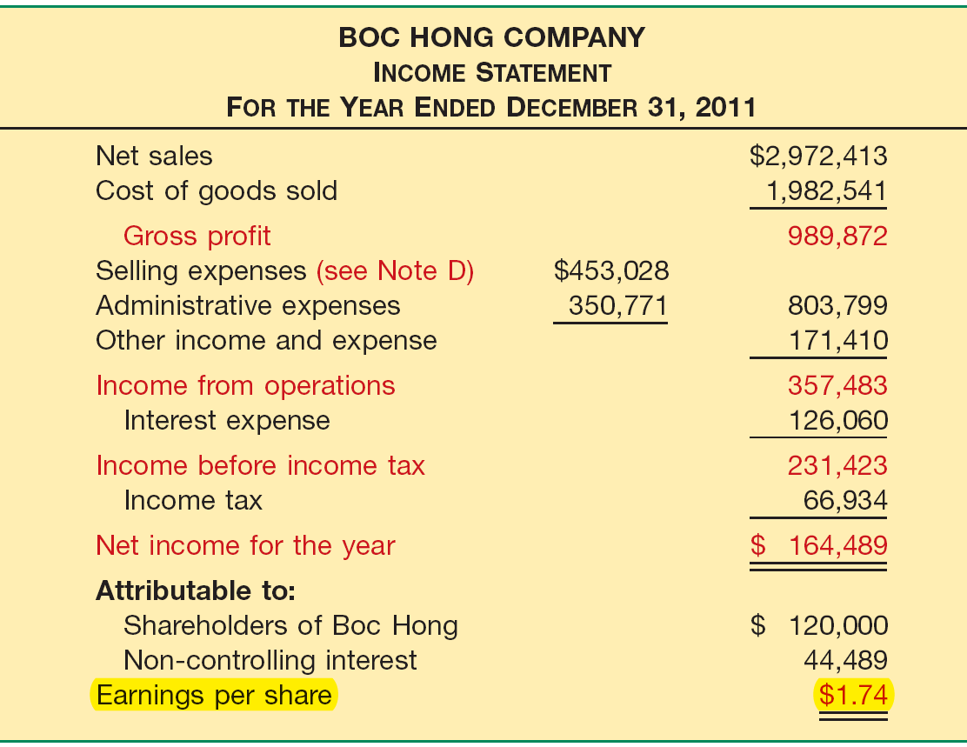
Format of the Income Statement
Condensed
More representative of the type found in practice.
Illustration 4-3
Condensed Income Statement
LO 3 Prepare an income statement.

Slide 17
Reporting Within the Income Statement
Gross Profit
Computed by deducting cost of goods sold from net sales revenue.
Disclosure of net sales revenue is useful.
Unusual or incidental revenue is disclosed in other income and expense.
Analysts can more easily understand and assess trends in revenue from continuing operations.
LO 4 Explain how to report items in the income statement.

Slide 18
Reporting Within the Income Statement
Income from Operations
Determined by deducting selling and administrative expenses as well as other income and expense from gross profit.
Highlights items that affect regular business activities.
Used to predict the amount, timing, and uncertainty of future cash flows.
LO 4 Explain how to report items in the income statement.

Slide 19
Reporting Within the Income Statement
Income from Operations
Expense Classification
Reported by
Nature, or
Function
LO 4 Explain how to report items in the income statement.

Slide 20
Reporting Within the Income Statement
Expense Classification
Illustration: Assume that the accounting firm of Telaris Co. provides audit, tax, and consulting services. It has the following revenues and expenses.
LO 4 Explain how to report items in the income statement.

Slide 21
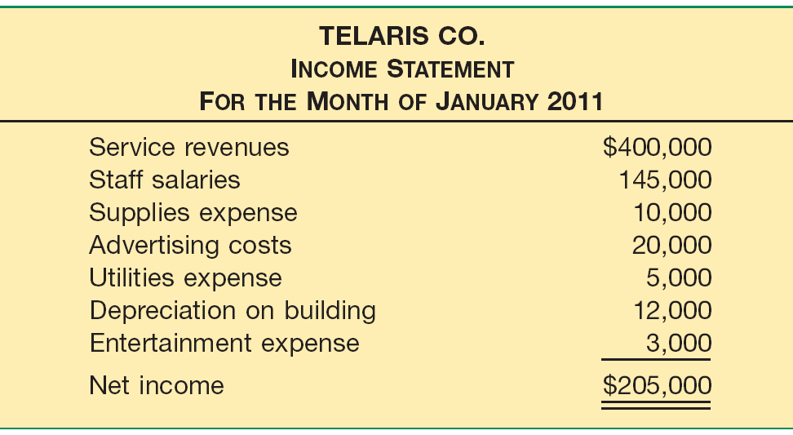
Reporting Within the Income Statement
Expense Classification (Nature-of-Expense Approach)
Illustration 4-5
LO 4 Explain how to report items in the income statement.

Slide 22
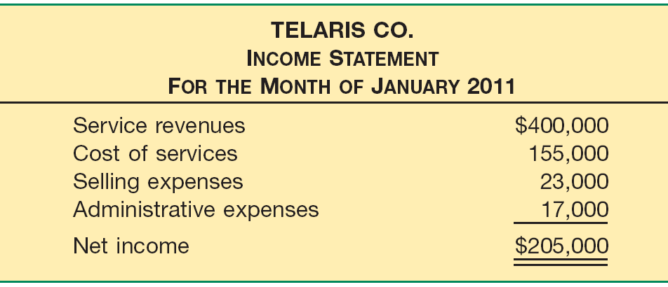
Reporting Within the Income Statement
Expense Classification (Function-of-Expense Approach)
Illustration 4-6
The function-of-expense method is generally used in practice although many companies believe both approaches have merit.
LO 4 Explain how to report items in the income statement.

Slide 23
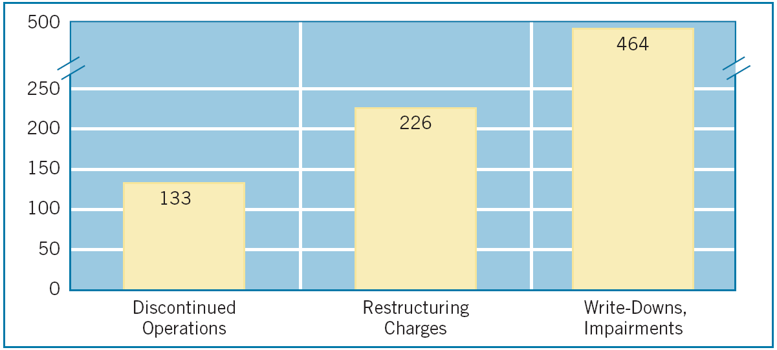
Reporting Within the Income Statement
Gains and Losses
Illustration 4-7 Number of Unusual Items Reported in a Recent Year by 600 Large Companies
LO 4 Explain how to report items in the income statement.

Slide 24
Reporting Within the Income Statement
Gains and Losses
IASB takes the position that both
revenues and expenses and
other income and expense
should be reported as part of income from operations.
Companies can provide additional line items, headings, and subtotals when such presentation is relevant to an understanding of the entity’s financial performance.
LO 4 Explain how to report items in the income statement.

Slide 25
Reporting Within the Income Statement
Gains and Losses
Additional items that may need disclosure:
Losses on write-downs of inventories to net realizable value or of property, plant, and equipment to recoverable amount, as well as reversals of such write-downs.
Losses on restructurings of the activities and reversals of any provisions for the costs of restructuring.
Gains or losses on the disposal of items of property, plant, and, equipment or investments.
Litigation settlements.
Other reversals of liabilities.
LO 4 Explain how to report items in the income statement.

Slide 26
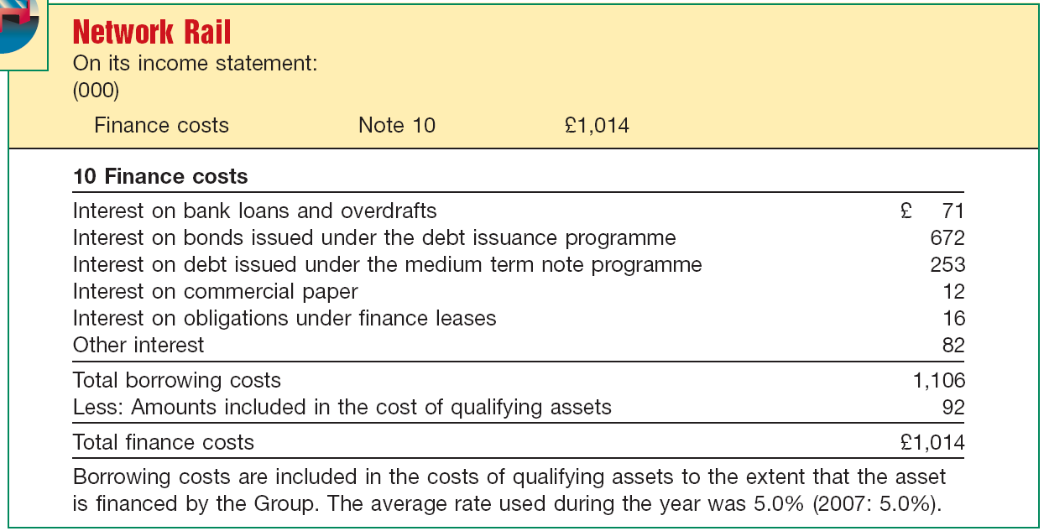
Reporting Within the Income Statement
Income before Income Tax
Financing costs must be reported on the income statement.
Illustration 4-8
LO 4 Explain how to report items in the income statement.

Slide 27
Reporting Within the Income Statement
Net Income
Represents the income after all
revenues and
expenses
for the period are considered.
Viewed by many as the most important measure of a company’s success or failure for a given period of time.
LO 4 Explain how to report items in the income statement.

Slide 28
Reporting Within the Income Statement
Allocation to Non-Controlling Interest
If a company prepares a consolidated income statement that includes a partially own subsidiary. IFRS requires that net income of the subsidiary be allocated to the controlling and non-controlling interest. This allocation is reported at the bottom of the income statement after net income.
Illustration 4-9
(amounts given)
LO 4 Explain how to report items in the income statement.

Slide 29
Reporting Within the Income Statement
BE4-3: Presented below is some financial information related to Volaire Group. Compute the following:
Other Income and Expense
Revenues €800,000
Income from continuing operations 100,000
Comprehensive income 120,000
Net income 90,000
Income from operations 220,000
Selling and administrative expenses 500,000
Income before income tax 200,000
€800,000
100,000
120,000
90,000
- 220,000
- 500,000
200,000
€80,000
Solution on notes page
LO 4 Explain how to report items in the income statement.

Slide 30
Reporting Within the Income Statement
BE4-3: Presented below is some financial information related to Volaire Group. Compute the following:
Financing Costs
Revenues €800,000
Income from continuing operations 100,000
Comprehensive income 120,000
Net income 90,000
Income from operations 220,000
Selling and administrative expenses 500,000
Income before income tax 200,000
€800,000
100,000
120,000
90,000
220,000
500,000
- 200,000
€20,000
Solution on notes page
LO 4 Explain how to report items in the income statement.

Slide 31
Reporting Within the Income Statement
BE4-3: Presented below is some financial information related to Volaire Group. Compute the following:
Income Tax
Revenues €800,000
Income from continuing operations 100,000
Comprehensive income 120,000
Net income 90,000
Income from operations 220,000
Selling and administrative expenses 500,000
Income before income tax 200,000
€800,000
- 100,000
120,000
90,000
220,000
500,000
200,000
€100,000
Solution on notes page
LO 4 Explain how to report items in the income statement.

Slide 32
Reporting Within the Income Statement
BE4-3: Presented below is some financial information related to Volaire Group. Compute the following:
Discontinued Operations
Revenues €800,000
Income from continuing operations 100,000
Comprehensive income 120,000
Net income 90,000
Income from operations 220,000
Selling and administrative expenses 500,000
Income before income tax 200,000
€800,000
100,000
120,000
- 90,000
220,000
500,000
200,000
- €10,000
Solution on notes page
LO 4 Explain how to report items in the income statement.

Slide 33
Reporting Within the Income Statement
BE4-3: Presented below is some financial information related to Volaire Group. Compute the following:
Other Comprehensive Income
Revenues €800,000
Income from continuing operations 100,000
Comprehensive income 120,000
Net income 90,000
Income from operations 220,000
Selling and administrative expenses 500,000
Income before income tax 200,000
€800,000
100,000
120,000
- 90,000
220,000
500,000
200,000
€30,000
Solution on notes page
LO 4 Explain how to report items in the income statement.

Slide 34
Reporting Within the Income Statement
Earnings Per Share
Net income - Preference dividends
Weighted average of ordinary shares outstanding
Important business indicator.
Measures the dollars earned by each ordinary share.
Must be disclosed on the income statement.
LO 5 Identify where to report earnings per share information.

Slide 35
Reporting Within the Income Statement
Earnings Per Share (BE4-10): In 2010, Hollis Corporation reported net income of $1,000,000. It declared and paid preference share dividends of $250,000. During 2010, Hollis had a weighted average of 190,000 ordinary shares outstanding. Compute Hollis’s 2010 earnings per share.
Net income - Preference dividends
Weighted average number of ordinary shares
$1,000,000
- $250,000
=
$3.95 per share
190,000
LO 5 Identify where to report earnings per share information.

Slide 36
Reporting Within the Income Statement
Discontinued Operations
A component of an entity that either has been disposed of, or is classified as held-for-sale, and:
Represents a major line of business or geographical area of operations, or
Is part of a single, co-coordinated plan to dispose of a major line of business or geographical area of operations, or
Is a subsidiary acquired exclusively with a view to resell.
LO 5 Identify where to report earnings per share information.

Slide 37
Reporting Within the Income Statement
Discontinued Operations
Companies report as discontinued operations
(in a separate income statement category) the gain or loss from disposal of a component of a business.
The results of operations of a component that has been or will be disposed of separately from continuing operations.
The effects of discontinued operations net of tax, as a separate category after continuing operations.
LO 5 Identify where to report earnings per share information.

Slide 38
Reporting Within the Income Statement
Illustration: Multiplex Products, a highly diversified company, decides to discontinue its electronics division. During the current year, the electronics division lost $300,000 (net of tax). Multiplex sold the division at the end of the year at a loss of $500,000 (net of tax).
Income from continuing operations $20,000,000
Discontinued operations:
Loss from operations, net of tax 300,000
Loss on disposal, net of tax 500,000
Total loss on discontinued operations 800,000
Net income $19,200,000
LO 5 Identify where to report earnings per share information.

Slide 39
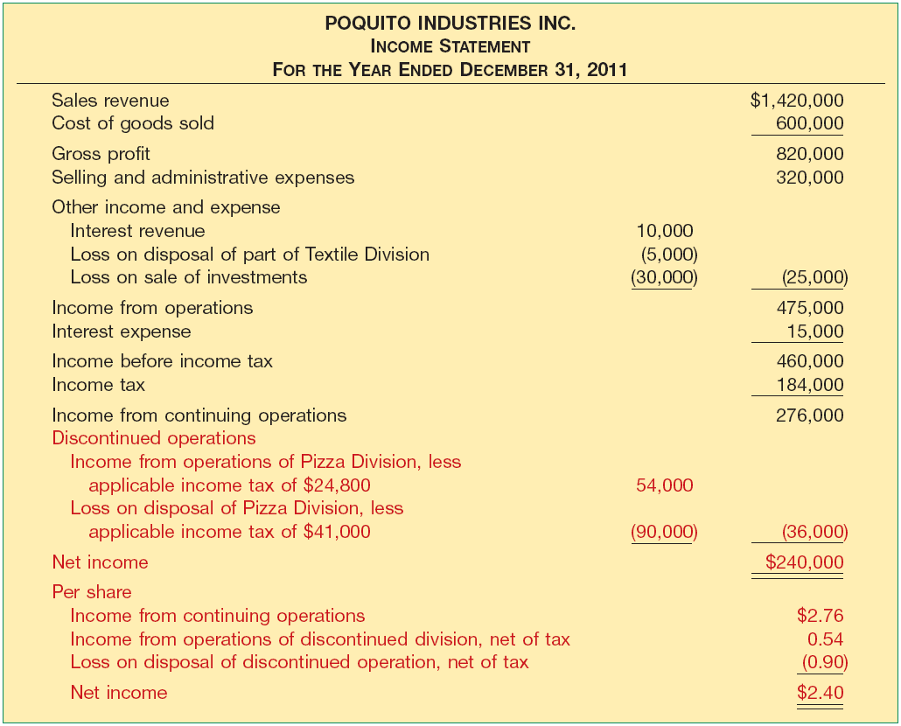
Reporting Within the Income Statement
Illustration 4-12
A company that reports a discontinued operation must report per share amounts for the line item either on the face of the income statement or in the notes to the financial statements.
LO 5 Identify where to report earnings per share information.

Slide 40
Reporting Within the Income Statement
Intraperiod Tax Allocation
Relates the income tax expense to the specific items that give rise to the amount of the tax expense.
On the income statement, income tax is allocated to:
(1) Income from continuing operations before tax
(2) Discontinued operations
“let the tax follow the income”
LO 6 Explain intraperiod tax allocation.

Slide 41
Reporting Within the Income Statement
Intraperiod Tax Allocation
Illustration: Schindler Co. has income before income tax of $250,000. It has a gain of $100,000 from a discontinued
operation. Assuming a 30 percent income tax rate, Schindler presents the following information on the income statement.
Illustration 4-13
LO 6 Explain intraperiod tax allocation.

Slide 42
Reporting Within the Income Statement
Intraperiod Tax Allocation
Illustration: Schindler Co. has income before income tax of $250,000. It has a loss of $100,000 from a discontinued
operation. Assuming a 30 percent income tax rate, Schindler presents the following information on the income statement.
Illustration 4-14
LO 6 Explain intraperiod tax allocation.

Slide 43
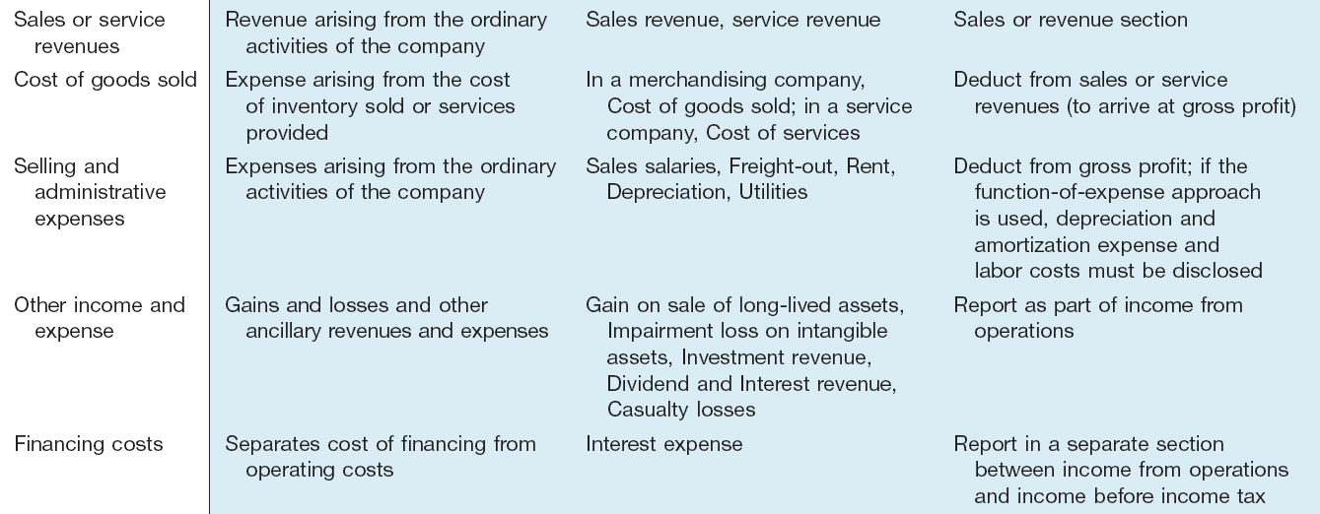
Reporting Within the Income Statement
Summary
LO 6 Explain intraperiod tax allocation.

Slide 44
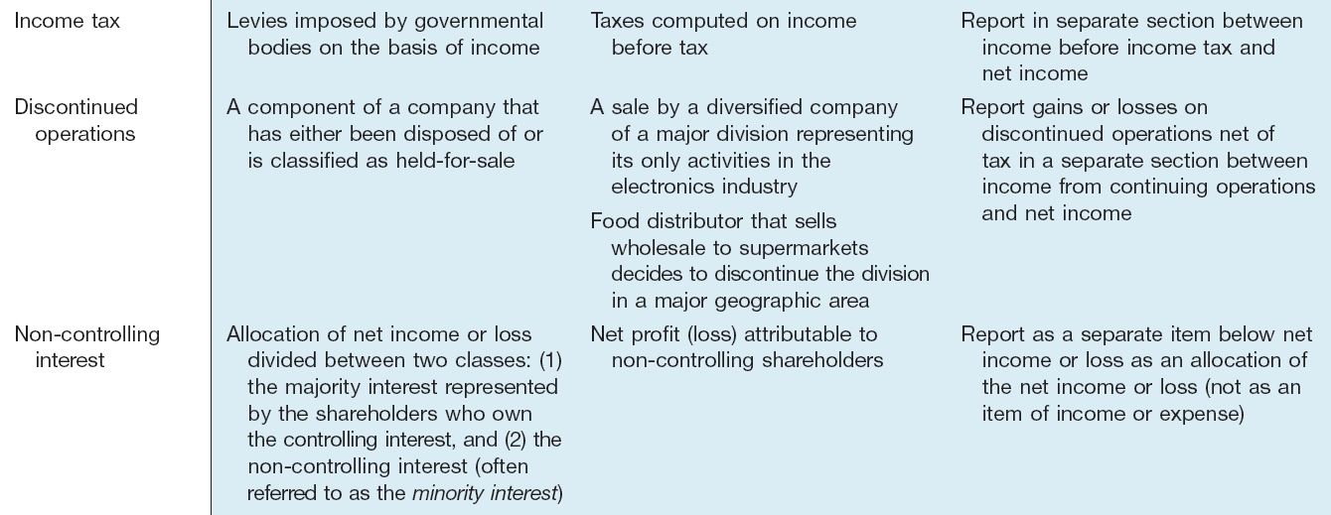
Reporting Within the Income Statement
Summary
LO 6 Explain intraperiod tax allocation.

Slide 45
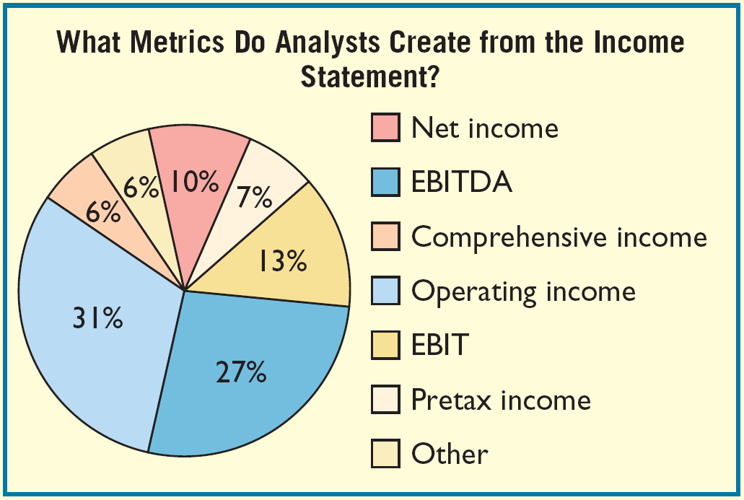
Reporting Within the Income Statement
Different Income Concepts
Users and preparers look at more than just the bottom line
income number, which supports the IFRS requirement to provide subtotals within the income statement.
LO 6 Explain intraperiod tax allocation.

Slide 46
Other Reporting Issues
Accounting Changes and Errors
Changes in Accounting Principle
Company adopts a different accounting principle.
Retrospective adjustment.
Cumulative effect adjustment to beginning retained earnings.
Approach preserves comparability.
Examples include:
Change from FIFO to average cost.
Change from the percentage-of-completion to the completed-contract method.
LO 7 Understand the reporting of accounting changes and errors.

Slide 47
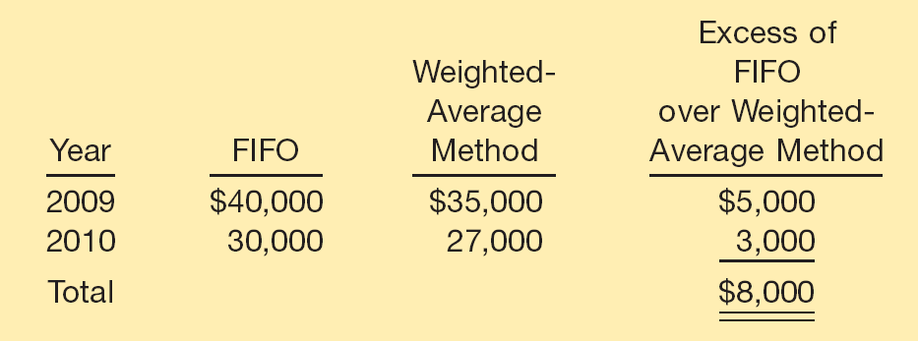
Other Reporting Issues
Change in Accounting Principle: Gaubert Inc. decided in March 2011 to change from FIFO to weighted-average inventory pricing. Gaubert’s income before taxes, using the new weighted-average method in 2011, is $30,000.
Pretax Income Data
Illustration 4-17
Calculation of a Change in
Accounting Principle
Illustration 4-18
Income Statement
Presentation of a Change
in Accounting Principle (Based on 30% tax rate)
Solution on notes page
LO 7 Understand the reporting of accounting changes and errors.

Slide 48
Other Reporting Issues
Changes in Estimate
Accounted for in the period of change and future periods.
Not handled retrospectively.
Not considered errors.
Examples include:
Useful lives and residual values of depreciable assets.
Allowance for uncollectible receivables.
Inventory obsolescence.
LO 7 Understand the reporting of accounting changes and errors.

Slide 49
Other Reporting Issues
Change in Estimate: Arcadia HS, purchased equipment for $510,000 which was estimated to have a useful life of 10 years with a salvage value of $10,000 at the end of that time. Depreciation has been recorded for 7 years on a straight-line basis. In 2011 (year 8), it is determined that the total estimated life should be 15 years with a salvage value of $5,000 at the end of that time.
Questions:
What is the journal entry to correct the prior years’ depreciation?
Calculate the depreciation expense for 2011.
No Entry
Required
LO 7 Understand the reporting of accounting changes and errors.

Slide 50
Other Reporting Issues
After 7 years
Equipment cost $510,000
Residual value - 10,000
Depreciable base 500,000
Useful life (original) 10 years
Annual depreciation $ 50,000
First, establish NBV at date of change in estimate.
x 7 years = $350,000
Balance Sheet (Dec. 31, 2010)
Fixed Assets:
Equipment
$510,000
Accumulated depreciation
350,000
Net book value (NBV)
$160,000
LO 7 Understand the reporting of accounting changes and errors.

Slide 51
Other Reporting Issues
After 7 years
Net book value $160,000
Residual value (new) - 5,000
Depreciable base 155,000
Useful life remaining 8 years
Annual depreciation $ 19,375
Depreciation Expense calculation for 2011.
Journal entry for 2011
Depreciation expense 19,375
Accumulated depreciation 19,375
LO 7 Understand the reporting of accounting changes and errors.

Slide 52
Other Reporting Issues
Corrections of Errors
Result from:
mathematical mistakes.
mistakes in application of accounting principles.
oversight or misuse of facts.
Corrections treated as prior period adjustments.
Adjustment to the beginning balance of retained earnings.
LO 7 Understand the reporting of accounting changes and errors.

Slide 53
Other Reporting Issues
Corrections of Errors: To illustrate, in 2012, Hillsboro Co. determined that it incorrectly overstated its accounts
receivable and sales revenue by $100,000 in 2011. In 2012, Hillsboro makes the following entry to correct for this error (ignore income taxes).
Retained earnings 100,000
Accounts receivable 100,000
LO 7 Understand the reporting of accounting changes and errors.

Slide 54
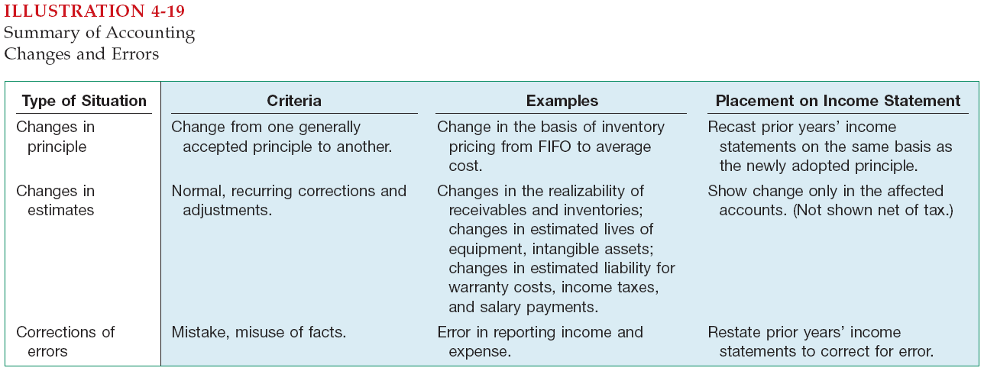
Other Reporting Issues
LO 7 Understand the reporting of accounting changes and errors.

Slide 55
Other Reporting Issues
Retained Earnings Statement
Increase
Decrease
Net income
Change in accounting principle
Prior period adjustment
Net loss
Dividends
Change in accounting principle
Prior period adjustment
LO 8 Prepare a retained earnings statement.

Slide 56
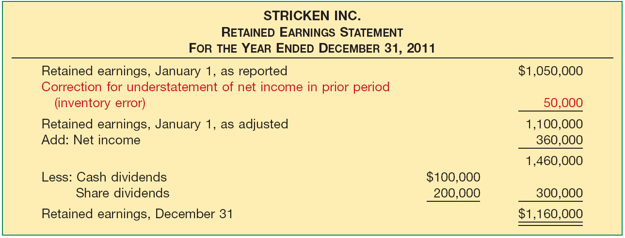
Other Reporting Issues
Retained Earnings Statement
Illustration 4-20
LO 8 Prepare a retained earnings statement.

Slide 57
Other Reporting Issues
Illustration
Before issuing the report for the year ended December 31, 2012, you discover a $50,000 error (net of tax) that caused 2011 inventory to be overstated (overstated inventory caused COGS to be lower and thus net income to be higher in 2011). Would this discovery have any impact on the reporting of the Statement of Retained Earnings for 2012?
LO 8 Prepare a retained earnings statement.

Slide 58
Other Reporting Issues
Illustration
Solution on notes page
LO 8 Prepare a retained earnings statement.

Slide 59
Other Reporting Issues
Restrictions of Retained Earnings
Disclosed
In notes to the financial statements.
As Appropriated Retained Earnings.
LO 8 Prepare a retained earnings statement.

Slide 60
Other Reporting Issues
Comprehensive Income
All changes in equity during a period except those resulting from investments by owners and distributions to owners.
Includes:
all revenues and gains, expenses and losses reported in net income, and
all gains and losses that bypass net income but affect equity.
LO 9 Explain how to report other comprehensive income.

Slide 61
Other Reporting Issues
Comprehensive Income
Other Comprehensive Income
+
Income Statement
Unrealized gains and losses on available-for-sale securities.
Translation gains and losses on foreign currency.
Plus others
Reported in Equity
LO 9 Explain how to report other comprehensive income.

Slide 62
Other Reporting Issues
Review Question
Gains and losses that bypass net income but affect equity are referred to as
a. comprehensive income.
b. other comprehensive income.
c. prior period income.
d. unusual gains and losses.
Gains and losses that bypass net income but affect equity are referred to as
a. comprehensive income.
b. other comprehensive income.
c. prior period income.
d. unusual gains and losses.
LO 9 Explain how to report other comprehensive income.

Slide 63
Other Reporting Issues
Two approaches to reporting Comprehensive Income:
A second income statement.
A combined statement of comprehensive income.
LO 9 Explain how to report other comprehensive income.

Slide 64
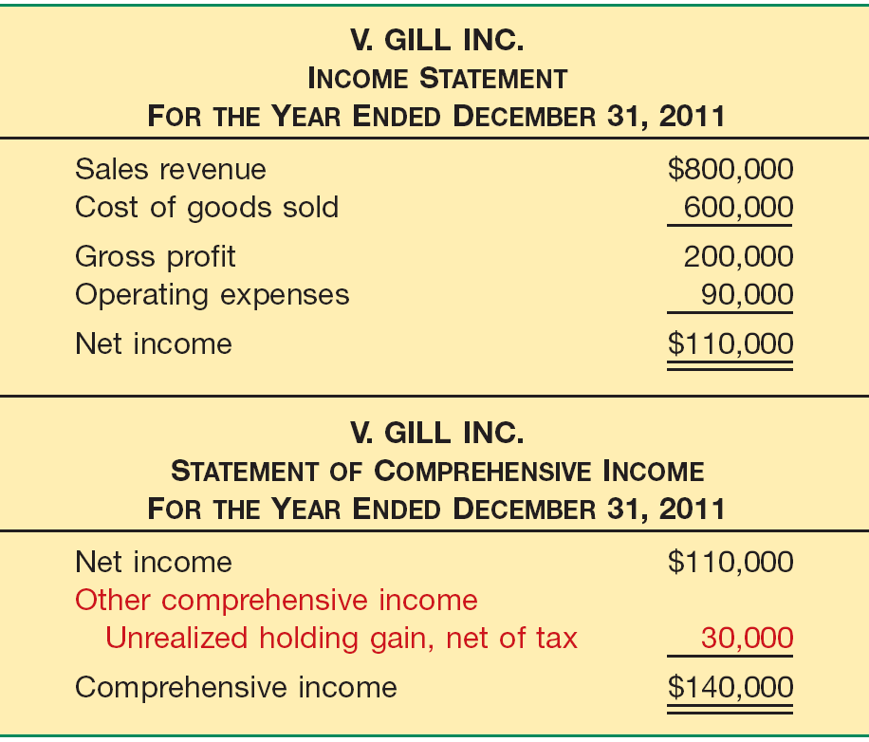
Other Reporting Issues
Comprehensive Income
Two-statement format: Comprehensive Income
Illustration 4-21
LO 9 Explain how to report other comprehensive income.

Slide 65
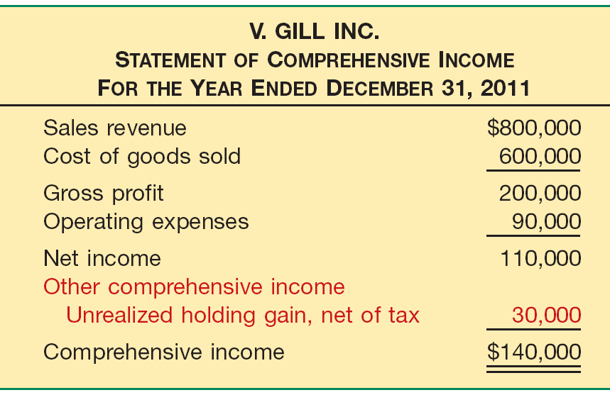
Other Reporting Issues
Comprehensive Income
Combined statement format: Comprehensive Income
Illustration 4-22
LO 9 Explain how to report other comprehensive income.

Slide 66
Other Reporting Issues
Statement of Changes in Equity
Required, in addition to a statement of comprehensive income.
Generally comprised of
share capital—ordinary,
share premium—ordinary,
retained earnings, and the
accumulated balances in other comprehensive items.
LO 9 Explain how to report other comprehensive income.

Slide 67
Other Reporting Issues
Statement of Changes in Equity
Reports the change in each equity account and in total equity for the period.
Comprehensive income for the period.
Contributions (issuances of shares) and distributions (dividends) to owners.
Reconciliation of the carrying amount of each component of equity from the beginning to the end of the period.
LO 9 Explain how to report other comprehensive income.

Slide 68
Other Reporting Issues
Statement of Changes in Equity
Illustration 4-23
LO 9 Explain how to report other comprehensive income.

Slide 69
Other Reporting Issues
Statement of Changes in Equity
Regardless of the display format used, V. Gill reports the accumulated other comprehensive income of $90,000 in the equity section of the statement of financial position as follows.
Illustration 4-24
LO 9 Explain how to report other comprehensive income.

Slide 70
Presentation of the income statement under U.S. GAAP follows either a single-step or multiple-step format. IFRS does not mention a single-step or multiple-step approach. In addition, under U.S. GAAP, companies must report an item as extraordinary if it is unusual in nature and infrequent in occurrence. Extraordinary items are prohibited under IFRS.
Under IFRS, companies must classify expenses by either nature or function. U.S. GAAP does not have that requirement, but the U.S. SEC requires a functional presentation.

Slide 71
IFRS identifies certain minimum items that should be presented on the income statement. U.S. GAAP has no minimum information requirements. However, the SEC rules have more rigorous presentation requirements.
IFRS does not define key measures like income from operations. SEC regulations define many key measures and provide requirements and limitations on companies reporting non-U.S. GAAP/IFRS information.
U.S. GAAP does not require companies to indicate the amount of net income attributable to non-controlling interest.
U.S. GAAP and IFRS follow the same presentation guidelines for discontinued operations, but IFRS defines a discontinued operation more narrowly. Both standard-setters have indicated a willingness to develop a similar definition to be used in the joint project on financial statement presentation.

Slide 72
Both U.S. GAAP and IFRS have items that are recognized in equity as part of comprehensive income but do not affect net income. U.S. GAAP provides three possible formats for presenting this information: single income statement, combined income statement of comprehensive income, in the statement of shareholders’ equity. Most companies that follow U.S. GAAP present this information in the statement of shareholders’ equity. IFRS allows a separate statement of comprehensive income or a combined statement.
Under IFRS, revaluation of property, plant, and equipment, and intangible assets is permitted and is reported as other comprehensive income. The effect of this difference is that application of IFRS results in more transactions affecting equity but not net income.

Slide 73
The terminology used in the IFRS literature is sometimes different than what is used in U.S. GAAP.

Slide 74
Copyright
Copyright © 2011 John Wiley & Sons, Inc. All rights reserved. Reproduction or translation of this work beyond that permitted in Section 117 of the 1976 United States Copyright Act without the express written permission of the copyright owner is unlawful. Request for further information should be addressed to the Permissions Department, John Wiley & Sons, Inc. The purchaser may make back-up copies for his/her own use only and not for distribution or resale. The Publisher assumes no responsibility for errors, omissions, or damages, caused by the use of these programs or from the use of the information contained herein.

Slide 75
SEKIAN DAN TERIMA KASIH

