Slide 1
STATEMENT OF FINANCIAL POSITION AND STATEMENT OF CASH FLOWS
PERTEMUAN #5
EBA302
AKUNTANSI KEUANGAN MENENGAH I + LAB
6542– SRI HANDAYANI, SE, MM, MAk, CPMA
PROGRAM STUDI AKUNTANSI
FAKULTAS EKONOMI DAN BISNIS
UNIVERSITAS ESA UNGGUL

Slide 2
KEMAMPUAN AKHIR YANG DIHARAPKAN
Mahasiswa mampu menjelaskan dan membuat neraca dan arus kas

Slide 3
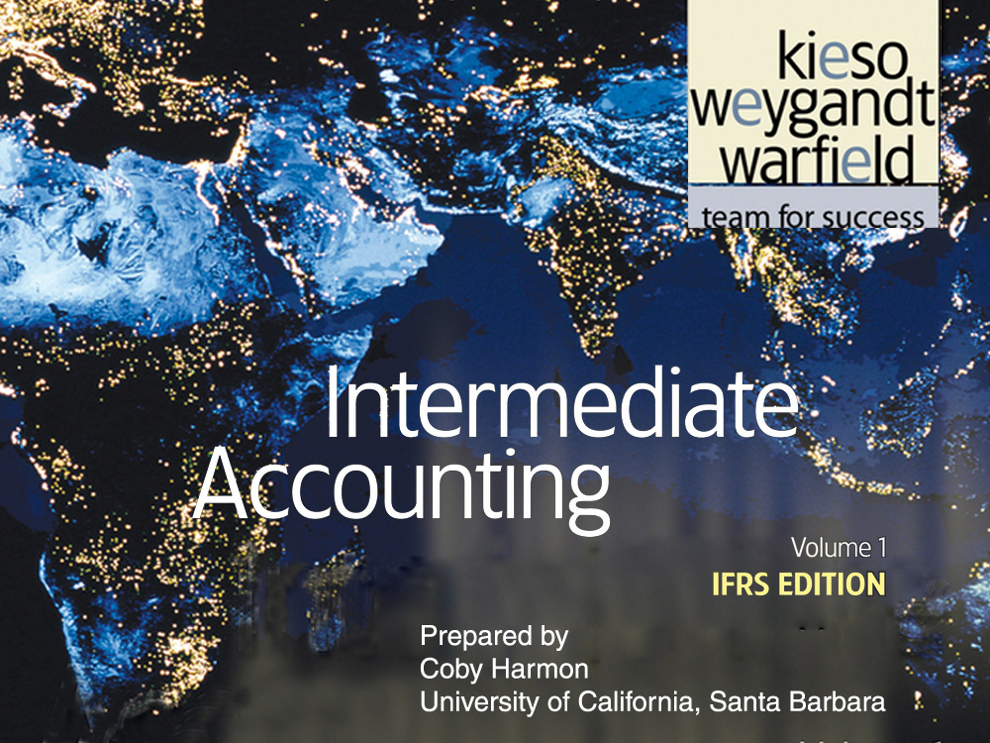

Slide 4
C H A P T E R 5
STATEMENT OF FINANCIAL POSITION AND STATEMENT OF CASH FLOWS
Intermediate Accounting
IFRS Edition
Kieso, Weygandt, and Warfield

Slide 5
Learning Objectives
Explain the uses and limitations of a statement of financial position.
Identify the major classifications of the statement of financial position.
Prepare a classified statement of financial position using the report and account formats.
Indicate the purpose of the statement of cash flows.
Identify the content of the statement of cash flows.
Prepare a basic statement of cash flows.
Understand the usefulness of the statement of cash flows.
Determine additional information requiring note disclosure.
Describe the major disclosure techniques for financial statements.

Slide 6
Statement of Financial Position
and Statement of Cash Flows
Statement of Financial Position
Statement of Cash Flows
Additional Information
Usefulness
Limitations
Classification
Purpose
Content and format
Preparation
Usefulness
Notes
Techniques of disclosure
Other guidelines

Slide 7
Statement of Financial Position
Statement of Financial Position, also referred to as the balance sheet:
  Reports assets, liabilities, and equity at a specific date.
  Provides information about resources, obligations to creditors, and equity in net resources.
  Helps in predicting amounts, timing, and uncertainty of future cash flows.
LO 1 Explain the uses and limitations of a statement of financial position.

Slide 8
Statement of Financial Position
Usefulness
Computing rates of return.
Evaluating capital structure.
Assess risk and future cash flows.
Analyze company’s:
  Liquidity
  Solvency
  Financial flexibility
LO 1 Explain the uses and limitations of a statement of financial position.

Slide 9
Statement of Financial Position
Limitations
Most assets and liabilities are reported at historical cost.
Use of judgments and estimates.
Many items of financial value are omitted.
LO 1 Explain the uses and limitations of a statement of financial position.

Slide 10
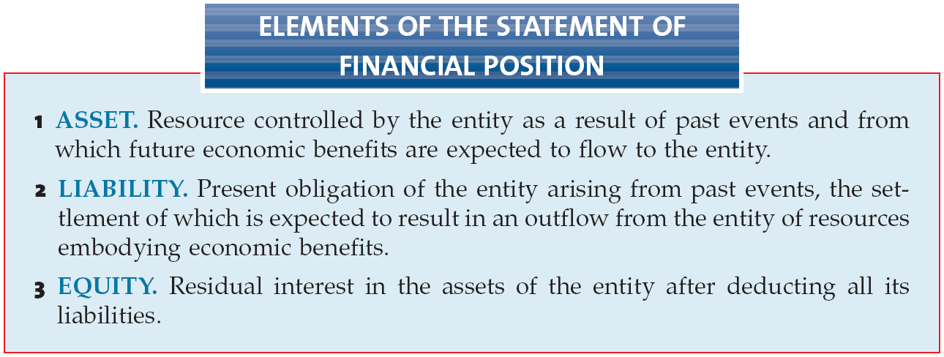
Statement of Financial Position
Classification
LO 2 Identify the major classifications of the statement of financial position.

Slide 11
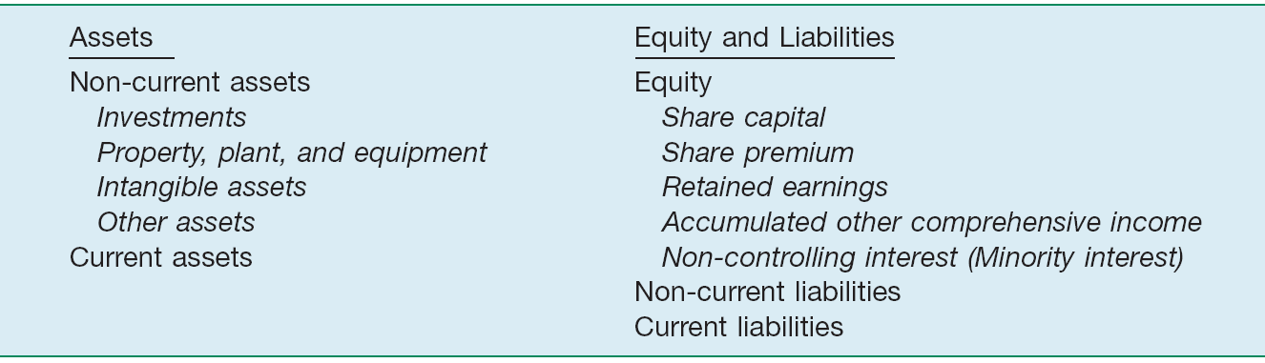
Statement of Financial Position
Subclassifications
Illustration 5-1
In some countries, such as Germany, companies often list current assets first. IAS No. 1 requires companies to distinguish current assets and liabilities from non-current ones, except in limited situations.
LO 2 Identify the major classifications of the statement of financial position.

Slide 12
Classification
Non-Current Assets
Generally consists of:
  Long-term Investments
  Property, Plant, and Equipment
  Intangibles Assets
  Other Assets
LO 2 Identify the major classifications of the statement of financial position.

Slide 13
Classification
Non-Current Assets
  Long-term Investments
  Securities (bonds, ordinary shares, or long-term notes).
  Tangible assets not currently used in operations (land held for speculation).
  Special funds (sinking fund, pension fund, or plant expansion fund.
  Non-consolidated subsidiaries or associated companies.
LO 2 Identify the major classifications of the statement of financial position.

Slide 14
Classification
  Investments in Debt and Equity Securities
Portfolio
Type
Valuation
Classification
Held-for-Collection
Debt
Amortized Cost
Current or Noncurrent
Trading
Debt or Equity
Fair Value
Current
Non-Trading Equity
Equity
Fair Value
Current or Noncurrent
LO 2 Identify the major classifications of the statement of financial position.

Slide 15

Classification
Long-Term Investments
Illustration 5-2
Statement of Financial
Position Presentation of
Long-Term Investments
LO 2 Identify the major classifications of the statement of financial position.

Slide 16
Classification
Property, Plant, and Equipment
Tangible long-lived assets used in the regular operations of the business.
  Physical property such as land, buildings, machinery, furniture, tools, and wasting resources (minerals).
  With the exception of land, a company either depreciates (e.g., buildings) or depletes (e.g., oil reserves) these assets.
LO 2 Identify the major classifications of the statement of financial position.

Slide 17
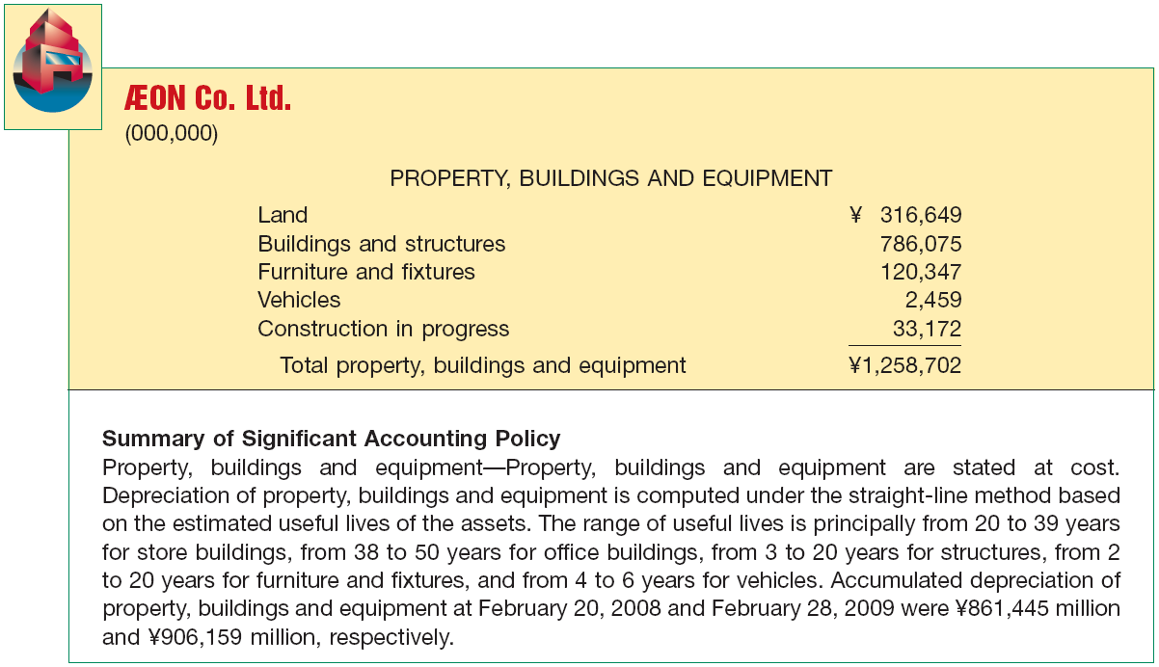
Classification
Illustration 5-3
Statement of Financial Position Presentation of Property, Plant, and Equipment
LO 2 Identify the major classifications of the statement of financial position.

Slide 18
Classification
Intangible Assets
Lack physical substance and are not financial instruments.
  Patents, copyrights, franchises, goodwill, trademarks, trade names, and customer lists.
  Amortize limited-life intangible assets over their useful lives.
  Periodically assess indefinite-life intangibles for impairment.
LO 2 Identify the major classifications of the statement of financial position.

Slide 19
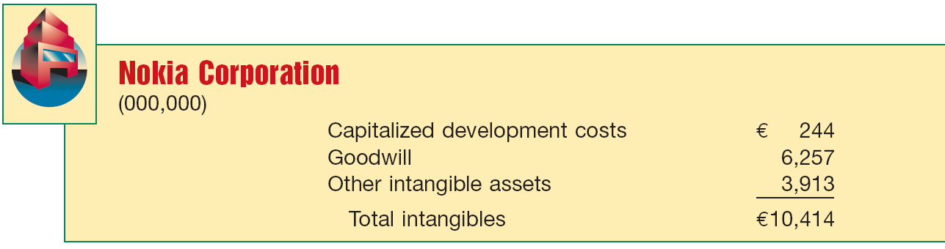
Classification
Intangible Assets
Illustration 5-4
Statement of Financial
Position Presentation of
Intangible Assets
LO 2 Identify the major classifications of the statement of financial position.

Slide 20
Classification
Other Assets
Items vary in practice. Can include:
  Long-term prepaid expenses
  Non-current receivables
  Assets in special funds
  Property held for sale
  Restricted cash or securities
LO 2 Identify the major classifications of the statement of financial position.

Slide 21
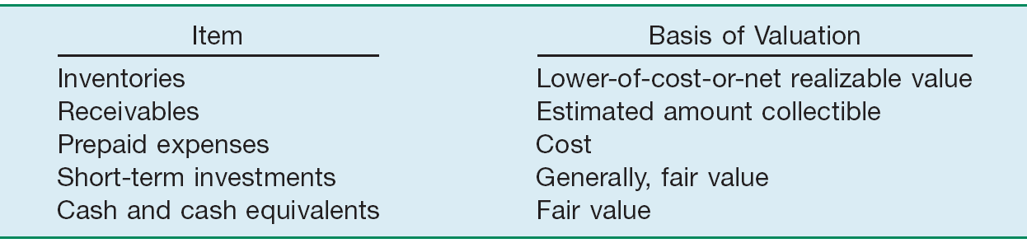
Classification
Current Assets
Cash and other assets a company expects to convert into cash, sell, or consume either in one year or in the operating cycle, whichever is longer.
Illustration 5-5
LO 2 Identify the major classifications of the statement of financial position.

Slide 22
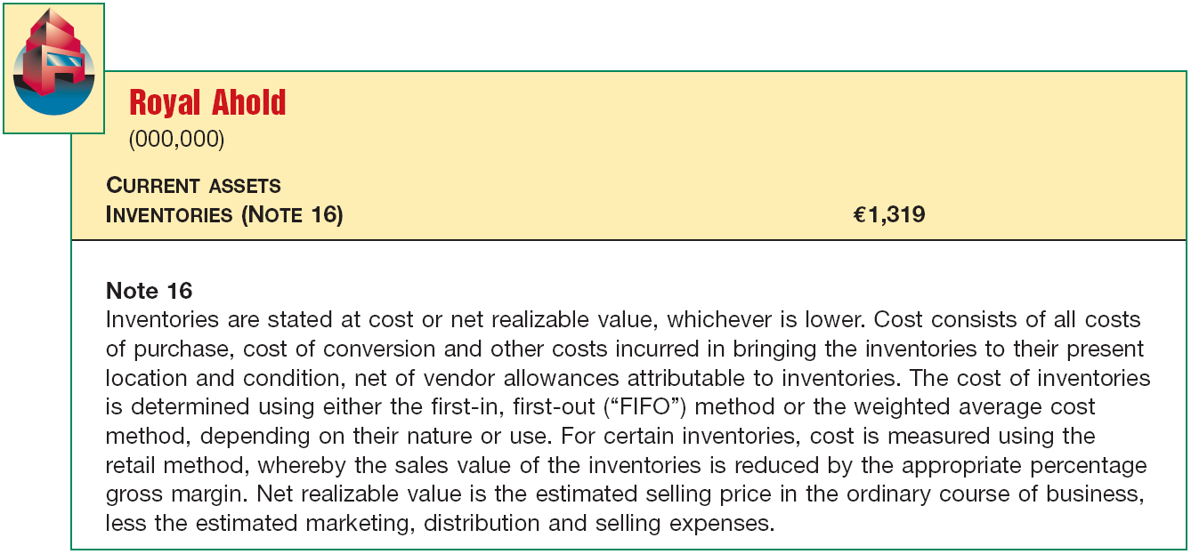
Classification
Inventories
Disclose:
  Basis of valuation (e.g., lower-of-cost-or-market).
  Cost flow assumption (e.g., FIFO or average cost).
Illustration 5-6
LO 2

Slide 23
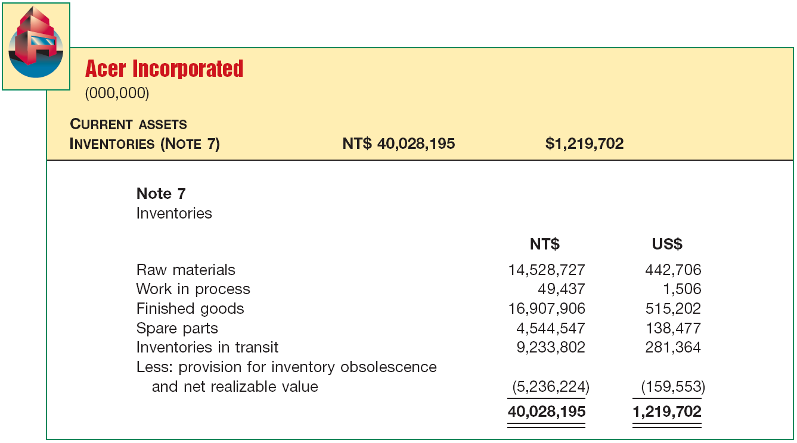
Classification
Inventories
Manufacturing Company
Illustration 5-8
Statement of Financial Position Presentation of Inventories
LO 2

Slide 24
Classification
Receivables
Claims held against customers and others for
  money,
  goods, or
  services.
Major categories of receivables should be shown in the statement of financial position or the related notes.
LO 2 Identify the major classifications of the statement of financial position.

Slide 25
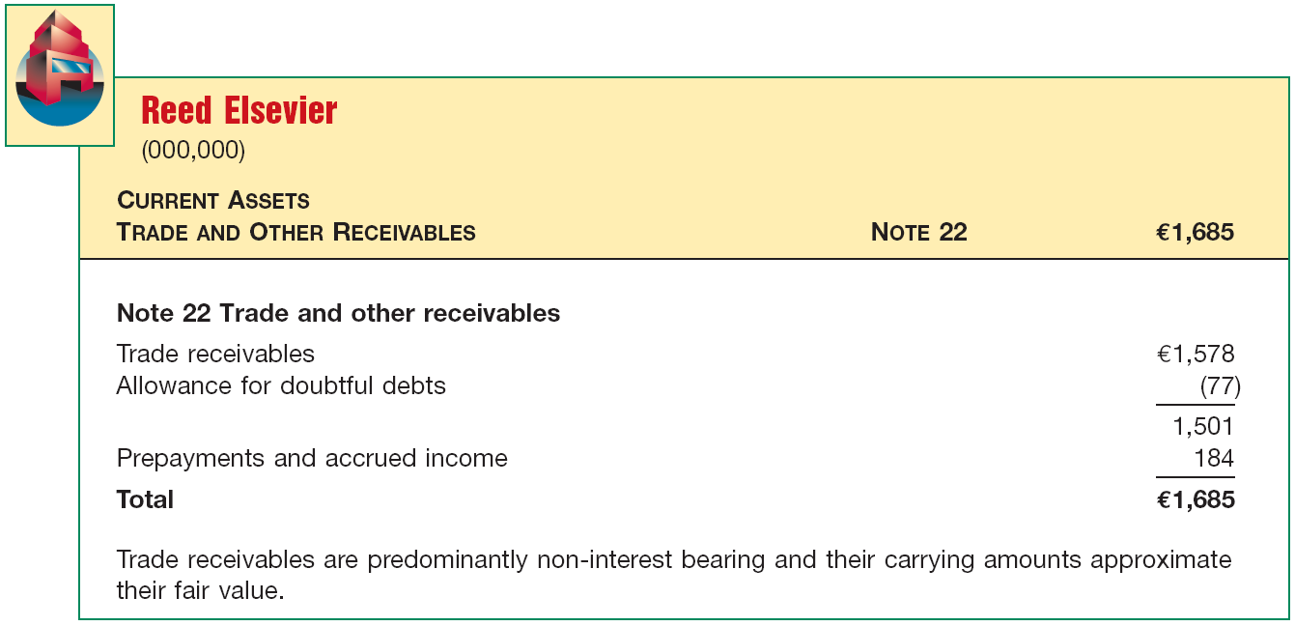
Classification
Receivables
Illustration 5-8
Statement of Financial Position Presentation of Receivables
LO 2 Identify the major classifications of the statement of financial position.

Slide 26
Classification
Prepaid Expenses
Payment of cash, that is recorded as an asset because service or benefit will be received in the future.
Cash Payment
BEFORE
Expense Recorded
Prepayments often occur in regard to:
  insurance
  supplies
  advertising
  rent
  maintenance on equipment
LO 2 Identify the major classifications of the statement of financial position.

Slide 27
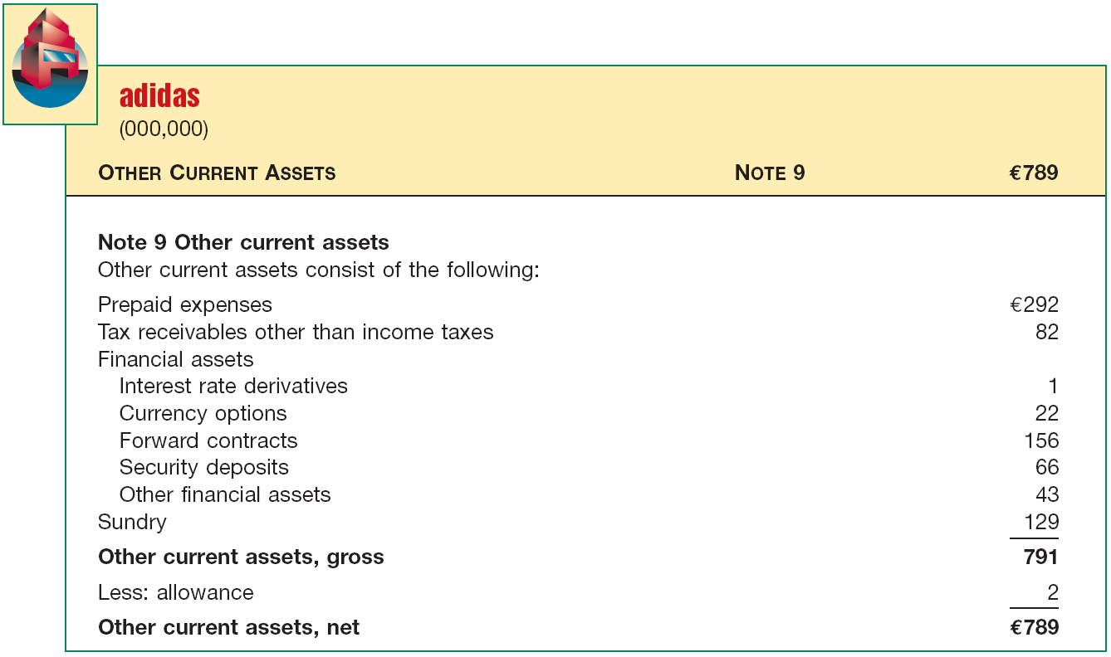
Classification
Prepaid Expenses
Illustration 5-9
Statement of Financial Position Presentation of Prepaid Expenses
LO 2

Slide 28
Classification
Short-Term Investments
Portfolios
Type
Valuation
Classification
Held-to-Maturity
Debt
Amortized Cost
Current or Noncurrent
Trading
Debt or Equity
Fair Value
Current
Available- for-Sale
Debt or Equity
Fair Value
Current or Noncurrent
LO 2 Identify the major classifications of the statement of financial position.

Slide 29
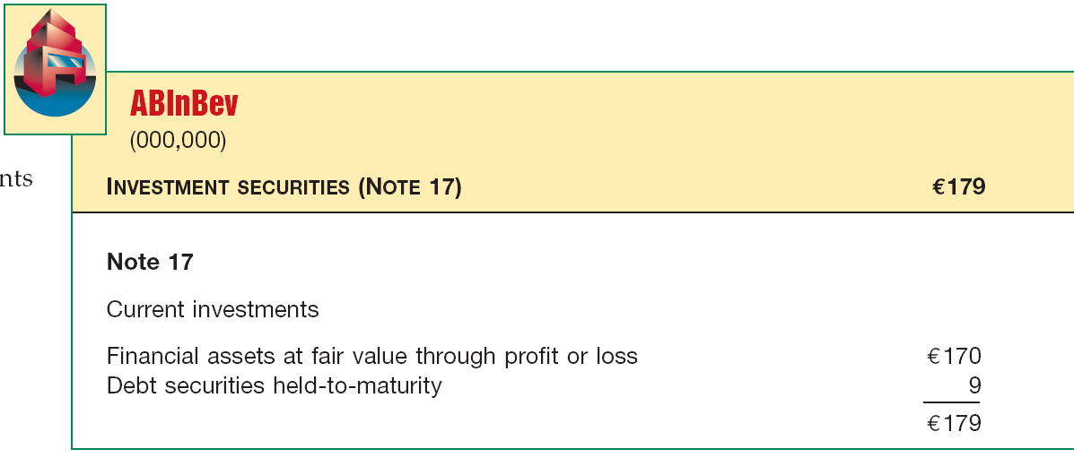
Classification
Short-Term Investments
Illustration 5-10
Statement of Financial Position Presentation of Short-Term Investments
LO 2 Identify the major classifications of the statement of financial position.

Slide 30
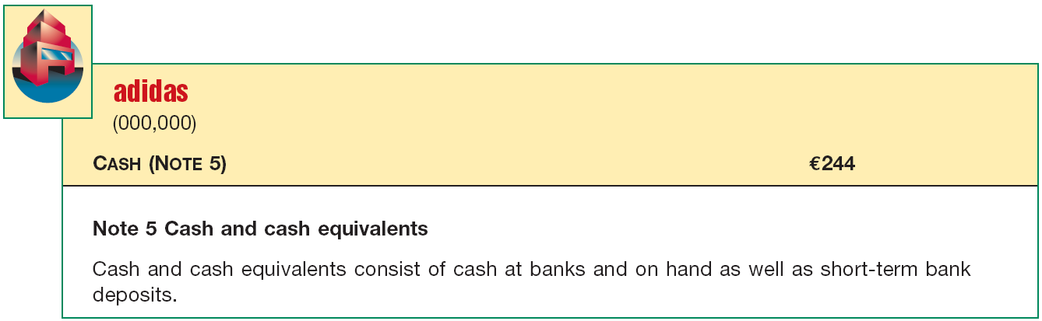
Classification
Cash
Generally any monies available “on demand.”
Cash equivalents - short-term highly liquid investments that mature within three months or less.
Restrictions or commitments must be disclosed.
Illustration 5-11
LO 2 Identify the major classifications of the statement of financial position.

Slide 31
Classification
Cash
Illustration 5-12
Statement of Financial
Position—Restricted Cash
LO 2 Identify the major classifications of the statement of financial position.

Slide 32
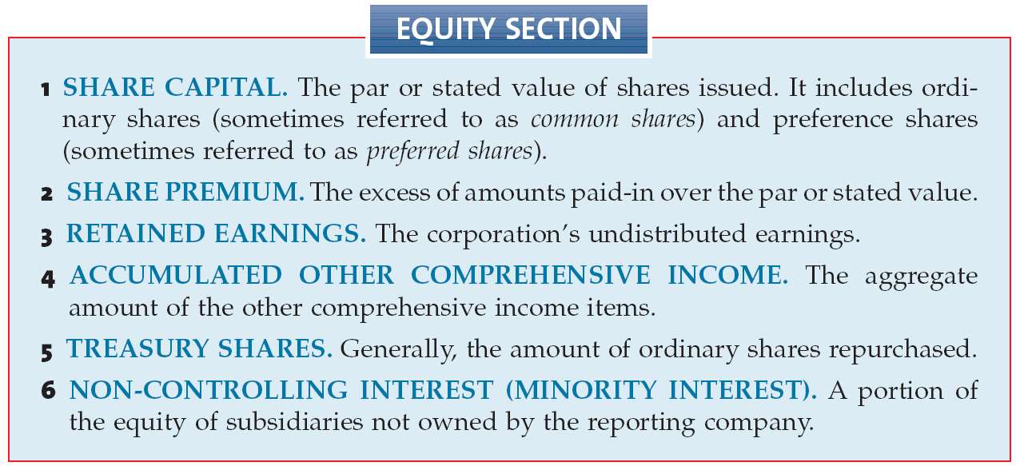
Classification
Equity
LO 2 Identify the major classifications of the statement of financial position.

Slide 33
Classification
Equity
  Ordinary shares and preference shares - must disclose the par value and the authorized, issued, and outstanding amounts.
  Share premium - company usually presents one amount for ordinary and preference shares.
  Retained earnings - amount may be divided between the unappropriated and restricted amounts.
  Treasury shares - shown as a reduction of equity.
LO 2 Identify the major classifications of the statement of financial position.

Slide 34
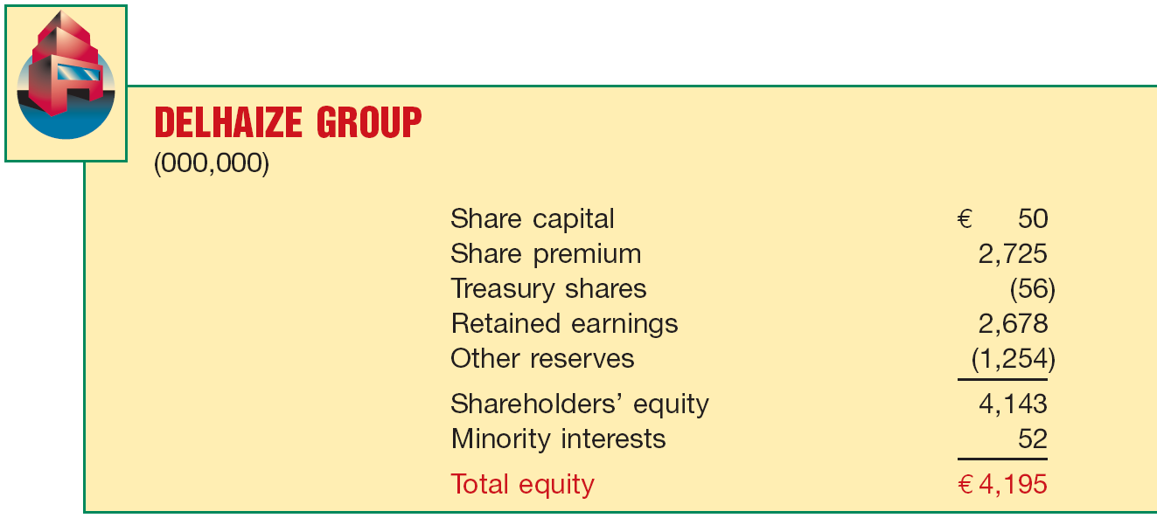
Classification
Equity
Illustration 5-13
Statement of Financial
Position—Equity
LO 2 Identify the major classifications of the statement of financial position.

Slide 35
Classification
Non-Current Liabilities
  Obligations that a company does not reasonably expect to liquidate within the longer of one year or the normal operating cycle. Three types:
    Obligations arising from specific financing situations.
    Obligations arising from the ordinary operations of the company.
    Obligations that depend on the occurrence or non-occurrence of one or more future events to confirm the amount payable, or the payee, or the date payable.
LO 2 Identify the major classifications of the statement of financial position.

Slide 36
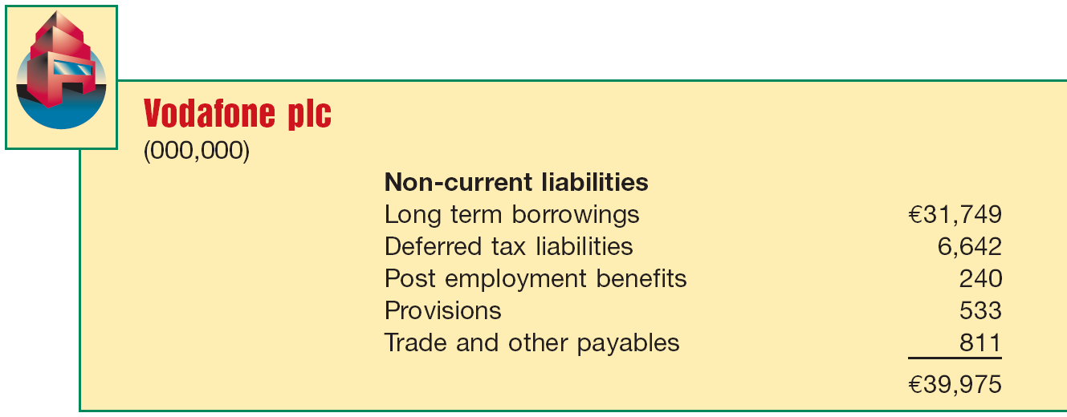
Classification
Non-Current Liabilities
Illustration 5-15
Statement of Financial
Position Presentation of Non-Current Liabilities
LO 2 Identify the major classifications of the statement of financial position.

Slide 37
Classification
Current Liabilities
  Obligations that a company generally expects to settle in its normal operating cycle or one year, whichever is longer. This concept includes:
    Payables resulting from the acquisition of goods and services: accounts payable, wages payable, and so on.
    Collections received in advance for the delivery of goods or performance of services, such as unearned rent revenue.
    Other liabilities whose liquidation will take place within the operating cycle or one year.
LO 2 Identify the major classifications of the statement of financial position.

Slide 38
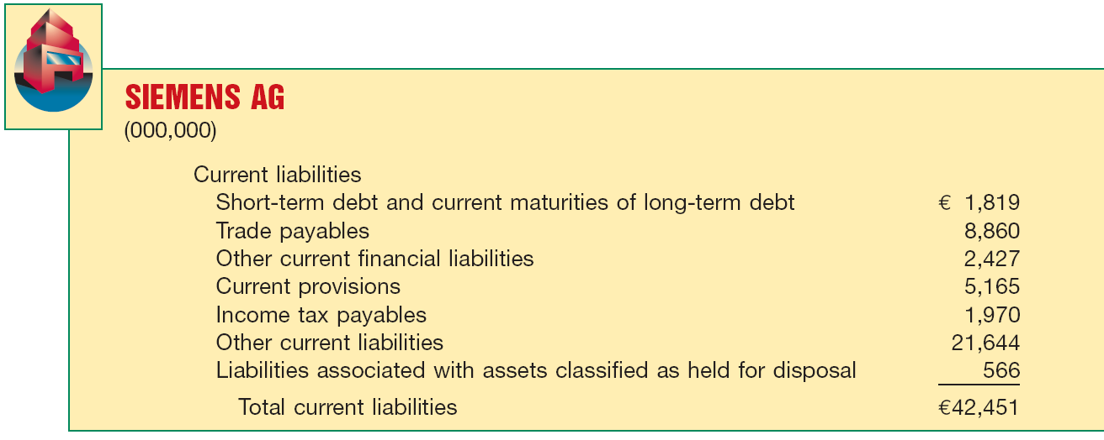
Classification
Current Liabilities
Illustration 5-16
Statement of Financial
Position Presentation of Current Liabilities
LO 2 Identify the major classifications of the statement of financial position.

Slide 39
Classification
Statement of Financial Position Format
  IFRS does not specify the order or format in which a company presents items in the statement of financial position.
  Account form or report form.
LO 3 Prepare a classified statement of financial position using the report and account formats.

Slide 40
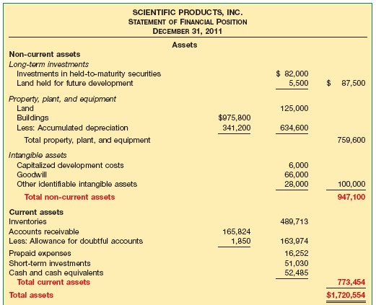
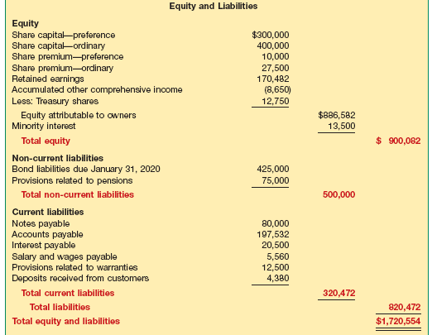
Classification
Account Form
Illustration 5-17
LO 3 Prepare a classified statement of financial position using the report and account formats.

Slide 41
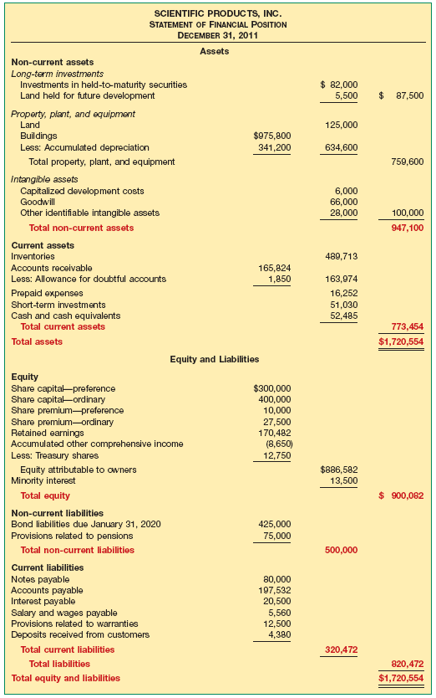
Classification
Report Form
Illustration 5-17
LO 3

Slide 42
The Statement of Cash Flows
One of the three basic objectives of financial reporting is
“assessing the amounts, timing, and uncertainty of cash flows.”
IASB requires the statement of cash flows (also called the cash flow statement).

Slide 43
Purpose of the Statement of Cash Flows
Primary Purpose: To provide relevant information about the cash receipts and cash payments of an enterprise during a period.
The statement provides answers to the following questions:
  Where did the cash come from?
  What was the cash used for?
  What was the change in the cash balance?
LO 4 Indicate the purpose of the statement of cash flows.

Slide 44
Content and Format
Operating
Investing
Financing
Cash inflows and outflows from operations.
Cash inflows and outflows from non-current assets.
Cash inflows and outflows from non-current liabilities and equity.
Statement helps users evaluate liquidity, solvency, and financial flexibility.
LO 5 Identify the content of the statement of cash flows.

Slide 45
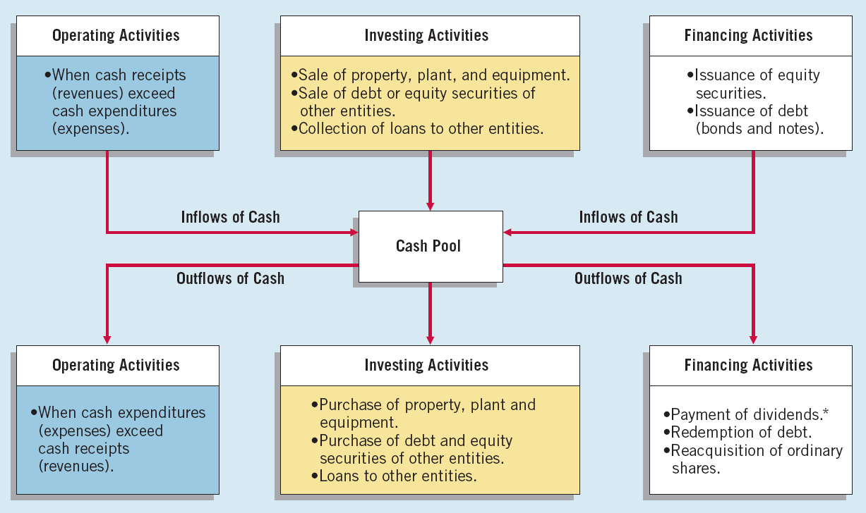
Content and Format
Illustration 5-19
LO 5 Identify the content of the statement of cash flows.

Slide 46
Preparation of the Statement of Cash Flows
Sources of Information
Information obtained from several sources:
(1) comparative statement of financial position,
(2) current income statement, and
(3) selected transaction data.
LO 6 Prepare a basic statement of cash flows.

Slide 47
Preparation of the Statement of Cash Flows
Statement of Cash Flows: On January 1, 2011, in its first year of operations, Telemarketing Inc. issued 50,000 ordinary shares ($1 par value) for $50,000 cash. The company rented its office space, furniture, and telecommunications equipment and performed marketing services throughout the first year. In June 2011 the company purchased land for $15,000. Illustration 5-20 shows the company’s comparative statement of financial position at the beginning and end of 2011.
LO 6 Prepare a basic statement of cash flows.

Slide 48
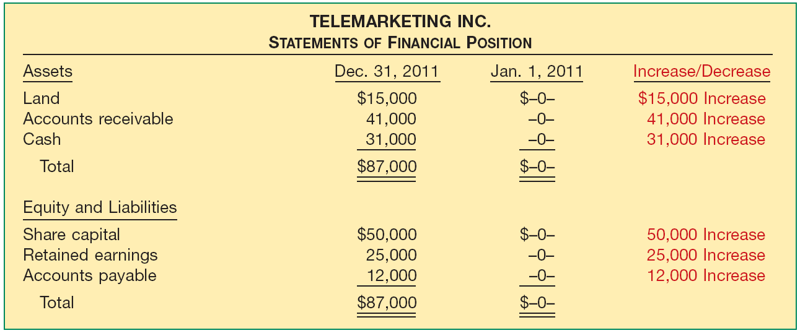
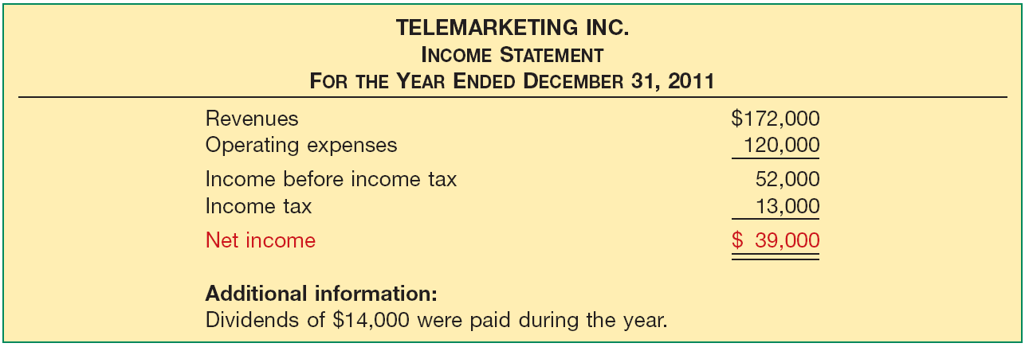
Preparation of the Statement of Cash Flows
Illustration 5-20
Illustration 5-21
LO 6

Slide 49
Preparation of the Statement of Cash Flows
Preparing the Statement of Cash Flows
Determine:
  Cash provided by (or used in) operating activities.
  Cash provided by or used in investing and financing activities.
  Determine the change (increase or decrease) in cash during the period.
  Reconcile the change in cash with the beginning and the ending cash balances.
LO 6 Prepare a basic statement of cash flows.

Slide 50
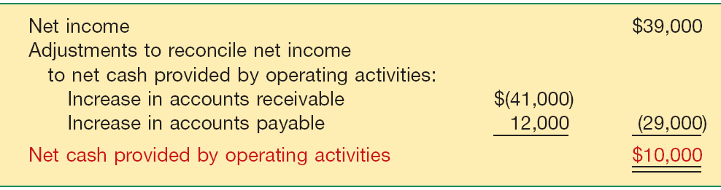
Preparation of the Statement of Cash Flows
Illustration 5-20
Illustration 5-21
Cash provided by operating activities
Illustration 5-22
LO 6 Prepare a basic statement of cash flows.

Slide 51
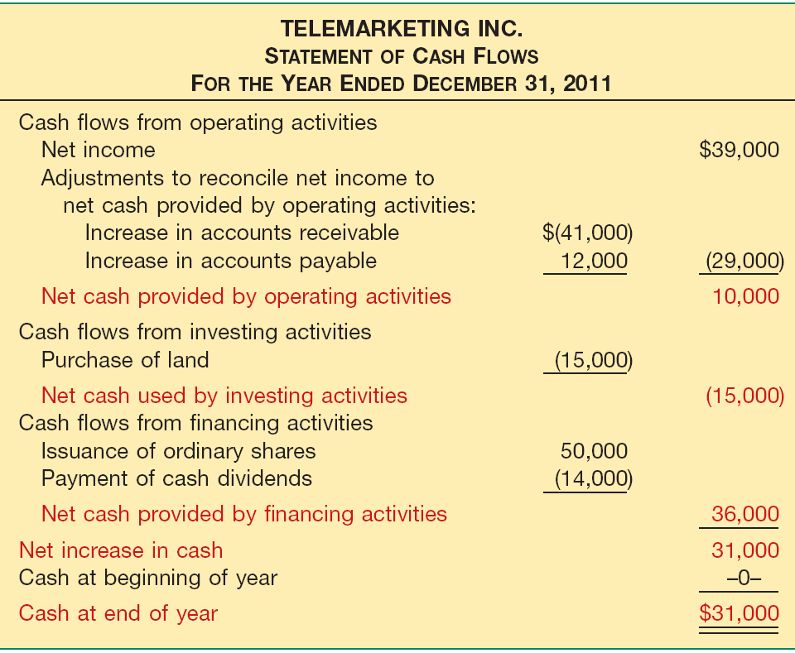
The Statement of Cash Flows
Illustration 5-20
Illustration 5-21
Illustration 5-29
Next, the company determines its investing and financing activities.

Slide 52
Preparation of the Statement of Cash Flows
Statement of Cash Flows (BE 5-12): Keyser Beverage Company reported the following items in the most recent year.
Activity
Net income $40,000
Dividends paid 5,000
Increase in accounts receivable 10,000
Increase in accounts payable 7,000
Purchase of equipment 8,000
Depreciation expense 4,000
Issue of notes payable 20,000
Operating
Financing
Operating
Operating
Investing
Operating
Financing
Required: Prepare a Statement of Cash Flows
LO 6 Prepare a basic statement of cash flows.

Slide 53
Preparation of the Statement of Cash Flows
Statement of Cash Flows (BE 5-12)
Noncash credit to revenues.
Noncash charge to expenses.
LO 6 Prepare a basic statement of cash flows.

Slide 54
Preparation of the Statement of Cash Flows
Review
In preparing a statement of cash flows, which of the following transactions would be considered an investing activity?
a. Sale of equipment at book value
b. Sale of merchandise on credit
c. Declaration of a cash dividend
d. Issuance of bonds payable.
LO 6 Prepare a basic statement of cash flows.

Slide 55
Preparation of the Statement of Cash Flows
Significant Non-Cash Activities
Significant financing and investing activities that do not affect cash are reported in either a separate schedule at the bottom of the statement of cash flows or in the notes.
Examples include:
  Issuance of ordinary shares to purchase assets.
  Conversion of bonds into ordinary shares.
  Issuance of debt to purchase assets.
  Exchanges on long-lived assets.
LO 6 Prepare a basic statement of cash flows.

Slide 56
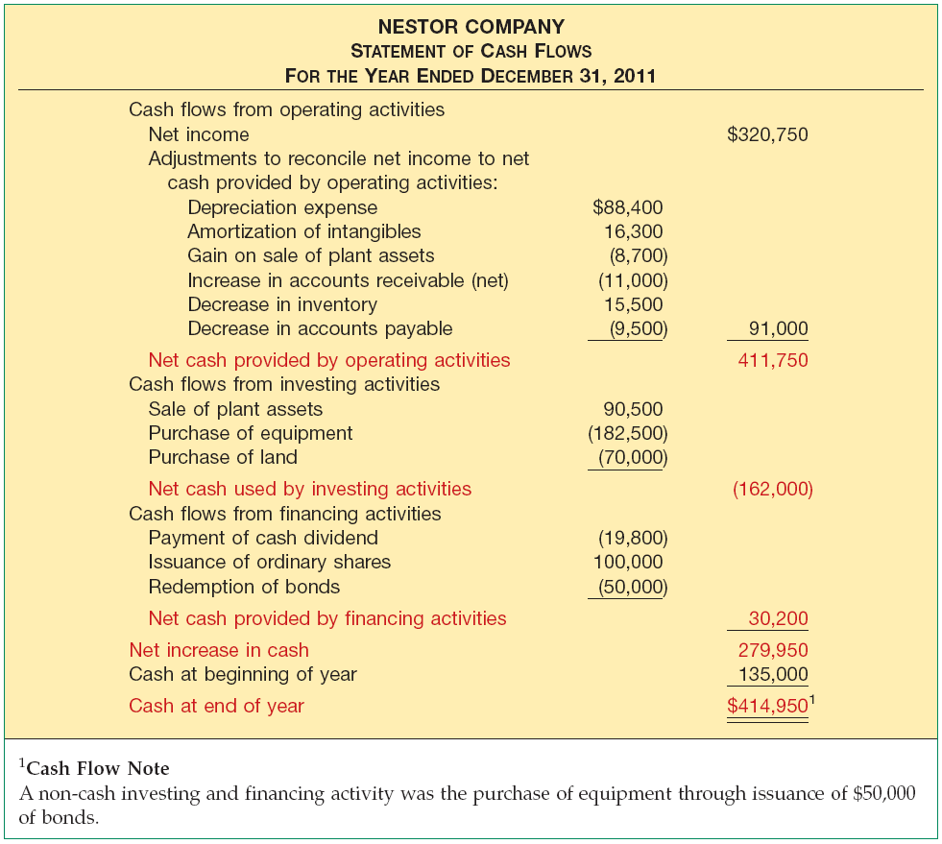
Preparation of the Statement of Cash Flows
Illustration 5-24
Comprehensive Statement
of Cash Flows

Slide 57
Usefulness of the Statement of Cash Flows
Without cash, a company will not survive.
Cash flow from Operations:
  High amount - company able to generate sufficient cash to pay its bills.
  Low amount - company may have to borrow or issue equity securities to pay bills.
LO 7 Understand the usefulness of the statement of cash flows.

Slide 58
Usefulness of the Statement of Cash Flows
Financial Liquidity
Illustration 5-26
Net Cash Provided by Operating Activities
Current Cash Debt Coverage Ratio
=
Average Current Liabilities
Ratio indicates whether the company can pay off its current liabilities from its operations. A ratio near 1:1 is good.
LO 7 Understand the usefulness of the statement of cash flows.

Slide 59
Usefulness of the Statement of Cash Flows
Financial Flexibility
Illustration 5-27
Net Cash Provided by Operating Activities
Cash Debt Coverage Ratio
=
Average Total Liabilities
This ratio indicates a company’s ability to repay its liabilities from net cash provided by operating activities, without having to liquidate the assets employed in its operations.
LO 7 Understand the usefulness of the statement of cash flows.

Slide 60
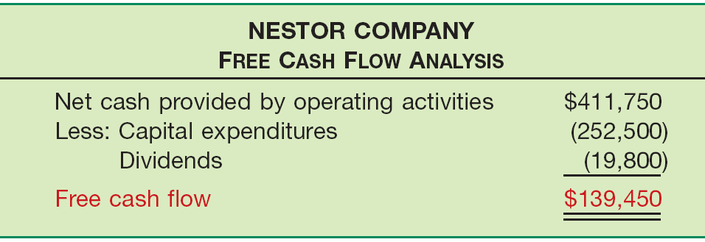
Usefulness of the Statement of Cash Flows
Free Cash Flow
Illustration 5-29
The amount of discretionary cash flow a company has for purchasing additional investments, retiring its debt, purchasing treasury stock, or simply adding to its liquidity.
LO 7 Understand the usefulness of the statement of cash flows.

Slide 61
Usefulness of the Statement of Cash Flows
Review
The current cash debt coverage ratio is often used to assess
a. financial flexibility.
b. liquidity.
c. profitability.
d. solvency.
LO 7 Understand the usefulness of the statement of cash flows.

Slide 62
Financial Statements and Notes
IFRS requires that a complete set of financial statements be presented annually. Comprised of the following:
Statement of financial position at the end of the period;
Statement of comprehensive income for the period to be presented either as:
  One single statement of comprehensive income.
  A separate income statement and statement of comprehensive income.
Statement of changes in equity;
Statement of cash flows; and
Notes, comprising a summary of significant accounting policies and other explanatory information.
LO 8 Determine additional information requiring note disclosure.

Slide 63
Financial Statements and Notes
Notes to the Financial Statements
  Accounting policies
    Specific principles, bases, conventions, rules, and practices applied by a company in preparing and presenting financial information.
    First note generally titled, “Summary of Significant Accounting Policies.”
LO 8 Determine additional information requiring note disclosure.

Slide 64
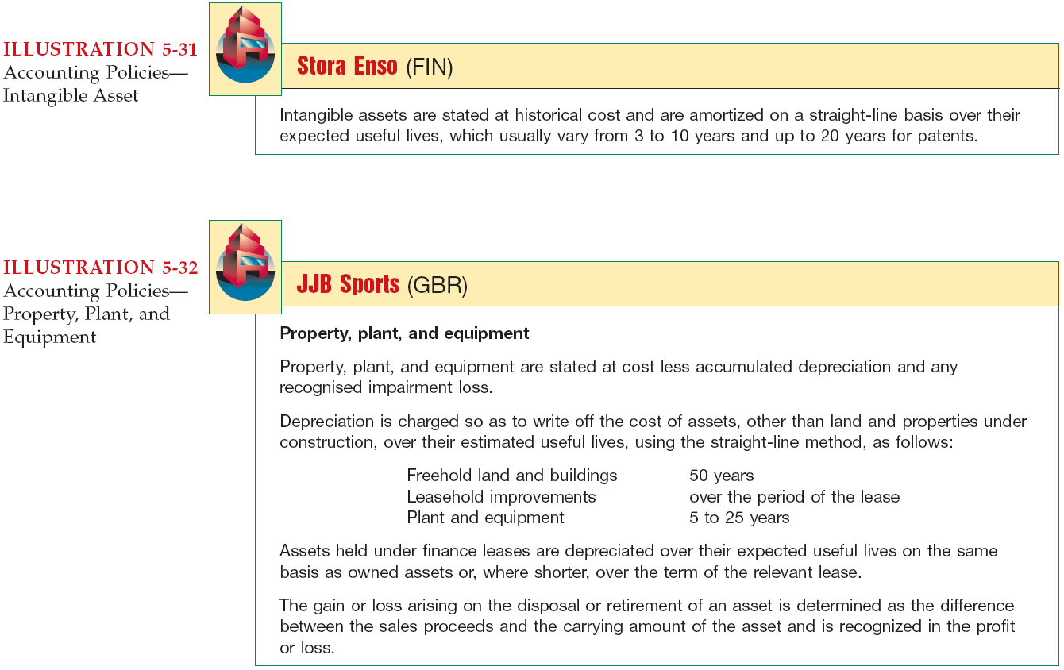
Financial Statements and Notes

Slide 65
Financial Statements and Notes
  Additional Notes to the Financial Statements
    In many cases, IFRS requires specific disclosures. Examples include:
      Items of property, plant, and equipment are disaggregated into classes.
      Receivables are disaggregated into amounts receivable from trade customers, receivables from related parties, prepayments, and other amounts.
      Inventories are disaggregated into classifications such as merchandise, production supplies, work in process, and finished goods.
LO 8 Determine additional information requiring note disclosure.

Slide 66

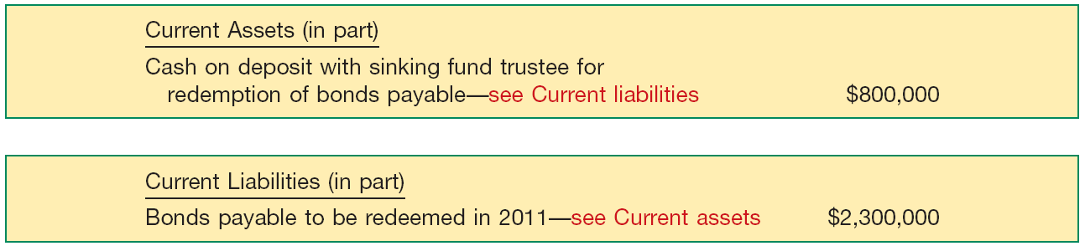
Techniques of Disclosure
  Parenthetical Explanations
Illustration 5-37
  Cross-Reference and Contra Items
Illustration 5-38
LO 9 Describe the major disclosure techniques for financial statements.

Slide 67
Other Guidelines
  Offsetting
  IAS No. 1 indicates that it is important that assets and liabilities, and income and
expense, be reported separately.
  Consistency
  IAS No. 8, for example, notes that users of the financial statements need to be
  able to compare the financial statements of a company over time to identify trends
  in financial position, financial performance, and cash flows.
  Fair Presentation
  Faithful representation of transactions and events using the definitions and recognition criteria in the Framework.
LO 9 Describe the major disclosure techniques for financial statements.

Slide 68


  IFRS requires that specific items be reported on the statement of financial position. No such general standard exists in U.S. GAAP. However under U.S. GAAP, public companies must follow U.S. SEC regulations, which require specific line items.
  U.S. GAAP statements report current assets first, followed by non-current assets. Current liabilities, noncurrent liabilities, and shareholders’ equity then follow.
  While the use of the term “reserve” is discouraged in U.S. GAAP, there is no such prohibition in IFRS.

Slide 69
  There are many similarities between IFRS and U.S. GAAP related to statement of financial position presentation. For example:
    U.S. GAAP specifies minimum note disclosures, similar to IFRS on accounting policies and judgments. These must include information about (1) accounting policies followed, (2) judgments that management has made in applying the entity’s accounting policies, and (3) key assumptions and estimation uncertainty that could result in a material adjustment to the carrying amounts of assets and liabilities.
    Financial statements must be prepared annually.

Slide 70
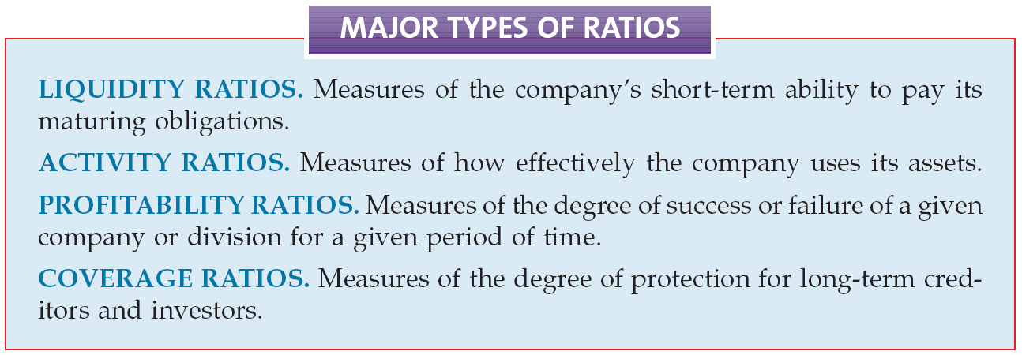
Using Ratios to Analyze Performance
  Analysts and other interested parties can gather qualitative information from financial statements by examining relationships between items on the statements and identifying trends in these relationships.
LO 10 Identify the major types of financial ratios and what they measure.

Slide 71
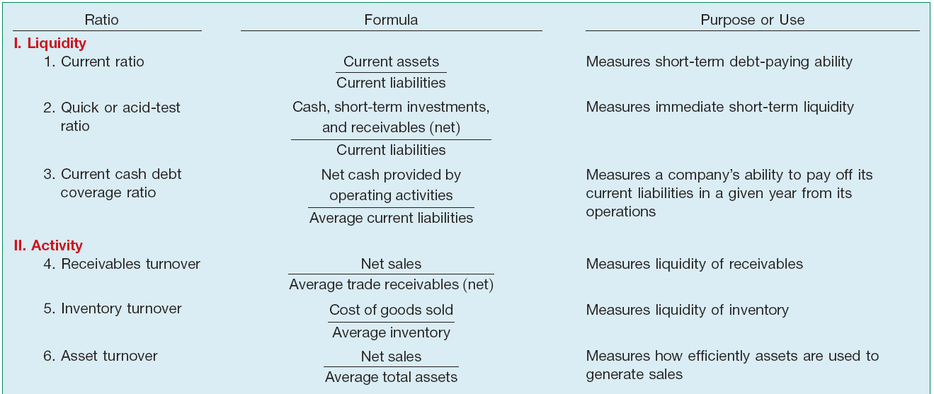
Using Ratios to Analyze Performance
Illustration 5A-1
A Summary of Financial Ratios
LO 10 Identify the major types of financial ratios and what they measure.

Slide 72
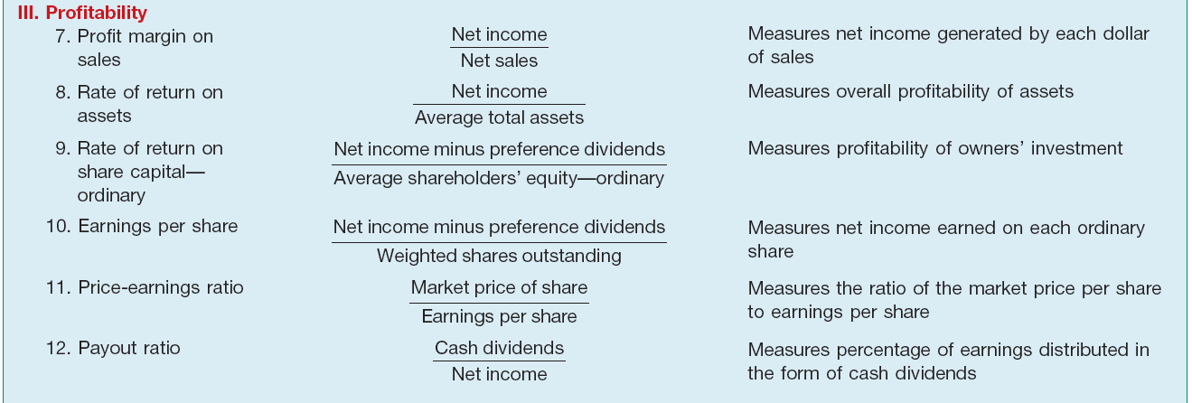
Using Ratios to Analyze Performance
Illustration 5A-1
A Summary of Financial Ratios
LO 10 Identify the major types of financial ratios and what they measure.

Slide 73
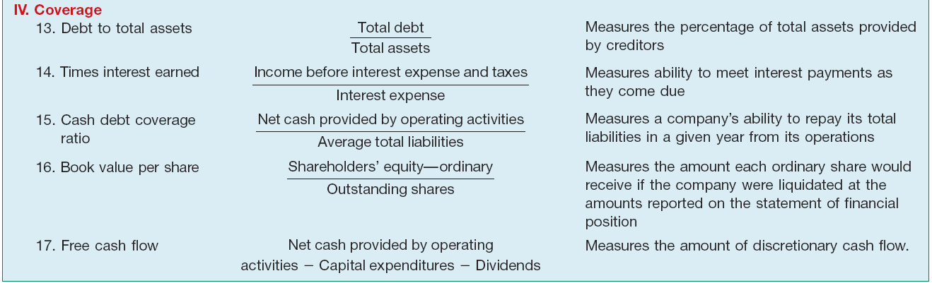
Using Ratios to Analyze Performance
Illustration 5A-1
A Summary of Financial Ratios
LO 10 Identify the major types of financial ratios and what they measure.

Slide 74
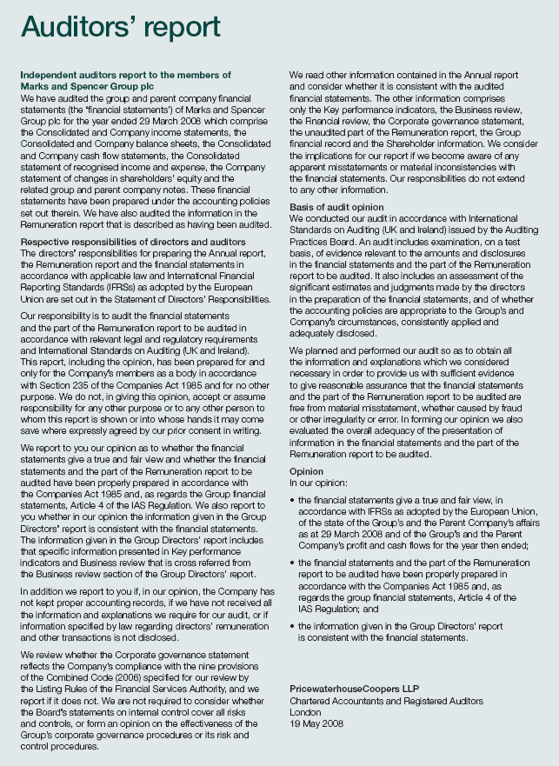



Slide 75
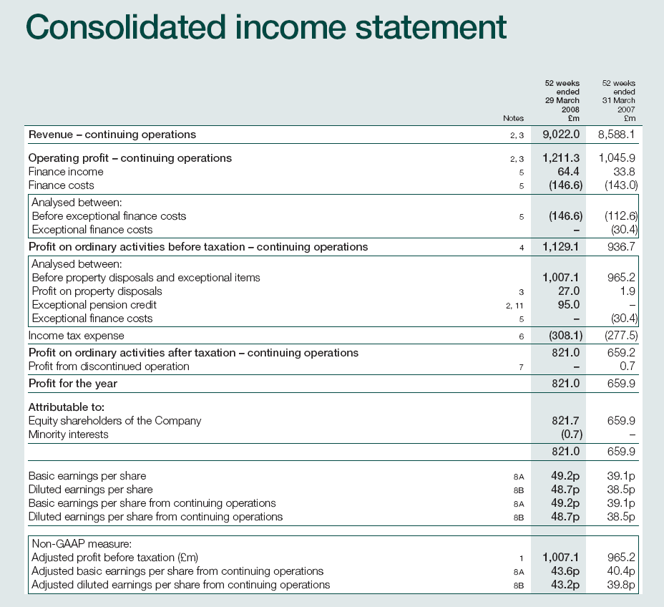

Slide 76
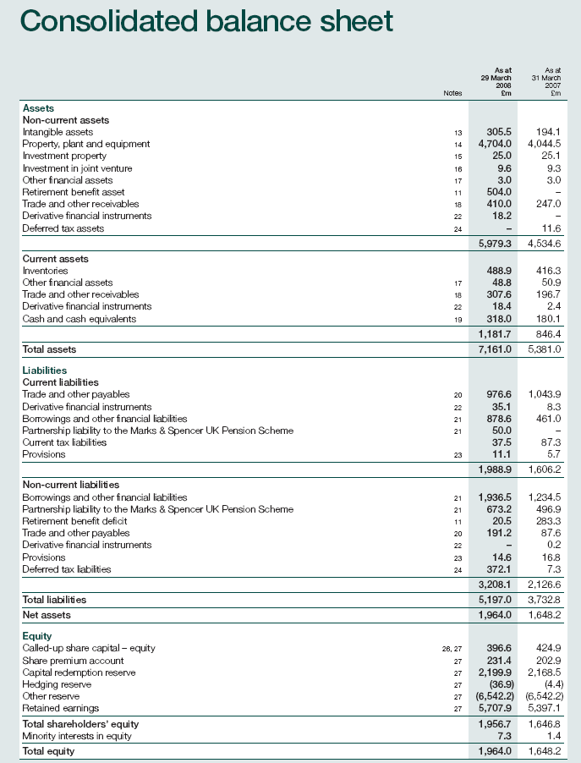

Slide 77
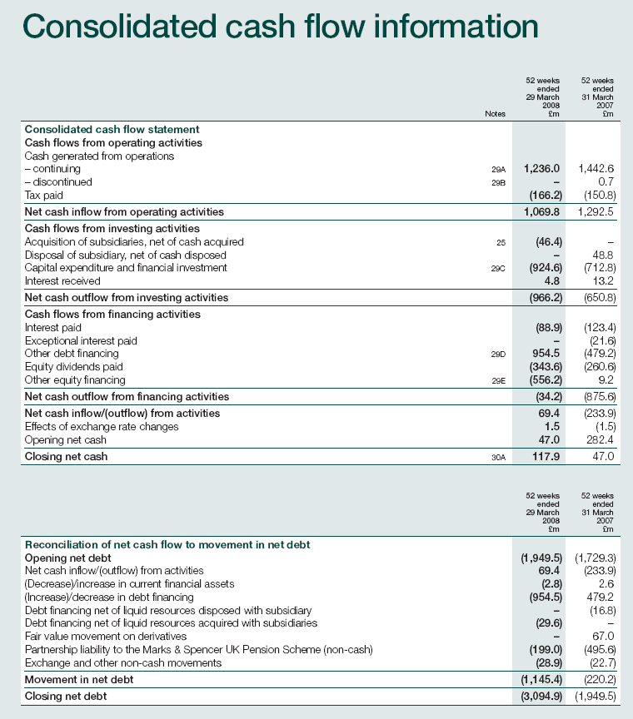

Slide 78
Copyright
Copyright © 2011 John Wiley & Sons, Inc. All rights reserved. Reproduction or translation of this work beyond that permitted in Section 117 of the 1976 United States Copyright Act without the express written permission of the copyright owner is unlawful. Request for further information should be addressed to the Permissions Department, John Wiley & Sons, Inc. The purchaser may make back-up copies for his/her own use only and not for distribution or resale. The Publisher assumes no responsibility for errors, omissions, or damages, caused by the use of these programs or from the use of the information contained herein.

Slide 79
SEKIAN
DAN
TERIMA KASIH

