Slide 1
ACCOUNTING AND THE TIME VALUE OF MONEY
PERTEMUAN #6
EBA302
AKUNTANSI KEUANGAN MENENGAH I + LAB
6542– SRI HANDAYANI, SE, MM, MAk, CPMA
PROGRAM STUDI AKUNTANSI
FAKULTAS EKONOMI DAN BISNIS
UNIVERSITAS ESA UNGGUL

Slide 2
KEMAMPUAN AKHIR YANG DIHARAPKAN
Mahasiswa mampu menghitung nilai waktu dari uang dengan konsep dasar single sum

Slide 3
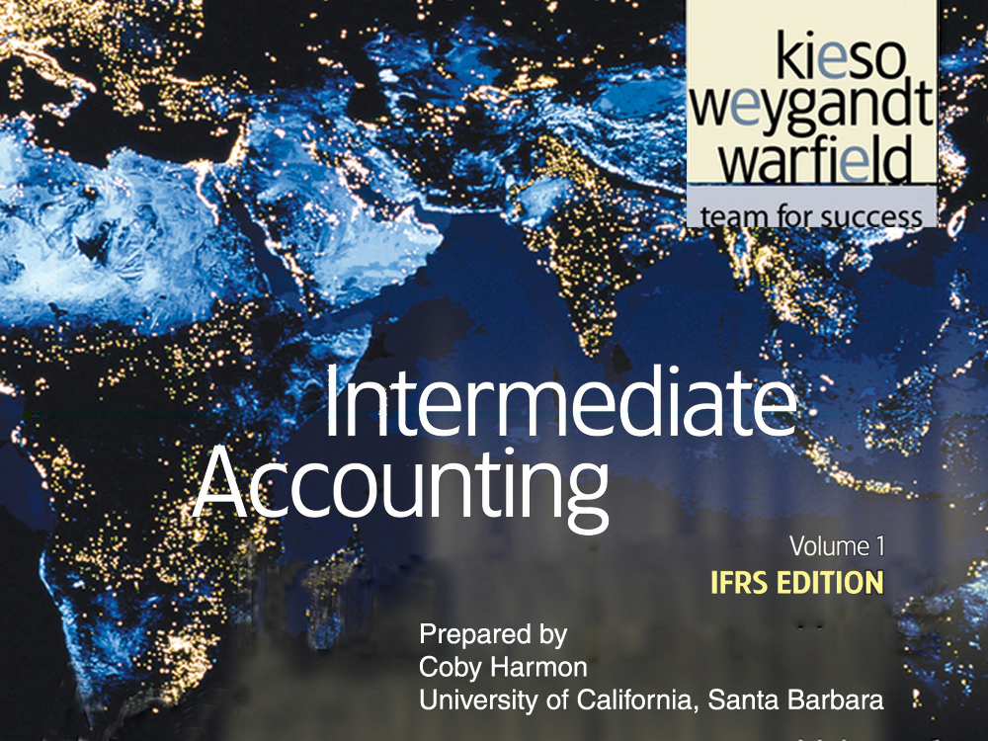

Slide 4
C H A P T E R 6
ACCOUNTING AND THE TIME VALUE OF MONEY
Intermediate Accounting
IFRS Edition
Kieso, Weygandt, and Warfield

Slide 5
Learning Objectives
Identify accounting topics where the time value of money is relevant.
Distinguish between simple and compound interest.
Use appropriate compound interest tables.
Identify variables fundamental to solving interest problems.
Solve future and present value of 1 problems.
Solve future value of ordinary and annuity due problems.
Solve present value of ordinary and annuity due problems.
Solve present value problems related to deferred annuities and bonds.
Apply expected cash flows to present value measurement.

Slide 6
Accounting and the Time Value of Money
Basic Time Value Concepts
Single-Sum Problems
Annuities
More Complex Situations
Present Value Measurement
Applications
The nature of interest
Simple interest
Compound interest
Fundamental variables
Future value of a single sum
Present value of a single sum
Solving for other unknowns
Future value of ordinary annuity
Future value of annuity due
Examples of FV of annuity
Present value of ordinary annuity
Present value of annuity due
Examples of PV of annuity
Deferred annuities
Valuation of long-term bonds
Effective-interest method of bond discount/ premium amortization
Choosing an appropriate interest rate
Example of expected cash flow

Slide 7
Basic Time Value Concepts
Time Value of Money
A relationship between time and money.
A dollar received today is worth more than a dollar promised at some time in the future.
LO 1 Identify accounting topics where the time value of money is relevant.

Slide 8
Basic Time Value Concepts
Applications to Accounting Topics:
Notes
Leases
Pensions and Other Postretirement Benefits
Long-Term Assets
Shared-Based Compensation
Business Combinations
Disclosures
Environmental Liabilities
LO 1 Identify accounting topics where the time value of money is relevant.

Slide 9
Basic Time Value Concepts
The Nature of Interest
Payment for the use of money.
Excess cash received or repaid over the amount borrowed (principal).
LO 1 Identify accounting topics where the time value of money is relevant.

Slide 10
Basic Time Value Concepts
Simple Interest
Interest computed on the principal only.
Illustration: KC borrows $20,000 for 3 years at a rate of 7% per year. Compute the total interest to be paid for the 3 years.
Interest = p x i x n
Total Interest
= $20,000 x .07 x 3
= $4,200
Many regulatory frameworks require disclosure of interest rates on an annual basis.
LO 2 Distinguish between simple and compound interest.

Slide 11
Basic Time Value Concepts
Simple Interest
Interest computed on the principal only.
Illustration: KC borrows $20,000 for 3 years at a rate of 7% per year. Compute the total interest to be paid for the 1 year.
Interest = p x i x n
Annual Interest
= $20,000 x .07 x 1
= $1,400
LO 2 Distinguish between simple and compound interest.

Slide 12
Basic Time Value Concepts
Simple Interest
Interest computed on the principal only.
Illustration: On March 31, 2011, KC borrows $20,000 for 3 years at a rate of 7% per year. Compute the total interest to be paid for the year ended Dec. 31, 2011.
Interest = p x i x n
Partial Year
= $20,000 x .07 x 9/12
= $1,050
LO 2 Distinguish between simple and compound interest.

Slide 13
Basic Time Value Concepts
Compound Interest
Computes interest on
principal and
interest earned that has not been paid or withdrawn.
Most business situations use compound interest.
LO 2 Distinguish between simple and compound interest.

Slide 14
Basic Time Value Concepts
Illustration: Tomalczyk Company deposits $10,000 in the Last National Bank, where it will earn simple interest of 9% per year. It deposits another $10,000 in the First State Bank, where it will earn compound interest of 9% per year compounded annually. In both cases, Tomalczyk will not withdraw any interest until 3 years from the date of deposit.
Illustration 6-1 Simple vs. Compound Interest
Year 1 $10,000.00 x 9%
$ 900.00
$ 10,900.00
Year 2 $10,900.00 x 9%
$ 981.00
$ 11,881.00
Year 3 $11,881.00 x 9%
$1,069.29
$ 12,950.29
LO 2 Distinguish between simple and compound interest.

Slide 15
Basic Time Value Concepts
Compound Interest Tables
Table 1 - Future Value of 1
Table 2 - Present Value of 1
Table 3 - Future Value of an Ordinary Annuity of 1
Table 4 - Present Value of an Ordinary Annuity of 1
Table 5 - Present Value of an Annuity Due of 1
Number of Periods = number of years x the number of compounding periods per year.
Compounding Period Interest Rate = annual rate divided by the number of compounding periods per year.
LO 3 Use appropriate compound interest tables.

Slide 16
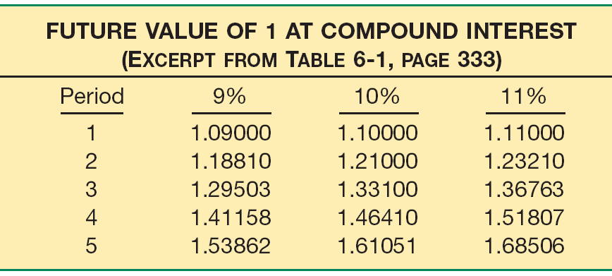
Basic Time Value Concepts
Compound Interest
Illustration 6-2
Excerpt from Table 6-1
How much principal plus interest a dollar accumulates to at the end of each of five periods, at three different rates of compound interest.
LO 3 Use appropriate compound interest tables.

Slide 17
Basic Time Value Concepts
Compound Interest
Formula to determine the future value factor (FVF) for 1:
Where:
= future value factor for n periods at i interest
n = number of periods
i = rate of interest for a single period
FVF
n,i
LO 3 Use appropriate compound interest tables.

Slide 18
Basic Time Value Concepts
Compound Interest
Determine the number of periods by multiplying the number of years involved by the number of compounding periods per year.
Illustration 6-4
Frequency of Compounding
LO 3 Use appropriate compound interest tables.

Slide 19
Basic Time Value Concepts
Compound Interest
9% annual interest compounded daily provides a 9.42% yield.
Illustration 6-5
Comparison of Different Compounding Periods
Effective Yield for a $10,000 investment.
LO 3 Use appropriate compound interest tables.

Slide 20
Basic Time Value Concepts
Fundamental Variables
Rate of Interest
Number of Time Periods
Future Value
Present Value
Illustration 6-6
LO 4 Identify variables fundamental to solving interest problems.

Slide 21
Single-Sum Problems
Two Categories
Unknown Present Value
Unknown Future Value
Illustration 6-6
LO 5 Solve future and present value of 1 problems.

Slide 22
Single-Sum Problems
Future Value of a Single Sum
Value at a future date of a given amount invested, assuming compound interest.
Where:
FV = future value
PV = present value (principal or single sum)
= future value factor for n periods at i interest
FVF
n,i
LO 5 Solve future and present value of 1 problems.

Slide 23
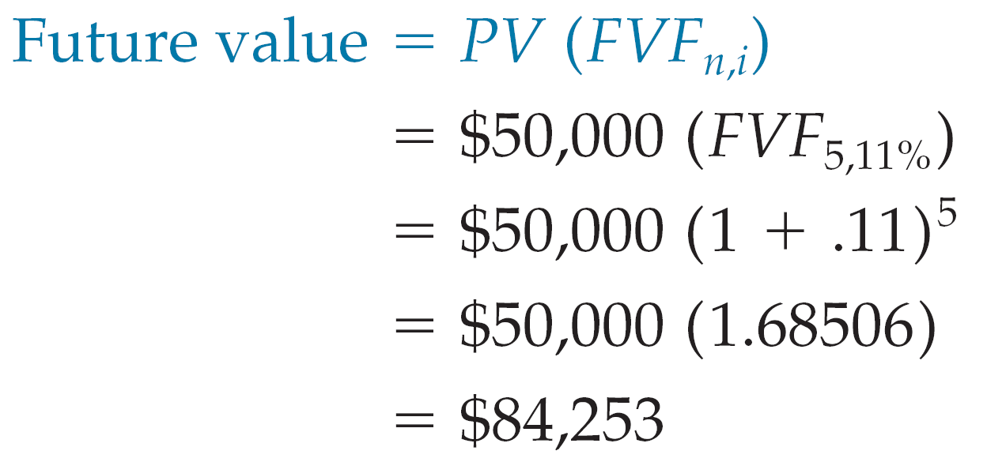
Future Value of a Single Sum
Illustration: Bruegger Co. wants to determine the future value of $50,000 invested for 5 years compounded annually at an interest rate of 11%.
= $84,253
Illustration 6-7
LO 5 Solve future and present value of 1 problems.

Slide 24
Future Value of a Single Sum
Alternate Calculation
Illustration: Bruegger Co. wants to determine the future value of $50,000 invested for 5 years compounded annually at an interest rate of 11%.
What table do we use?
Illustration 6-7
LO 5 Solve future and present value of 1 problems.

Slide 25
Alternate Calculation
Future Value of a Single Sum
i=11%
n=5
What factor do we use?
$50,000
x 1.68506
= $84,253
Present Value
Factor
Future Value
LO 5 Solve future and present value of 1 problems.

Slide 26
Future Value of a Single Sum
BE6-1: Bob Anderson invested $15,000 today in a fund that earns 8% compounded annually. To what amount will the investment grow in 3 years?
Present Value $15,000
Future Value?
0
1
2
3
4
5
6
What table do we use?
LO 5 Solve future and present value of 1 problems.

Slide 27
Future Value of a Single Sum
i=8%
n=3
$15,000
x 1.25971
= $18,896
Present Value
Factor
Future Value
LO 5 Solve future and present value of 1 problems.

Slide 28
Future Value of a Single Sum
PROOF
BE6-1: Bob Anderson invested $15,000 today in a fund that earns 8% compounded annually. To what amount will the investment grow in 3 years?
LO 5 Solve future and present value of 1 problems.

Slide 29
Future Value of a Single Sum
Present Value $15,000
Future Value?
0
1
2
3
4
5
6
BE6-1: Bob Anderson invested $15,000 today in a fund that earns 8% compounded semiannually. To what amount will the investment grow in 3 years?
What table do we use?
LO 5 Solve future and present value of 1 problems.

Slide 30
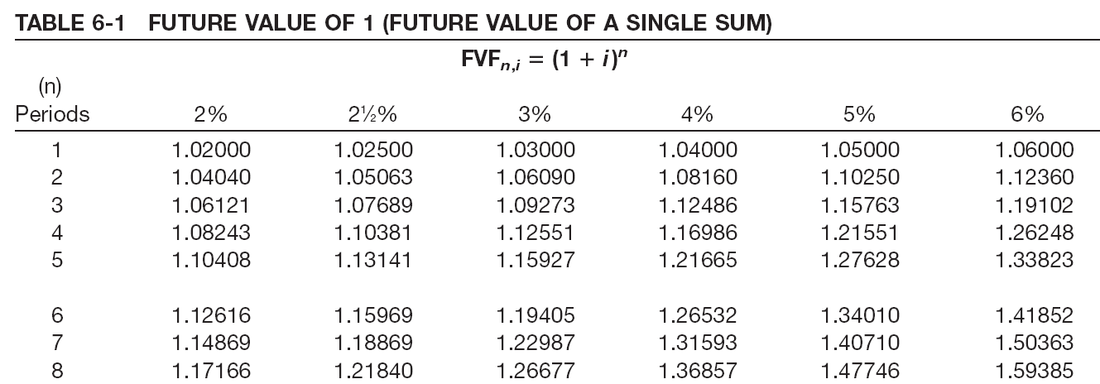
Future Value of a Single Sum
i=4%
n=6
What factor?
$15,000
x 1.26532
= $18,980
Present Value
Factor
Future Value
LO 5 Solve future and present value of 1 problems.

Slide 31
Single-Sum Problems
Present Value of a Single Sum
Value now of a given amount to be paid or received in the future, assuming compound interest.
Where:
FV = future value
PV = present value (principal or single sum)
= present value factor for n periods at i interest
PVF
n,i
LO 5 Solve future and present value of 1 problems.

Slide 32
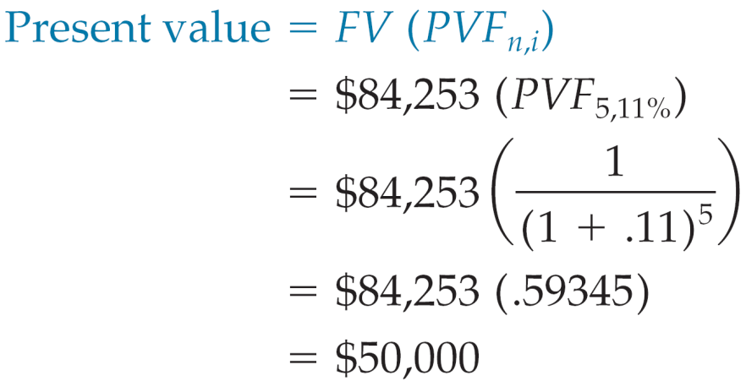
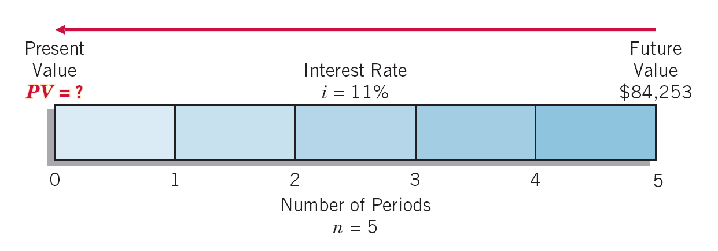
Present Value of a Single Sum
Illustration: What is the present value of $84,253 to be received or paid in 5 years discounted at 11% compounded annually?
= $50,000
Illustration 6-11
LO 5 Solve future and present value of 1 problems.

Slide 33
Present Value of a Single Sum
Alternate Calculation
Illustration: What is the present value of $84,253 to be received or paid in 5 years discounted at 11% compounded annually?
What table do we use?
Illustration 6-11
LO 5 Solve future and present value of 1 problems.

Slide 34
Present Value of a Single Sum
i=11%
n=5
What factor?
$84,253
x .59345
= $50,000
Future Value
Factor
Present Value
LO 5 Solve future and present value of 1 problems.

Slide 35
Present Value of a Single Sum
BE6-2: Caroline and Clifford need $25,000 in 4 years. What amount must they invest today if their investment earns 12% compounded annually?
Present Value?
Future Value $25,000
0
1
2
3
4
5
6
What table do we use?
LO 5 Solve future and present value of 1 problems.

Slide 36
Present Value of a Single Sum
i=12%
n=4
What factor?
$25,000
x .63552
= $15,888
Future Value
Factor
Present Value
LO 5 Solve future and present value of 1 problems.

Slide 37
Present Value of a Single Sum
BE6-2: Caroline and Clifford need $25,000 in 4 years. What amount must they invest today if their investment earns 12% compounded quarterly?
Present Value?
Future Value $25,000
0
1
2
3
4
5
6
What table do we use?
LO 5 Solve future and present value of 1 problems.

Slide 38
Present Value of a Single Sum
i=3%
n=16
$25,000
x .62317
= $15,579
Future Value
Factor
Present Value
LO 5 Solve future and present value of 1 problems.

Slide 39
Single-Sum Problems
Solving for Other Unknowns
Example—Computation of the Number of Periods
The Village of Somonauk wants to accumulate $70,000 for the construction of a veterans monument in the town square. At the beginning of the current year, the Village deposited $47,811 in a memorial fund that earns 10% interest compounded annually. How many years will it take to accumulate $70,000 in the memorial fund?
Illustration 6-13
LO 5 Solve future and present value of 1 problems.

Slide 40
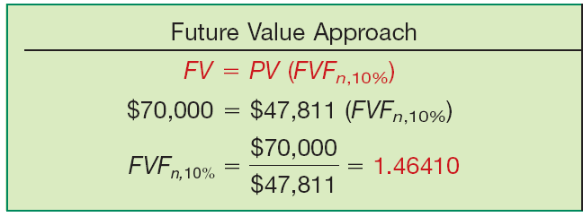
Single-Sum Problems
Example—Computation of the Number of Periods
Illustration 6-14
Using the future value factor of 1.46410, refer to Table 6-1 and read down the 10% column to find that factor in the 4-period row.
LO 5 Solve future and present value of 1 problems.

Slide 41
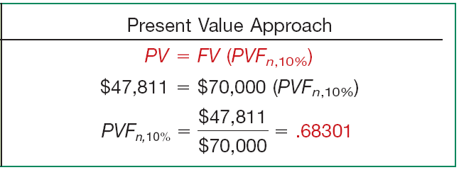
Single-Sum Problems
Example—Computation of the Number of Periods
Illustration 6-14
Using the present value factor of .68301, refer to Table 6-2 and read down the 10% column to find that factor in the 4-period row.
LO 5 Solve future and present value of 1 problems.

Slide 42
Single-Sum Problems
Solving for Other Unknowns
Example—Computation of the Number of Periods
The Village of Somonauk wants to accumulate $70,000 for the construction of a veterans monument in the town square. At the beginning of the current year, the Village deposited $47,811 in a memorial fund that earns 10% interest compounded annually. How many years will it take to accumulate $70,000 in the memorial fund?
Illustration 6-13
LO 5 Solve future and present value of 1 problems.

Slide 43
Single-Sum Problems
Solving for Other Unknowns
Example—Computation of the Interest Rate
Advanced Design, Inc. needs €1,409,870 for basic research 5 years from now. The company currently has €800,000 to invest for that purpose. At what rate of interest must it invest the €800,000 to fund basic research projects of €1,409,870, 5 years from now?
Illustration 6-15
LO 5 Solve future and present value of 1 problems.

Slide 44
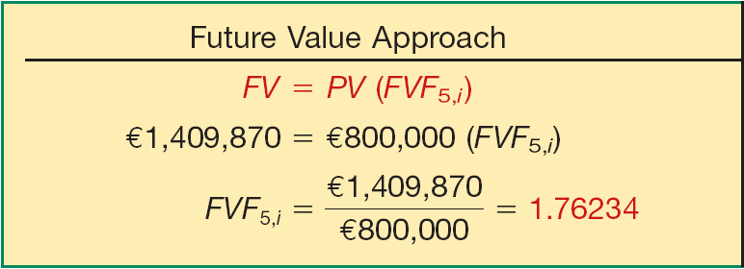
Single-Sum Problems
Example—Computation of the Interest Rate
Illustration 6-16
Using the future value factor of 1.76234, refer to Table 6-1 and read across the 5-period row to find the factor.
LO 5 Solve future and present value of 1 problems.

Slide 45
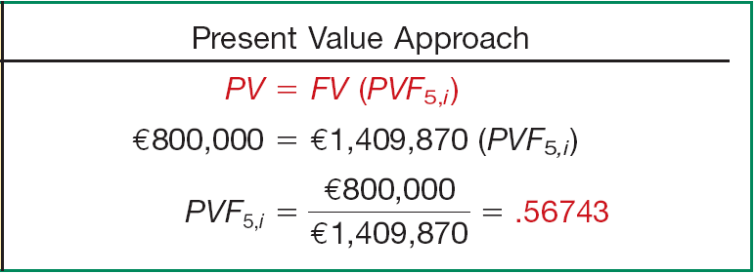
Single-Sum Problems
Example—Computation of the Interest Rate
Illustration 6-16
Using the present value factor of .56743, refer to Table 6-2 and read across the 5-period row to find the factor.
LO 5 Solve future and present value of 1 problems.

Slide 46
Annuities
Annuity requires:
Periodic payments or receipts (called rents) of the same amount,
Same-length interval between such rents, and
Compounding of interest once each interval.
Two Types
Ordinary Annuity - rents occur at the end of each period.
Annuity Due - rents occur at the beginning of each period.
LO 6 Solve future value of ordinary and annuity due problems.

Slide 47
Annuities
Future Value of an Ordinary Annuity
Rents occur at the end of each period.
No interest during 1st period.
Present Value
Future Value
$20,000
20,000
20,000
20,000
20,000
20,000
20,000
20,000
0
1
2
3
4
5
6
7
8
LO 6 Solve future value of ordinary and annuity due problems.

Slide 48
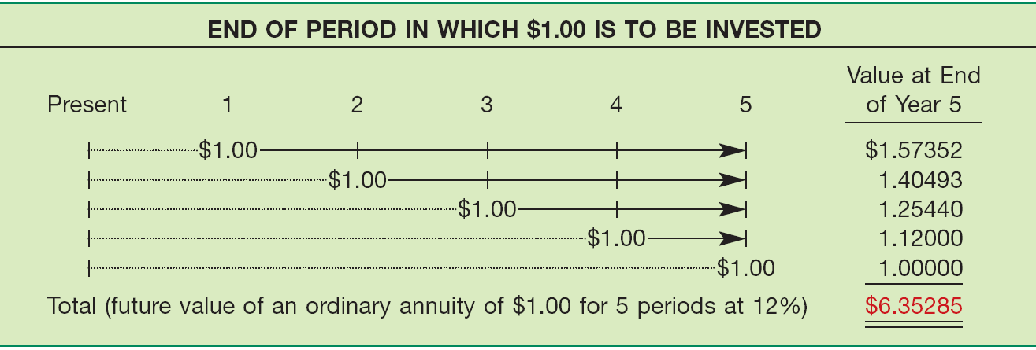
Future Value of an Ordinary Annuity
Illustration: Assume that $1 is deposited at the end of each of 5 years (an ordinary annuity) and earns 12% interest compounded annually. Following is the computation of the future value, using the “future value of 1” table (Table 6-1) for each of the five $1 rents.
Illustration 6-17
LO 6 Solve future value of ordinary and annuity due problems.

Slide 49
Future Value of an Ordinary Annuity
A formula provides a more efficient way of expressing the future value of an ordinary annuity of 1.
Where:
R = periodic rent
FVF-OA = future value factor of an ordinary annuity
i = rate of interest per period
n = number of compounding periods
n,i
LO 6 Solve future value of ordinary and annuity due problems.

Slide 50
Future Value of an Ordinary Annuity
Illustration: What is the future value of five $5,000 deposits made at the end of each of the next 5 years, earning interest of 12%?
= $31,764.25
Illustration 6-19
LO 6 Solve future value of ordinary and annuity due problems.

Slide 51
Future Value of an Ordinary Annuity
Alternate Calculation
Illustration: What is the future value of five $5,000 deposits made at the end of each of the next 5 years, earning interest of 12%?
What table do we use?
Illustration 6-19
LO 6 Solve future value of ordinary and annuity due problems.

Slide 52
Future Value of an Ordinary Annuity
i=12%
n=5
What factor?
$5,000
x 6.35285
= $31,764
Deposits
Factor
Present Value
LO 6 Solve future value of ordinary and annuity due problems.

Slide 53
Future Value of an Ordinary Annuity
Present Value
Future Value
$30,000
30,000
30,000
30,000
30,000
30,000
30,000
30,000
0
1
2
3
4
5
6
7
8
BE6-13: Gomez Inc. will deposit $30,000 in a 12% fund at the end of each year for 8 years beginning December 31, 2010. What amount will be in the fund immediately after the last deposit?
What table do we use?
LO 6 Solve future value of ordinary and annuity due problems.

Slide 54
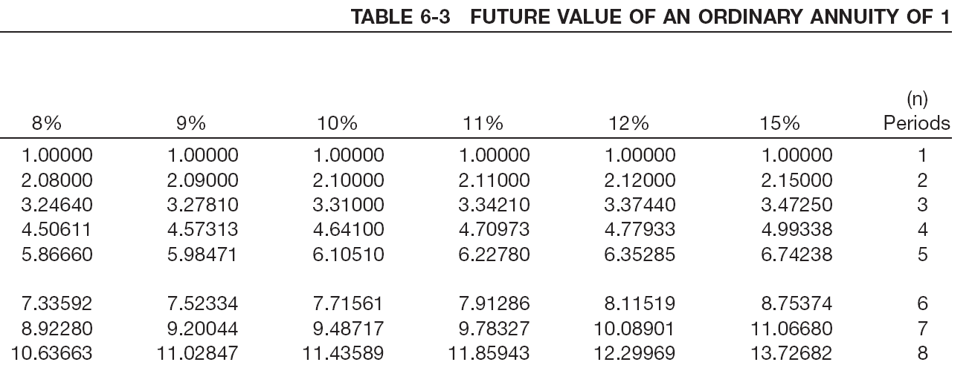
Future Value of an Ordinary Annuity
i=12%
n=8
$30,000
x 12.29969
= $368,991
Deposit
Factor
Future Value
LO 6 Solve future value of ordinary and annuity due problems.

Slide 55
Annuities
Future Value of an Annuity Due
Rents occur at the beginning of each period.
Interest will accumulate during 1st period.
Annuity Due has one more interest period than Ordinary Annuity.
Factor = multiply future value of an ordinary annuity factor by 1 plus the interest rate.
Future Value
$20,000
20,000
20,000
20,000
20,000
20,000
20,000
20,000
0
1
2
3
4
5
6
7
8
LO 6 Solve future value of ordinary and annuity due problems.

Slide 56
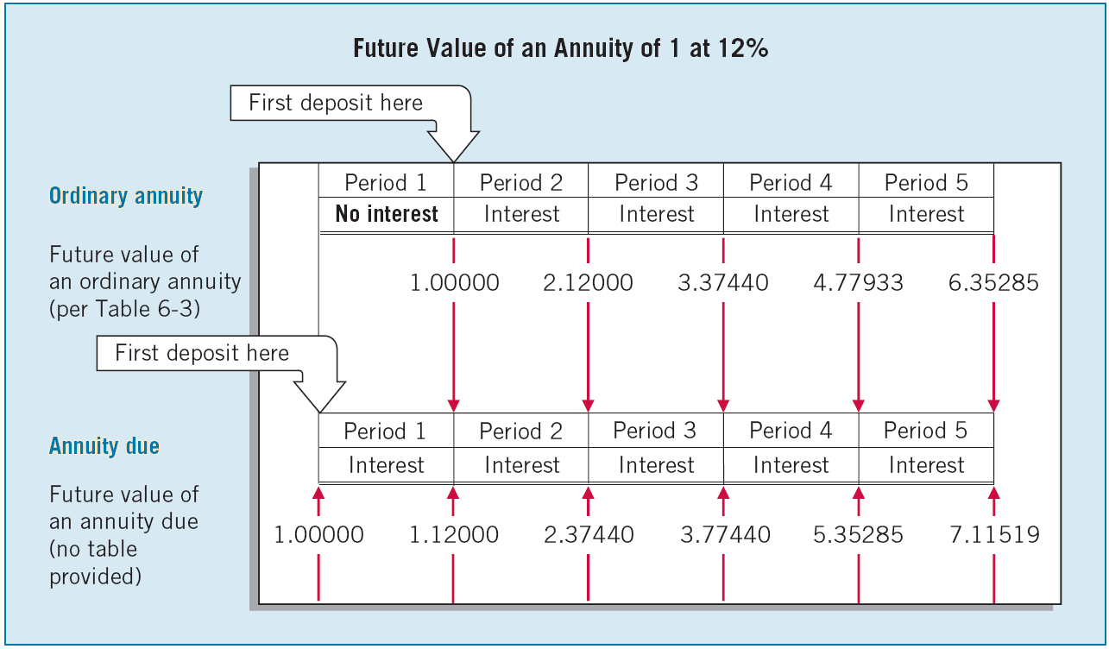
Future Value of an Annuity Due
Comparison of Ordinary Annuity with an Annuity Due
Illustration 6-21
LO 6 Solve future value of ordinary and annuity due problems.

Slide 57
Future Value of an Annuity Due
Computation of Rent
Illustration: Assume that you plan to accumulate $14,000 for a down payment on a condominium apartment 5 years from now. For the next 5 years, you earn an annual return of 8% compounded semiannually. How much should you deposit at the end of each 6-month period?
R = $1,166.07
Illustration 6-24
LO 6 Solve future value of ordinary and annuity due problems.

Slide 58
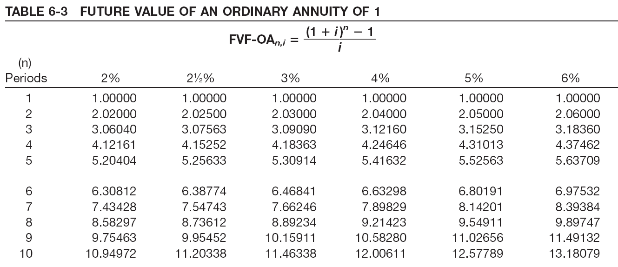
Alternate Calculation
Future Value of an Annuity Due
Illustration 6-24
Computation of Rent
$14,000
= $1,166.07
12.00611
LO 6 Solve future value of ordinary and annuity due problems.

Slide 59
Future Value of an Annuity Due
Computation of Number of Periodic Rents
Illustration: Suppose that a company’s goal is to accumulate $117,332 by making periodic deposits of $20,000 at the end of each year, which will earn 8% compounded annually while accumulating. How many deposits must it make?
5.86660
Illustration 6-25
LO 6 Solve future value of ordinary and annuity due problems.

Slide 60
Future Value of an Annuity Due
Computation of Future Value
Illustration: Mr. Goodwrench deposits $2,500 today in a savings account that earns 9% interest. He plans to deposit $2,500 every year for a total of 30 years. How much cash will Mr. Goodwrench accumulate in his retirement savings account, when he retires in 30 years?
Illustration 6-27
LO 6 Solve future value of ordinary and annuity due problems.

Slide 61
Future Value of an Annuity Due
Present Value
Future Value
20,000
$20,000
20,000
20,000
20,000
20,000
20,000
20,000
0
1
2
3
4
5
6
7
8
Illustration: Bayou Inc. will deposit $20,000 in a 12% fund at the beginning of each year for 8 years beginning January 1, Year 1. What amount will be in the fund at the end of Year 8?
What table do we use?
LO 6 Solve future value of ordinary and annuity due problems.

Slide 62
Future Value of an Annuity Due
i=12%
n=8
12.29969 x 1.12 = 13.775652
$20,000
x 13.775652
= $275,513
Deposit
Factor
Future Value
LO 6 Solve future value of ordinary and annuity due problems.

Slide 63
Annuities
Present Value of an Ordinary Annuity
Present value of a series of equal amounts to be withdrawn or received at equal intervals.
Periodic rents occur at the end of the period.
Present Value
$100,000
100,000
100,000
100,000
100,000
100,000
. . . . .
0
1
2
3
4
19
20
LO 7 Solve present value of ordinary and annuity due problems.

Slide 64
Present Value of an Ordinary Annuity
Illustration: Assume that $1 is to be received at the end of each of 5 periods, as separate amounts, and earns 12% interest compounded annually.
Illustration 6-28
LO 7 Solve present value of ordinary and annuity due problems.

Slide 65
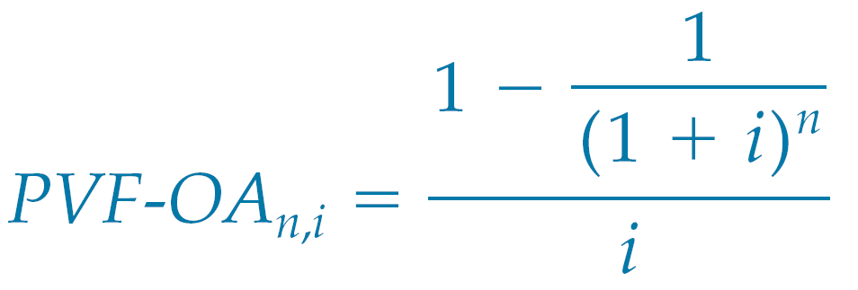
Present Value of an Ordinary Annuity
A formula provides a more efficient way of expressing the present value of an ordinary annuity of 1.
Where:
LO 7 Solve present value of ordinary and annuity due problems.

Slide 66
Present Value of an Ordinary Annuity
Illustration: What is the present value of rental receipts of $6,000 each, to be received at the end of each of the next 5 years when discounted at 12%?
Illustration 6-30
LO 7 Solve present value of ordinary and annuity due problems.

Slide 67
Present Value of an Ordinary Annuity
Present Value
$100,000
100,000
100,000
100,000
100,000
100,000
. . . . .
0
1
2
3
4
19
20
Illustration: Jaime Yuen wins $2,000,000 in the state lottery. She will be paid $100,000 at the end of each year for the next 20 years. How much has she actually won? Assume an appropriate interest rate of 8%.
What table do we use?
LO 7 Solve present value of ordinary and annuity due problems.

Slide 68
Present Value of an Ordinary Annuity
i=5%
n=20
$100,000
x 9.81815
= $981,815
Receipts
Factor
Present Value
LO 7 Solve present value of ordinary and annuity due problems.

Slide 69
Annuities
Present Value of an Annuity Due
Present value of a series of equal amounts to be withdrawn or received at equal intervals.
Periodic rents occur at the beginning of the period.
Present Value
$100,000
100,000
100,000
100,000
100,000
100,000
. . . . .
0
1
2
3
4
19
20
LO 7 Solve present value of ordinary and annuity due problems.

Slide 70
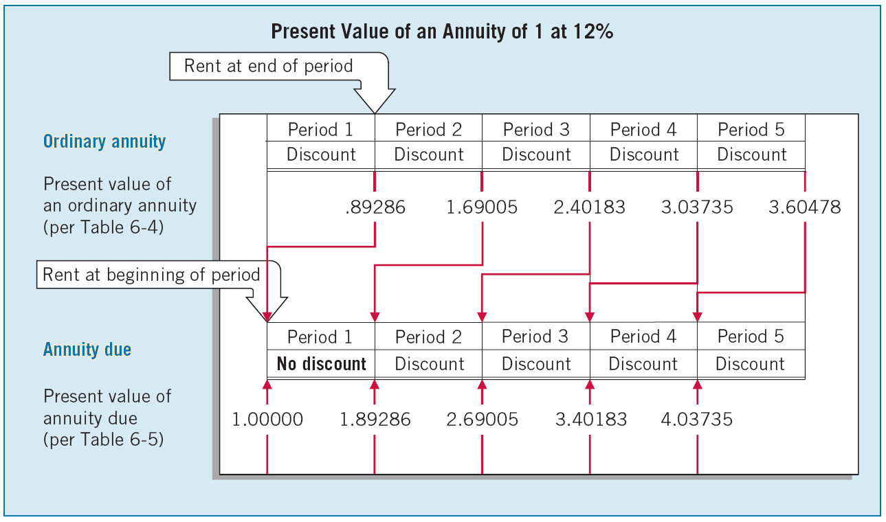
Present Value of an Annuity Due
Comparison of Ordinary Annuity with an Annuity Due
Illustration 6-31
LO 7 Solve present value of ordinary and annuity due problems.

Slide 71
Present Value of an Annuity Due
Illustration: Space Odyssey, Inc., rents a communications satellite for 4 years with annual rental payments of $4.8 million to be made at the beginning of each year. If the relevant annual interest rate is 11%, what is the present value of the rental obligations?
Illustration 6-33
LO 7 Solve present value of ordinary and annuity due problems.

Slide 72
Present Value of an Annuity Due
Present Value
$100,000
100,000
100,000
100,000
100,000
100,000
. . . . .
0
1
2
3
4
19
20
Illustration: Jaime Yuen wins $2,000,000 in the state lottery. She will be paid $100,000 at the beginning of each year for the next 20 years. How much has she actually won? Assume an appropriate interest rate of 8%.
What table do we use?
LO 7 Solve present value of ordinary and annuity due problems.

Slide 73
Present Value of an Annuity Due
i=8%
n=20
$100,000
x 10.60360
= $1,060,360
Receipts
Factor
Present Value
LO 7 Solve present value of ordinary and annuity due problems.

Slide 74
Present Value of an Annuity Due
Computation of the Interest Rate
Illustration: Assume you receive a statement from MasterCard with a balance due of $528.77. You may pay it off in 12 equal monthly payments of $50 each, with the first payment due one month from now. What rate of interest would you be paying?
Referring to Table 6-4 and reading across the 12-period row, you find 10.57534 in the 2% column. Since 2% is a monthly rate, the nominal annual rate of interest is 24% (12 x 2%). The effective annual rate is 26.82413% [(1 + .02) - 1].
12
LO 7 Solve present value of ordinary and annuity due problems.

Slide 75
More Complex Situations
Deferred Annuities
Rents begin after a specified number of periods.
Future Value - Calculation same as the future value of an annuity not deferred.
Present Value - Must recognize the interest that accrues during the deferral period.
Future Value
Present Value
100,000
100,000
100,000
. . . . .
0
1
2
3
4
19
20
LO 8 Solve present value problems related to deferred annuities and bonds.

Slide 76
More Complex Situations
Valuation of Long-Term Bonds
Two Cash Flows:
Periodic interest payments (annuity).
Principal paid at maturity (single-sum).
2,000,000
$140,000
140,000
140,000
140,000
140,000
140,000
. . . . .
0
1
2
3
4
9
10
LO 8 Solve present value problems related to deferred annuities and bonds.

Slide 77
Valuation of Long-Term Bonds
Present Value
$140,000
140,000
140,000
140,000
140,000
2,140,000
. . . . .
0
1
2
3
4
9
10
BE6-15: Wong Inc. issues HK$2,000,000 of 7% bonds due in 10 years with interest payable at year-end. The current market rate of interest for bonds of similar risk is 8%. What amount will Wong receive when it issues the bonds?
LO 8 Solve present value problems related to deferred annuities and bonds.

Slide 78
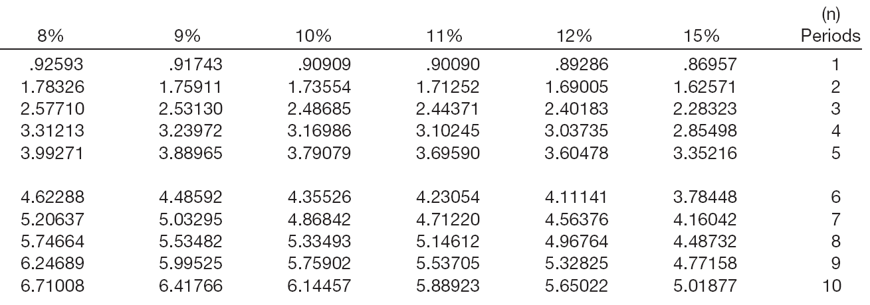
Valuation of Long-Term Bonds
i=8%
n=10
PV of Interest
$140,000 x 6.71008 = $939,411
Interest Payment
Factor
Present Value
LO 8 Solve present value problems related to deferred annuities and bonds.

Slide 79
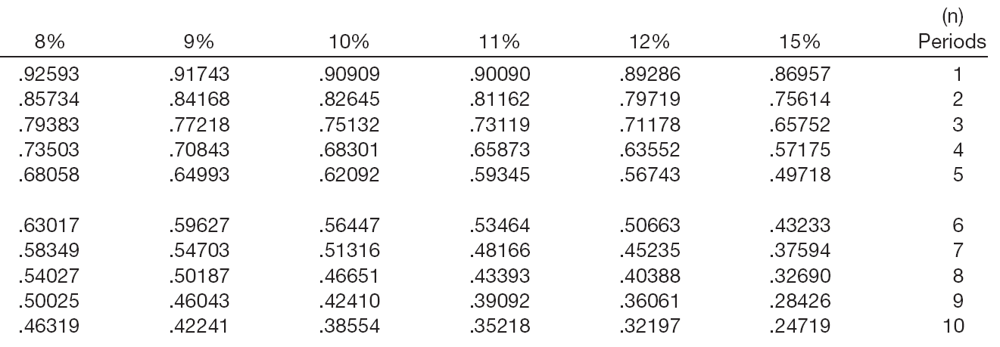
Valuation of Long-Term Bonds
i=8%
n=10
PV of Principal
$2,000,000 x .46319 = $926,380
Principal
Factor
Present Value
LO 8 Solve present value problems related to deferred annuities and bonds.

Slide 80
Valuation of Long-Term Bonds
BE6-15: Wong Inc. issues $2,000,000 of 7% bonds due in 10 years with interest payable at year-end.
Present value of Interest $939,411
Present value of Principal 926,380
Bond current market value $1,865,791
LO 8 Solve present value problems related to deferred annuities and bonds.

Slide 81
Valuation of Long-Term Bonds
BE6-15:
LO 8 Solve present value problems related to deferred annuities and bonds.

Slide 82
Present Value Measurement
International Accounting Standard No. 36 introduces an expected cash flow approach that uses a range of cash flows and incorporates the probabilities of those cash flows.
Choosing an Appropriate Interest Rate
Three Components of Interest:
Pure Rate
Expected Inflation Rate
Credit Risk Rate
Risk-free rate of return. IASB states a company should discount expected cash flows by the risk-free rate of return.
LO 9 Apply expected cash flows to present value measurement.

Slide 83
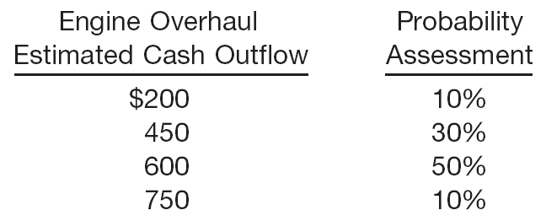
Present Value Measurement
E6-21: Angela Contreras is trying to determine the amount
to set aside so that she will have enough money on hand in 2 years to overhaul the engine on her vintage used car. While there is some uncertainty about the cost of engine overhauls in 2 years, by conducting some research online, Angela has developed the following estimates.
Instructions: How much should Angela Contreras deposit today in an account earning 6%, compounded annually, so that she will have enough money on hand in 2 years to pay for the overhaul?
LO 9 Apply expected cash flows to present value measurement.

Slide 84
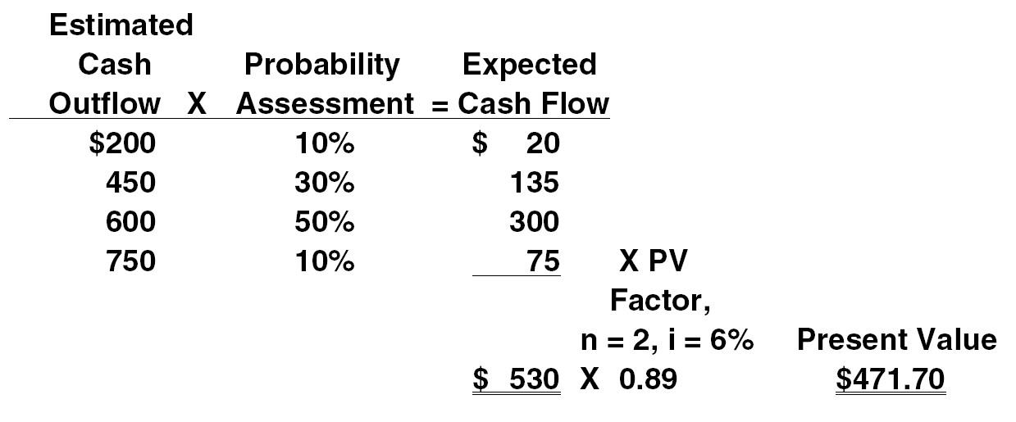
Present Value Measurement
Instructions: How much should Angela Contreras deposit today in an account earning 6%, compounded annually, so that she will have enough money on hand in 2 years to pay for the overhaul?
LO 9 Apply expected cash flows to present value measurement.

Slide 85
Copyright
Copyright © 2011 John Wiley & Sons, Inc. All rights reserved. Reproduction or translation of this work beyond that permitted in Section 117 of the 1976 United States Copyright Act without the express written permission of the copyright owner is unlawful. Request for further information should be addressed to the Permissions Department, John Wiley & Sons, Inc. The purchaser may make back-up copies for his/her own use only and not for distribution or resale. The Publisher assumes no responsibility for errors, omissions, or damages, caused by the use of these programs or from the use of the information contained herein.

Slide 86
SEKIAN DAN TERIMA KASIH

