Slide 1
CASH AND RECEIVABLES
PERTEMUAN #8
EBA302
AKUNTANSI KEUANGAN MENENGAH I + LAB
6542– SRI HANDAYANI, SE, MM, MAk, CPMA
PROGRAM STUDI AKUNTANSI
FAKULTAS EKONOMI DAN BISNIS
UNIVERSITAS ESA UNGGUL

Slide 2
KEMAMPUAN AKHIR YANG DIHARAPKAN
Mahasiswa mampu memproses secara akuntansi transaksi kas dan piutang

Slide 3


Slide 4
C H A P T E R 7
CASH AND RECEIVABLES
Intermediate Accounting
IFRS Edition
Kieso, Weygandt, and Warfield

Slide 5
Learning Objectives
Identify items considered cash.
Indicate how to report cash and related items.
Define receivables and identify the different types of receivables.
Explain accounting issues related to recognition of accounts receivable.
Explain accounting issues related to valuation of accounts receivable.
Explain accounting issues related to recognition of notes receivable.
Explain accounting issues related to valuation of notes receivable.
Understand special topics related to receivables.
Describe how to report and analyze receivables.

Slide 6
Cash and Receivables
Cash
Accounts Receivable
Notes Receivable
Special Issues
What is cash?
Reporting cash
Summary of cash-related items
Recognition
Valuation
Impairment evaluation process
Recognition
Valuation
Fair value option
Derecognition of receivables
Presentation and analysis

Slide 7
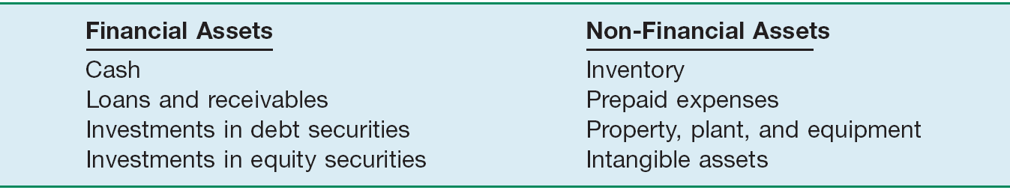
Cash
What is Cash?
A financial asset—also a financial instrument.
Financial Instrument - Any contract that gives rise to a financial asset of one entity and a financial liability or equity interest of another entity.
Illustration 7-1 Types of Assets
LO 1 Identify items considered cash.

Slide 8
Cash
What is Cash?
Most liquid asset.
Standard medium of exchange.
Basis for measuring and accounting for all other items.
Current asset.
Examples: coin, currency, available funds on deposit at the bank, money orders, certified checks, cashier’s checks, personal checks, bank drafts and savings accounts.
LO 1 Identify items considered cash.

Slide 9
Cash
Reporting Cash
Cash Equivalents
Short-term, highly liquid investments that are both
readily convertible to cash, and
so near their maturity that they present insignificant risk of changes in interest rates.
Examples: Treasury bills, commercial paper, and money market funds.
LO 2 Indicate how to report cash and related items.

Slide 10
Cash
Restricted Cash
When material in amount:
  Segregate restricted cash from “regular” cash.
  Current assets or non-current assets
  Examples, restricted for: (1) plant expansion, (2) retirement of long-term debt, and (3) compensating balances.
LO 2 Indicate how to report cash and related items.

Slide 11
Cash
Bank Overdrafts
When a company writes a check for more than the amount in its cash account.
Generally reported as a current liability.
Offset against cash account only when available cash is present in another account in the same bank on which the overdraft occurred.
Included as cash component if such overdraft are repayable on demand and are integral part of a company’s cash management (such as the common practising establishing offseting arrangements againts other accounts at the same at the same bank)
LO 2 Indicate how to report cash and related items.’

Slide 12
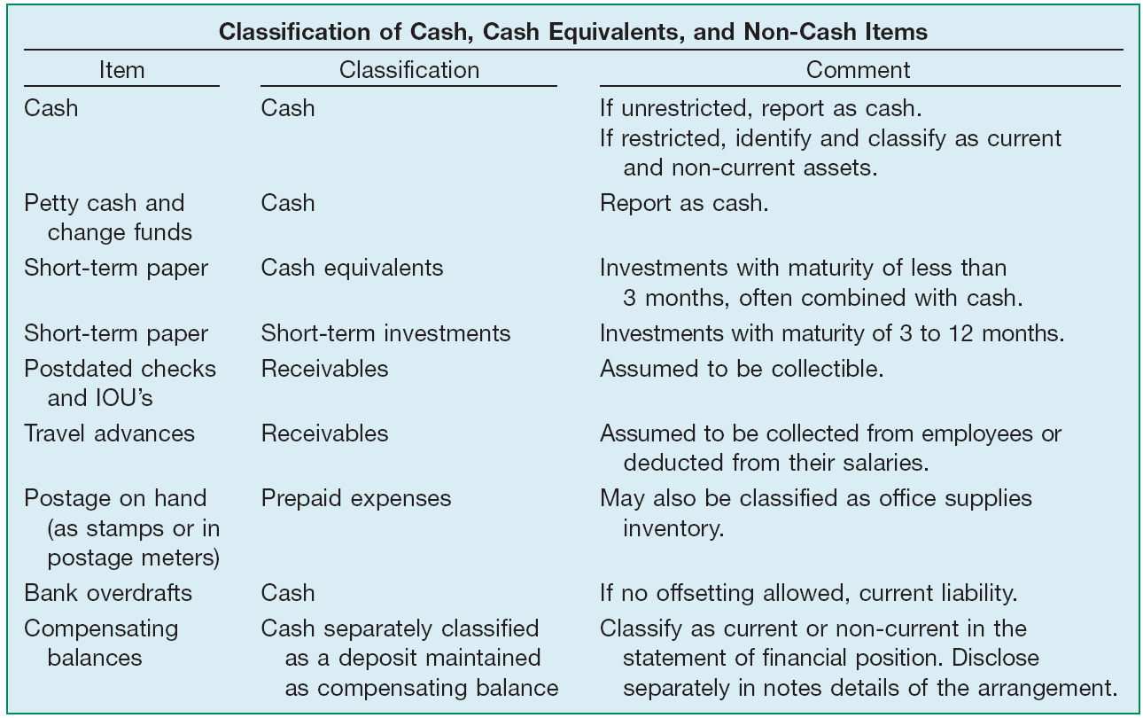
Cash
Summary of Cash-Related Items
Illustration 7-3
LO 2

Slide 13

Accounts Receivable
Receivables are claims held against customers and others for money, goods, or services.
Oral promises of the purchaser to pay for goods and services sold.
Written promises to pay a sum of money on a specified future date.
Accounts Receivable
Notes Receivable
LO 3 Define receivables and identify the different types of receivables.

Slide 14
Accounts Receivable
Non-trade Receivables
Advances to officers and employees.
Advances to subsidiaries.
Deposits to cover potential damages or losses.
Deposits as a guarantee of performance or payment.
Dividends and interest receivable.
Claims against:
  Insurance companies for casualties sustained.
  Defendants under suit.
  Governmental bodies for tax refunds.
  Common carriers for damaged or lost goods.
  Creditors for returned, damaged, or lost goods.
  Customers for returnable items (crates, containers, etc.).
LO 3 Define receivables and identify the different types of receivables.

Slide 15
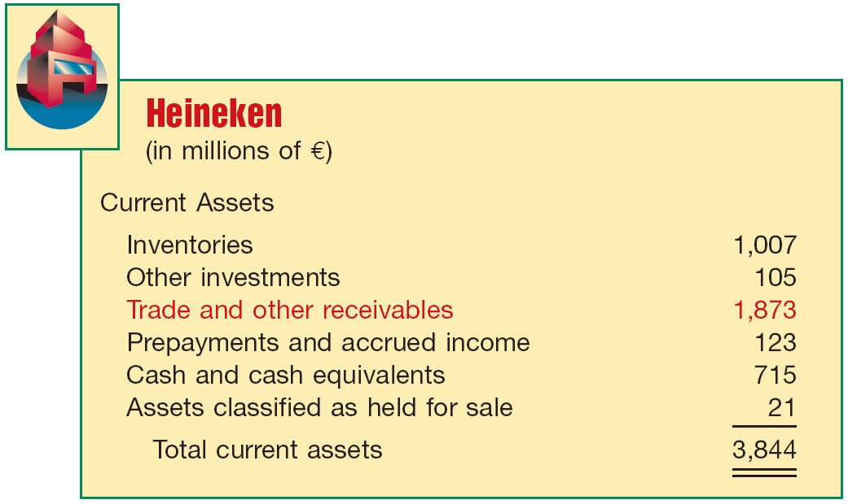
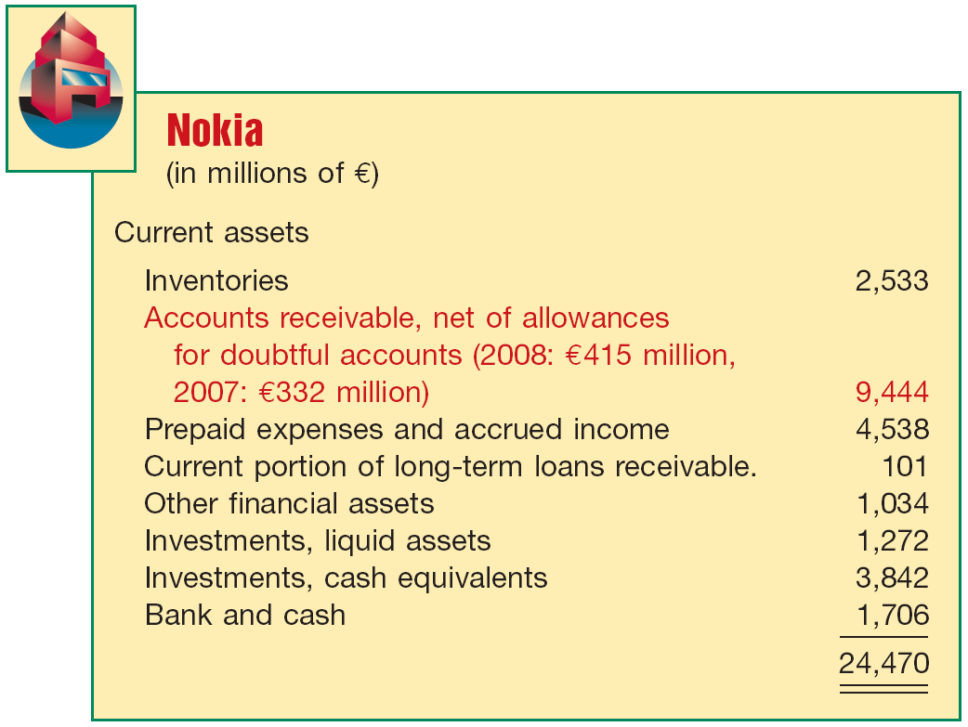
Accounts Receivable
Non-trade Receivables
Illustration 7-4
Receivables Statement
of Financial Position
Presentations
LO 3 Define receivables and identify the different types of receivables.

Slide 16
Accounts Receivable
Recognition of Accounts Receivable
Trade Discounts
Reductions from the list price
Not recognized in the accounting records
Customers are billed net of discounts
10 % Discount for new Retail Store Customers
LO 4 Explain accounting issues related to recognition of accounts receivable.

Slide 17
Accounts Receivable
Recognition of Accounts Receivable
Cash Discounts
(Sales Discounts)
Inducements for prompt payment
Gross Method vs. Net Method
Payment terms are 2/10, n/30
LO 4 Explain accounting issues related to recognition of accounts receivable.

Slide 18
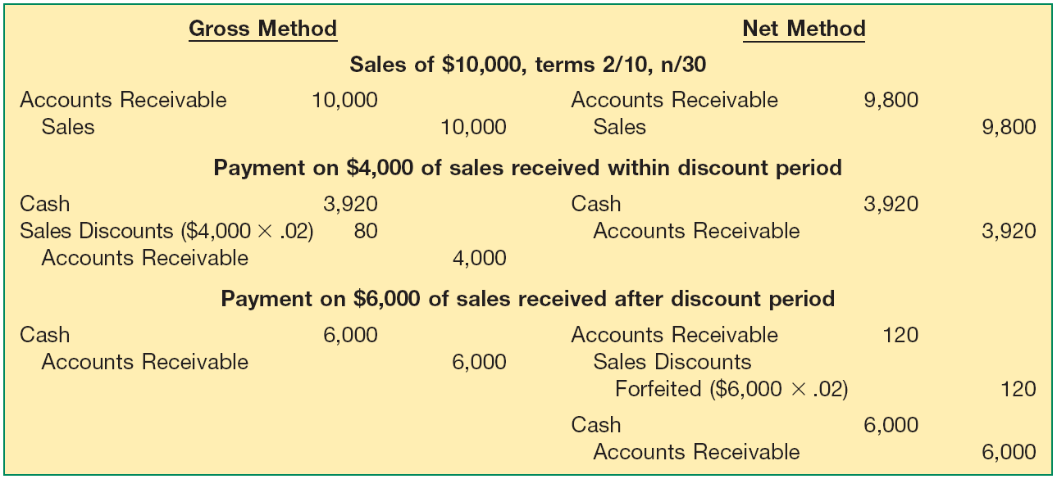
Accounts Receivable
Cash Discounts (Sales Discounts)
Illustration 7-5
Entries under Gross and
Net Methods of Recording
Cash (Sales) Discounts
LO 4 Explain accounting issues related to recognition of accounts receivable.

Slide 19
Accounts Receivable
E7-5: On June 3, Bolton Company sold to Arquette Company merchandise having a sale price of £2,000 with terms of 2/10, n/60, f.o.b. shipping point. On June 12, the company received a check for the balance due from Arquette Company. Prepare the journal entries on Bolton Company books to record the sale assuming Bolton records sales using the gross method.
June 3
Accounts receivable 2,000
Sales 2,000
June 12
Cash 1,960
Sales discounts (£2,000 x 2%) 40
Accounts receivable 2,000
LO 4 Explain accounting issues related to recognition of accounts receivable.

Slide 20
Accounts Receivable
E7-5: On June 3, Bolton Company sold to Arquette Company merchandise having a sale price of £2,000 with terms of 2/10, n/60, f.o.b. shipping point. On June 12, the company received a check for the balance due from Arquette Company. Prepare the journal entries on Bolton Company books to record the sale assuming Bolton records sales using the net method.
June 3
Accounts receivable 1,960
Sales 1,960
June 12
Cash (£2,000 x 98%) 1,960
Accounts receivable 1,960
LO 4 Explain accounting issues related to recognition of accounts receivable.

Slide 21
Accounts Receivable
E7-5: On June 3, Bolton Company sold to Arquette Company merchandise having a sale price of £2,000 with terms of 2/10, n/60, f.o.b. shipping point. Prepare the journal entries on Bolton Company books to record the sale assuming Bolton records sales using the net method, and Arquette did not remit payment until July 29.
June 3
Accounts receivable 1,960
Sales 1,960
June 12
Cash 2,000
Accounts receivable 1,960
Sales discounts forfeited 40
LO 4 Explain accounting issues related to recognition of accounts receivable.

Slide 22
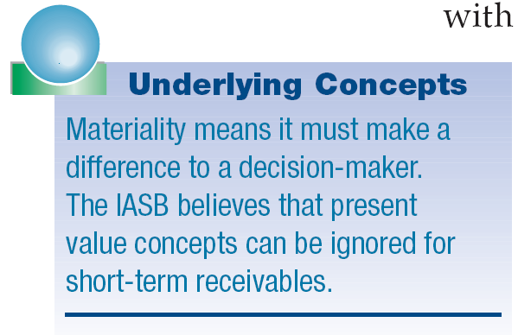
Accounts Receivable
Non-Recognition of Interest Element
A company should measure receivables in terms of their present value.
In practice, companies ignore interest revenue related to accounts receivable because, for current assets, the amount of the discount is not usually material in relation to the net income for the period.
LO 4 Explain accounting issues related to recognition of accounts receivable.

Slide 23
Accounts Receivable
How are these accounts presented on the Statement of Financial Position?
Allowance for Doubtful Accounts
Accounts Receivable
Beg. 500
25 Beg.
End. 500
25 End.
LO 4 Explain accounting issues related to recognition of accounts receivable.

Slide 24
Accounts Receivable
LO 4 Explain accounting issues related to recognition of accounts receivable.

Slide 25
Accounts Receivable
LO 4 Explain accounting issues related to recognition of accounts receivable.

Slide 26
Accounts Receivable
Journal entry for credit sale of $100?
Accounts receivable 100
Sales 100
Allowance for Doubtful Accounts
Accounts Receivable
Beg. 500
25 Beg.
End. 500
25 End.
LO 4 Explain accounting issues related to recognition of accounts receivable.

Slide 27
Accounts Receivable
Journal entry for credit sale of $100?
Accounts receivable 100
Sales 100
Allowance for Doubtful Accounts
Accounts Receivable
Beg. 500
25 Beg.
Sale 100
End. 600
25 End.
LO 4 Explain accounting issues related to recognition of accounts receivable.

Slide 28
Accounts Receivable
Collected of $333 on account?
Cash 333
Accounts receivable 333
Allowance for Doubtful Accounts
Accounts Receivable
Beg. 500
25 Beg.
Sale 100
End. 600
25 End.
LO 4 Explain accounting issues related to recognition of accounts receivable.

Slide 29
Accounts Receivable
Collected of $333 on account?
Cash 333
Accounts receivable 333
Allowance for Doubtful Accounts
Accounts Receivable
Beg. 500
25 Beg.
Sale 100
333 Coll.
End. 267
25 End.
LO 4 Explain accounting issues related to recognition of accounts receivable.

Slide 30
Accounts Receivable
Adjustment of $15 for estimated Bad-Debts?
Bad debt expense 15
Allowance for Doubtful Accounts 15
Allowance for Doubtful Accounts
Accounts Receivable
Beg. 500
25 Beg.
Sale 100
333 Coll.
End. 267
25 End.
LO 4 Explain accounting issues related to recognition of accounts receivable.

Slide 31
Accounts Receivable
Adjustment of $15 for estimated Bad-Debts?
Bad debt expense 15
Allowance for Doubtful Accounts 15
Allowance for Doubtful Accounts
Accounts Receivable
Beg. 500
25 Beg.
Sale 100
333 Coll.
15 Est.
End. 267
40 End.
LO 4 Explain accounting issues related to recognition of accounts receivable.

Slide 32
Accounts Receivable
Write-off of uncollectible accounts for $10?
Allowance for Doubtful accounts 10
Accounts receivable 10
Allowance for Doubtful Accounts
Accounts Receivable
Beg. 500
25 Beg.
Sale 100
333 Coll.
15 Est.
End. 267
40 End.
LO 4 Explain accounting issues related to recognition of accounts receivable.

Slide 33
Accounts Receivable
Write-off of uncollectible accounts for $10?
Allowance for Doubtful accounts 10
Accounts receivable 10
Allowance for Doubtful Accounts
Accounts Receivable
Beg. 500
25 Beg.
Sale 100
333 Coll.
15 Est.
10 W/O
W/O 10
End. 257
30 End.
LO 4 Explain accounting issues related to recognition of accounts receivable.

Slide 34
Accounts Receivable
LO 4 Explain accounting issues related to recognition of accounts receivable.

Slide 35
Accounts Receivable
Valuation of Accounts Receivables
Classification
Valuation (cash realizable value)
Uncollectible Accounts Receivable
Sales on account raise the possibility of accounts not being collected.
LO 5 Explain accounting issues related to valuation of accounts receivable.

Slide 36
Valuation of Accounts Receivable
Uncollectible Accounts Receivable
An uncollectible account receivable is a loss of revenue that requires,
  a decrease in the asset accounts receivable and
  a related decrease in income and shareholders’ equity.
LO 5 Explain accounting issues related to valuation of accounts receivable.

Slide 37
Valuation of Accounts Receivable
Methods of Accounting for Uncollectible Accounts
Direct Write-Off
Theoretically undesirable:
  No matching
  Receivable not stated at cash realizable value
  Not IFRS when material in amount
Allowance Method
Losses are Estimated:
  Percentage-of-sales
  Percentage-of-receivables
  IFRS requires when material in amount
LO 5 Explain accounting issues related to valuation of accounts receivable.

Slide 38
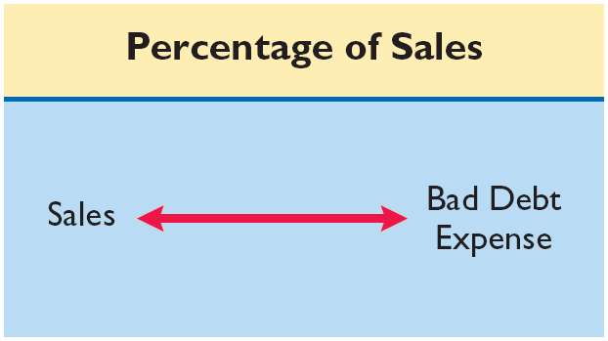
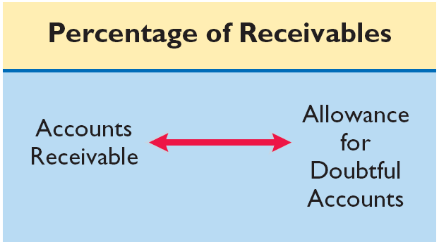
Uncollectible Accounts Receivable
Illustration 7-7
Emphasis on the Income Statement
Emphasis on the Statement of Financial Position
LO 5 Explain accounting issues related to valuation of accounts receivable.

Slide 39
Uncollectible Accounts Receivable
Percentage-of-Sales Approach
  Percentage based upon past experience and anticipate credit policy.
  Achieves proper matching of costs with revenues.
  Existing balance in Allowance account not considered.
LO 5 Explain accounting issues related to valuation of accounts receivable.

Slide 40
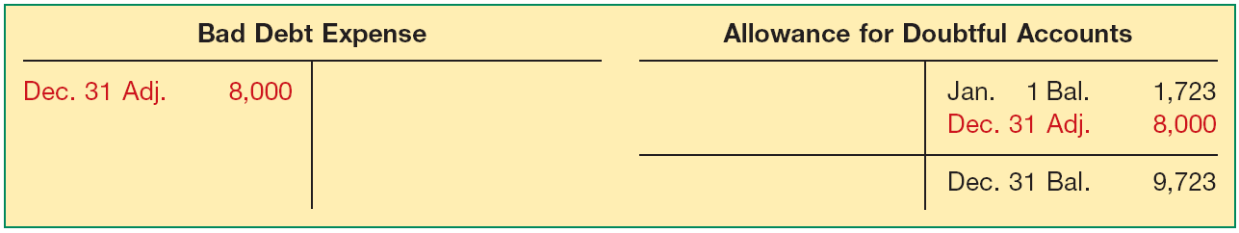
Uncollectible Accounts Receivable
Percentage-of-Sales Approach
Illustration: Gonzalez Company estimates from past experience that about 1% of credit sales become uncollectible. If net credit sales are $800,000 in 2011, it records bad debt expense as follows.
Bad Debt Expense 8,000
Allowance for Doubtful Accounts 8,000
Illustration 7-8
LO 5

Slide 41
Uncollectible Accounts Receivable
Percentage-of-Receivables Approach
  Not matching.
  Reports receivables at cash realizable value.
Companies may apply this method using
  one composite rate, or
  an aging schedule using different rates.
LO 5 Explain accounting issues related to valuation of accounts receivable.

Slide 42
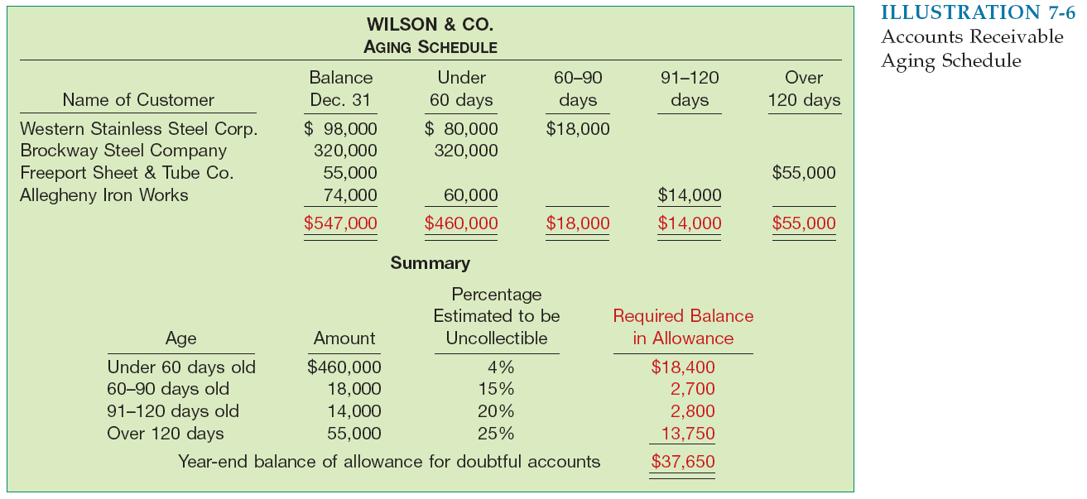
Uncollectible Accounts Receivable
Illustration 7-9
Accounts Receivable Aging Schedule
What entry would Wilson make assuming that no balance
existed in the allowance account?
Bad Debt Expense 37,650
Allowance for Doubtful Accounts 37,650
LO 5 Explain accounting issues related to valuation of accounts receivable.

Slide 43
Uncollectible Accounts Receivable
Illustration 7-9
Accounts Receivable Aging Schedule
What entry would Wilson make assuming the allowance account had a credit balance of $800 before adjustment?
Bad Debt Expense ($37,650 – $800) 36,850
Allowance for Doubtful Accounts 36,850
LO 5 Explain accounting issues related to valuation of accounts receivable.

Slide 44
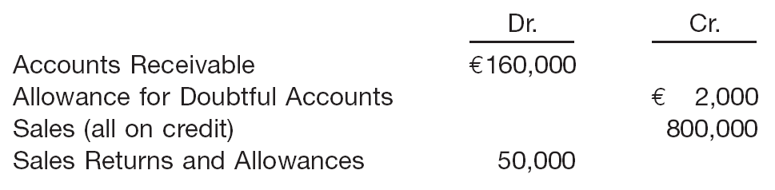
Uncollectible Accounts Receivable
E7-7 (Recording Bad Debts): Sandel Company reports the following financial information before adjustments.
Instructions: Prepare the journal entry to record bad debt expense assuming Sandel Company estimates bad debts at
(a) 1% of net sales and (b) 5% of accounts receivable.
LO 5 Explain accounting issues related to valuation of accounts receivable.

Slide 45
Uncollectible Accounts Receivable
E7-7 (Recording Bad Debts): Sandel Company reports the following financial information before adjustments.
Instructions: Prepare the journal entry to record bad debt expense assuming Sandel Company estimates bad debts at
(a) 1% of net sales.
(€800,000 – €50,000) x 1% = €7,500
Bad Debt Expense 7,500
Allowance for Doubtful Accounts 7,500
LO 5 Explain accounting issues related to valuation of accounts receivable.

Slide 46
Uncollectible Accounts Receivable
E7-7 (Recording Bad Debts): Sandel Company reports the following financial information before adjustments.
Instructions: Prepare the journal entry to record bad debt expense assuming Sandel Company estimates bad debts at
(b) 5% of accounts receivable.
(€160,000 x 5%) – €2,000) = €6,000
Bad Debt Expense 6,000
Allowance for Doubtful Accounts 6,000
LO 5 Explain accounting issues related to valuation of accounts receivable.

Slide 47
Recovery of Uncollectible Accounts
Illustration: Assume that the financial vice president of Brown Furniture authorizes a write-off of the $1,000 balance owed by Randall Co. on March 1, 2012. The entry to record the write-off is:
Bad Debt Expense 1,000
Accounts Receivable 1,000
Assume that on July 1, Randall Co. pays the $1,000 amount that Brown had written off on March 1. These are the entries:
Accounts Receivable 1,000
Allowance for Doubtful Accounts 1,000
Cash 1,000
Accounts Receivable 1,000
LO 5

Slide 48
Accounts Receivable
Impairment Evaluation Process
Companies assess their receivables for impairment each reporting period. Possible loss events are:
  Significant financial problems of the customer.
  Payment defaults.
  Renegotiation of terms of the receivable due to financial difficulty of the customer.
  Decrease in estimated future cash flows from a group of receivables since initial recognition, although the decrease cannot yet be identified with individual assets in the group.
LO 5 Explain accounting issues related to valuation of accounts receivable.

Slide 49
Accounts Receivable
Impairment Evaluation Process
A receivable is considered impaired when a loss event indicates a negative impact on the estimated future cash flows to be received from the customer. The IASB requires that the impairment assessment should be performed as follows.
  Receivables that are individually significant should be considered for impairment separately.
  Any receivable individually assessed that is not considered impaired should be included with a group of assets with similar credit-risk characteristics and collectively assessed for impairment.
  Any receivables not individually assessed should be collectively assessed for impairment.
LO 5

Slide 50
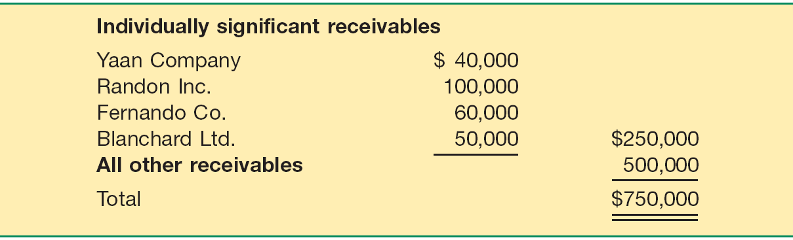
Accounts Receivable
Illustration: Hector Company has the following receivables classified into individually significant and all other receivables.
Hector determines that Yaan’s receivable is impaired by $15,000, and Blanchard’s receivable is totally impaired. Both Randon’s and Fernando’s receivables are not considered impaired. Hector also determines that a composite rate of 2% is appropriate to measure impairment on all other receivables.
LO 5

Slide 51
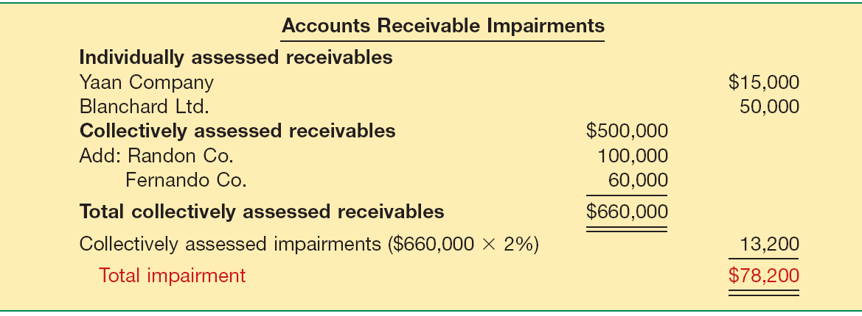
Accounts Receivable
The total impairment is computed as follows.
Illustration 7-10
LO 5 Explain accounting issues related to valuation of accounts receivable.

Slide 52
Notes Receivable
Supported by a formal promissory note.
A negotiable instrument.
Maker signs in favor of a Payee.
Interest-bearing (has a stated rate of interest) OR
Zero-interest-bearing (interest included in face amount).
LO 6 Explain accounting issues related to recognition of notes receivable.

Slide 53
Notes Receivable
Generally originate from:
Customers who need to extend payment period of an outstanding receivable.
High-risk or new customers.
Loans to employees and subsidiaries.
Sales of property, plant, and equipment.
Lending transactions (the majority of notes).
LO 6 Explain accounting issues related to recognition of notes receivable.

Slide 54
Recognition of Notes Receivable
Short-Term
Long-Term
Record at Face Value,
less allowance
Record at Present Value
of cash expected to be collected
Interest Rates
Stated rate = Market rate
Stated rate > Market rate
Stated rate < Market rate
Note Issued at
Face Value
Premium
Discount
LO 6 Explain accounting issues related to recognition of notes receivable.

Slide 55
Note Issued at Face Value
Illustration: Bigelow Corp. lends Scandinavian Imports $10,000 in exchange for a $10,000, three-year note bearing interest at 10 percent annually. The market rate of interest for a note of similar risk is also 10 percent. How does Bigelow record the receipt of the note?
i = 10%
$10,000 Principal
$1,000
$1,000
$1,000 Interest
0
1
2
3
4
n = 3
LO 6 Explain accounting issues related to recognition of notes receivable.

Slide 56
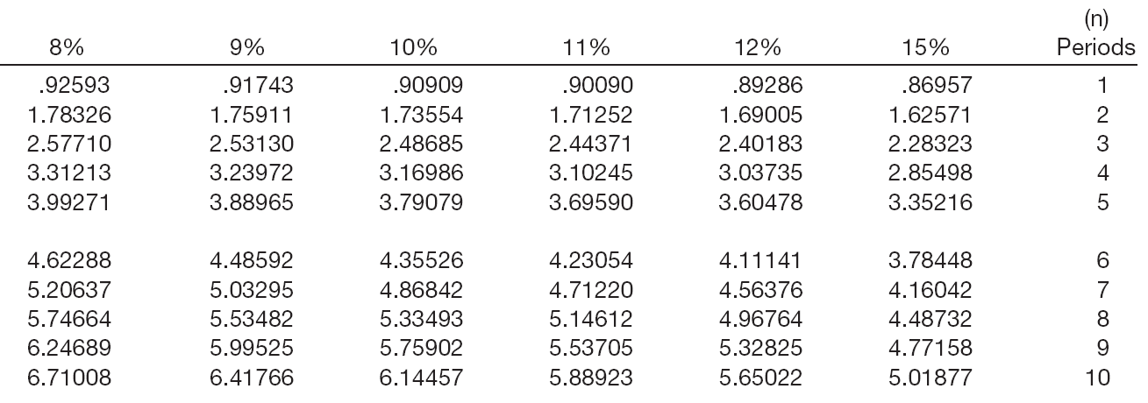
Note Issued at Face Value
PV of Interest
$1,000 x 2.48685 = $2,487
Interest Received
Factor
Present Value
LO 6 Explain accounting issues related to recognition of notes receivable.

Slide 57
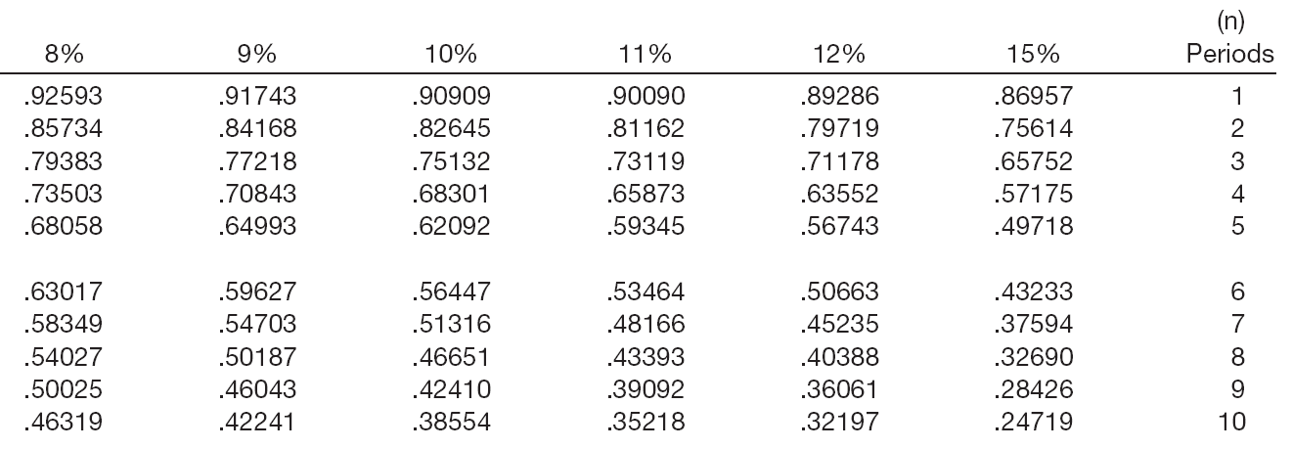
Note Issued at Face Value
PV of Principal
$10,000 x .75132 = $7,513
Principal
Factor
Present Value
LO 6 Explain accounting issues related to recognition of notes receivable.

Slide 58
Note Issued at Face Value
Summary
Present value of interest $ 2,487
Present value of principal 7,513
Note current market value $10,000
Notes receivable 10,000
Cash 10,000
Cash 1,000
Interest revenue 1,000
LO 6 Explain accounting issues related to recognition of notes receivable.

Slide 59
Zero-Interest-Bearing Note
Illustration: Jeremiah Company receives a three-year, $10,000 zero-interest-bearing note. The market rate of interest for a note of similar risk is 9 percent. How does Jeremiah record the receipt of the note?
i = 9%
$10,000 Principal
$0
$0
$0 Interest
0
1
3
3
4
n = 3
LO 6 Explain accounting issues related to recognition of notes receivable.

Slide 60
Zero-Interest-Bearing Note
PV of Principal
$10,000 x .77218 = $7,721.80
Principal
Factor
Present Value
LO 6 Explain accounting issues related to recognition of notes receivable.

Slide 61
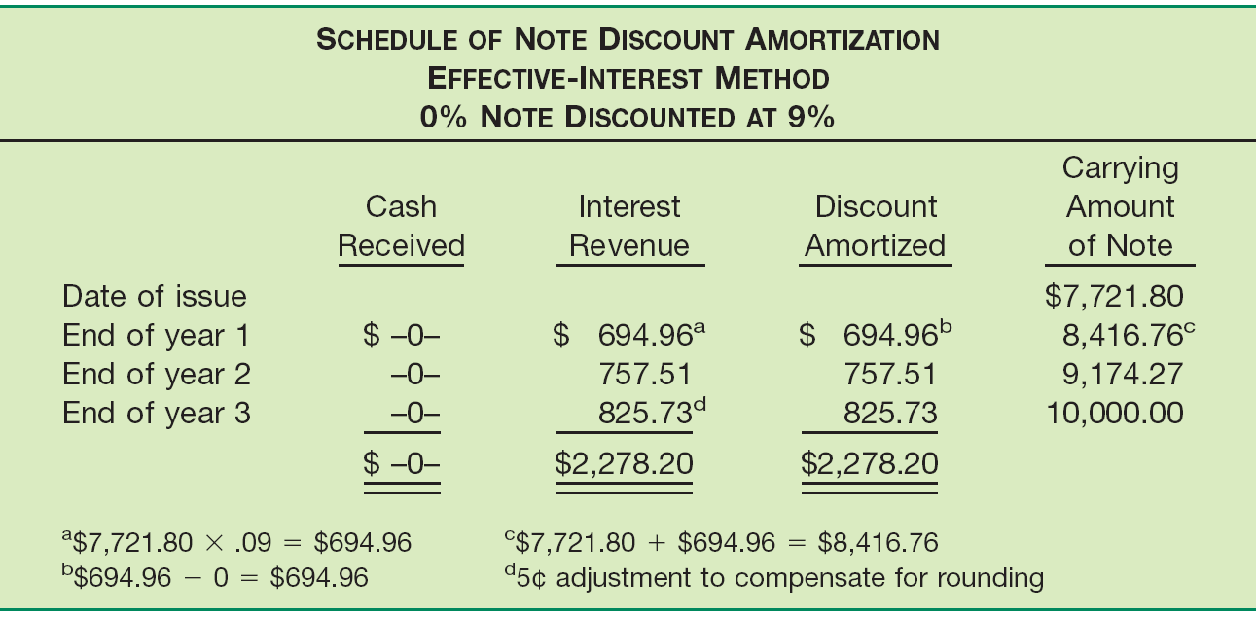
Zero-Interest-Bearing Note
Illustration 7-14
LO 6 Explain accounting issues related to recognition of notes receivable.

Slide 62
Zero-Interest-Bearing Note
Journal Entries for Zero-Interest-Bearing note
Present value of Principal $7,721.80
LO 6 Explain accounting issues related to recognition of notes receivable.

Slide 63
Interest-Bearing Note
Illustration: Morgan Corp. makes a loan to Marie Co. and receives in exchange a three-year, $10,000 note bearing interest at 10 percent annually. The market rate of interest for a note of similar risk is 12 percent. How does Morgan record the receipt of the note?
i = 12%
$10,000 Principal
$1,000
$1,000
$1,000 Interest
0
1
2
3
4
n = 3
LO 6 Explain accounting issues related to recognition of notes receivable.

Slide 64
Interest-Bearing Note
PV of Interest
$1,000 x 2.40183 = $2,402
Interest Received
Factor
Present Value
LO 6 Explain accounting issues related to recognition of notes receivable.

Slide 65
Interest-Bearing Note
PV of Principal
$10,000 x .71178 = $7,118
Principal
Factor
Present Value
LO 6 Explain accounting issues related to recognition of notes receivable.

Slide 66
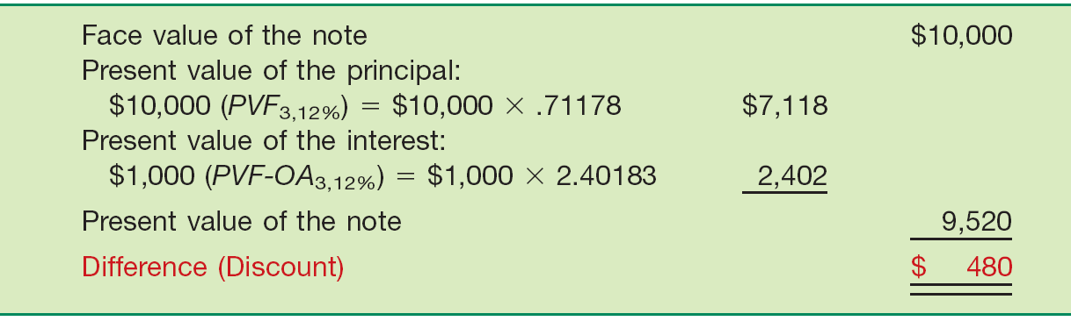
Interest-Bearing Note
Illustration: How does Morgan record the receipt of the note?
Illustration 7-13
Notes Receivable 9,520
Cash 9,520
LO 6 Explain accounting issues related to recognition of notes receivable.

Slide 67
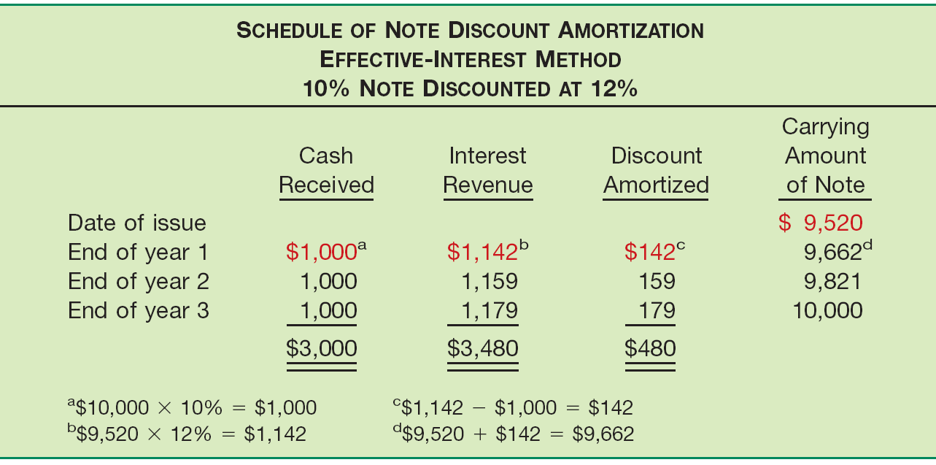
Interest-Bearing Note
Illustration 7-14
LO 6 Explain accounting issues related to recognition of notes receivable.

Slide 68
Interest-Bearing Note
Journal Entries for Interest-Bearing Note
Cash 1,000
Notes receivable 142
Interest revenue 1,142
LO 6 Explain accounting issues related to recognition of notes receivable.

Slide 69
Notes Receivable
Notes Received for Property, Goods, or Services
In a bargained transaction entered into at arm’s length, the stated interest rate is presumed to be fair unless:
  No interest rate is stated, or
  Stated interest rate is unreasonable, or
  Face amount of the note is materially different from the current cash sales price.
LO 6 Explain accounting issues related to recognition of notes receivable.

Slide 70
Notes Receivable
Illustration: Oasis Development Co. sold a corner lot to Rusty Pelican as a restaurant site. Oasis accepted in exchange a five-year note having a maturity value of £35,247 and no stated interest rate. The land originally cost Oasis £14,000. At the date of sale the land had a fair market value of £20,000. Oasis uses the fair market value of the land, £20,000, as the present value of the note. Oasis therefore records the sale as:
(£35,247 - £20,000) = £15,247
Notes Receivable 20,000
Land 14,000
Gain on Sale of Land 6,000
LO 6 Explain accounting issues related to recognition of notes receivable.

Slide 71
Notes Receivable
Valuation of Notes Receivable
Short-Term reporting parallels that for trade accounts receivable.
Long-Term - impairment tests are often done on an individual assessment basis. Impairment losses are measured as the difference between the carrying value of the receivable and the present value of the estimated future cash flows discounted at the original effective-interest rate.
LO 7 Explain accounting issues related to valuation of notes receivable.

Slide 72
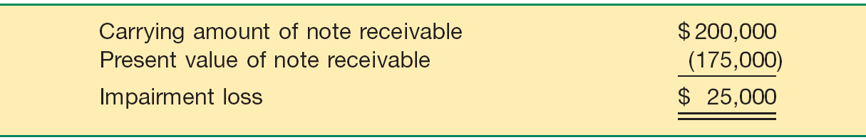
Notes Receivable
Illustration: Tesco Inc. has a note receivable with a carrying amount of $200,000. The debtor, Morganese Company, has indicated that it is experiencing financial difficulty. Tesco decides that Morganese’s note receivable is therefore impaired. Tesco computes the present value of the future cash flows discounted at its original effective-interest rate to be $175,000. The computation of the loss on impairment is as follows.
LO 7 Explain accounting issues related to valuation of notes receivable.

Slide 73
Notes Receivable
The computation of the loss on impairment is as follows.
The entry to record the impairment loss is as follows.
Bad Debt Expense 25,000
Allowance for Doubtful Accounts 25,000
LO 7 Explain accounting issues related to valuation of notes receivable.

Slide 74
Special Issues Related To Receivables
Fair Value Option
Companies have the option to record fair value in their accounts for most financial assets and liabilities, including receivables. [6]
The IASB believes that fair value measurement for financial instruments provides more relevant and understandable information than historical cost because it reflects the current cash equivalent value of financial instruments.
[6] International Accounting Standard 39, Financial Instruments: Recognition and Measurement (London, U.K.: International Accounting Standards Committee Foundation, 2003), paras. IN16 and 9.
LO 8 Understand special topics related to receivables.

Slide 75
Special Issues Related To Receivables
Fair Value Measurement
  Receivables are recorded at fair value.
  Unrealized holding gains or losses reported as part of net income.
  If a company elects the fair value option for a receivable, it must continue to use fair value measurement for that receivable until the company no longer owns this receivable.
LO 8 Understand special topics related to receivables.

Slide 76
Special Issues Related To Receivables
Fair Value Measurement
  Receivables are recorded at fair value on the statement of financial position.
  Unrealized holding gains or losses reported as part “Other income and expense” on the income statement.
  If a company elects the fair value option, it must continue to use fair value measurement for that receivable.
  If the company does not elect the fair value option at the date of recognition, it may not use this option on that specific receivable in subsequent periods.
LO 8 Understand special topics related to receivables.

Slide 77
Special Issues Related To Receivables
Illustration (Recording Fair Value Option): Assume that Escobar Company has notes receivable that have a fair value of $810,000 and a carrying amount of $620,000. Escobar decides on December 31, 2011, to use the fair value option for these receivables. This is the first valuation of these recently acquired receivables. At December 31, 2011, Escobar makes an adjusting entry to record the increase in value of Notes Receivable and to record the unrealized holding gain, as follows.
Notes Receivable 190,000
Unrealized Holding Gain or Loss—Income 190,000
LO 8 Understand special topics related to receivables.

Slide 78
Special Issues Related To Receivables
Derecognition of Receivables
Company may transfer (e.g., sells) a receivables to another company for cash.
Reasons:
Competition.
Sell receivables because money is tight.
Billing / collection are time-consuming and costly.
Transfer accomplished by:
Secured borrowing
Sale of receivables
LO 8 Understand special topics related to receivables.

Slide 79
Special Issues Related To Receivables
Secured Borrowing
Using receivables as collateral in a borrowing transaction.
Illustration: March 1, 2011, Howat Mills, Inc. provides (assigns) $700,000 of its accounts receivable to Citizens Bank as collateral for a $500,000 note. Howat Mills continues to collect the accounts receivable; the account debtors are not notified of the arrangement. Citizens Bank assesses a finance charge of 1 percent of the accounts receivable and interest on the note of 12 percent. Howat Mills makes monthly payments to the bank for all cash it collects on the receivables.
LO 8 Understand special topics related to receivables.

Slide 80
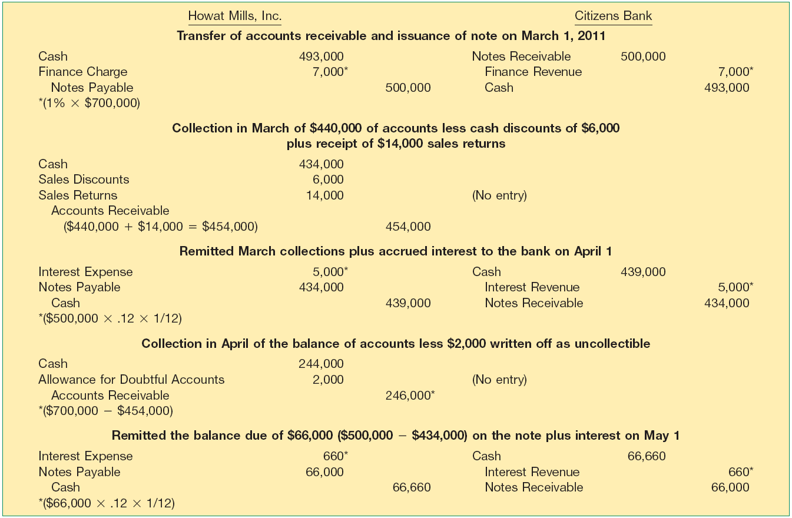
Secured Borrowing - Illustration
Illustration 7-18
LO 8

Slide 81
Secured Borrowing - Exercise
E7-14: On April 1, 2010, Prince Company assigns $500,000 of its
accounts receivable to the Hibernia Bank as collateral for a $300,000 loan due July 1, 2010. The assignment agreement calls for Prince Company to continue to collect the receivables. Hibernia Bank assesses a finance charge of 2% of the accounts receivable, and interest on the loan is 10% (a realistic rate of interest for a note of this type).
Instructions:
Prepare the April 1, 2010, journal entry for Prince Company.
Prepare the journal entry for Prince’s collection of $350,000 of the accounts receivable during the period from April 1, 2010, through June 30, 2010.
On July 1, 2010, Prince paid Hibernia all that was due from the loan it secured on April 1, 2010. Prepare the entry to record this payment.
LO 8 Understand special topics related to receivables.

Slide 82
Secured Borrowing - Exercise
E7-14 continued
LO 8 Understand special topics related to receivables.

Slide 83
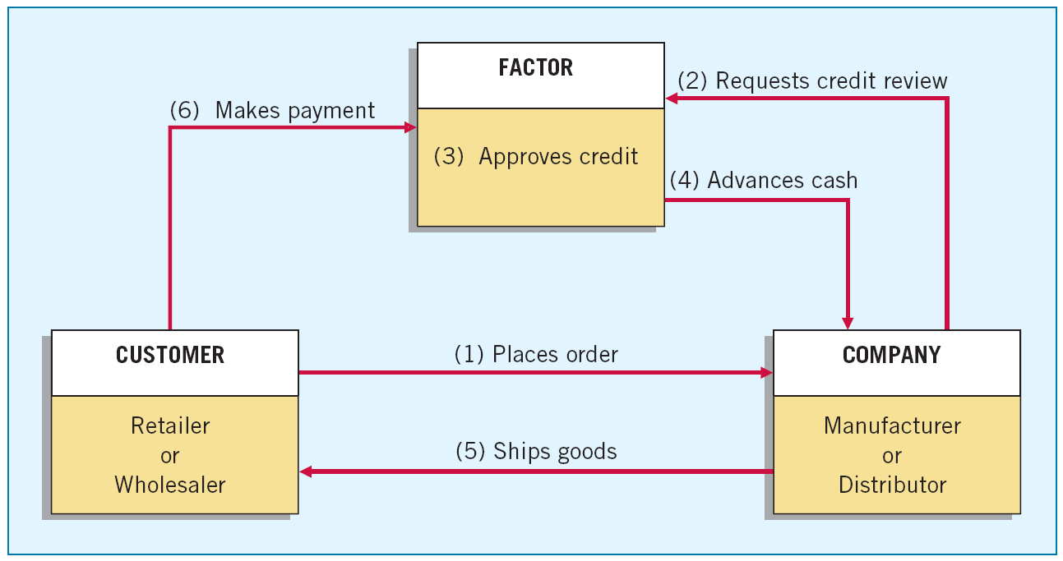
Sales of Receivables
Factors are finance companies or banks that buy receivables from businesses for a fee.
Illustration 7-19
LO 8 Understand special topics related to receivables.

Slide 84
Sales of Receivables
Sale without Guarantee
Purchaser assumes risk of collection.
Transfer is outright sale of receivable.
Seller records loss on sale.
Seller use Due from Factor (receivable) account to cover discounts, returns, and allowances.
LO 8 Understand special topics related to receivables.

Slide 85
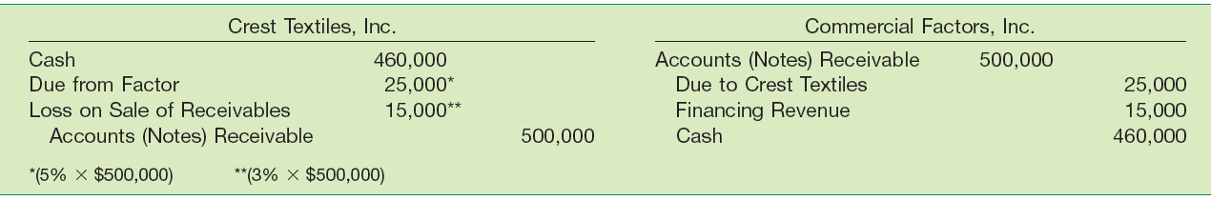
Sales of Receivables
Illustration: Crest Textiles, Inc. factors €500,000 of accounts receivable with Commercial Factors, Inc., on a non-guarantee (or without recourse) basis. Commercial Factors assesses a finance charge of 3 percent of the amount of accounts receivable and retains an amount equal to 5 percent of the accounts receivable (for probable adjustments). Crest Textiles and Commercial Factors make the following journal entries for the receivables transferred without recourse.
Illustration 7-20
LO 8 Understand special topics related to receivables.

Slide 86
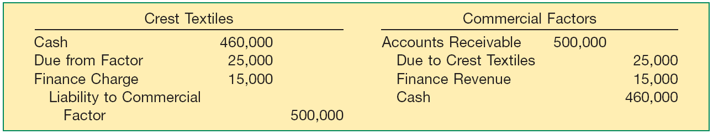
Sales of Receivables
Sale with Guarantee
Seller guarantees payment to purchaser.
Transfer is considered a borrowing—sometimes referred to as a failed sale.
Assume Crest Textiles sold the receivables on a with guarantee basis.
Illustration 7-21
LO 8 Understand special topics related to receivables.

Slide 87
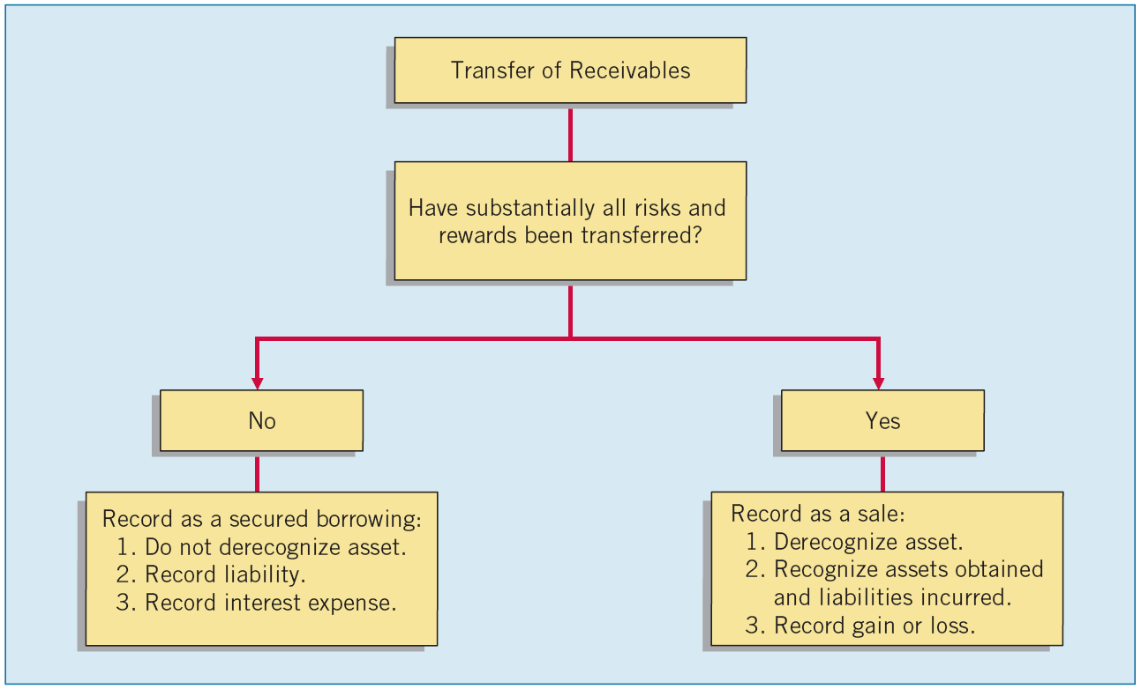
Summary of Transfers
Illustration 7-22
Determining whether receivables that are transferred can be derecognized and accounted for as a sale is based on an evaluation of whether the seller has transferred substantially all the risks and rewards of ownership of the financial asset.
LO 8

Slide 88
Presentation and Analysis
General rule in classifying receivables are:
Segregate and report carrying amounts of different categories of receivables.
Indicate receivables classified as current and non-current in the statement of financial position.
Appropriately offset the valuation accounts for receivables that are impaired, including a discussion of individual and collectively determined impairments.
Disclose the fair value of receivables in such a way that permits it to be compared with its carrying amount.
Disclose information to assess the credit risk inherent in the receivables by providing information on:
Disclose any receivables pledged as collateral.
Disclose all significant concentrations of credit risk arising from receivables.
LO 9 Describe how to report and analyze receivables.

Slide 89
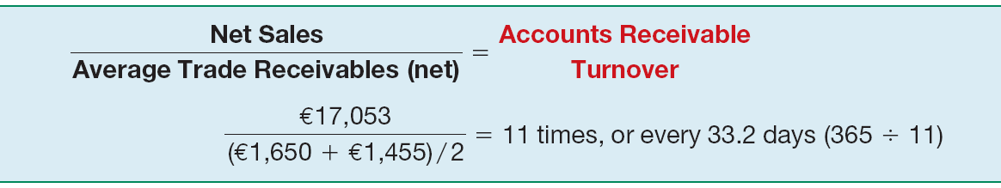
Presentation and Analysis
Analysis of Receivables
Illustration 7-24
This Ratio used to:
  Assess the liquidity of the receivables.
  Measure the number of times, on average, a company collects receivables during the period.
LO 9 Describe how to report and analyze receivables.

Slide 90


  The accounting and reporting related to cash is essentially the same under both IFRS and U.S. GAAP.
  The basic accounting and reporting issues related to recognition and measurement of receivables are essentially the same between IFRS and U.S. GAAP.
  Although IFRS implies that receivables with different characteristics should be reported separately, there is no standard that mandates this segregation. In addition, there is no specific standard related to pledging, assignment, or factoring.

Slide 91
  Like the IASB, the FASB has worked to implement fair value measurement for all financial instruments, but both Boards have faced bitter opposition from various factions. As a consequence, the Boards have adopted a piecemeal approach in which disclosure of fair value information in the notes is the first step. The second step is the fair value option, which permits companies to record fair values in the financial statements. Both Boards have indicated that they believe all financial instruments should be recorded and reported at fair value.

Slide 92
  IFRS and U.S. GAAP standards on the fair value option are similar but not identical. The international standard related to the fair value option is subject to certain qualifying criteria not in the U.S. standard. In addition, there is some difference in the financial instruments covered.
  IFRS and U.S. GAAP differ in the criteria used to derecognize a receivable. IFRS is a combination of an approach focused on risks and rewards and loss of control. U.S. GAAP uses loss of control as the primary criterion.

Slide 93
Management faces two problems in accounting for cash transactions:
  Establish proper controls to prevent any unauthorized transactions by officers or employees.
  Provide information necessary to properly manage cash on hand and cash transactions.
LO 10 Explain common techniques employed to control cash.

Slide 95
The Imprest Petty Cash System
To pay small amounts for miscellaneous expenses.
Steps:
Record $300 transfer of funds to petty cash:
Petty Cash 300
Cash 300
Petty cash custodian obtains signed receipts from each individual to whom he or she pays cash.
LO 10 Explain common techniques employed to control cash.

Slide 96
The Imprest Petty Cash System
Steps:
Custodian receives a company check to replenish the fund.
Office Supplies Expense 42
Postage Expense 53
Entertainment Expense 76
Cash Over and Short 2
Cash 173
LO 10 Explain common techniques employed to control cash.

Slide 97
The Imprest Petty Cash System
Steps:
If the company decides that the amount of cash in the petty cash fund is excessive by $50, it lowers the fund balance as follows.
Cash 50
Petty cash 50
LO 10 Explain common techniques employed to control cash.

Slide 98
Physical Protection of Cash Balances
Company should
  Minimize the cash on hand.
  Only have on hand petty cash and current day’s receipts.
  Keep funds in a vault, safe, or locked cash drawer.
  Transmit each day’s receipts to the bank as soon as practicable.
  Periodically prove (reconcile) the balance shown in the general ledger.
LO 10 Explain common techniques employed to control cash.

Slide 99
Reconciliation of Bank Balances
Schedule explaining any differences between the bank’s and the company’s records of cash.
Reconciling Items:
  Deposits in transit.
  Outstanding checks.
  Bank charges and credits.
  Bank or Depositor errors.
Time Lags
LO 10 Explain common techniques employed to control cash.

Slide 100
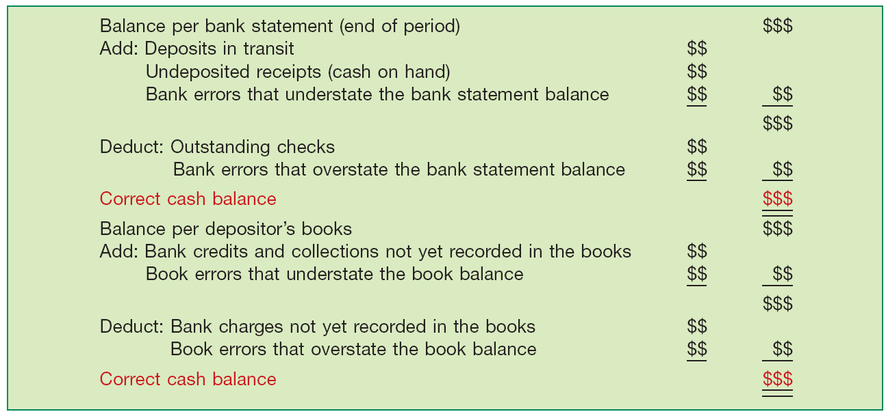
Reconciliation of Bank Balances
Illustration 7A-1
Bank Reconciliation Form and Content
LO 10 Explain common techniques employed to control cash.

Slide 101
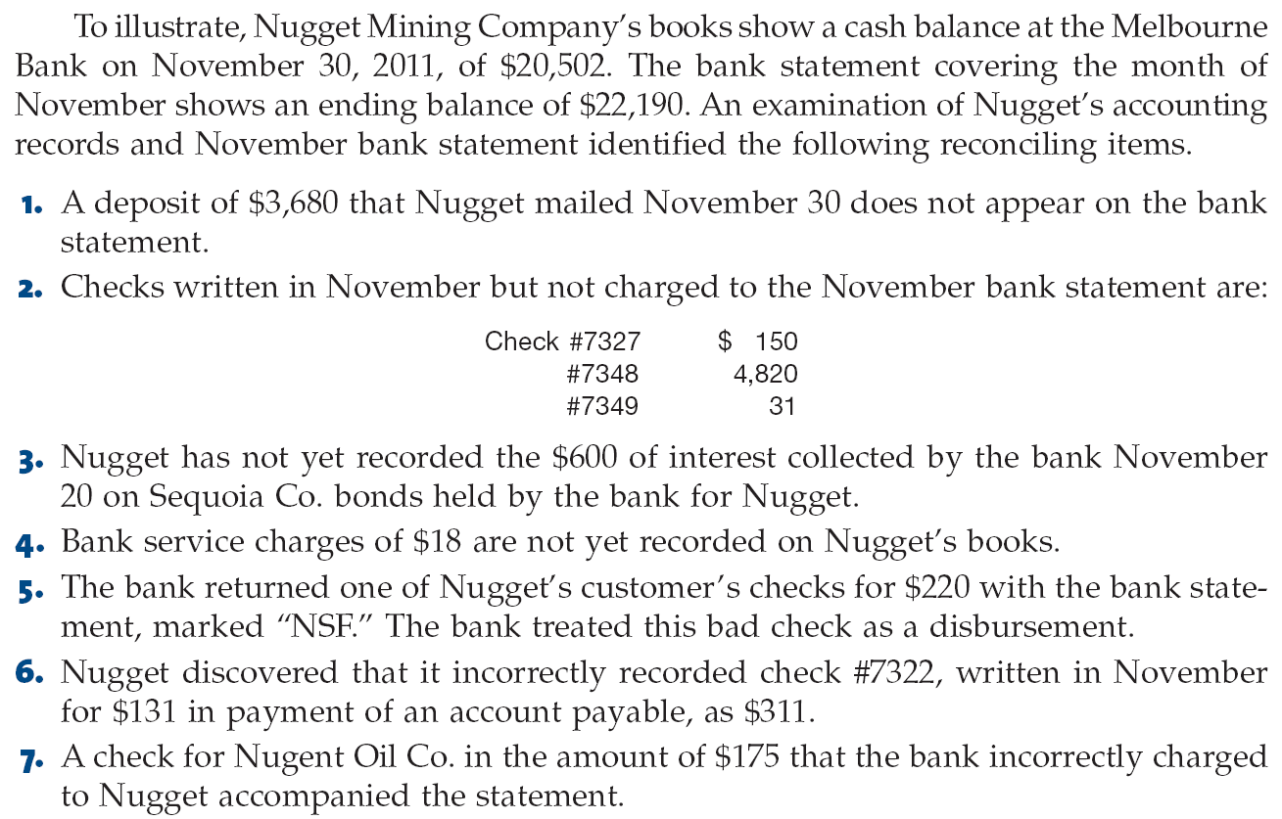
Reconciliation of Bank Balances
LO 10

Slide 102
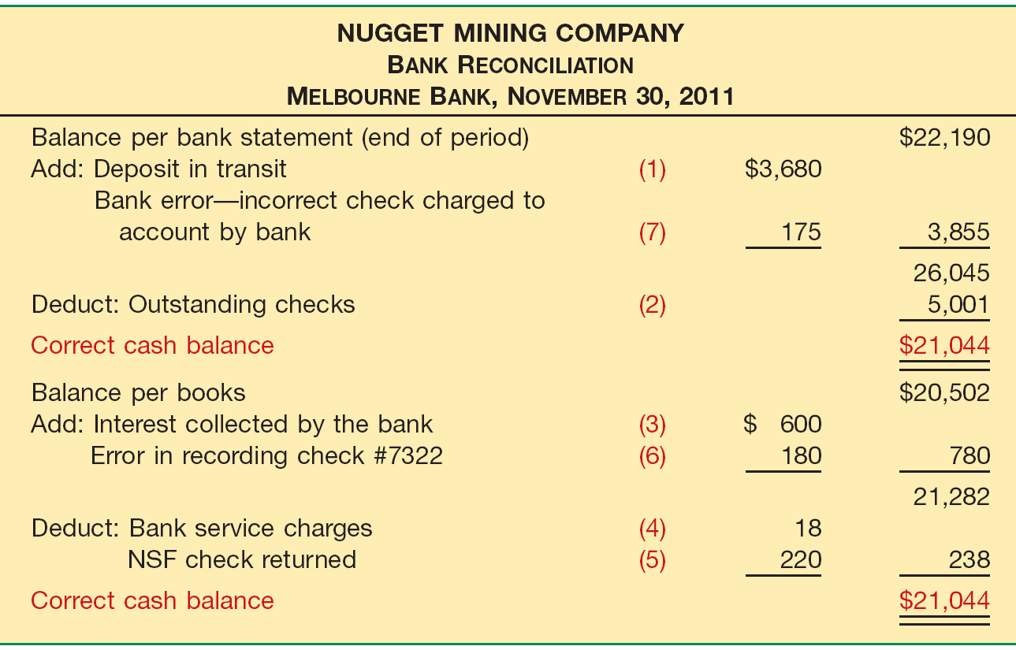
Illustration 7A-2
LO 10 Explain common techniques employed to control cash.

Slide 103
Illustration: Journalize the adjusting entries at November 30 on the books of Nugget Mining Company.
Nov. 30
Cash 542
Office expense 18
Accounts receivable 220
Accounts payable 180
Interest revenue 600
LO 10 Explain common techniques employed to control cash.

Slide 104
Review Question
The reconciling item in a bank reconciliation that will result in an adjusting entry by the depositor is:
a. outstanding checks.
b. deposit in transit.
c. a bank error.
d. bank service charges.
LO 10 Explain common techniques employed to control cash.

Slide 105
Companies assess their receivables for impairment each reporting period.
Examples of possible loss events are:
  Significant financial problems of the customer.
  Payment defaults.
  Renegotiation of terms of the receivable.
In this appendix, we discuss impairments based on the individual assessment approach for long-term receivables.
LO 11 Describe the accounting for a loan impairment.

Slide 106
Impairment Measurement and Reporting
Impairment loss is calculated as the difference between:
  the carrying amount (generally the principal plus accrued interest) and
  the expected future cash flows discounted at the loan’s historical effective-interest rate.
In estimating future cash flows, the creditor should use reasonable and supportable assumptions and projections.
LO 11 Describe the accounting for a loan impairment.

Slide 107
Impairment Loss Example
Impairment loss is calculated as the difference between:
  the carrying amount (generally the principal plus accrued interest) and
  the expected future cash flows discounted at the loan’s historical effective-interest rate.
In estimating future cash flows, the creditor should use reasonable and supportable assumptions and projections.
LO 11 Describe the accounting for a loan impairment.

Slide 108
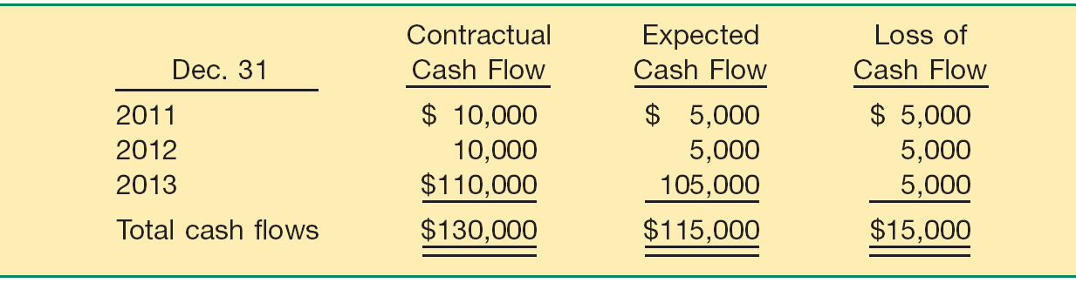
Illustration: At December 31, 2010, Ogden Bank recorded an investment of $100,000 in a loan to Carl King. The loan has an historical effective-interest rate of 10 percent, the principal is due in full at maturity in three years, and interest is due annually. The loan officer performs a review of the loan’s expected future cash flow and utilizes the present value method for measuring the required impairment loss.
Illustration 7B-1
LO 11 Describe the accounting for a loan impairment.

Slide 109
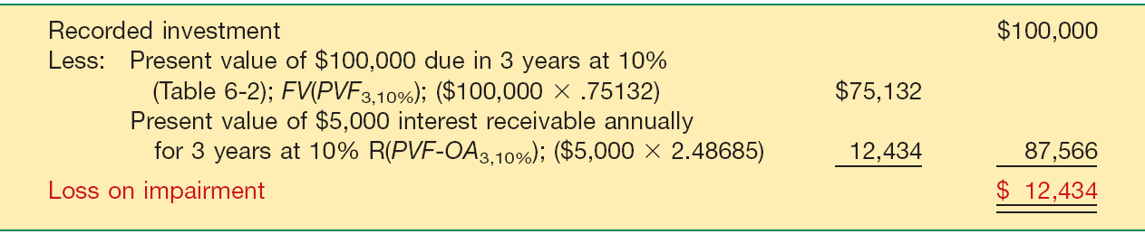
Illustration: Computation of Impairment Loss
Illustration 7B-2
Recording Impairment Losses
Bad Debt Expense 12,434
Allowance for Doubtful Accounts 12,434
LO 11 Describe the accounting for a loan impairment.

Slide 110
Recovery of Impairment Loss
Illustration: Assume that in the year following the impairment recorded by Ogden, Carl King has worked his way out of financial difficulty. Ogden now expects to receive all payments on the loan according to the original loan terms. Based on this new information, the present value of the expected payments is $100,000. Thus, Ogden makes the following entry to reverse the previously recorded impairment.
Allowance for Doubtful Accounts 12,434
Bad Debt Expense 12,434
LO 11 Describe the accounting for a loan impairment.

Slide 111
Copyright
Copyright © 2011 John Wiley & Sons, Inc. All rights reserved. Reproduction or translation of this work beyond that permitted in Section 117 of the 1976 United States Copyright Act without the express written permission of the copyright owner is unlawful. Request for further information should be addressed to the Permissions Department, John Wiley & Sons, Inc. The purchaser may make back-up copies for his/her own use only and not for distribution or resale. The Publisher assumes no responsibility for errors, omissions, or damages, caused by the use of these programs or from the use of the information contained herein.

Slide 112
SEKIAN
DAN
TERIMA KASIH

