Slide 1
INVENTORIES: ADDITIONAL VALUATION ISSUES
PERTEMUAN #9
EBA302
AKUNTANSI KEUANGAN MENENGAH I + LAB
6542– SRI HANDAYANI, SE, MM, MAk, CPMA
PROGRAM STUDI AKUNTANSI
FAKULTAS EKONOMI DAN BISNIS
UNIVERSITAS ESA UNGGUL

Slide 2
KEMAMPUAN AKHIR YANG DIHARAPKAN
Mahasiswa mampu melakukan valuasi inventori dan memproses secara akuntansi.

Slide 3
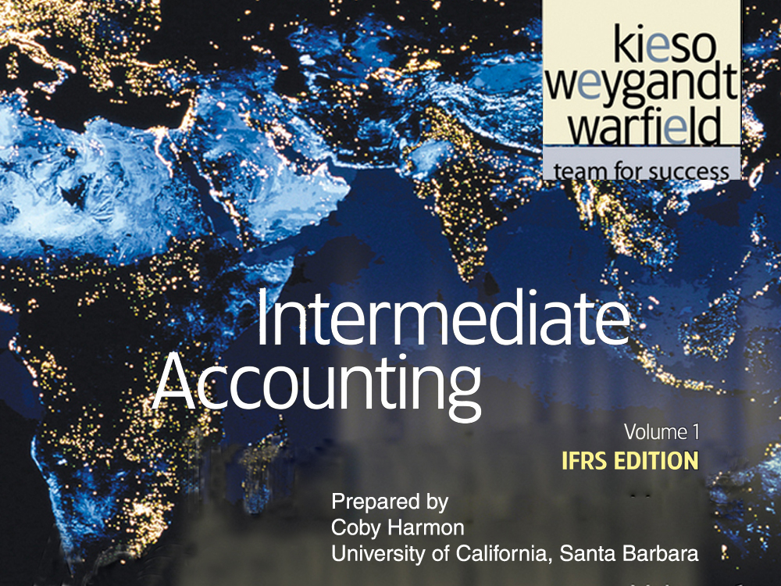

Slide 4
C H A P T E R 9
INVENTORIES:
ADDITIONAL VALUATION ISSUES
Intermediate Accounting
IFRS Edition
Kieso, Weygandt, and Warfield

Slide 5
Learning Objectives
Describe and apply the lower-of-cost-or-net realizable value rule.
Explain when companies value inventories at net realizable value.
Explain when companies use the relative sales value method to value inventories.
Discuss accounting issues related to purchase commitments.
Determine ending inventory by applying the gross profit method.
Determine ending inventory by applying the retail inventory method.
Explain how to report and analyze inventory.

Slide 6
Inventories: Additional Valuation Issues
Lower-of-Cost-or-Net Realizable Value (LCNRV)
Valuation Bases
Gross Profit Method
Retail Inventory Method
Presentation and Analysis
Net realizable value
Illustration of LCNRV
Application of LCNRV
Recording net realizable value
Use of an allowance
Recovery of inventory loss
Evaluation of rule
Special valuation situations
Relative sales value
Purchase commitments
Gross profit percentage
Evaluation of method
Concepts
Conventional method
Special items
Evaluation of method
Presentation
Analysis

Slide 7
Lower-of-Cost-or-Net Realizable Value
LCNRV
A company abandons the historical cost principle when the future utility (revenue-producing ability) of the asset drops below its original cost.
LO 1 Describe and apply the lower-of-cost-or-net realizable value rule.

Slide 8
Lower-of-Cost-or-Net Realizable Value
Net Realizable Value
Estimated selling price in the normal course of business less estimated costs to complete and estimated costs to make a sale.
Illustration 9-1
LO 1 Describe and apply the lower-of-cost-or-net realizable value rule.

Slide 9
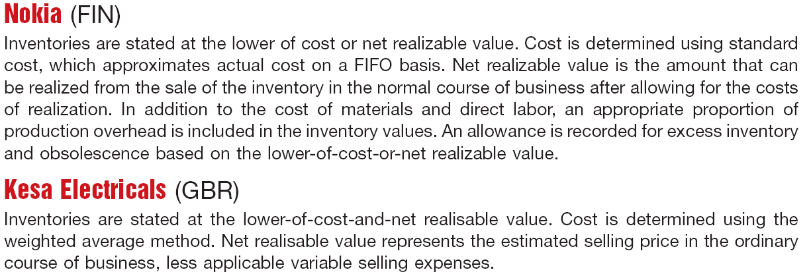
Lower-of-Cost-or-Net Realizable Value
Net Realizable Value
Illustration 9-2
LCNRV Disclosures
LO 1 Describe and apply the lower-of-cost-or-net realizable value rule.

Slide 10
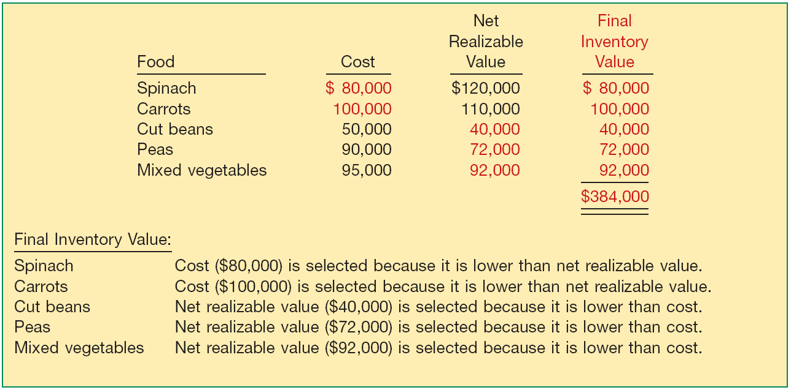
Lower-of-Cost-or-Net Realizable Value
Illustration of LCNRV: Regner Foods computes its inventory at LCNRV.
Illustration 9-3
LO 1 Describe and apply the lower-of-cost-or-net realizable value rule.

Slide 11
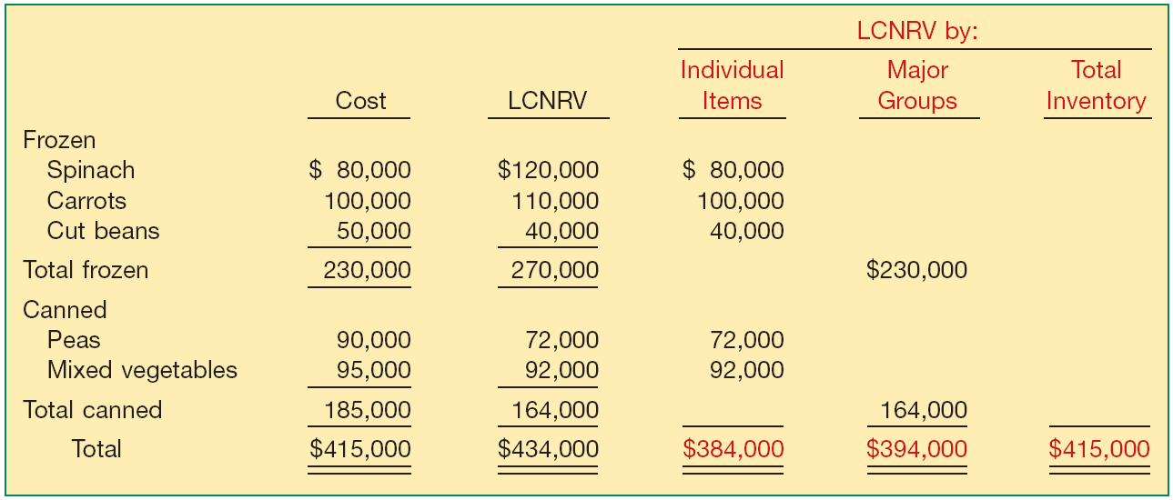
Lower-of-Cost-or-Net Realizable Value
Methods of Applying LCNRV
Illustration 9-4
LO 1 Describe and apply the lower-of-cost-or-net realizable value rule.

Slide 12
Lower-of-Cost-or-Net Realizable Value
Methods of Applying LCNRV
In most situations, companies price inventory on an item-by-item basis.
Tax rules in some countries require that companies use an individual-item basis.
Individual-item approach gives the lowest valuation for statement of financial position purposes.
Method should be applied consistently from one period to another.
LO 1 Describe and apply the lower-of-cost-or-net realizable value rule.

Slide 13
Lower-of-Cost-or-Net Realizable Value
Recording Net Realizable Value Instead of Cost
Cost of goods sold (before adj. to NRV) $ 108,000
Ending inventory (cost) 82,000
Ending inventory (at NRV) 70,000
Loss
Method
Loss due to decline to NRV 12,000
Inventory 12,000
COGS
Method
Cost of goods sold 12,000
Inventory 12,000
LO 1 Describe and apply the lower-of-cost-or-net realizable value rule.

Slide 14
Lower-of-Cost-or-Net Realizable Value
Statement of Financial Position Presentation
Partial Statement
LO 1 Describe and apply the lower-of-cost-or-net realizable value rule.

Slide 15
Lower-of-Cost-or-Net Realizable Value
Income Statement Presentation
LO 1

Slide 16
Lower-of-Cost-or-Net Realizable Value
Use of an Allowance
Instead of crediting the Inventory account for net realizable value adjustments, companies generally use an allowance account.
Loss
Method
Loss due to decline to NRV 12,000
Allowance to reduce inventory to NRV 12,000
LO 1 Describe and apply the lower-of-cost-or-net realizable value rule.

Slide 17
Lower-of-Cost-or-Net Realizable Value
Statement of Financial Position Presentation
Partial Statement
LO 1 Describe and apply the lower-of-cost-or-net realizable value rule.

Slide 18
Lower-of-Cost-or-Net Realizable Value
Recovery of Inventory Loss
Amount of write-down is reversed.
Reversal limited to amount of original write-down.
Continuing the Ricardo example, assume the net realizable value increases to $74,000 (an increase of $4,000). Ricardo makes the following entry, using the loss method.
Allowance to reduce inventory to NRV 4,000
Recovery of inventory loss 4,000
LO 1 Describe and apply the lower-of-cost-or-net realizable value rule.

Slide 19
Lower-of-Cost-or-Net Realizable Value
Recovery of Inventory Loss
Allowance account is adjusted in subsequent periods, such that inventory is reported at the LCNRV.
Illustration 9-8
Inventory should not be reported at a value above original cost.
LO 1 Describe and apply the lower-of-cost-or-net realizable value rule.

Slide 20
Lower-of-Cost-or-Net Realizable Value
Evaluation of LCM Rule
Some Deficiencies:
Decreases in the value of the asset and the charge to expense are recognized in the period in which the loss in utility occurs—not in the period of sale.
Increases in the value of the asset (in excess of original cost) recognized only at the point of sale.
Inconsistency because a company may value inventory at cost in one year and at net realizable value in the next year.
LCNRV values inventory conservatively. Net income for the year in which a company takes the loss is definitely lower. Net income of the subsequent period may be higher than normal if the expected reductions in sales price do not materialize.
LO 1 Describe and apply the lower-of-cost-or-net realizable value rule.

Slide 21
Lower-of-Cost-or-Net Realizable Value
P9-1: Remmers Company manufactures desks. Most of the company’s desks are standard models and are sold on the basis of catalog prices. At December 31, 2010, the following finished desks appear in the company’s inventory.
Instructions: At what amount should the desks appear in the company’s December 31, 2010, inventory, assuming that the company has adopted a lower-of-FIFO-cost-or-net realizable value approach for valuation of inventories on an individual-item basis?
LO 1 Describe and apply the lower-of-cost-or-net realizable value rule.

Slide 22
Lower-of-Cost-or-Net Realizable Value
P9-1: Remmers Company manufactures desks. Most of the company’s desks are standard models and are sold on the basis of catalog prices. At December 31, 2010, the following finished desks appear in the company’s inventory.
LO 1 Describe and apply the lower-of-cost-or-net realizable value rule.

Slide 23
Valuation Bases
Special Valuation Situations
Departure from LCNRV rule may be justified in situations when
cost is difficult to determine,
items are readily marketable at quoted market prices, and
units of product are interchangeable.
Two common situations in which NRV is the general rule:
Agricultural assets
Commodities held by broker-traders.
LO 2 Explain when companies value inventories at net realizable value.

Slide 24
Valuation Bases
NRV
Agricultural Inventory
Biological asset (classified as a non-current asset) is a living animal or plant, such as sheep, cows, fruit trees, or cotton plants.
Biological assets are measured on initial recognition and at the end of each reporting period at fair value less costs to sell (NRV).
Companies record gain or loss due to changes in NRV of biological assets in income when it arises.
LO 2 Explain when companies value inventories at net realizable value.

Slide 25
Valuation Bases
NRV
Agricultural Inventory
Agricultural produce is the harvested product of a biological asset, such as wool from a sheep, milk from a dairy cow, picked fruit from a fruit tree, or cotton from a cotton plant.
Agricultural produce are measured at fair value less costs to sell (NRV) at the point of harvest.
Once harvested, the NRV becomes cost.
LO 2 Explain when companies value inventories at net realizable value.

Slide 26
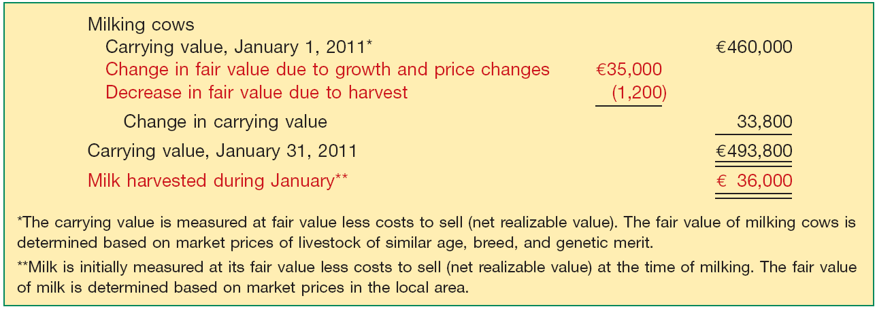
Valuation Bases
Illustration: Bancroft Dairy produces milk for sale to local cheese-makers. Bancroft began operations on January 1, 2011, by purchasing 420 milking cows for €460,000. Bancroft provides the following information related to the milking cows.
Illustration 9-9
LO 2 Explain when companies value inventories at net realizable value.

Slide 27
Valuation Bases
Illustration 9-9
Bancroft makes the following entry to record the change in carrying value of the milking cows.
Biological Asset—Milking Cows 33,800
Unrealized Holding Gain or Loss—Income 33,800
LO 2 Explain when companies value inventories at net realizable value.

Slide 28
Valuation Bases
Biological Asset—Milking Cows 33,800
Unrealized Holding Gain or Loss—Income 33,800
Reported in statement of financial position reports the Biological Asset—Milking Cows as a non-current asset at fair value less costs to sell (net realizable value).
Reported as “Other income and expense” on the income statement.
LO 2 Explain when companies value inventories at net realizable value.

Slide 29
Valuation Bases
Illustration: Bancroft makes the following summary entry to record the milk harvested for the month of January.
Milk Inventory 36,000
Unrealized Holding Gain or Loss—Income 36,000
Assuming the milk harvested in January was sold to a local cheese-maker for €38,500, Bancroft records the sale as follows.
Cash 38,500
Sales 38,500
Cost of Goods Sold 36,000
Milk Inventory 36,000
LO 2

Slide 30
Valuation Bases
NRV
Commodity Broker-Traders
Generally measure their inventories at fair value less costs to sell (NRV), with changes in NRV recognized in income in the period of the change.
Buy or sell commodities (such as harvested corn, wheat, precious metals, heating oil).
Primary purpose is to sell the commodities in the near term and generate a profit from fluctuations in price.
LO 2 Explain when companies value inventories at net realizable value.

Slide 31
Valuation Bases
Valuation Using Relative Sales Value
Permitted by GAAP under the following conditions:
a controlled market with a quoted price applicable to all quantities, and
no significant costs of disposal (rare metals and agricultural products)
or
(3) too difficult to obtain cost figures (meatpacking).
LO 3 Explain when companies use the relative sales value method to value inventories.

Slide 32
Valuation Bases
Valuation Using Relative Sales Value
Used when buying varying units in a single lump-sum purchase.
E9-9: Larsen Realty Corporation purchased a tract of unimproved land for $55,000. This land was improved and subdivided into building lots at an additional cost of $30,000. These building lots were all of the same size but owing to differences in location were offered for sale at different prices as follows. Operating expenses allocated to this project total $18,200.
Instructions: Calculate the net income realized on this operation to date.
LO 3 Explain when companies use the relative sales value method to value inventories.

Slide 33
Valuation Bases
E9-9 (Relative Sales Value Method):
x
=
x
=
x
=
LO 3 Explain when companies use the relative sales value method to value inventories.

Slide 34
Valuation Bases
Purchase Commitments—A Special Problem
Generally seller retains title to the merchandise.
Buyer recognizes no asset or liability.
If material, the buyer should disclose contract details in footnote.
If the contract price is greater than the market price, and the buyer expects that losses will occur when the purchase is effected, the buyer should recognize a liability and a corresponding loss in the period during which such declines in market prices take place.
LO 4 Discuss accounting issues related to purchase commitments.

Slide 35
Valuation Bases
Illustration: St. Regis Paper Co. signed timber-cutting contracts to be executed in 2013 at a price of $10,000,000. Assume further that the market price of the timber cutting rights on December 31, 2012, dropped to $7,000,000. St. Regis would make the following entry on December 31, 2012.
Unrealized Holding Gain or Loss—Income 3,000,000
Purchase Commitment Liability 3,000,000
Other income and expense in the Income statement.
Current liabilities on the statement of financial position.
LO 4 Discuss accounting issues related to purchase commitments.

Slide 36
Valuation Bases
Illustration: When St. Regis cuts the timber at a cost of $10 million, it would make the following entry.
Purchases (Inventory) 7,000,000
Purchase Commitment Liability 3,000,000
Cash 10,000,000
Assume the government permitted St. Regis to reduce its contract price and therefore its commitment by $1,000,000.
Purchase Commitment Liability 1,000,000
Unrealized Holding Gain or Loss—Income 1,000,000
LO 4 Discuss accounting issues related to purchase commitments.

Slide 37
Gross Profit Method of Estimating Inventory
Substitute Measure to Approximate Inventory
Relies on Three Assumptions:
Beginning inventory plus purchases equal total goods to be accounted for.
Goods not sold must be on hand.
(3) The sales, reduced to cost, deducted from the sum of the opening inventory plus purchases, equal ending inventory.
LO 5 Determine ending inventory by applying the gross profit method.

Slide 38
Gross Profit Method
Illustration: Cetus Corp. has a beginning inventory of €60,000 and purchases of €200,000, both at cost. Sales at selling price amount to €280,000. The gross profit on selling price is 30 percent. Cetus applies the gross margin method as follows.
Illustration 9-13
LO 5 Determine ending inventory by applying the gross profit method.

Slide 39
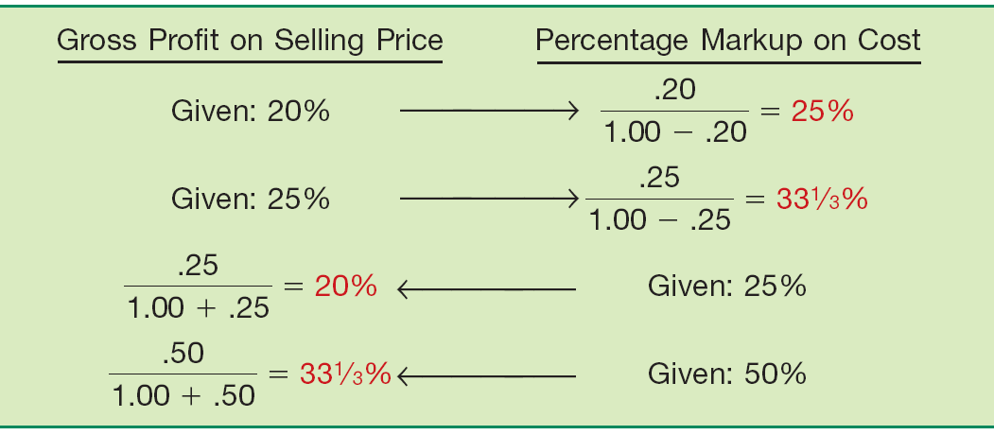
Gross Profit Method
Computation of Gross Profit Percentage
Illustration 9-16
LO 5 Determine ending inventory by applying the gross profit method.

Slide 40
Gross Profit Method
E9-14: Astaire Company uses the gross profit method to estimate inventory for monthly reporting purposes. Presented below is information for the month of May.
Instructions:
(a) Compute the estimated inventory at May 31, assuming that the gross profit is 25% of sales.
(b) Compute the estimated inventory at May 31, assuming that the gross profit is 25% of cost.
LO 5

Slide 41
Gross Profit Method
E9-14 (Solution):
(a) Compute the estimated inventory assuming gross profit is 25% of sales.
LO 5 Determine ending inventory by applying the gross profit method.

Slide 42
Gross Profit Method
E9-14 (Solution):
(b) Compute the estimated inventory assuming gross profit is 25% of cost.
25%
100% + 25%
= 20% of sales
LO 5 Determine ending inventory by applying the gross profit method.

Slide 43
Gross Profit Method
Evaluation
Disadvantages:
Provides an estimate of ending inventory.
Uses past percentages in calculation.
A blanket gross profit rate may not be representative.
Normally unacceptable for financial reporting purposes. IFRS requires a physical inventory as additional verification.
LO 5 Determine ending inventory by applying the gross profit method.

Slide 44
Retail Inventory Method
A method used by retailers, to value inventory without a physical count, by converting retail prices to cost.
Requires retailers to keep:
Total cost and retail value of goods purchased.
Total cost and retail value of the goods available for sale.
Sales for the period.
Conventional Method or Cost Method
(based on LCNRV)
LO 6 Determine ending inventory by applying the retail inventory method.

Slide 45
Retail Inventory Method
P9-9: Fuque Inc. uses the retail inventory method to estimate ending inventory for its monthly financial statements. The following data pertain to a single department for the month of October 2011.
Instructions:
Prepare a schedule computing estimate retail inventory using the following methods:
(1) Conventional
(2) Cost
LO 6 Determine ending inventory by applying the retail inventory method.

Slide 46
Retail Inventory Method
/
=
LO 6 Determine ending inventory by applying the retail inventory method.

Slide 47
Retail Inventory Method
/
=
LO 6 Determine ending inventory by applying the retail inventory method.

Slide 48
Retail Inventory Method
Special Items
Freight costs
Purchase returns
Purchase discounts and allowances
Transfers-in
Normal spoilage
Abnormal shortages
Employee discounts
LO 6 Determine ending inventory by applying the retail inventory method.

Slide 49
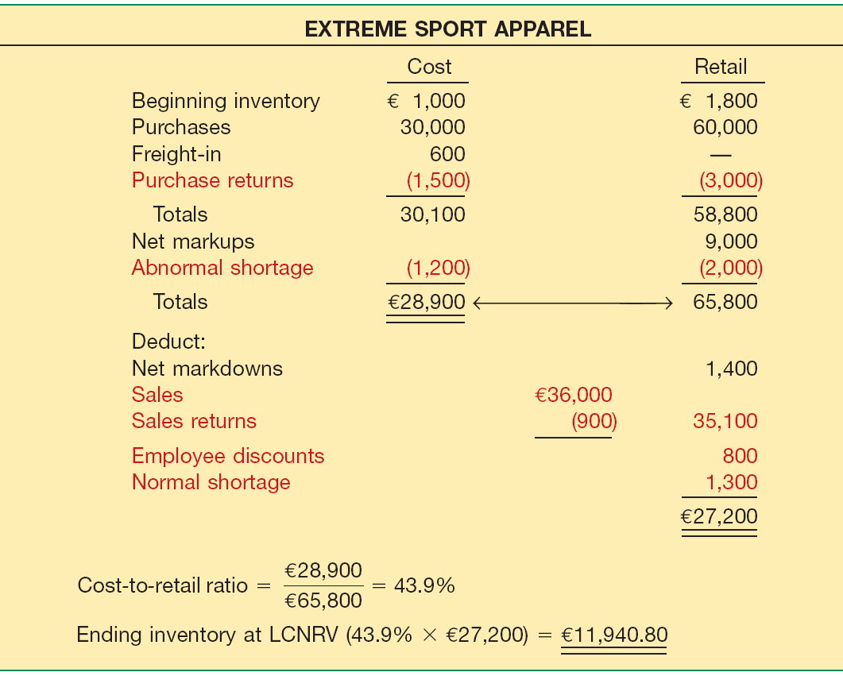
Retail Inventory Method
Special Items
Illustration 9-22
LO 6 Determine ending inventory by applying the retail inventory method.

Slide 50
Retail Inventory Method
Evaluation
Widely used for the following reasons:
To permit the computation of net income without a physical count of inventory.
Control measure in determining inventory shortages.
Regulating quantities of merchandise on hand.
Insurance information.
Some companies refine the retail method by computing inventory separately by departments or class of merchandise with similar gross profits.
LO 6 Determine ending inventory by applying the retail inventory method.

Slide 51
Presentation and Analysis
Presentation of Inventories
Accounting standards require disclosure of:
Accounting policies adopted in measuring inventories, including the cost formula used (weighted-average, FIFO).
Total carrying amount of inventories and the carrying amount in classifications (merchandise, production supplies, raw materials, work in progress, and finished goods).
Carrying amount of inventories carried at fair value less costs to sell.
Amount of inventories recognized as an expense during the period.
LO 7 Explain how to report and analyze inventory.

Slide 52
Presentation and Analysis
Presentation of Inventories
Accounting standards require disclosure of:
Amount of any write-down of inventories recognized as an expense in the period and the amount of any reversal of write-downs recognized as a reduction of expense in the period.
Circumstances or events that led to the reversal of a write-down of inventories.
Carrying amount of inventories pledged as security for liabilities, if any.
LO 7 Explain how to report and analyze inventory.

Slide 53
Presentation and Analysis
Analysis of Inventories
Common ratios used in the management and evaluation of inventory levels are inventory turnover and average days to sell the inventory.
LO 7 Explain how to report and analyze inventory.

Slide 54
Presentation and Analysis
Inventory Turnover Ratio
Measures the number of times on average a company sells the inventory during the period.
Illustration: In its 2009 annual report Tate & Lyle plc (GBR)
reported a beginning inventory of £562 million, an ending inventory of £538 million, and cost of goods sold of £2,019 million for the year.
Illustration 9-25
LO 7 Explain how to report and analyze inventory.

Slide 55
Presentation and Analysis
Average Days to Sell Inventory
Measure represents the average number of days’ sales for which a company has inventory on hand.
Illustration 9-25
Average Days to Sell
365 days / 3.67 times = every 99.5 days
LO 7 Explain how to report and analyze inventory.

Slide 56
The requirements for accounting for and reporting inventories are more principles-based under IFRS. That is, U.S. GAAP provides more detailed guidelines in inventory accounting.
Who owns the goods—goods in transit, consigned goods, special sales agreements—as well as the costs to include in inventory are essentially accounted for the same under IFRS and U.S. GAAP.
U.S. GAAP permits the use of LIFO for inventory valuation. IFRS prohibits its use. FIFO and average cost are the only two acceptable cost flow assumptions permitted under IFRS. Both sets of standards permit specific identification where appropriate.

Slide 57
In the lower-of-cost-or-market test for inventory valuation, IFRS defines market as net realizable value. U.S. GAAP, on the other hand, defines market as replacement cost subject to the constraints of net realizable value (the ceiling) and net realizable value less a normal markup (the floor). IFRS does not use a ceiling or a floor to determine market.
Under U.S. GAAP, if inventory is written down under the LCM valuation, the new basis is now considered its cost. As a result, the inventory may not be written back up to its original cost in a subsequent period. Under IFRS, the write-down may be reversed in a subsequent period up to the amount of the previous write-down. Both the write-down and any subsequent reversal should be reported on the income statement.

Slide 58
SEKIAN DAN TERIMA KASIH

