Slide 1
Design and perform audit tests of property, plant, and equipment and related accounts.
Yulazri M.Ak., CPA

Slide 2
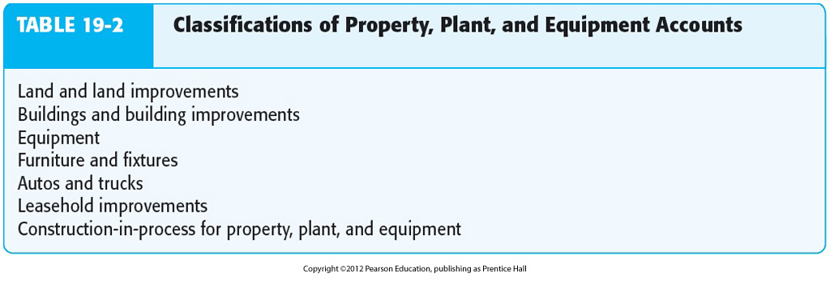
Classifications of Property, Plant and Equipment
Notes:
The primary account record for equipment and other property, plant, and equipment accounts is generally a fixed asset master file. It includes a detailed record for each piece of equipment and other types of property owned.
The totals for all records in the master file equal the general ledger balances for the related accounts: equipment, depreciation expense, and accumulated depreciation.

Slide 3
Equipment and Related Accounts
Manufacturing
Equipment
Accumulated
Depreciated
Beginning
balance
Disposals
Disposals
Beginning
balance
Acquisitions
Current period
depreciation
Ending
balance
Ending balance
Gain or Loss
on Disposals
Depreciation
Expense

Slide 4
Auditing Manufacturing Equipment and Related Accounts
Perform analytical procedures
Plus verify:
Current year acquisitions
Current year disposals
Ending balance in the asset account
Depreciation expense
Ending balance in accumulated depreciation
Notes:
Auditors verify equipment differently from current asset accounts for three reasons:
There are usually fewer current period acquisitions of equipment, especially large equipment used in manufacturing
The amount of any given acquisition is often material
The equipment is likely to be kept and maintained in the accounting records for several years.

Slide 5
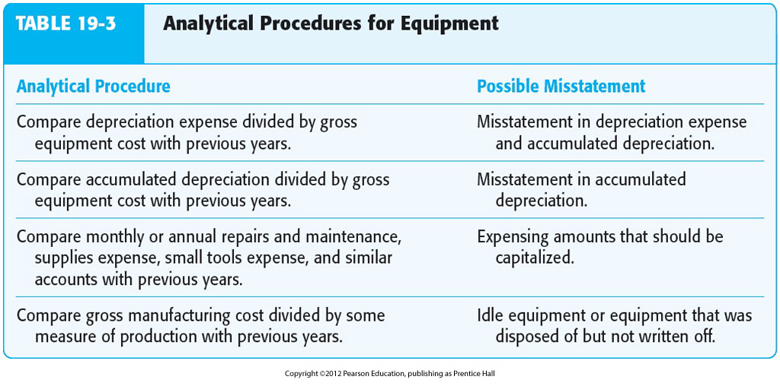
Analytical Procedures for Manufacturing Equipment

Slide 6
Verify Current Year Acquisitions
Current year additions have a long-term effect
on the financial statements.
Seven of the eight balance-related
audit objectives are used as a frame of reference.
Notes:
The correct recording of current year additions is important because of the long-term effect
the assets have on the financial statements.

Slide 7
Balance-related Audit Objectives
Detail tie-in:
Current acquisitions agree
with the master file.
1. Foot the acquisition schedule.
2. Trace the individual acquisitions
to the master file.
3. Trace the total to the general ledger.
Notes:
Footing the acquisitions schedule and tracing individual acquisitions should be limited unless controls are deficient.
The totals in the master file equal the general ledger balances for the related accounts: equipment, depreciation expense, and accumulated depreciation.

Slide 8
Balance-related Audit Objectives
Existence:
Current acquisitions as listed exist.
1. Examine vendors’ invoices and
receiving reports
2. Physically examine assets.
Notes:
The most common audit test is to verify additions to examine vendor invoices. It is normal for auditors to verify large and unusual transactions for the entire year as well as a representative sample of typical additions.

Slide 9
Balance-related Audit Objectives
Completeness:
Existing acquisitions are recorded.
1. Examine vendors’ invoices of closely
related accounts to uncover items that
should be manufacturing equipment.
2. Review lease and rental agreements.
Notes:
This objective is one of the most important for equipment.

Slide 10
Balance-related Audit Objectives
Accuracy:
Current year acquisitions as listed
are accurate.
1. Examine vendors’ invoices.
Notes:
Extent of work depends on inherent risk and effectiveness of internal controls.

Slide 11
Balance-related Audit Objectives
Classification:
Current year acquisitions as listed
are correctly classified.
1. Examine vendors’ invoices in
manufacturing equipment account.
2. Examine vendors’ invoices of closely
related accounts.
3. Examine rent and lease expense
for capitalizable leases.
Notes:
The objective is closely related to tests for completeness. It is done in conjunction with that objective and the tests for accuracy.

Slide 12
Balance-related Audit Objectives
Cutoff:
Current year acquisitions are recorded
in the correct period.
1. Review transactions near the balance
sheet date for correct period.
Notes:
Usually done as part of accounts payable cutoff tests.

Slide 13
Major Balance-related Audit Objectives
Rights:
The client has rights to current year
acquisitions.
1. Examine vendors’ invoices.
Notes:
Ordinarily, the main concern is whether equipment is owned or leased. Purchase or lease contracts are examined for equipment and property deeds, abstracts, and tax bills are examined for land or major buildings.

Slide 14
Verify Current Year Disposals
Review whether newly acquired assets
replace existing assets
Analyze gains and losses on disposal
Review documents for indications of
deletion of equipment
Make inquiries about the possibility of
the disposal of assets
Notes:
Transactions involving the disposal of equipment are often misstated when company internal controls lack a formal method to inform management of the sale, trade-in, abandonment or theft of recorded machinery and equipment.

Slide 15
Verify Ending Balance of Asset Accounts
All recorded equipment physically
exists on the balance sheet date
All equipment owned is recorded
Notes:
Two of the auditor’s objectives when auditing the ending balance in the equipment accounts include determining the aforementioned points.

Slide 16
Verify Depreciation Expense
The most important objective is accuracy.
Consistent depreciation policy
Correct calculations
Notes:
Depreciation expense is one of the few expense accounts not verified as part of tests of controls and substantive tests of transactions. The recorded amounts are determined by internal allocations rather than by exchange transactions with outside parties.
A useful method of auditing depreciation is an analytical procedures test of reasonableness made by multiplying undepreciated fixed assets by the depreciation rate for the year.

Slide 17
Verify Ending Balance in Accumulated Depreciation
Accumulated depreciation as stated
in the property master file agrees
with the general ledger.
Accumulated depreciation in the
master file is accurate.
Notes:
The two objectives usually emphasized in the audit of the ending balance in accumulated depreciation are shown above.

