Slide 1
Penilaian Asset & Bisnis
PERTEMUAN #6
EBA 919
PENILAIAN
ASSET & BISNIS
PROGRAM STUDI AKUNTANSI
FAKULTAS EKONOMI DAN BISNIS
UNIVERSITAS ESA UNGGUL

Slide 2


Relative
Valuation and Private
Valuation
Aswath Damodaran
Company
Aswath Damodaran
1

Slide 3
The Essence of relative valuation?
■ In relative valuation, the value of an asset is compared to the values assessed
by the market for similar or comparable assets.
■ To do relative valuation then,
•
•
Need to identify comparable assets and obtain market values for these assets.
Convert these market values into standardized values, since the absolute prices
cannot be compared. This process of standardizing creates price multiples.
Compare the standardized value or multiple for the asset being analyzed to the standardized values for comparable asset, controlling for any differences between
•
the firms that might affect the multiple, to judge whether the asset is under or over
valued
Aswath Damodaran
2

Slide 4
Relative valuation is pervasive…
■ Most valuations on Wall Street are relative valuations.
•
•
•
Almost 85% of equity research reports are based upon a multiple and comparables.
More than 50% of all acquisition valuations are based upon multiples.
Rules of thumb based on multiples are not only common but are often the basis for final valuation judgments.
■ While there are more discounted cashflow valuations in consulting and
corporate finance, they are often relative valuations masquerading as
discounted cash flow valuations.
•
The objective in many discounted cashflow valuations is to back into a number that
has been obtained by using a multiple.
The terminal value in a significant number of discounted cashflow valuations is estimated using a multiple.
•
Aswath Damodaran
3

Slide 5
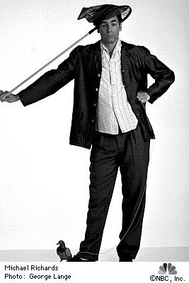
Why relative valuation?
de
“If you think I’m crazy, you should see the guy who lives
across the hall”
Jerry Sein!eld talking about Kramer in a Sein!eld episo
“ A little inaccuracy sometimes saves tons of explanation”
H.H. Munro
“ If you are going to screw up, make sure that you have lots of company”
Ex-portfolio manager
Aswath Damodaran
4

Slide 6
So, you believe only in intrinsic value? Here’s why you
should still care about relative value
■ Even if you are a true believer in discounted cashflow valuation, presenting
your findings on a relative valuation basis will make it more likely that your
findings/recommendations will reach a receptive audience.
■ In some cases, relative valuation can help find weak spots in discounted cash flow valuations and fix them.
■ The problem with multiples is not in their use but in their abuse. If we can find ways to frame multiples right, we should be able to use them better.
Aswath Damodaran
5

Slide 7
Multiples
are
just
standardized
estimates
of
price…
Market value of equity Market value for the firm Market value of operating assets of firm
Firm value = Market value of equity Enterprise value (EV) = Market value of equity
+ Market value of debt + Market value of debt
- Cash
Numerator = What you are paying for the asset
Multiple =
Denominator = What you are getting in return
Revenues
a. Accounting
revenues
b. Drivers
- # Customers
- # Subscribers
= # units
Earnings
a. To Equity investors
- Net Income
- Earnings per share
b. To Firm
- Operating income (EBIT)
Cash flow
a. To Equity
- Net Income + Depreciation
- Free CF to Equity
b. To Firm
- EBIT + DA (EBITDA)
- Free CF to Firm
Book Value
a. Equity
= BV of equity
b. Firm
= BV of debt + BV of equity
c. Invested Capital
= BV of equity + BV of debt - Cash
Aswath Damodaran
6

Slide 8
The Four Steps to Understanding Multiples
■ Define the multiple
•
In use, the same multiple can be defined in different ways by different users. When
comparing and using multiples, estimated by someone else, it is critical that we
understand how the multiples have been estimated
■ Describe the multiple
•
Too many people who use a multiple have no idea what its cross sectional
distribution is. If you do not know what the cross sectional distribution of a
multiple is, it is difficult to look at a number and pass judgment on whether it is too
high or low.
■ Analyze the multiple
•
It is critical that we understand the fundamentals that drive each multiple, and the
nature of the relationship between the multiple and each variable.
■ Apply the multiple
•
Defining the comparable universe and controlling for differences is far more
difficult in practice than it is in theory.
Aswath Damodaran
7

Slide 9
Definitional Tests
■ Is the multiple consistently defined?
•
Proposition 1: Both the value (the numerator) and the standardizing variable
( the denominator) should be to the same claimholders in the firm. In other
words, the value of equity should be divided by equity earnings or equity book value, and firm value should be divided by firm earnings or book value.
■ Is the multiple uniformly estimated?
•
The variables used in defining the multiple should be estimated uniformly across
assets in the “comparable firm” list.
If earnings-based multiples are used, the accounting rules to measure earnings
•
should be applied consistently across assets. The same rule applies with book-value
based multiples.
Aswath Damodaran
8

Slide 10
Descriptive Tests
■ What is the average and standard deviation for this multiple, across the
universe (market)?
■ How asymmetric is the distribution and what is the effect of this asymmetry on the moments of the distribution?
■ How large are the outliers to the distribution, and how do we deal with the
outliers?
•
Throwing out the outliers may seem like an obvious solution, but if the outliers all
lie on one side of the distribution, this can lead to a biased estimate.
Capping the outliers is another solution, though the point at which you cap is arbitrary and can skew results
•
■ Are there cases where the multiple cannot be estimated? Will ignoring these
cases lead to a biased estimate of the multiple?
■ How has this multiple changed over time?
Aswath Damodaran
9

Slide 11
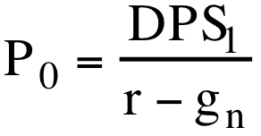
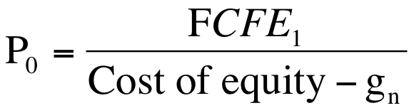
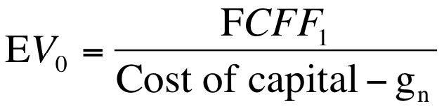
Analytical Tests
■ What are the fundamentals that determine and drive these multiples?
•
Proposition 2: Embedded in every multiple are all of the variables that drive every
discounted cash flow valuation - growth, risk and cash flow patterns.
■ How do changes in these fundamentals change the multiple?
•
The relationship between a fundamental (like growth) and a multiple (such as PE)
is almost never linear.
Proposition 3: It is impossible to properly compare firms on a multiple, if we do not know how fundamentals and the multiple move.
•
Equity Multiple or Firm Multiple
Equity Multiple Firm Multiple
1. Start with an equity DCF model (a dividend or FCFE 1. Start with a firm DCF model (a FCFF model)
model)
2. Isolate the denominator of the multiple in the model 2. Isolate the denominator of the multiple in the model
3. Do the algebra to arrive at the equation for the multiple 3. Do the algebra to arrive at the equation for the multiple
Aswath Damodaran
10

Slide 12
Application Tests
■ Given the firm that we are valuing, what is a “comparable” firm?
•
While traditional analysis is built on the premise that firms in the same sector are
comparable firms, valuation theory would suggest that a comparable firm is one which is similar to the one being analyzed in terms of fundamentals.
Proposition 4: There is no reason why a firm cannot be compared with another firm in a very different business, if the two firms have the same risk, growth and cash flow characteristics.
•
■ Given the comparable firms, how do we adjust for differences across firms on
the fundamentals?
•
Proposition 5: It is impossible to find an exactly identical firm to the one you
are valuing.
Aswath Damodaran
11

Slide 13
Price Earnings Ratio: Definition
PE = Market Price per Share I Earnings per Share
■ There are a number of variants on the basic PE ratio in use. They are based upon how the price and the earnings are defined.
■ Price:
•
is usually the current price (though some like to use average price over last 6
months or year)
EPS:
•
Time variants: EPS in most recent financial year (current), EPS in most recent four
quarters (trailing), EPS expected in next fiscal year or next four quartes (both called forward) or EPS in some future year
Primary, diluted or partially diluted
Before or after extraordinary items
Measured using different accounting rules (options expensed or not, pension fund income counted or not…)
•
•
•
Aswath Damodaran
12

Slide 14
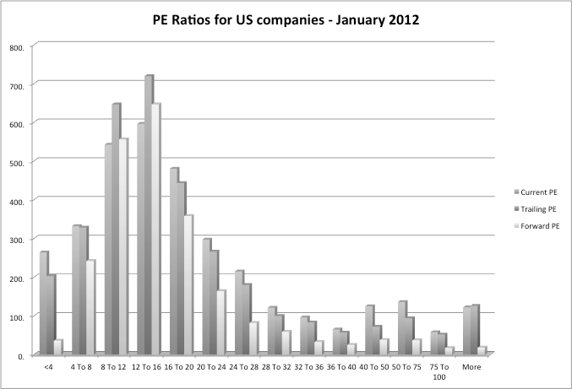
Characteristic 1: Skewed
Distributions
PE
ratios
for
US
companies
in
January
2012
Aswath Damodaran
13

Slide 15
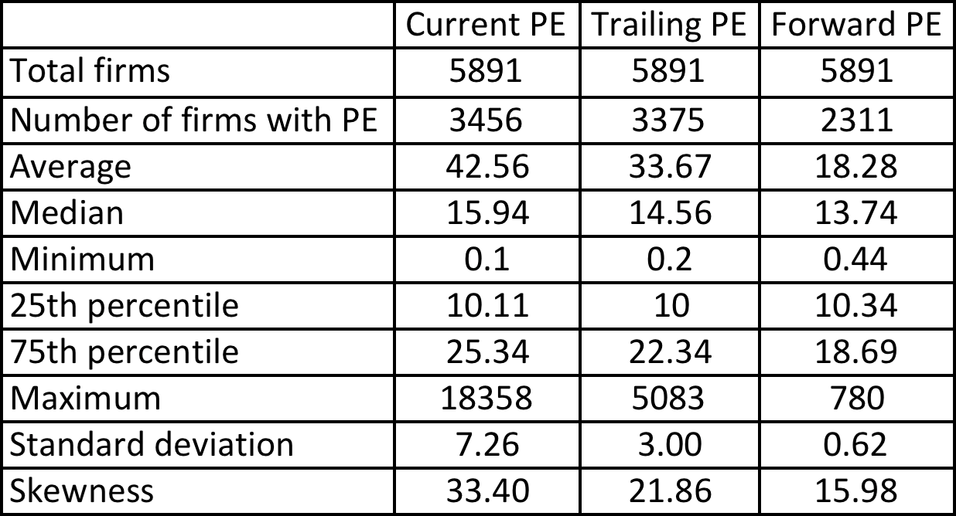
Characteristic 2: Biased Samples
PE
ratios
in
January
2012
Aswath Damodaran
14

Slide 16
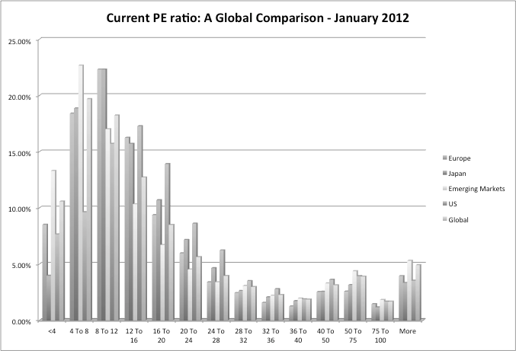
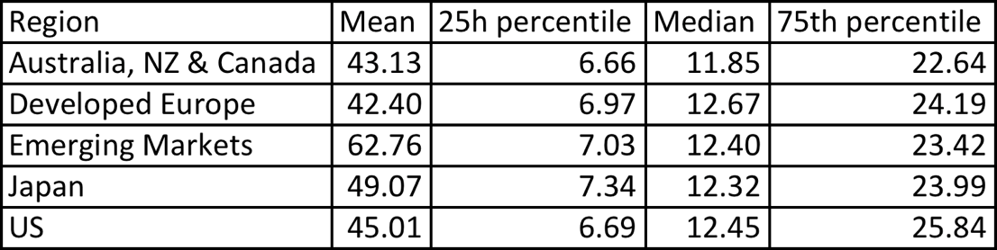
Characteristic 3: Across Markets
PE
Ratios:
US,
Europe, Japan and Emerging
Markets
–
January
2012
Aswath Damodaran
15

Slide 17
PE Ratio: Understanding the Fundamentals
■ To understand the fundamentals, start with a basic equity discounted cash flow
model. With a stable growth dividend discount model:
DPS1
n
P 0 =
r − g
■ Dividing both sides by the current earnings per share or forward EPS:
Current EPS
Forward EPS
P_{0 = PE =} Payout Ratio * (1 + g _{n} )
^{EPS}0 r- g
P Payout Ratio
1 r-g_{n}
0
= PE =
n
EPS
■ If this had been a FCFE Model,
FCFE₁
n
P₀ =
r − g
^{P0} = PE = ^{(FCFE/Earnings) * (1 + gn )}
n
EPS₀
r-g
Aswath Damodaran
16

Slide 18
PE Ratio and Fundamentals
■ Proposition: Other things held equal, higher growth firms will have
higher PE ratios than lower growth firms.
■ Proposition: Other things held equal, higher risk firms will have lower PE
ratios than lower risk firms
■ Proposition: Other things held equal, firms with lower reinvestment needs
will have higher PE ratios than firms with higher reinvestment rates.
■ Of course, other things are difficult to hold equal since high growth firms, tend to have risk and high reinvestment rats.
Aswath Damodaran
17

Slide 19
Using the Fundamental Model to Estimate PE For a High
Growth Firm
■ The price-earnings ratio for a high growth firm can also be related to
fundamentals. In the special case of the two-stage dividend discount model,
this relationship can be made explicit fairly simply:
"$ ^{(1 + g)n %}
# & EPS₀ * Payout Ratio _{n} * (1 + g) * (1 + g _{n} )
n
EPS₀ * Payout Ratio * (1 + g) *
1 −
(1 + r) ^{n}
n
P₀ =
r - g
+
(r - g )(1 + r)^{n}
•
For a firm that does not pay what it can afford to in dividends, substitute FCFE/
Earnings for the payout ratio.
■ Dividing both sides by the earnings per share:
n
n n
EPS₀ r - g (r - g _{n} )(1 + r) ^{n}
"
Payout Ratio * (1 + g) * 1 − ^{(1 + g)} '
$
%
^{P0} = ^{# (1 + r) &}
+
^{Payout Ratio} n ^{*(1+ g) * (1 + g}n ⁾
Aswath Damodaran
18

Slide 20
Expanding the Model
■ In this model, the PE ratio for a high growth firm is a function of growth, risk
and payout, exactly the same variables that it was a function of for the stable
growth firm.
■ The only difference is that these inputs have to be estimated for two phases - the high growth phase and the stable growth phase.
■ Expanding to more than two phases, say the three stage model, will mean that risk, growth and cash flow patterns in each stage.
Aswath Damodaran
19

Slide 21

A Simple Example
■ Assume that you have been asked to estimate the PE ratio for a firm which has
the following characteristics:
Variable
Expected Growth Rate
Payout Ratio
Beta
Number of years
High Growth Phase
25%
20%
1.00
5 years
Stable Growth Phase
8%
50%
1.00
Forever after year 5
■ Riskfree rate = T.Bond Rate = 6%
■ Required rate of return = 6% + 1(5.5%)= 11.5%
Aswath Damodaran
20

Slide 22
PE
and
Growth:
Firm
grows
at
x%
for
5
years,
8%
thereafter
PE Ratios and Expected Growth: Interest Rate Scenarios
180
160
140
120
100 r= 4 %
r= 6 %
r= 8 %
80 r= 1 0 %
60
40
20
0
5% 10% 15% 20% 25% 30% 35% 40% 45% 50%
Expected Growth Rate
PE Ratio
Aswath Damodaran
21

Slide 23
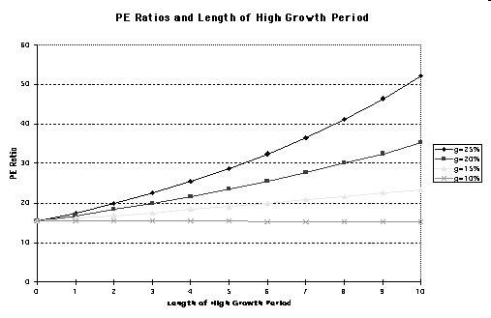
PE
Ratios
and
Length of
years;
High Growth:
25%
growth
for
n
8%
thereafter
Aswath Damodaran
22

Slide 24
PE
and
Risk: Effects of Changing Betas on
Firm with x% growth for 5 years; 8% thereafter
PE
Ratio:
PE Ratios and Beta: Growth Scenarios
50
45
40
35
30
g=25%
g=20%
g=15%
g=8%
20
15
10
5
0
0.75 1.00 1.25 1.50 1.75 2.00
Be ta
PE Ratio
25
Aswath Damodaran
23

Slide 25
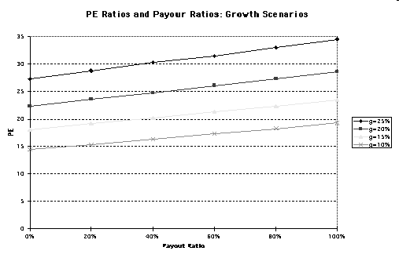
PE
and
Payout/
ROE
Aswath Damodaran
24

Slide 26
The perfect under valued company…
■ If you were looking for the perfect undervalued asset, it would be one
•
•
•
•
With a low PE ratio (it is cheap)
With high expected growth in earnings With low risk (and a low cost of equity) And with high ROE
In other words, it would be cheap with no good reason for being cheap.
■ In the real world, most assets that look cheap on a multiple of earnings basis
deserve to be cheap. In other words, one or more of these variables works
against the company (It has low growth, high risk or a low ROE).
■ When presented with a cheap stock (low PE), here are the key questions:
•
•
•
What is the expected growth in earnings?
What is the risk in the stock?
How efficiently does this company generate its growth?
Aswath Damodaran
25

Slide 27
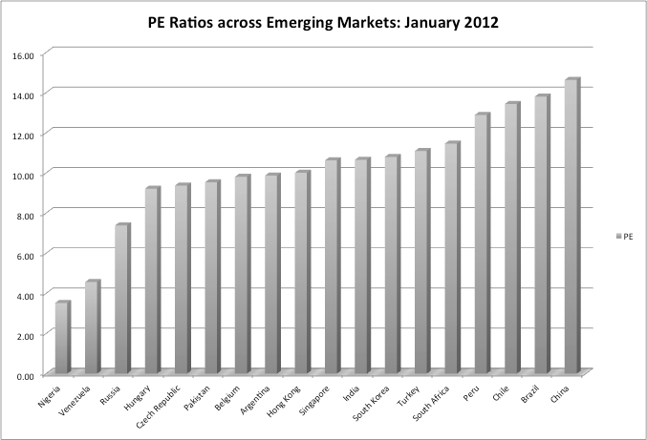

I.
Comparing
PE
ratios
across
Emerging
Markets
Aswath Damodaran
26

Slide 28
II.
An
Old
Example
with
Emerging
Markets:
June
2000
Country PE Ratio Interest GDP Real Country
Rates Growth Risk
Argentina 14 18.00% 2.50% 45
Brazil 21 14.00% 4.80% 35
Chile 25 9.50% 5.50% 15
Hong Kong 20 8.00% 6.00% 15
India 17 11.48% 4.20% 25
Indonesia 15 21.00% 4.00% 50
Malaysia 14 5.67% 3.00% 40
Mexico 19 11.50% 5.50% 30
Pakistan 14 19.00% 3.00% 45
Peru 15 18.00% 4.90% 50
Phillipines 15 17.00% 3.80% 45
Singapore 24 6.50% 5.20% 5
South Korea 21 10.00% 4.80% 25
Thailand 21 12.75% 5.50% 25
Turkey 12 25.00% 2.00% 35
Venezuela 20 15.00% 3.50% 45
Aswath Damodaran
27

Slide 29
Regression Results
■ The regression of PE ratios on these variables provides the following –
PE = 16.16
- 7.94 Interest Rates
+ 154.40 Growth in GDP
- 0.1116 Country Risk
R Squared = 73%
Aswath Damodaran
28

Slide 30
Predicted
PE
Ratios
Country
PE Ratio
Interest
Rates
GDP Real
Growth
Country
Predicted PE
Risk
Argentina
14
18.00%
2.50%
45
13.57
Brazil
21
14.00%
4.80%
35
18.55
Chile
25
9.50%
5.50%
15
22.22
Hong Kong
20
8.00%
6.00%
15
23.11
India
17
11.48%
4.20%
25
18.94
Indonesia
15
21.00%
4.00%
50
15.09
Malaysia
14
5.67%
3.00%
40
15.87
Mexico
19
11.50%
5.50%
30
20.39
Pakistan
14
19.00%
3.00%
45
14.26
Peru
15
18.00%
4.90%
50
16.71
Phillipines
15
17.00%
3.80%
45
15.65
Singapore
24
6.50%
5.20%
5
23.11
South Korea
21
10.00%
4.80%
25
19.98
Thailand
21
12.75%
5.50%
25
20.85
Turkey
12
25.00%
2.00%
35
13.35
Venezuela
20
15.00%
3.50%
45
15.35
Aswath Damodaran
29

Slide 31
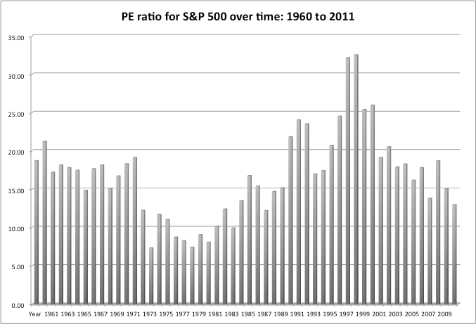
III.
Comparisons
of
PE
across time:
500
PE
Ratio
for
the
S&P
Aswath Damodaran
30

Slide 32
Is low (high) PE cheap (expensive)?
■ A market strategist argues that stocks are cheap because the PE ratio today is
low relative to the average PE ratio across time. Do you agree?
 Yes
 No
■ If you do not agree, what factors might explain the lower PE ratio today?
Aswath Damodaran
31

Slide 33
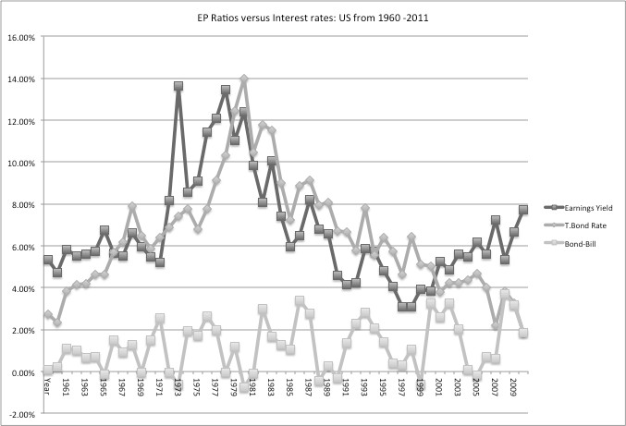
E/P
Ratios
,
T.Bond
Rates
and
Term
Structure
Aswath Damodaran
32

Slide 34
Regression Results
■ There is a strong positive relationship between E/P ratios and T.Bond rates, as
evidenced by the correlation of 0.69 between the two variables.,
■ In addition, there is evidence that the term structure also affects the PE ratio.
■ In the following regression, using 1960-2011 data, we regress E/P ratios against the level of T.Bond rates and a term structure variable (T.Bond - T.Bill rate)
E/P = 3.16% + 0.597 T.Bond Rate – 0.213 (T.Bond Rate-T.Bill Rate)
(3.98)
(5.71)
(-0.92)
R squared = 40.92%
Given the treasury bond rate and treasury bill rate today, is the market under or
over valued today?
Aswath Damodaran
33

Slide 35
IV. Valuing one company relative to others…
Relative valuation with comparables
■ Ideally, you would like to find lots of publicly traded firms that look just like
your firm, in terms of fundamentals, and compare the pricing of your firm to the pricing of these other publicly traded firms. Since, they are all just like your firm, there will be no need to control for differences.
■ In practice, it is very difficult (and perhaps impossible) to find firms that share the same risk, growth and cash flow characteristics of your firm. Even if you are able to find such firms, they will very few in number. The trade off then becomes:
Small sample of Large sample firms that are of firms that are “just like” your similar in some firm dimensions but
different on others
Aswath Damodaran
34

Slide 36
Techniques for comparing across firms
■
Direct comparisons: If the comparable firms are “just like” your firm, you can compare
multiples directly across the firms and conclude that your firm is expensive (cheap) if it
trades at a multiple higher (lower) than the other firms.
Story telling: If there is a key dimension on which the firms vary, you can tell a story
■
based upon your understanding of how value varies on that dimension.
•
An example: This company trades at 12 times earnings, whereas the rest of the
sector trades at 10 times earnings, but I think it is cheap because it has a much
higher growth rate than the rest of the sector.
■
Modified multiple: You can modify the multiple to incorporate the dimension on which
there are differences across firms.
Statistical techniques: If your firms vary on more than one dimension, you can try using
■
multiple regressions (or variants thereof) to arrive at a “controlled” estimate for your
firm.
Aswath Damodaran
35

Slide 37
Example
Comparing
1: Let’s try some story telling
PE
ratios across firms in a sector
Company Name
Coca-Cola Bottling
Molson Inc. Ltd. 'A'
Anheuser-Busch
Corby Distilleries Ltd.
Chalone Wine Group Ltd.
Andres Wines Ltd. 'A'
Todhunter Int'l
Brown-Forman 'B'
Coors (Adolph) 'B'
PepsiCo, Inc.
Coca-Cola
Boston Beer 'A'
Whitman Corp.
Mondavi (Robert) 'A'
Coca-Cola Enterprises
Hansen Natural Corp
!Trailing PE
!29.18
!43.65
!24.31
!16.24
!21.76
!8.96
!8.94
!10.07
!23.02
!33.00
!44.33
!10.59
!25.19
!16.47
!37.14
!9.70
!!
!Expected Growth
!9.50%
!15.50%
!11.00%
!7.50%
!14.00%
!3.50%
!3.00%
!11.50%
!10.00%
!10.50%
!19.00%
!17.13%
!11.50%
!14.00%
!27.00%
!17.00%
!Standard Dev
!20.58%
!21.88%
!22.92%
!23.66%
!24.08%
!24.70%
!25.74%
!29.43%
!29.52%
!31.35%
!35.51%
!39.58%
!44.26%
!45.84%
!51.34%!
!62.45%
!!
!!
!!
!!
!!
!!
!!
!!
!!
!!
!!
!!
!!
!!
!!
!
Aswath Damodaran
36

Slide 38
A Question
You are reading an equity research report on this sector, and the analyst claims
that Andres Wine and Hansen Natural are under valued because they have low
PE ratios. Would you agree?
□ Yes
□ No
■ Why or why not?
Aswath Damodaran
37

Slide 39
Example 2: The limits of story telling
Telecom
ADRs
in
1999
Company Name
PE
Growth
PT Indosat ADR
7.8
0.06
Telebras ADR
8.9
0.075
Telecom Corporation of New Zealand ADR
11.2
0.11
Telecom Argentina Stet - France Telecom SA ADR B
12.5
0.08
Hellenic Telecommunication Organization SA ADR
12.8
0.12
Telecomunicaciones de Chile ADR
16.6
0.08
Swisscom AG ADR
18.3
0.11
Asia Satellite Telecom Holdings ADR
19.6
0.16
Portugal Telecom SA ADR
20.8
0.13
Telefonos de Mexico ADR L
21.1
0.14
Matav RT ADR
21.5
0.22
Telstra ADR
21.7
0.12
Gilat Communications
22.7
0.31
Deutsche Telekom AG ADR
24.6
0.11
British Telecommunications PLC ADR
25.7
0.07
Tele Danmark AS ADR
27
0.09
Telekomunikasi Indonesia ADR
28.4
0.32
Cable & Wireless PLC ADR
29.8
0.14
APT Satellite Holdings ADR
31
0.33
Telefonica SA ADR
32.5
0.18
Royal KPN NV ADR
35.7
0.13
Telecom Italia SPA ADR
42.2
0.14
Nippon Telegraph & Telephone ADR
44.3
0.2
France Telecom SA ADR
45.2
0.19
Korea Telecom ADR
71.3
0.44
Aswath Damodaran
38

Slide 40
PE, Growth and Risk
Dependent variable is:
PE
R squared = 66.2%
R squared (adjusted) = 63.1%
Variable
Constant Growth rate Emerging Market
Coefficient
13.1151
1.21223
-13.8531
SE
3.471
19.27
3.606
t-ratio
3.78
6.29
-3.84
prob
0.0010
≤ 0.0001
0.0009
Emerging Market is a dummy: 1 if emerging market
0 if not
Aswath Damodaran
39

Slide 41
Is Telebras under valued?
■ Predicted PE = 13.12 + 1.2122 (7.5) - 13.85 (1) = 8.35
■ At an actual price to earnings ratio of 8.9, Telebras is slightly overvalued.
Aswath Damodaran
40

Slide 42
Relative to the entire market
Extending your sample
■ If you can control for differences in risk, growth and cash flows, you can
expand your list of comparable firms significantly. In fact, there is no reason
why you cannot bring every firm in the market into your comparable firm list.
■ The simplest way of controlling for differences is with a multiple regression,
with the multiple (PE, EV/EBITDA etc) as the dependent variable, and proxies
for risk, growth and payout forming the independent variables.
■ When you make this comparison, you are estimating the value of your company relative to the entire market (rather than just a sector).
Aswath Damodaran
41

Slide 43
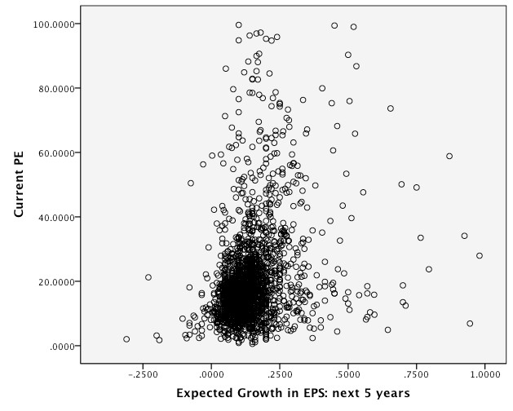
PE
versus
Expected
EPS
Growth:
January
2012
Aswath Damodaran
42

Slide 44
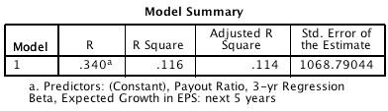
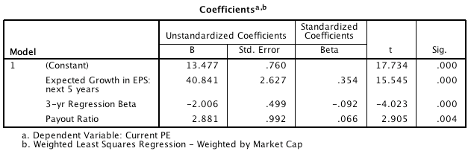
PE
Ratio:
Standard
Regression
for
US
stocks
-
January
2012
Aswath Damodaran
43

Slide 45
Problems with the regression methodology
■ The basic regression assumes a linear relationship between PE ratios and the
financial proxies, and that might not be appropriate.
■ The basic relationship between PE ratios and financial variables itself might not be stable, and if it shifts from year to year, the predictions from the model
may not be reliable.
■ The independent variables are correlated with each other. For example, high
growth firms tend to have high risk. This multi-collinearity makes the
coefficients of the regressions unreliable and may explain the large changes in
these coefficients from period to period.
Aswath Damodaran
44

Slide 46
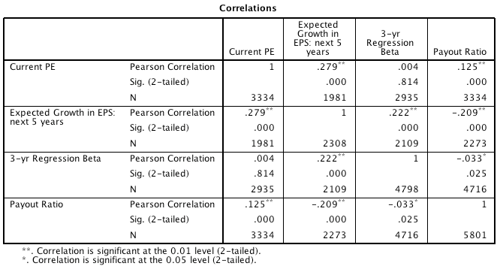
The
Multicollinearity
Problem
Aswath Damodaran
45

Slide 47
Using the PE ratio regression
■ Assume that you were given the following information for Dell. The firm has
an expected growth rate of 10%, a beta of 1.20 and pays no dividends. Based
upon the regression, estimate the predicted PE ratio for Dell.
Predicted PE =
■ Dell is actually trading at 18 times earnings. What does the predicted PE tell
you?
Aswath Damodaran
46

Slide 48
The value of growth
Time Period
January 2012
January 2011
January 2010
January 2009
January 2008
January 2007
January 2006
January 2005
January 2004
January 2003
January 2002
January 2001
January 2000
PE Value of extra 1% of growth
0.408
0.836
0.550
0.780
1.427
1.178
1.131
0.914
0.812
2.621
1.003
1.457
2.105
Equity Risk Premium
6.04%
5.20%
4.36%
6.43%
4.37%
4.16%
4.07%
3.65%
3.69%
4.10%
3.62%
2.75%
2.05%
Aswath Damodaran
47

Slide 49
Fundamentals
in
other markets: PE
markets…
regressions
across
Region
Regression - January 2012
R squared
Europe
PE = 19.57 - 2.91 Payout - 3.67 Beta
6.9%
Japan
PE = 21.69 - 0.31 Expected Growth -4.12 Beta
5.3%
Emerging
Markets
PE = 15.48+ 9.03 ROE - 2.77 Beta + 2.91 Payout
4.3%
Aswath Damodaran
48

Slide 50
Investment Strategies that compare PE to the expected
growth rate
■ If we assume that all firms within a sector have similar growth rates and risk, a
strategy of picking the lowest PE ratio stock in each sector will yield
undervalued stocks.
■ Portfolio managers and analysts sometimes compare PE ratios to the expected growth rate to identify under and overvalued stocks.
•
In the simplest form of this approach, firms with PE ratios less than their expected
growth rate are viewed as undervalued.
In its more general form, the ratio of PE ratio to growth is used as a measure of relative value.
•
Aswath Damodaran
49

Slide 51
Problems with comparing PE ratios to expected growth
■ In its simple form, there is no basis for believing that a firm is undervalued just
because it has a PE ratio less than expected growth.
■ This relationship may be consistent with a fairly valued or even an overvalued firm, if interest rates are high, or if a firm is high risk.
■ As interest rates decrease (increase), fewer (more) stocks will emerge as undervalued using this approach.
Aswath Damodaran
50

Slide 52
PEG Ratio: Definition
■ The PEG ratio is the ratio of price earnings to expected growth in earnings per
share.
PEG = PE / Expected Growth Rate in Earnings
■ Definitional tests:
•
Is the growth rate used to compute the PEG ratio
– on the same base? (base year EPS)
– over the same period?(2 years, 5 years)
– from the same source? (analyst projections, consensus estimates..)
Is the earnings used to compute the PE ratio consistent with the growth rate estimate?
– No double counting: If the estimate of growth in earnings per share is from the current year, it would be a mistake to use forward EPS in computing PE
– If looking at foreign stocks or ADRs, is the earnings used for the PE ratio consistent with the growth rate estimate? (US analysts use the ADR EPS)
•
Aswath Damodaran
51

Slide 53
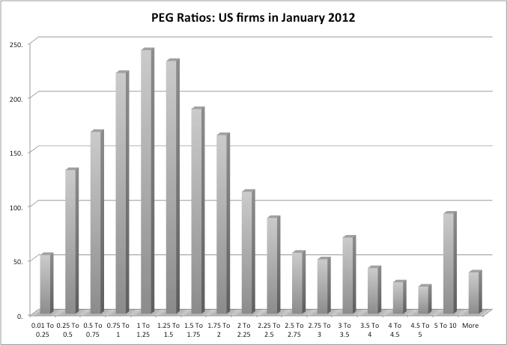
PEG
Ratio:
Distribution
–
US
stocks
Aswath Damodaran
52

Slide 54
PEG
Ratios: The Beverage
Sector
Company Name
Coca-Cola Bottling
Molson Inc. Ltd. 'A'
Anheuser-Busch
Corby Distilleries Ltd.
Chalone Wine Group Ltd.
Andres Wines Ltd. 'A'
Todhunter Int'l
Brown-Forman 'B'
Coors (Adolph) 'B'
PepsiCo, Inc.
Coca-Cola
Boston Beer 'A'
Whitman Corp.
Mondavi (Robert) 'A'
Coca-Cola Enterprises
Hansen Natural Corp
Average
!Trailing PE
!29.18
!43.65
!24.31
!16.24
21.76
!8.96
!8.94
!10.07
!23.02
!33.00
!44.33
!10.59
!25.19
!16.47
!37.14
!9.70
!22.66
!Growth
!9.50%
!15.50%
!11.00%
!7.50%
!14.00%
!3.50%
!3.00%
!11.50%
!10.00%
!10.50%
!19.00%
!17.13%
!11.50%
!14.00%
!27.00%
!17.00%
!13.00%
!Std Dev
!20.58%
!21.88%
!22.92%
!23.66%
!24.08%
!24.70%
!25.74%
!29.43%
!29.52%
!31.35%
!35.51%
!39.58%
!44.26%
!45.84%
!51.34%
!62.45%
!33.00%
!PEG
!3.07
!2.82
!2.21
!2.16
!1.55
!2.56
!2.98
!0.88
!2.30
!3.14
!2.33
!0.62
!2.19
!1.18
!1.38
!0.57
!2.00
!!
!!
!!
!!
!!
!!
!!
!!
!!
!!
!!
!!
!!
!!
!!
!!
!!
!!
Aswath Damodaran
53

Slide 55
PEG Ratio: Reading the Numbers
■ The average PEG ratio for the beverage sector is 2.00. The lowest PEG ratio in
the group belongs to Hansen Natural, which has a PEG ratio of 0.57. Using
this measure of value, Hansen Natural is
□ the most under valued stock in the group
□ the most over valued stock in the group
■ What other explanation could there be for Hansen’s low PEG ratio?
Aswath Damodaran
54

Slide 56
PEG Ratio: Analysis
■ To understand the fundamentals that determine PEG ratios, let us return again
to a 2-stage equity discounted cash flow model
"$ ^{(1 + g)n %}
# & EPS₀ * Payout Ratio _{n} * (1 + g) * (1 + g _{n} )
n
EPS₀ * Payout Ratio * (1 + g) *
1 −
(1 + r) ^{n}
n
P₀ =
r - g
+
(r - g )(1 + r)^{n}
■ Dividing both sides of the equation by the earnings gives us the equation for
the PE ratio. Dividing it again by the expected growth ‘g’
" (1 + g)^{n} %
# (1 + r) ^{n} & Payout Ratio * (1 + g)^{n} * (1 + g )
n
Payout Ratio * (1 + g) * $1 −
PEG =
g(r - g)
+
n n
g(r - g_{n} )(1 + r)
Aswath Damodaran
55

Slide 57
PEG Ratios and Fundamentals
■ Risk and payout, which affect PE ratios, continue to affect PEG ratios as well.
•
Implication: When comparing PEG ratios across companies, we are making
implicit or explicit assumptions about these variables.
■ Dividing PE by expected growth does not neutralize the effects of expected
growth, since the relationship between growth and value is not linear and
fairly complex (even in a 2-stage model)
Aswath Damodaran
56

Slide 58
A Simple Example
■ Assume that you have been asked to estimate the PEG ratio for a firm which
has the following characteristics:
Variable
Expected Growth Rate
Payout Ratio
Beta
High Growth Phase
25%
20%
1.00
Stable Growth Phase
8%
50%
1.00
■ Riskfree rate = T.Bond Rate = 6%
■ Required rate of return = 6% + 1(5.5%)= 11.5%
■ The PEG ratio for this firm can be estimated as follows:
# ⁵ &
$ (1.115)⁵ ' 0.5 * (1.25)⁵ * (1.08)
.25(.115 - .25) .25(.115 - .08) (1.115)⁵
0.2
*
(1.25)
*
(1.25)
%¹ ⁻ (
PEG =
+
= 115 or 1.15
Aswath Damodaran
57

Slide 59
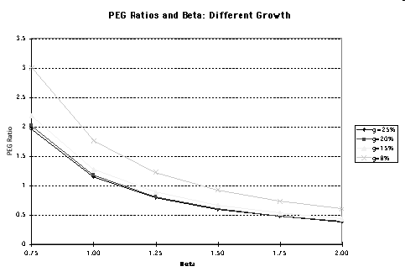
PEG
Ratios
and
Risk
Aswath Damodaran
58

Slide 60
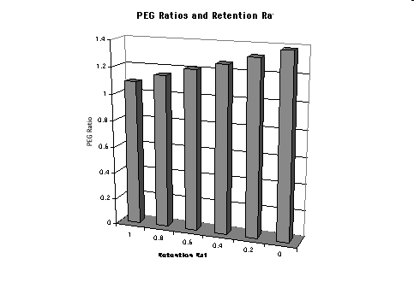
PEG
Ratios
and
Quality
of
Growth
Aswath Damodaran
59

Slide 61
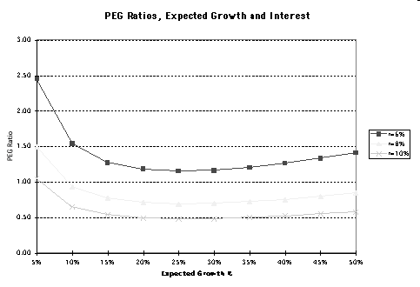
PE
Ratios
and
Expected
Growth
Aswath Damodaran
60

Slide 62
PEG Ratios and Fundamentals: Propositions
■ Proposition 1: High risk companies will trade at much lower PEG ratios than
low risk companies with the same expected growth rate.
•
Corollary 1: The company that looks most under valued on a PEG ratio basis in a
sector may be the riskiest firm in the sector
■ Proposition 2: Companies that can attain growth more efficiently by investing
less in better return projects will have higher PEG ratios than companies that
grow at the same rate less efficiently.
•
Corollary 2: Companies that look cheap on a PEG ratio basis may be companies
with high reinvestment rates and poor project returns.
■ Proposition 3: Companies with very low or very high growth rates will tend to
have higher PEG ratios than firms with average growth rates. This bias is
worse for low growth stocks.
•
Corollary 3: PEG ratios do not neutralize the growth effect.
Aswath Damodaran
61

Slide 63
PE,
PEG
Ratios
and
Risk
45 2.5
40
2
30
1.5
25
PE
PEG Ratio
20
1
15
10
5
0 0
Lowest 2 3 4 Highest
35
0.5
Risk classes
Aswath Damodaran
62

Slide 64
PEG Ratio:
Returning
to the Beverage
Sector
Company Name
Coca-Cola Bottling
Molson Inc. Ltd. 'A'
Anheuser-Busch
Corby Distilleries Ltd.
Chalone Wine Group Ltd.
Andres Wines Ltd. 'A'
Todhunter Int'l
Brown-Forman 'B'
Coors (Adolph) 'B'
PepsiCo, Inc.
Coca-Cola Boston
Beer 'A' Whitman
Corp. Mondavi
(Robert) 'A'
Coca-Cola Enterprises
Hansen Natural Corp
Average
!Trailing PE
!29.18
!43.65
!24.31
!16.24
!21.76
!8.96
!8.94
!10.07
!23.02
!33.00
!44.33
!10.59
!25.19
!16.47
!37.14
!9.70
!22.66
!Growth
!9.50%
!15.50%
!11.00%
!7.50%
!14.00%
!3.50%
!3.00%
!11.50%
!10.00%
!10.50%
!19.00%
!17.13%
!11.50%
!14.00%
!27.00%
!17.00%
!13.00%
!Std Dev
!20.58%
!21.88%
!22.92%
!23.66%
!24.08%
!24.70%
!25.74%
!29.43%
!29.52%
!31.35%
!35.51%
!39.58%
!44.26%
!45.84%
!51.34%
!62.45%
!33.00%
!PEG
!3.07
!2.82
!2.21
!2.16
!1.55
!2.56
!2.98
!0.88
!2.30
!3.14
!2.33
!0.62
!2.19
!1.18
!1.38
!0.57
!2.00
!!
!!
!!
!!
!!
!!
!!
!!
!!
!!
!!
!!
!!
!!
!!
!!
!!
!!
Aswath Damodaran
63

Slide 65
Analyzing PE/Growth
■ Given that the PEG ratio is still determined by the expected growth rates, risk
and cash flow patterns, it is necessary that we control for differences in these
variables.
■ Regressing PEG against risk and a measure of the growth dispersion, we get:
PEG = 3.61 -.0286 (Expected Growth) - .0375 (Std Deviation in Prices)
R Squared = 44.75%
■ In other words,
• PEG ratios will be lower for high growth companies
• PEG ratios will be lower for high risk companies
■ We also ran the regression using the deviation of the actual growth rate from
the industry-average growth rate as the independent variable, with mixed
results.
Aswath Damodaran
64

Slide 66
Estimating the PEG Ratio for Hansen
■ Applying this regression to Hansen, the predicted PEG ratio for the firm can
be estimated using Hansen’s measures for the independent variables:
•
•
Expected Growth Rate = 17.00%
Standard Deviation in Stock Prices = 62.45%
■ Plugging in,
Expected PEG Ratio for Hansen = 3.61 - .0286 (17) - .0375 (62.45)
= 0.78
■ With its actual PEG ratio of 0.57, Hansen looks undervalued, notwithstanding its high risk.
Aswath Damodaran
65

Slide 67
Extending the Comparables
■ This analysis, which is restricted to firms in the software sector, can be
expanded to include all firms in the firm, as long as we control for differences
in risk, growth and payout.
■ To look at the cross sectional relationship, we first plotted PEG ratios against expected growth rates.
Aswath Damodaran
66

Slide 68
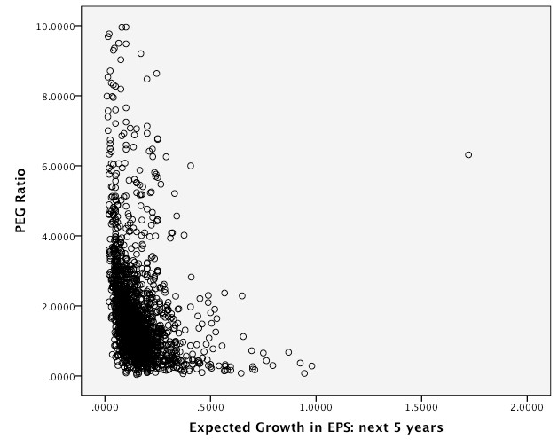
PEG
versus
Growth
–
January
2012
Aswath Damodaran
67

Slide 69
Analyzing the Relationship
■ The relationship in not linear. In fact, the smallest firms seem to have the
highest PEG ratios and PEG ratios become relatively stable at higher growth
rates.
■ To make the relationship more linear, we converted the expected growth rates
in ln(expected growth rate). The relationship between PEG ratios and
ln(expected growth rate) was then plotted.
Aswath Damodaran
68

Slide 70
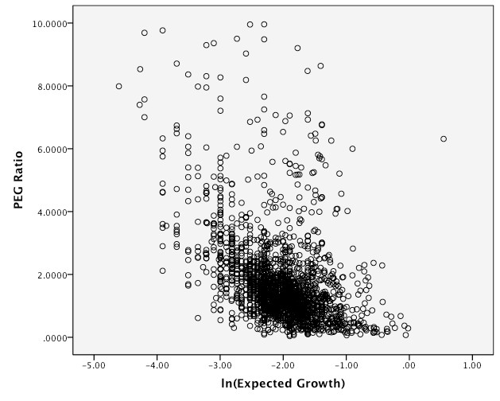
PEG
versus
ln(Expected
Growth)
–
January
2012
Aswath Damodaran
69

Slide 71
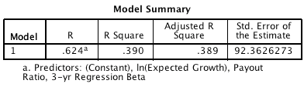
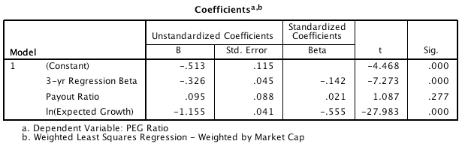
PEG
Ratio Regression -
US
stocks
January
2012
Aswath Damodaran
70

Slide 72
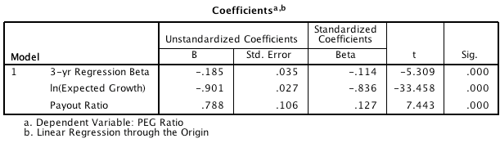
Negative intercepts…and problem forecasts..
■ When the intercept in a multiples regression is negative, there is the possibility
that forecasted values can be negative as well. One way (albeit imperfect) is to
re-run the regression without an intercept.
Aswath Damodaran
71

Slide 73
Applying the PEG ratio regression
■ Consider Dell again. The stock has an expected growth rate of 10%, a beta of
1.20 and pays out no dividends. What should its PEG ratio be?
■ If the stock’s actual PE ratio is 18, what does this analysis tell you about the
stock?
Aswath Damodaran
72

Slide 74
A Variant on PEG Ratio: The PEGY ratio
■ The PEG ratio is biased against low growth firms because the relationship
between value and growth is non-linear. One variant that has been devised to
consolidate the growth rate and the expected dividend yield:
PEGY = PE / (Expected Growth Rate + Dividend Yield)
■ As an example, Con Ed has a PE ratio of 16, an expected growth rate of 5% in earnings and a dividend yield of 4.5%.
•
•
PEG = 16/ 5 = 3.2
PEGY = 16/(5+4.5) = 1.7
Aswath Damodaran
73

Slide 75
Value/Earnings and Value/Cashflow Ratios
■ While Price earnings ratios look at the market value of equity relative to
earnings to equity investors, Value earnings ratios look at the market value of the operating assets of the firm (Enterprise value or EV) relative to operating earnings or cash flows.
EV = Market value of equity + Debt – Cash
■ The form of value to cash flow ratios that has the closest parallels in DCF
valuation is the ratio of Firm value to Free Cash Flow to the Firm.
•
FCFF = EBIT (1-t) - Net Cap Ex - Change in WC
■ In practice, what we observe more commonly are firm values as multiples of
operating income (EBIT), after-tax operating income (EBIT (1-t)) or EBITDA.
Aswath Damodaran
74

Slide 76
Value/FCFF Multiples and the Alternatives
■ Assume that you have computed the value of a firm, using discounted cash
flow models. Rank the following multiples in the order of magnitude from
lowest to highest?
□ EV/EBIT
□ EV/EBIT(1-t)
□ EV/FCFF
□ EV/EBITDA
■ What assumption(s) would you need to make for the Value/EBIT(1-t) ratio to be equal to the Value/FCFF multiple?
Aswath Damodaran
75

Slide 77
EV/FCFF: Determinants
■ Reverting back to a two-stage FCFF DCF model, we get:
! n
&
V = + ^{0 n}
n
FCFF
(1 + g) #1 - ^{(1 + g) $}
⁰ " (1 + WACC)^{n} %
FCFF (1 + g)^{n} (1 + g )
0
WACC - g
(WACC - g )(1 + WACC)^{n}
•
•
•
•
FCFF0 = Free Cashflow to the firm in current year
g = Expected growth rate in FCFF in extraordinary growth period (first n years)
WACC = Weighted average cost of capital
g_{n} = Expected growth rate in FCFF in stable growth period (after n years)\
■
Dividing both sides by the FCFF
n
n n
n
!
(1 + g) #1 -
(1 + g) $
V₀
" (1 + WACC) %
(1 + g) (1 + g_{n} )
=
+
FCFF₀
WACC - g
(WACC - g_{n} )(1 + WACC)
Aswath Damodaran
76

Slide 78
Illustration: Using Value/FCFF Approaches to value a firm:
MCI Communications
■ MCI Communications had earnings before interest and taxes of $3356 million
in 1994 (Its net income after taxes was $855 million).
■ It had capital expenditures of $2500 million in 1994 and depreciation of $1100 million; Working capital increased by $250 million.
■ It expects free cashflows to the firm to grow 15% a year for the next five years and 5% a year after that.
■ The cost of capital is 10.50% for the next five years and 10% after that.
■ The company faces a tax rate of 36%.
⎛⎛⎜⎜
5
⎞⎞
(1.15) 1 -
(1.15)
V0
FCFF₀
⎝⎝
(1.105)5
⎠⎠
5
=
+
(1.15) (1.05)
.105 - .15
5
(.10 - .05)(1.105)
= 31.28
Aswath Damodaran
77

Slide 79
Multiple Magic
■ In this case of MCI there is a big difference between the FCFF and short cut
measures. For instance the following table illustrates the appropriate multiple
using short cut measures, and the amount you would overpay by if you used
the FCFF multiple.
Free Cash Flow to the Firm
= EBIT (1-t) - Net Cap Ex - Change in Working Capital
= 3356 (1 - 0.36) + 1100 - 2500 - 250 = $ 498 million
FCFF
EBIT (1-t)
EBIT
EBITDA
$ Value
$498
$2,148
$ 3,356
$4,456
Correct Multiple
31.28382355
7.251163362
4.640744552
3.49513885
Aswath Damodaran
78

Slide 80
Reasons for Increased Use of Value/EBITDA
1. The multiple can be computed even for firms that are reporting net losses, since
earnings before interest, taxes and depreciation are usually positive.
2. For firms in certain industries, such as cellular, which require a substantial
investment in infrastructure and long gestation periods, this multiple seems to
be more appropriate than the price/earnings ratio.
3. In leveraged buyouts, where the key factor is cash generated by the firm prior to
all discretionary expenditures, the EBITDA is the measure of cash flows from
operations that can be used to support debt payment at least in the short term.
4. By looking at cashflows prior to capital expenditures, it may provide a better estimate of “optimal value”, especially if the capital expenditures are unwise
or earn substandard returns.
5. By looking at the value of the firm and cashflows to the firm it allows for comparisons across firms with different financial leverage.
Aswath Damodaran
79

Slide 81
Enterprise
Value/EBITDA
Multiple
■ The Classic Definition
Value Market Value of Equity + Market Value of Debt
EBITDA Earnings before Interest, Taxes and Depreciation
=
■ The No-Cash Version
Enterprise Value Market Value of Equity + Market Value of Debt - Cash
EBITDA Earnings before Interest, Taxes and Depreciation
=
Aswath Damodaran
80

Slide 82
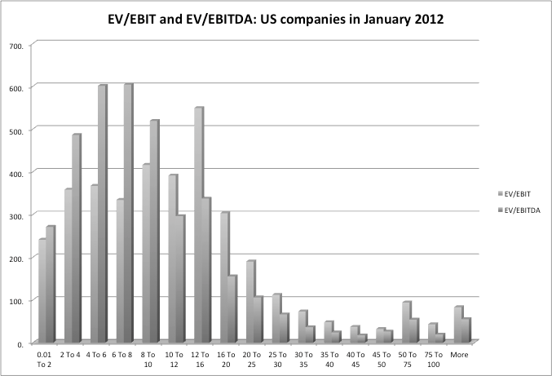
Enterprise
Value/EBITDA
Distribution
–
US
Aswath Damodaran
81

Slide 83
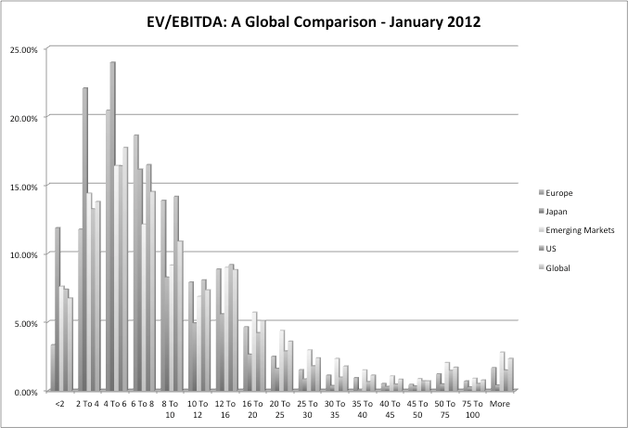
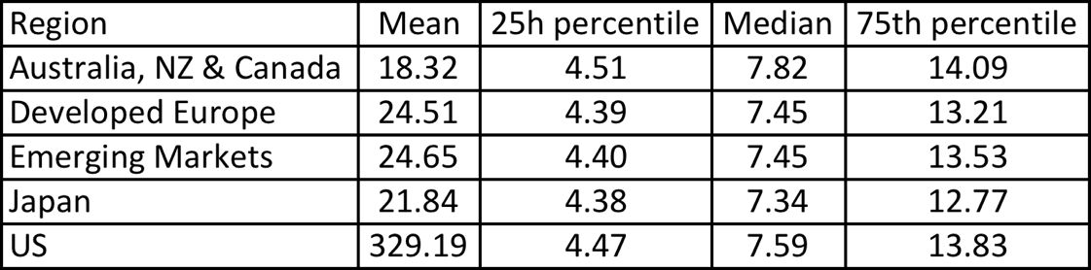
Enterprise Value/EBITDA
: Global Data
6
times
EBITDA
may
seem
like
a
good
rule
of
thumb..
Aswath Damodaran
82

Slide 84
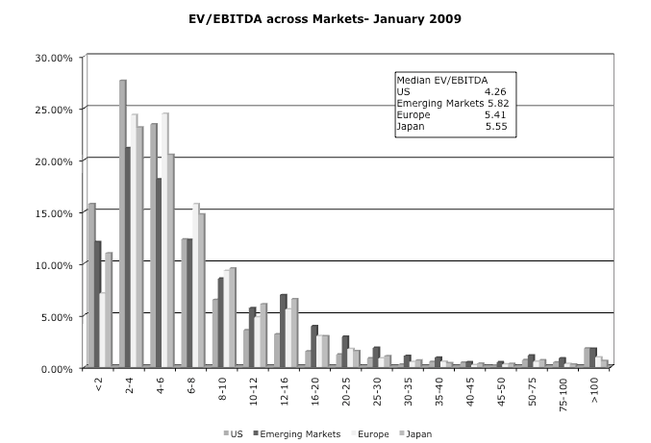
But
not
in
early
2009…"
Aswath Damodaran
83

Slide 85
The
Determinants of Value/EBITDA Multiples: Linkage
DCF Valuation
to
■
The value of the operating assets of a firm can be written as:
FCFF₁
EV₀ =
WACC - g
■
The numerator can be written as follows:
FCFF
= EBIT (1-t) - (Cex - Depr) -  Working Capital
= (EBITDA - Depr) (1-t) - (Cex - Depr) -  Working Capital
= EBITDA (1-t) + Depr (t) - Cex -  Working Capital
Aswath Damodaran
84

Slide 86
From Firm Value to EBITDA Multiples
■ Now the value of the firm can be rewritten as,
EV = EBITDA (1 - t) + Depr (t) - Cex - Δ Working Capital
WACC - g
■ Dividing both sides of the equation by EBITDA,
^{EV} = ^{(1 - t)} + ^{Depr (t)/EBITDA} - ^{CEx/EBITDA} - ^{Δ Working Capital/EBITDA}
EBITDA
WACC - g
WACC - g
WACC - g
WACC - g
■ Since Reinvestment = (CEx – Depreciation
determinants of EV/EBITDA are:
+
 Working
Capital), the
•
•
•
•
The cost of capital
Expected growth rate
Tax rate
Reinvestment rate (or ROC)
Aswath Damodaran
85

Slide 87
A Simple Example
■ Consider a firm with the following characteristics:
•
•
•
•
•
•
Tax Rate = 36%
Capital Expenditures/EBITDA = 30%
Depreciation/EBITDA = 20%
Cost of Capital = 10%
The firm has no working capital requirements
The firm is in stable growth and is expected to grow 5% a year forever.
Aswath Damodaran
86

Slide 88
Calculating Value/EBITDA Multiple
■ In this case, the Value/EBITDA multiple for this firm can be estimated as
follows:
Value (1 - .36) (0.2)(.36) 0.3 0
EBITDA .10 - .05 .10 - .05 .10 - .05 .10 - .05
=
+
-
-
=
8.24
Aswath Damodaran
87

Slide 89
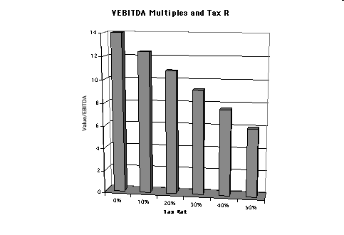
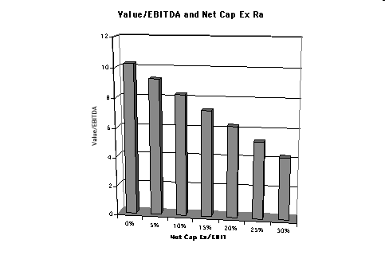
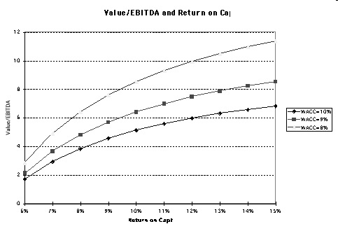
The
Determinants
of
EV/EBITDA
■
Tax
Rates
Reinvestment
Needs
Excess
Returns
Aswath Damodaran
88

Slide 90
Is this stock cheap?
■ Assume that I am trying to convince you to buy a company, because it trades
at 5 times EBITDA. What are some of the questions you would ask me as a
potential buyer?
■ Following through, what combination of fundamentals would make for a
cheap company on an EV/EBITDA basis:
•
•
•
•
Tax rate
Growth
Return on capital
Cost of capital/Risk
Aswath Damodaran
89

Slide 91
Value/EBITDA Multiple: Trucking
Companies:
Is
Ryder
cheap?
Company Name
Value
EBITDA
Value/EBITDA
KLLM Trans. Svcs.
$ 114.32
$ 48.81
2.34
Ryder System
$ 5,158.04
$ 1,838.26
2.81
Rollins Truck Leasing
$ 1,368.35
$ 447.67
3.06
Cannon Express Inc.
$ 83.57
$ 27.05
3.09
Hunt (J.B.)
$ 982.67
$ 310.22
3.17
Yellow Corp.
$ 931.47
$ 292.82
3.18
Roadway Express
$ 554.96
$ 169.38
3.28
Marten Transport Ltd.
$ 116.93
$ 35.62
3.28
Kenan Transport Co.
$ 67.66
$ 19.44
3.48
M.S. Carriers
$ 344.93
$ 97.85
3.53
Old Dominion Freight
$ 170.42
$ 45.13
3.78
Trimac Ltd
$ 661.18
$ 174.28
3.79
Matlack Systems
$ 112.42
$ 28.94
3.88
XTRA Corp.
$ 1,708.57
$ 427.30
4.00
Covenant Transport Inc
$ 259.16
$ 64.35
4.03
Builders Transport
$ 221.09
$ 51.44
4.30
Werner Enterprises
$ 844.39
$ 196.15
4.30
Landstar Sys.
$ 422.79
$ 95.20
4.44
AMERCO
$ 1,632.30
$ 345.78
4.72
USA Truck
$ 141.77
$ 29.93
4.74
Frozen Food Express
$ 164.17
$ 34.10
4.81
Arnold Inds.
$ 472.27
$ 96.88
4.87
Greyhound Lines Inc.
$ 437.71
$ 89.61
4.88
USFreightways
$ 983.86
$ 198.91
4.95
Golden Eagle Group Inc.
$ 12.50
$ 2.33
5.37
Arkansas Best
$ 578.78
$ 107.15
5.40
Airlease Ltd.
$ 73.64
$ 13.48
5.46
Celadon Group
$ 182.30
$ 32.72
5.57
Amer. Freightways
$ 716.15
$ 120.94
5.92
Transfinancial Holdings
$ 56.92
$ 8.79
6.47
Vitran Corp. 'A'
$ 140.68
$ 21.51
6.54
Interpool Inc.
$ 1,002.20
$ 151.18
6.63
Intrenet Inc.
$ 70.23
$ 10.38
6.77
Swift Transportation
$ 835.58
$ 121.34
6.89
Landair Services
$ 212.95
$ 30.38
7.01
CNF Transportation
$ 2,700.69
$ 366.99
7.36
Budget Group Inc
$ 1,247.30
$ 166.71
7.48
Caliber System
$ 2,514.99
$ 333.13
7.55
Knight Transportation Inc
$ 269.01
$ 28.20
9.54
Heartland Express
$ 727.50
$ 64.62
11.26
Greyhound CDA Transn Corp
$ 83.25
$ 6.99
11.91
Mark VII
$ 160.45
$ 12.96
12.38
Coach USA Inc
$ 678.38
$ 51.76
13.11
US 1 Inds Inc.
$ 5.60
$ (0. 17)
NA
Average
5. 61
Aswath Damodaran
90

Slide 92
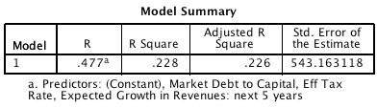
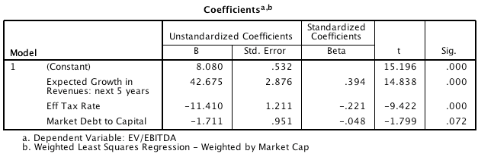
Extending to the market
US
Market:
January
2012
Aswath Damodaran
91

Slide 93
EBITDA
regressions across
markets…
January
2012
Region
Regression - January 2011
R squared
Europe
EV/EBITDA= 12.47 +0.02 Interest Coverage
Ratio - 11.50 Tax Rate -3.31 Reinvestment Rate
8.9%
Japan
EV/EBITDA= 3.70 -0.01 Interest Coverage
Ratio + 8.00 Tax Rate + 3.05 Reinvestment Rate
6.6%
Emerging
Markets
EV/EBITDA= 15.01 - 10.70 Tax Rate -3.04
Reinvestment Rate
2.2%
Aswath Damodaran
92

Slide 94
Price-Book Value Ratio: Definition
■ The price/book value ratio is the ratio of the market value of equity to the book
value of equity, i.e., the measure of shareholders’ equity in the balance sheet.
■ Price/Book Value =
Market Value of Equity
Book Value of Equity
■ Consistency Tests:
•
If the market value of equity refers to the market value of equity of common stock
outstanding, the book value of common equity should be used in the denominator.
If there is more that one class of common stock outstanding, the market values of
all classes (even the non-traded classes) needs to be factored in.
•
Aswath Damodaran
93

Slide 95
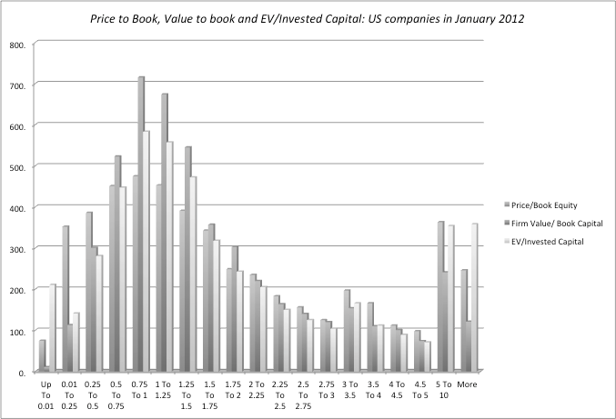
Book
Value
Multiples:
US
stocks
Aswath Damodaran
94

Slide 96
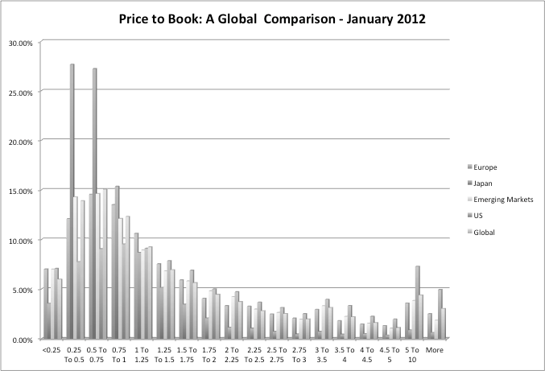
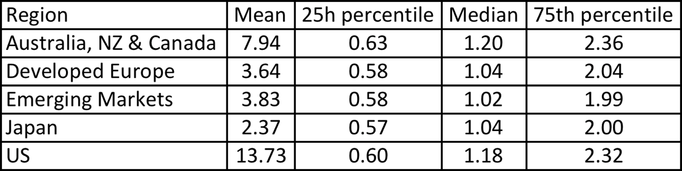
Price to
Book:
U.S.,
Europe, Japan and
Emerging
Markets
–
January
2012
Aswath Damodaran
95

Slide 97
Price Book Value Ratio: Stable Growth Firm
■ Going back to a simple dividend discount model,
DPS1
n
P 0 =
r − g
■ Defining the return on equity (ROE) = EPS₀ / Book Value of Equity, the value of equity can be written as:
^{BV} 0 ^{* ROE * Payout Ratio * (1 + g}n ⁾
r -g_{n}
^{P} 0 ⁼
^{P 0} = PBV = ROE * Payout Ratio * (1 + g n )
n
^{BV} 0
r-g
■ If the return on equity is based upon expected earnings in the next time period, this can
be simplified to,
^{P 0} = PBV = ^{ROE * Payout Ratio}
n
^{BV} 0
r-g
Aswath Damodaran
96

Slide 98
Price Book Value Ratio: Stable Growth Firm
Another Presentation
■ This formulation can be simplified even further by relating growth to the
return on equity:
g = (1 - Payout ratio) * ROE
■ Substituting back into the P/BV equation,
^{P0} = PBV = ^{ROE - gn}
n
BV₀
r-g
■ The price-book value ratio of a stable firm is determined by the differential
between the return on equity and the required rate of return on its projects.
Aswath Damodaran
97

Slide 99
Looking for undervalued securities - PBV Ratios and ROE
■ Given the relationship between price-book value ratios and returns on equity,
it is not surprising to see firms which have high returns on equity selling for well above book value and firms which have low returns on equity selling at or below book value.
■ The firms which should draw attention from investors are those which provide mismatches of price-book value ratios and returns on equity - low P/BV ratios and high ROE or high P/BV ratios and low ROE.
Aswath Damodaran
98

Slide 100
An Eyeballing Exercise:
European
Banks
in
2010
Name
PBV Ratio
Return on Equity
Standard Deviation
BAYERISCHE HYPO-UND VEREINSB
0.80
-1.66%
49.06%
COMMERZBANK AG
1.09
-6.72%
36.21%
DEUTSCHE BANK AG -REG
1.23
1.32%
35.79%
BANCA INTESA SPA
1.66
1.56%
34.14%
BNP PARIBAS
1.72
12.46%
31.03%
BANCO SANTANDER CENTRAL HISP
1.86
11.06%
28.36%
SANPAOLO IMI SPA
1.96
8.55%
26.64%
BANCO BILBAO VIZCAYA ARGENTA
1.98
11.17%
18.62%
SOCIETE GENERALE
2.04
9.71%
22.55%
ROYAL BANK OF SCOTLAND GROUP
2.09
20.22%
18.35%
HBOS PLC
2.15
22.45%
21.95%
BARCLAYS PLC
2.23
21.16%
20.73%
UNICREDITO ITALIANO SPA
2.30
14.86%
13.79%
KREDIETBANK SA LUXEMBOURGEOI
2.46
17.74%
12.38%
ERSTE BANK DER OESTER SPARK
2.53
10.28%
21.91%
STANDARD CHARTERED PLC
2.59
20.18%
19.93%
HSBC HOLDINGS PLC
2.94
18.50%
19.66%
LLOYDS TSB GROUP PLC
3.33
32.84%
18.66%
Average
2.05
12.54%
24.99%
Median
2.07
11.82%
21.93%
Aswath Damodaran
99

Slide 101
The median test…
■ We are looking for stocks that trade at low price to book ratios, while
generating high returns on equity, with low risk. But what is a low price to
book ratio? Or a high return on equity? Or a low risk
■ One simple measure of what is par for the sector are the median values for
each of the variables. A simplistic decision rule on under and over valued
stocks would therefore be:
•
Undervalued stocks: Trade at price to book ratios below the median for the sector,
(2.05), generate returns on equity higher than the sector median (11.82%) and have
standard deviations lower than the median (21.93%).
•
Overvalued stocks: Trade at price to book ratios above the median for the sector
and generate returns on equity lower than the sector median.
Aswath Damodaran
100

Slide 102
How about this mechanism?
■ We are looking for stocks that trade at low price to book ratios, while
generating high returns on equity. But what is a low price to book ratio? Or a
high return on equity?
■ Taking the sample of 18 banks, we ran a regression of PBV against ROE and standard deviation in stock prices (as a proxy for risk).
PBV =
2.27
(5.56)
+
3.63 ROE
(3.32)
-
2.68 Std dev
(2.33)
R squared of
regression = 79%
Aswath Damodaran
101

Slide 103
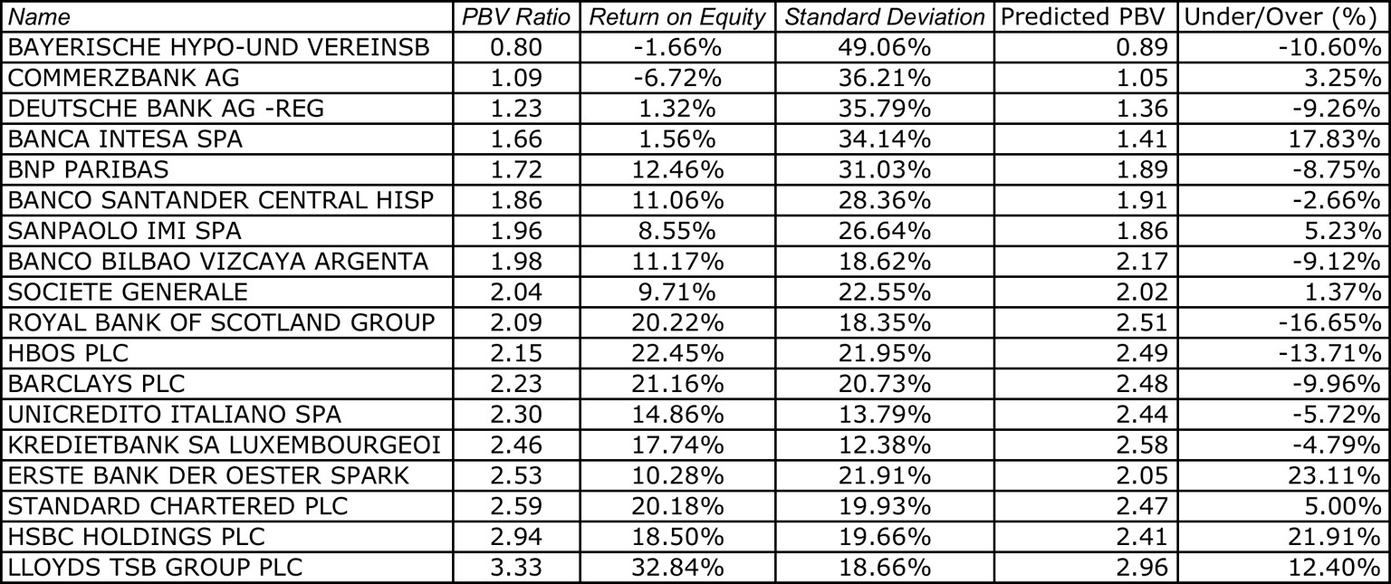
And
these
predictions?
Aswath Damodaran
102

Slide 104


The
Valuation
Matrix
MV/BV
Overvalued Low ROE High MV/BV
High ROE
ROE-r
High MV/BV
Low ROE Low MV/BV
Undervalued
Low MV/BV
High ROE
Aswath Damodaran
103

Slide 105
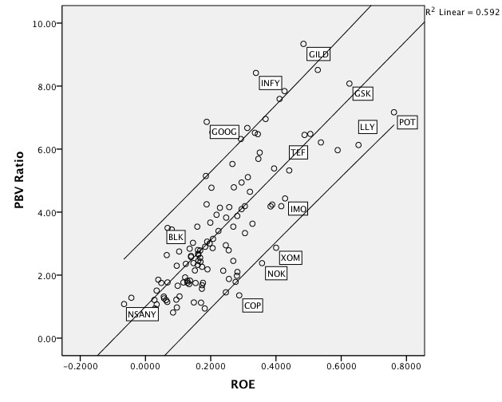
Price
to
Book vs ROE: Largest Market Cap
Firms
in
the
United
States:
January
2010
Aswath Damodaran
104

Slide 106
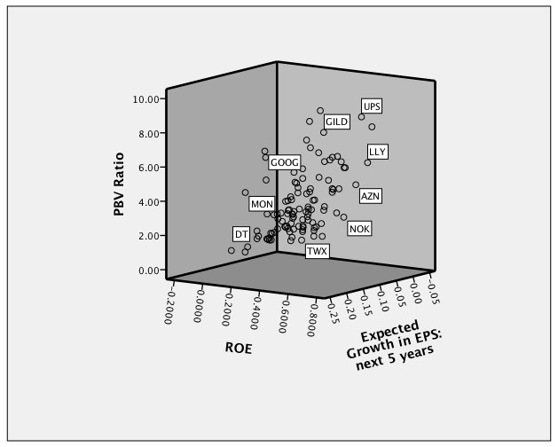
What
are
we
missing?
Aswath Damodaran
105

Slide 107
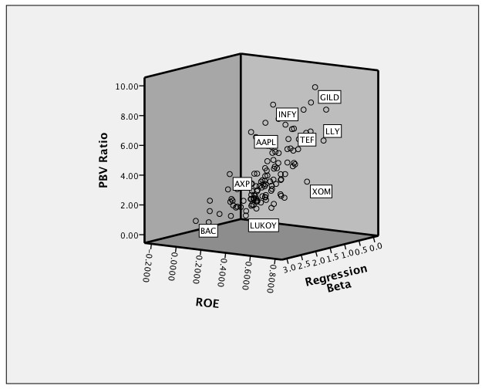
What else are
we missing?
PBV,
ROE
and
Risk:
Large
Cap
US
firms
Cheapest
Aswath Damodaran
106

Slide 108
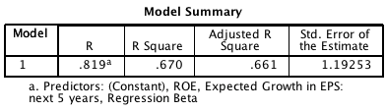
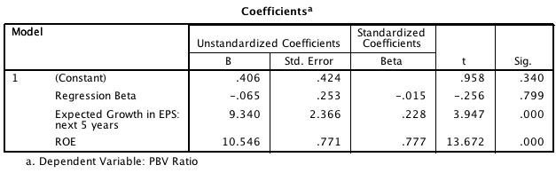
Bringing
it
all
together…
Largest
US
stocks
Aswath Damodaran
107

Slide 109
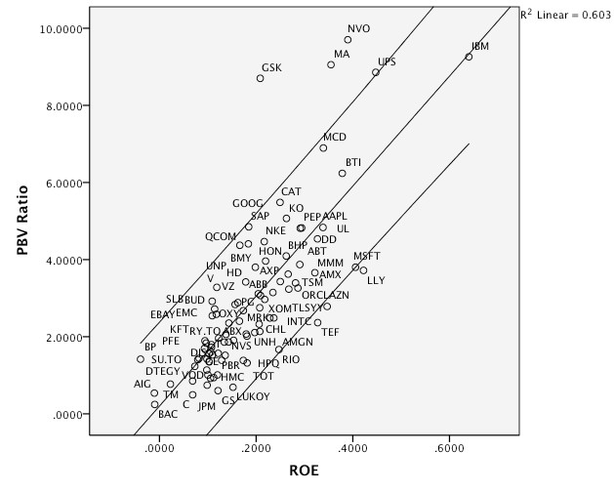
PBV
Ratios
–
Largest
Market Cap
2012
US
companies
in
January
Aswath Damodaran
108

Slide 110
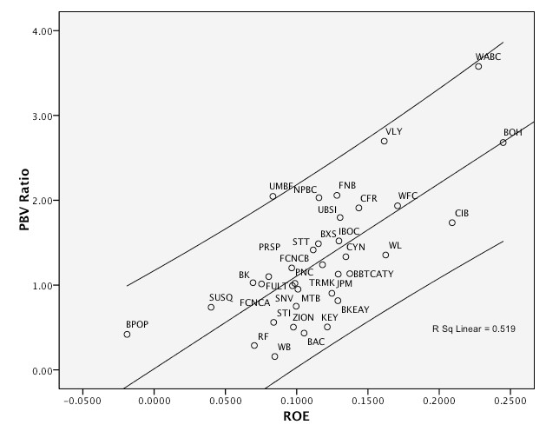
Even in chaos, there is order…
US
Banks
(Mkt
cap>
$
1
billion)
in
January
2009
Aswath Damodaran
109

Slide 111
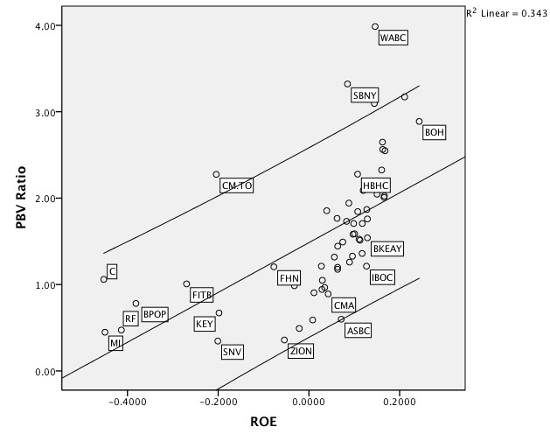
In
January
2010…
Another
look
at
US
Banks
Aswath Damodaran
110

Slide 112
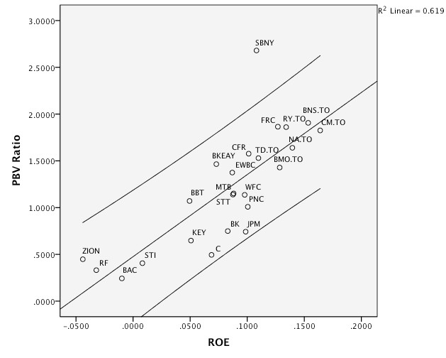
Banks
again..
In
January
2012
Aswath Damodaran
111

Slide 113
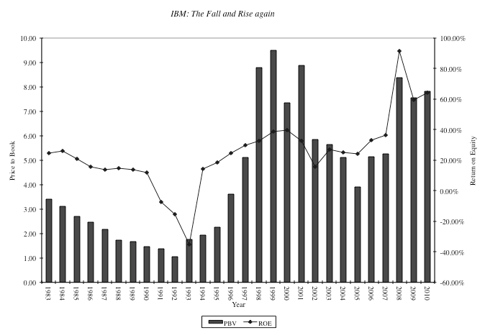
IBM:
The Rise and Fall and Rise
Again
PBV
vs
ROE:
1983-2010
Aswath Damodaran
112

Slide 114
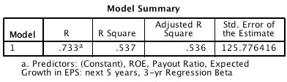

PBV
Ratio Regression:
US
January
2012
Aswath Damodaran
113

Slide 115
PBV
Ratio
Regression- Other
Markets
January
2012
Region
Regression - January 2012
R squared
Australia, NZ & Canada
PBV = 0.90 + 0.92 Payout – 0.18 Beta + 5.43 ROE
38.6%
Europe
PBV = 1.14 + 0.76 Payout – 0.67 Beta + 7.56 ROE
47.2%
Japan
PBV = 1.21 + 0.67 Payout – 0.40 Beta + 3.26 ROE
22.1%
Emerging
Markets
PBV = 0.77 + 1.16 Payout – 0.17 Beta + 5.78 ROE
20.8%
Aswath Damodaran
114

Slide 116
Value/Book Value Ratio: Definition
■ While the price to book ratio is a equity multiple, both the market value and
the book value can be stated in terms of the firm.
■ Value/Book Value = Market Value of Equity + Market Value of Debt
Book Value of Equity + Book Value of Debt
Aswath Damodaran
115

Slide 117
Determinants of Value/Book Ratios
■ To see the determinants of the value/book ratio, consider the simple free cash
flow to the firm model:
FCFF₁
V₀ =
WACC - g
■ Dividing both sides by the book value, we get:
^{V0} = ^{FCFF1 /BV}
BV
WACC - g
■ If we replace, FCFF = EBIT(1-t) - (g/ROC) EBIT(1-t),we get
^{V0} = ^{ROC - g}
BV
WACC - g
Aswath Damodaran
116

Slide 118
Value/Book Ratio: An Example
■ Consider a stable growth firm with the following characteristics:
•
•
•
Return on Capital = 12%
Cost of Capital = 10% Expected Growth = 5%
■ The value/BV ratio for this firm can be estimated as follows:
Value/BV = (.12 - .05)/(.10 - .05) = 1.40
■ The effects of ROC on growth will increase if the firm has a high growth phase, but the basic determinants will remain unchanged.
Aswath Damodaran
117

Slide 119

Value/Book
and
the
Return
Spread
Aswath Damodaran
118

Slide 120


EV/
Invested
Capital
Regression
-
US
-
January
2012
Aswath Damodaran
119

Slide 121
Price Sales Ratio: Definition
■ The price/sales ratio is the ratio of the market value of equity to the sales.
Market value of equity
Revenues
■ Price/ Sales=
■ Consistency Tests
•
The price/sales ratio is internally inconsistent, since the market value of equity is
divided by the total revenues of the firm.
Aswath Damodaran
120

Slide 122

Revenue
Multiples:
US
stocks
Aswath Damodaran
121

Slide 123
Price/Sales Ratio: Determinants
■ The price/sales ratio of a stable growth firm can be estimated beginning with a
2-stage equity valuation model:
^{DPS}1
n
P 0 =
r − g
■ Dividing both sides by the sales per share:
P₀ Net Profit Margin * Payout Ratio * (1 + g _{n} )
Sales0 r-g
=
PS =
n
Aswath Damodaran
122

Slide 124
Price/Sales Ratio for High Growth Firm
■ When the growth rate is assumed to be high for a future period, the dividend
discount model can be written as follows:
" (1 + g)^{n} %
# (1 + r) ^{n} & EPS₀ * Payout Ratio _{n} * (1 + g )^{n} *(1+ g _{n} )
n
EPS0 * Payout Ratio * (1 + g) * $1 −
'
P 0 =
r - g
+
( r - g
)(1 + r) ^{n}
■ Dividing both sides by the sales per share:
' " (1 + g) ^{n} % *
P₀ ₌ ⁾ # (1 + r) & ₊ Net Margin_{n} * Payout Ratio _{n} * (1 + g) * (1 + g_{n} ) ,
) ,
Net Margin * Payout Ratio * (1 + g) * $1 −
n
n
Sales₀
)
r - g
n
,
(r - g_{n} )(1 + r)
(
+
where Net Marginn = Net Margin in stable growth phase
Aswath Damodaran
123

Slide 125
Price Sales Ratios and Profit Margins
■ The key determinant of price-sales ratios is the profit margin.
■ A decline in profit margins has a two-fold effect.
•
•
First, the reduction in profit margins reduces the price-sales ratio directly.
Second, the lower profit margin can lead to lower growth and hence lower price- sales ratios.
Expected growth rate
= Retention ratio * Return on Equity
= Retention Ratio *(Net Profit / Sales) * ( Sales / BV of Equity)
= Retention Ratio * Profit Margin * Sales/BV of Equity
Aswath Damodaran
124

Slide 126
Price/Sales Ratio: An Example
High Growth Phase
5 years
10%
2.5
1.25
20% (.1)(2.5)(.8)=20%
Stable Growth
Forever after year 5
6%
2.5
1.00
60% (.06)(2.5)(.4)=.06
Length of Period
Net Margin
Sales/BV of Equity
Beta
Payout Ratio
Expected Growth
Riskless Rate =6%
' " (1.20)⁵ % *
⁾ # (1.12875)⁵ & 0.06 * 0.60 * (1.20) ⁵ * (1.06) ,
⁾ (.12875 - .20) (.115 - .06) (1.12875) ^{5 ,}
) ,
0.10 * 0.2
*
(1.20)
*
$1 −
PS =
+
=
1.06
(
+
Aswath Damodaran
125

Slide 127







Effect
of
Margin
Changes
Price/Sales Ratios and Net Margins
1.8
1.6
1.4
1.2
1
0.8
0.6
0.4
0.2
0
2% 4% 6% 8% 10% 12% 14% 16% Net Margin
PS Ratio
Aswath Damodaran
126

Slide 128
Price
to
Sales
Multiples:
Grocery
2007
Stores
-
US
in
January
1 .6
WF MI
ARD
WMK
AHO
PTMK
MARSA
1 .4
1 .2
1 .0
.8
.6
O ATS
S WY ^{R DK}
.4
.2
0 .0
PS_RATIO
-.2
-3
-2
-1
0 1
2
3 4
5
R sq = 0.5947
Net
Mar gin
Whole Foods: In
2007: Net Margin was 3.41% and Price/ Sales ratio was 1.41
Predicted Price to Sales = 0.07 + 10.49 (0.0341) = 0.43
Aswath Damodaran
127

Slide 129

Reversion
to
normalcy:
Grocery
Stores
-
US
in
January
2009
Whole Foods: In 2009, Net Margin had dropped to 2.77% and Price to Sales ratio was
down to 0.31.
Predicted Price to Sales = 0.07 + 10.49 (.0277) = 0.36
Aswath Damodaran
128

Slide 130

And
again
in
2010..
Whole Foods: In 2010, Net Margin had dropped to 1.44% and Price to Sales ratio increased to 0.50.
Predicted Price to Sales = 0.06 + 11.43 (.0144) = 0.22
Aswath Damodaran
129

Slide 131

Here
is
2011…
PS Ratio= - 0.585 + 55.50 (Net Margin)
R²= 48.2%
PS Ratio for WFMI = -0.585 + 55.50 (.0273) = 0.93
At a PS ratio of 0.98, WFMI is slightly over valued.
Aswath Damodaran
130

Slide 132
Current versus Predicted Margins
■
One of the limitations of the analysis we did in these last few pages is the
focus on current margins. Stocks are priced based upon expected margins
rather than current margins.
For most firms, current margins and predicted margins are highly correlated, making the analysis still relevant.
For firms where current margins have little or no correlation with expected margins, regressions of price to sales ratios against current margins (or price to book against current return on equity) will not provide much explanatory power.
In these cases, it makes more sense to run the regression using either predicted margins or some proxy for predicted margins.
■
■
■
Aswath Damodaran
131

Slide 133
A
Case
Study:
Internet
Stocks in
January
2000
30
PKSI
20
LCOS
SPYG
INTM
SCNT
MMXI
A
d j P S
MQST CNET
FFIV
ATHM
RAMP
DCLK
10
INTW
CSGP
CBIS
NTPA
NETO
SONE
APNT
CLKS
P
CLN
R
AMZN
SPLN
EDG
PSIX
BIDS
ALOY
ATHY
ACOM
BIZZ
IIXL
ITRA
EGRP
ONEM
RM
ABTL
INFO
TMNT
ANET
FATB
II
TURF
GSVI
BUYX
GEEK
ELTX
-0
PPOD
ROWE
-0.8
-0.6
AdjMargin
-0.4
-0.2
Aswath Damodaran
132

Slide 134
PS Ratios and Margins are not highly correlated
■ Regressing PS ratios against current margins yields the following
- 7.54(Net Margin) R² = 0.04
(0.49)
■ This is not surprising. These firms are priced based upon expected margins,
rather than current margins. Consequently, there is little relationship between
current margins and market values.
PS = 81.36
Aswath Damodaran
133

Slide 135
Solution 1: Use proxies for survival and growth: Amazon in
early 2000
■ Hypothesizing that firms with higher revenue growth and higher cash balances
should have a greater chance of surviving and becoming profitable, we ran the
following regression: (The level of revenues was used to control for size)
PS = 30.61 - 2.77 ln(Rev) + 6.42 (Rev Growth) + 5.11 (Cash/Rev)
(0.66)
R squared = 31.8%
(2.63)
(3.49)
Predicted PS = 30.61 - 2.77(7.1039) + 6.42(1.9946) + 5.11 (.3069) = 30.42
Actual PS = 25.63
Amazon is undervalued, relative to other internet stocks.
Aswath Damodaran
134

Slide 136
Solution 2: Use forward multiples
■ You can always estimate price (or value) as a multiple of revenues, earnings or
book value in a future year. These multiples are called forward multiples.
■ For young and evolving firms, the values of fundamentals in future years may provide a much better picture of the true value potential of the firm. There are two ways in which you can use forward multiples:
•
Look at value today as a multiple of revenues or earnings in the future (say 5 years
from now) for all firms in the comparable firm list. Use the average of this multiple in conjunction with your firm’s earnings or revenues to estimate the value of your firm today.
Estimate value as a multiple of current revenues or earnings for more mature firms in the group and apply this multiple to the forward earnings or revenues to the forward earnings for your firm. This will yield the expected value for your firm in the forward year and will have to be discounted back to the present to get current value.
•
Aswath Damodaran
135

Slide 137
An Example
of Forward Multiples: Global Crossing
■
Global Crossing,
continue to lose
Global Crossing,
$ 1,371 million.
a distressed telecom firm, lost $1.9 billion in 2001 and is expected to
money for the next 3 years. In a discounted cashflow valuation of
we estimated an expected EBITDA for Global Crossing in five years of
■
The average enterprise value/ EBITDA multiple for healthy telecomm firms is 7.2
currently.
Applying this multiple to Global Crossing’s EBITDA in year 5, yields a value in year 5
of
• Enterprise Value in year 5 = 1371 * 7.2 = $9,871 million
• Enterprise Value today = $ 9,871 million/ 1.138⁵ = $5,172 million
This enterprise value does not fully reflect the possibility that Global Crossing will not make it as a going concern.
■
■
•
Based on the price of traded bonds issued by Global Crossing, the probability that Global
Crossing will not make it as a going concern is 77% and the distress sale value is only a $ 1
billion (1/2 of book value of assets).
Adjusted Enterprise value = 5172 * .23 + 1000 (.77) = 1,960 million
•
Aswath Damodaran
136

Slide 138


PS
Regression:
United
States
-
January
2012
Aswath Damodaran
137

Slide 139
EV/Sales Ratio: Definition
■ The value/sales ratio is the ratio of the market value of the firm to the sales.
■ EV/ Sales=
Market Value of Equity + Market Value of Debt-Cash
Total Revenues
Aswath Damodaran
138

Slide 140


EV
Sales
across
markets
Aswath Damodaran
139

Slide 141
EV/Sales Ratios: Analysis of Determinants
■ If pre-tax operating margins are used, the appropriate value estimate is that of
the firm. In particular, if one makes the assumption that
•
Free Cash Flow to the Firm = EBIT (1 - tax rate) (1 - Reinvestment Rate)
■ Then the Value of the Firm can be written as a function of the after-tax
operating margin= (EBIT (1-t)/Sales
⁽ " (1 + g) ^{n} % ⁺
Value # (1 + WACC) ^{n} & (1 - RIR )(1 + g)^{n} * (1 + g )
n
* -
*^{(1 - RIR}growth^{)(1 + g) *} $¹ ⁻
= After - tax Oper. Margin * *
'
-
n -
^{Sales} 0
*
)
WACC - g
+
stable
-
,
^{(WACC - g} n ^{)(1 + WACC)}
g = Growth rate in after-tax operating income for the first n years
g_{n} = Growth rate in after-tax operating income after n years forever (Stable growth rate)
RIRGrowth, Stable
= Reinvestment rate in high growth and stable periods
WACC = Weighted average cost of capital
Aswath Damodaran
140

Slide 142
EV/Sales Ratio: An Example with Coca Cola
■ Consider, for example, the Value/Sales ratio of Coca Cola. The company had
the following characteristics:
After-tax Operating Margin =18.56% Sales/BV of Capital = 1.67
Return on Capital = 1.67* 18.56% = 31.02%
Reinvestment Rate= 65.00% in high growth; 20% in stable growth;
Expected Growth = 31.02% * 0.65 =20.16%
Length of High Growth Period = 10 years
(Stable Growth Rate=6%)
Cost of Equity
=12.33%
E/(D+E) = 97.65%
After-tax Cost of Debt = 4.16%
D/(D+E)
2.35%
Cost of Capital= 12.33% (.9765)+4.16% (.0235) =12.13%
10
* $ ₁₀ ' ₁₀ -
Sales ₀ * .1213 - .2016 (.1213 - .06)(1.1213)¹⁰ -
) ,
( " %
(1 - .65)(1.2016) * 1 − ^{(1.2016)}
+
(1 - .20)(1.2016) * (1.06) ₋
^{Value of Firm} 0
_{= .1856 *} * # (1.1213) &
+
= 6.10
*
-
Aswath Damodaran
141

Slide 143

EV/Sales
Ratios
and
Operating
Margins
Aswath Damodaran
142

Slide 144
Brand Name Premiums in Valuation
■ You have been hired to value Coca Cola for an analyst reports and you have
valued the firm at 6.10 times revenues, using the model described in the last few pages. Another analyst is arguing that there should be a premium added on to reflect the value of the brand name. Do you agree?
□ Yes
□ No
■ Explain.
Aswath Damodaran
143

Slide 145
The value of a brand name
■ One of the critiques of traditional valuation is that is fails to consider the value
of brand names and other intangibles.
■ The approaches used by analysts to value brand names are often ad-hoc and may significantly overstate or understate their value.
■ One of the benefits of having a well-known and respected brand name is that
firms can charge higher prices for the same products, leading to higher profit
margins and hence to higher price-sales ratios and firm value. The larger the
price premium that a firm can charge, the greater is the value of the brand
name.
■ In general, the value of a brand name can be written as:
Value of brand name ={(V/S)_{b}-(V/S)_{g} }* Sales
(V/S)_{b} = Value of Firm/Sales ratio with the benefit of the brand name
(V/S)g = Value of Firm/Sales ratio of the firm with the generic product
Aswath Damodaran
144

Slide 146
Valuing Brand
Name
Coca Cola
$21,962.00
10
50%
15.57%
1.34
20.84%
10.42%
7.65%
With Cott Margins
$21,962.00
10
50%
5.28%
1.34
7.06%
3.53%
7.65%
Current Revenues =
Length of high-growth period
Reinvestment Rate =
Operating Margin (after-tax)
Sales/Capital (Turnover ratio)
Return on capital (after-tax)
Growth rate during period (g) =
Cost of Capital during period
Stable Growth Period
Growth rate in steady state =
Return on capital =
Reinvestment Rate =
Cost of Capital =
Value of Firm =
=
4.00%
7.65%
52.28%
7.65%
$79,611.25
4.00%
7.65%
52.28%
7.65%
$15,371.24
Value of brand name = $79,611 -$15,371 = $64,240 million
Aswath Damodaran
145

Slide 147
More on brand name value…
■
When we use the difference in margins to value brand name, we are assuming
that the difference in margins is entirely due to brand name and that it affects nothing else (cost of capital, for instance) . To the extent that this is not the case, we may be under or over valuing brand name.
In which of these companies do you think valuing brand name will be easiest to do and which of them will it be hardest?
Kelloggs
Sony
Goldman Sachs
Apple
■
□
□
□
□
Explain.
Aswath Damodaran
146

Slide 148




EV/Sales
Ratio
Regression:
US
in
January
2012
Aswath Damodaran
147

Slide 149
EV/Sales
Regressions
across
markets…
Region
Regression - January 2011
R Squared
Europe
EV/Sales =2.28 - 0.01 Interest Coverage Ratio + 6.47
Operating Margin –3.70 Tax Rate -0.67 Reinvestment
Rate
49.8%
Japan
EV/Sales =1.01 + 5.31Operating Margin
18.9%
Emerging
Markets
EV/Sales = 1.67 - 2.70 Tax rate + 8.25 Operating
Margin - 0.002 Interest Coverage Ratio -0.29
Reinvestment Rate
31.7%
Aswath Damodaran
148

Slide 150
Choosing Between the Multiples
■ As presented in this section, there are dozens of multiples that can be
potentially used to value an individual firm.
■ In addition, relative valuation can be relative to a sector (or comparable firms)
or to the entire market (using the regressions, for instance)
■ Since there can be only one final estimate of value, there are three choices at this stage:
•
Use a simple average of the valuations obtained using a number of different
multiples
Use a weighted average of the valuations obtained using a nmber of different multiples
Choose one of the multiples and base your valuation on that multiple
•
•
Aswath Damodaran
149

Slide 151
Averaging Across Multiples
■ This procedure involves valuing a firm using five or six or more multiples and
then taking an average of the valuations across these multiples.
■ This is completely inappropriate since it averages good estimates with poor ones equally.
■ If some of the multiples are “sector based” and some are “market based”, this will also average across two different ways of thinking about relative
valuation.
Aswath Damodaran
150

Slide 152
Weighted Averaging Across Multiples
■ In this approach, the estimates obtained from using different multiples are
averaged, with weights on each based upon the precision of each estimate. The more precise estimates are weighted more and the less precise ones weighted less.
■ The precision of each estimate can be estimated fairly simply for those estimated based upon regressions as follows:
Precision of Estimate = 1 / Standard Error of Estimate
where the standard error of the predicted value is used in the denominator.
■ This approach is more difficult to use when some of the estimates are subjective and some are based upon more quantitative techniques.
Aswath Damodaran
151

Slide 153
Picking one Multiple
■ This is usually the best way to approach this issue. While a range of values can
be obtained from a number of multiples, the “best estimate” value is obtained
using one multiple.
■ The multiple that is used can be chosen in one of two ways:
•
Use the multiple that best fits your objective. Thus, if you want the company to be
undervalued, you pick the multiple that yields the highest value.
Use the multiple that has the highest R-squared in the sector when regressed against
•
fundamentals. Thus, if you have tried PE, PBV, PS, etc. and run regressions of
these multiples against fundamentals, use the multiple that works best at explaining differences across firms in that sector.
Use the multiple that seems to make the most sense for that sector, given how value
•
is measured and created.
Aswath Damodaran
152

Slide 154
Self Serving … But all too common
■
When a firm is valued using several multiples, some will yield really high
values and some really low ones.
If there is a significant bias in the valuation towards high or low values, it is tempting to pick the multiple that best reflects this bias. Once the multiple that works best is picked, the other multiples can be abandoned and never brought up.
This approach, while yielding very biased and often absurd valuations, may serve other purposes very well.
As a user of valuations, it is always important to look at the biases of the entity doing the valuation, and asking some questions:
■
■
■
•
•
Why was this multiple chosen?
What would the value be if a different multiple were used? (You pick the specific multiple that you want to see tried.)
Aswath Damodaran
153

Slide 155
The Statistical Approach
■ One of the advantages of running regressions of multiples against
fundamentals across firms in a sector is that you get R-squared values on the regression (that provide information on how well fundamentals explain differences across multiples in that sector).
■ As a rule, it is dangerous to use multiples where valuation fundamentals (cash flows, risk and growth) do not explain a significant portion of the differences across firms in the sector.
■ As a caveat, however, it is not necessarily true that the multiple that has the highest R-squared provides the best estimate of value for firms in a sector.
Aswath Damodaran
154

Slide 156
A More Intuitive Approach
■ Managers in every sector tend to focus on specific variables when analyzing
strategy and performance. The multiple used will generally reflect this focus.
Consider three examples.
•
In retailing: The focus is usually on same store sales (turnover) and profit margins.
Not surprisingly, the revenue multiple is most common in this sector.
In financial services: The emphasis is usually on return on equity. Book Equity is often viewed as a scarce resource, since capital ratios are based upon it. Price to book ratios dominate.
In technology: Growth is usually the dominant theme. PEG ratios were invented in this sector.
•
•
Aswath Damodaran
155

Slide 157
Sector or Market Multiples
■ The conventional approach to using multiples is to look at the sector or
comparable firms.
■ Whether sector or market based multiples make the most sense depends upon how you think the market makes mistakes in valuation
•
If you think that markets make mistakes on individual firm valuations but that
valuations tend to be right, on average, at the sector level, you will use sector-based valuation only,
If you think that markets make mistakes on entire sectors, but is generally right on the overall market level, you will use only market-based valuation
•
■ It is usually a good idea to approach the valuation at two levels:
•
At the sector level, use multiples to see if the firm is under or over valued at the
sector level
At the market level, check to see if the under or over valuation persists once you correct for sector under or over valuation.
•
Aswath Damodaran
156

Slide 158
Relative versus Intrinsic Value
■ If you do intrinsic value right, you will bring in a company’s risk, cash flow
and growth characteristics into the inputs, preserve internal consistency and derive intrinsic value. If you do relative value right, you will find the right set of comparables, control well for differences in risk, cash flow and growth characteristics. Assume you value the same company doing both DCF and relative valuation correctly, should you get the same value?
a) Yes
b) No
■ If not, how would you explain the difference?
■ If the numbers are different, which value would you use?
a)
b) c) d) e) f)
Intrinsic value
Relative value
A composite of the two values
The higher of the two values
The lower of the two values
Depends on what my valuation “mission” is.
Aswath Damodaran
157

Slide 159
Conventional
usage…
Sector
Multiple Used
Rationale
Cyclical Manufacturing
PE, Relative PE
Often with normalized earnings
Growth firms
PEG ratio
Big differences in growth rates
Young growth firms w/
losses
Revenue Multiples
What choice do you have?
Infrastructure
EV/EBITDA
Early losses, big DA
REIT
P/CFE (where CFE = Net income + Depreciation)
Big depreciation charges on real estate
Financial Services
Price/ Book equity
Marked to market?
Retailing
Revenue multiples
Margins equalize sooner or later
Aswath Damodaran
158

Slide 160
SEKIAN
DAN
TERIMA KASIH

