Slide 1
Ema 501
Pengembangan dan pemberdayaan sdm

Slide 2
motivasi

Slide 3
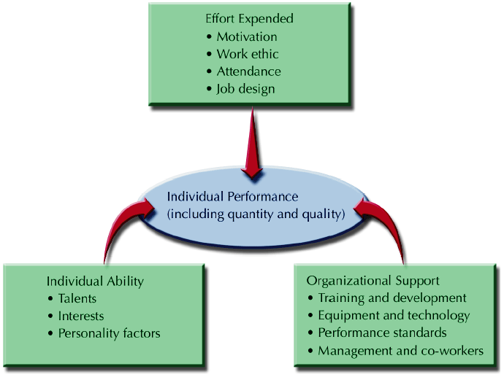
Faktor yang mempegaruhi KINerja (performance)
Tahun | Pendapatan Nasional (milyar Rupiah)
1990 1991 1992 1993 1994 1995 1996 1997 | 590,6 612,7 630,8 645 667,9 702,3 801,3 815,7

Slide 4
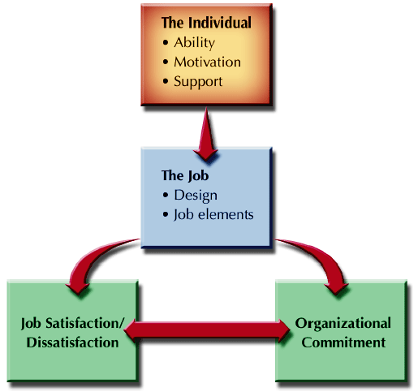
Kaitan motivasi-pengembangan-pemberdayaan
Tahun | Pendapatan Nasional (milyar Rupiah)
1990 1991 1992 1993 1994 1995 1996 1997 | 590,6 612,7 630,8 645 667,9 702,3 801,3 815,7

Slide 5
Definisi motif
dorongan kebutuhan dalam diri pegawai yang perlu dipenuhi agar pegawai tersebut dapat menyesuaikan dirinya dengan lingkungannya
Tahun | Pendapatan Nasional (milyar Rupiah)
1990 1991 1992 1993 1994 1995 1996 1997 | 590,6 612,7 630,8 645 667,9 702,3 801,3 815,7

Slide 6
Definisi motivasi
keadaan kejiwaan dan sikap mental manusia yang memberikan dorongan, atau gerakan yang mengarahkan danmenyalurkan perilaku ke arah pencapaian kebnutuhan yang memberikankepuasan atau mengurangi ketidakseimbangan (Berelson dan Steiner).
Tahun | Pendapatan Nasional (milyar Rupiah)
1990 1991 1992 1993 1994 1995 1996 1997 | 590,6 612,7 630,8 645 667,9 702,3 801,3 815,7

Slide 7
motivasi
Motivation
The intensity of a person’s desire to engage in some activity.
Extrinsic motivation
When a person works hard at a task because of the promise that some tangible reward will be given if the job is done well
Intrinsic motivation
When a person performs a task in the absence of any tangible reward
Tahun | Pendapatan Nasional (milyar Rupiah)
1990 1991 1992 1993 1994 1995 1996 1997 | 590,6 612,7 630,8 645 667,9 702,3 801,3 815,7

Slide 8
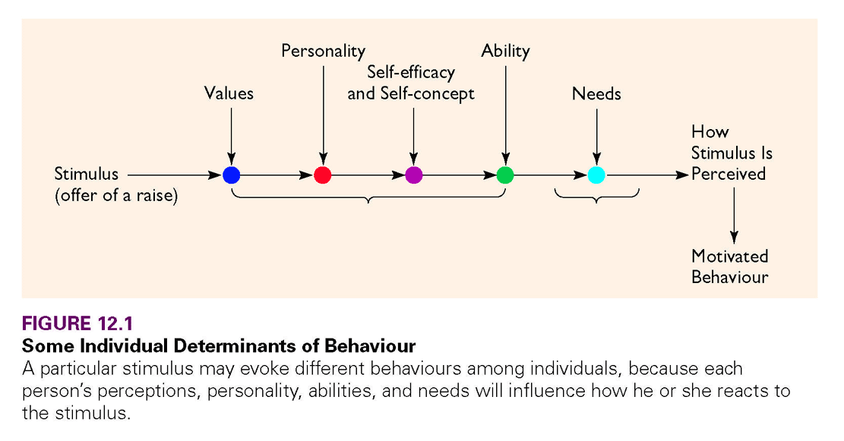
Stimulus motivasi
Tahun | Pendapatan Nasional (milyar Rupiah)
1990 1991 1992 1993 1994 1995 1996 1997 | 590,6 612,7 630,8 645 667,9 702,3 801,3 815,7

Slide 9
Teori motivasi
Incentives
Financial rewards paid to workers whose production exceeds a predetermined standard.
Frederick Taylor
Popularized scientific management and the use of financial incentives in the late 1800s.
Systematic soldiering: the tendency of employees to work at the slowest pace possible and to produce at the minimum acceptable level.
Tahun | Pendapatan Nasional (milyar Rupiah)
1990 1991 1992 1993 1994 1995 1996 1997 | 590,6 612,7 630,8 645 667,9 702,3 801,3 815,7

Slide 10
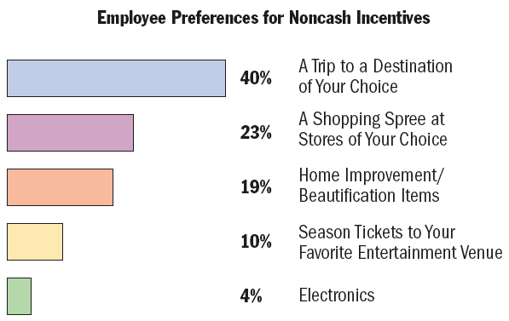
Teori motivasi taylor masih berlaku???
Tahun | Pendapatan Nasional (milyar Rupiah)
1990 1991 1992 1993 1994 1995 1996 1997 | 590,6 612,7 630,8 645 667,9 702,3 801,3 815,7

Slide 11
Teori motivasi
Maslow’s Hierarchy of Needs
Categories of needs that ascend in order; lower needs must be fulfilled before person will strive to meet higher needs.
Physiological needs
Safety and security needs
Belonging and love needs
Esteem needs
Self-actualization needs
Tahun | Pendapatan Nasional (milyar Rupiah)
1990 1991 1992 1993 1994 1995 1996 1997 | 590,6 612,7 630,8 645 667,9 702,3 801,3 815,7

Slide 12
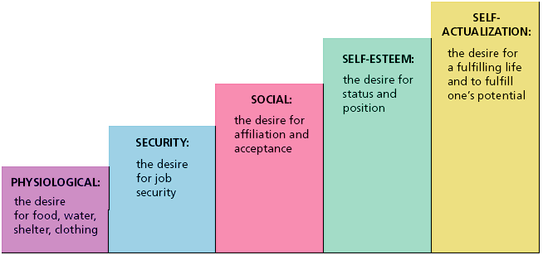
Teori motivasi
Tahun | Pendapatan Nasional (milyar Rupiah)
1990 1991 1992 1993 1994 1995 1996 1997 | 590,6 612,7 630,8 645 667,9 702,3 801,3 815,7

Slide 13
Teori motivasi
Herzberg’s Motivation/Hygiene Theory
Motivators—account for job satisfaction and motivation
Achievement • Recognition • Work itself
Responsibility • Advancement
Hygiene factors—cause dissatisfaction with work
Interpersonal relationships
Company policy/administration
Supervision • Salary • Working conditions
Tahun | Pendapatan Nasional (milyar Rupiah)
1990 1991 1992 1993 1994 1995 1996 1997 | 590,6 612,7 630,8 645 667,9 702,3 801,3 815,7

Slide 14
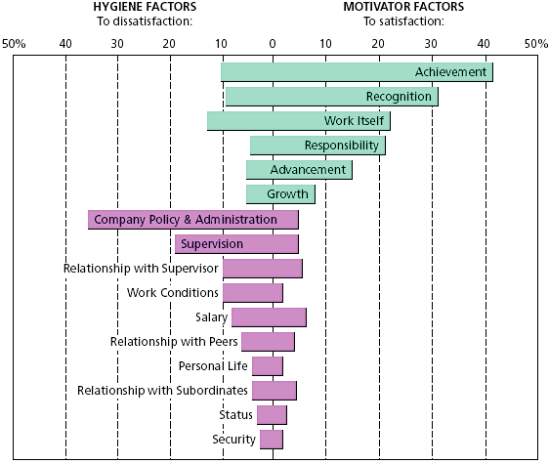
Tahun | Pendapatan Nasional (milyar Rupiah)
1990 1991 1992 1993 1994 1995 1996 1997 | 590,6 612,7 630,8 645 667,9 702,3 801,3 815,7

Slide 15
Teori motivasi
Edward Deci
Intrinsically motivated behaviors are motivated by the underlying need for competence and self-determination.
Offering an extrinsic reward for an intrinsically-motivated act can conflict with the acting individual’s internal sense of responsibility.
Some behaviors are best motivated by job challenge and recognition, others by financial rewards.
Tahun | Pendapatan Nasional (milyar Rupiah)
1990 1991 1992 1993 1994 1995 1996 1997 | 590,6 612,7 630,8 645 667,9 702,3 801,3 815,7

Slide 16
Teori motivasi
Vroom’s Expectancy Theory
A person’s motivation to exert some level of effort is a function of three things:
Expectancy: that effort will lead to performance.
Instrumentality: the connection between performance and the appropriate reward.
Valence: the value the person places on the reward.
Motivation = E x I x V
If any factor (E, I, or V) is zero, then there is no motivation to work toward the reward.
Employee confidence building and training, accurate appraisals, and knowledge of workers’ desired rewards can increase employee motivation.
Tahun | Pendapatan Nasional (milyar Rupiah)
1990 1991 1992 1993 1994 1995 1996 1997 | 590,6 612,7 630,8 645 667,9 702,3 801,3 815,7

Slide 17
Teori motivasi
Equity
The perceived fairness of what the person does compared to what the person receives.
The perception of the fair value of rewards (outcomes) for efforts (inputs) that individuals make when comparing their results to others in the organization.
Tahun | Pendapatan Nasional (milyar Rupiah)
1990 1991 1992 1993 1994 1995 1996 1997 | 590,6 612,7 630,8 645 667,9 702,3 801,3 815,7

Slide 18
Tujuan motivasi
Meningkatkan moral dan kepuasan kerja karyawan
Meningkatkan produktivitas kerja karyawan
Meningkatkan kesejahteraan karyawan
Mempertahankan kestabilan kerja karyawan
Meningkatkan kedisplinan kerja karyawan
Tahun | Pendapatan Nasional (milyar Rupiah)
1990 1991 1992 1993 1994 1995 1996 1997 | 590,6 612,7 630,8 645 667,9 702,3 801,3 815,7

Slide 19
Tujuan motivasi
Mengefektifkan keadaan karyawan
Meningkatkan loyalitas, kreatifitas dan partisipasi karyawan
Mempertinggi rasa tanggung jawab karyawan terhadap tugas-tugasnya
Meningkatkan efisiensi penggunaan alat-alat kerja
Tahun | Pendapatan Nasional (milyar Rupiah)
1990 1991 1992 1993 1994 1995 1996 1997 | 590,6 612,7 630,8 645 667,9 702,3 801,3 815,7

Slide 20
FUNGSI motivasi
Menggerakkan
Mempertahankan
Mengarahkan
Mengendalikan
Tahun | Pendapatan Nasional (milyar Rupiah)
1990 1991 1992 1993 1994 1995 1996 1997 | 590,6 612,7 630,8 645 667,9 702,3 801,3 815,7

