Slide 1
Ema603
Pengembangan sdm

Slide 2
Development through Career??

Slide 3
CAREER
Career
The series of work-related positions a person occupies through life.
Organization-Centered Career Planning
Focuses on jobs and on identifying career paths that provide for the logical progression of people between jobs in the organization.
Individual-Centered Career Planning
Focuses on individuals’ careers rather than in organizational needs.
Tahun | Pendapatan Nasional (milyar Rupiah)
1990 1991 1992 1993 1994 1995 1996 1997 | 590,6 612,7 630,8 645 667,9 702,3 801,3 815,7

Slide 4
CAREER
Career planning
The deliberate process through which someone becomes aware of personal skills, interests, knowledge, motivations, and other characteristics; and establishes action plans to attain specific goals.
Careers today
Careers are no simple progressions of employment in one or two firms with a single profession.
Employees now want to exchange performance for training, learning, and development that keep them marketable.
Tahun | Pendapatan Nasional (milyar Rupiah)
1990 1991 1992 1993 1994 1995 1996 1997 | 590,6 612,7 630,8 645 667,9 702,3 801,3 815,7

Slide 5
CAREER management
Career
The occupational positions a person has had over many years.
Career management
The process for enabling employees to better understand and develop their career skills and interests, and to use these skills and interests more effectively.
Career development
The lifelong series of activities that contribute to a person’s career exploration, establishment, success, and fulfillment.
Tahun | Pendapatan Nasional (milyar Rupiah)
1990 1991 1992 1993 1994 1995 1996 1997 | 590,6 612,7 630,8 645 667,9 702,3 801,3 815,7

Slide 6
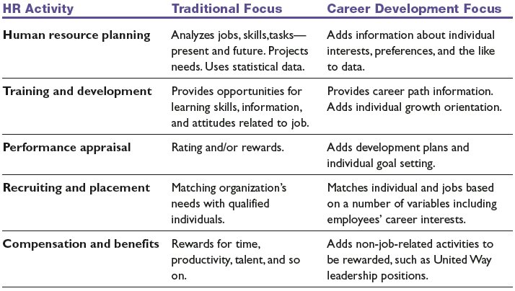
CAREER development
Tahun | Pendapatan Nasional (milyar Rupiah)
1990 1991 1992 1993 1994 1995 1996 1997 | 590,6 612,7 630,8 645 667,9 702,3 801,3 815,7

Slide 7
The Individual
• Accept responsibility for your own career.
• Assess your interests, skills, and values.
• Seek out career information and resources.
• Establish goals and career plans.
• Utilize development opportunities.
• Talk with your manager about your career.
• Follow through on realistic career plans.
The Manager
• Provide timely performance feedback.
• Provide developmental assignments and support.
• Participate in career development discussions.
• Support employee development plans.
The Organization
• Communicate mission, policies, and procedures.
• Provide training and development opportunities.
• Provide career information and career programs.
• Offer a variety of career options.
Roles in CAREER development
Tahun | Pendapatan Nasional (milyar Rupiah)
1990 1991 1992 1993 1994 1995 1996 1997 | 590,6 612,7 630,8 645 667,9 702,3 801,3 815,7

Slide 8
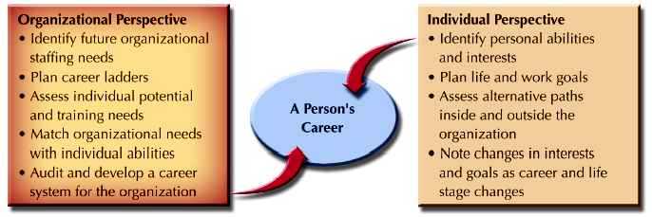
CAREER Planning
Tahun | Pendapatan Nasional (milyar Rupiah)
1990 1991 1992 1993 1994 1995 1996 1997 | 590,6 612,7 630,8 645 667,9 702,3 801,3 815,7

Slide 9
CAREER Management >> individual??
Self-Assessment
Feedback on Reality
Tahun | Pendapatan Nasional (milyar Rupiah)
1990 1991 1992 1993 1994 1995 1996 1997 | 590,6 612,7 630,8 645 667,9 702,3 801,3 815,7
Career Management
Setting Career Goals

Slide 10
CAREER periods
Tahun | Pendapatan Nasional (milyar Rupiah)
1990 1991 1992 1993 1994 1995 1996 1997 | 590,6 612,7 630,8 645 667,9 702,3 801,3 815,7

Slide 11
CAREER issues
Career Plateaus
Employees who are “stuck” at a career level and lack opportunities for upward mobility.
Technical and Professional Workers
Dual-career ladders provide advancement pathways for specialists and technical employees.
Dual-Career Couples
Problems occur when one partner is promoted or transferred, causing the other partner to have to relocate.
Tahun | Pendapatan Nasional (milyar Rupiah)
1990 1991 1992 1993 1994 1995 1996 1997 | 590,6 612,7 630,8 645 667,9 702,3 801,3 815,7

Slide 12
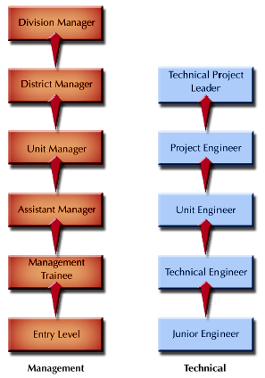
Dual CAREER
Tahun | Pendapatan Nasional (milyar Rupiah)
1990 1991 1992 1993 1994 1995 1996 1997 | 590,6 612,7 630,8 645 667,9 702,3 801,3 815,7

