Slide 1
MATERI IV
LIMIT

Slide 2
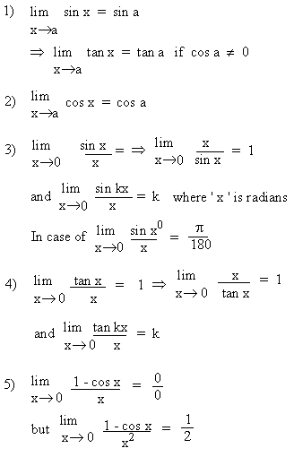
Limit of Trigonometric functions

Slide 3
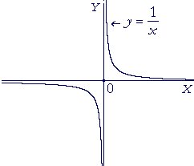
Limits at Infinity
When the variable is f(x), it will become positively or negatively infinite when x approaches some value c. We will write

Slide 4
As the sequence of values of x become very small numbers, then the sequence of values of y, the reciprocals, , become very large numbers. The values of y will become and remain greater, for example, than 10100000000 y becomes infinite.
We write, in this case,

Slide 5
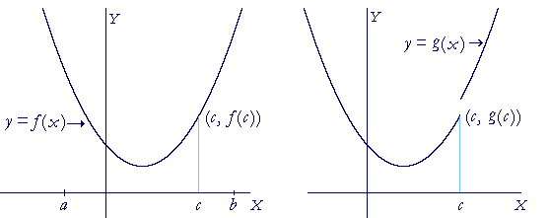
Continuity of Functions
In any real problem of continuous motion, the distance traveled will be represented by a "continuous function" of the time traveled, because we always treat time as continuous. Therefore, we must investigate what we mean by a continuous function.
A continuous function

Slide 6
The graph on the left is the graph of a continuous function; it is one unbroken line. We say that the function f(x) is continuous at every value of x in the interval [a, b]. In particular, f(x) is continuous at the value x = c.
The graph on the right, however, is discontinuous at x = c. If we think of each function as having two "branches" -- one to the left of x = c, and the other to the right -- then in the continuous function there is no gap between the branches: the endpoints, which are the boundaries or the limits of each branch, coincide at (c, f(c)). But in the graph on the right, the endpoints of each branch do not coincide.

