Slide 1
MATERI V
TURUNAN

Slide 2
Rules for Finding Derivatives
By the derivative of a function f(x), we mean the following limit, if it exists:
We call that limit f '(x) and we say that f itself is differentiable at x, and that f has a derivative.

Slide 3
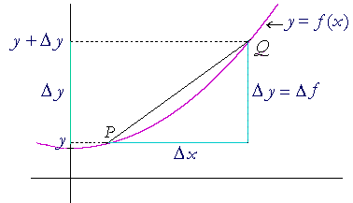
A simple difference quotient

Slide 4
Derivatives of Trigonometric Functions

Slide 5
The Chain Rule
The derivative of a function of a function
Let f (x) = x5 and g(x) = x² + 1.
If we now let g(x) be the argument of f, then f will be a function of g. f (g(x)) = (x² + 1)5.
What is the derivative of f (g(x)) ?
First, note that

Slide 6
First, note that
d f(x) dx = 5x4.That is: The derivative of f with respect to its argument (which in this case is x) is equal to 5 times the 4th power of the argument.

Slide 7
This means that if g -- or any variable -- is the argument of f, the same form applies:
d f(g) dg = 5g4.
d f(h) dh = 5h4.
d f(v) dv = 5v4.
In other words, we can really take the derivative of a function of an argument only with respect to that argument.

Slide 8
Therefore, since g = x² + 1,
d f(g) dg = 5g4 = 5(x² + 1)4.

