Slide 1
The Matching Concept and the Adjusting Process
PERTEMUAN #5
FEB103
PENGANTAR AKUNTANSI I + LAB
6542– SRI HANDAYANI, SE, MM, MAk, CPMA
PROGRAM STUDI MANAJEMEN & AKUNTANSI
FAKULTAS EKONOMI DAN BISNIS
UNIVERSITAS ESA UNGGUL

Slide 2
KEMAMPUAN AKHIR YANG DIHARAPKAN
Mahasiswa mampu memahami dan menjelaskan konsep penandingan (Matching concept) dan proses penyesuaian dalam akuntansi

Slide 3
KEMAMPUAN AKHIR YANG DIHARAPKAN
Mahasiswa mampu memahami dan menjelaskan konsep penandingan (Matching concept) dan proses penyesuaian dalam akuntansi

Slide 4
Chapter 3
The Matching Concept and the Adjusting Process
Accounting, 21st Edition
Warren Reeve Fess
© Copyright 2004 South-Western, a division of Thomson Learning. All rights reserved.
PowerPoint Presentation by Douglas Cloud Professor Emeritus of Accounting Pepperdine University
Task Force Image Gallery clip art included in this electronic presentation is used with the permission of NVTech Inc.

Slide 5
Some of the action has been automated, so click the mouse when you see this lightning bolt in the lower right-hand corner of the screen. You can point and click anywhere on the screen.

Slide 6
Objectives
1. Explain how the matching concept relates to the accrual basis of accounting.
2. Explain why adjustments are necessary and list the characteristics of adjusting entries.
3. Journalize entries for accounts requiring adjustment.
4. Summarize the adjustment process and prepare an adjusted trial balance.
5. Use vertical analysis to compare financial statement items with each other and with industry averages.
After studying this chapter, you should be able to:

Slide 7
The Matching Concept
Revenue
Expenses

Slide 8
Reporting Revenue and Expenses
TWO METHODS
Cash Basis of Accounting
Accrual Basis of Accounting

Slide 9
Under the cash basis for the accounting period concept, revenues and expenses are reported in the income statement in the period in which cash is received or paid.

Slide 10
Under the accrual basis for the accounting period concept, revenues are reported in the income statement in the period in which they are earned.

Slide 11
Accrual Basis of Accounting
Revenue reported when earned
Expense reported when incurred
Properly matches revenues and expenses in determining net income
Requires adjusting entries at end of period

Slide 12
The matching concept supports reporting revenues and related expenses in the same period.
Paid $10,000 for an advertising campaign for a product that will be introduced in 2003.
Paid $10,000 for an advertising campaign for a product that will be introduced in 2005.
Sold the advertised product.
$10,000 recorded as an asset
$10,000 expensed in 2005 to match revenues
2004
2005

Slide 13
NetSolutions
Trial Balance
December 31, 2005
Cash 2 065 00
Accounts Receivable 2 220 00
Supplies 2 000 00
Prepaid Insurance 2 400 00
Land 20 000 00
Office Equipment 1 800 00
Accounts Payable 900 00
Unearned Rent 360 00
Chris Clark, Capital 25 000 00
Chris Clark, Drawing 4 000 00
Fees Earned 16 340 00
Wages Expense 4 275 00
Rent Expense 1 600 00
Utilities Expense 985 00
Supplies Expense 800 00
Miscellaneous Expense 455 00
42 600 00 42 600 00
Unadjusted trial balance

Slide 14
NetSolutions
Trial Balance
December 31, 2005
Cash 2 065 00
Accounts Receivable 2 220 00
Supplies 2 000 00
Prepaid Insurance 2 400 00
Land 20 000 00
Office Equipment 1 800 00
Accounts Payable 900 00
Unearned Rent 360 00
Chris Clark, Capital 25 000 00
Chris Clark, Drawing 4 000 00
Fees Earned 16 340 00
Wages Expense 4 275 00
Rent Expense 1 600 00
Utilities Expense 985 00
Supplies Expense 800 00
Miscellaneous Expense 455 00
42 600 00 42 600 00
Assets

Slide 15
NetSolutions
Trial Balance
December 31, 2005
Cash 2 065 00
Accounts Receivable 2 220 00
Supplies 2 000 00
Prepaid Insurance 2 400 00
Land 20 000 00
Office Equipment 1 800 00
Accounts Payable 900 00
Unearned Rent 360 00
Chris Clark, Capital 25 000 00
Chris Clark, Drawing 4 000 00
Fees Earned 16 340 00
Wages Expense 4 275 00
Rent Expense 1 600 00
Utilities Expense 985 00
Supplies Expense 800 00
Miscellaneous Expense 455 00
42 600 00 42 600 00
Liabilities

Slide 16
NetSolutions
Trial Balance
December 31, 2005
Cash 2 065 00
Accounts Receivable 2 220 00
Supplies 2 000 00
Prepaid Insurance 2 400 00
Land 20 000 00
Office Equipment 1 800 00
Accounts Payable 900 00
Unearned Rent 360 00
Chris Clark, Capital 25 000 00
Chris Clark, Drawing 4 000 00
Fees Earned 16 340 00
Wages Expense 4 275 00
Rent Expense 1 600 00
Utilities Expense 985 00
Supplies Expense 800 00
Miscellaneous Expense 455 00
42 600 00 42 600 00
Owner’s Equity

Slide 17
NetSolutions
Trial Balance
December 31, 2005
Cash 2 065 00
Accounts Receivable 2 220 00
Supplies 2 000 00
Prepaid Insurance 2 400 00
Land 20 000 00
Office Equipment 1 800 00
Accounts Payable 900 00
Unearned Rent 360 00
Chris Clark, Capital 25 000 00
Chris Clark, Drawing 4 000 00
Fees Earned 16 340 00
Wages Expense 4 275 00
Rent Expense 1 600 00
Utilities Expense 985 00
Supplies Expense 800 00
Miscellaneous Expense 455 00
42 600 00 42 600 00
Revenue

Slide 18
NetSolutions
Trial Balance
December 31, 2005
Cash 2 065 00
Accounts Receivable 2 220 00
Supplies 2 000 00
Prepaid Insurance 2 400 00
Land 20 000 00
Office Equipment 1 800 00
Accounts Payable 900 00
Unearned Rent 360 00
Chris Clark, Capital 25 000 00
Chris Clark, Drawing 4 000 00
Fees Earned 16 340 00
Wages Expense 4 275 00
Rent Expense 1 600 00
Utilities Expense 985 00
Supplies Expense 800 00
Miscellaneous Expense 455 00
42 600 00 42 600 00
Expenses

Slide 19
NetSolutions
Chart of Accounts
Balance Sheet
Income Statement
1. Assets
11 Cash
12 Accounts Receivable
14 Supplies
15 Prepaid Insurance
17 Land
18 Office Equipment
19 Accumulated Depreciation19 Accumulated Depreciation
2. Liabilities
21 Accounts Payable
22 Wages Payable
23 Unearned Rent
3. Owner’s Equity
31 Chris Clark, Capital
32 Chris Clark, Drawing
4. Revenue
41 Fees Earned
42 Rent Revenue
5. Expenses
51 Wages Expense
52 Rent Expense
53 Depreciation Expense
54 Utilities Expense
55 Supplies Expense
56 Insurance Expense
59 Miscellaneous Expense

Slide 20
Deferred Expenses (Prepaid Expenses)

Slide 21
NetSolutions
Trial Balance
December 31, 2005
Cash 2 065 00
Accounts Receivable 2 220 00
Supplies 2 000 00
Prepaid Insurance 2 400 00
Land 20 000 00
Office Equipment 1 800 00
Accounts Payable 900 00
Unearned Rent 360 00
Chris Clark, Capital 25 000 00
Chris Clark, Drawing 4 000 00
Fees Earned 16 340 00
Wages Expense 4 275 00
Rent Expense 1 600 00
Utilities Expense 985 00
Supplies Expense 800 00
Miscellaneous Expense 455 00
42 600 00 42 600 00
Some of these supplies have been used. On December 31, a count reveals that $760 of supplies are on hand.

Slide 22
Supplies (balance on trial balance) $2,000
Supplies on hand, December 31 – 760
Supplies used $1,240
2005
1
2
3
4
Dec. 31
Supplies Expense 1 240 00
55
Supplies 1 240 00
14
Supplies
14
Supplies Expense
55
Bal. 2,000
Dec. 31 1,240
Bal. 800
760
Dec. 31 1,240
2,040

Slide 23
NetSolutions
Trial Balance
December 31, 2005
Cash 2 065 00
Accounts Receivable 2 220 00
Supplies 2 000 00
Prepaid Insurance 2 400 00
Land 20 000 00
Office Equipment 1 800 00
Accounts Payable 900 00
Unearned Rent 360 00
Chris Clark, Capital 25 000 00
Chris Clark, Drawing 4 000 00
Fees Earned 16 340 00
Wages Expense 4 275 00
Rent Expense 1 600 00
Utilities Expense 985 00
Supplies Expense 800 00
Miscellaneous Expense 455 00
42 600 00 42 600 00
The prepayment for 24 months of insurance does not reflect that December’s insurance has theoretically expired.

Slide 24
4
5
6
7
31
Insurance Expense 100 00
56
Prepaid Insurance 100 00
15
Prepaid Insurance
15
Insurance Expense
56
Bal. 2,400
Dec. 31 100
Dec. 31 100
2,300
Note: You probably have the idea of how posting flows, so the rest of the slides will omit the arrows.

Slide 25
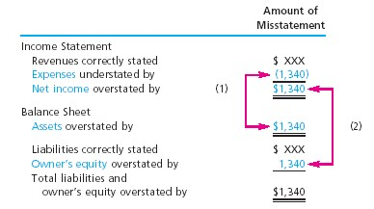
Effect of Omitting Adjustment

Slide 26
Deferred Revenue (Unearned Revenue)

Slide 27
NetSolutions
Trial Balance
December 31, 2005
Cash 2 065 00
Accounts Receivable 2 220 00
Supplies 2 000 00
Prepaid Insurance 2 400 00
Land 20 000 00
Office Equipment 1 800 00
Accounts Payable 900 00
Unearned Rent 360 00
Chris Clark, Capital 25 000 00
Chris Clark, Drawing 4 000 00
Fees Earned 16 340 00
Wages Expense 4 275 00
Rent Expense 1 600 00
Utilities Expense 985 00
Supplies Expense 800 00
Miscellaneous Expense 455 00
42 600 00 42 600 00
Three months’ rent, $360, was received on December 1. As of December 31, only $120 has been earned.

Slide 28
7
8
9
10
31
Unearned Rent 120 00
23
Rent Revenue 120 00
42
Unearned Rent
23
Rent Revenue
42
Dec. 31 120
Bal. 360
Dec. 31 120
240

Slide 29
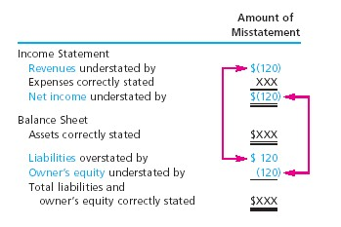
Effect of Omitting Adjustment

Slide 30
Accrued Expenses (Accrued Liabilities)

Slide 31
NetSolutions
Trial Balance
December 31, 2005
25
Cash 2 065 00
Accounts Receivable 2 220 00
Supplies 2 000 00
Prepaid Insurance 2 400 00
Land 20 000 00
Office Equipment 1 800 00
Accounts Payable 900 00
Unearned Rent 360 00
Chris Clark, Capital 25 000 00
Chris Clark, Drawing 4 000 00
Fees Earned 16 340 00
Wages Expense 4 275 00
Rent Expense 1 600 00
Utilities Expense 985 00
Supplies Expense 800 00
Miscellaneous Expense 455 00
42 600 00 42 600 00
At the end of December, accrued wages amounted to $250. Currently, Wages Expense is understated and there is no liability shown for these wages.

Slide 32
10
11
12
13
31
Wages Expense 250 00
51
Wages Payable 250 00
22
Wages Payable
22
Wages Expense
51
Dec. 31 250
Bal. 4,275
Dec. 31 250

Slide 33
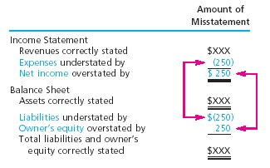
Effect of Omitting Adjustment

Slide 34
Accrued Revenues (Accrued Assets)

Slide 35
NetSolutions
Trial Balance
December 31, 2005
29
Cash 2 065 00
Accounts Receivable 2 220 00
Supplies 2 000 00
Prepaid Insurance 2 400 00
Land 20 000 00
Office Equipment 1 800 00
Accounts Payable 900 00
Unearned Rent 360 00
Chris Clark, Capital 25 000 00
Chris Clark, Drawing 4 000 00
Fees Earned 16 340 00
Wages Expense 4 275 00
Rent Expense 1 600 00
Utilities Expense 985 00
Supplies Expense 800 00
Miscellaneous Expense 455 00
42 600 00 42 600 00
NetSolutions provided $500 in services during December for which the customer has not been billed.

Slide 36
13
14
15
16
31
12
Accounts Receivable 500 00
Fees Earned 500 00
41
Accounts Receivable
12
Fees Earned
41
Bal. 2,220
Bal. 16,340
Dec. 31 500
Dec. 31 500
2,720
16,840

Slide 37
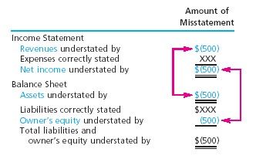
Effect of Omitting Adjustment

Slide 38
Fixed Assets

Slide 39
Land
Land has an infinite life; therefore, it does not depreciate.

Slide 40
Building
A building has a limited life, so it must be depreciated. The contra account used in the adjusting entry is Accumulated Depreciation—Building

Slide 41
Equipment
Because equipment has a limited life, it depreciates. The contra account used is Accumulated Depreciation—Equipment

Slide 42
NetSolutions estimates the depreciation on its office equipment to be $50 for the month of December.
16
17
18
19
31
Depreciation Expense 50 00
53
Accumulated Depreciation—
Office Equipment 50 00
19
Accumulated Depreciation—Office Equipment
19
Depreciation Expense
53
Dec. 31 50
Dec. 31 50

Slide 43
NetSolutions’ balance sheet would show the office equipment at cost, less the accumulated depreciation.
Office equipment $1,800
Less accumulated
depreciation 50 $1,750
Book value

Slide 44
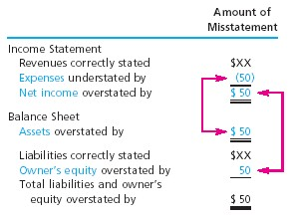
Effect of Omitting Adjustment

Slide 45
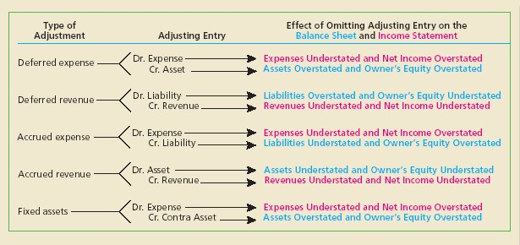
Summary of Basic Adjustments

Slide 46
NetSolutions’ Adjusted Trial Balance for December 31, 2005

Slide 47
NetSolutions
Adjusted Trial Balance
December 31, 2005
41
Cash 2 065 00
Accounts Receivable 2 720 00
Supplies 760 00
Prepaid Insurance 2 300 00
Land 20 000 00
Office Equipment 1 800 00
Accumulated Depreciation 50 00
Accounts Payable 900 00
Wages Payable 250 00
Unearned Rent 240 00
Chris Clark, Capital 25 000 00
Chris Clark, Drawing 4 000 00
Fees Earned 16 840 00
Rent Revenue 120 00
Wages Expense 4 525 00
Rent Expense 1 600 00
Utilities Expense 985 00
Continued

Slide 48
NetSolutions
Trial Balance
December 31, 2005 (Continued)
42
Supplies Expense 2 040 00
Insurance Expense 100 00
Miscellaneous Expense 455 00
43 400 00 43 400 00

Slide 49
Vertical Analysis and Interpretation

Slide 50
J. Holmes, Attorney-at-Law
Income Statements
For the Years Ended December 31, 2005 and 2006
2006 2005
Amount Percent Amount Percent
Fees earned $187,500 $150,000
Operating expenses:
Wages expense $60,000 $45,000
Rent expense 15,000 12,000
Utilities expense 12,500 9,000
Supplies expense 2,700 3,000
Miscellaneous exp. 2,300 1,800
Total operating
expenses $92,500 $70,800
Net income $95,000 $79,200

Slide 51
2006 2005
Amount Percent Amount Percent
Fees earned $187,500 100.0% $150,000 100.0%
Operating expenses:
Wages expense $60,000 $45,000
Rent expense 15,000 12,000
Utilities expense 12,500 9,000
Supplies expense 2,700 3,000
Miscellaneous exp. 2,300 1,800
Total operating
expenses $92,500 $70,800
Net income $95,000 $79,200

Slide 52
2006 2005
Amount Percent Amount Percent
Fees earned $187,500 100.0% $150,000 100.0%
Operating expenses:
Wages expense $60,000 $45,000
Rent expense 15,000 12,000
Utilities expense 12,500 9,000
Supplies expense 2,700 3,000
Miscellaneous exp. 2,300 1,800
Total operating
expenses $92,500 $70,800
Net income $95,000 $79,200
$60,000
$187,500
$15,000
$187,500
32.0%
38.0%

Slide 53
2006 2005
Amount Percent Amount Percent
6.7%
1.4%
1.2%
49.3%
50.7%
Fees earned $187,500 100.0% $150,000 100.0%
Operating expenses:
Wages expense $60,000 $45,000 30.0%
Rent expense 15,000 12,000 8.0%
Utilities expense 12,500 9,000 6.0%
Supplies expense 2,700 3,000 2.0%
Miscellaneous exp. 2,300 1,800 1.2%
Total operating
expenses $92,500 $70,800 47.2%
Net income $95,000 $79,200 52.8%
32.0%
8.0%

Slide 54
Chapter 3
The End

