Slide 1
Manajemen Persediaan
PERTEMUAN #12
FEB 302
MANAJEMEN KEUANGAN
FAKULTAS EKONOMI DAN BISNIS
UNIVERSITAS ESA UNGGUL

Slide 2
KEMAMPUAN AKHIR YANG DIHARAPKAN
Memahami dan memiliki wawasan: Pengelolaan Persediaan

Slide 3
Principles of Managerial Finance 9th Edition
Chapter 14
Financial Planning

Slide 4
Learning Objectives
Understand the financial planning process, including long-term (strategic) financial plans and short-term (operating) plans.
Discuss the cash planning process, the role of sales forecasts, and the procedures for preparing the cash budget.
Describe the cash budget evaluation process, procedures for coping with uncertainty, and the issue of cash flow within the month.

Slide 5
Learning Objectives
Prepare a pro forma income statement using both the percent-of-sales method and a breakdown of costs and expenses into their fixed and variable components.
Explain the procedures used to develop a pro forma balance sheet using the judgmental approach and the use of the plug figure -- external financing required -- in this process.
Describe the weakness of the simplified approaches to pro forma preparation and the common uses of pro forma statements.

Slide 6
The Financial Planning Process
Long-Term (Strategic) Financial Plans
Long-term strategic financial plans lay out a company’s planned financial actions and the anticipated impact of those actions over periods ranging from 2 to 10 years.
Firms that are exposed to a high degree of operating uncertainty tend to use shorter plans.
These plans are one component of a company’s integrated strategic plan (along with production and marketing plans) that guide a company toward achievement of its goals.

Slide 7
The Financial Planning Process
Long-Term (Strategic) Financial Plans
Long-term financial plans consider a number of financial activities including:
proposed fixed asset investments
research and development activities
marketing and product development
capital structure
sources of financing
These plans are generally supported by a series of annual budgets and profit plans.

Slide 8
The Financial Planning Process
Short-Term (Operating) Financial Plans
Short-term (operating) financial plans specify short-term financial actions and the anticipated impact of those actions and typically cover a 1 - to - 2 year operating period. This chapter and the following three chapters focus on this short-term financial plan.
Key inputs include the sales forecast and other operating and financial data.
Key outputs include operating budgets, the cash budget, and pro forma financial statements.
This process is described on the following slide.

Slide 9
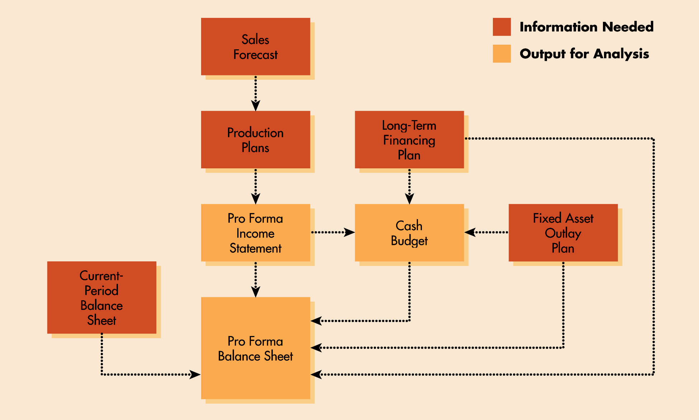
The Financial Planning Process
Short-Term (Operating) Financial Plans

Slide 10
The Financial Planning Process
Short-Term (Operating) Financial Plans
As indicated in the previous exhibit, short-term financial planning begins with a sales forecast.
From this sales forecast, production plans are developed that consider lead times and raw material requirements.
From the production plans, direct labor, factory overhead, and operating expense estimates are developed.
From this information, the pro forma income statement and cash budget are prepared -- ultimately leading to the development of the pro forma balance sheet.

Slide 11
Cash Planning: Cash Budgets
Cash forecast
The cash budget is a statement of the firm’s planned inflows and outflows of cash.
It is used to estimate short-term cash requirements with particular attention to anticipated cash surpluses and shortfalls.
Surpluses must be invested and shortfalls must be funded.
The cash budget is a useful tool for determining the timing of cash inflows and outflows during a given period.
Typically, monthly budgets are developed covering a 1-year time period.

Slide 12
Cash Planning: Cash Budgets
The cash budget begins with a sales forecast, which is simply a prediction of the sales activity during a given period.
A prerequisite to the sales forecast is a forecast for the economy, the industry, the company and other external and internal factors that might influence company sales.
The sales forecast is then used as a basis for estimating the monthly cash inflows that will result from projected sales -- and outflows related to production, overhead and other expenses.
External forecast: 考慮GDP，disposable personal income, …
Internal forecast: 銷售人員的預估

Slide 13
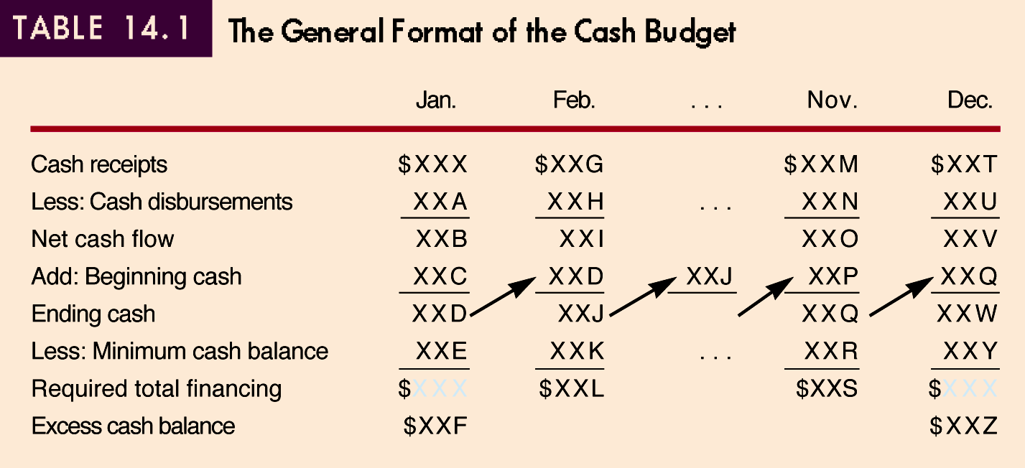
Cash Planning: Cash Budgets

Slide 14
Cash Planning: Cash Budgets
An Example: The Halley Company
⇒百分比編製法
Halley Company, a defense contractor, is developing a cash budget for October, November, and December. Halley’s sales in August and September were $100,000 and $200,000 respectively. Sales of $400,000, $300,000 and $200,000 have been forecast for October, November, and December. Historically, 20% of the firm’s sales have been for cash, 50% have been collected after 1 month, and the remaining 30% after 2 months. In December, Halley will receive a $30,000 dividend from stock in a subsidiary.

Slide 15
Cash Planning: Cash Budgets
An Example: The Halley Company
Based on this information, we are able to develop the following schedule of cash receipts for Halley Company

Slide 16
Cash Planning: Cash Budgets
An Example: The Halley Company
Halley Company has also gathered the relevant information for the development of a cash disbursement schedule. Purchases will represent 70% of sales -- 10% will be paid immediately in cash, 70% is paid the month following the purchase, and the remaining 20% is paid two months following the purchase. The firm will also expend cash on rent, wages and salaries, taxes, fixed assets, interest, dividends, and a portion of the principal on its loans. The resulting disbursement schedule thus follows.

Slide 17
Cash Planning: Cash Budgets
An Example: The Halley Company
=$8+10%×Sales

Slide 18
Cash Planning: Cash Budgets
An Example: The Halley Company
The Cash Budget for Halley can be derived by combining the receipts budget with the disbursements budget. At the end of September, Halley’s cash balance was $50,000, notes payable was $0, and marketable securities balance was $0. Halley also wishes to maintain a minimum cash balance of $25,000. As a result, it will have excess cash in October, and a deficit of cash in November and December. The resulting cash budget follows.

Slide 19
Cash Planning: Cash Budgets
An Example: The Halley Company
Notes payable
Marketable securities

Slide 20
Evaluating Cash Budgets
Cash budgets indicate the extent to which cash shortages or surpluses are expected in the months covered by the forecast.
The excess cash of $22,000 in October should be invested in marketable securities. The deficits in November and December need to be financed.

Slide 21
Coping with Uncertainty in the Cash Budget
One way to cope with cash budgeting uncertainty is to prepare several cash budgets based on several forecasted scenarios (ex: pessimistic, most likely, optimistic).
From this range of cash flows, the financial manager can determine the amount of financing necessary to cover the most adverse situation.
This method will also provide a sense of the riskiness of alternatives.
An example of this sort of “sensitivity analysis” for the Halley Company for the month of October is shown on the following slide.

Slide 22
Coping with Uncertainty in the Cash Budget

Slide 23
Cash Flow Within The Month
Because the cash budget shows cash flows only on a total monthly basis, the information provided is not necessarily sufficient.
Companies must also evaluate the pattern of daily cash inflows and outflows to ensure cash is available for paying bills as they come due.
For an example related to this issue, please see the website for this text at http:\\www.awlonline.com/gitman

Slide 24
Profit Planning: Pro Forma Financial Statements
Pro forma financial statements are projected, or forecast, financial statements - income statements and balance sheets.
The inputs required to develop pro forma statements using the most common approaches include:
financial statements from the preceding year
the sales forecast for the coming year
key assumptions about a number of factors
The development of pro forma financial statements will be demonstrated using the financial statements for the Metcalfe Company.

Slide 25
Profit Planning: Pro Forma Financial Statements

Slide 26
Profit Planning: Pro Forma Financial Statements

Slide 27
Profit Planning: Pro Forma Financial Statements
Step 1: Start with a Sales Forecast
The first and key input for developing pro forma financial statements is the sales forecast for Metcalfe Company.

Slide 28
Profit Planning: Pro Forma Financial Statements
Step 1: Start with a Sales Forecast
This forecast is based on an increase from $20 to $25 per unit for Model X and $40 to $50 per unit for Model Y.
These increases are required to cover anticipated increases in various costs, including labor, materials, & overhead .

Slide 29
Profit Planning: Pro Forma Financial Statements
Step 2: Develop the Pro Forma Income Statement
One method for developing a pro forma income statement is the “percent-of-sales” method.
This method starts with the sales forecast and then expresses the cost of goods sold, operating expenses, and other accounts as a percentage of projected sales.
Using the Metcalfe example, the easiest way to do this is to recast the historical (2000) income statement as a percentage of sales as shown on the following slide.

Slide 30
Profit Planning: Pro Forma Financial Statements
Step 2: Develop the Pro Forma Income Statement

Slide 31
Profit Planning: Pro Forma Financial Statements
Step 2: Develop the Pro Forma Income Statement
Using these percentages and the 2001 sales forecast we developed, the entire income statement can be projected.
The results are shown on the following slide.
It is important to note that this method implicitly assumes that all costs are variable and that for a given percentage increase or decrease in sales, the same percentage increase or decrease in each of these components.
This will understate profits when sales are increasing and overstate them when sales are decreasing.
因為這裡假設fixed cost=0，也就是沒有economies of scale

Slide 32
Profit Planning: Pro Forma Financial Statements
Step 2: Develop the Pro Forma Income Statement

Slide 33
Profit Planning: Pro Forma Financial Statements
Step 2: Develop the Pro Forma Income Statement
( or cost )
Clearly, some of the firm’s expenses will increase with the level of sales while others will not.
As a result, the strict application of the percent-of-sales method is a bit naïve.
The best way to generate a more realistic pro forma income statement is to segment the firm’s expenses into fixed and variable components.
This may be demonstrated as follows.

Slide 34
Profit Planning: Pro Forma Financial Statements
Step 2: Develop the Pro Forma Income Statement

Slide 35
Profit Planning: Pro Forma Financial Statements
Step 3: Develop the Pro Forma Balance Sheet
Probably the best approach to use in developing the pro forma balance sheet is the judgmental approach.
Using this approach, the values of some balance sheet accounts are estimated while others are calculated.
The company’s external financing is used as the balancing account.
To apply this method to Metcalfe Manufacturing, a number of simplifying assumptions must be made.

Slide 36
Profit Planning: Pro Forma Financial Statements
Step 3: Develop the Pro Forma Balance Sheet
1. A minimum cash balance of $6,000 is desired.
2. Marketable securities will remain at their current level of $4,000.
3. Accounts receivable represents 45 days of sales on average, i.e., AR= [(45/360) x $135,000]= $16,875.
4. Ending inventory will remain at about $16,000. 25% ($4,000) represents raw materials and 75% ($12,000) is finished goods.
5. A new machine costing $20,000 will be purchased. Total depreciation for year 2000 will be $8,000. Adding $20,000 to existing net fixed assets of $51,000 and subtracting the $8,000 depreciation yields a net fixed assets figure of $63,000.
AR週轉天數

Slide 37
Profit Planning: Pro Forma Financial Statements
Step 3: Develop the Pro Forma Balance Sheet
6. Purchases will be $40,500 which represents 30% of annual sales (30% x $135,000). Metcalfe takes about 72 days to pay its accounts payable. Assume that all the purchases are made on credit. As a result, accounts payable will equal $8,100 [(72/360) x $40,500].
7. Taxes payable will be $455 which represents one-fourth of the 2001 tax liability $1,823.
8. Notes payable will remain unchanged at $8,300.
9. There will be no change in other current liabilities ($3,400), long-term debt ($18,000), and common stock ($30,000).
10. Retained earnings will change in accordance with the pro forma income statement.
2000年底之保留盈餘為 $23,000
2001年預計損益表新增R.E.6,327
2001年底預計之R.E. $29,327

Slide 38
Profit Planning: Pro Forma Financial Statements
Step 3: Develop the Pro Forma Balance Sheet
1.若為正值，表示公司應進行issue more equity或borrow debt
2.若為負值，表公司應多發現金股利，或贖回負債或進行股票再買回
3.不管是1或2都應重新編製本表

Slide 39
Evaluation of Pro Forma Statements
Weaknesses of Simplified Approaches
The major weaknesses of the approaches to pro forma statement development outlined above lie in two assumptions:
that the firm’s past financial performance will be replicated in the future
that certain accounts can be forced to take on desired values
For these reasons, it is imperative to first develop a forecast of the overall economy and make adjustments to accommodate other facts or events.
*利用pro forma statements，可計算未來各項財務比率，並據以採取適當action

Slide 40
SEKIAN DAN TERIMA KASIH

